Slide 1
In The Name God

Slide 2
A 41 y/o man known case of Prolactinoma (on medical treatment) was referred to endocrine clinic for high IGF1 level and impaired GH-GTT test
Presented by Suzan Maleki MD
2023 JAN

Slide 3
Patient ID
41 y/o man
From Amol
Married

Slide 4
Chief compliant
Known case of Macroprolactinoma was referred to endocrine clinic for ↑IGF1 and impaired GT-GTT test

Slide 5
Present Illness
The patient had loss of libido and impotency for 6 month(4 years ago)
Visual changes (-) | Galactorea (-)
Headache (-) | weight loss/gain (-)
Mood disorder (-) | Hyperhidrosis (-)
Decreased facial hair growing (-) | proximal muscle weakness (-)
fatigue (-) | Polyuria/Polydipsia (-)

Slide 6
Present Illness
Lab tests (1397/11/17)
Prolactin | FSH | LH | Testosterone
1110 ng/ml (4.1-18.4) | 2.1 MIU/ml (1-12) | 1.4 MIU/ml (2.8-6.8) | 1.92 nmol/l (8.64-29) (0.55 ng/ml)

Slide 7
Present Illness

Slide 11
Present Illness
Cabergoline 0.5 mgr every three days was prescribed
Symptoms resolved after 1 month

Slide 12
Present Illness
visual field examination(1397/12/20)
Visual field defect on temporal 60° (both eyes)

Slide 13
Present Illness
Lab tests (1398/1/24)
Prolactin | FSH | LH | Testosterone | Cortisol 8 AM | T3 | F T4 | IGF1
2ng/ml (4.1-18.4) | 3.8 MIU/ml (1-12) | 2.8 MIU/ml (2.8-6.8) | 5.9nmol/L (8.64-29) 1.7 ng/dl | 186 nmol/l (138-690) 6.8 ng/ml | 2 nmol/L (1.2-3.2) | 20.9 Pmol/L (12-22) | 366 ng/ml (83-233)

Slide 14
Present Illness
Lab tests (1398/5/10)
GH Base | GH 60 min | GH 120 min | IGF1
1.2ng/ml (<1.23) | 0.5 ng/ml | 0.56 ng/ml | 428 ng/ml (83-233)

Slide 15
Present Illness
Lab tests (1398/5/10)
Prolactin | FSH | LH | Testosterone
2 ng/ml (4.1-18.4) Cabergoline 5 mg/month | 3.4 MIU/ml (1-12) | 3.1 MIU/ml (2.8-6.8) | 6.3 nmol/l (8.64-29) 1.8 ng/ml

Slide 16
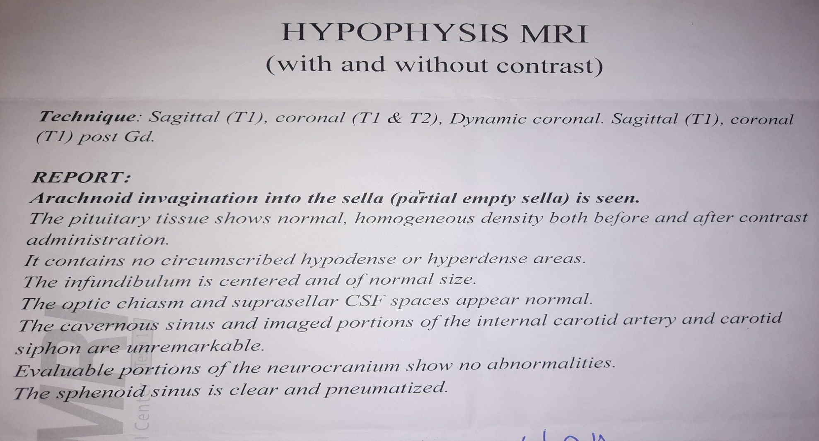
Present Illness
Pituitary MRI (1398/7/17)

Slide 18
Present Illness
Lab tests (1399/2/20)
GH Base | GH 60 min | GH 120 min | IGF1
0.91 ng/ml (0-4) | 0.69ng/ml | 0.85 ng/ml | 278 ng/ml (83-237)

Slide 19
Present Illness
Lab tests (1399/2/20)
Prolactin | Testosterone
2.66 ng/ml (2.5-17) Cabergoline 5mg/month | 2.38 ngr/ml (1.6-7-2)

Slide 20
Present Illness
Cabergoline was tapered to every 5 days(0.5 mg)

Slide 21
Present Illness
Pituitary MRI 1399/10/14

Slide 24
Present Illness
Lab tests (1400/1/25)
Prolactin | TSH | Free t4 | Free T3 | IGF1
2.8ng/ml (3-25) Cabergoline 3mg/m | 1.9 MIU/ml | 0.8 Pg/ml (0.7-1.8) | 3.2 Pg/ml (1.9-4.3) | 573 ng/ml (69-348)

Slide 25
Present Illness
Lab tests (1400/11/11)
GH Base | GH 60 min | GH 120 min | IGF1 | prolactin
4.8 μiu/ml (1.85ng/ml) (0.1-55) | 3.4μiu/ml (1.3ng/ml) | 4.6μiu/ml (1.75ng/ml) | 210 ng/ml (190-294) | 1.4 ng/ml (1.5-21)

Slide 26
Present Illness
1401/1/27

Slide 27
Present Illness
GH-GTT tests (1401/7/7)
GH Base | GH 30 min | GH 60 min | GH 120 min | prolactin
3.1ng/ml (0.02-1.23) | 2.9 ng/ml | 2.5 ng/ml | 2.4 ng/ml | 2.46 ng/ml (2.5-17)

Slide 28
Present Illness
GH-GTT(1401/9/14)
GH Base | GH 60 min | GH 120 min | FBS | BS(1hour) | IGF1
2.43 ng/ml (1.85) (up to 3) | 2.15ng/ml (1.3) | 4.6μiu/ml (1.75) | 101 mg/dl | 135 mg/dl | 496 ng/ml (109-284)

Slide 29
Present Illness
Lab tests (1401/9/14)
Prolactin | FSH | LH | Testosterone | TSH | Free t4
3.2 ng/ml (1.5-20) Cabergoline 1.5 mg/m | 4.7 MIU/ml (1.5-12) | 6.9 MIU/ml (1.7-8.6) | 4.2 ng/ml (2-6.9) | 2.6 miU/ml | 1.3 ng/dl

Slide 30
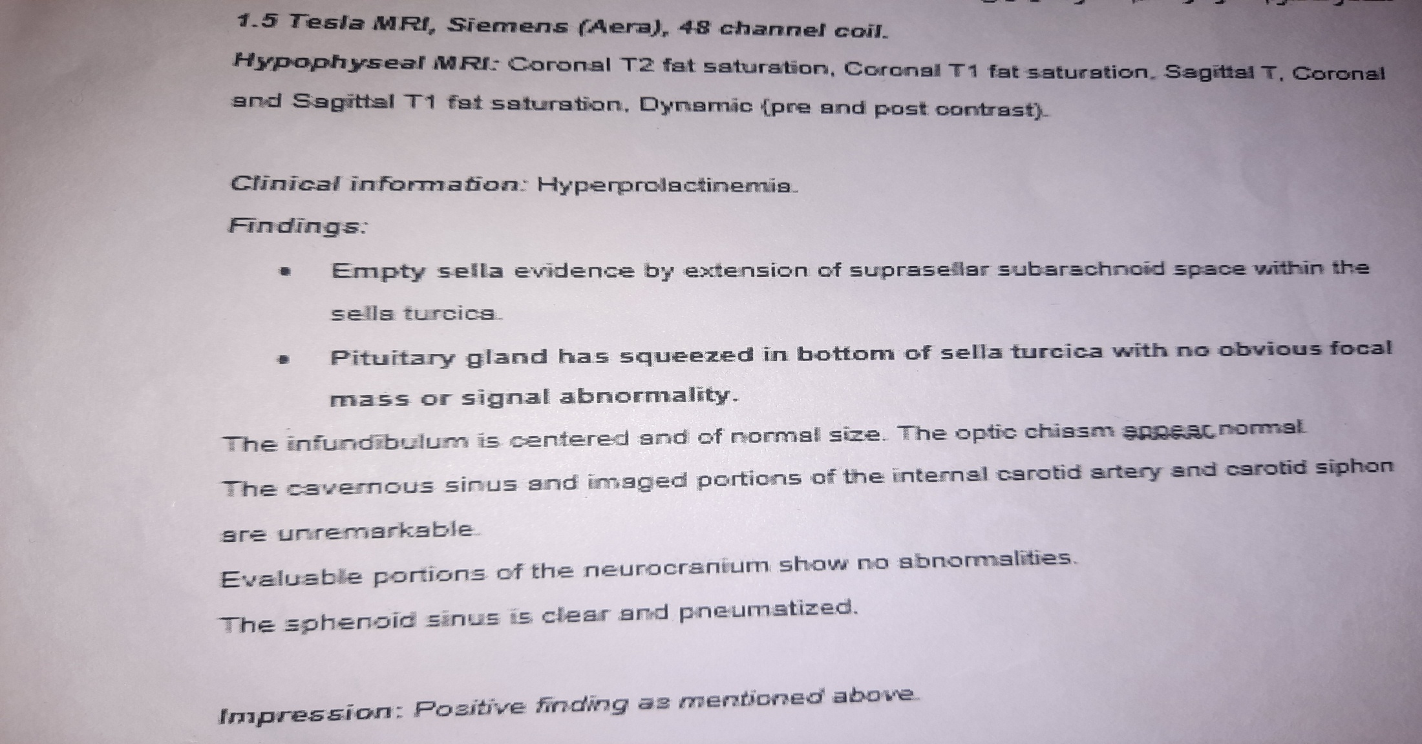
Present Illness
PITUITARY MRI(1401/9/18)

Slide 34
Present Illness
The patient was referred to Taleghani Endocrine clinic for further evaluation

Slide 35
Present Illness
GH-GTT(1401/9/27)→ (pathobiology lab)
Time | 0 | 30 | 60 | 90 | 120
GH | 2.3 ng/ml Up to 3 | 2.1 ng/ml | 2.2 ng/ml | 2.2 ng/ml | 2.5 ng/ml
BS | 108 mg/dl | 158 mg/dl | 161 mg/dl | 103 mg/dl | 112 mg/dl

Slide 36
Present Illness
1401/9/27 → (pathobiology lab)
IGF1
484 ng/ml (58-219)

Slide 37
Present Illness

Slide 38
Present Illness

Slide 39
Present Illness
date | 1398/1/24 | 1398/5/10 | 1399/2/20 | 1400/1/25 | 1400/11/11 | 1401/9/14 | 1401/9/27
IGF1 | 366 ng/ml (83-233) | 428 ng/ml (83-233) | 278 ng/ml (83-237) | 573 ng/ml (69-348) | 210 ng/ml (69-348) | 496 ng/ml (109-284) | 484 ng/ml (58-219)

Slide 40
Present Illness
Cardiologist visit:
Normal ECG
Echocardiography: no valvular defect. No hypertrophy

Slide 41
Past Medical History: Nasal polypectomy
DH: Cabergoline 0.5 mgr every 10 days
Habit: smoker (-) substance user (-)
Family history:No family history of endocrine disorders

Slide 42
Review Of System
Decreased facial hair growing (-) | Galactorea (-)
Mood disorder (-) | weight loss/gain (-)
Headache (-) | Hyperhidrosis (-)
Snoring (sleep apnea?) | change in facial features (-)
Arthralgia (-) | Increase in hand and foot size(-)
Ring tightening | proximal muscle weakness (-)
fatigue (-) | Polyuria/Polydipsia (-)

Slide 43
Physical Exam
BP: 140/90 mmhg
PR:80/min
BMI: 25.7 kg / m²
H&N: Frontal bossing (-) coarse facial features ( -) thyromegaly (-) macroglossia (-)
Chest: cardiac murmur (-)
Abdomen organomegaly (-)
Extremities enlargement (-)
Skin tag (-)

Slide 44
Problem List:
41 y/o man
Known case of Pituitary Macroprolactinoma(loss of libido and impotency as initial symptoms)
High level IGF1 (was detected 1 month after cabergoline treatment)
IGF1 & GH/GTT test discrepancy
IFG/ mildly elevated BP
Empty sella(?) on Pituitary MRI

Slide 45
Agenda
Development of acromegaly (biochemical & clinical) in patient with prolactinoma
IGF1 & GH/GTT discrepancy
EMPTY SELLA & pituitary biochemical/clinical abnormality
Effect of dopamine agonist on Acromegaly treatment

Slide 46
Discussion

Slide 47
GH secreting pituitary adenoma (GHPA)
Acidophil stem cell adenoma
Plurihormonal adenoma
Somatotroph adenoma
Mammosomatotroph adenoma
Mixed somatotroph-lactotroph adenoma
Mammosomatotroph and mixed somatotroph-lactotroph adenoma in acromegaly: a retrospective study with long-term follow-up Liang Lv et al 8 June 2019

Slide 48
Development of acromegaly in patients with prolactinomas
Up to 25% GH-producing adenomas cosecrete prolactin.
The prevalence of GH secretion among prolactinomas is unknown but thought to be rare.
the current recommendation is to obtain an IGF-1 in patients with prolactinoma at the initial diagnosis.
Long-term follow-up of IGF-1 is not routinely done.
Late presentation of acromegaly in medically controlled prolactinoma patients Ekaterina Manuylova et al 2016

Slide 49
Development of acromegaly in patients with prolactinoma
Anderson et al routinely obtained IGF-1 levels on 78 patients with prolactinoma.
3 out of 78 patients developed acromegaly during the 5-year study period. (All patients had normal levels of GH and/or IGF-I at themtime when hyperprolactinaemia was first diagnosed)
5 out of 78 patients had isolated IGF-1 elevation with a normal glucose suppression test.
Andersen M et al. 2003 Development of acromegaly in patients with prolactinomas

Slide 50
Development of acromegaly in patients with prolactinoma
Rosario et al performed a cross-sectional study of 121 patients with diagnosis of prolactinoma.(All patients were lacking symptoms of acromegaly)
Five patients were diagnosed with acromegaly. Two of them underwent pituitary surgery and had mixed GH/PRL adenomas.
Rosario PW et al. 2010 Biochemical acromegaly in patients with prolactinoma during treatment with dopaminergic agonists.

Slide 52
Development of acromegaly in patients with prolactinoma
2 cases:
two cases of well-controlled prolactinoma on dopamine agonists with the development of acromegaly 10–20 years after the initial diagnoses.
In both patients, a mixed PRL/GH-cosecreting adenoma was confirmed on the pathology examination after TSS
Late presentation of acromegaly in medically controlled prolactinoma patients Ekaterina Manuylova et al 2016

Slide 53
Development of acromegaly in patients with prolactinoma
Acromegaly can develop in about 4% of the prolactinoma patients during long-term follow-up. The interval from the diagnosis of prolactinoma to the development of acromegaly can be up to 20 years
periodic routine measurements of IGF-1 should be considered regardless of the duration and biochemical control of prolactinoma
Late presentation of acromegaly in medically controlled prolactinoma patients Ekaterina Manuylova et al 2016

Slide 54
Development of acromegaly in patients with prolactinoma
Series of ten patients PRL secreting tumors without clinical/biochemical evidence of acromegaly at the time of diagnosis
A subsequent increase in IGF-1 levels was associated with DA treatment
With a reduction or even normalization of IGF-1 levels following dose reduction or interruption of cabergoline.
IGF-1 levels may increase paradoxically with dopamine agonist treatment for prolactinomas Amit Akirov et al 2018

Slide 55
Development of acromegaly in patients with prolactinoma
Natural course of some mixed adenomas originating from lactotrophes and somatotrophes(these adenomas secrete PRL and GH asynchronously)
DAs may inhibit GH secretion in patients with acromegaly, in healthy subjects they may increase GH secretion from normal pituitary somatotrophs via central mechanisms
Another possibility is that the increase of IGF-1 levels is not due to an increase in GH secretion from pituitary adenoma

Slide 56
Development of acromegaly in patients with prolactinoma
As untreated acromegaly is associated with increased morbidity and mortality, it is important to correctly identify and treat these patients. Even in cases of very mild acromegaly, or subclinical acromegaly

Slide 57
Silent Somatotropinomas
three female patients with pituitary tumors who presented without any signs or symptoms of acromegaly but with elevated IGF-I levels. Plasma GH was measured every 10 min for 24 h, and an oral glucose tolerance test was performed.
All patients had abnormally elevated mean and trough plasma GHlevels as well as post-glucose nadir GH concentrations.
All patients had magnetic resonance imaging scans revealing pituitary tumors and underwent transsphenoidal surgery.
Clinically Silent Somatotropinomas May Be Biochemically ActiveAlla A. Sakharova

Slide 58
Subclinical Acromegaly
A Retrospective study
The study group consisted of 8 patients (6 females) with incidentally diagnosed acromegaly and without the specific signs of acromegaly
Subclinical Acromegaly: to Treat or Not to Treat? Ilan Shimon 2021

Slide 59
Subclinical Acromegaly
Mean age at diagnosis was 50.1 ± 16.3 years.
Baseline IGF-1 ranged between 1.27–2.08 x upper limit of normal
MRI depicted a pituitary microadenoma in 6 patients, one patient presented with an intrasellar macroadenoma and one had no visible pituitary mass.

Slide 60
Subclinical Acromegaly
Three patients underwent TSS
two achieved hormonal remission and one improved but did not normalize IGF-1 following surgery.
Five patients (including one following surgery) were given somatostatin analogs, and three normalized IGF-1.
Several patients improved clinically following treatment, reporting improvement in snoring, hypertension, or weight loss, and pituitary adenoma decreased in size in 2 patients that responded medical treatment

Slide 61
EMPTY SELLA
73-year-old male patient/ colorectal adenocarcinoma/ acromegalic phenotype/IGF-1: 531 ng/mL/ OGTT: no supression/GHRH was within the normal range/18F-FDG PET/CT and Ga-DOTATADE PET/CT did not show any finding
T1-weighted MRI revealed an ES
EMPTY SELLA IN A PATIENT WITH CLINICAL AND BIOCHEMICAL DIAGNOSIS OF ACROMEGALY N. Bestepe 2022

Slide 62
IGF1 & GH/GTT discrepancy
less sensitive tests and laboratory errors
Too high cut-off point for GH suppression in the GH assays
GH nadir values not adjusted to age, sex, and BMI
The influence of concomitant medication, co-existing physiologic and pathologic conditions
Discordance between growth hormone and insulin-like growth factor-1 after pituitary surgery for acromegaly: a stepwise approach and management mehdi zeinalzadeh et al 2015

Slide 63
Cabergoline in Acromegaly
Endocrine Society (ES)
Cabergoline is first line in patients with only modest elevations of serum IGF-1 and mild signs and symptoms of GH excess. ES suggests a trial of a dopamine agonist, usually cabergoline, as the initial adjuvant medical therapy
A Comprehensive Review of Four Clinical Practice Guidelines of Acromegaly Oboseh J. 2022

Slide 64
Cabergoline in Acromegaly
American Association of Clinical Endocrinologists (AACE)
Dopamine agonists are recommended as first line. They recommend using dopamine agonists in patients with modestly elevated serum IGF-1 levels (weak recommendation)
A Comprehensive Review of Four Clinical Practice Guidelines of Acromegaly Oboseh J. 2022

Slide 65
Cabergoline in Acromegaly
Pituitary Society (PS)
Not specified
A Comprehensive Review of Four Clinical Practice Guidelines of Acromegaly Oboseh J. 2022

Slide 66
Cabergoline in Acromegaly
Acromegaly Consensus Group (ACG)
using dopamine agonists as first line occasionally In patients who prefer oral formulations have markedly elevated prolactin modestly raised GH or IGF-1 levels
A Comprehensive Review of Four Clinical Practice Guidelines of Acromegaly Oboseh J. 2022

