Slide 1
Contraception in Women With Polycystic Ovary Syndrome
Maryam-kabootari MD
Research Institute for Endocrine Sciences Shahid Beheshti University of Medical Sciences
Farvaedin 95

Slide 2
AGENDA
OCP types
OCP benefit
OCP risk:
Venous thrombosis
Arterial thrombosis
Cancer
Overall mortality
Other

Slide 4
Oral contraceptives
OCs, have traditionally been the mainstay of chronic treatment in PCOS patients not seeking pregnancy.
They ameliorate hyperandrogenism and regulate menstrual cycles.
benefits of OCs outweigh the risks in most patients with PCOS.
potential adverse cardiometabolic effects of OCs represent a concern, given that women with PCOS use these drugs for several years.

Slide 5
Currently Available Low-Dose Combined OC Pills According to Type of Progestin and EE Dose

Slide 6
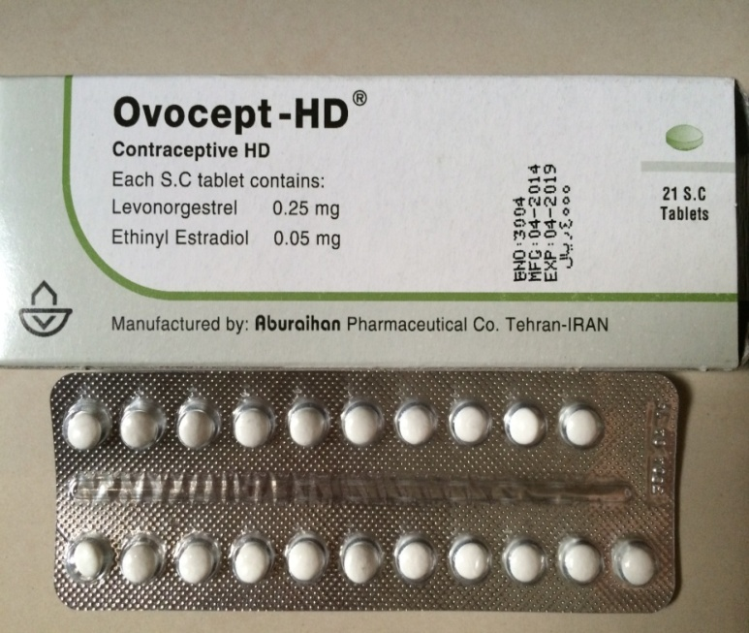
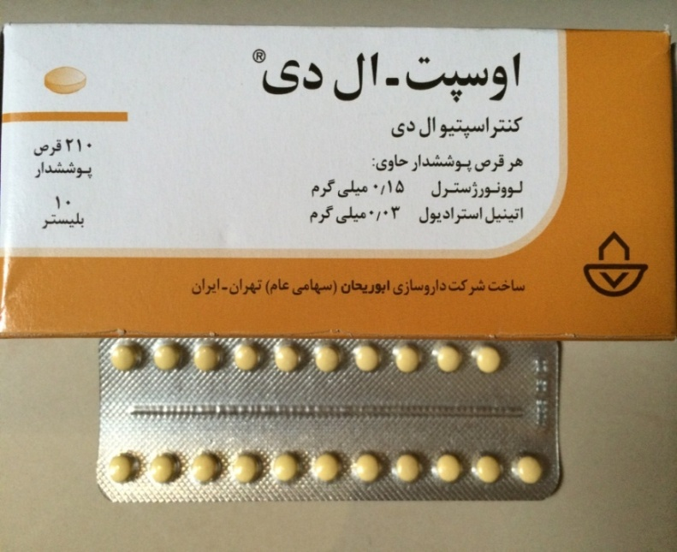
Second generation

Slide 7
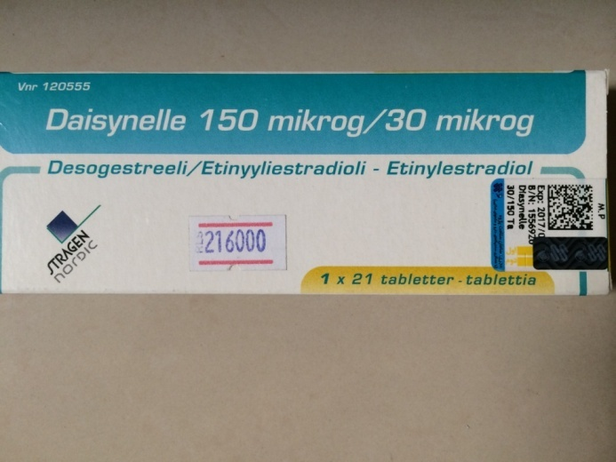
Third generation

Slide 8
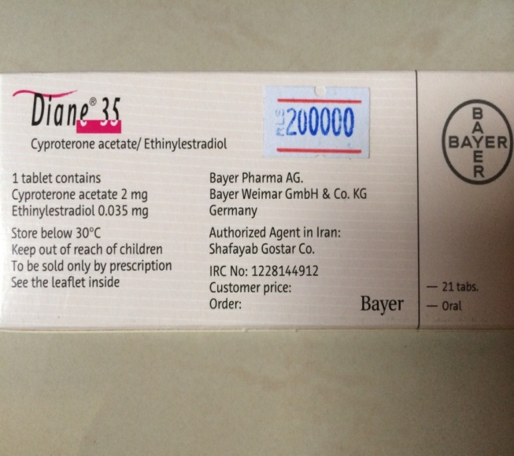
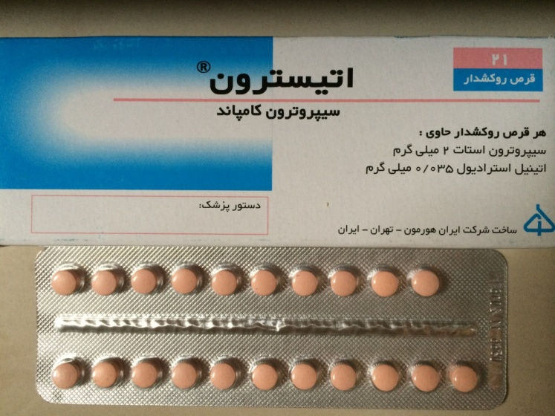
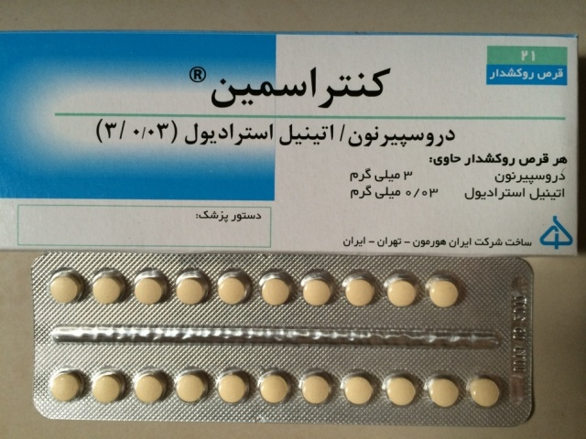
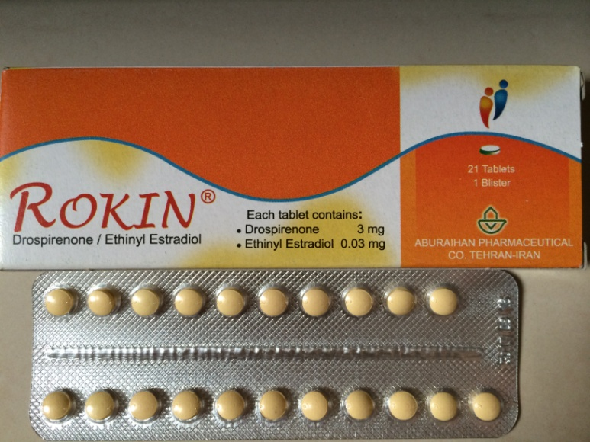
Antiandrogenic

Slide 9
Pills containing less than 50 µg of EE are called “low-dose” OCs.
Virtually all low-dose OCs contain 35 µg EE, and the dose of synthetic progestin ranges between 0.1 and 3 mg.
The initial OCs in the 1960s contained mestranol in doses as high as 150 µg.
EE has stronger effects than natural estradiol on hepatic metabolism, including synthesis of SHBG, lipoproteins, angiotensinogen, and some estrogen-dependent clotting factors.
17-estradiol, estradiol valerate, and estetrol(less metabolic changes than OCs containing EE).

Slide 10
Synthetic progestins used in first- and second-generation OCs are chemically related to T.
androgenic side effects:oily skin, acne, and hirsutism.
cyproterone acetate has the highest antiandrogenic effect.
Antiandrogenic potencies of dienogest and drospirenone are approximately 40 and 30% of the potency of cyproterone acetate, respectively.

Slide 11
Metabolic effects of estrogen in OCs are modulated by the type of the progestin included.
OCs containing third-generation progestins as well as drospirenone and cyproterone acetate have reduced metabolic side effects

Slide 12
Noncontraceptive benefits and side effects of OCs
decreased dysmenorrhea, menorrhagia, and anemia
improvements in acne and hirsutism
decreased risk of osteoporosis and ectopic pregnancy
Long-term OC use is also associated with decreased risk of ovarian and endometrial cancer

Slide 13
Absolute and relative contraindications to the use of low-dose OCs according to the WHO guideline
Absolute contraindications (ie, unacceptable health risk)
6 weeks postpartum if breastfeeding
Smoker over the age of 35 y (≥15 cigarettes per day)
Hypertension (systolic ≥ 160 mm Hg or diastolic ≥ 100 mm Hg)
History of deep venous thrombosis/pulmonary embolism
Current deep venous thrombosis/pulmonary embolism
Major surgery with prolonged immobilization
Known thrombogenic mutations (eg, Factor V Leiden, prothrombin mutation, protein S, protein C, and antithrombin deficiencies)
a Current case and history of ischemic heart disease
Stroke (history of cerebrovascular accident)
Complicated valvular heart disease
Systemic lupus erythematosus with positive antiphospholipid antibodies
Migraine headache with focal neurological symptoms
Current breast cancer
Diabetes with nephropathy/retinopathy/neuropathy
Other vascular disease or diabetes of> 20-y duration
Active viral hepatitis
Severe cirrhosis
Liver tumors

Slide 14
Selected relative contraindications (risks generally outweigh advantages)
Smoker over the age of 35 y (<15 cigarettes per day)
Adequately controlled hypertension
Hypertension (systolic 140–159 mm Hg, diastolic 90–99 mm Hg)
Migraine headache over the age of 35
Current gallbladder disease
Past OC-related history of cholestasis
Mild (compensated) cirrhosis
Use of drugs that affect liver enzymes
Anticonvulsant therapy
Antiretroviral therapy

Slide 15
Diagnosis and Treatment of Polycystic Ovary Syndrome: An Endocrine Society Clinical Practice GuidelineJ Clin Endocrinol Metab, December 2013, 98(12):4565–4592

Slide 16
Diagnosis and Treatment of Polycystic Ovary Syndrome: An Endocrine Society Clinical Practice GuidelineJ Clin Endocrinol Metab, December 2013, 98(12):4565–4592

Slide 17
Adverse effects
The most common side effects of OCs include:
Abnormal menstrual bleeding
Nausea
Breast tenderness
Headache
Mood changes
Most of these side effects lessen significantly after the first few months of use.

Slide 18
OC use and the risk of venous thrombosis

Slide 20
Objective: To investigate the association between use of combined oral contraceptives and risk of venous thromboembolism, taking the type of progestogen into account.
Design: Two nested case-control studies.
Setting: General practices in the United Kingdom contributing to the Clinical Practice Research Datalink (CPRD; 618 practices) and QResearch primary care database (722 practices).
Participants: Women aged 15-49 years with a first diagnosis of venous thromboembolism in 2001-13, each matched with up to five controls by age, practice, and calendar year.
Main outcome measures: Odds ratios for incident venous thromboembolism and use of combined oral contraceptives in the previous year, adjusted for smoking status, alcohol consumption, ethnic group, body mass index, comorbidities, and other contraceptive drugs. Results were combined across the two datasets.

Slide 23
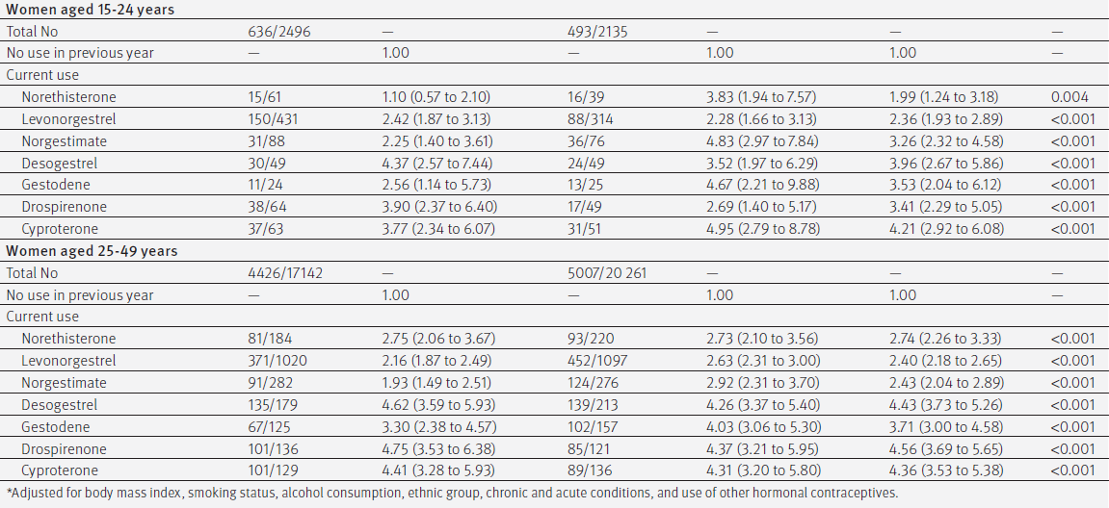

Slide 24
Key massage
Current exposure to any combined oral contraceptive was associated with an increased risk of venous thromboembolism (adjusted odds ratio 2.97, 95%confidence interval 2.78 to 3.17) compared with no exposure in the previous year.
risks of venous thromboembolism associated with combined oral contraceptives were, with the exception of norgestimate, higher for newer drug preparations than for second generation drugs.

Slide 26
Methods:
We developed a population-based cohort from the IMS LifeLink Health Plan Claims Database, which includes managed care organizations in the United States. Women aged 18– 46 years taking combined oral contraceptives and who had a claim for PCOS (n = 43 506) were matched, based on a propensity score, to control women (n = 43 506) taking oral contraceptives.
For inclusion in the PCOS cohort (nested within the combined oral contraceptive cohort), women were also required to have a diagnosis of PCOS.
A 1:1 matching technique, based on the propensity score, was used to select a comparator group of women without PCOS with similar baseline comorbidities.
The outcome of nonfatal venous thromboembolism was a combined outcome of pulmonary embolism and deep vein thrombosis during or within 30 days after cessation of combined oral contraceptive therapy(also required to initiate anticoagulant treatment)

Slide 27
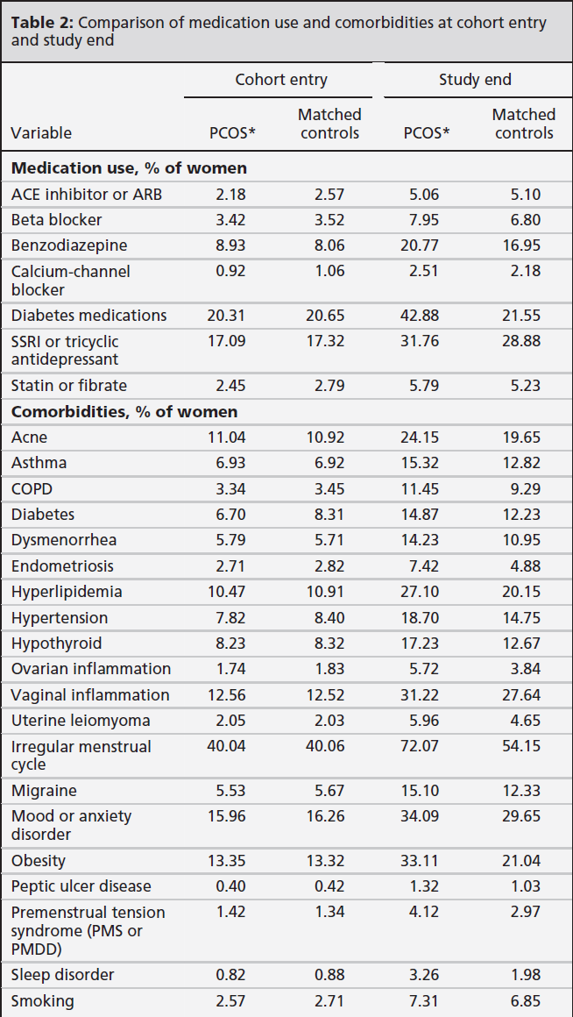

Slide 28
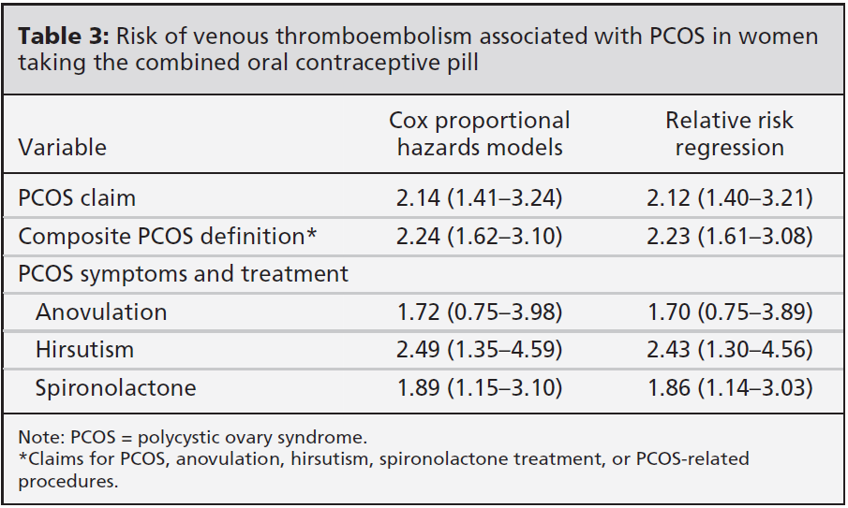
In sensitivity analysis: a more inclusive definition of PCOS also included women who met a diagnostic criteria for PCOS (anovulation or hirsutism) or treatment for PCOS (spironolactone).
This analysis included 89 555 women (5.5% of the total population) with PCOS, and 84 632 (94.5%) were successfully matched, defining a second cohort with 169 264 women.
In the stratified analyses, all additional measures of PCOS in this inclusive definition demonstrated increased risk of venous thromboembolism.

Slide 29
Key massage
Women with PCOS taking combined oral contraceptives had a 2-fold increased risk of venous thromboembolism, while such women not taking these drugs had a 1.5-fold increased risk.

Slide 30
The VTE rates in women of reproductive age are 0.5–1, 6–10, and 50 per 10 000 women-years in the general population, in pregnancy, and in the puerperal period, respectively.
The risk of VTE is increased 2- to 6-fold in OC users compared to nonusers.
The risk is highest during the first 3 months of use and returns to that of nonusers within weeks of discontinuation.
VTE risk depends on the dose of EE and the type of progestin.
A lowering of estrogen dose from 100 to 50 g(decreased risk of venous thrombosis)
lowering of the estrogen dose to 30 or 20 g (decrease in the risk of venous thrombosis ?)
Newer generation OCs have up to about a 2-fold increased risk of VTE compared with second-generation OCs containing levonorgestrel.

Slide 31
Clinicians should compare the risk of VTE per OC preparation and evaluate the additional acquired or genetic risk factors for VTE, such as obesity, smoking, advanced age (particularly after the age of 35 years), immobility, and hereditary thrombophilia.
RR of VTE in young healthy women is low, and the absolute risk is even smaller than the risk associated with pregnancy .
PCOS appears to be associated with a prothrombotic state.
available data suggest a 1.5- to 2-fold increased risk of VTE in PCOS.

Slide 32
OC use and the risk of arterial thrombosis in PCOS

Slide 33
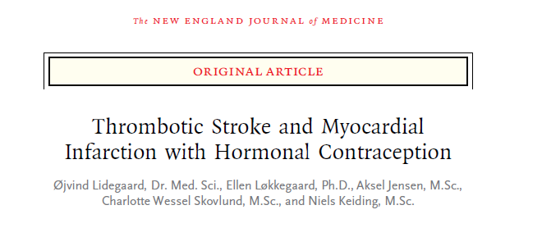
N Engl J Med 2012;366:225766

Slide 34
Methods
In this 15-year Danish historical cohort study, we followed nonpregnant women, 15 to 49 years old, with no history of cardiovascular disease or cancer.
the study cohort included 1,626,158 women, with 14,251,063 person-years of observation
Data on use of hormonal contraception, clinical end points, and potential confounders were obtained from four national registries

Slide 35
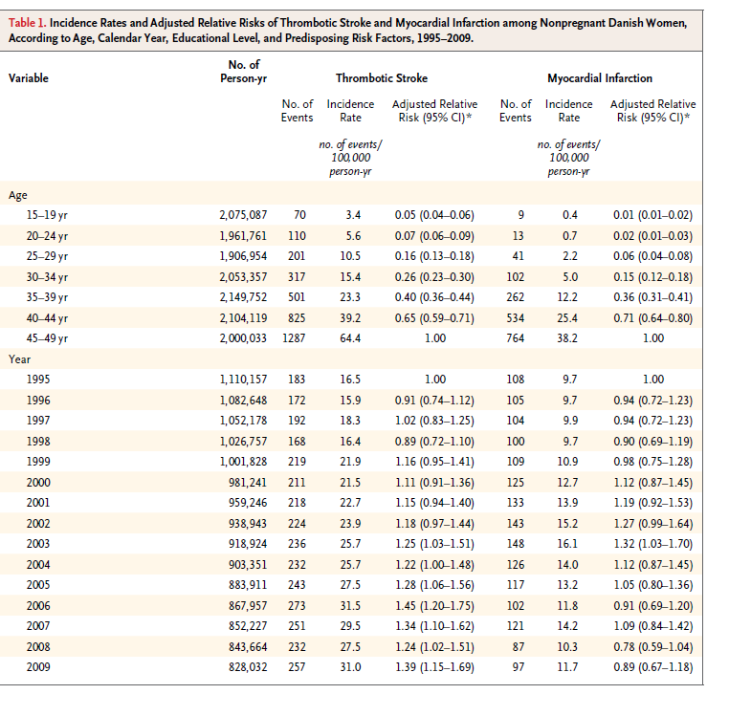
Notes:
بروز در افراد مسن تر بیشتر -

Slide 36
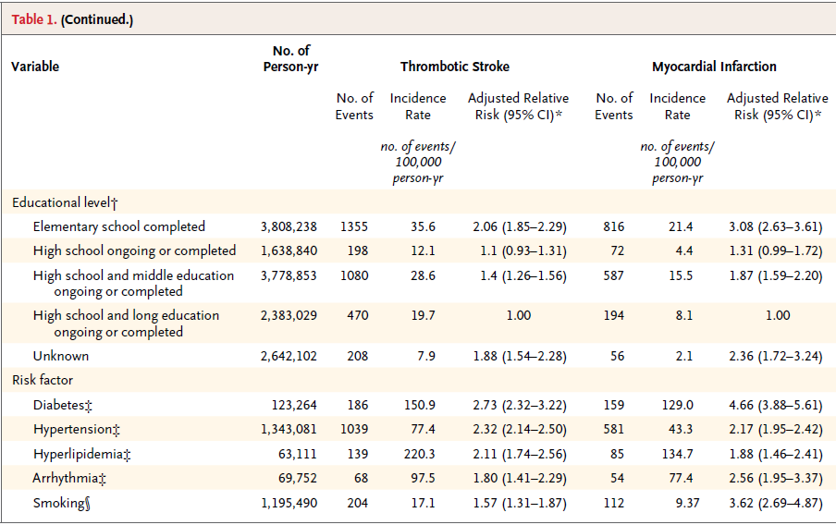
Women with the highest level of education had about half as many thrombotic strokes and about one third as many myocardial infarctions as women with the lowest level of education

Slide 37
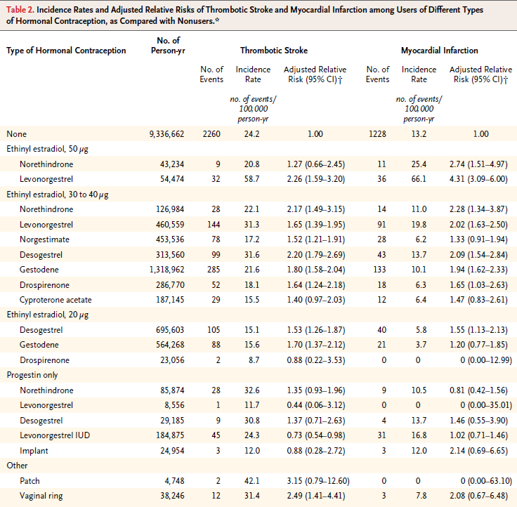
Notes:
در 20 شانس ترومبوز 0/9-107 و در 30-40 103-203 برابر عدم مصرف -در 30-40 بر حسب نوع پروژسترون فرقی نداشت -

Slide 38
combined oral contraceptives with doses of ethinyl estradiol of 20 μg, 30 to 40 μg, and 50 μg were associated with a relative risk of thrombotic stroke of 1.60 (95% CI, 1.37 to 1.86), 1.75 (95% CI, 1.61 to 1.92), and 1.97 (95% CI, 1.45 to 2.66), respectively (P = 0.24 for trend).
The corresponding relative risks for myocardial infarction were 1.40 (95% CI, 1.07 to 1.81), 1.88 (95% CI, 1.66 to 2.13), and 3.73 (95% CI, 2.78 to 5.00), respectively (P<0.001 for trend).

Slide 39
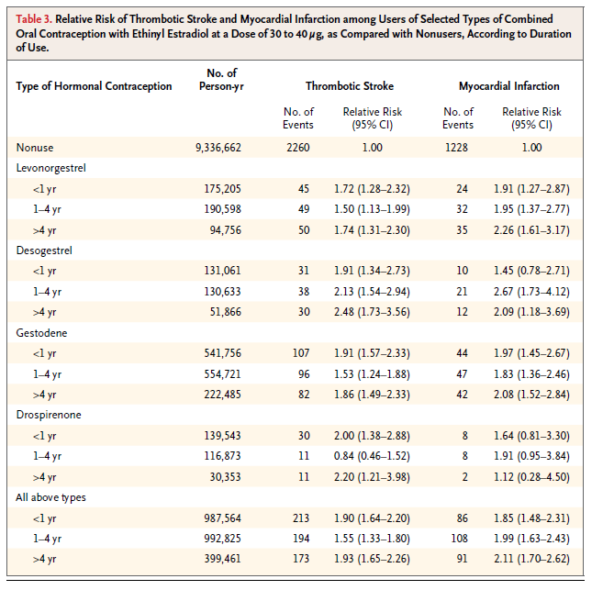
Notes:
بر حسب طول مصرف فرق نداشت -

Slide 40
Key massage
women who used oral contraceptives with ethinyl estradiol at a dose of 30 to 40 μg had a risk of arterial thrombosis that was 1.3 to 2.3 times as high as the risk among nonusers, and women who used pills with ethinyl estradiol at a dose of 20 μg had a risk that was 0.9 to 1.7 times as high, with only small differences according to progestin type.

Slide 41
the absolute risks of thrombotic stroke and myocardial infarction were low decision should be individualized based on age and known risk factors for both VT and AT.
The progestin-only products should be considered in older women and women with risk factors for AT.
Some non-oral hormonal contraceptives, such as vaginal rings, implants and skin patches carry a higher risk of venous thromboembolism - blood clots - when compared to oral contraceptive pills.

Slide 42
Hypertension
OCs frequently cause a mild elevation in blood pressure within the normal range; however, overt hypertension can occur.
Overall, only 41.5 cases per 10,000 person-years could be attributed to OC use; this risk rapidly declined with cessation of therapy.

Slide 43
RISK OF CANCER

Slide 45
Design: Inception cohort study.
Participants: Directly standardised data from the Royal College of General Practitioners’ oral contraception study.
Main outcome measures:
Adjusted relative risks between never and ever users of oral contraceptives for different types of cancer, main gynaecological cancers combined, and any cancer.
The main dataset contained about 744 000 woman years of observation for ever users of oral contraception and 339 000 woman years for never users.
The corresponding values for the general practitioner observation dataset were 331 000 and 224 000 woman years.

Slide 48
women who used oral contraceptives for more than eight years had a statistically significant increased risk of any cancer, cancers of the cervix and central nervous system
or pituitary

Slide 49
protective effect of oral contraception for ovarian cancer lasts for at least 15 years after stopping, with reduced (statistically nonsignificant) relative risks still seen after longer time intervals

Slide 50
Key massage
In this UK cohort, oral contraception was not associated with an overall increased risk of cancer.
Depending on which dataset was examined, our analyses suggest either a statistically significant 12% reduced risk of any cancer (main dataset) or a more modest, non-significant, 3% reduction (general practitioner observation dataset).
These results suggest that, at least in this relatively healthy UK cohort, the cancer benefits associated with oral contraception outweigh the risks.

Slide 51
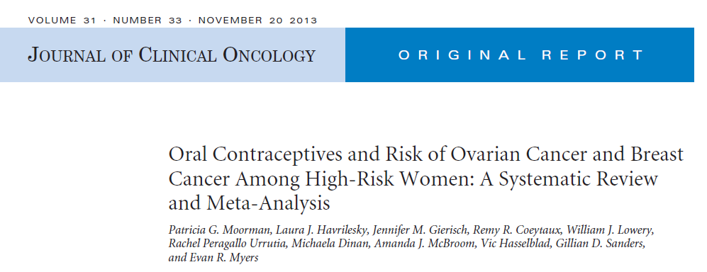

Slide 52
Purpose
To estimate the risks of ovarian cancer and breast cancer associated with oral contraceptive (OC) use among women at elevated risk owing to mutations in BRCA1/2 or a strong family history.
Methods
We searched PubMed, Embase, the Cochrane Database of Systematic Reviews, and ClinicalTrials. gov for studies published 2000 to 2012 that evaluated associations between OC use and breast or ovarian cancer among women who are carriers of a BRCA1/2 mutation or have a family history of breast or ovarian cancer.
From 6,476 unique citations, we identified six studies examining ovarian cancer risk in BRCA1/2 mutation carriers and eight studies examining breast cancer risk in BRCA1/2 mutation carriers.

Slide 53
Fig 2. Forest plots for associations between oral contraceptives and ovarian cancer among (A) BRCA1 mutation carriers, (B) BRCA2 mutation carriers, and (C) BRCA1 and BRCA2 mutation carriers combined. There was no significant heterogeneity in these analyses. (A) Q-value of 1.24 for 3 df, P .743. (B) Q-value of 4.68 for 2 df, P .096. (C) Q-value of 3.12 for 2 df, P .210. OC, oral contraceptive.

Slide 54
Fig 3. Forest plots for association between oral contraceptives and breast cancer among (A) BRCA1 mutation carriers, (B) BRCA2 mutation carriers, and (C) BRCA1 and BRCA2 mutation carriers combined. There was evidence of heterogeneity in these analyses. (A) Q-value 15.1117 for 4 df, P .004. (B) Q-value was 9.618 for 3 df, P .022. (C) Q-value of 20.005 for 4 df, P .001. OC, oral contraceptive.

Slide 55
Key massage
For women with a family history of ovarian or breast cancer, we identified four studies examining risk for ovarian cancer and three for breast cancer, but differences between studies precluded combining the data for meta-analyses, and no overall pattern could be discerned.
Our analyses suggest that associations between ever use of OCs and ovarian and breast cancer among women who are BRCA1 or BRCA2 mutation carriers are similar to those reported for the general population

Slide 57
Purpose: We hypothesized that PCOS, specific PCOS-related symptoms/sequelae, or clusters of PCOS-related symptoms/sequelae may be differentially associated with pre- versus postmenopausal breast cancer risk.
Materials and methods :Cases were 1,508 women newly diagnosed with a first primary in situ or invasive breast cancer between 1 August 1996 and 31 July 1997. Cases were identified through daily or weekly contact with the 28 hospitals on Long Island and three large tertiary care hospitals in New York City and the 1,556 population-based controls were frequency-matched by age.
Participants completed a 100-min structured questionnaire conducted by a trained interviewer in the respondent’s home shortly after diagnosis (or date of identification for controls).

Slide 60
Key massage
PCOS and associated PCOS-related symptoms/ sequelae including OC use may play a role in the development of premenopausal breast cancer.
Our findings require confirmation in studies with a larger number of premenopausal women with systematically applied diagnostic criteria for PCOS.

Slide 61
OVERALL MORTALITY

Slide 62
Objective: To see if the mortality risk among women who have used oral contraceptives differs from that of never users.
Design: Prospective cohort study started in 1968 with mortality data supplied by participating general practitioners, National Health Service central registries, or both.
Participants: 46 112 women observed for up to 39 years, resulting in 378 006 woman years of observation among never users of oral contraception and 819 175 among ever users.
Main outcome: measures Directly standardised adjusted relative risks between never and ever users for all cause and cause specific mortality.

Slide 63
Compared with never users, ever users tended to be younger, smokers, and of higher parity and manual social class at recruitment and to have used hormone replacement therapy while under general practice observation

Slide 66
No difference in all cause
Trends of decreasing rates of death from large bowel/rectum, uterine body, and ovarian cancers
increasing rates of other circulatory disease and violent deaths among women who used oral contraception for longer durations.

Slide 67
Key massage
Oral contraception was not associated with an increased long term risk of death in this large UK cohort; indeed, a net benefit was apparent.
The balance of risks and benefits, however, may vary globally, depending on patterns of oral contraception usage and background risk of disease.

Slide 68
Carbohydrate and lipid metabolism
Available data in a healthy population do not support a significant influence of OCs on glucose and insulin homeostasis.
There are no major differences between different OCs regarding their effects on carbohydrate metabolism.
OC use is not associated with any significant change of fasting glucose, fasting insulin or homeostasis model assessment of insulin resistance in women with PCOS.

Slide 69
The effect of OCs on serum lipid values depends upon the estrogen dose and the androgenicity of the progestin.
In general, serum triglyceride concentrations rise slightly (Oral but not transdermal preparations)
no consistent changes in serum (HDL) or (LDL) cholesterol concentrations.
The estrogen component of OCs increases serum triglycerides and HDL concentrations and lowers serum LDL cholesterol concentrations.
The progestin usually increases serum LDL cholesterol and lowers serum HDL cholesterol concentrations, particularly the androgenic progestins.
The newer progestins, such as desogestrel, tend to raise serum HDL cholesterol and lower LDL cholesterol concentrations.

Slide 70
Liver disorders:
Association with hepatic adenoma is good,
Association with focal nodular hyperplasia (FNH) and hepatocellular carcinoma (HCC) is inconclusive.
Estrogen-progestin contraceptives containing ≤35 mcg of ethinyl estradiol have not been shown to have an adverse effect on liver function tests.
Pancreatitis :
recommend against use of Ocs :triglyceride levels >500 mg/dL
weight gain
No evidence supporting a causal association between Ocs and weight gain.

Slide 71
Headaches :
●There does not appear to be a strong relationship between OC use and headache for most women.
●Women with a strong personal or family history of troublesome headaches (in particular, migraine) did appear to be at higher risk for new-onset headache related to OC use. However, most women with this history reported no change in overall headache history.
●The dose or type of progestin did not appear to affect headache risk. The effect of estrogen dose was unclear.
●Regardless of cause, when headaches started or worsened with OC use, they tended to improve despite continued use.

Slide 72
Migraine headaches :
The WHO and ACOG conclude from the literature that women with a history of migraine headaches who take OCs are at increased risk for cerebral thromboembolism, and that the risks of OC use usually outweigh the benefits in women over age 35 years with migraines.
In addition, they suggest that for women of any age with migraines associated with aura or focal symptoms, the risk of OC use is unacceptable.
In women with migraines without aura, other modifiable risk factors for stroke such as smoking, hypertension, and dyslipidemia should be identified and treated before considering using an OC.

Slide 74
Objective: We summarized the evidence about the side effects of oral contraceptive pills, metformin, and anti-androgens in women with PCOS.
Data Source: Sources included Ovid Medline, OVID EMBASE, OVID Cochrane Library, Web of Science, Scopus, PsycInfo, and CINAHL from inception through April 2011.
Study Selection: We included comparative observational studies enrolling women with PCOS who received the agents of choice for at least 6 months and reported adverse effects.

Slide 76
How to start an OC in a patient with PCOS?

Slide 77
Breast examination, pelvic and genital examination, and cervical cytology screening are not routinely recommended.
Cardiometabolic risk assessment needs to be performed, including a 75-g standard 2-hour OGTT and lipid profile at baseline and during follow-up with regular intervals.
A thrombophilia screen is not recommended routinely
Women with a family history of VTE in a first-degree relative 45 years of age may indicate an increased likelihood of hereditary thrombophilia.
In PCOS patients with a personal history of thrombophilia, progesterone-only pills would be an option.
Contraceptive pills containing progestin only (referred to as the mini-pill) do not have a significant impact on coagulation or fibrinolysis and do not significantly alter carbohydrate or lipid metabolism.

Slide 78
Controversies and Areas of Uncertainty
Definition of PCOS by different diagnostic criteria brings significant heterogeneity to the clinical phenotypes, with potentially varying degrees of cardiometabolic risk starting from the diagnosis.
Head-to-head blinded trials comparing different OCs are lacking. Longitudinal follow-up data on benefits and risks of Ocs are not available.
It should be emphasized that most of the risk estimates of venous and arterial thrombosis associated with OC use in the general population are derived from case-control and cohort studies providing a RR increase in users compared with nonusers.
It is not feasible to conduct randomized controlled trials in PCOS that are large enough to detect differences between various OCs in terms of rare adverse events such as venous and arterial thrombosis. Alternatively, well-designed observational studies with sufficient long-term follow-up deserve more attention.

Slide 79
Conclusion
OCs are a key component of the chronic treatment of PCOS.
Although guidelines do not suggest one OC formulation over another in terms of effectiveness, low-dose OCs containing neutral or antiandrogenic progestins may be the choice in the treatment of PCOS.
Potential adverse cardiovascular and metabolic effects of OCs present.
current evidence suggests that the benefits of oral contraception outweigh the risks in the vast majority of women with PCOS.

Slide 80
Thank you

