Slide 1
Diabetic Neuropathy
N.Beladimoghadam.MD
Shahid Beheshti University of Medical Science

Slide 2
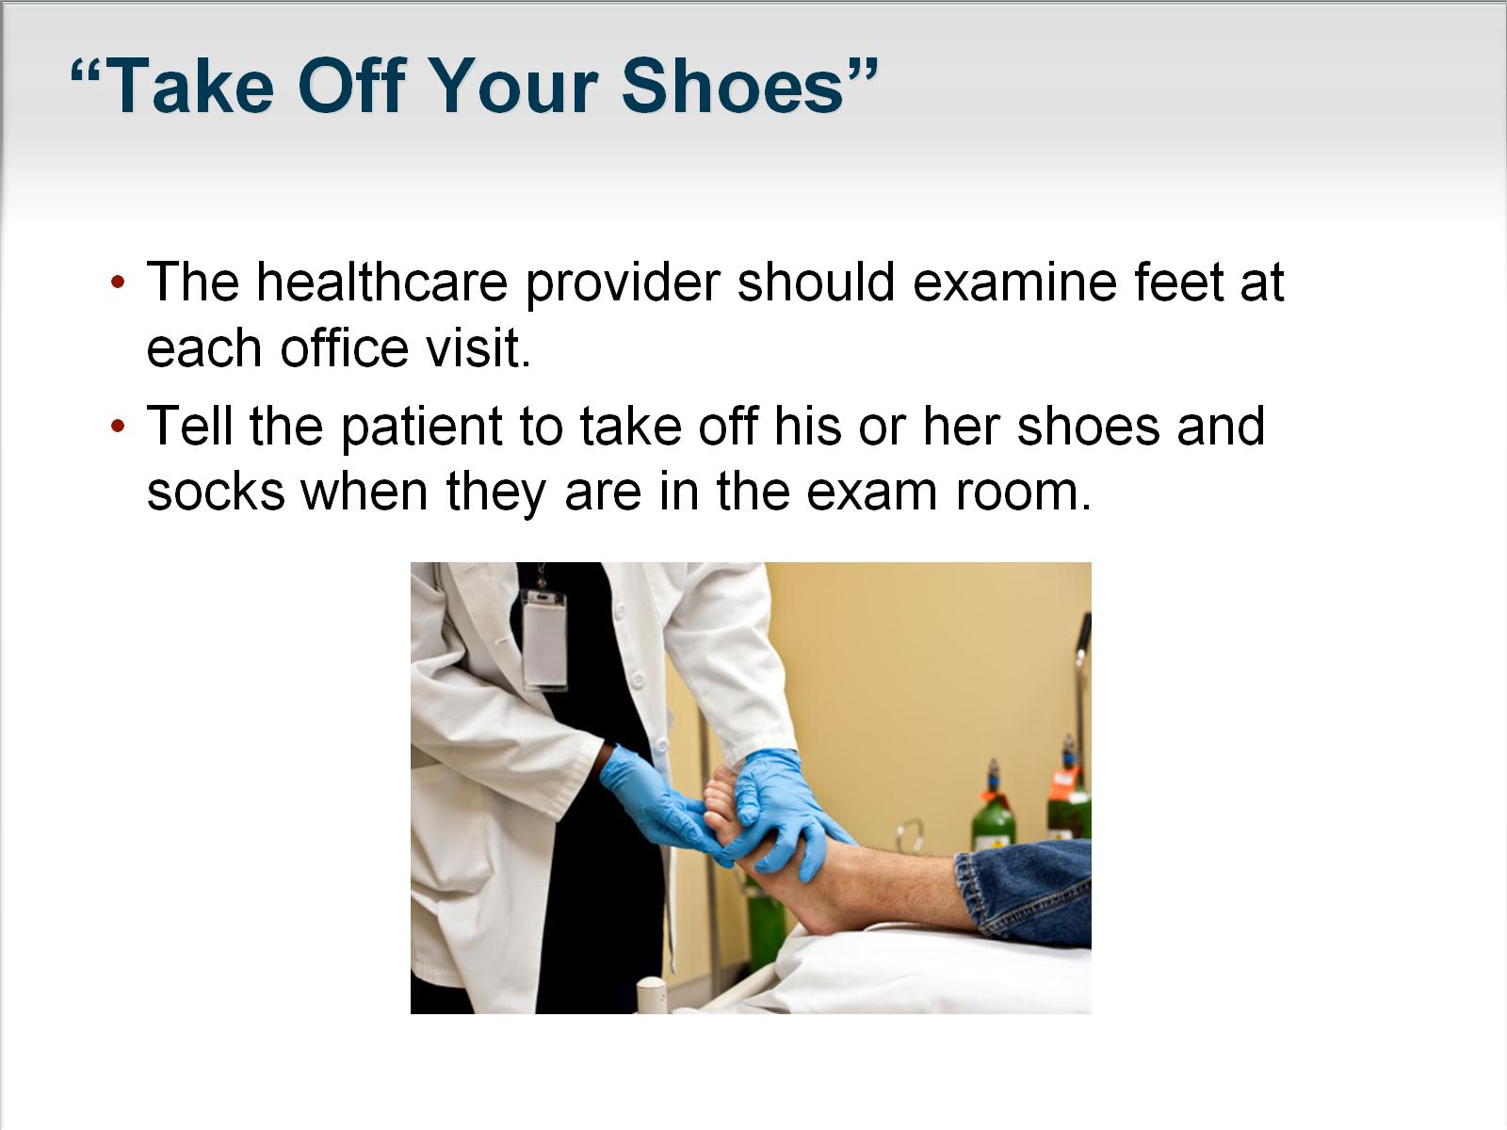

Slide 3
Semiology of neuropathyies
1-Motor symptoms & signs:
Weakness:distal muscles (occasionally :proximal+distal,such as GBS,Diabet,CIDP,…) –May be accompanied with cranial neuropathies so related cranial muscles weakness is added.
Atrophy+decreased or absent reflexes
2-Sensory symptoms & signs: Paresthesia+Numbness+Dysesthesia+Burning pain
Stocking & gloves pattern sensory impairment
Proprioceptive & vibration impairment (-Romberg sign)

Slide 4
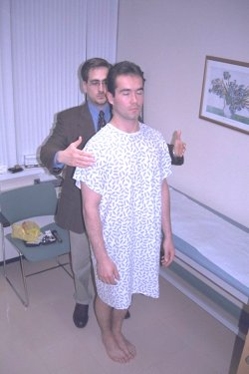

Slide 5
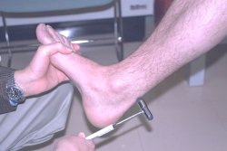

Slide 6
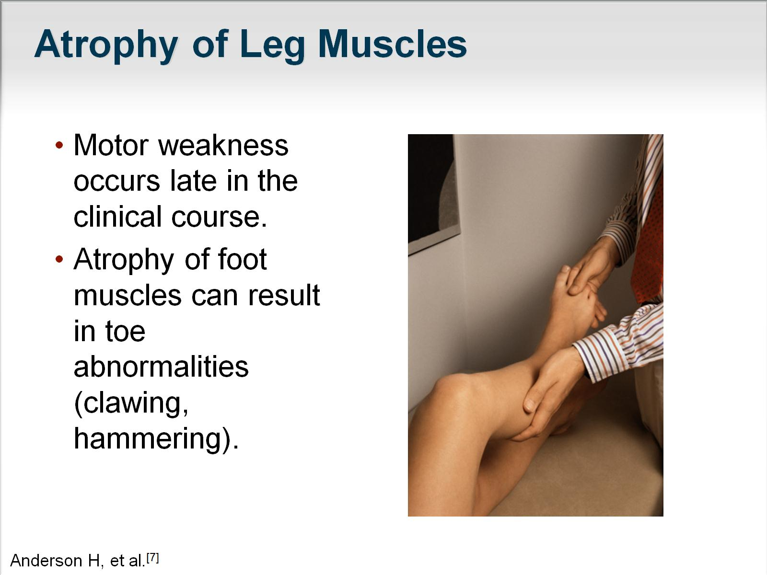

Slide 7
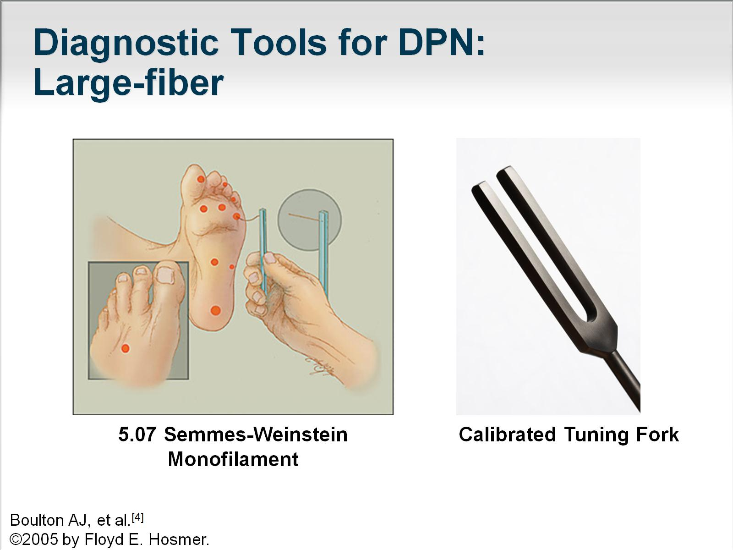

Slide 8
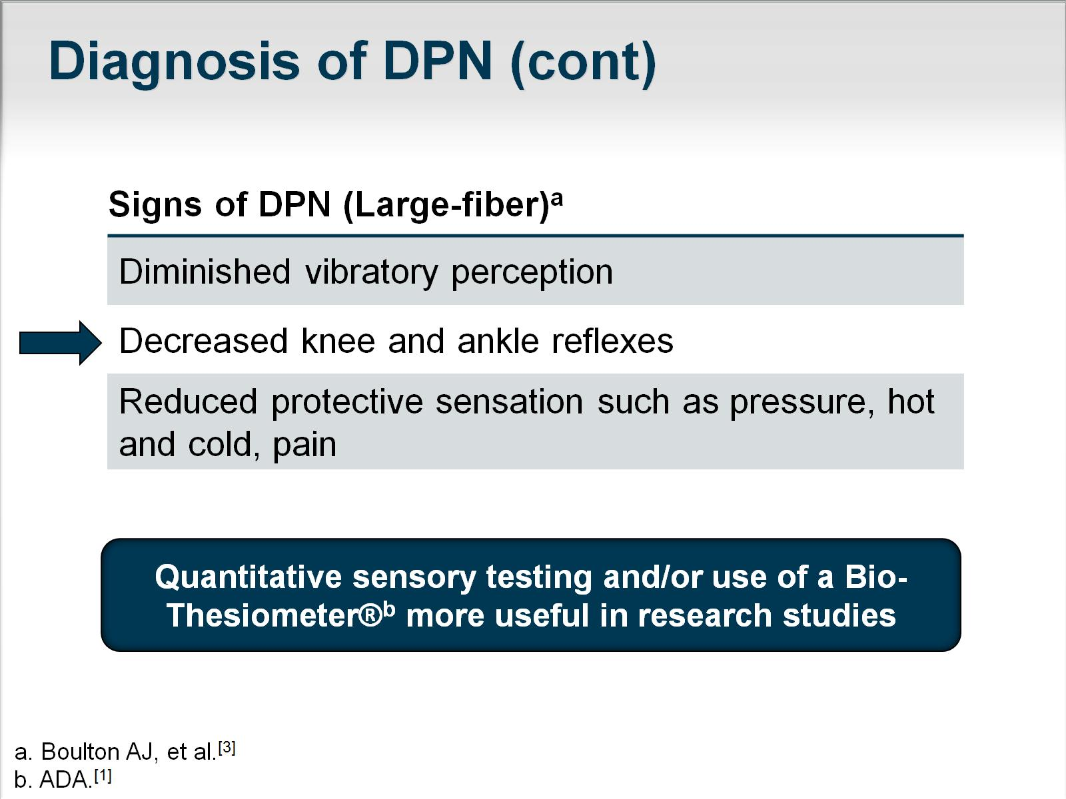

Slide 9
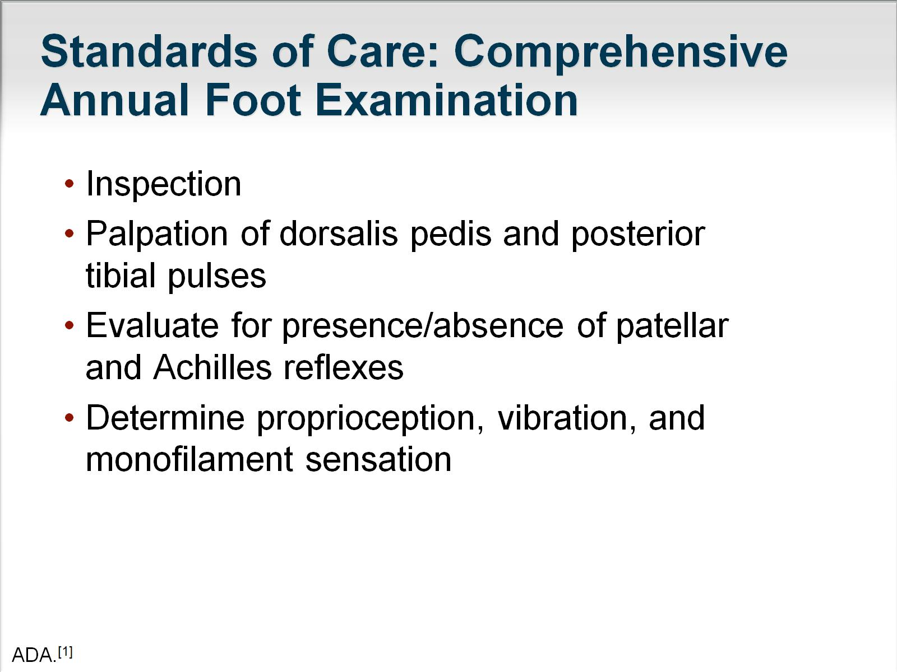

Slide 10
Classification of neuropathies:
1-By duration: Acute-subacute-chronic
2-By type of involved nerves :sensory-motor-sensorymotor
3-By pathology:Axonal-Demyelinatig-Mixed axonal & Demyelinatig.
4-Cranial or Peripheral nerves involvement or both
5-By distribution of involvement (Mononeuropathy such as CTS-Asymmetric involvement of 2 or more nerves : Mononeurit multiplex---Symmetric involvement of peripheral nerves in 4 limbs:Polyneuropathy)
Diabetic neuropathy could be presented in all above forms

Slide 11

Diabetic neuropathy is defined as :
The presence of symptoms and signs of peripheral or cranial nerve dysfunction in individuals with diabetes after the exclusion of other causes .

Slide 12

Longer duration of diabetes and male gender may predispose to the development of neuropathy.
..
Consume excessive amounts of alcohol. Tobacco use , height, and age, poor glycemic control may predispose to earlier development and more severe symptoms of neuropathy, presumably by inducing vasoconstriction and nerve ischemia.

Slide 13

Several recent studies have shown that patients presenting with a chronic "idiopathic" axonal polyneuropathy have nearly a twofold higher frequency of undiagnosed diabetes mellitus and impaired fasting blood glucose than age-matched controls.
These studies suggest that an axonal neuropathy may be the presenting or the earliest manifestation in diabetes.

Slide 14


Treatment-induced neuropathy
Burning pain and paresthesias develop in the distal lower extremities after th establishment of glucose control.
Pain persists for weeks or up to several
months with spontaneous resolution.

Slide 15
May coincide with
other conditions that cause similar manifestations including CIDP, vitamin Bl2 deficiency, alcoholic neuropathy, and endocrine neuropathies.
Additional causes of polyneuropathy may be present in 10% and up to 55% of patients with diabetes mellitus .

Slide 16
A useful classification divides the diabetic neuropathies into symmetrical polyneuropathies versus focal or multifocal neuropathies However, there is significant overlap between these syndromes.

Slide 17
Classification of Diabetic Neuropathies
SYMMETRICAL POLYNEUROPATHIES
Distal sensory or sensorimotor polyneuropathy
Small-fiber neuropathy
Autonom ic neuropathy
Large-fib er neurop athy
ASYMMETRICAL NEUROPATHIES
Cranial neuropathy (single or multiple )
Truncal neuropathy (thoracic radiculopathy)
Limb mononeuropathy (single or multiple)
Lumbosacral radiculoplexopathy (asymmetrical proximal motor
neuropathy )
Entrapment neuropathy
COMBINATIONS
Polyradiculoneuropathy
Diabetic neuropathic cachexia
Symmetrical polyneuropathies

Slide 18
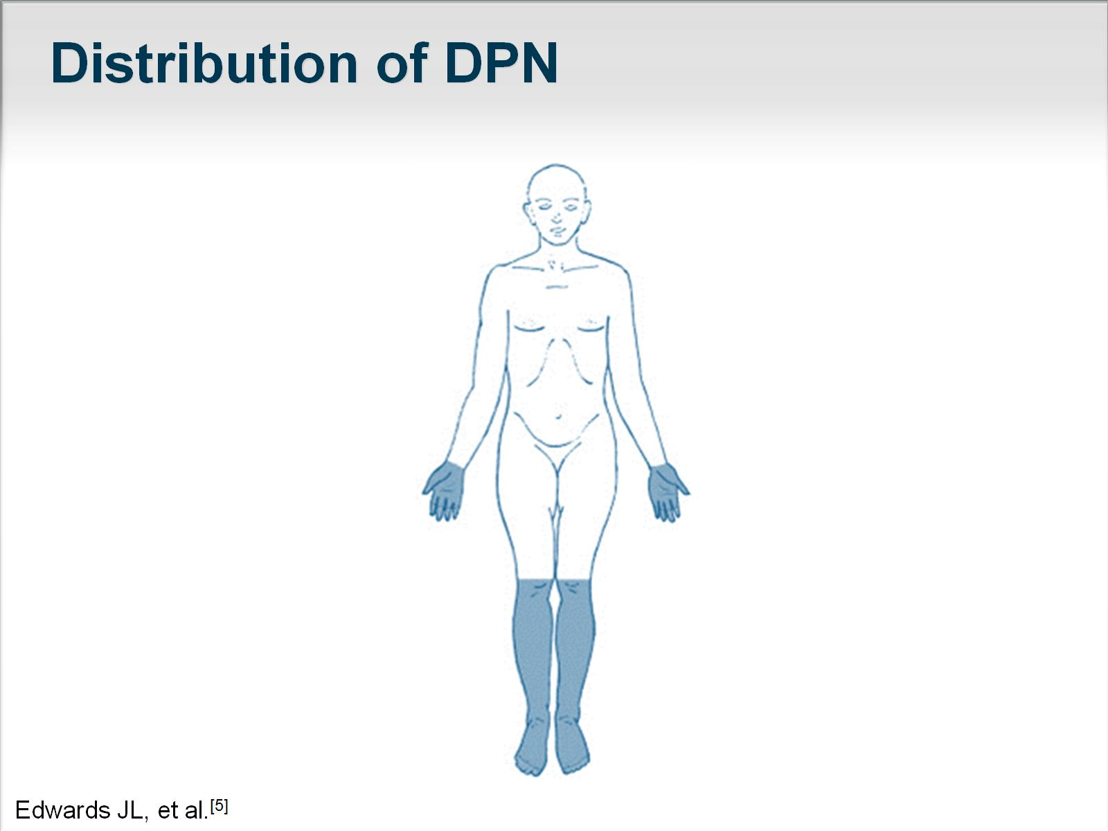

Slide 19

The large-fiber variant presents with painless paresthesias beginning at the toes and feet, impairment of vibration and joint position sense, and diminished muscle stretch reflexes.
In advanced cases, significant ataxia may develop due to sensory deafferentation. Large-fiber involvement is often asymptomatic, but sensory deficit may be detected by careful examination .
In contrast to the large-fiber neuropathy, the small-fiber variant frequently presents with pain of a deep, burning, stinging, aching character, often associated with spontaneous shooting pains and allodynia to light touch. Pain and temperature modalities are impaired with relative preservation of vibration and
joint position sensation and muscle stretch reflexes. The small-fiber variant is often accompanied by autonomic neuropathy

Slide 20
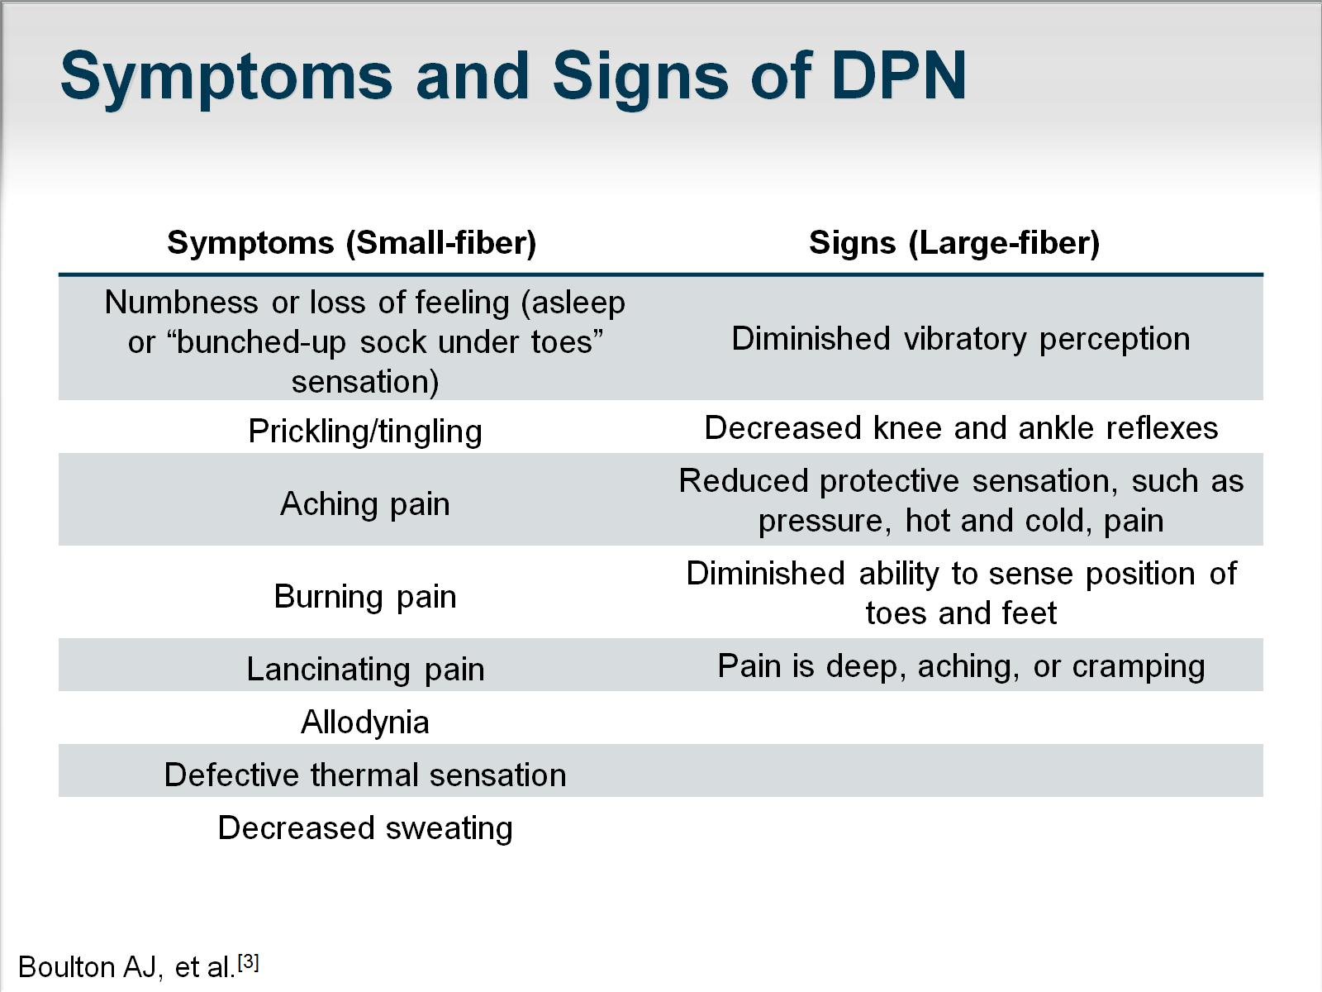

Slide 21
Distal Symmetrical Polyneuropathy
sensory deficits predominate, and autonomic
symptoms usually correlate with the severity of the neuropathy.
Most patients will develop only a minor motor involvement affecting the distal muscles of the lower extremities.
Sensory disturbances have a stocking-glove distrib ution following a length-dependent pattern.
Early sensory manifestations begin in the toes, gradually spreading proximally; when these reach above knee level, the fingers and hands become affected .
.

Slide 22
Asymmetric Leg Weakness and Diabetes
A 56-year-old diabetic woman developed gait difficulty over a 7-month period.
She had pain & had occasional hand numbness. There was a medical history of hypertension.
PHYSICAL EXAMINATION. Cranial nerves and cerebellar and sensory function were normal.
There was isolated weakness and atrophy of the left quadriceps. DTRs were active and symmetric, except for absence of the left knee jerk and ankle jerks. Plantar responses were normal.
1-Where is the lesion?
UMN?-LMN?(Ant horn cell?-Radiculopathy?-Plexopathy?-Neuropathy?)-NMJ ?-Myopathy?)
2. What are the neurological complications of diabetes?
3-Comment on the syndrome of diabetic amyotrophy.
Plan
Screen for polyneuropathy.
Delineate the pattern of abnormality.

Slide 23
Electrodiagnostic Examination:EMG-NCS
NCS:Distal latency-CMAP Amplitude-NCV
Motor Conduction :
Tibial :No response-peroneal:NCV: slow-Femoral:No response
Sensory Nerve Action: Median:Low amplitude SNAPS-
absent SNAPS in lower limbs-
EMG(Electromyography ):The EMG reveals disproportionate denervation in the Left quadriceps-and also neurogenic in paravertebral,Ant.Tibialis –Gastrocnemious-Adductors-bilateral asymmetrically .
1-Does patient have a polyneuropathy?
2. Patient was referred with a diagnosis of femoral neuropathy.
Any Comment ?.
Electrodiagnostic Interpretation
Left L_{2,3,4} radiculopathy. This is superimposed on a sensorimotor axonal polyneuropathy in a mononeuritis multiplex pattern.

Slide 24

Asymmetrical Proximal Diabetic Neuropathy or
Lumbosacral Radiculoplexopathy (diabetic amyotrophy)
Clinically, asymmetrical weakness and wasting of pelvifemoral muscles may occur either abruptly or in a stepwise progression in individuals with diabetes who are older than 50 years.
Most patients have NIDDM, but the onset is unrelated to the duration of diabetes .

Slide 25
In some cases, the opposite leg becomes affected after a latency of days to months .
Reduction or absence of knee and ankle jerks is the rule.
Numbness or paresthesias are minor complaints.
Weight loss occurs in more than half of patients .
Recovery takes up to 24 months ,

Slide 26
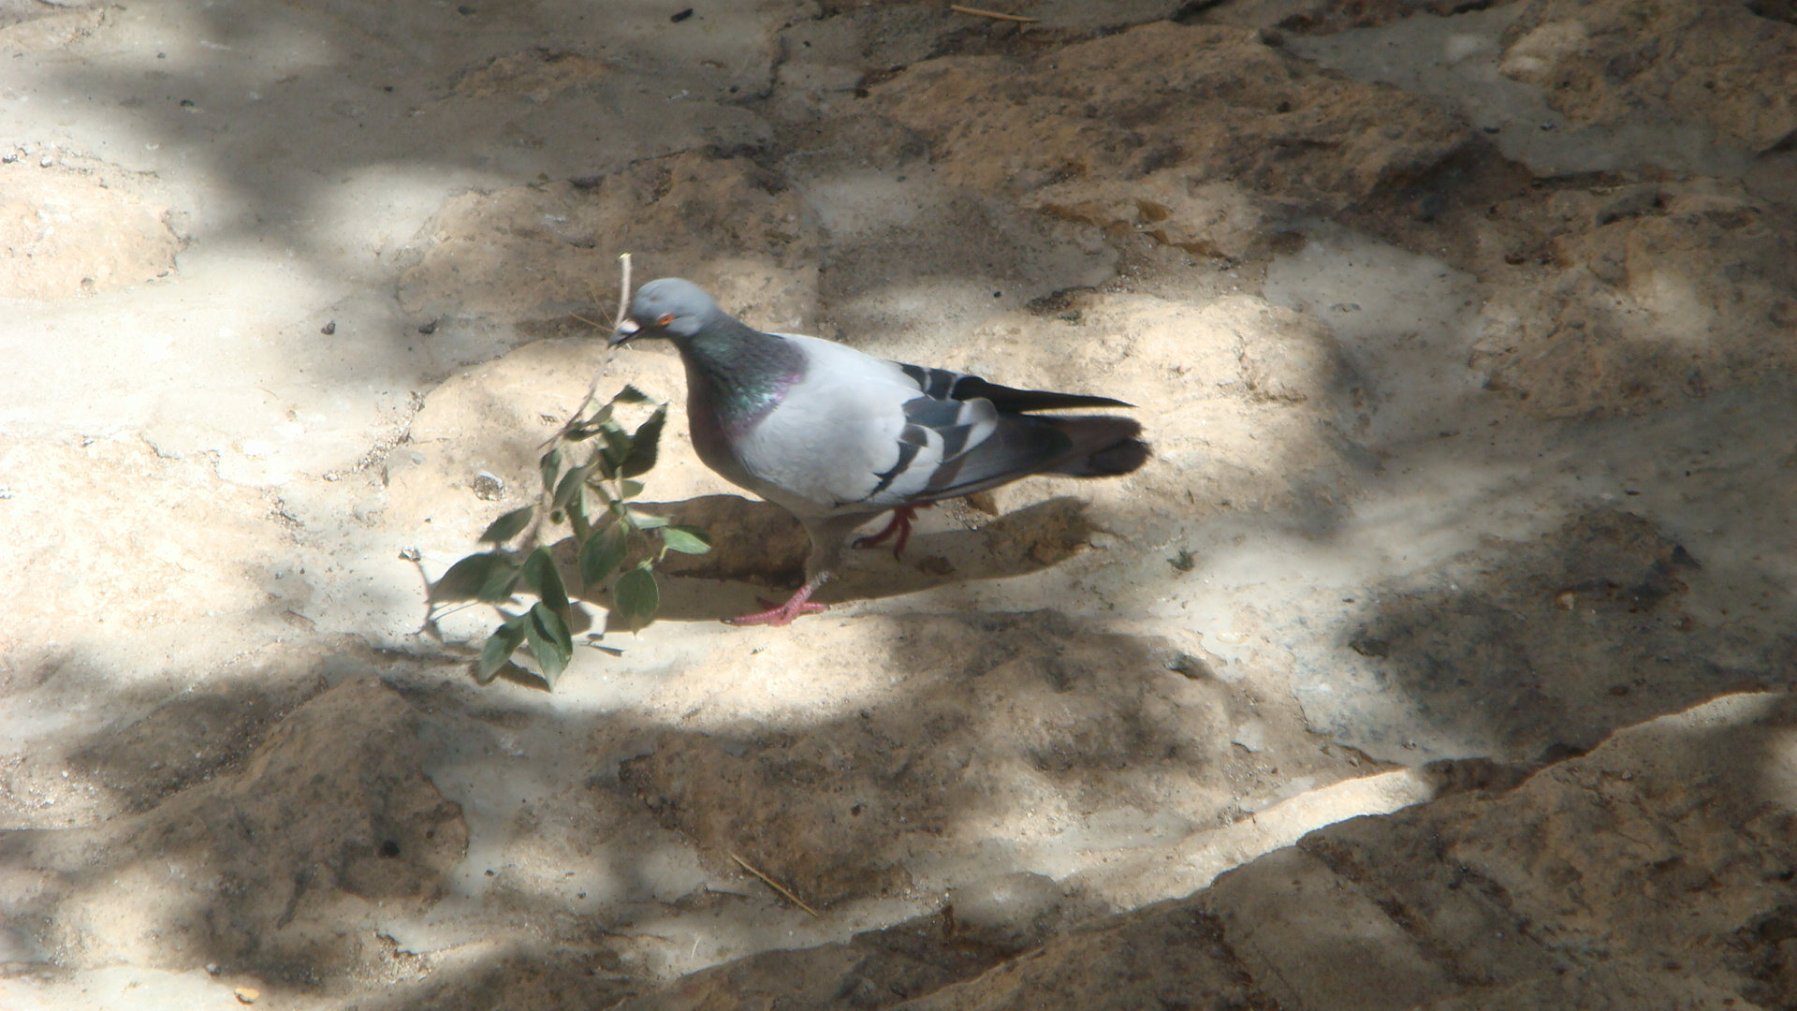
Where is the lesion?
There is not any other symptoms and signs,so it is unlikely to be an intra-axial(brain stem) lesion.
A lesion in the pathway of the 3th cranial nerve between brain stem and globe is possible without any other abnormality so it is an isolated 3th nerve cranial neuropathy due to ischemic etiology.
Diabetic Cranial Mononeuropathy.
3th nerve palsy is the most common.
PupiIlary sparing: the hallmark of diabetic third-nerve palsy .
With decreasing frequency, the fourth , sixth, and seventh nerves are also affected.

Slide 27
For 6 years, a 73-year-old woman experienced low back pain radiating into her right leg.
She denied numbness, weakness, and bladder problems. Symptoms were not increased by Valsalva's maneuver. Medical history included insulin-dependent diabetes mellitus, hypertension, and removal of a benign colon tumor 4 years ago.
PHYSICAL EXAMINATION. Cranial nerves and cerebellar function were normal. No weakness or sensory deficit was found. DTRs were absent and Plantar responses flexor. There was no Lasegue's sign
1. What do the patient's symptoms suggest?
The symptoms of low back pain with radiation to a leg are suggestive of lumbosacral radiculopathy.
There was no supportive clinical evidence, such as Lasegue's sign, sensory deficit, or motor deficit, but this is often the case.
2. In view of the diabetes mellitus, what else has to be considered?
Diabetes can affect the peripheral nervous system in many patterns, including (1) focal, or multiple nerve lesions (mononeuritis multiplex) possibly on a vascular basis
; (2) diffuse symmetrical polyneuropathy suggesting a metabolic process; or
(3) lesions of the proximal neuraxis (radiculopathy, or polyradiculopathy). The last occurs in varying patterns depending on the roots involved (diabetic amyotrophy, thoracoabdominal neuropathy, truncal mono-neuropathy).
In this case, the global absence of DTRs (although of lesser significance with advancing age) can alert the examiner to a diffuse problem.

Slide 28
Plan:Look for right-sided lumbosacral radiculopathy.
Screen for more diffuse problems)
Motor NCS: Rt Tibial & Peroneal:Low amplitude CMAPs-NCV slowing-and the same on Left side
Sensory NCS:Absent SNAPs in 4 limbs
EMG:Neurogenic pattern in all paravertebral and lower limbs muscles
Electrodiagnostic Interpretation :diffuse polyradiculoneuropathy
1-Why were other limbs & lumbar paraspinal muscles sampled? 2-Are there any clues to suggest this diffuse pled?
With what conditions is this diffuse pattern associated? The polyradiculopathy pattern of diffuse paraspinal abnormalities is not specific to diabetes mellitus.
/Other conditions noted in the literature associated with diffuse paravertebral muscle abnormalities include leptomeningeal carcinomatosis (metastatic cancer, leukemia), AIDS, Lyme disease, sarcoidosis, and eosinophilia-myalgia syndrome

Slide 29
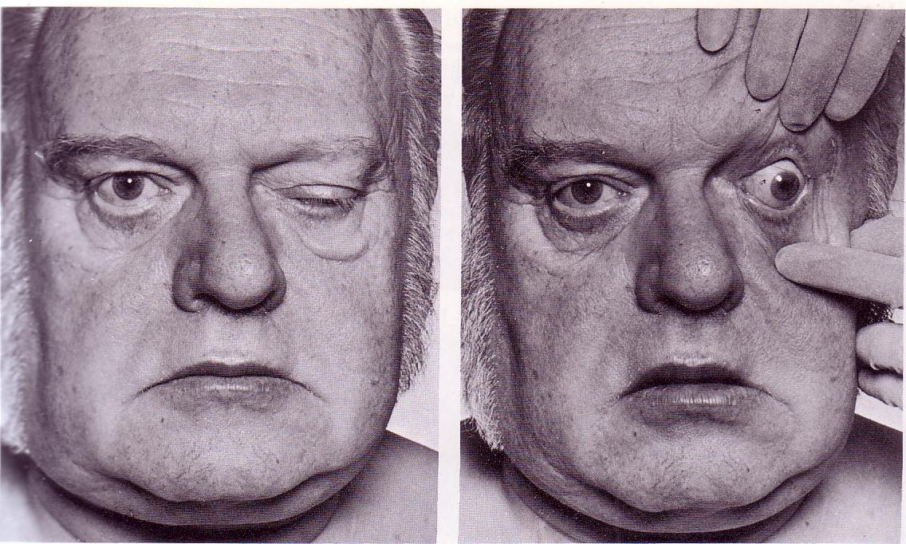
A 70 years old man with diabetes and acute left side ptosis + diplopia

Slide 30
Diabetic Neuropathic Pain Management
According to the 2011 AAN/AANEM/AAPMR guideline, dextromethorphan, morphine sulfate, tramadol, and oxycodone should be considered for PDN treatment. No one opioid is recommended over another.
Topical therapy with capsaicin or transdermal lidocaine may be useful in some patients, especially those with more localized pain or those in whom interactions with existing oral medications is a concern. The 2011 AAN/AANEM/AAPMR guideline recommends that both of these agents be considered in for treatment of PDN. Any of these medications may be associated with adverse effects, and patients should be counseled about possible problems before initiating treatment

Slide 31
Diabetic Neuropathic Pain Management
Oral agents include antidepressants and anticonvulsant drugs.
According to the 2011 guideline issued by the American Academy of Neurology (AAN), American Academy of Physical Medicine and Rehabilitation (AANEM) and the American Academy of Physical Medicine and Rehabilitation (AAPMR) guideline for the treatment of painful diabetic neuropathy (PDN), pregabalin is recommended for treatment of diabetic neuropathic pain.
The drug has been proven effective and can improve quality of life. However, physicians should determine if the drug is clinically appropriate for their patients on a case-by-case basis.
Gabapentin and sodium valproate should also be considered for diabetic neuropathy pain management

Slide 32
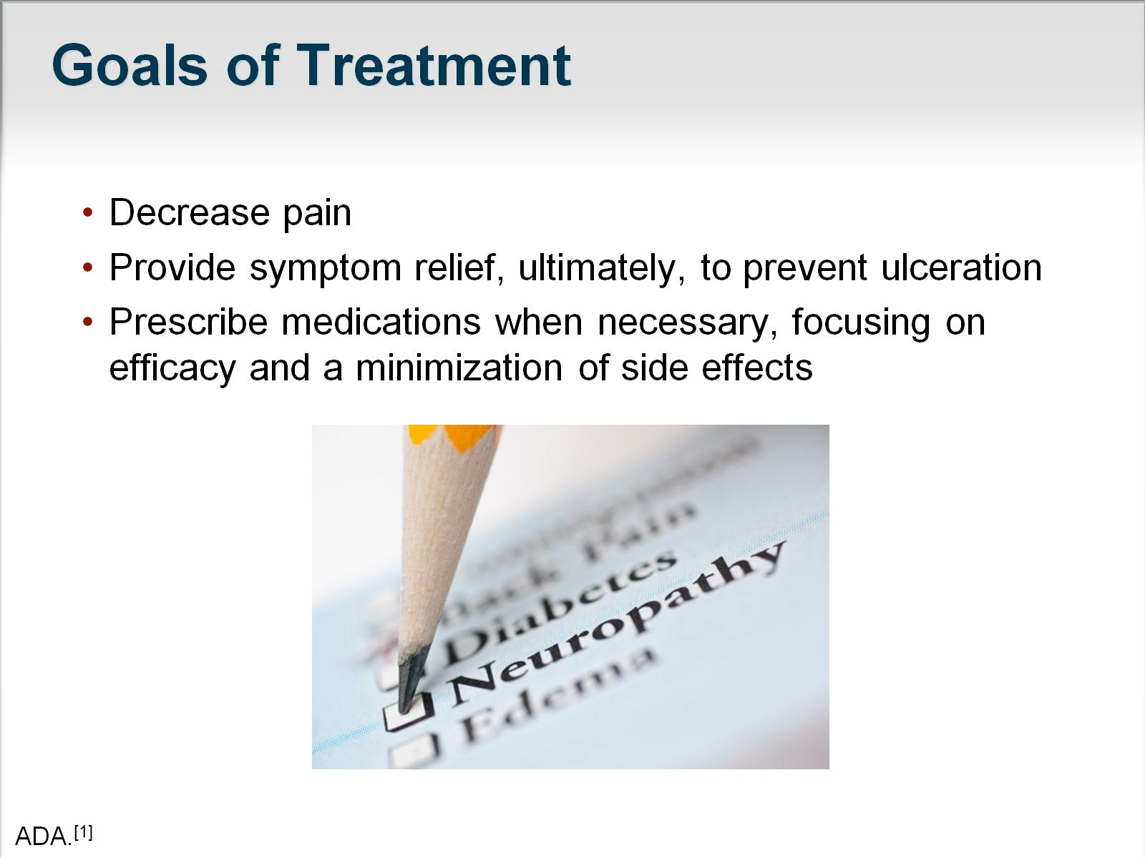

Slide 33
Anticonvulsant
Gabapentin (Neurontin) has been reported to work excellently in the treatment of dysesthetic pain.
Carbamazepine (Tegretol) has been used mainly for partial seizures and can be used in peripheral neuropathy as a third-line agent if all other agents fail to reduce or improve symptoms of diabetic neuropathy.
Pregabalin (Lyrica) is approved for the treatment of pain due to generalized diabetic peripheral neuropathy and may be considered as a first-line agent in diabetic peripheral neuropathic pain.

Slide 34

Antidepressants
Tricyclic
For paresthetic pain, tricyclic antidepressants such as imipramine (Tofranil), nortriptyline (Pamelor, Aventyl), and amitriptyline (Elavil) have been shown to be useful as analgesics for paresthetic pain,
Selective Serotonin/norepinephrine Reuptake Inhibitor (ssnri)
Duloxetine (Cymbalta) was the first medication to be approved specifically for the treatment of diabetic neuropathy. Venlafaxine (Effexor) has been recommended by the AAN/AANEM/AAPMR guidelines for consideration in diabetic neuropathy pain management.
Serotonin Reuptake Inhibitor
Paroxetine-- Citalopram
Tetracyclic
Desipramine

Slide 35
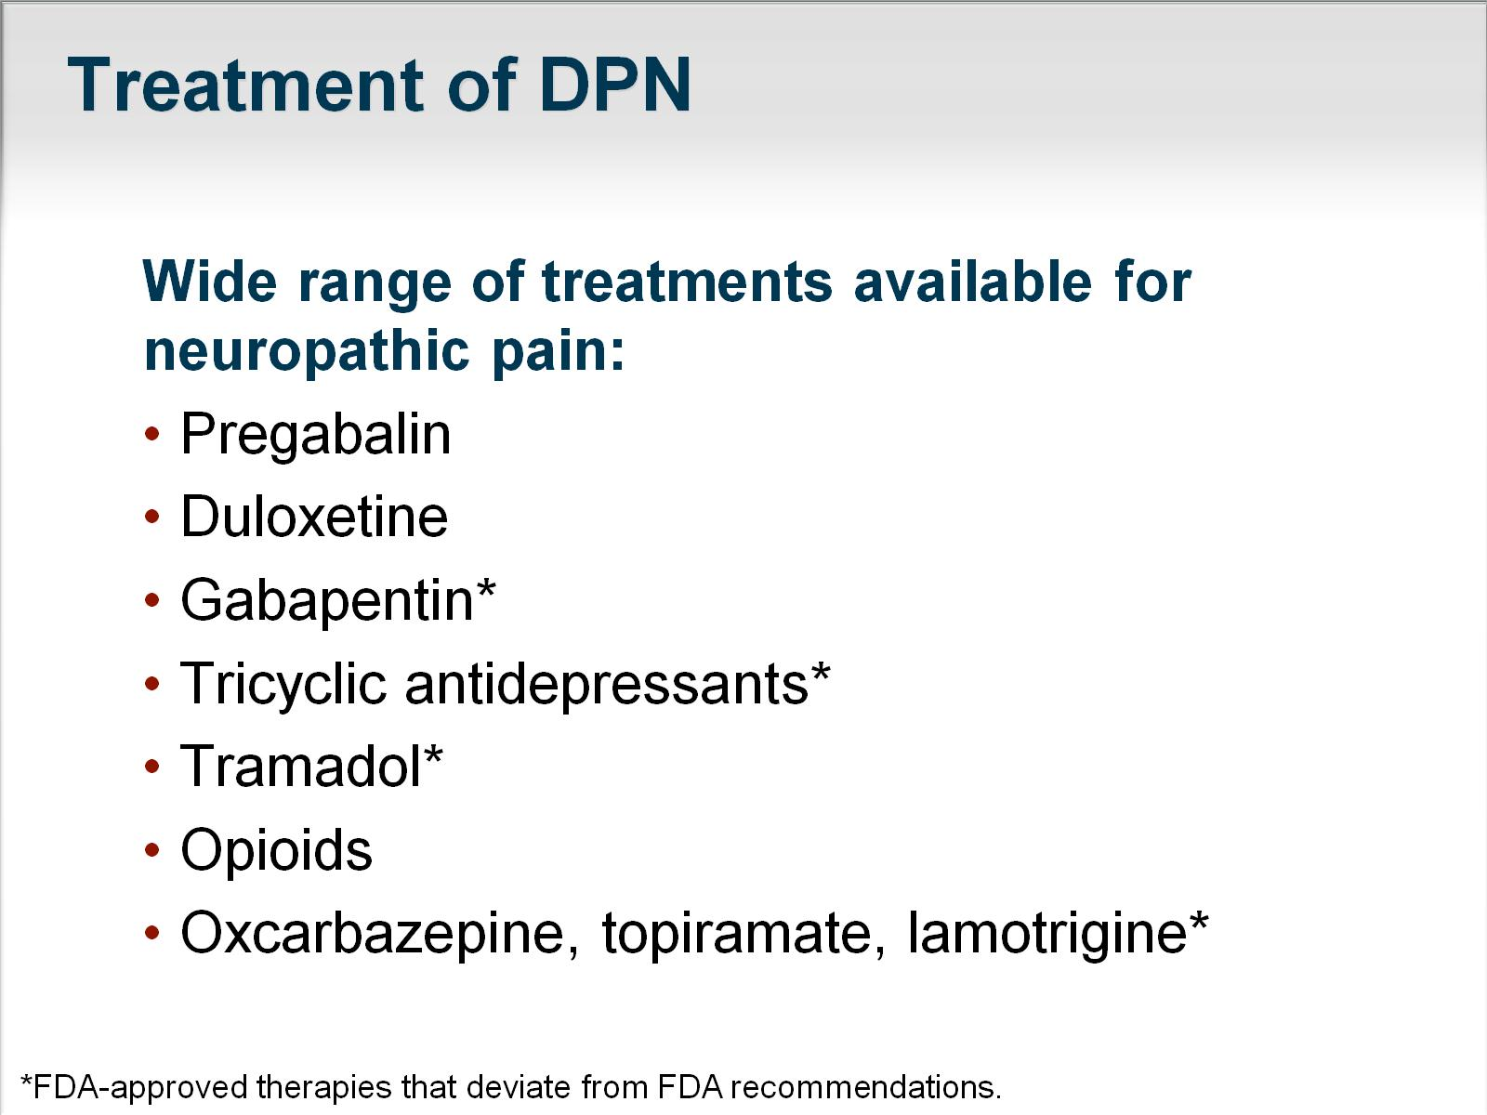

Slide 36
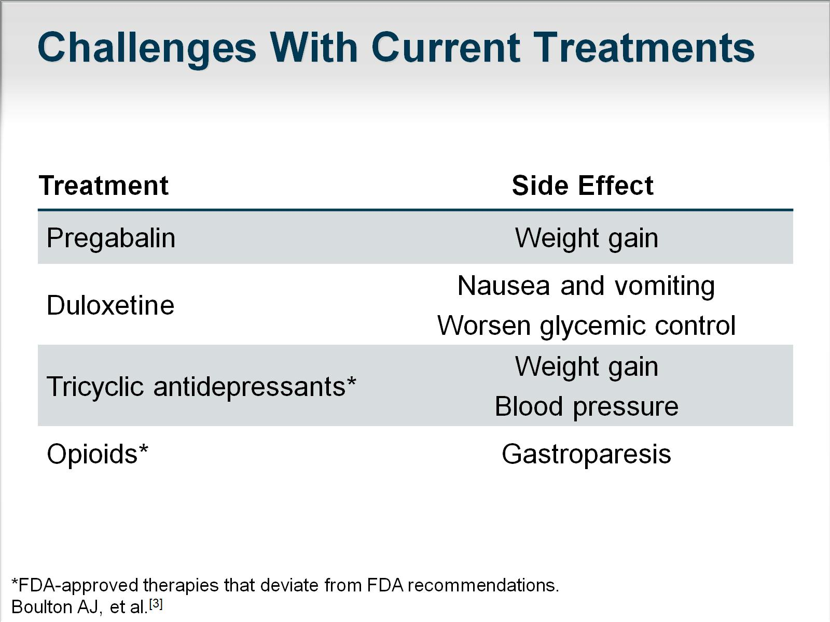

Slide 37
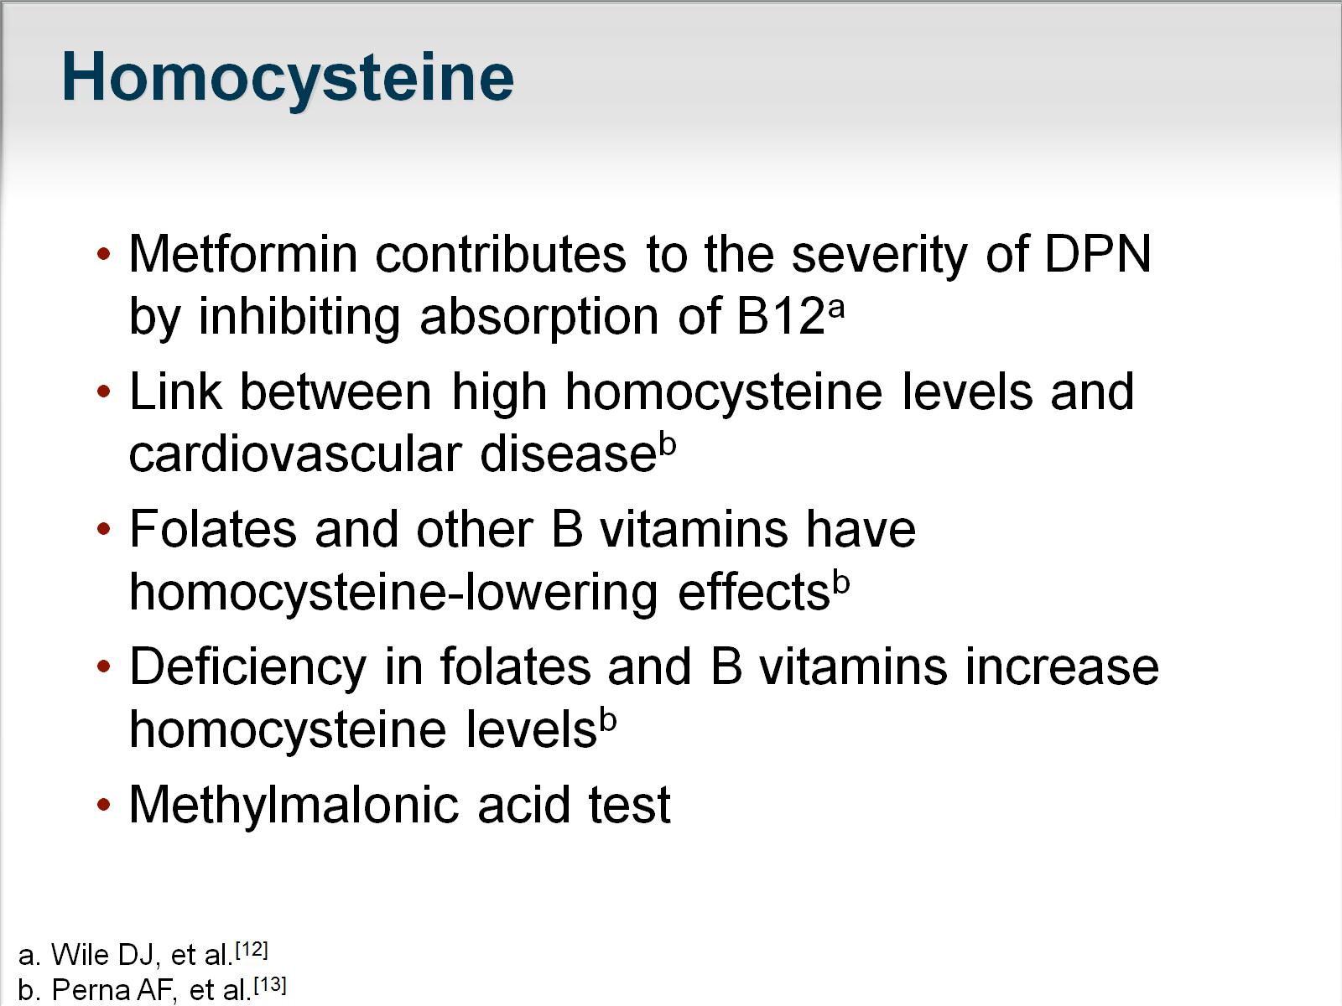

Slide 38
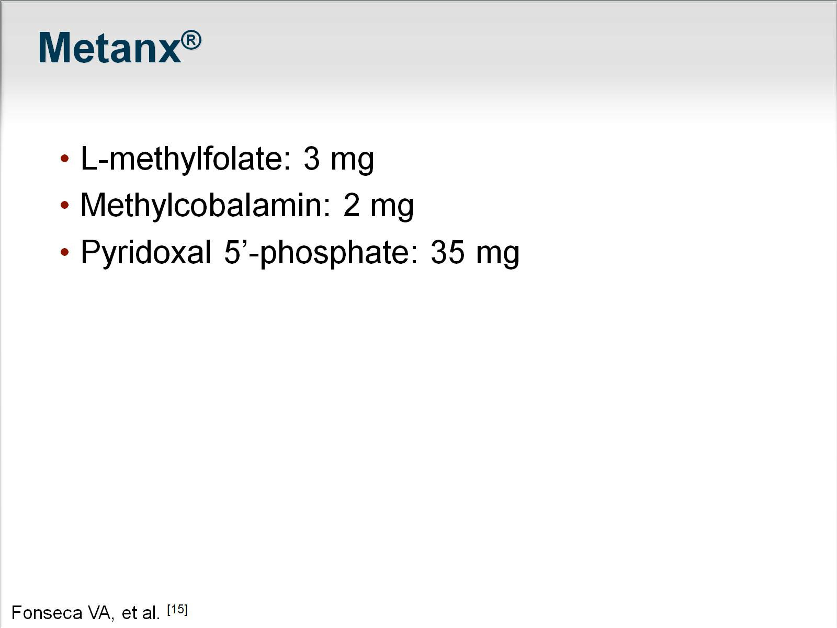

Slide 39
Glycemic Control
Of all treatments, tight and stable glycemic control is probably the most important for slowing the progression of neuropathy.
Because rapid swings from hypoglycemia to hyperglycemia have been suggested to induce and aggravate neuropathic pain, the stability of glycemic control may be as important as the actual level of control in relieving neuropathic pain.
The Diabetes Control and Complications Trial (DCCT) demonstrated that tight blood sugar control in patients with type 1 diabetes decreased the risk of neuropathy by 60% in 5 years.
The effect of tight glycemic control on polyneuropathy in patients with type 2 diabetes or those with impaired glucose tolerance/impaired fasting glucose is not as clear and requires further prospective study

Slide 40
Pathology
Cranial and limb mononeuropathy
and multiple mononeuropathies are thought to be caused by small-vessel occlusive disese.
In multiple lumbar roots, plexus, or proximal nerve segments: Whether ischemic or inflammatory lesions?

Slide 41
Pathogenesis of Diabetic Neuropathy
Currently accepted hypotheses focus on the possibilities of metabolic and ischemic factors and their interactions in causing nerve injury .
Hyperglycemia increase endoneurial vascular resistance and reduce nerve blood flow.
Hyperglycemia also causes depletion of nerve myoinositol.
Persistant hyperglycemia enhances the polyol pathway in nerve tissue through the enzyme aldose reductase, which leads to the accumulation of sorbitol and fructose in nerve and enhancement of nonenzymatic glycosylation of structural nerve proteins.

Slide 42
Symptomatic treatment for autonomic manifestations
Patient s with symptomatic orthostatic hypotension are advised to sleep with the head of the bed elevated 6 to 10 inches .
.
Practical suggestions include drinking two cups of strong coffee or tea with meals, eating more frequent small meals rather than a few large ones , and increasing the daily fluid intake (>20 0z/day) and salt ingestion (10 to 20 g/day). Elastic body stockings may be beneficial by reducing the venous capacitance in bed but are poorly tolerated by many patients. Plasma volume expansion can be achieved by fludrocortisone (0.1 to 0.6 mg/day)

Slide 43
Treatment of Autonomic Dysfunction
Erectile dysfunction from diabetic neuropathy is a very difficult condition to treat. All other causes of impotence must be excluded. Once the diagnosis has been confirmed, the oral agent sildenafil Viagra) and related phosphodiesterase type 5 (PDE5) inhibitors can be used (if not contraindicated in the patient). Older methods such as vacuum devices or intracavernosal papaverine injections may be tried. Referral to a urologist is suggested.
Orthostatic hypotension:Increasing the dietary fluid and salt intake, along with use of compression stockings, may help. If these modalities do not improve symptoms, then medication may help
Gustatory sweating: Glycopyrrolate is an antimuscarinic compound that can be used for the treatment for diabetic gustatory sweating. When applied topically to the affected area, it results in a marked reduction in sweating while eating a meal

Slide 44
Diabetic Gastroparesis
Erythromycin, cisapride, and metoclopramide are used to treat diabetic gastroparesis. Additionally, MiraLax (polyethylene glycol 3350) is gaining increasing popularity as the first-line agent for severe constipation and lower motor unit bowel.
A newer agent, tegaserod (Zelnorm), may be helpful in patients with chronic ileus. In early 2010, however, tegaserod marketing was suspended because of a meta-analysis showing an excess number of serious cardiovascular adverse events, including angina, myocardial infarction, and stroke, in those taking tegaserod compared with placebo. Tegaserod is currently available only on an emergency basis

Slide 45
Surgical Treatment
Charcot foot can be treated with bracing or special boots. In some cases, surgery is used to correct the deformity.
Jejunostomy may be performed in patients with intractable gastroparesis (ie, severe nausea and vomiting, severe weight loss). This will allow patients to be fed enterally, bypassing the paralytic stomach.
When impotence is a continual problem, the patient may pursue the option of a penile prosthesis.
Pancreatic transplantation in patients with diabetes and end-stage renal disease can stabilize neuropathy and in some instances improve motor, sensory, and autonomic function for as long as 48 months after uremia plateaus

Slide 46
Experimental Therapies
Aldose reductase inhibitors(eg, alrestatin, sorbinil, tolrestat, epralrestat) Aldose reductase inhibitors block the rate-limiting enzyme in the polyol pathway that is activated in hyperglycemic states.
Epralrestat is currently marketed only in Japan. Epalrestat reduces intracellular sorbitol accumulation, which has been implicated in the pathogenesis of late-onset complications of diabetes mellitus. Epalrestat 150 mg/day for 12 weeks improved motor and sensory nerve conduction velocity and vibration threshold compared with baseline and placebo in patients with diabetic neuropathy. Subjective symptoms, including pain, numbness, hyperesthesia, coldness in the extremities, muscular weakness, dizziness, and orthostatic fainting, were also improved
Alpha-lipoic acid
Actovegin
Spinal cord stimulators and other therapies

Slide 47
Dietary Supplements
Vitamin supplementation is being studied to see if that can have an impact.
One study of zinc sulfide showed improvement in glycemic control in 60 patients.
Certain B vitamins are often prescribed in an attempt to reduce paresthesias

Slide 48
Pain Control in Pregnancy
During pregnancy, prescribing medicine for pain control is difficult. The best hope for pain control in rare cases of young women with severe neuropathy is to control their blood glucose diligently and try to control pain with acetaminophen.
At the end of the third trimester, the physician can prescribe amitriptyline, gabapentin, and other medications as indicated if the benefit clearly outweighs the risk to the fetus.
Physical therapy may be effective in pregnant patients by increasing their circulation.

Slide 49
Intravenous methylprednisolone therapy for patients with diabetic lumbo sacral radiculoplexopathy showed no beneficial effect in the weakness and atrophy but some lessening of pain and positive neuropathic symptoms.
Use of high-dose intra venous immunoglobulin or methylprednisolone has been reported to benefit patients with progressive deficits and biopsy evidence of inflammation in uncontrolled studies.

Slide 50

Proper skin care in diabetics with cutaneous sensory loss, impaired sweating, and
vascular disease is extremely important
to prevent foot ulcers.

