Slide 1
In the name of god
Presentation by:
Dr. Elahe. Sheklabadi
1401.07.25​

Slide 2
Patient history
A 62-year old woman.
Born & live in Tehran.
Source of history: the patient, reliable.
Chief complaint: fatigue, itching, depression.

Slide 3
Present illness
Known case CKD (Alport syndrome), since 23y.
Since 1401.04.01:
Fatigue, night & generalized itching, depression, constipation,
Anorexia, nausea, Back & hip pain
No vomiting
No cognitive disorder
No polyurea, polydipsia, nocturia
She met nephrologist

Slide 4
Present illness
Dr. vishgaii lab | 1401.06.03
Hb | 13.3 gr/dl
FBS | 88 mg/dl
BUN | 83 mg/dl
Cr | 5.1 mg/dl
GFR(CKD-EPI) | 8.1 ml/$min/1.73m^{2}$
Calcium | 11.7 mg/dl (On Rocaltrol x1/d)
phosphor | 7.4 mg/dl
Na | 140 mEq/L
K | 4.6 mEq/L
25(OH) Vit D3 | 64.9 ng/ml
TSH | 0.3 µIU/mL (On LT4)

Slide 5
Present illness
Recheck | 1401.06.14
Hb | 12.9 gr/dl
BUN | 83 mg/dl
Cr | 4.8 mg/dl
GFR(CKD-EPI) | 9 ml/$min/1.73m^{2}$
Calcium | 12.2 mg/dl (On Rocaltrol x1/d)
phosphor | 6.1 mg/dl
Na | 137mEq/L
K | 4.0 mEq/L
25(OH) Vit D3 | 54.8 ng/ml
iPTH | 70.5 pg/ml (10-75) ??

Slide 6
Present illness
 | 1378 | 1384 | 1388 (Danesh lab) | 1390 (Danesh lab) | 1392 (Danesh lab) | 1397 (Danesh lab) | 1400 (Vishgai lab)
Cr | 1.5 | 1.7 | 2.4 | 2.6 | 3 | 3.1 | 3.8
GFR (CKD-EPI) | 43.57 (ml/ 𝒎𝒊𝒏 $/1.73m^{2}$) | 35.9 | 23.01 | 20.6 | 17.08 | 15.8 | 12.13
Ca (mg/dl) | 9.3 | 9.6 | 9.9 | 9.8 | 10.5 | 10.4 | 9.9
P (mg/dl) | 4.3 | 4.1 | 5 | 4 | 4.7 | 4.9 | 3.8
Drugs | Ca-D x1 Rocaltrol x1 | Ca-D x1 Rocaltrol x1 | Ca-D x1 Rocaltrol x1 | Ca-D x1 Rocaltrol x1 | Ca-D x1 Rocaltrol x1 Renagel x2 | Rocaltrol x1 Renagel x2 | Rocaltrol x1 Renagel x2
iPTH: 216 recheck: 141 pg/ml
(15-65)
Sesetamibi parathyroid scan: NL

Slide 7
Present illness
She was hospitalized.
Pars | 1401.06.19
Hb | 13 gr/dl
BUN | 96 mg/dl
Cr | 5.4 mg/dl
GFR(CKD-EPI) | 7.8 ml/$min/1.73m^{2}$
Calcium | 13.4 mg/dl (On Rocaltrol x1/d)
phosphor | 6 mg/dl
Na | 136mEq/L
K | 4.7 mEq/L
25(OH) Vit D3 | 46.2 ng/ml
PTH(CLIA) | 899 pg/ml (15-68) Recheck: 1114.4

Slide 8
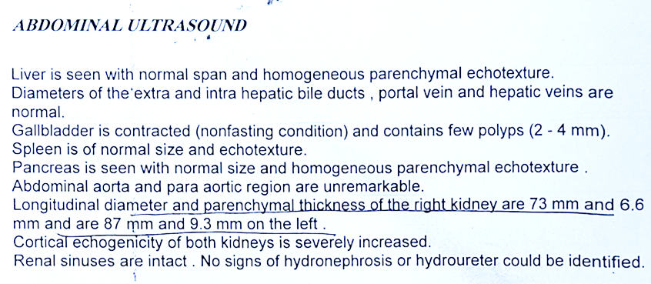
Present illness
1401.06.20

Slide 9
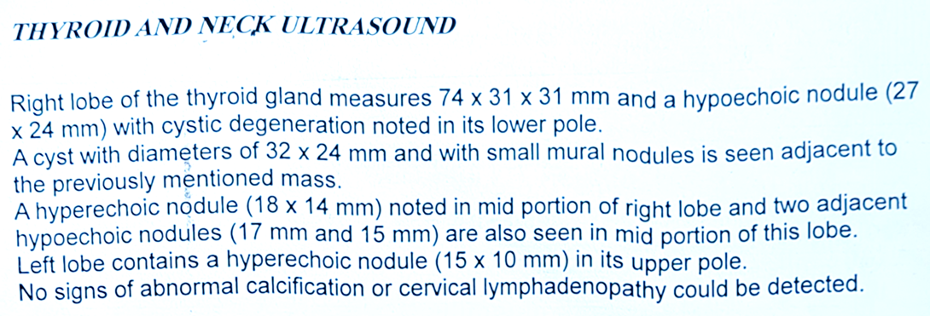
Present illness
1401.06.20

Slide 10
Present illness
Endocrinologist consult was performed.
Hydration, Calcitonin, Lasix initiated.
Pars | BW: 55kg
24hr urine, calcium | 241 mgr/24hr
24hr urine, volume | 3250 ml/24hr
24hr urine, cr | 715 mg/dl
U/C | E.Coli
Calcium | 14 mg/dl (Rocaltrol: DC)
phosphor | 4.6 mg/dl
TSH | 0.1 µIU/mL (On LT4)

Slide 11
B.M.D | T- score | Z-score
Radius (1/3) | -2.9 | -1.5
Femur (neck) | -1.4 | 0.0

Slide 12
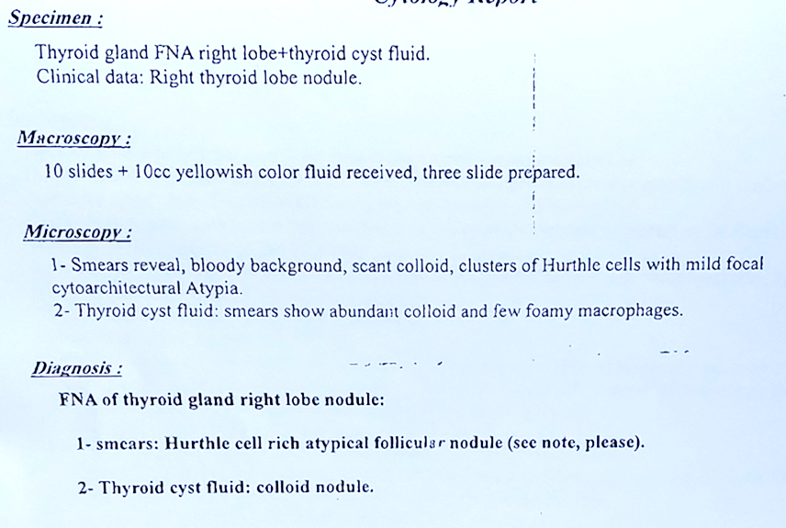
Present illness
1401.06.22

Slide 13
Present illness
1401.06.23

Slide 14
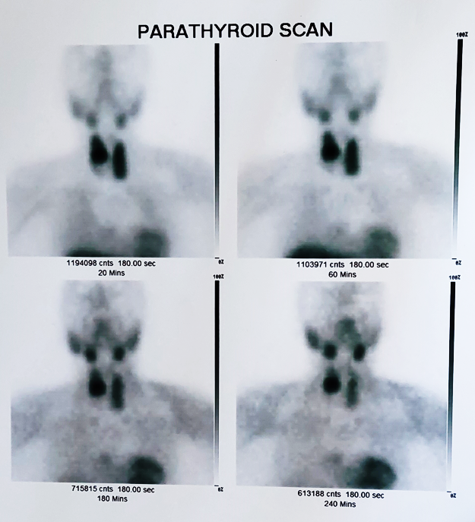
Present illness
1401.06.23

Slide 15
Present illness
HD, total thyroidectomy and parathyroidectomy(06.30) was performed.
Frozen section of a large nodule,2 cm: parathyroid adenoma.
No other adenoma in exploration
Symptoms improved
After surgery | 1401.07.02
BUN | 102 mg/dl
Cr | 5.0 mg/dl
GFR(CKD-EPI) | 8.6 ml/$min/1.73m^{2}$
Calcium | 10 mg/dl (On Rocaltrol x1/d)
PTH(CLIA) | 4.7 pg/ml (15-68)

Slide 16
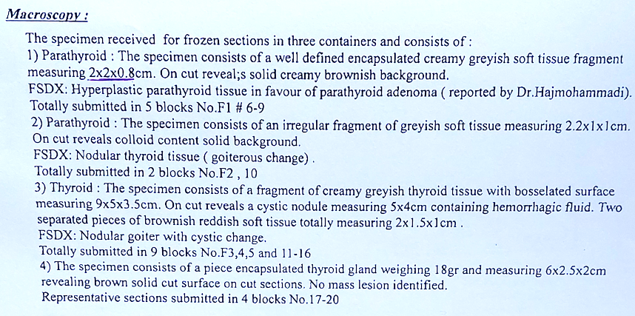
Present illness
Pathology

Slide 17
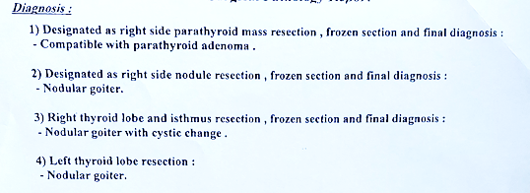
Present illness
Pathology

Slide 18
Past History
Alport syndrome(23y ago)
Gout 23y ago
MNG(20y ago. FNA x2: benign)
Neg. for renal stone, pathologic Fx., HTN,CAD
DM2(4months ago)
Canal stenosis

Slide 19
Drug History
Colchicine 0.5mg/day
Allopurinol 100mg/day
Diltiazem 30mg BID
Enalapril 5mg/day
Levothyroxine 700 µg/w
Nephrovit once daily
Folic acid 1mg/day
Renagel 800mg BID(since 5y ago, irregular usage)
Calcitriol 0.25ug/day (now DC)
Calcium-D x 1/day with meal (for 8 y until 7y ago)
Newbet 0.5mg TDS
Alendronate 70/w(for 4y until 4y ago)??

Slide 20
Family History
Mother: DM2, osteomyelitis(1395 died)
Father: recurrent renal stone, mesenteric ischemia &DVT after surgery (1398 died)
Sister: Alport syndrome, kidney transplantation for 18y, kidney rejection(1398) & then HD for 1y(1399 died due to MI)
Brother: Alport syndrome, kidney transplantation(1383)(HD for 3y before transplantation), parathyroidectomy(1397), kidney rejection(1399) (1400 died due to covid19 infection)
Sister (56y/o): renal stone(31y ago)
No cancer
No elements of MEN syndrome

Slide 21
Other Histories
Social Hx.: Single, Teacher, MSC
Allergy: Neg.
Gynecology: menopause 45Y, no history of menstruation problem before menopause

Slide 22
ros
Constitutional symptoms
Ears
THROAT
Cardiovascular & Respiratory
GI
GU
Fatigue
No weight change
No polyurea
No chest pain
No dyspnea
Nausea
No vomiting
Constipation
No abdominal pain
No polyuria
No nocturia
SNHL
No hearing aids
Hoarseness

Slide 23
ros
Extremity
Integumentary
Musculoskeletal
Neurologic
Psychiatric
No edema
No weakness
No paralysis
No cramp
No headache
No dizziness
No Tremor
No memory loss
Itching
No Paleness
No skin change
Depression
No cognitive disorders
No mental status changes

Slide 24
pe
General appearance
Vital sign
Skin
PULSES
Head & neck
Thorax
Abdomen
extremity
A 62y/o female
Awake & alert
Bw:55 kg
Height: 152 (no decreased)
BMI: 23.8 kg/$m^{2}$
BP: 110/70mmHg
PR: 70 beats/min
RR: 16 /min
T: ${37}^{0}C$
NL
Jugular access
Neck scar
NL

Slide 25
Problem list
history
Lab data
Imaging & pathology
CKD
MNG
Fatigue
Nausea
Constipation
Itching
Bone pain
GFR(EPI)˂10
Ca: 9.3 10.4 13.4
P:4.3 4.9 6
PTH: 216 1114
Sesetamibi-SPECT parathyroid scan:
Rt parathyroid adenoma
Pathology:
Parathyroid adenoma

Slide 26
Hyperparathyroidism with hypercalcemia in chronic kidney disease
Dx.
Primary?
or
Tertiary?

Slide 27
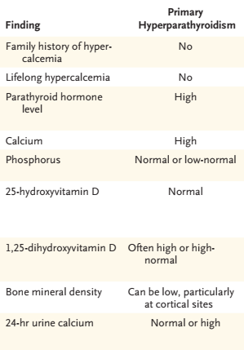
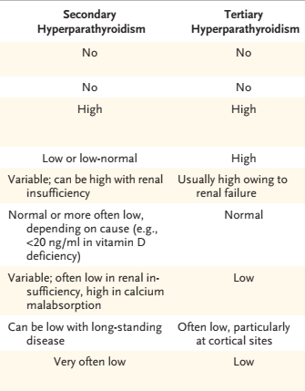
PTH
Average iPTH∼120 pg/mL
N Engl J Med 2018;379:1050-9

Slide 28
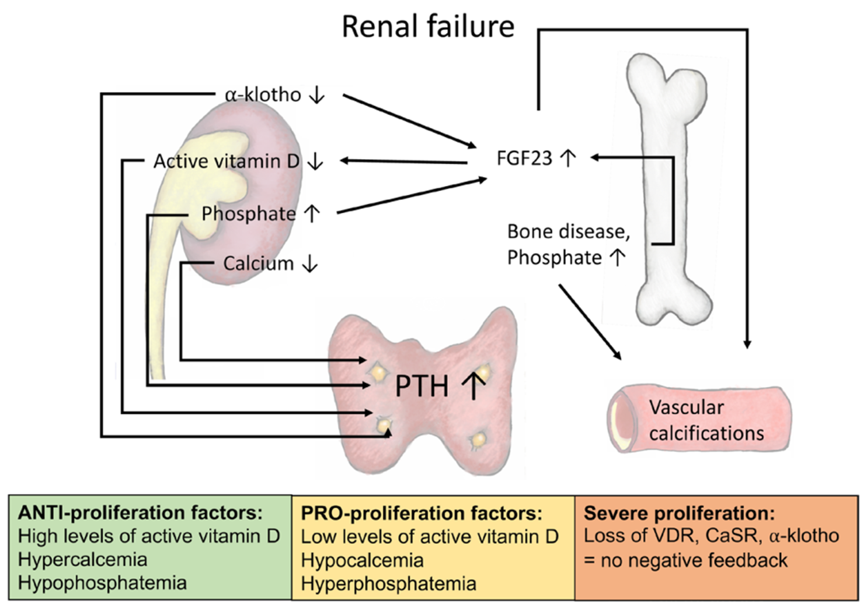
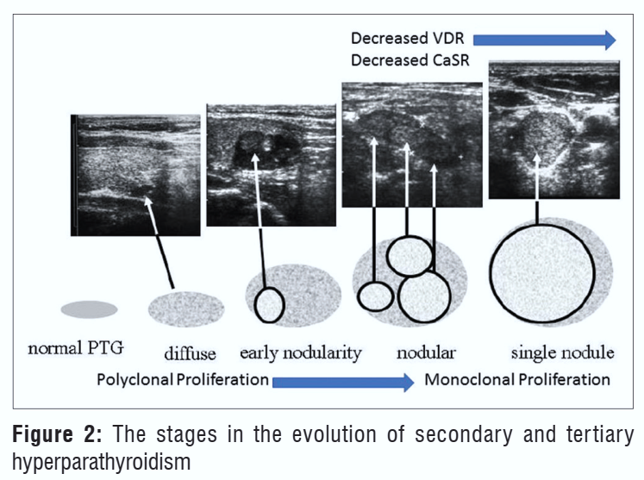
Schematic image: pathophysiology of renal HPT
Endocrine-Related Cancer (2020) 27, R21–R34

Slide 29
↑PTH typically develops when the GFR˂60 mL/min/1.73 m2.
Abnormalities in P & Ca tend to occur much later in the course of CKD(typically when the GFR ˂40 mL/min/1.73 m2).
2°HPT:
- A compensatory mechanism of the parathyroid
- Enlarged all the parathyroid glands (diffused polyclonal hyperplasia).
The Permanente Journal/Perm J 2016 Summer;20(3):15-127

Slide 30
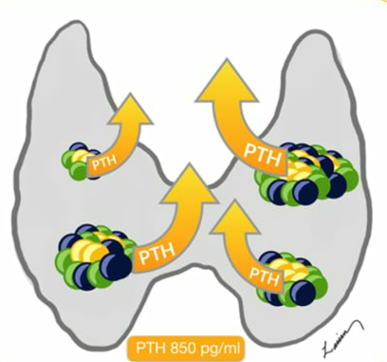
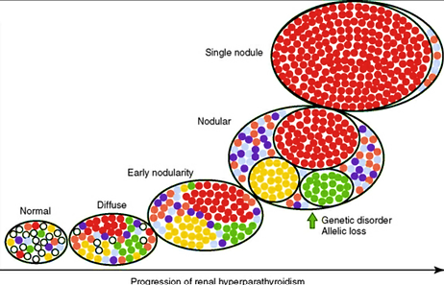
Hypercalcemia
developed gradually during a mean of 7.6 ± 3.1 years after the diagnosis of renal disease
Altered set point of CASR
Indian J Endocr Metab 2019;23:391-9

Slide 31
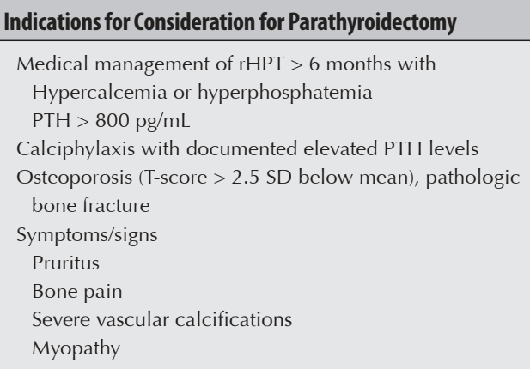
THPT
Symptoms: pruritus, osteodynia, concentration difficulties, depression
Longstanding hd
or
Successful kidney transplantation(30%)
(Longstanding 2°HPT)
Commonly:
Parathyroid hyperplasia,
4 glands,
Monoclonal.
Sometimes: Asymmetry
Single or double adenomas
(2.6-32%)
Bilateral neck exploration:
Subtotal or TPX with autotransplantation
It is unclear whether single or double adenomas in THPT represent:
(1) An autonomous monoclonal parathyroid gland growth
(2) A PHPT that was present before a patient developed secondary& then tertiary HPT
(3) An asymmetric regression of hyperplastic parathyroid glands after successful kidney transplantation.
!! Localizing studies:
not accurate in identifying all abnormal PTs,
Not routinely required
PX is recommended:
- Asymptomatic dis. with total calcium ˃11 mg/dL for ˃1y
- Acute hypercalcemia
- Symptomatic
hypercalcemia
Not predict which patients will require a
PX:
- Duration of dialysis
- Cause of CKD
-Immunosuppressive regimens
- PTH, Cr , P & ALP levels
PX is required in ~15% of patients after 10 y & in 38% of patients after 20 y of ongoing dialysis
Initial limited PX: higher risk of persistent or recurrent THPT
Imaging: R/O ectopic gland
Arch Surg. 2004;139:974-977

Slide 32
THPT: yes or no??

Slide 33
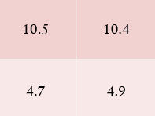
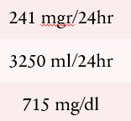
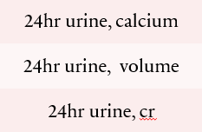
THPT : not possible
​
After surgery
Pathology:
adenoma
After 9y, GFR˂20
No classic scenario for 2°HPT :
-No hypocalcemia
-No hyperphosphatemia
-No HD
-No kidney transplant
-No resistant to medical treatment
24hr urine calcium in
2°HPT & 3°HPT : Low
Possible familial HPT
Single gland resection
Patient dx. : PHPT
Suspicious to PHPT in moderate to sever CKD:
markedly hypercalcemic with a normal serum P

Slide 34
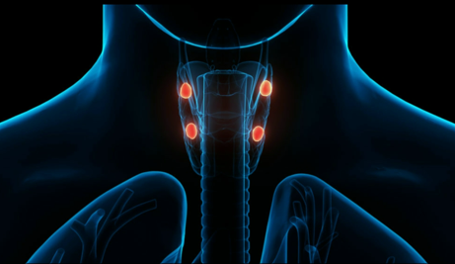
Same case report

Slide 35
A 55 y/o man with underlying CKD(Cr:3mg/dl)(GFR:22)
Presented with intractable nausea, vomiting, fatigue, constipation.
Admitted with Ca: 17.2 mg/dl, P:4.8mg/dl & Cr: 3.8mg/dl
PTH: 496pg/ml
BMD: osteoporosis
Neck ultrasound: 4.5 × 1.2 × 1.2cm soft tissue mass behind the left lobe of the thyroid.
99mTc-sestamibi: showed abnormal radiopharmaceutical accumulation in the region of the superior & inferior left parathyroid glands suggestive of adenoma or hyperplasia.
Treated with: hydration, lasix, calcitonin, ibandronate, HD.
Surgical excision was recommended but due to recent MI, Cinacalcet was started.
After 6 months PTH: 2400pg/ml, Ca:16 mg/dl, P:5 mg/dl
The patient underwent the left parathyroidectomy
One day after surgery, the PTH declined to 7pg/mL & the serum calcium declined to 12.1 mg/dl.
Pathology was: parathyroid adenoma
Cr: 1.5 mg/dL ∼6 months after discharge
NDT Plus (2010) 3: 366–371

Slide 36
Points:
Severe hypercalcemia: rare in primary HPT.
Markedly elevated PTH: more typical of secondary or tertiary HPT.
In a recent series of 80 patients with PHPT from adenoma, the highest
reported PTH was 2578 pg/Ml.
Vasoconstriction induced by severe hypercalcemia is an important contributing cause of the ARF.
The resultant decline in GFR: normal to slightly elevated serum P, (typically low–normal in PHPT).
R/O other etiology for ↑Ca such as high-dose oral calcium and activated vitamin D derivatives.
Refractory to treatment.
HPT and hypercalcemia resolved rapidly following adenoma resection.
Severe hypercalcemia requiring hemodialysis, large adenoma size, acute-on-chronic kidney injury and markedly elevated PTH concentration in association with primary HPT in CKD
NDT Plus (2010) 3: 366–371

Slide 37
Acute hypercalcemia management in ckd
Hydration (unsafe in ESRD)
Furosemide (if volume overload)
Calcitonin
Pamidronate (30-60 mg over 4-6hr if GFR<30/HD )
Denosumab (60-120 mg, no dose adjustment)
HD with low calcium dialysate

Slide 38
Treatment of CKD-MBD In patients with CKD G3a–G5D
Targeted lowering high serum P and maintaining serum Ca:
Lowering elevated P levels toward the normal range.
P-lowering treatment should be based on progressively or persistently elevated serum P.
Restricting the dose of calcium-based P binders, in receiving P-lowering treatment.
Avoiding hypercalcemia.
Treatment of abnormal PTH levels:
Modifiable factors: ↑P, ↓Ca, ↑P intake, & vit D deficiency.
In adult patients with CKD G3a–G5 not on dialysis, calcitriol and vitamin D analogs not be routinely used.
In CKD G5D requiring PTH-lowering therapy: calcimimetics, calcitriol, or vitamin D analogs, or a combination of calcimimetics with calcitriol or vitamin D analogs.
Severe HPT who fail to medical therapy: PX
KDIGO 2017

Slide 39
THANK YOU
ONLY WOMEN CAN DELIVER EVERYTHING THEY RECEIVE TO THE WORLD MANY TIMES BETTER

