Slide 1
Incretin Mimetics and Newer Drugs in Diabetes Treatment
Alireza Amirbaigloo, MD

Slide 2
Agenda
Introduction (challenges in Type 2 Diabetes)
Physiology of GLP-1 and GLP-1 agonists
SGLT-2 Inhibitors
Cardiovascular Safety
Newer Insulins
Combination Therapies
Future

Slide 3
Introduction

Slide 4
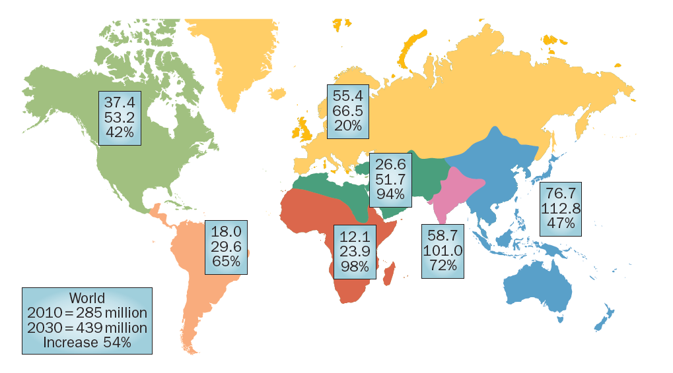
Global projections for the diabetes epidemic: 2010-2030
Chen et al. Nat. Rev. Endocrinol. 2012; 8:228–36.

Slide 5

Introduction
GLOBAL CONSIDERATIONS
The worldwide prevalence of DM has risen dramatically over the past two decades, from an estimated 30 million cases in 1985 to 415 million in 2015.
Based on current trends, the International Diabetes Federation projects that 642 million individuals will have diabetes by the year 2040.
IDF 2016

Slide 6
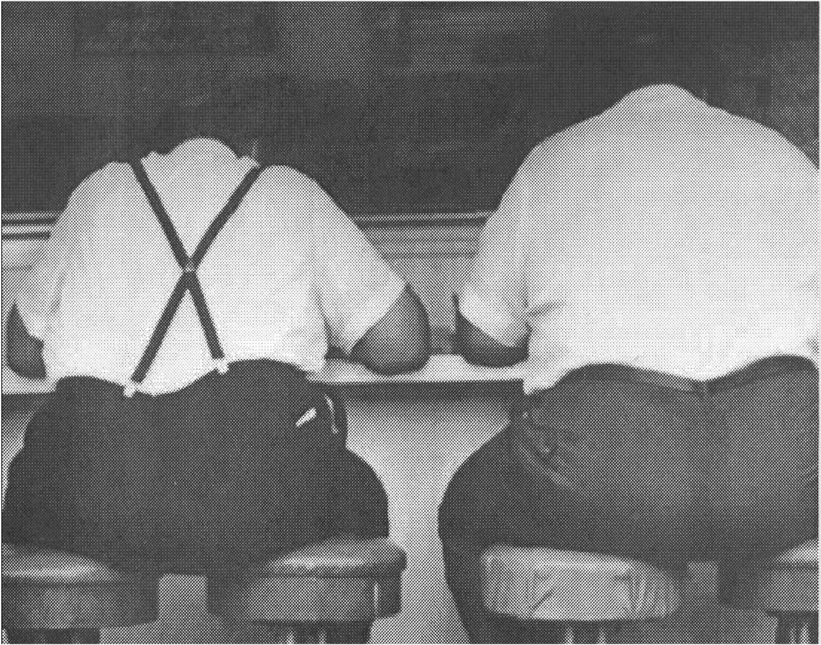
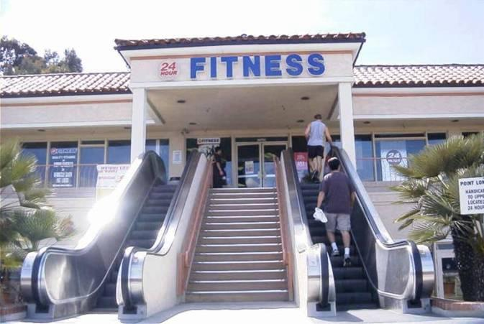
Diabetes Epidemic -Drivers
Obesity
Exercise
AGING and FAMILY HISTORY
Intervention therapies
should be weight neutral or weight reducing

Slide 7
Key challenges of type 2 diabetes
As diabetes treatments are added to control glucose, physicians and patients face trade-offs such as:
  hypoglycaemia
  weight gain
  complex treatment regimens (multiple daily dosing and need for self-monitoring of blood glucose)
  Cardiovascular risk
Notes:
Key challenges of type 2 diabetes

Slide 8
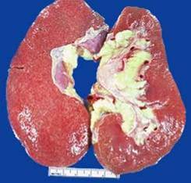
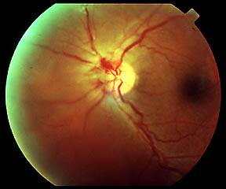
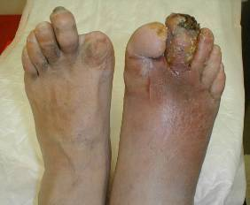
Poor glycaemic control leads to long-term complications…
Diabetic nephropathy
Atherosclerosis
Diabetic foot
Proliferative
diabetic retinopathy

Slide 9
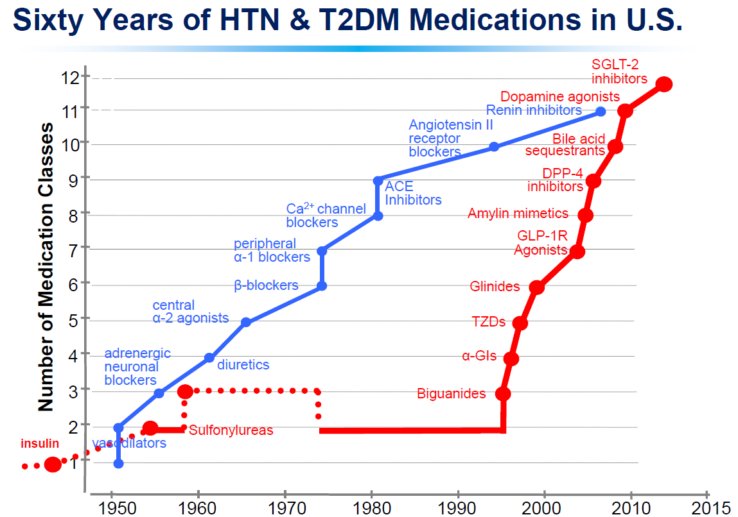

Slide 10
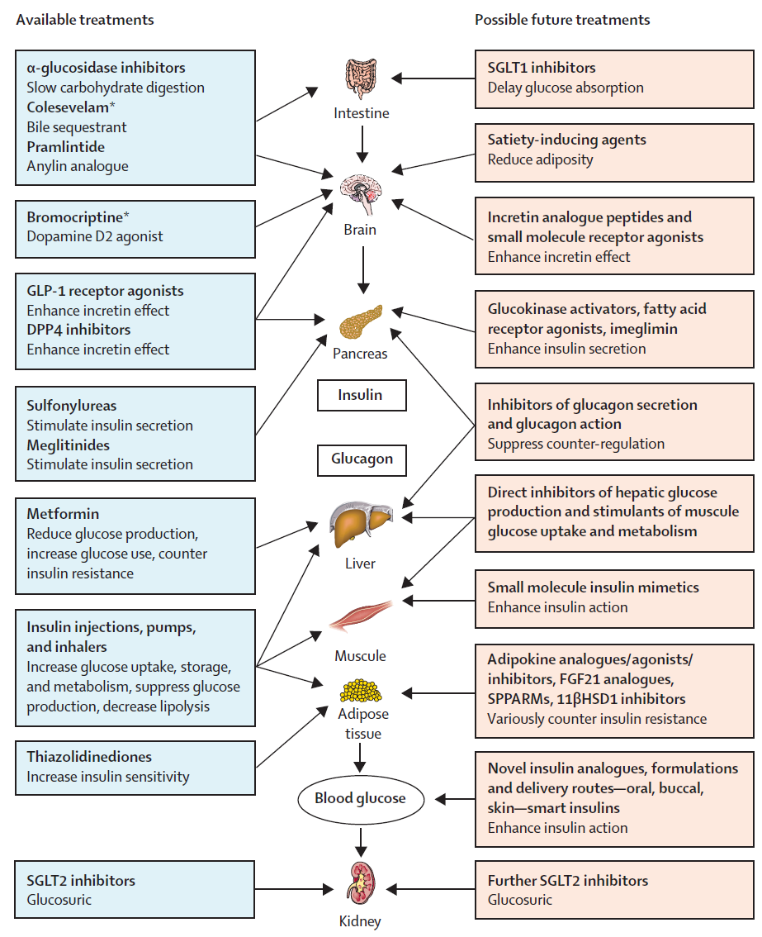
The Lancet Diabetes & Endocrinology 4.4 (2016): 350-359

Slide 11
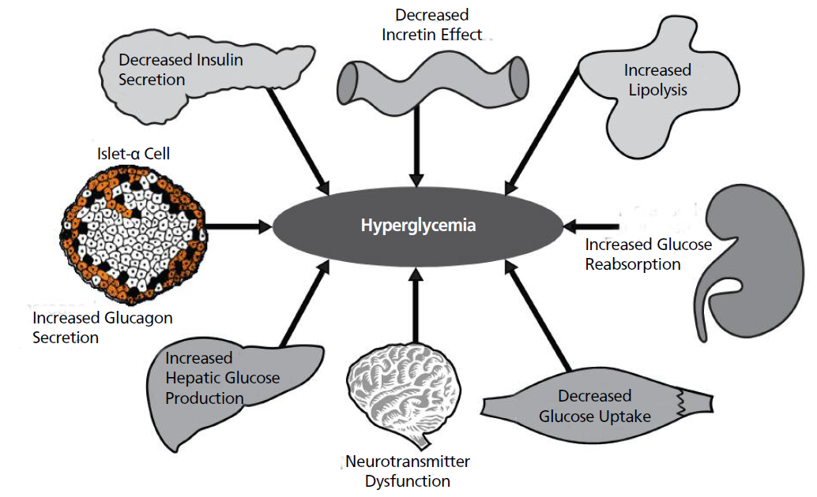
The DeFronzo’s “ominous octect.” Pathologic defects in patients with type 2 diabetes mellitus

Slide 12
Physiology of GLP-1

Slide 13
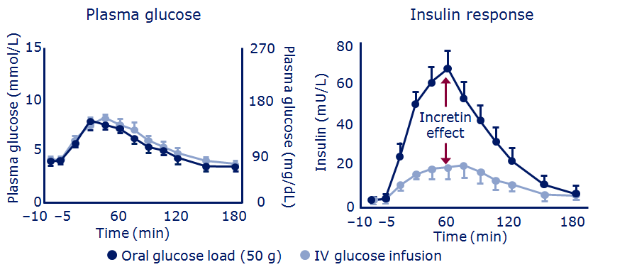
The incretin hormones play a crucial role in a healthy insulin response
  Insulin response is greater following oral glucose than IV glucose, despite similar plasma glucose concentration
Nauck et al. Diabetologia 1986;29:46–52, healthy volunteers (n=8); Wick & Newlin. J Am Acad Nurse Pract 2009;21:623–30
Notes:
The incretin hormones play a crucial role in a healthy insulin response
The effect of incretins on insulin secretion is clearly indicated in this study. Healthy volunteers (n=8) fasted overnight before they received an oral glucose load of 50 g/400 ml or an isoglycaemic intravenous glucose infusion for 180 minutes. As can be seen in the left figure, venous plasma glucose concentration was similar with both glucose interventions. However, insulin concentration was greater following oral glucose ingestion than following intravenous glucose infusion, demonstrating the contribution of incretins on insulin secretion.
Reference
Nauck et al. Diabetologia 1986;29:46–52

Slide 14
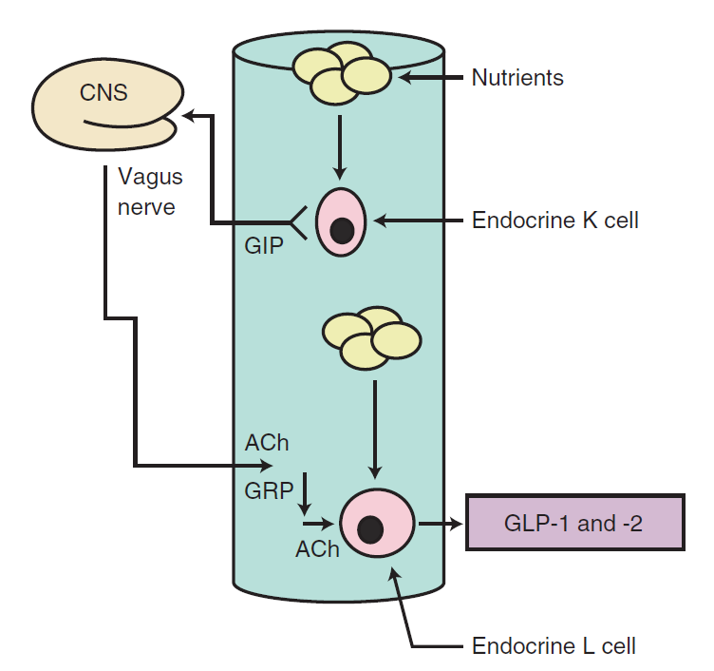

Slide 15
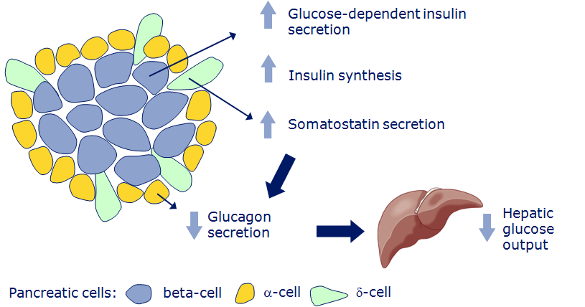
GLP-1: functional pancreatic effects
Ørskov et al. Endocrinology 1988;123:2009–13; Drucker et al. Proc Natl Acad Sci USA 1987;84:3434–8;
Hvidberg et al. Metabolism 1994;43:104–8
Notes:
GLP-1: functional pancreatic effects
GLP-1 has a direct functional effect on pancreatic cells, influencing secretions from alpha-, beta- and delta- cells. One of its most important effects is to increase insulin secretion. Importantly, however, its insulinotropic action is glucose dependent. Consequently, GLP-1 has the capacity to lower blood glucose while protecting against hypoglycaemia.
GLP-1 also regulates glucagon secretion, partly via an increase in somatostatin secretion, and partly via a direct effect on the alpha-cell. This reduction in glucagon secretion serves to decrease hepatic glucose output.
References
Drucker et al. Proc Natl Acad Sci USA 1987;84:3434–3438
Ørskov et al. Endocrinology 1988;123:2009-2013

Slide 16
Effect of GLP-1 is glucose-dependent
Glucose (mmol/L)
300
Insulin (pmol/L)
20
Glucagon (pmol/L)
15
*
*
200
10
*
*
*
10
*
*
*
*
*
*
*
100
*
*
5
*
*
*
*
*
0
0
0
-30
0
60
120
180
240
-30
0
60
120
180
240
-30
0
60
120
180
240
Time (min)
Time (min)
Time (min)
Placebo
Native human GLP-1
Effects of 4-hour GLP-1 infusion (1.2 pmol/kg/min) in 10 patients with type 2 diabetes
Mean (SE); n=10
*p<0.05
GLP-1, glucagon-like peptide-1; SE, standard error
Nauck M et al. Diabetologia 1993;36:741–744
Notes:
GLP-1 increases insulin and reduces glucagon, lowering glucose levels
1.2 pmol/kg/min GLP-1 (7-36 amide) or placebo was infused intravenously in the fasting state
GLP-1, glucagon-like peptide-1
Reference
Nauck M et al. Diabetologia 1993;36:741–744

Slide 17
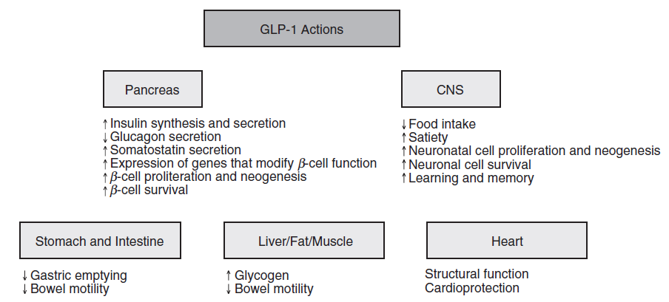
Notes:
References:

Slide 18
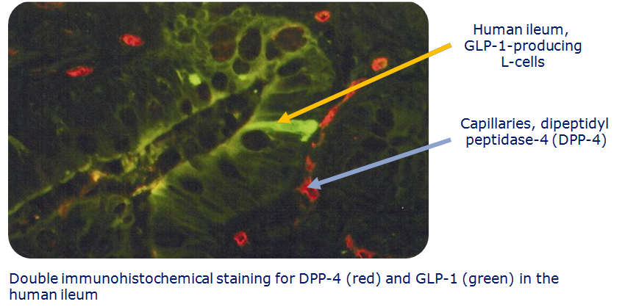
Native GLP-1 is rapidly degraded by DPP-4
Adapted from Hansen et al. Endocrinology 1999;140:5356–63
Notes:
Native GLP-1 is rapidly degraded by DPP-4
GLP-1 is stored in intestinal L-cells. As active GLP-1 is secreted from these cells, it is rapidly degraded by the enzyme dipeptidyl peptidase IV (DPP 4) resulting in the inactive, N-terminally truncated form, GLP-1-(9-36)amide. More than 50% of plasma GLP-1 appears to be in this inactive form.
In this slide, immunohistochemical staining shows the very close proximity of active GLP-1 in the L-cells and DPP-4 in the capillaries within the human ileum.
References
Hansen et al. Endocrinology 1999;140:5356–5363

Slide 19
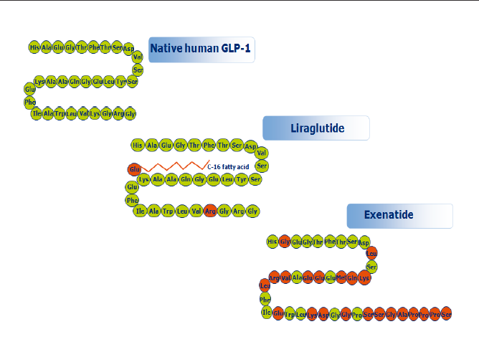
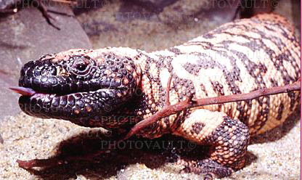

Slide 20

Exenatide, the first of a new class of compounds similar to the GLP-1
Exenatide 10 μg twice a day evaluated in randomised studies, showed similar reduction of HbA1c as glargine once a day or premixed biphasic insulin aspart (30/70) twice a day
Exenatide had the advantage of less hypoglycaemia and less weight gain

Slide 21
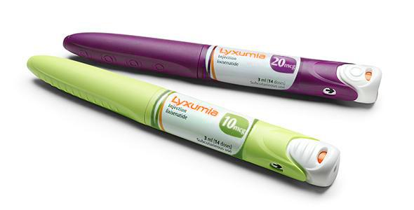
Lixisenatide (Lyxumia-Adlyxin) 10/20 µg once daily with the same advantages of exenetide
A GLP-1 agonist (Exendin-based) not analogue
It was created by Zealand Pharma of Denmark; in 2003 Zealand licensed it to Sanofi
Starting in 2008 but FDA approved it in September 2015 (GETGOAL & ELIXIA studies)

Slide 22
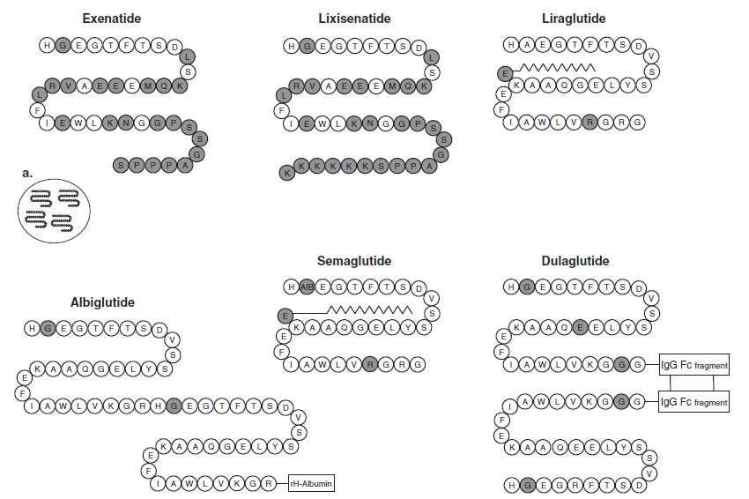

Slide 23
Liraglutide is a Once-daily, Human
GLP-1 Analogue
Native human GLP-1
Liraglutide
7
9
7
9
His
Ala
Glu
Gly
Thr
Phe
Thr
Ser
Asp
His
Ala
Glu
Gly
Thr
Phe
Thr
Ser
Asp
Val
C-16 fatty acid (palmitoyl)
Val
Ser
Glu
Ser
Lys
Ala
Ala
Gln
Gly
Glu
Leu
Tyr
Ser
Lys
Ala
Ala
Gln
Gly
Glu
Leu
Tyr
Ser
Glu
Glu
Phe
36
Phe
36
Ile
Ala
Trp
Leu
Val
Lys
Gly
Arg
Gly
Ile
Ala
Trp
Leu
Val
Arg
Gly
Arg
Gly
Enzymatic degradation by
DPP-4
97% amino acid homology to human GLP-1;
improved PK: albumin binding through acylation; self-association
T_{½}=1.5–2.1 min
Slow absorption from subcutis
Resistant to DPP-4
Long plasma half-life (T_{½}=13 h)
Knudsen et al. J Med Chem 2000;43:1664–9; Degn et al. Diabetes 2004;53:1187–94
Notes:
Liraglutide is a once-daily human GLP-1 analogue
In creating liraglutide, two modifications to the amino acid sequence of GLP-1 are made: a fatty acid is acylated to lysine at position 26 and the lysine at position 34 is replaced with arginine.
These modifications result in increased self-association (which slows absorption from the subcutaneous depot), albumin binding and reduced susceptibility to DPP-IV, which combine to prolong its plasma half-life, protracting its action. Thus, the problem of the short half-life, which is the major clinical drawback of native GLP-1, is overcome.
For comparison, the plasma half-life of exenatide is 4 to 6 hours (reviewed in Nauck and Drucker, 2006)
Reference
Knudsen et al. J Med Chem 2000;43:1664–69

Slide 24
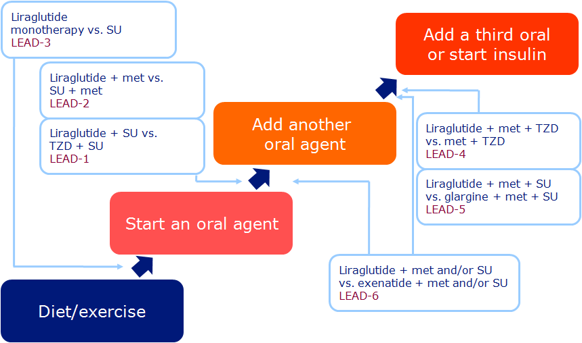
LEAD, Liraglutide Effect and Action in Diabetes. Marre et al. Diabet icMed 2009;26;268–78 (LEAD-1); Nauck et al. Diabetes Care 2009;32;84–90 (LEAD-2); Garber et al. Lancet 2009;373:473–81 (LEAD-3); Zinman et al. Diabetes Care 2009;32:1224–30 (LEAD-4); Russell-Jones et al. Diabetologia 2009;52:2046–55 (LEAD-5); Buse et al. Lancet 2009; 374:39–47 (LEAD-6)

Slide 25

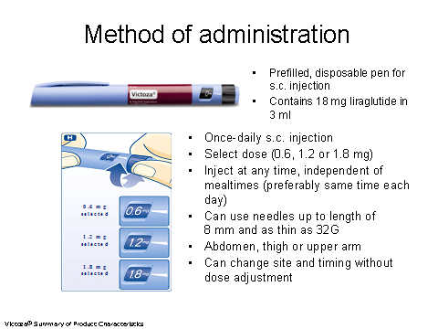

Slide 26
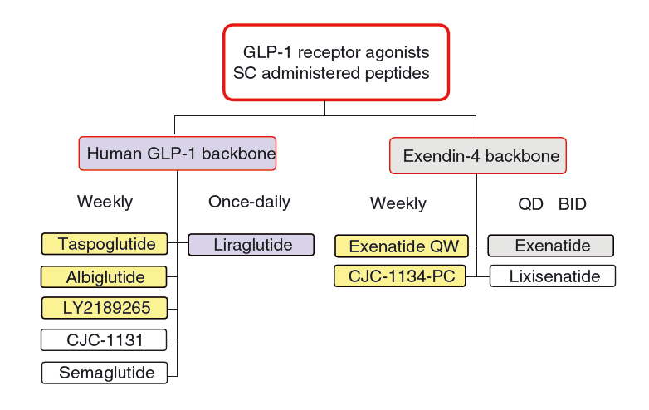
(Dulaglutide)
Diabetes, Obesity and Metabolism 13: 394–407, 2011

Slide 27
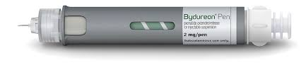
EQW (Bydureon) is based on the Medisorb™ microsphere technology (Alkermes, Inc.)
Sandostatin LAR (Novartis Pharmaceuticals)
Medisorb technology encapsulates a medication in injectable microspheres that slowly degrade in situ and release drug into circulation
Diabetes Technology & Therapeutics, 13: 1145-54, 2011

Slide 28
structural matrix of the microsphere is composed of a biodegradable polymer called poly-(d,l-lactide-co-glycolide) (PLG)
has been used in surgical sutures, bone plates, and orthopedic implants for decades and in microsphere form as a long-acting drug delivery system since 1984
PLG hydrolysis of the ester linkages into lactic acid and glycolic acid, naturally occurring substances that are easily eliminated as CO2 and H2O
Diabetes Technology & Therapeutics, 13: 1145-54, 2011

Slide 29
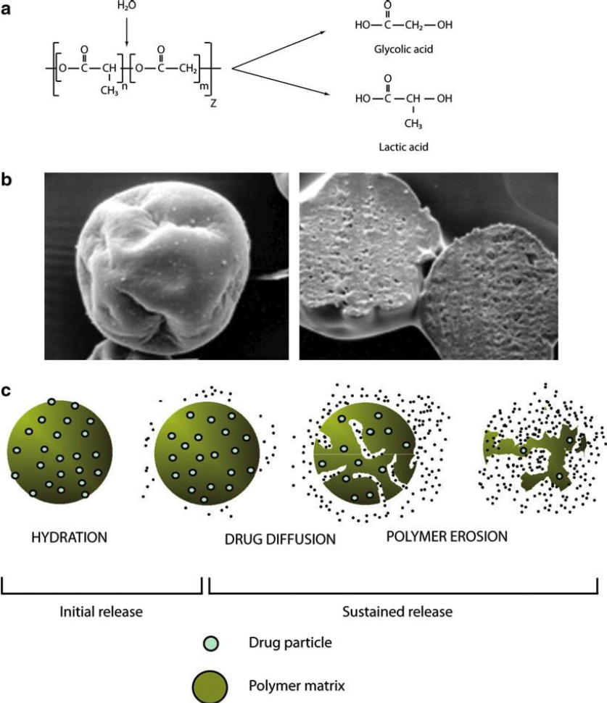
Diabetes Technology & Therapeutics, 13: 1145-54, 2011

Slide 30
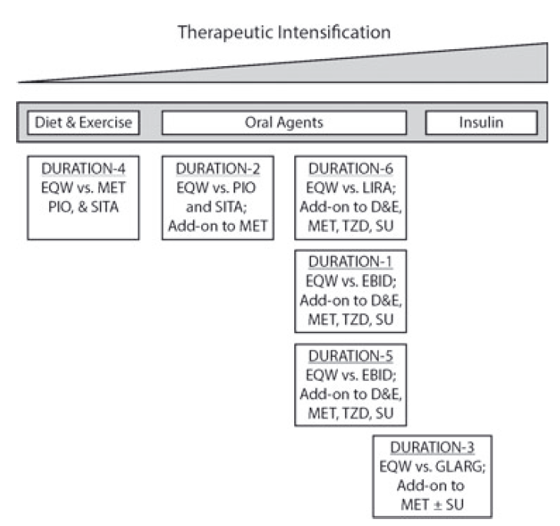
Diabetes, Obesity and Metabolism 15: 871–881, 2013

Slide 31
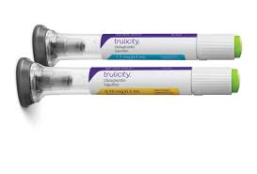
Dulaglutide, 0.75/1.5 mg Once weekly
manufactured by Eli Lilly
Fusion of GLP-1 to a modified IgG4 Fc fragment
AWARD studies & REWIND study

Slide 32

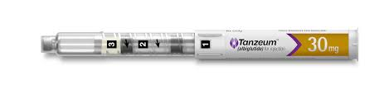
Albiglutide, 30/50 mg Once weekly
manufactured by GlaxoSmithKline
Half-life increased by fusion with albumin
HARMONY studies

Slide 33
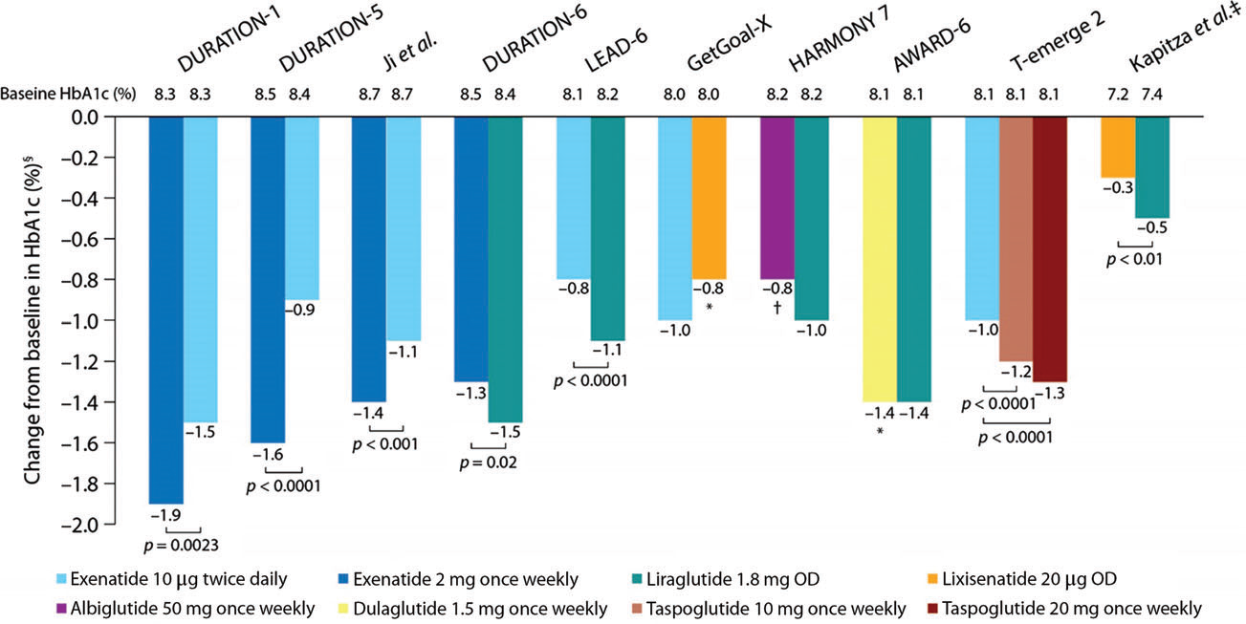
Reductions in HbA1c
Diabetes, Obesity and Metabolism 2016; 18: 317–332

Slide 34
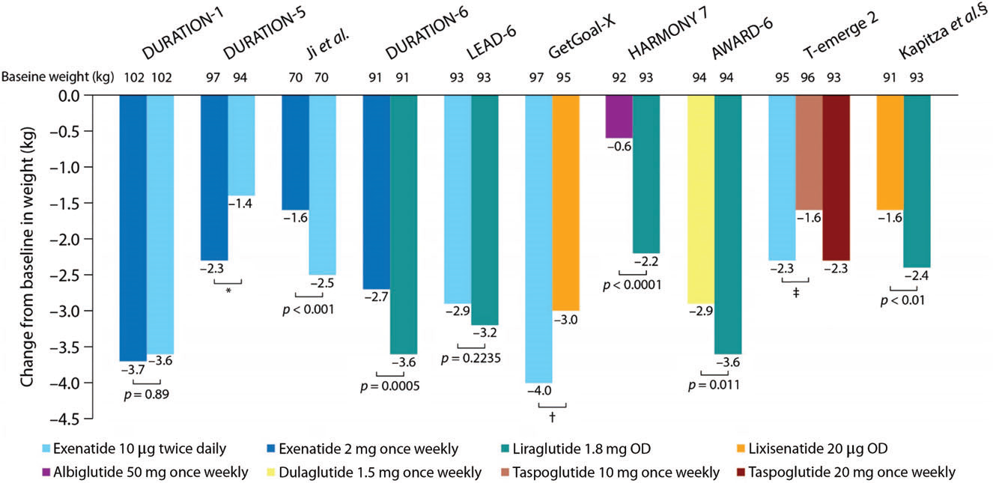
Reductions in weight
Diabetes, Obesity and Metabolism 2016; 18: 317–332

Slide 35
SGLT-2 Inhibitors

Slide 36

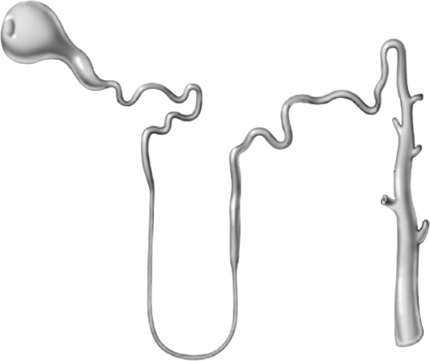

Renal glucose re-absorption in healthy individuals
Filtered glucose load 180 g/day
SGLT2
~ 90%
SGLT1
~ 10%
Gerich JE. Diabet Med. 2010;27:136–142.
Notes:
In healthy subjects, in the kidney, the amount of glucose re-absorbed through the SGLT1 and SGLT2 transporters is equal to the amount of glucose that is filtered by the glomerulus. Glucose re-absorption by the proximal tubule increases linearly with increasing glucose concentration, up to a theoretical threshold of ~ 180 mg/dL.
The SGLT2 transporter mediates 90% of renal glucose re-absorption by coupling glucose transport to the electrochemical sodium gradient. The other 10% of renal glucose re-absorption occurs through SGLT1, a high-affinity, low-capacity transport protein that is found in the more distal, straight section of the proximal tubule (S3), where there is less luminal glucose.
Recent studies suggest that in subjects with low blood glucose, SGLT1 is responsible for a higher percentage of renal re-absorption.

Slide 37
Renal glucose re-absorption in patients with hyperglycaemia
Filtered glucose load > 180 g/day
SGLT2
When blood glucose increases above the renal threshold
(~ 10 mmol/l or 180 mg/dL), the capacity of the transporters is exceeded, resulting in urinary glucose excretion
~ 90%
SGLT1
~ 10%
Gerich JE. Diabet Med. 2010;27:136–142.
Notes:
At a certain glucose concentration the glucose flux is to high and the glucose transport system becomes saturated . All the filtered glucose in excess of this threshold is excreted In the urine.
DeFronZo EASD 2012 abstract:
Dapagliflozin reduces renal threshold for glucose excretion in T2D
R.A. DeFronzo1, M. Hompesch2, S. Kasichayanula3, X. Liu3, Y. Hong3, M. Pfister3, L.A. Morrow2,
B.R. Leslie3, D.W. Boulton4, A. Ching3, F.P. LaCreta3, S.C. Griffen3;
1
University of Texas Health Science Center, San Antonio, 2Profil Institute for Clinical Research,
Chula Vista, 3Bristol-Myers Squibb, Princeton, 4Bristol-Myer Squibb, Princeton, USA.
Background and aims: Dapagliflozin is a selective sodium-glucose co-transporter 2 (SGLT2)
inhibitor that reduces hyperglycaemia in T2D by promoting urinary glucose excretion. This
study examined the effect of dapagliflozin on renal glucose kinetics in healthy subjects and subjects
with T2D.
Materials and methods: Renal glucose kinetics were assessed in 12 healthy control subjects (HbA_{1c}
5.5 %, 41 years, 27 kg/m², 7 male/5 female) and 12 subjects with T2D (HbA_{1c} 6.5%, 53
years, 30 kg/m², 7 male/5 female). All subjects had an estimated glomerular filtration rate (eGFR) ≥
60 and ≤ 160 mL/min∙1.73 m² by the Modification of Diet in Renal Disease equation. Subjects
underwent a combined pancreatic and stepped hyperglycaemic clamp at baseline and after 7 days of
dapagliflozin 10 mg/day. The pancreatic/stepped hyperglycaemic clamp was performed with
octreotide and basal insulin/glucagon/growth hormone replacement, and evaluated a plasma glucose
range of 100-550 mg/dL. Subjects with T2D continued on baseline therapy unless taking
metformin, which was held for 48 h before the pancreatic stepped hyperglycaemic clamp. A model
was developed to describe maximum tubular glucose transport (TmG), renal glucose threshold (for
onset of glucosuria), and splay of the glucose titration curve for healthy and T2D
populations, and then used to estimate these parameters from individual titration curves.
Results: At baseline, the TmG (443 vs 326 mg/min, p < 0.04) and splay (28,650 vs 14,248 mg2/min2,
p < 0.0001) were significantly higher in subjects with T2D vs controls. The baseline
threshold was similar in subjects with T2D (196 mg/dL [10.9 mmol/L]) and controls (171
mg/dL [9.5 mmol/L]). Dapagliflozin treatment reduced TmG by 58% in T2D subjects and
53% in healthy subjects. The splay declined similarly by ~ 37% for both groups. Following
dapagliflozin, the modelled threshold was markedly reduced in T2D patients, by 89% (21
mg/dL [1.2 mmol/L]) and in healthy controls, by 78% (37 mg/dL [2.1 mmol/L]). These modelled
threshold values were well below the plasma glucose levels measured in this study. A modest
reduction in GFR (~ 14%) was observed following dapagliflozin treatment in both groups.
Conclusion: In summary, T2D subjects have a higher TmG and splay than healthy
controls. Dapagliflozin treatment for 7 days reduced TmG and splay. However, the markedly
decreased renal glucose threshold was the primary mechanism responsible for the induction of
glucosuria with dapagliflozin in both subjects with T2D and healthy controls.
Clinical Trial Registration Number: NCT01165268
Supported by: AstraZeneca and Bristol-Myers Squibb

Slide 38
Urinary glucose excretion via SGLT2 inhibition
Filtered glucose load
> 180 g/day
SGLT2 inhibitors reduce glucose
re-absorption
in the proximal tubule, leading to urinary glucose excretion* and osmotic diuresis
SGLT2
inhibitor
SGLT2
SGLT1
*Loss of ~ 80 g of glucose/day (~ 240 cal/day).
Gerich JE. Diabet Med. 2010;27:136–142.
Notes:
SGLT2 inhibition lowers the Tm – the maximum re-absorptive capacity of the proximal tubule and lower the renal threshold for Glucose. Therefore, treated subjects will start to renally excrete glucose. The amount of excreted glucose is dependent on the Glucose filtration and therefore dependent on the blood glucose values. In the hypoglycaemic Range the amount of Glucose which is excreted will be very small and with rising blood Glucose the excreted glucose will also increase. Subjects with high baseline glucose will have a much higher glucose excretion rate than subjects which are near normal. In the PK/PD studies a UGE (urinary glucose excretion) of around 80 g/day was measured. The Glucose loss is associated with fluid loss (increase in urine volume), osmotic diuresis and of with caloric loss. (average of 240 cal/day)

Slide 39

Phlorizin (1933): extracted from bark of apple trees

Slide 40
Cardiovascular Safety

Slide 41
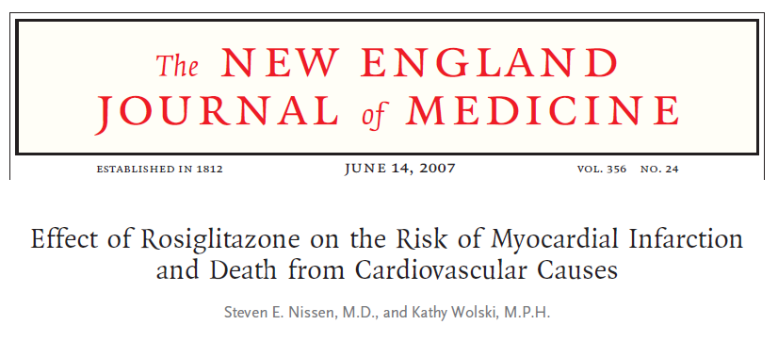

Slide 42
FDA Guidance on diabetes drugs
Conduct phase II and III studies using consistent definitions of adverse cardiovascular events.
Submit meta-analysis of all phase II and III studies
to quantify cardiovascular risk
Conduct large prospective safety trial
pre-or post marketing approval. Timing depends on
upper point of the 2 sided 95% confidence interval
of hazard ratio
Food and drug Administration 2008 www.fda.gov/download/DrugsguidanceComplianceRegulatoryinformation

Slide 43
FDA Guidance on diabetes drugs
Perform meta-analyses of phase II/III trials ( or specific Phase III
cardiovascular (CV) outcome studies to assess the risk of major CV events
<1.3 – a post marketing cardiovascular trial may not generally be necessary
<1.8 – conduct large safety trial post-approval
>1.8 – conduct large safety trial pre-approval
0.4
0.5
0.67
1.0
1.3
1.8
Food and drug Administration 2008 www.fda.gov/download/DrugsguidanceComplianceRegulatoryinformation

Slide 44
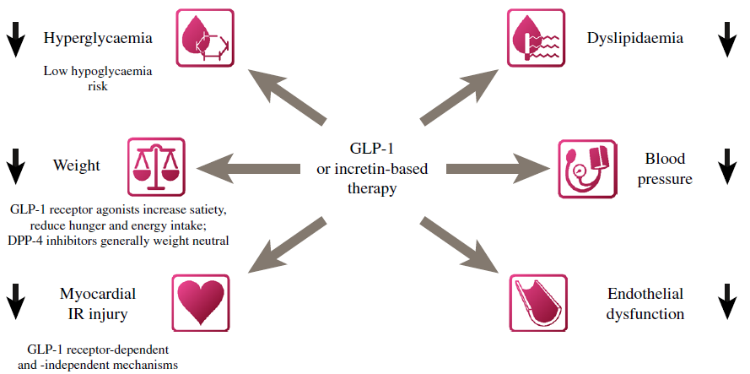
Cardiovascular Diabetology 2013, 12:130

Slide 45
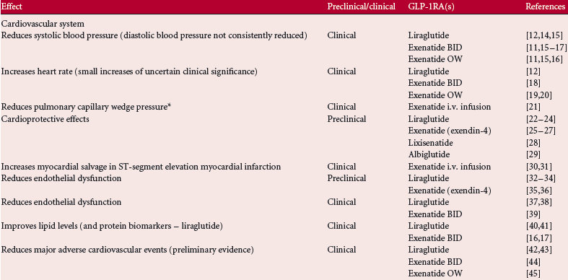
Diabetes, Obesity and Metabolism 2014, doi:10.1111/dom.12251, published ahead of press

Slide 46
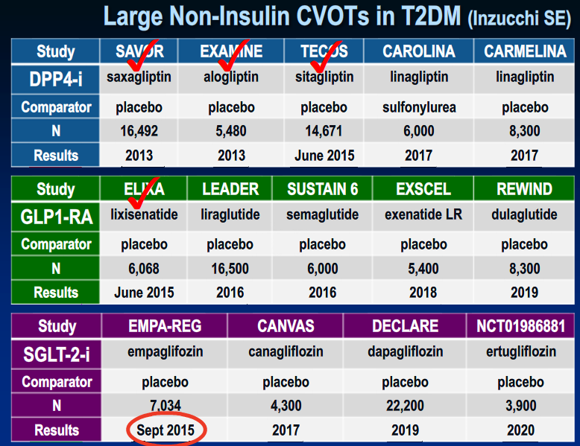

Slide 47
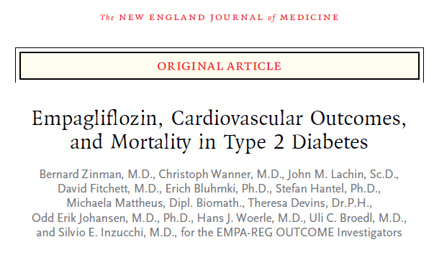

Slide 48
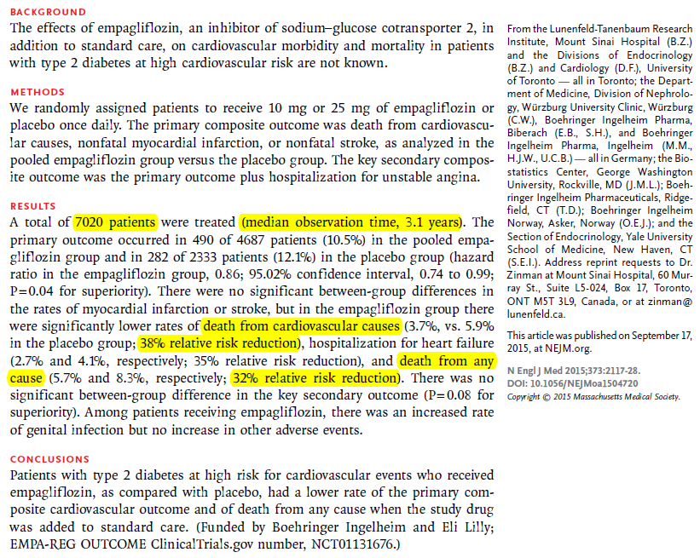

Slide 49
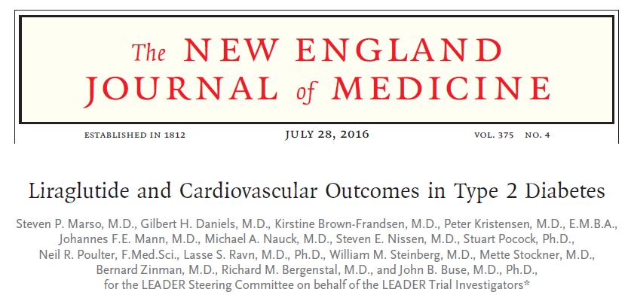

Slide 50
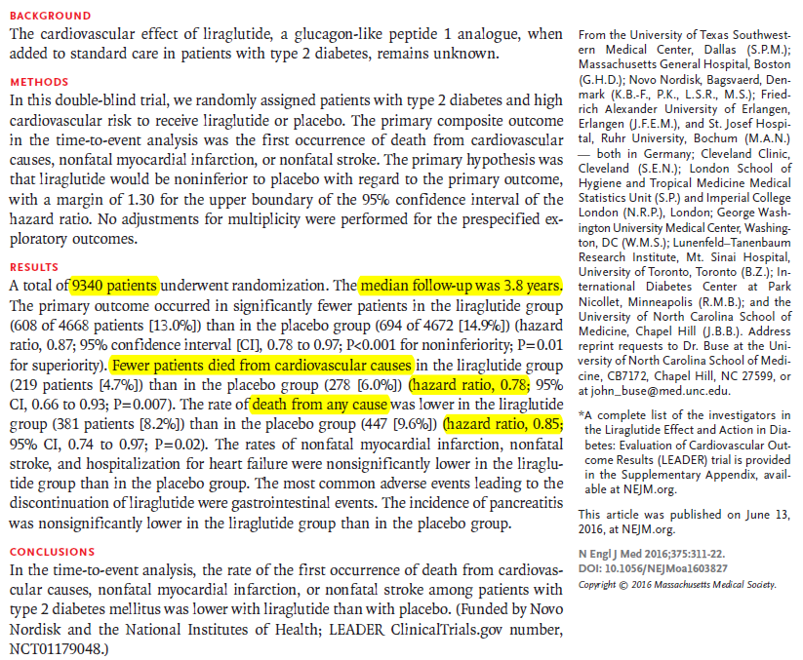

Slide 51
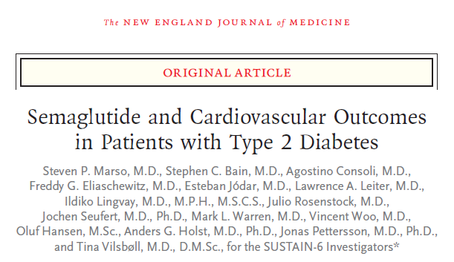

Slide 52
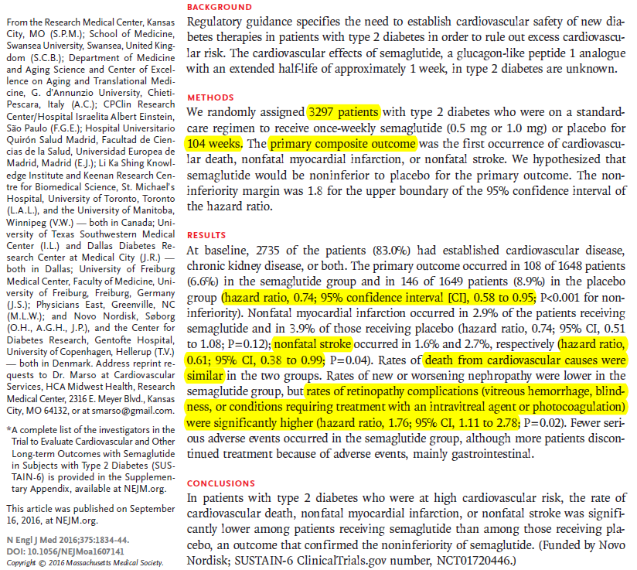

Slide 53
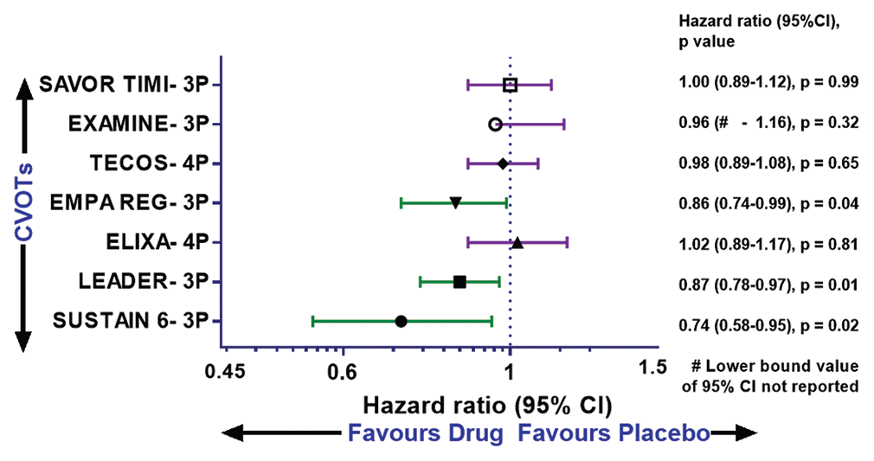
Primary Major Cardiovascular Outcomes

Slide 54
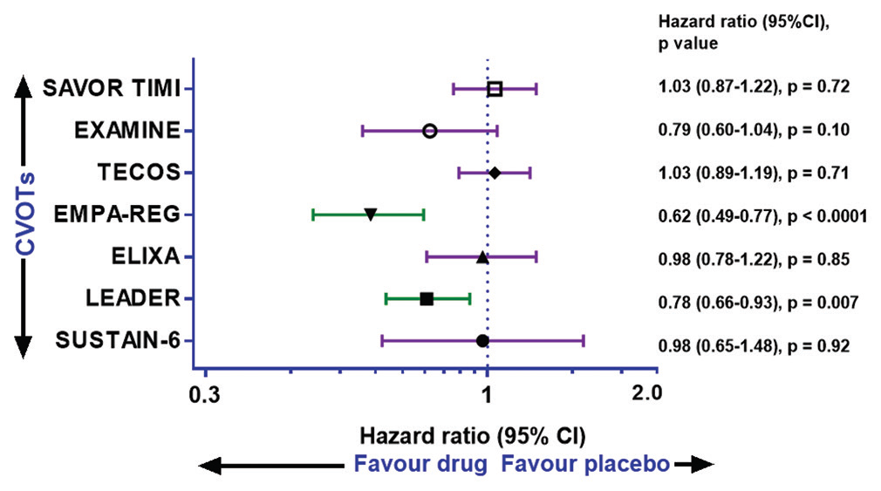
Cardiovascular Death

Slide 55
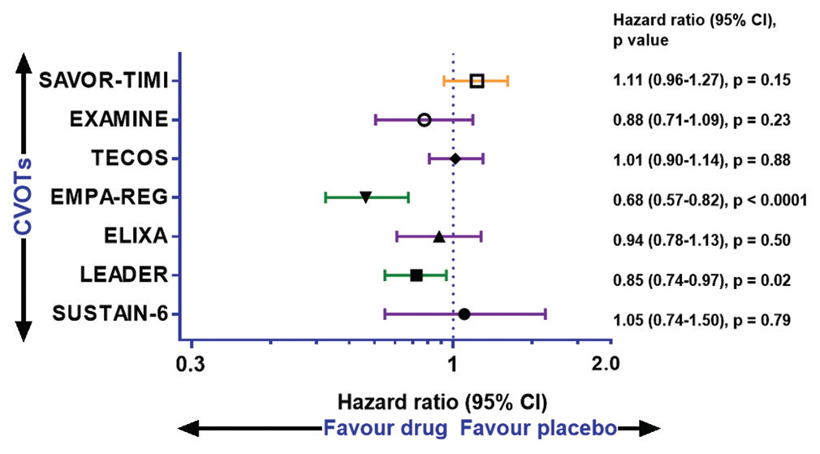
All-cause Mortality

Slide 56
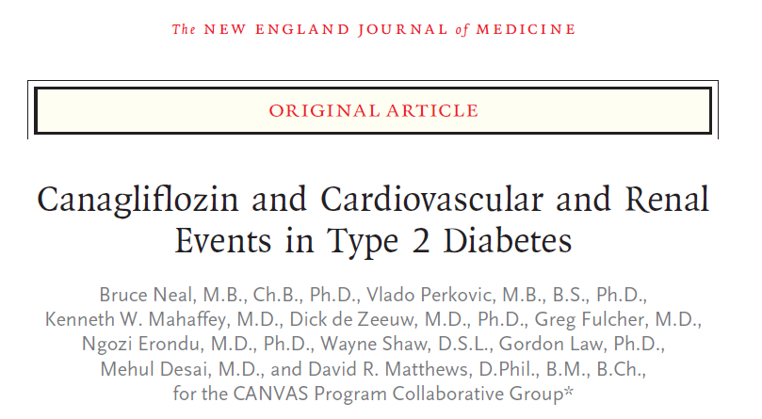

Slide 57
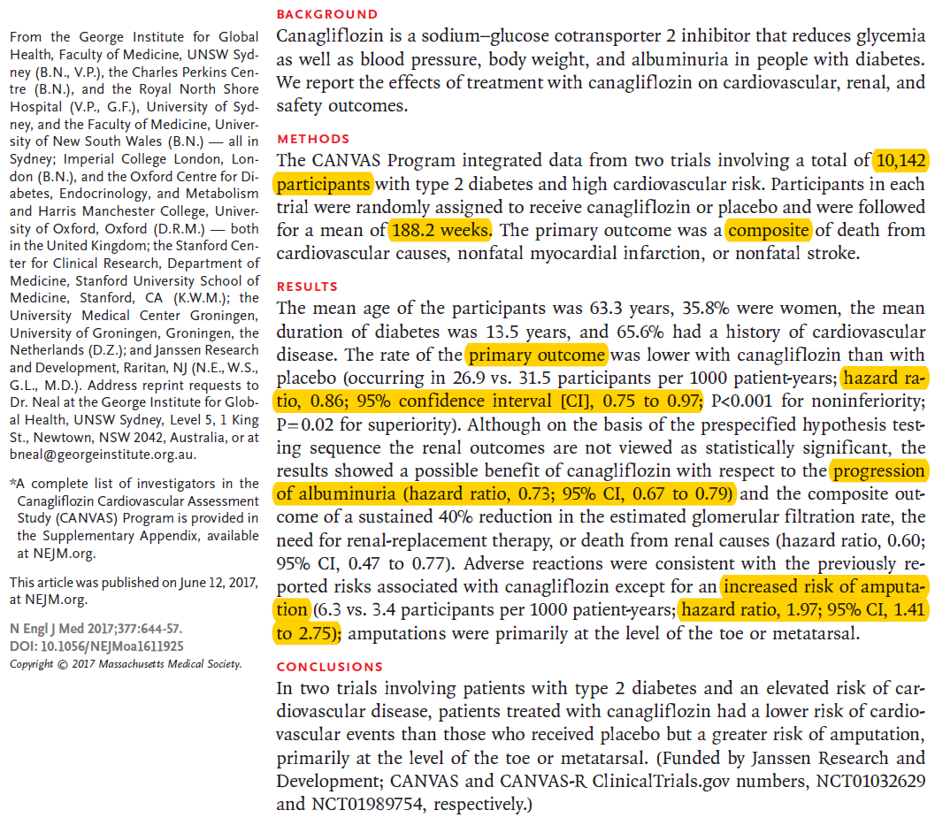

Slide 58
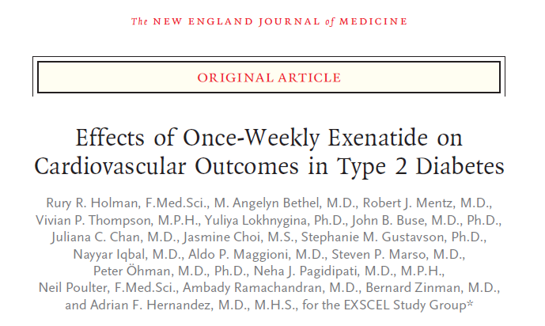

Slide 59
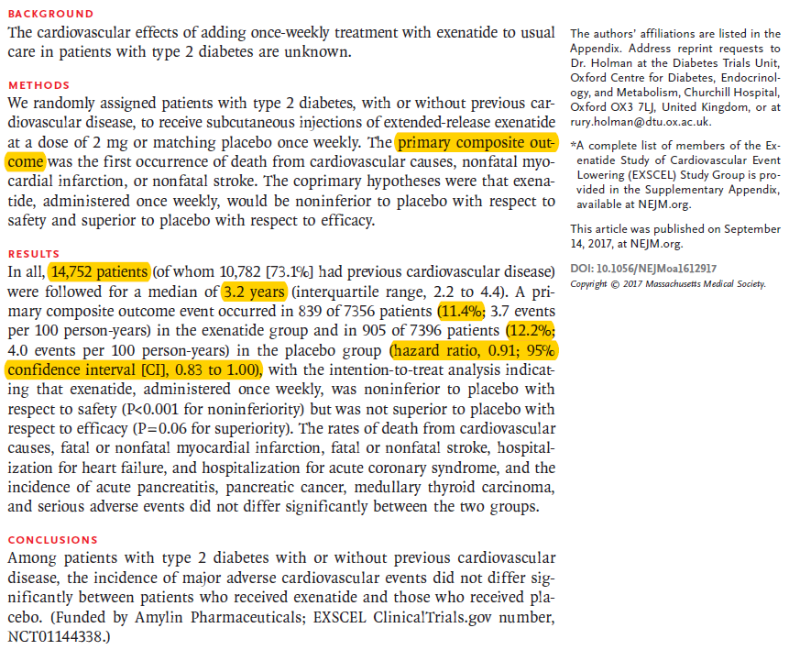

Slide 60
Future
Name (brand name) | Developer | Remarks
Albiglutide (Syncria®) | GlaxoSmithKline | GLP-1 dimer fused to human albumin; once weekly
Dulaglutide (LY2189265) | Eli Lilly | GLP-1 analogue fused to Fc antibody fragment once weekly
Exenatide- QM | Amylin | P II; once monthly
ITCA 650 | Eli Lilly/ Intarcia Therapeutics | P II; Exenatide administered using a DUROS® device; once yearly
NN9924 | Novo Nordisk | P I; oral formulation of a GLP-1 analogue

Slide 61
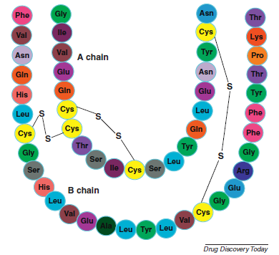

Slide 62
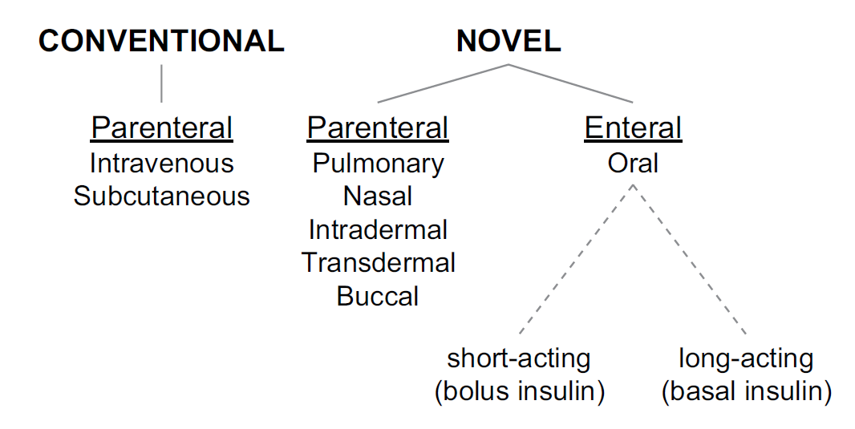

Slide 63
Inhaled insulins

Slide 64
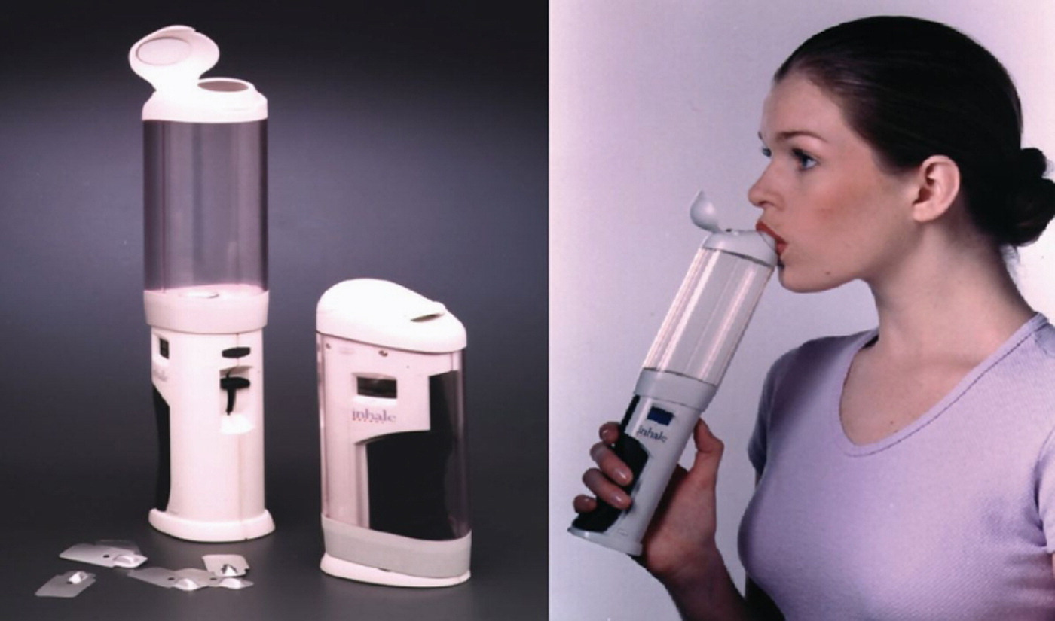

Exubera
Clinical Therapeutics 2014 36, 1275-1289DOI: (10.1016/j.clinthera.2014.06.025)
Copyright © 2014 Elsevier HS Journals, Inc. Terms and Conditions
Notes:
Exubera® (Nektar Therapeutics [San Carlos, California]/Pfizer Inc [New York, New York]) inhaler.¹⁰ Reproduction of Figure 1 of Selam JL. Inhaled Insulin: Promises and Concerns. J Diab Sci Technology 2008;2(1):311-315. Copyright: License # 3412630488870, SAGE Publications.

Slide 65
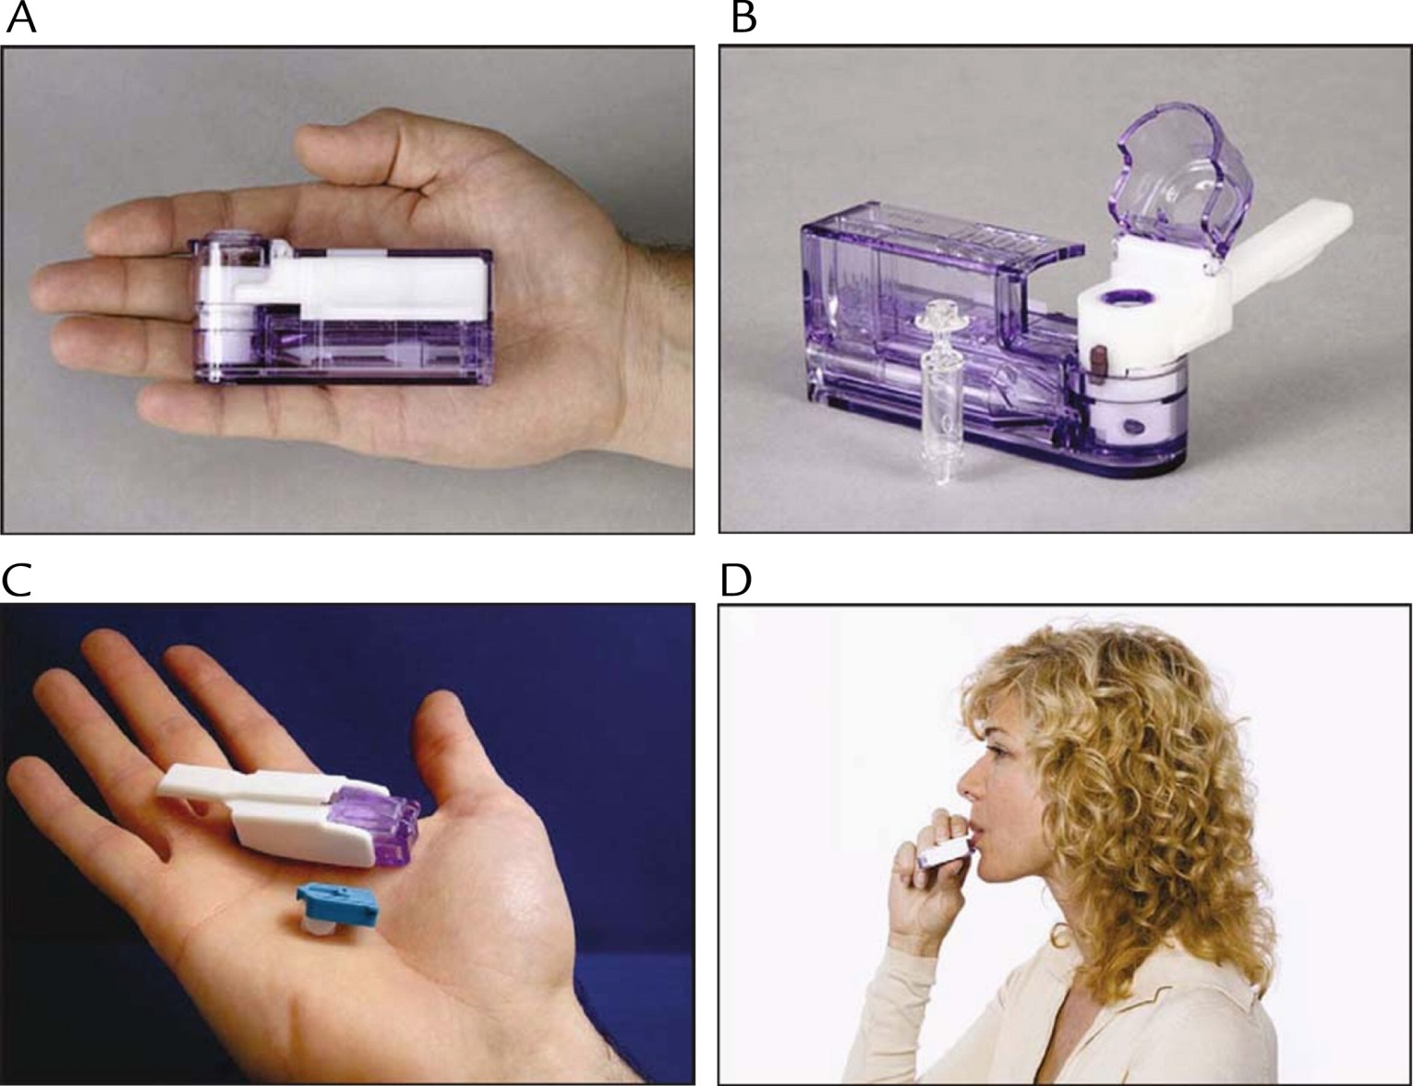
Figure 2
Clinical Therapeutics 2014 36, 1275-1289DOI: (10.1016/j.clinthera.2014.06.025)
Copyright © 2014 Elsevier HS Journals, Inc. Terms and Conditions
Notes:
Technosphere® insulin (MannKind Corporation, Valencia, California). (A and B) The original MedTone® inhaler (MannKind). (C and D) The Gen2 device combined with TI into the drug–device combination system called Afrezza® (MannKind).³⁵ Reproduction of Figure 1 of Neumiller JJ, Campbell RK. Technosphere® Insulin. An Inhaled Prandial Insulin Product. Biodrugs 2010;24(3):165-172. Copyright: 3412630859531, Springer.

Slide 66
Type 1 diabetes : We recommend subcutaneous rapid-acting insulin rather than inhaled insulin for the management of type 1 diabetes (Grade 1B)
Type 2 diabetes : For the majority of patients, we suggest intermediate- or long-acting ("basal") insulin administration as the first step in insulin treatment. For patients who subsequently require premeal rapid-acting insulin, we suggest subcutaneous rapid-acting insulin rather than inhaled insulin (Grade 2B)

Slide 67
Mean A1C levels were reduced to a similar degree in both groups; However, neither arm reached A1C levels less than 7 percent
comparison between inhaled therapy and sub-standard therapy not standard therapy
a higher incidence of DKA was observed among Afrezza-treated patients (4.8 times more frequent than with subcutaneous insulin)

Slide 68

However, in a later trial comparing inhaled insulin plus insulin glargine to biphasic insulin, there was no difference in quality of life or attitudes toward insulin therapy

Slide 69
Not recommended for patients who smoke
Large 5-year safety study to assess potential risk of pulmonary malignancy to be conducted
Contraindicated in patients with chronic lung disease such as asthma or COPD
Before initiating, perform a detailed medical history, physical exam, and spirometry (FEV1) in all patients to identify lung disease
Exercise
Cardiovascular safety profile

Slide 70
Oral insulins

Slide 71


Slide 72
Approaches to overcome
encapsulation in nanoparticles by polymers such as chitosan, poly (lacticco-glycolic acid) (PLGA), and alginate which prevent enzymatic degradation, and allow absorption across the epithelial layer
co-administeration with protease inhibitors such as bacitracin, sodium glycocholate and camostat mesilate
permeation and absorption enhancers such as fatty acid salts, Zonula occludens toxin (ZOT), and monosodium N-(4-chlorosalicyloyl)-4-aminobutyrate (4-CNAB)
modification by PEGylation, or by adding other factors, which changes the pharmacokinetics, prevents enzymatic degradation, and increases absorption

Slide 73

Journal of Diabetes Science and Technology 8(3)

Slide 74



Slide 75
Future
hard to imagine that an oral insulin product will be approved for marketing by 2019.
“Pharmaceutical companies are on the frontline in developing a system to deliver insulin orally; however, most of them abandon their delivery systems at the first stages of development. It would be very interesting if they would clearly disclose what went wrong in those studies.”
J Diabetes Sci Technol Vol 7, Issue 2, March 2013

Slide 76


Insulin Degludec
Onset of action : 1-4 hours
No peak
Duration of action : up to 40 hours
Approved in children older than 1 year
DEVOTE study
Ryzodeg : Insulin Degludec and insulin Aspart

Slide 77

Other not so new basal insulins

Slide 78
Concentrated Insulins
When higher doses are needed
Insulin Glargine U-300 (Tuojeo) : similar A1C control with less nocturnal hypoglycemia
Insulin Lispro U-200 (Humalog 200) the first approved concentrated rapid acting insulin
Insulin Regular U-500 (Humulin R-500)

Slide 79



Concentrated Insulins

Slide 80
What’s the difference between Gla-300 and Gla-100?
Smaller surface area^{1,2}
More compact smaller
SC depot with Gla-300
vs Gla-100^{1,2}
Gla-100
Gla-300
For illustrative purposes only²
Different absorption kinetics:
More gradual and slower release¹⁻⁴
Gla-300 has a distinct PK/PD profile vs Gla-100:
More stable, prolonged duration
of action beyond 24 hours⁴
Insulin glargine metabolism is the same regardless of Gla-100 or Gla-300 administration; M1 metabolite was confirmed as the prinicpal active moiety circulating in blood³
PD, pharmacodynamic; PK, pharmacokinetic; SC, subcutaneous
1. Pettus J, et al. Diabetes Metab Res Rev. 2015 Oct 28. doi: 10.1002/dmrr.2763. [Epub ahead of print]; 2. Adapted from Sutton G et al. Expert Opin Biol Ther. 2014;14:1849-60; 3. Steinstraesser A et al. Diabetes Obes Metab. 2014;16:873-6; 4. Becker RH et al. Diabetes Care. 2015;38:637-43
80

Slide 81
Basal Insulin & GLP-1 Agonist Combinations
Better A1c reduction than either drug alone
Single injection combines two drugs
Less weight gain and hypoglycemia than basal insulin
Less nausea than GLP-1 agonists
Single co-pay
https://diatribe.org/drugdevice-name

Slide 82



https://diatribe.org/drugdevice-name

Slide 83


Slide 85


Slide 86
Future

Slide 87
The Lancet Diabetes & Endocrinology 4.4 (2016): 350-359

Slide 88


Harrison's principles of internal medicine. McGraw-Hill

Slide 89


