Slide 1
Brittle diabetes
Dr. Abolfazl Heidari

Slide 2
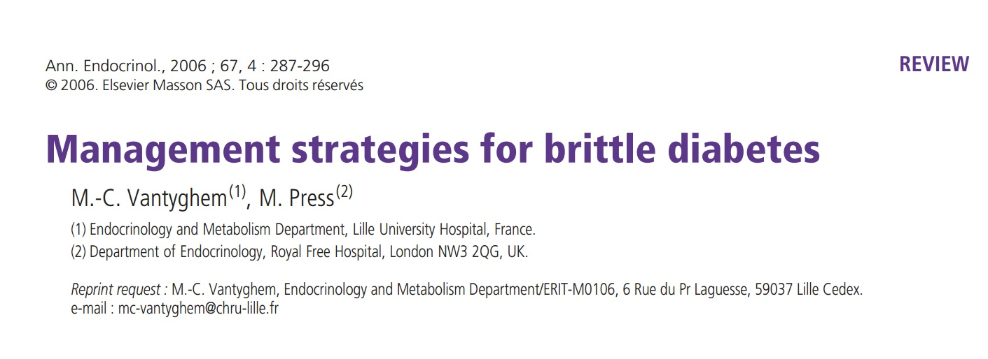

Slide 3
EPIDEMIOLOGY
Brittle diabetes is a small but significant problem, affecting 1/1000 diabetic patients and about 3 /1000 insulin dependent diabetes.
It mainly affects young people (mean age 26±15 years) with a second frequency peak around 60-70 years.
Two thirds of affected patients are female
shorter duration of diabetes than stable controls (13±9 vs. 19±11 years) associated with higher HbA1c levels and greater insulin requirements.

Slide 4
EPIDEMIOLOGY
Three forms of labile diabetes have been described.
  The most common form is recurrent diabetic ketoacidosis, defined as at least three episodes per 2 years and accounting for 59% of labile forms. This form, which is more common in younger patients, is recognised as often reflecting simple non-compliance with insulin injections.
  Predominant hypoglycemic forms (defined as at least 3 severe episodes per year) account for 17%
  mixed instability for 24%.
These two last forms are more common in older age groups.

Slide 5
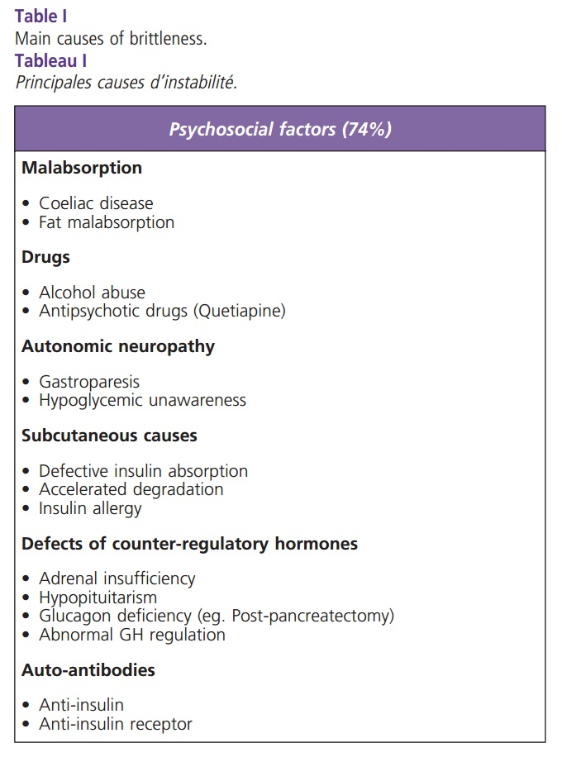

Slide 6
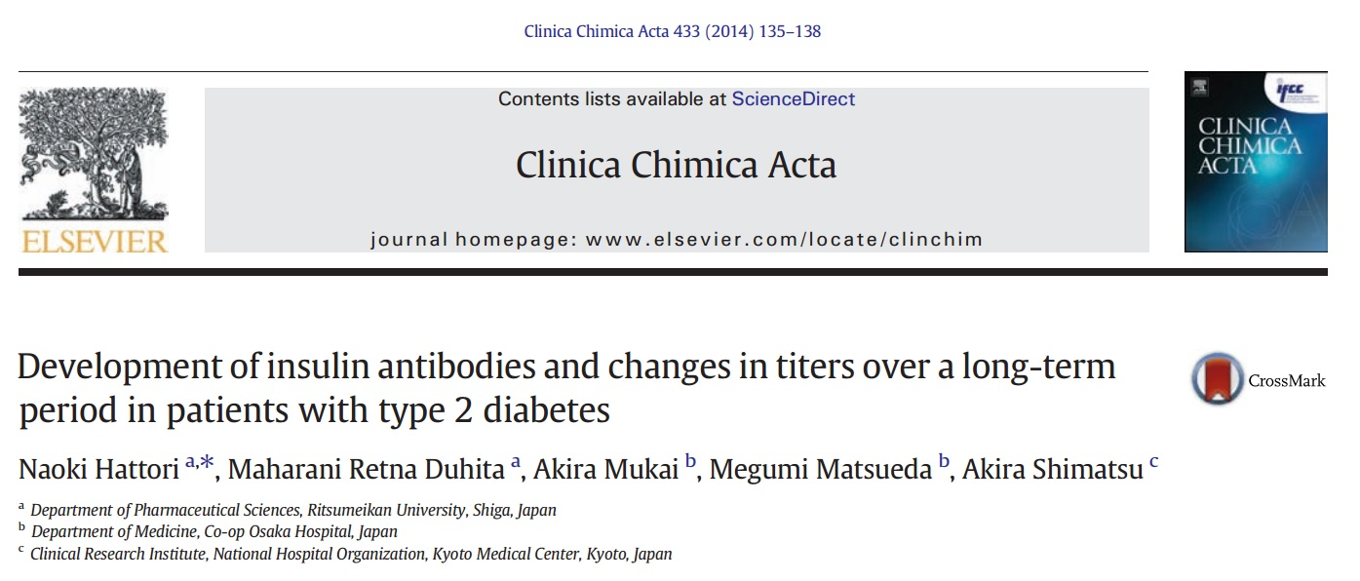

Slide 7
The aim of this study was to evaluate:
  the prevalence of insulin antibodies in patients with type 2 diabetes using insulin analogs
  differences in the antigenicity of the analogs
  effects of insulin antibodies on serum insulin levels
  the changes in the insulin antibody titers over a long-term period

Slide 8
a total of 118 patients with type 2 diabetes (80 men and 38 women, aged 62.5 ± 13.5 (SD) years) on insulin therapy, and 263 patients with type 2 diabetes (176 men and 87 women, aged 63.3 ± 11.5 years) who have never used insulin.
The treatment histories of these patients were reviewed from our digital medical records for the past 6 years.
23 subjects without diabetes (10 men and 13 women, aged 60.0 ± 3.2 years) volunteered to submit their blood samples for the controls.

Slide 9
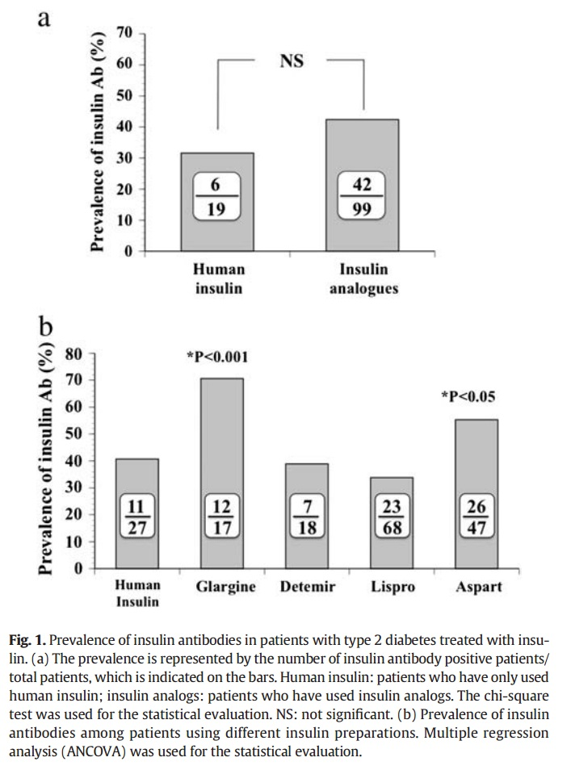

Slide 10
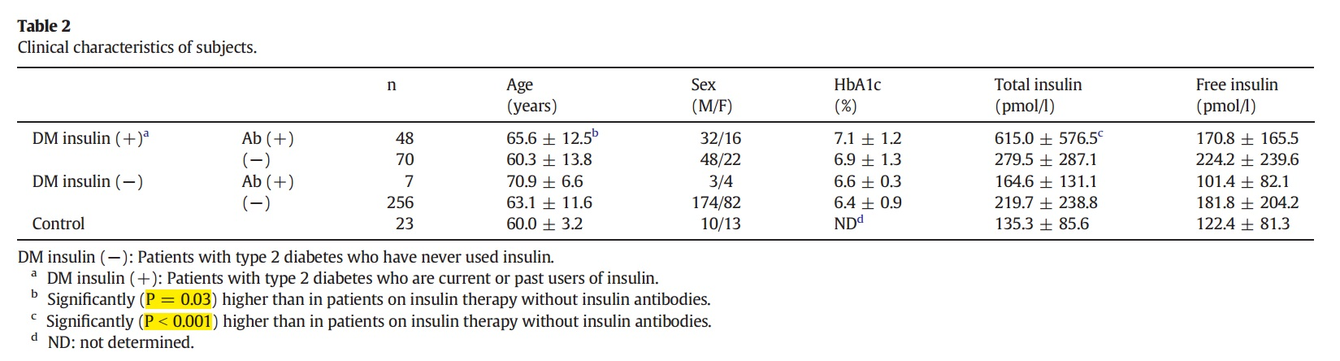

Slide 11
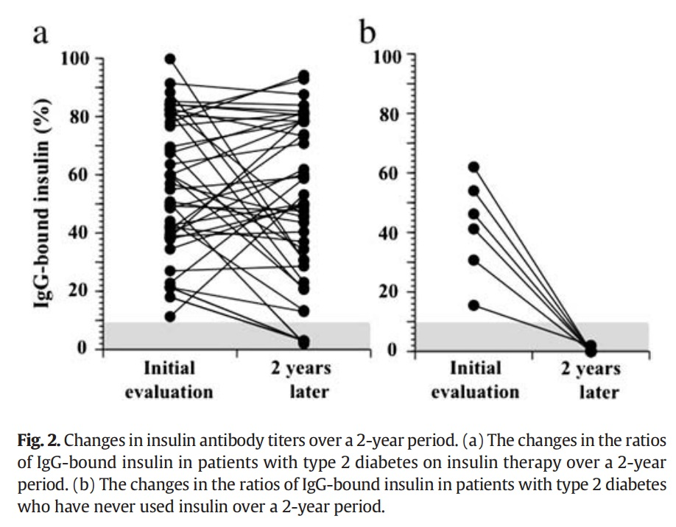

Slide 12
We conclude that
  1) insulin glargine and aspart are more antigenic than other insulin analogs
  2) insulin antibodies raise serum insulin levels
  3) insulin antibodies persist for a long time
  4) insulin antibodies develop even in patients who have never used insulin, but they are transient.
Insulin antibodies should be suspected when inappropriately high serum insulin concentrations are observed even in patients not currently on insulin therapy.

Slide 13
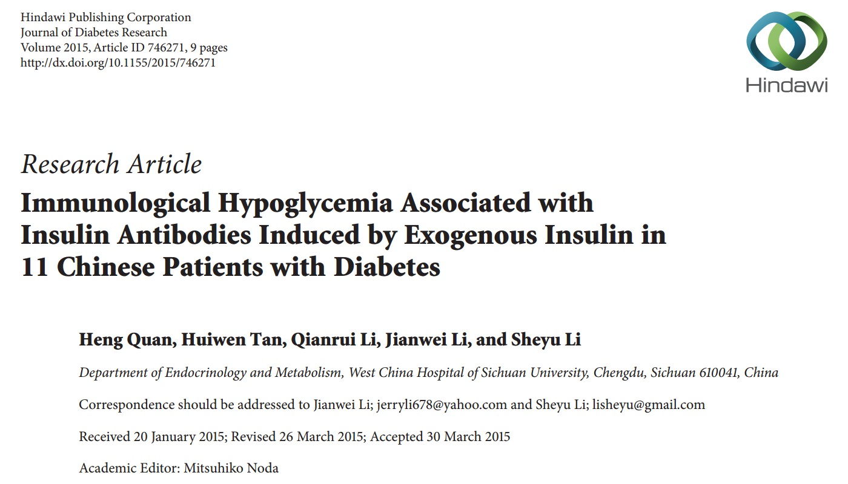

Slide 14
Patients were eligible for inclusion in the study if
  they had hypoglycemia
  received insulin therapy prior to admission with positive IAb, and
  had available results from blood glucose monitoring,
  standard meal tolerance test (MTT), and
  insulin and C-peptide release test during hospitalization

Slide 15
Additionally, we selected patients hospitalized during the same period with negative IAb and no record of unexpected hypoglycemia episodes, matched to each case patient by insulin type, age (within a 3-year range), and gender in a 1 : 1 ratio, as controls to evaluate the eﬀects of the agents’ crossreaction in the insulin test.

Slide 16
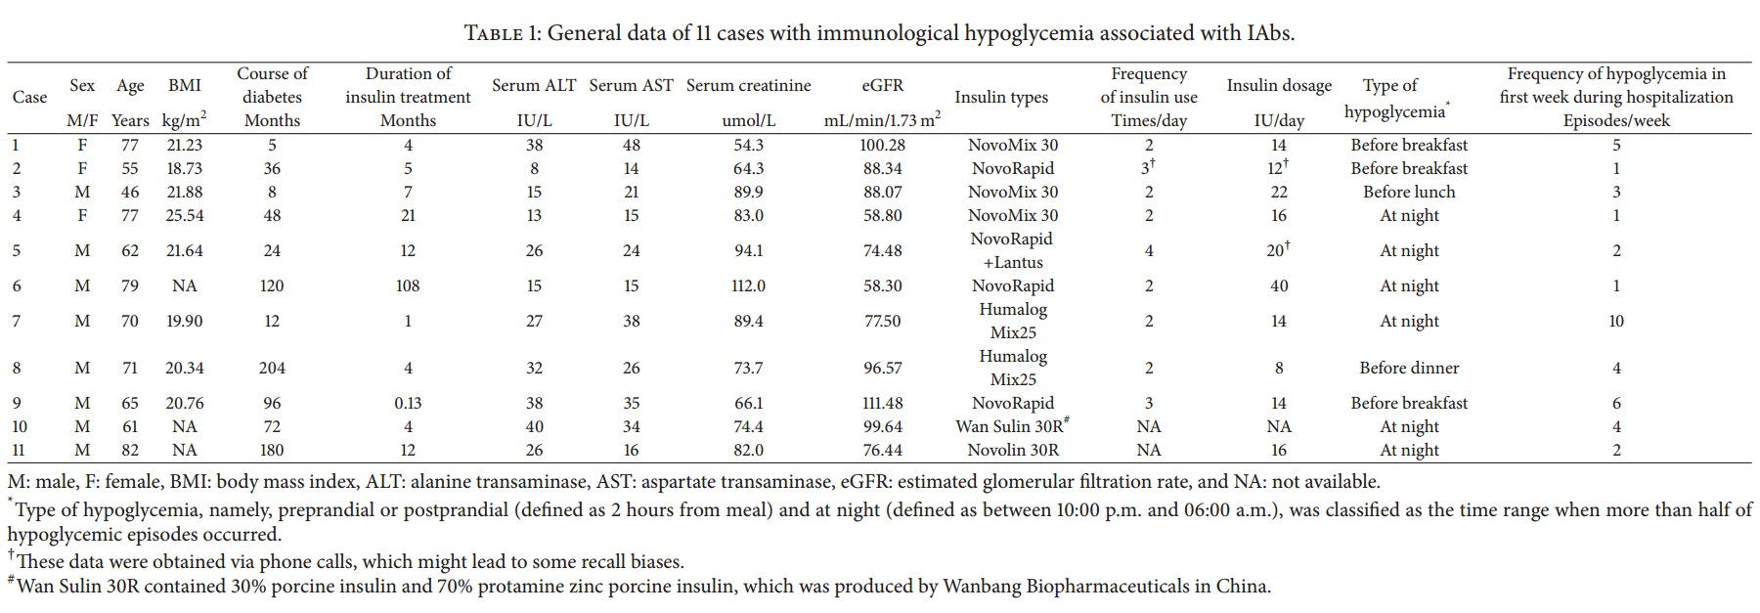

Slide 17
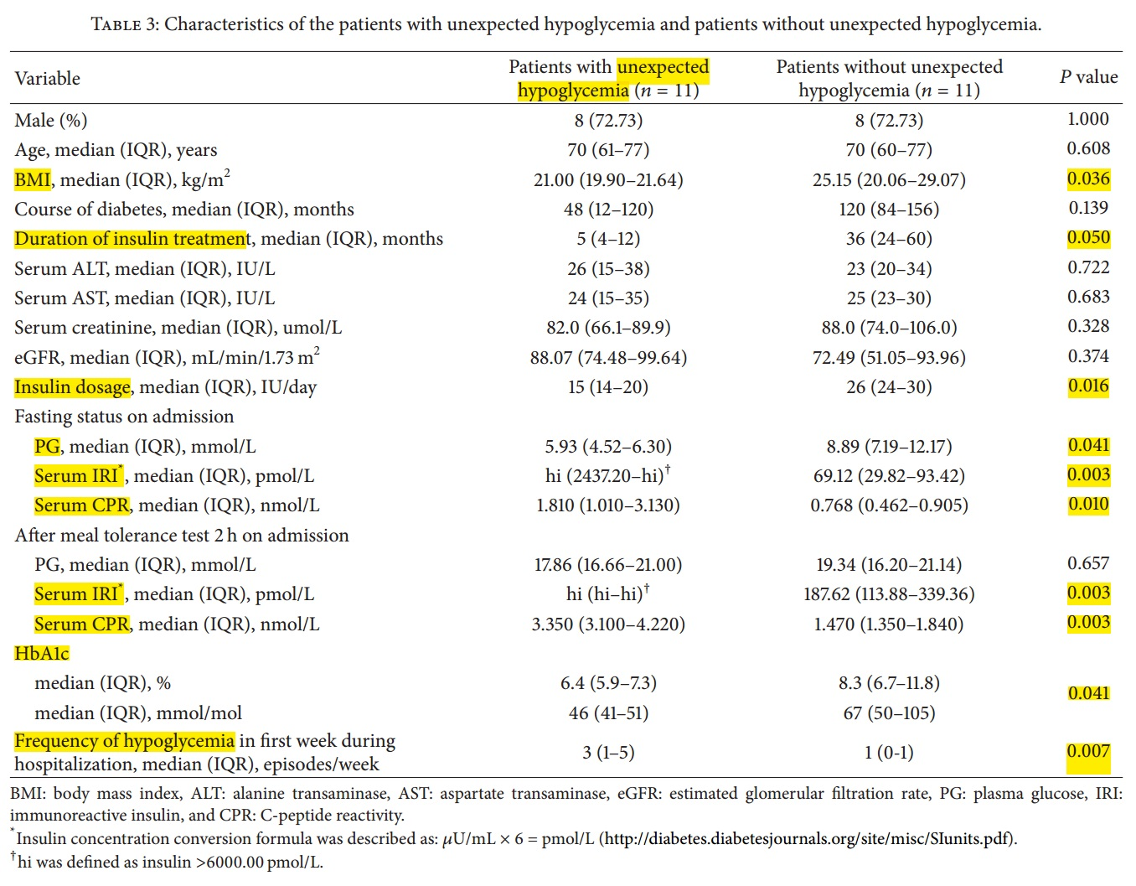

Slide 18
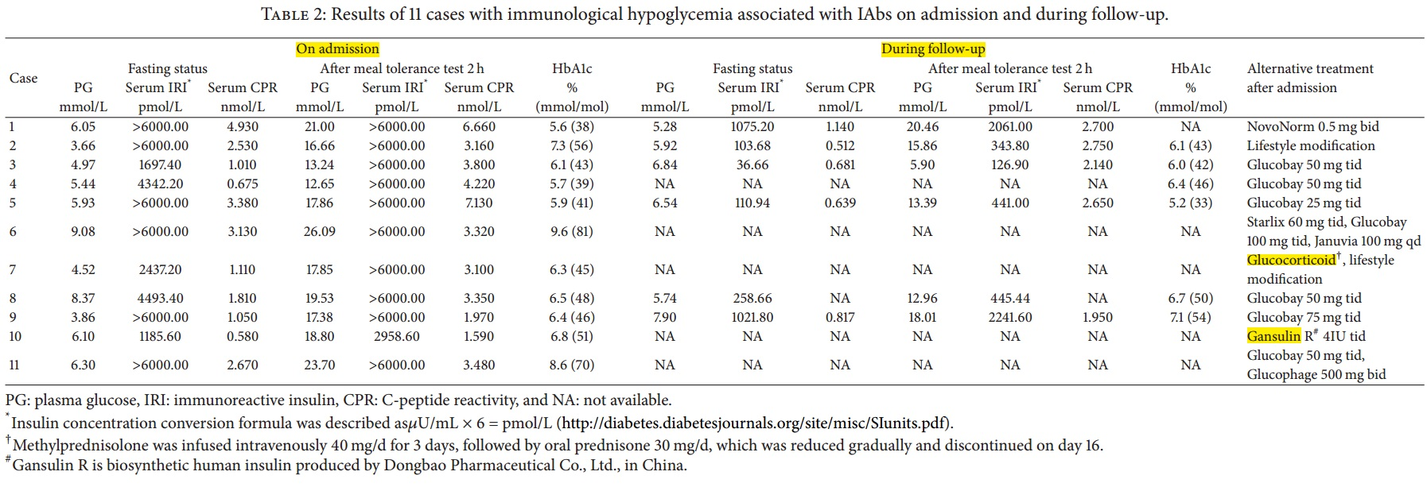

Slide 19
The median time when hypoglycemic episodes vanished during hospitalization after previous insulin withdrawal was 20 days.
Seven patients with unexpected hypoglycemia were followed up after discharge. Six of them (cases 2–5, 8, and 9) got complete remission of hypoglycemia, while case 1 had a signifcant reduction of the frequency of hypoglycemia (only two episodes before breakfast during the 9-month follow-up).
IAbs turned negative in four cases (cases 3, 4, 8, and 9) afer a median of 17 months .

Slide 20
HbA1c was 6.25% in six cases (cases 2–5, 8, and 9) afer a median of 23.5 months.
serum IRI levels substantially dropped afer a median of 22 months.

Slide 21
THERAPEUTIC STRATEGIES
Optimization of standard insulin therapy
Thorough education of patients by a team including diabetologist, diabetes specialist nurse, dietician and, when necessary, psychologist may uncover unsuspected misunderstandings of diet or insulin dosage adjustment, or inappropriate expectations of control.

Slide 22
Glucose meter accuracy,
attention to injection technique and needle length to exclude intramuscular injections and
examination of injection sites to exclude lipohypertrophies and lipodystrophies must all be checked.
Nevertheless 50% of type 1 diabetic patients do not reach the objectives recommended by current guidelines

Slide 23
Treatment of organic causes of brittleness
  Gastroparesis
  Celiac disease
  Hypothyroidism
  Adrenal insufficiency

Slide 24
Psychological causes of brittleness
  factitious hypoglycemia
  depression
  anxiety and fear of hypoglycaemia

Slide 25
Alternative therapeutic strategies
  Continuous subcutaneous insulin infusion (CSII)
    Several studies, including the DCCT, have shown that CSII results in better glycaemic control than multiple injections, with an improvement of HbA1c of about 0.2 to 0.4% and, more importantly, a decrease in hypoglycemia frequency.
  Continuous intraperitoneal insulin delivery through an implantable pump (IPII)
  intraportal islet transplantation (IIT)
  Whole pancreas transplantation

