Slide 1
Diagnostic Approach of Acromegaly
Mahtab Niroomand M.D.
Assistant Professor of Endocrinology
2014
Tehran

Slide 2
Out line
Introduction and epidemiology
Etiology and differential diagnosis
Clinical features
Survival
Diagnostic modality
Endocrine society guideline overview

Slide 3
Introduction
Acromegaly is a chronic, rare, and possibly life-threating condition when not treated.
GH circulates and stimulates production of IGF-1 from the liver and systemic tissues.
Serum levels of both GH and IGF-1 are used for biochemical diagnosis and level of control.
J Clin Endocrinol Metab 93: 2035 2041,2008
J Clin Endocrinol Metab 99: 3933–3951, 2014

Slide 4
Introduction
Hypersecretion of GH leads to excess production of IGF-1, leading to a multisystem disease characterized by somatic overgrowth, multiple comorbidities, premature mortality, and physical disfigurement.
A multidisciplinary approach is critical for the management of acromegaly.
J Clin Endocrinol Metab 93: 2035–2041,2008
J Clin Endocrinol Metab 99: 3933–3951, 2014

Slide 5
Epidemiology
Incidence: 3-4 case /1 million persons/year
Prevalence: 40-70 cases/million
Mean age of disease occurrence:32 yr
Mean age at diagnosis: 39-42 yr
Delay in the diagnosis from the onset of signs and symptoms: 7-10 yr
J Clin Endocrinol Metab 93: 2035 2041,2008

Slide 6
Hypothalamic Pituitary Control of GH Secretion
N Engl J Med 2006;355:2558-73

Slide 7
Causes of Acromegaly
N Engl J Med 2006;355:2558-73

Slide 8
Familial acromegaly syndromes
Comprehensive Clinical of Endocrinology, 3rd ed. HarcourtPublications,Kent, 2001

Slide 9
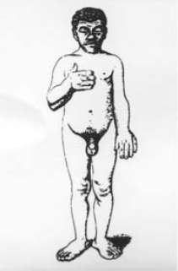
Clinical Features of Acromegaly
Original figure depicting earliest illustration of clinical features of acromegaly by Minkowski in 1887
Melmed S, Braunstein G. Stein’s Textbook of Medicine, 5th ed. St Louis: Mosby,1998;1773–1788

Slide 10
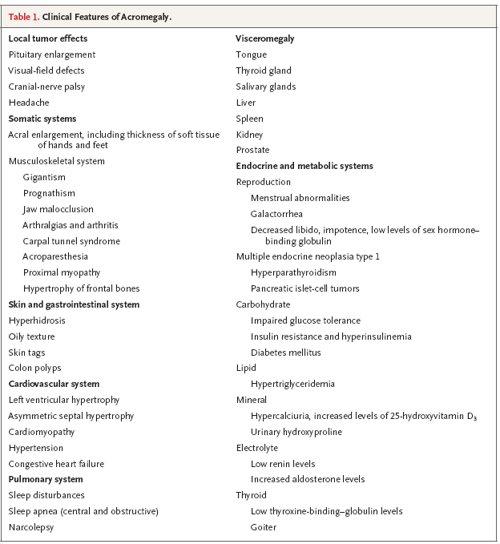
Clinical Features of Acromegaly
N Engl J Med 2006;355:2558-73

Slide 11
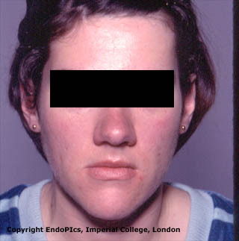
Clinical Features of Acromegaly
Soft tissue hypertrophy of face and hand
prognatism
Faciai seborrhea and acne

Slide 12
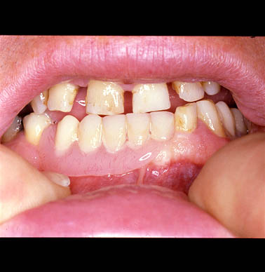
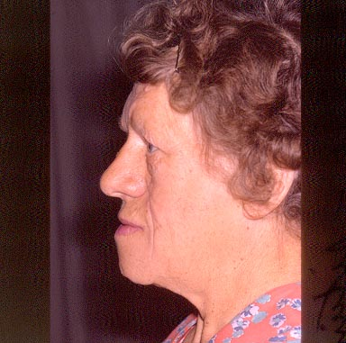
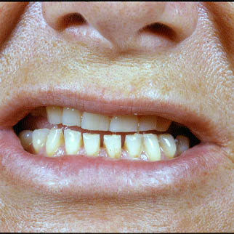
Clinical Features of Acromegaly
Marked Separation of teeth
prognathism

Slide 13
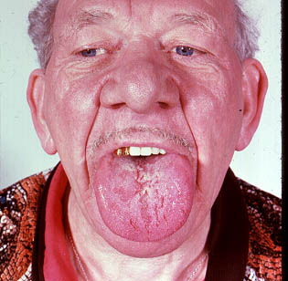
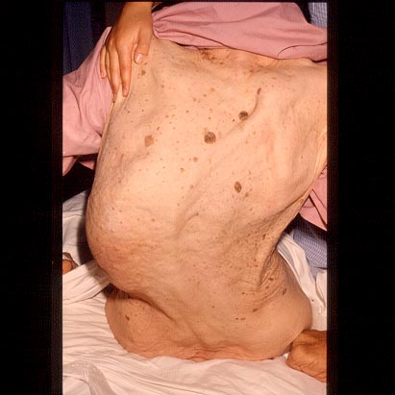
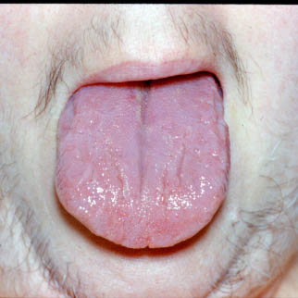
Clinical Features of Acromegaly
macroglossia
Nose hypertrophy
scolosis

Slide 14
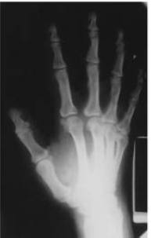
Clinical Features of Acromegaly
X-ray image of bony “tufting” seen at ends of terminal phalanges indicates bony overgrowth.
Acromegaly in a young male with active
perspiration, oily skin, acne, and widened tooth gap
Melmed S, Braunstein G. Stein’s Textbook of Medicine, 5th ed. St Louis: Mosby,1998;1773–1788

Slide 15
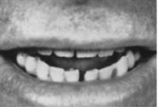
Clinical Features of Acromegaly
Jaw overbite , widening of spaces between incisors due to mandibular growth
Prominent skin tags
Increased heal pad thickness
Melmed S, Braunstein G. Stein’s Textbook of Medicine, 5th ed. St Louis: Mosby,
1998;1773–1788.

Slide 16
Survival
The overall standardized mortality ratio of acromegalic patients is 1.48
Factors contributing to increased mortality include the higher prevalence of :
Hypertension
Hyperglycemia or overt diabetes
Cardiomyopathy
Sleep apnea
N Engl J Med 2006;355:2558-73

Slide 17
Survival
Independent predictor of longer survival:
GH levels of <2.5 μg/liter
Younger age
Shorter duration of disease
Absence of hypertension
J Clin Endocrinol Metab 2005;90:4081-6

Slide 18
Outcome determinants of Acromegaly
Melmed S, Braunstein G. Stein’s Textbook of Medicine, 5th ed. St Louis: Mosby,1998;

Slide 19
Diagnosis
The diagnostic workup of a patient must confirm:
Autonomy of GH secretion
look for possible concomitant hyperprolactinemia
Document the space-occupying lesion and its extension
Search for possible complications:
Anterior pituitary insufficiency
Visual impairment
Carpal tunnel syndrome,…..

Slide 20
Autonomy of GH secretion
Basal GH concentration
GH nadir post 2hrs-75-gr OGTT
Dynamic GH test
Urinary GH
Serum IGF-1 levels (peripheral biologic effect of hypersecretion of GH)
IGFBP-3

Slide 21
Basal GH concentration
GH secretion in normal subjects is:
Pulsatile
Diurnal
Stimulated by variety of factors including:
Short-term fasting
Exercise
Stress
Sleep
Serum GH concentrations fluctuate widely (<0.5-1ng/ml during most of the day to 20-30 ng/ml at night or after vigorous exercise)
N Engl J Med 2006;355:2558-73

Slide 22
Basal GH concentration
In acromegaly samples collected over 24 hours contain detectable levels of GH (>2μg/L) and mean 24 hour integrated GH levels <2.5μg/L exclude acromegaly

Slide 23
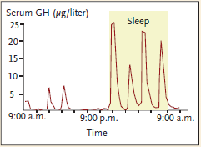
Basal GH concentration
In acromegaly the episodic basal pattern of GH secretion is sustained, but normal diurnal variation of GH is absent with a loss of sleep-related rise in GH and there are higher episodic GH pulse frequency in these patients
N Engl J Med 2006;355:2558-73

Slide 24
GH nadir after 2hrs-75-gr OGTT
Absolute nadir in levels of GH after a glucose load is required both to confirm the diagnosis and to assess the efficacy of treatment, and the establishment of this level is assay-dependent
With the use of most commercial assays, nadir levels of <1 μg/liter of GH rule out the diagnosis. (some ultrasensitive assays, nadir levels of <0.3μg/liter )
Clin Endocrinol Metab 2009;89:495-500.

Slide 25
GH nadir after 2hrs-75-grOGTT {False (+)}
The production of GH may not be suppressed in:
Liver disease
Renal insufficiency
Uncontrolled diabetes
Malnutrition, or anorexia
Pregnant patients
Who are receiving estrogens
During late adolescence
N Engl J Med 2006;355:2558-73

Slide 26
Serum IGF-1
GH induces the synthesis of peripheral IGF-I and IGF-1 induces cell proliferation and inhibits apoptosis
Levels of IGF-I are highest during late adolescence and decline throughout adulthood and are elevated during pregnancy
IGF-1 levels are determined by:
Sex
Genetic factors
Endocr Dev2005;9:55-65
Horm Res 2003;60:53-60

Slide 27
Serum IGF-1
The production of IGF-I is suppressed in : {false(-)} :
Malnourished patients
liver disease
Hypothyroidism
Poorly controlled diabetes
Endocr Dev2005;9:55-65
Horm Res 2003;60:53-60

Slide 28
Serum IGF-1
IGF-I levels should ideally serve as a biomarker for GH activity
Serum IGF-1 concentration reflect integrated GH secretion during the preceding day or longer
Serum IGF-I levels are invariably high in acromegaly
A high IGF-I level is highly specific for acromegaly in the non pregnant adult and correlates with clinical indices of disease activity.
J. Clin. Endocrinol. Metab. 2009 94:1255-1263
N Engl J Med 2006;355:2558-73
J Clin Endocrinol Metab 2004;89:495-500

Slide 29
Serum IGF-1
Age- and sex matched IGF-I elevations may persist for several months when GH levels are apparently controlled after treatment
In some patients whose disease is controlled by therapy, levels of GH and IGF-I are discrepant.
Nadir levels of GH and IGF-I ,together , provide complementary evidence for establishing biochemical diagnosis.
J. Clin. Endocrinol. Metab. 2009 94:1255-1263
N Engl J Med 2006;355:2558-73
J Clin Endocrinol Metab 2004;89:495-500

Slide 30
Other Dynamic test
TRH and GnRH test: Discordant GH responses to TRH and GnRH administration have been described in up to 50% of patients, these adjunctive tests are rarely indicated to confirm the diagnosis
L-dopa test: 500 mg orally reduces serum GH by ≥50% in about one-half of patients while it raises the GH in normal subject
Uptodate
Melmed, the pituitary date modified 2008

Slide 31
Serum IGFBP-3
IGFBP-3 secretion is GH dependent
Serum IGFBP-3 concentration are elevated in acromegaly
There is considerable overlap of these values with those in normal persons thereby limiting the utility of this measurement

Slide 32
Urinary GH
Normal subjects secrete 0.4–15ng GH/g Cr
Untreated acromegalic pts secrete >40 ngGH/gCr
In the absence of renal disease, urinary GH levels appear to correlate with serum GH profiles
Measurement of urinary GH may offer a relatively easy assessment of integrated GH secretion during the period of collection
The utility of this screening test still requires controlled confirmation.
Melmed, the pituitary date modified 2008
J Endocrinol Inv 1989;12:461–467.

Slide 33
Differential Diagnosis of Acromegaly
Over 95% of acromegalic patients harbor a GH-cell pituitary adenoma
Distinction of pituitary vs extrapituitary acromegaly is extremely important in planning effective management
Regardless of the cause, GH and IGF-I levels are invariably elevated and GH levels fail to suppress (<1µg/L) after an oral glucose load in all forms of acromegaly
J Clin Endocrinol Metab 2004;89:495-500 Melmed, the pituitary date modified 2008

Slide 34
Differential Diagnosis of Acromegaly
Dynamic pituitary tests are not helpful in distinguishing GH-secreting pituitary tumors from extrapituitary tumors
GH responses to dopamine agonists, and to GHRH administration, do not provide useful information for identifying the source of excess GH secretion
Plasma GHRH levels are usually elevated in patients with peripheral GHRH-secreting tumors, and are normal or low in patients with pituitary acromegaly
Measuring GHRH plasma levels provides a precise and cost-effective test for the diagnosis of ectopic acromegaly
Melmed, the pituitary date modified 2008

Slide 35
Differential Diagnosis of Acromegaly
Unique and unexpected clinical features in an acromegalic patient, including respiratory wheezing or dyspnea, facial flushing, peptic ulcers, or renal stones will sometimes be helpful in alerting the physician to diagnosing nonpituitary endocrine tumor
Melmed, the pituitary date modified 2008

Slide 36
Imaging
Anatomic localization of the pituitary or extra-pituitary tumor is achieved using imaging techniques, including MRI and CT scanning
As routine abdominal or chest imaging will yield a very low incidence of true positive cases of ectopic tumor, such screening of these patients is not recommended as being cost effective
Melmed, the pituitary date modified 2008

Slide 37
Imaging
Indications for extra-pituitary imaging:
Elevated circulating GHRH levels
Normal or small-sized pituitary gland
Clinical and biochemical features of other tumors known to be associated with extra-pituitary acromegaly

Slide 38
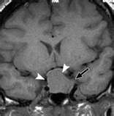
Imaging
Pituitary MRI with contrast material :
The most sensitive imaging study for determining the source of excess growth hormone.
Visualization of:
Adenomas > 2 mm in diameter
Tumor dimensions
Invasive features
Optic tract contiguity
J. Clin. Endocrinol. Metab. 2009 94:1255-1263
N Engl J Med 2006;355:2558-73

Slide 39
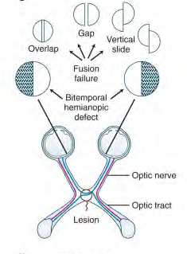
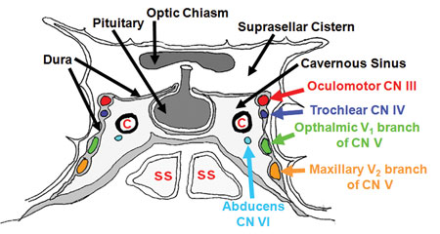
Imaging
At diagnosis, more than 75% of patients with acromegaly have a macroadenoma (>10 mm ), which often extends laterally to the cavernous sinus or dorsally to the suprasellar region.
J. Clin. Endocrinol. Metab. 2009 94:1255-1263

Slide 40
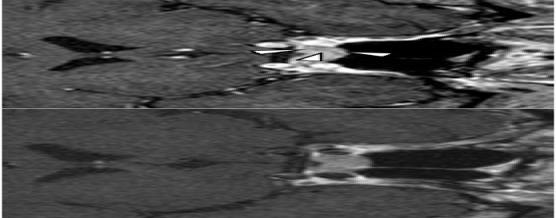
Imaging
GH secreting pituitary adenomas that are not evident on conventional MRI:
Spin echo(SE) T1-weighted MRI post-contrast
Volumetric interpolated breath-hold examination (VIBE) MRI sequence (1.2 mm slice thickness)
Post-contrast,
volumetric interpolated breath-hold
examination on MRI
Post-contrast SE
T1-weighted imaging
J. Clin. Endocrinol. Metab. 2010 95:4191-4196
Notes:
acromegalic patients without imaging evidence of a pituitary adenoma on pre- and postcontrast,
spin echo (SE) T1-weighted MR-imaging and who lacked evidence of an ectopic (non-pituitary) source causing GH excess at the National Institutes of Health and the University of Virginia were included.
3% of all GH adenomas resected by surgeons) with suspected GH secreting adenomas did not demonstrate imaging evidence of pituitary adenoma on conventional MR-imaging

Slide 41
Imaging
Abdominal and chest CT or MRI:
when a nonpituitary cause of excess GH or GHRH is suspected, abdominal and chest computed tomography, MRI, or both are indicated
J. Clin. Endocrinol. Metab. 2009 94:1255-1263

Slide 42
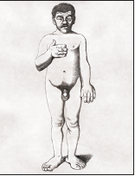
Diagnosis and Treatment of Acromegaly
J. Clin. Endocrinol. Metab. 2009 94:1255-1263
N Engl J Med 2006;355:2558-73

Slide 43
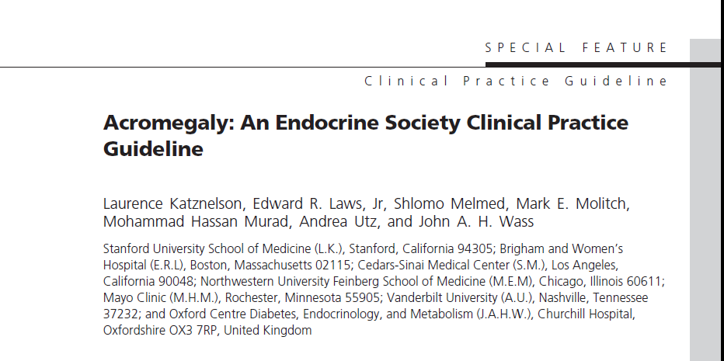
J Clin Endocrinol Metab, November 2014, 99(11):3933–3951

Slide 44
Clinical practice guideline 2014
We recommend measurement of IGF-1 levels in patients with typical clinical manifestations of acromegaly, especially those with acral and facial features. (1|QQQE)
We suggest the measurement of IGF-1 in patients without the typical manifestations of acromegaly, but who have several of these associated conditions:
Sleep apnea syndrome, type 2 DM, debilitating arthritis, carpal tunnel syndrome, hyperhidrosis, and hypertension.(2|QQEE)
J Clin Endocrinol Metab, November 2014, 99(11):3933–3951

Slide 45
Clinical practice guideline 2014
1.3 We recommend measuring serum IGF-1 to rule out acromegaly in a patient with a pituitary mass.
1.4 We recommend against relying on the use of random GH levels to diagnose acromegaly.
1.5 In patients with elevated or equivocal serum IGF-1 levels, we recommend confirmation of the diagnosis by finding lack of suppression of GH to1g/L following documented hyperglycemia during an oral glucose load.

Slide 46
Clinical practice guideline 2014
1.6 Following biochemical diagnosis of acromegaly, we recommend performing an imaging study to visualize tumor size and appearance, as well as parasellar extent .
We suggest MRI as the imaging modality of choice, followed by CT scan when MRI is contraindicated or unavailable.
1.7 We suggest performing formal visual field testing when the tumor is found to abut the optic chiasm on an imaging study.
J Clin Endocrinol Metab, November 2014, 99(11):3933–3951

Slide 47
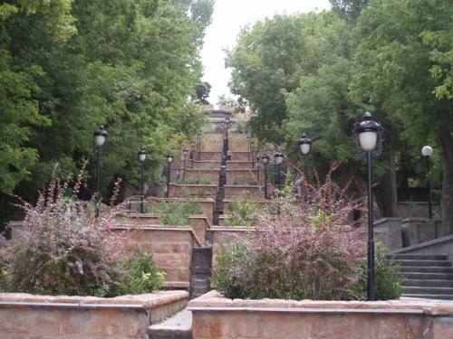
Thank You For Your Attention

Slide 48
Treatment
Surgery
Radiotherapy
Medical therapy:
Somatostatin receptor ligand (SRL)
GH receptor antagonist
Dopamin agonist
J Clin Endocrinol Metab, May 2009, 94(5):1509–1517

Slide 49
Treatment
Goals of treatment:
Mortality reduction
Tumor shrinkage
Treatment of comorbidities
J Clin Endocrinol Metab, May 2009, 94(5):1509–1517

Slide 50
Goals of Treatment
Mortality reduction:
normalizing mortality in patients with acromegaly is a key aim of disease management
main determinants of mortality:
Basal GH levels > 2.5 ng/ml
Elevated IGF-I
Age
Disease duration
Hypertension
Diabetes
Cardiac disease
J Clin Endocrinol Metab, May 2009, 94(5):1509–1517

Slide 51
Goals of Treatment
biochemical goals to control mortality :
GH < 2.5 ng/ml
Normal age and sex-adjusted IGF-I level
Treatment of comorbidities
Early diagnosis of acromegaly and treatment (reduced disease duration)
J Clin Endocrinol Metab, May 2009, 94(5):1509–1517

Slide 52
Post-treatment GH levels and mortality in acromegaly
J Clin Endocrinol Metab 1998;83:2730–2734

Slide 53
Goals of Treatment
Tumor shrinkage:
Control of tumor mass, which may impinge on vital central structures, is an essential goal of acromegaly therapy
The different treatment modalities have different effects on tumor mass
There is a concordance between biochemical
and anatomical response, but tumor shrinkage may occur even in the absence of biochemical response
Tumor mass should be monitored with MRI, and the frequency of MRI should be decreased after tumor growth control is established
J Clin Endocrinol Metab, May 2009, 94(5):1509–1517

Slide 54
Goals of Treatment
Treatment of comorbidities:
The most important comorbidities of acromegaly that can all lead to significant functional disability include:
Hypertension, cardiac dysfunction, diabetes, osteoarthropathy,and OSA
Surgical removal of pituitary tumors and biochemical control of acromegaly may reverse or halt progression of these comorbidities in some patients, but a significant proportion will need additional management
The incidence of premalignant colonic lesions may be increased in acromegaly
At diagnosis, all patients should have a colonoscopy. Subsequent follow-up investigation should be implemented as in the general population.
The evidence for a link between an increased risk of colorectal malignancies and uncontrolled acromegaly is controversial.
J Clin Endocrinol Metab, May 2009, 94(5):1509–1517

Slide 55
Treatment
Surgery
Radiotherapy
Medical therapy:
Somatostatin receptor ligand (SRL)
GH receptor antagonist
Dopamin agonist
J Clin Endocrinol Metab, May 2009, 94(5):1509–1517

Slide 56
Treatment
Williams textbook of endocrinology,11th edition 2008

Slide 57
Treatment
Williams textbook of endocrinology,11th edition 2008

Slide 58
Summary of management strategy for patients with acromegaly
J Clin Endocrinol Metab, May 2009, 94(5):1509–1517

Slide 59
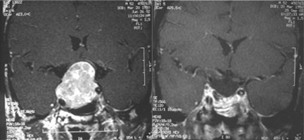
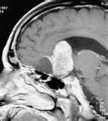

Slide 60
Effective management of GH secreting adenomas

Slide 61
Acromegaly treatment outcomes
J Clin Endocrinol Metab 2000;85:526–52

Slide 62
Diagnosis of acromegaly
Random GH>0.4 μg/l and elevated IGF-1
Or
GH nadir during OGTT >1μg/l
Comprehensive Clinical of Endocrinology, 3rd ed. Harcourt Publications,Kent, 2001

Slide 63
