Slide 1
Tall cell variant PTC

Slide 2
Definition
Presence of ≥ 30% of tall cells (2 - 3 times taller than wide) with abundant granular eosinophilic (oncocytic-like) cytoplasm and the typical nuclear changes of PTC

Slide 3
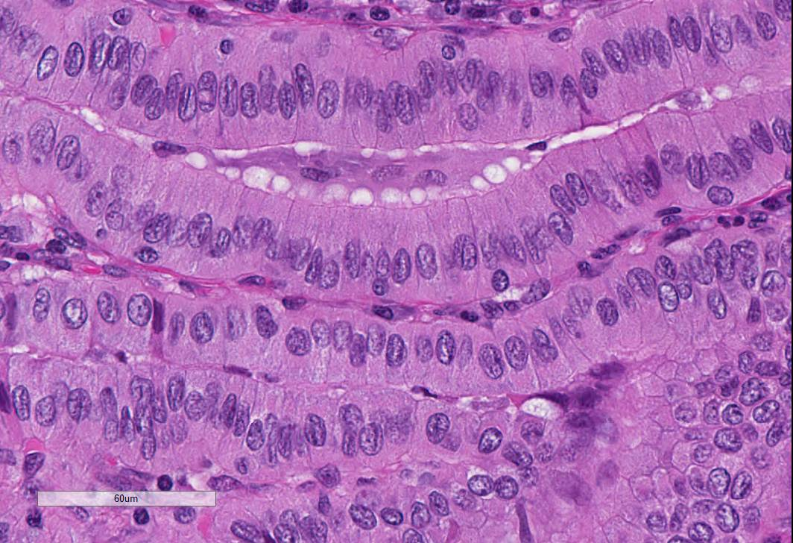

Slide 4
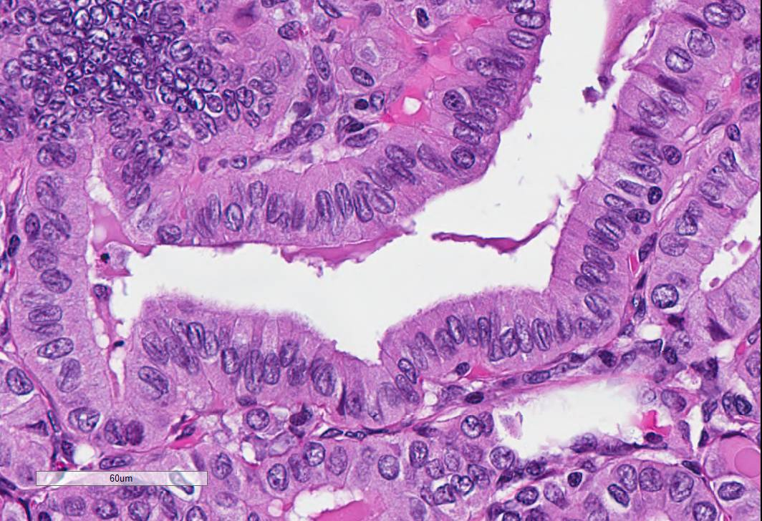

Slide 5
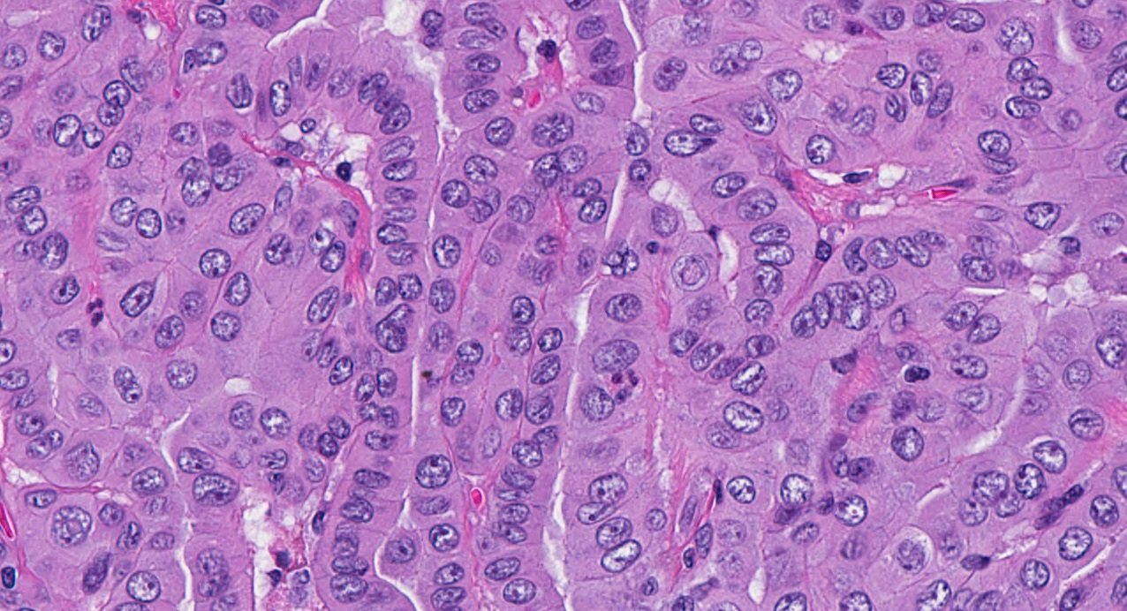

Slide 6
PTC with tall cell features
If tall cell features are > 10% but < 30%

Slide 7
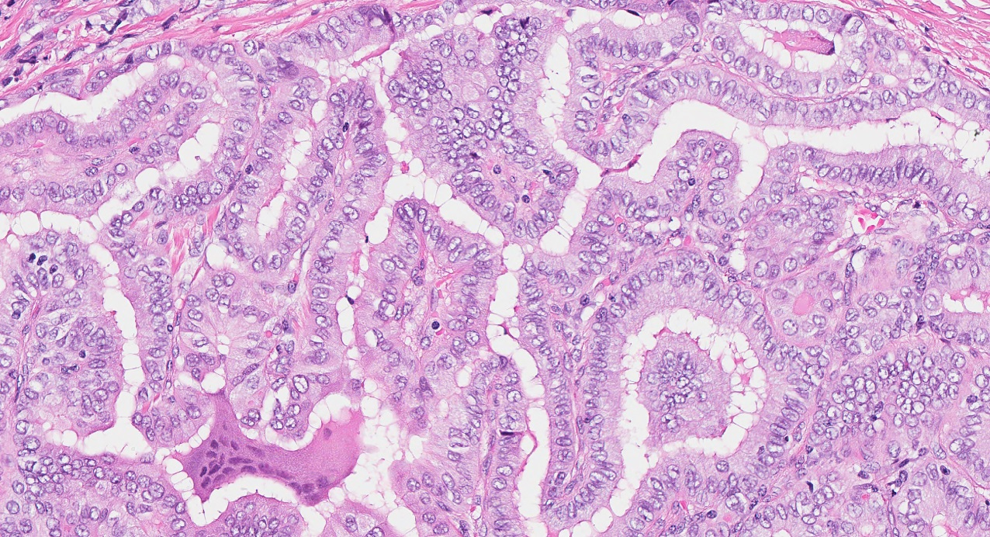

Slide 8
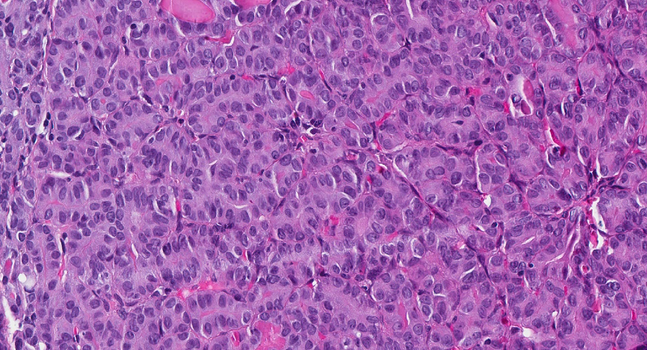

Slide 9
