Slide 1

بسم الله الرحمن الرحیم

Slide 2
Diabetes and depression
Akram.Beik Yazdi ,MD
Research Institute for Endocrine Sciences
Shahid Beheshti university of medical sciences
september, 2014, Tehran

Slide 3
Agenda
Overview of depression in DM2
Elevated Levels of hs-CRP and Associated With Prevalence of Depression in Japanese Patients With Type 2 Diabetes
The Association Between Depressive Symptoms and Systemic Inflammation in People With Type 2 Diabetes From the South London Diabetes Study
NIDDK International Conference Report on Diabetes and Depression

Slide 4
Introduction
The prevalence of depression and depressive symptoms is twice as common in individuals with type 2 DM compared with those without diabetes .
When depression and depressive symptoms are present, they are associated with worse glycemic control , an increased risk of microvascular and macro vascular diabetes complications and an increased risk of premature mortality
In prospective studies, the presence of depressive symptoms is associated with a 37–60% increased risk of incident type 2 diabetes, and there is a smaller reverse association of a 15–24% risk of incident depressive symptoms in those with DM2

Slide 5
Depression in the general population, when defined by diagnostic clinical interview, has a small but significant association with a systemic, cytokine mediated, chronic inflammatory state (a marker of activation of innate immunity) that differs according to subtype of depression .
Insulin resistance, type 2 diabetes, and CVD are also associated with a chronic low-grade inflammatory response due to activated innate immunity
In the last decade, several studies have been published that suggest a close association between diabetes and depression.

Slide 6
Multiple mechanisms are involved in the association between DM and inflammation, including modulation of lipolysis, alteration of glucose uptake by adipose tissue, and an indirect mechanism involving an increase in FFA levels blocking the insulin signaling pathway
Psychological stress can also cause inflammation via innervation of cytokine-producing cells and activation of the sympathetic nervous systems and adrenergic receptors on macrophages
Overproduction of inflammatory cytokines may stimulate CRH production, a mechanism that leads to hypothalamic- pituitary axis activity.
Conversely, cytokines induce depressive-like behaviors; in studies where healthy participants were given endotoxin infusions to trigger cytokine release, the participants developed classical depressive symptoms

Slide 7
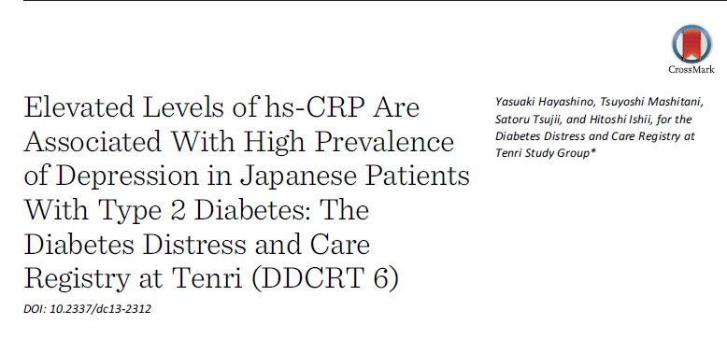

Slide 8
Introduction
Prospective studies have shown that raised acute phase proteins such as CRP and pro inflammatory cytokines such as IL-6, are associated with the onset of type 2 DM in cohorts with initially normal glucose tolerance .
Activated innate immunity is also a strong independent risk factor for CV events and mortality in the general population and in those with established type 2 DM
There have been similar observations of associations between inflammation and CVD ; in a cohort of people with depression, those with asymptomatic CVD had increased concentrations of markers of systemic inflammation .
Childhood adversity, a major rf for adult depression, is prospectively associated with higher concentrations of CRP in early adult life .
Depressive symptoms are associated with raised WBC in people with CVD

Slide 9
Based on this evidence, it could be hypothesized that inflammation is the common biological pathway underlying the association between DM and depression.
Recently, Doyle et al. examined the association between inflammation and elevated depressive symptoms, and they found that higher CRP levels were observed in patients with DM with depression than in those without.
Hypothese : High CRP levels were associated with the high prevalence of depression in patients with DM and that this association may be modified by obesity or glycemic control.

Slide 10
RESEARCH DESIGN AND METHODS
In brief, this study is a cohort study between Oct 2009 and Dec 2011.
Evaluation of psycho socio economic factors, biomarkers, and the incidence of micro- and macrovascular complications in patients with DM
The second year survey was performed from Jan to Dec 2011.
Excluded patients with pre diabetes diagnosed by an OGTT , GDM , type 1 DM, or DM induced by steroid use or other endocrinological diseases, and finally used data of patients diagnosed with type 2 diabetes.

Slide 11
In 2011, of all 4,332 eligible patients with diabetes
40.5% female patients with DM type 1 [4.6%] and type 2 [92.3%]
Mean [SD] age 65.6 [12.1] years,
4,197 provided consent to participate in the study
3,671 were confirmed to have type 2 diabetes.
Excluded 30 patients with missing data of hs-CRP levels and 67 patients who did not complete the PHQ-9.
The remaining 3,573 patients who met the inclusion criteria were included in the study.

Slide 12
Depression
The PHQ-9 has been validated as being appropriate for screening for depression in patients with DM and includes 9 items assessing 9 symptoms of depression as defined by the DSM-IV
Individuals who scored high (≥ 10) on the PHQ-9 were between 7 and 13.6 times more likely to be diagnosed with depression by the mental health professional.
Individuals scoring low (≤ 4) had a less than a 1 in 25 chance of having depression.
Major depression was diagnosed if 5 or more of the 9 depressive symptom criteria were present for at least “more than half the days” in the past 2 weeks and one of the symptoms was depressed mood or anhedonia
Physical exercise: measured using the short version of the IPAQ , a self-reporting instrument that asks for an estimate of total weekly physical activity (walking/vigorous and moderate-intensity activity) during the previous week and were categorized into (low, moderate, and high) categories

Slide 13
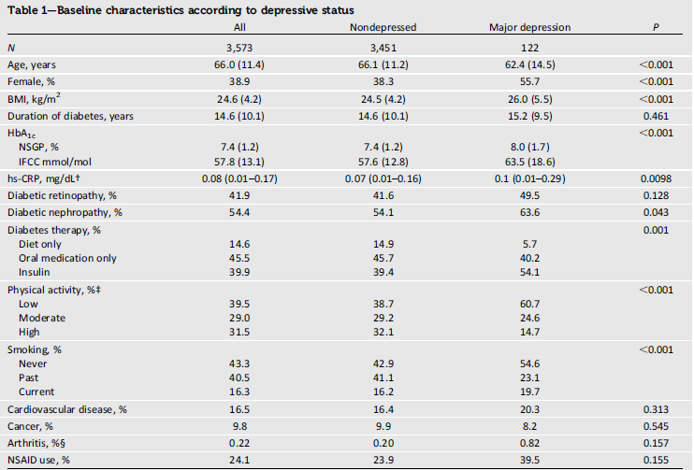
RESULTS

Slide 14
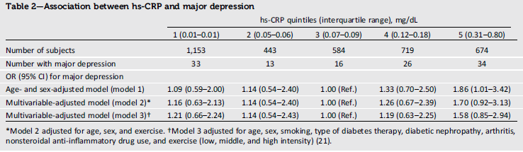

Slide 16
CONCLUSIONS
hs-CRP level was associated with a high prevalence of major depression in the age- and sex-adjusted model.However, multivariable adjustment diminished this association.
This finding is consistent with that of a previous study in which a crude association between inflammatory markers, including CRP, diminished after adjustment for clinical and demographic covariates in patient with type 1 DM
In our study, high hs-CRP were associated with a high prevalence of major depression in patients with type 2 DM if BMI was ≥25 kg/m2.
Hood et al evaluated the association between numerous inflammatory markers and depression in young patients (mean age 15.2 years) with type 2 DM
Even in a crude analysis, they did not identify a significant association between depression and inflammation in patients with DM.

Slide 17
Our study determined that several factors such as obesity and glycemic control may modify the association between inflammation and depression
It is well-known that exercise reduces the risk of developing type 2 diabetes, improves glycemic control in patients with diabetes, and improves the symptoms of depression
Long-term exercise reduced CRP in patients with DM
Based on these previous reports, our results suggest that inflammatory cytokines specifically from adipose tissue may play an important role in the association between type 2 DM and major depression , and exercise seems to be a strong confounder in this association between inflammation and depression in these patients.

Slide 18
Limitation
The first, the study was its cross-sectional design. Therefore, firm conclusions regarding the directions of the causality of the association between hs-CRP levels and depression in the current analysis cannot be drawn; however, we hypothesize a bidirectional association.
Second, we used self-reported measures to define major depression
Third, residual confounders may exist in the association with depression, such as socioeconomic status or marital status; however, we did not have sufficient data on these variables.
Forth, we did not have enough data on whether patients suffered from acute infections.
Finally, data were derived from the registry of a single diabetes center, thereby raising concerns regarding generalizations derived from the results, particularly for the multiethnic North American and European populations.

Slide 19
Key messages
hs-CRP levels were associated with a high prevalence of major depression in patients with type 2 DM with a BMI of ≥25 kg/m2.
This association was significant after adjustment for possible confounders.
The causality of this association remains unclear and requires evaluation in a future prospective study

Slide 20
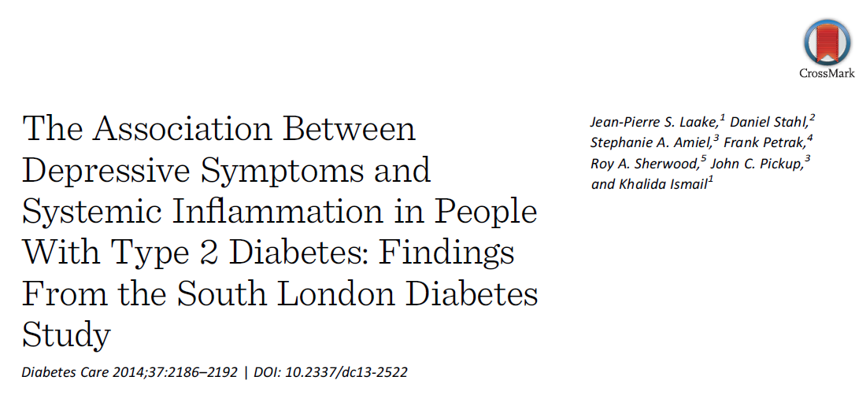

Slide 21
Hypothesis : the presence of depressive symptoms was associated with increased concentrations of circulating inflammatory markers in a cohort of newly diagnosed type 2 DM patients

Slide 22
RESEARCH DESIGN AND METHODS
Design The study used a population-based, cross-sectional design with the baseline participants in the South London Diabetes Study (SOUL-D), which is a prospective cohort study designed to test the relative effects of psychological and social factors on biomedical outcomes in people with newly diagnosed type 2 diabetes.

Slide 23
Setting and Sampling Frame
The study was set in South London, which collectively have ;0.75 million U.K. residents from diverse socioeconomic and ethnic background, with 66% white, 20% African/Caribbean, and 14% South Asian and other .
All 138 general practices were invited to participate, and this constituted the sampling frame.
Every 6 months, each diabetes register was searched for patients with a new diagnosis of type 2 diabetes

Slide 24
Study Population and Case Definition
People with a first (<6 months) diagnosis of type 2 diabetes according to WHO criteria
Aged between 18 and 75 years at diagnosis, were identified from diabetes registers of participating general practices and invited to participate.
Between May 2008 and September 2012
Main Explanatory Variables:
Selected 12 inflammatory markers identified a priori as associated with type 2 diabetes and/or depres.
Serum CRP was measured by a hs CRP

Slide 25
Main Outcome Variable
The presence of depressive symptoms at baseline was measured using PHQ-9.
This is a self-report measure that was developed for primary care to aid clinicians in identifying probable cases of depression.
A cutoff score of ≥ 10 is the optimal threshold for identifying probable cases of depression, with a sensitivity of 73% and specificity of 98% whereas those with a score <10 were defined as non depressed participants.
The PHQ-9 has acceptable validity in diabetes population

Slide 26
RESULTS:
Of 139 general practices invited, 96 (70%) agreed to participate, from which 1,790 participants with newly diagnosed type 2 diabetes were recruited.
There were>25% missing answers from PHQ-9 scores in 21 (1.2%) participants, so these were excluded and the analyses were conducted on n = 1,769 (98.8%).
Analyses of inflammatory markers were conducted on a subset of the cohort ( n = 1,227 (69%))
Those who had missing sample or unanalyzable (n=542):
Younger (mean age 57 [11] vs. 55 [11] years, P , 0.001)
More likely to be of black African or Caribbean ethnicity (36 vs. 50%, P , 0.001),
No statistically significant differences in sex (55 vs. 56% male, P = 0.83),
PHQ-9 depression cases (13.6 vs. 17.8%, P = 0.08), HbA1c 6.97% vs. 7.09% P = 0.148

Slide 27
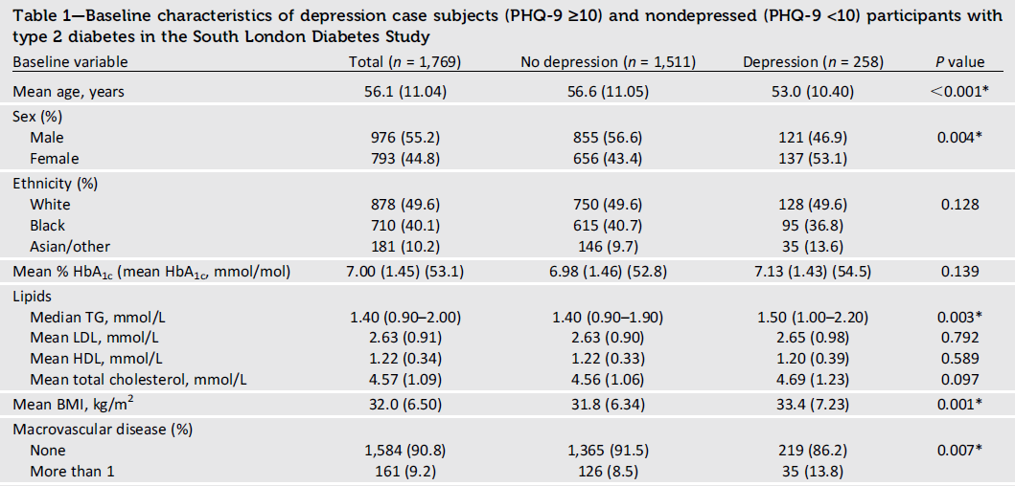

Slide 28
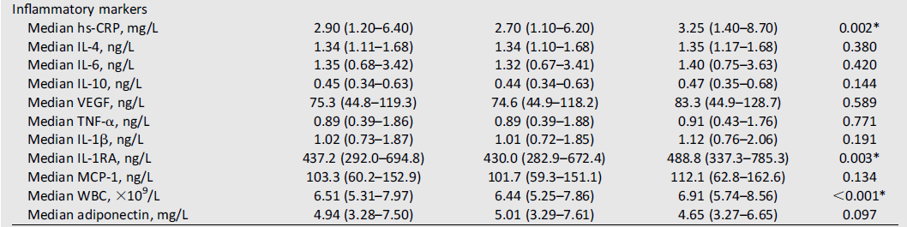

Slide 30
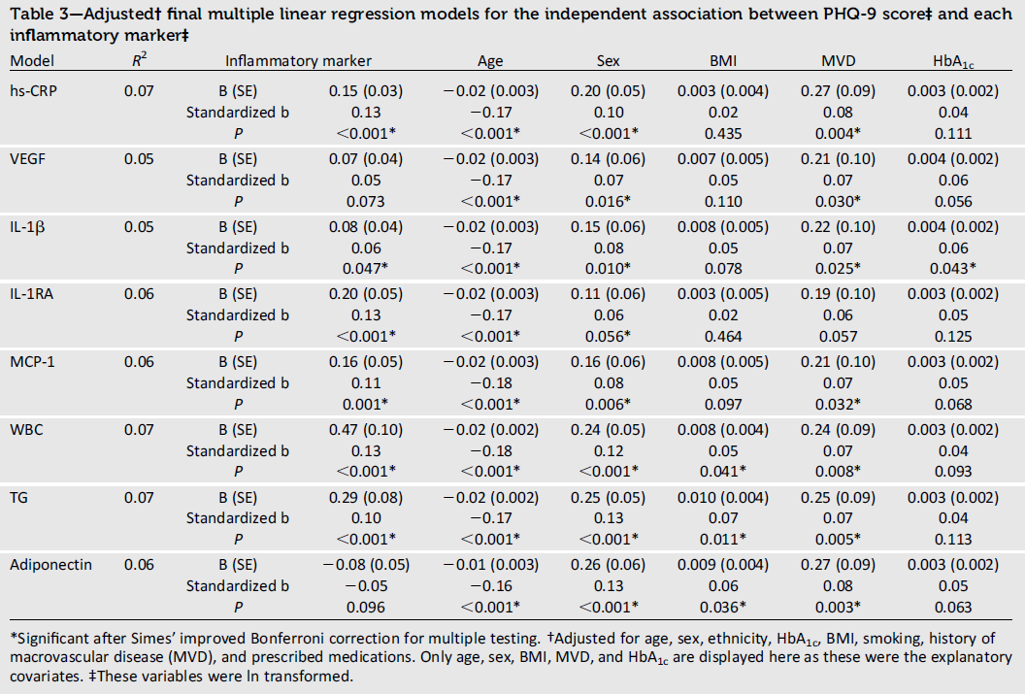

Slide 31
CONCLUSIONS
We found that depression case subjects as defined by the PHQ-9 were younger, more overweight, had more macro vascular disease, and had higher circulating concentrations of several established inflammatory markers.
After adjusting for relevant potential confounding variables, including adiposity, age, sex, ethnicity, smoking, HbA1c, DM complications, and medications with anti-inflammatory action, the association between depressive symptoms and hs-CRP, IL-1b, IL-1RA, MCP-1, WBC, and TG remained significant
Strength of the study :
Chose a large range of inflammatory markers that have been implicated in the pathogenesis of type 2 DM and/or depression ordepressive symptoms

Slide 32
Used a population-based primary care sample that aims to reduce selection bias.
Using a cohort design allowed us to include and adjust for a range of potential confounding variables linking innate immunity, inflammation, and depressive symptoms in type 2 diabetes, including diabetes-related medications that have anti-inflammatory properties, such as statins, systemic steroids, and NSAIDs.
As these type 2 diabetes patients were newly diagnosed (<6 months), only 63 (4%) were on insulin therapy. Insulin therapy was equally prescribed in those who were depression case subjects versus those who were not but could otherwise have been a significant confounder

Slide 33
Limitation
The main limitation of these data are that they are cross-sectional, so a causative link between inflammatory markers, depressive symptoms, and type 2 diabetes cannot be inferred.
When we defined a case of depression using a PHQ-9 cutoff ≥10, we did not confirm a diagnosis of major depression using a clinical interview.
Thus we may have overestimated its prevalence because although this cutoff has a high sensitivity, this comes at the expense of a lower specificity in diabetes patients

Slide 34
We did not adjust for antidepressants because there is no systematic pooled evidence from RCT or observation studies to support a direct pro- or anti-inflammatory effect.
There is a risk of residual confounding for poor adherence to medication, which we could not measure, although our medication data were derived from current general practitioner prescription records

Slide 35
There was a small risk that comorbid acute or chronic inflammatory conditions may have been included, which could have led to an overestimation of effects, but terminal and advanced conditions were exclusion criteria
We did not adjust for ERT or any potential inflammatory effects of pre menopause, but the majority of our female population was post menopausal.
We did not include diet and physical activity because self-report measures are not sufficiently accurate, but we used BMI.

Slide 36
It has been suggested that the increased risk of complications in type 2 DM with depression and depressive symptoms may be related to poorer glucose control (elevated HbA1c), but in the current study, we did not find significantly raised HbA1c in those who were depression case subjects.
However, as we studied newly diagnosed type 2 DM, most patients had not had the opportunity to improve their glycemic control and so the negative impact of the behavioral effects of depression on self-care and glycemic control that others have observed may not have been identifiable at this stage

Slide 37
It should be noted that glycemic control does not improve when depression alone is treated , which argues against the association between depression or depressive symptoms and poor glycemic control being mediated by reduced self-care behaviors alone.
Inflammation may have a role in the pathogenesis of depression and depressive symptoms via numerous mechanisms, including altering the metabolism and activity of monoamine transmitters, effects on neurogenesis and neuroplasticity, and activation of the hypothalamic-pituitary axis .
The increased concentrations of the inflammatory markers we detected in newly diagnosed type 2 diabetes participants with increased depressive symptom scores, independent of HbA1c and BMI, support an alternative hypothesis that activated innate immunity is involved in the etiology of depression and/or the increased complications associated with it in type 2 diabetes.

Slide 38
We found that IL-1b, a pro inflammatory cytokine, was positively associated with depressive symptoms as was IL-1RA, which blocks IL-1b from binding to its receptor.
Adiponectin, negatively associated with depressive symptom score in our data
In our data, the association between adiponectin and depressive symptom score was attenuated when adjusting for BMI, which was also a significant explanatory covariate in the final models for the association of PHQ-9 with WBC and TG. This suggests that some of the increased inflammation and the reduced concentrations of adiponectin that we detected in this group are associated with the increased adiposity

Slide 39
LIMITATION
First, although depression is recognized as a complication of established type 2 diabetes, we found that even at diagnosis, up to 15% of patients had probable clinical depression.
This underlines the importance of recent ADA guidelines alerting diabetes physicians to the need to screen, identify, and treat depression at the earliest stages of diabetes .
Second, the association of a higher degree of systemic inflammation with a higher depressive symptom score may explain the increased risk of macrovascular disease and mortality in this group
This may explain why treating depression does not necessarily improve diabetes outcomes , as the increased inflammation and accelerated disease pathology may not be resolved when using conventional pharmacological and psychological treatments for depression

Slide 40
Key messages
Inflammation in type 2 DM may cause the parallel development of depressive symptoms and atherosclerosis .
Anti-inflammatory therapies may influence both the course of diabetes and depressive symptoms, as has been suggested in the case of CVD; this hypothesis now needs testing.
More depressive symptoms and type 2 DM have higher circulating concentrations of inflammatory markers than people with diabetes with less depressive symptoms.
Studies are needed to examine whether the concentrations of inflammatory markers at diagnosis of DM predict the later development of depressive symptomology

Slide 41
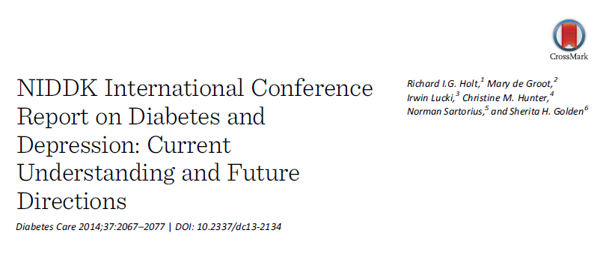

Slide 42
INTRODUCTION
In October 2012, NIDDK of NIH, in collaboration with the National Institute of Mental Health and the Dialogue on Diabetes and Depression , convened a meeting of experts from 15 countries.
This article summarizes the evidence-based presentations and discussions during the meeting and synthesizes the scientific content and future research recommendations

Slide 43
The structure of the article follows the format of the conference presentations, which were divided into three main areas:
1) The mechanisms and pathogenesis underlying the depression-diabetes association
2) Treatment of diabetes and depression
3) Prevention and public health consideration of the two disorders

Slide 44
METHODOLOGICAL CONSIDERATIONS IN DEFINING DEPRESSION
The term “depression” covers a range of problems that span minor occasional negative mood states to incapacitating and treatment-resistant disorders.
The definition of “depression” varies markedly across studies ranging from high levels of self-reported depressive symptoms to diabetes-related distress to formal psychiatric diagnoses.
Variability of measurement and use of terminology have contributed to heterogeneity and inconsistency in the reported results of prevalence and treatment outcomes
In this report, we have specified the definition of depression where indicated by speakers.

Slide 45
PREVALENCE AND INCIDENCE OF DIABETES AND DEPRESSION
Prevalence rates for depressive symptoms range in DM patient from 12–27% across studies , while rates of depressive disorders, as assessed by psychiatric interview protocols, range from 8–15%
The rates of depression, anxiety, and distress are also elevated in children and young adults with type 1 diabetes compared with the general population with prevalence rates ranging from 10–26%.
In adolescents with type 2 diabetes (8.6–14.8%).
Rates of diabetes-related distress have been shown to be higher (54%) than rates of psychiatrically diagnosed depression

Slide 46
Impact of Comorbid Depression and Diabetes
In adults, only a weak relationship between depression and glycemic control
There is a stronger association between comorbid depressive symptoms and a range of diabetes complications , although this was not observed in ACCORD trial
Increased health care costs , worsened functional disability ,and early mortality are seenin adults with comorbid DM and depression compared with either condition alone
Higher mortality among those with diabetes and depression is attributable to a variety of medical causes rather than CVD as previously assumed and is not wholly explained by traditional risk factors .
In children and adolescents, depressive symptoms are associated with poorer glycemic control and predict re hospitalization and retinopathy in type 1DM

Slide 47
MECHANISMS AND PATHOGENESIS UNDERLYING THE ASSOCIATION BETWEEN DIABETES AND DEPRESSION
Previous epidemiological studies have demonstrated a bidirectional association between depression and diabetes.
Studies showing higher rates of depression in people with diagnosed diabetes compared with undiagnosed diabetes support this model .
The increased rate of DM in people with depression has been attributed to obesity-promoting health behaviors, such as physical inactivity and poor dietary habits.
Non adherence to self care routines in those already diagnosed with DM and experiencing depressive symptoms has also been found, such that a 1-point increase in depressive symptom score was found to be associated with a 10% increased risk of non adherence to fruit and vegetable intake and foot care .

Slide 48
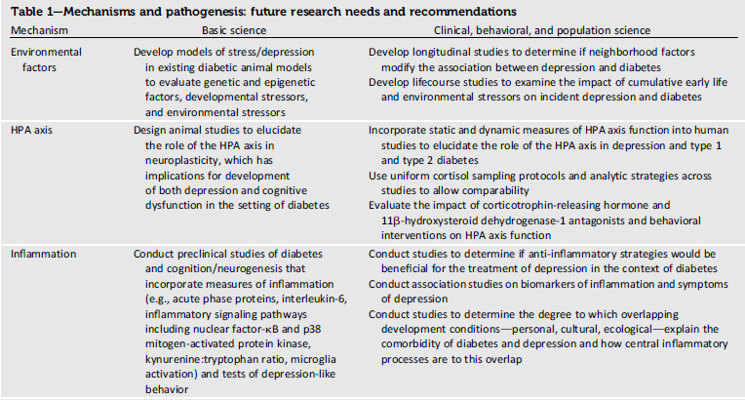

Slide 49
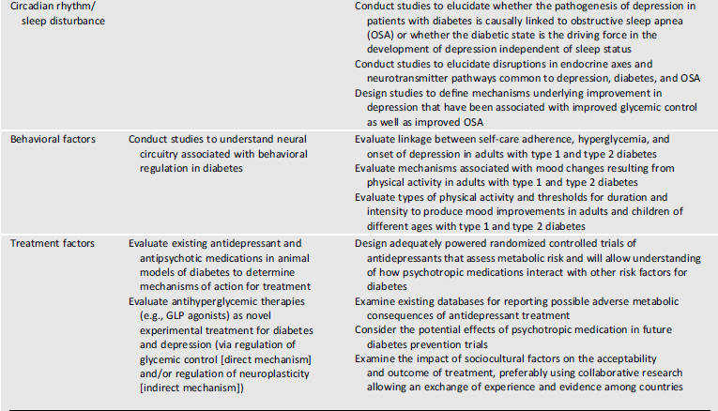

Slide 50
Current research also supports a contribution of biological changes in diabetes, such as structural, functional, and neurochemical changes in the brain regions responsible for affect and cognition in both type 1 and type 2 diabetes that may increase the risk of depression .
Specifically, animal models have shown that diabetes and hyperglycemia negatively affect hippocampal integrity and neurogenesis, reducing neuroplasticity and contributing to mood symptoms in diabetes.
In humans, hippocampal neurogenesis can be indirectly assessed via MRI, and hippocampal atrophy has been observed in people with diabetes

Slide 51
Intrauterine Environment
The earliest influence is the intrauterine environment and early life conditions, such as fetal under nutrition and stress and maternal stress, which can lead to LBW and a predisposition to adult diabetes .
Animal studies have shown an adaptive slowing of fetal growth rate and modification of organ structure in response to under nutrition .
The data about the relationship between adverse intrauterine environment and risk for depression in adulthood remain inconclusive, with some studies suggesting a positive association while others have null findings
Both LBW and fetal over exposure to cortisol secondary to maternal stress have been associated with HPA axis programming and elevated cortisol reactivity in childhood, adolescence, and adulthood, predisposing the individual to stress-related and metabolic disorders

Slide 52
External Environment
Several contextual factors, including childhood adversity (possibly mediated through increased adult CRP concentration ), neighborhood environment, and poverty, also influence the predisposition to depression and diabetes.
Poorer neighborhood physical environment (e.g., physical disorder, traffic, noise, decreased walkability) is associated with worse diet, lower physical activity , obesity, and diabetes .
Worse neighborhood social environment (e.g., lower social cohesion and social capital, increased violence, decreased residential stability) is associated with higher rates of depressive symptoms and mental health problems
Adverse neighborhood environments have also been associated with dysfunctional HPA axis activity and disruption of its normal circadian rhythm as well as enhanced inflammation

Slide 53
Common Interrelated Biological
Both diagnosed major depression and diabetes are associated with HPA axis dysfunction, which manifests as subclinical hyper cortisolism, blunted diurnal cortisol rhythm, or hypo cortisolism with impaired glucocorticoid sensitivity, and increased inflammation.
Disrupted sleep patterns are seen in people with major depression , and poor sleep quality and altered circadian rhythms are associated with insulin resistance and type 2 diabetes risk
All these biological pathways are activated in major depression and are associated with insulin resistance.
A recent meta-analysis showed that depressive symptoms are weakly associated with IR, providing a potential link to incident type 2 diabetes

Slide 54
Pathways Related to Medications for
Depression
While there have been concerns that certain antipsychotic medications, particularly some of the “atypical” or second-generation antipsychotic medications, are associated with a 2 to 3 fold increased risk of diabetes.
Cohort studies show a small increased risk of diabetes in those receiving antidepressant medications.
RCT, have emphasized that anti depressants vary considerably in weight gain and glycemic effects, ranging from hyperglycemic to hypoglycemic effects.
Remains unclear whether the weight gain results from poorly treated depression or a medication side effect.

Slide 55
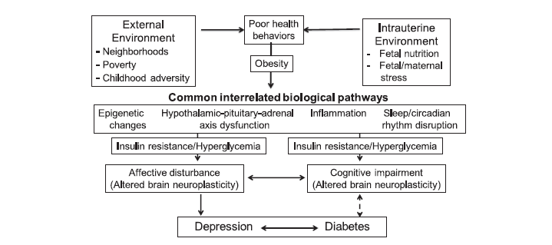

Slide 56
Research Recommendations: Mechanisms
Two important gaps.
First, many studies have been cross-sectional
Second, longitudinal studies typically capture a snapshot in the prospective associations between depression and diabetes when, in reality, these associations are influenced by exposures over the life course.
To address these critical gaps, prospective life course studies are needed in both animals and humans with detailed phenotypic characterization of the intrauterine environment and the external environment .

Slide 57
TREATMENT OF DIABETES AND DEPRESSION
Until recently, people with DM were specifically excluded from depression treatment trials in the general population, and consequently, there are relatively few studies examining antidepressant and psychotherapy treatment of depression that specifically focus on diabetes
Psychotherapy
Protocols predominantly used cognitive behavioral therapy (CBT) delivered individually by mental health providers or trained nurse case managers and are effective in reducing depressive symptoms
There are mixed effects on glycemic control, interventions that combine diabetes self-management education reported benefits for glycemic control

Slide 58
More research is needed to test alternative behavioral intervention approaches for treating diabetes and depression (e.g., electronic-based health [eHealth] intervention, exercise, mindfulness based stress reduction.
For example, trials of e Health and mobile technology– based health (m Health) interventions suggest that these are less effective than face-to-face psychotherapeutic treatments
There is a lack of evidence for psychotherapy that specifically addresses depression in children with type 1 or type 2 diabetes.
Brief behavioral interventions with families of children with DM 1 have been found to be effective in improving adherence to self-care behaviors and Hb A1C

Slide 59
Antidepressants
Antidepressant medications lead to amelioration of depressive symptoms and resolution of major depression in people with either type 1 or type 2 diabetes, but have mixed effects on glycemic control ranging from hyperglycemic effects with TCA medications to euglycemic or slightly hypoglycemic effects with SSRI and SNRI.
Fewer than half of the commonly prescribed medications of these types have been tested for their effects on glycemic control in people with diabetes.
The subsequent TEAM care approach combined behavioral and pharmacological treatment , leading to positive outcomes for depression and glycemic, SBP, and LDL cholesterol control and reduced costs

Slide 60
Treatment Modalities and Delivery
Depression Screening
The use of locally standardized screening instruments, such as PHQ9
Despite well-understood differences in the etiology and pathophysiology of type 1 and type 2 diabetes, existing treatment studies have examined mixed populations making generalizations about treatment efficacy of antidepressant medications or psychotherapy by diabetes type difficult .
Sample sizes for subgroups of people with type 1 diabetes within existing studies are too small to allow stratified analyses to determine similarities or differences in treatment modalities and outcomes compared with adults with type 2 diabetes.

Slide 61
The most common psychotherapeutic approach used to treat comorbid diabetes and depression is CBT.
There is also a need to expand treatment modalities beyond CBT to include additional approaches, such as exercise and/or community-based programs.
There is also evidence that exercise contributes to diabetes management. Yet, there are few trials that have evaluated this approach as potentially synergistic in treating comorbid depression and diabetes
People with comorbid mental illness are less likely to be offered screening for glycated hemoglobin or cholesterol, statin therapy, or diabetes education or be examined for microvascular complications, despite more clinic visits.
By contrast, depressive and other mental disorders are often missed and inadequately treated if the focus of care is the medical condition

Slide 62
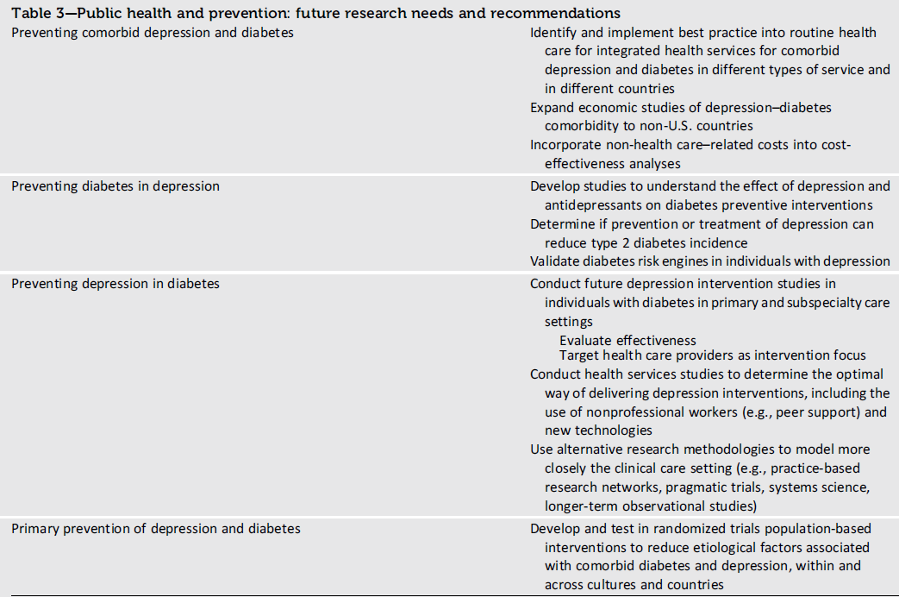

Slide 63
Prevention of Diabetes in People With
Depression
In DPP, a population with pre diabetes at enrollment, those taking anti depressants had a higher risk of developing diabetes than those not taking antidepressants in the placebo and lifestyle intervention arms, while the risk was lower in the metformin arm who did not receive lifestyle intervention and elevated depressive symptoms did not predict development of diabetes
This study excluded those with severe depression and the wide confidence intervals of the findings make it unclear whether these findings can be extrapolated to a broader population of people with depression.

Slide 64
Prevention of Depression in People With Diabetes
Many risk factors that predict the onset of depression in the general population are equally applicable to people with diabetes, but there are several diabetes specific factors, such as the development of complications and the need for insulin treatment in people with type 2 diabetes , that are associated with an increased prevalence of depression.
Despite our understanding of the epidemiology, there has been little research into the prevention of depression in people with diabetes
This is also true in people without diabetes, where most interventions have focused on secondary prevention.
A recent systematic review concluded that there was inadequate evidence to determine the clinical effectiveness or cost-effectiveness of low-intensity psychological interventions to prevent relapse or recurrence of depression .

Slide 65
Primary Prevention of Depression and Diabetes
There are many shared risk factors for diabetes and depression, suggesting that diabetes and depression may be two manifestations of a common set of psychological, lifestyle, and biological perturbations.
It is therefore possible that population approaches that focus on the common ground between diabetes and depression and the behaviors that relate to both may allow the effective prevention of both conditions, but this area is largely not researched.

Slide 66
Research Recommendations:
Prevention and Public Health Considerations
Future trials are needed to address these issues.
It is unclear whether effective prevention or treatment of depression can reduce incidence of type 2
The interaction of depression and anti depressants on interventions to prevent diabetes
When and how interventions to prevent depression can be introduced in people with diabetes

Slide 67
Key messages
The association between diabetes and depression or depressive symptoms is a major public health problem.
In prospective studies, the presence of depressive symptoms is associated with a 37–60% increased risk of incident type 2 diabetes, and there is a smaller reverse association of a 15–24% risk of incident depressive symptoms in those with type 2 diabetes
Insulin resistance, type 2 diabetes, and CVD are also associated with a chronic low-grade inflammatory response due to activated innate immunity
Current research also supports a contribution of biological changes in diabetes, such as structural, functional, and neurochemical changes in the brain regions responsible for affect and cognition in both type 1 and type 2 diabetes that may increase the risk of depression .

Slide 68
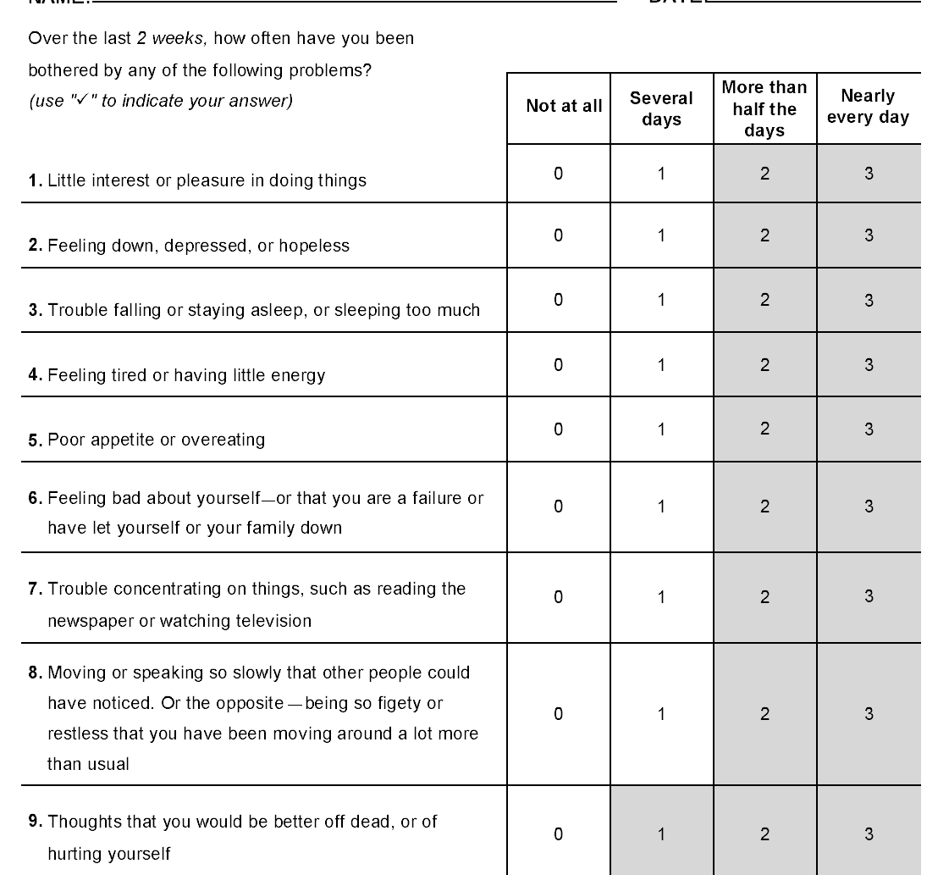

Slide 69


Slide 70


سپاس

