Slide 1
Research Methodology Measurement Errors
Davood Khalili, MD, MPH, PhD
Department of Biostatistics & Epidemiology
Research Institute for Endocrine Sciences
Shahid Beheshti University of Medical Sciences

Slide 2
Errors in Research
Systematic
Cause in: Invalidity & Spurious association
Random
Cause in: unreliability & Diluted association
Confounding
Cause in: a relationship but not causal association

Slide 3
Random Error
Deviations from the true value that
occur in a random chance pattern
frequency
the distribution of X with no random error
X

Slide 4
Random Error
Deviations from the true value that
occur in a random chance pattern
the distribution of X with random error
frequency
the distribution of X with no random error
X

Slide 5
Random Error
Deviations from the true value that
occur in a random chance pattern
the distribution of X with random error
frequency
the distribution of X with no random error
X
Notice that random error doesn’t
affect the average, only the
variability around the average

Slide 6
Systematic Error
Any process at any stage of inference which tends to produce results or conclusions that differ systematically from the truth
frequency
the distribution of X with no systematic error
X

Slide 7
Systematic Error
Any process at any stage of inference which tends to produce results or conclusions that differ systematically from the truth
the distribution of X with systematic error
frequency
the distribution of X with no systematic error
X

Slide 8
Systematic Error
Any process at any stage of inference which tends to produce results or conclusions that differ systematically from the truth
the distribution of X with systematic error
frequency
the distribution of X with no systematic error
X
Notice that systematic error does
affect the average -- we call this a bias

Slide 9
The Error Component
X
T
+
e
Two Components:
e_{r} (Random Error)
e_{s} (Systematic Error)

Slide 10
RELIABILITY AND VALIDITY
Not reliable
Biased (Not valid)
Reliable
Biased (Not valid)
Not reliable
Somehow valid
Reliable
Valid
In Random error measurement is not reliable.
In Systematic error measurement is biased (not valid).

Slide 11
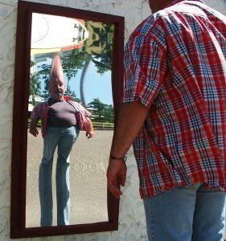

Slide 12
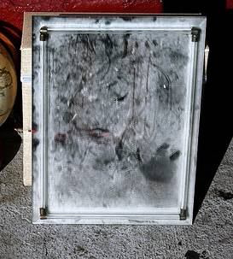

Slide 13
Errors in Research
Systematic
Cause in: Invalidity & Spurious association
Random
Cause in: unreliability & Diluted association
Confounding
Cause in: a relationship but not causal association

Slide 14
Selection Bias
the way in which cases and controls, or exposed and nonexposed individuals, are selected such that an apparent association is observed
Reference Population
Disease –
Exposure –
Disease +
Exposure -
Disease –
Exposure +
Disdease +
Exposure +
Study Sample

Slide 15
Selection Bias
Non-response Bias
Exclusion Bias
Berksonian Bias
Healthy worker effect
Differential losses to follow-up

Slide 16
Information Bias
a systematic tendency for individuals selected for inclusion in the study to be erroneously placed in different exposure/outcome categories, thus leading to misclassification.
Reference Population
Disease –
Exposure –
Disease +
Exposure -
Disease –
Exposure +
Disdease +
Exposure +
Study Sample

Slide 17
Information Bias
Exposure Identification Bias:
- Recall Bias
- Interviewer Bias
Outcome Identification Bias:.
- Observer Bias
- Respondent Bias

Slide 18
Systematic errors nearly always cannot be corrected.
Sometimes they can be estimated using some advanced epidemiological methods.

Slide 19
Errors in Research
Systematic
Cause in: Invalidity & Spurious association
Random
Cause in: unreliability & Diluted association
Confounding
Cause in: a relationship but not causal association

Slide 20
Random errors almost always cannot be corrected.
Routinely, they are estimated using statistical methods (i.e. Confidence Interval and p-value)

Slide 21
(Background) Errors in Research
Systematic
Cause in: Invalidity & Spurious association
Random
Cause in: unreliability & Diluted association
Confounding
Cause in: a relationship but not causal association

Slide 22
Considering 3rd Factor(S) in Causality
3rd variable(s)
Exposure
1st var
Outcome
2nd var

Slide 23
Kinds of RELATIONSHIPS OF 3rd VARIABLE(S) IN RESEARCH
CONFOUNDING
MEDIATION
COLLINEARITY
EFFECT MODIFICATION
(INTERACTION OR MODERATION)

Slide 24
A confusion of effect

Slide 26
The most applicable method

