Slide 1
Fracture risk prediction
F. Hosseinpanah, M.D.
Obesity Research Center
Research Institute for Endocrine sciences
Shahid Beheshti University
of Medical Sciences
janurary 11, 2018

Slide 2
Agenda
RFs for Fracture
Ways to express fracture risk
FRAX
BMD changes
TBS
Conclusions

Slide 3
Bone Mass
Bone Strength
Geometry
Microarchitecture
Bone turnover

Slide 4
Bone Strength
FRACTURE
Falls
Padding
Postural Reflexes

Slide 5
Risk factors for fracture
Age
BMD
Clinical risk factors

Slide 6
Risk factors for fracture
Age
BMD
Clinical risk factors

Slide 7
Fracture Risk
BMD is well correlated with bone strength by biomechanical testing
Relationship between BMD and fracture risk is exponential
BMD overlaps in patients with and without fracture

Slide 8
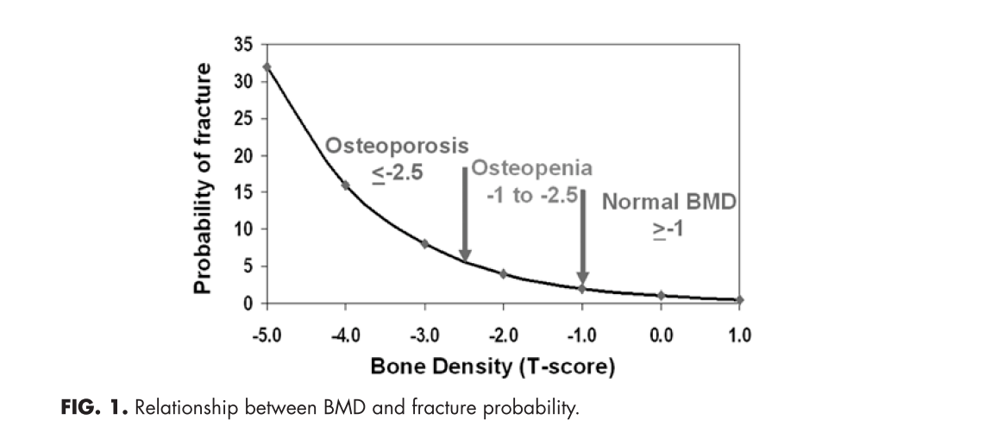
There is not a fracture threshold below which all osteoporotic fractures occur, rather ,there is a continuum of risk proportional to the decrease in fracture risk

Slide 9
Bone Density & Age vs. Fracture Risk
Age
80
70
Ten Year Fracture Probability (%)
60
50
Probability of first fracture of hip, distal forearm, proximal humerus, and symptomatic vertebral fracture in women of Malmö, Sweden.
Adapted from Kanis JA et al. Osteoporosis Int. 2001;12:989-995.

Slide 10
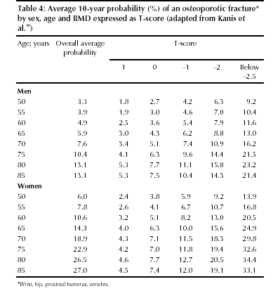

Slide 11
RR of Fx for 1 SD decrease in BMD (age-matched)
Site | Hip Fx | vertebral Fx
Distal radius | 1.8 | 1.7
Proximal radius | 2.1 | 2.2
Calcaneous | 2.0 | 2.4
Spine | 1.6 | 2.3
Femoral neck | 2.6 | 1.8
(marshall D,et al,BMJ. 1996:,312:1254)

Slide 12
Risk factors for fracture
Age
BMD
Clinical risk factors

Slide 13
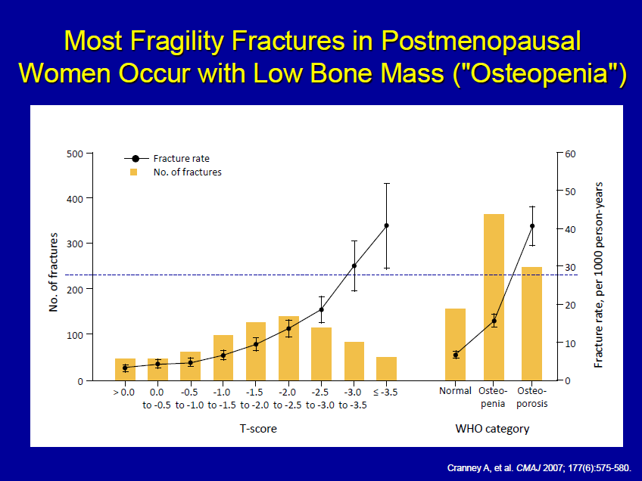

Slide 14
Validated Risk Factors
Advanced age
Previous fracture
Long-term glucocorticoid therapy
Low body weight (less than 58 kg [127 lb])
Family history of hip fracture
Cigarette smoking
Excess alcohol intake

Slide 15
Strongest non-BMD predictors
Age
Prior fragility fracture
Kanis JA; Borgstrom F; De Laet C; Johansson H; Johnell O; Jonsson B; Oden A; Zethraeus N; Pfleger B; Khaltaev N SO - Osteoporos Int 2005 Jun;16(6):581-9

Slide 16
Previous Fx and relative risk for future Fx
 | Wrist | Vertebra | Hip
Wrist Fx | 3.3 | 1.7 | 1.9
Vertebral Fx | 1.4 | 4.4 | 2.3
Hip Fx | NA | 2.5 | 2.3

Slide 17
Way to express fracture risk
Relative risk (RR of Fx for every SD difference in BMD compared to a young normal or age matched population with normal BMD )
Absolute Risk ( fracture risk per 1000 person years , 50% of women over 80 have osteoporosis)

Slide 18
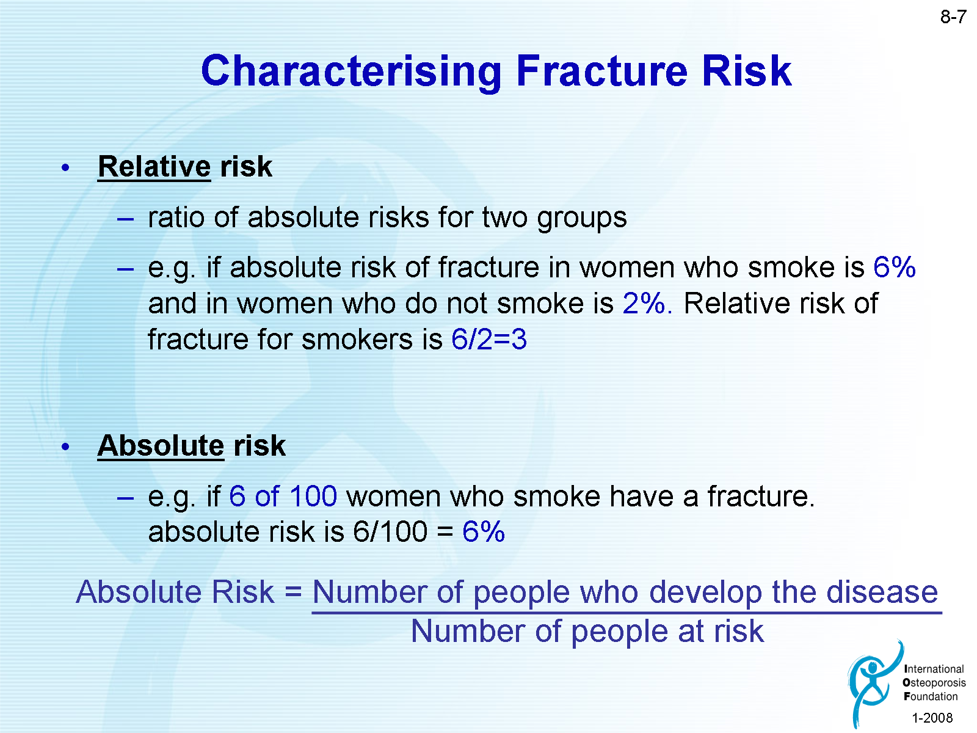
Notes:
Relative risk is used in drug trials and compares the risk of those on treatment compared to those on placebo.
The absolute risk is the risk to an individaul in any given time period. It equals the number of people who develop the disease divided by the number of subjects at risk. Usually expressed as a percentage.

Slide 19
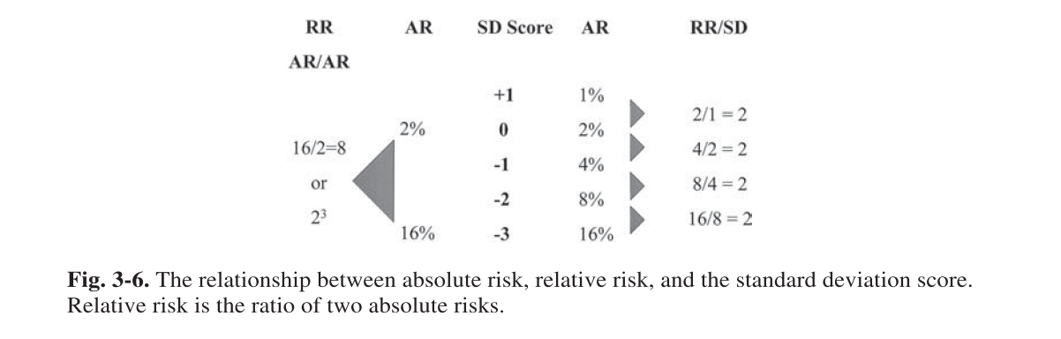

Slide 20
RR of Fx for 1 SD decrease in BMD (age-matched)
Site | Hip Fx | vertebral Fx
Distal radius | 1.8 | 1.7
Proximal radius | 2.1 | 2.2
Calcaneous | 2.0 | 2.4
Spine | 1.6 | 2.3
Femoral neck | 2.6 | 1.8
(marshall D,et al,BMJ. 1996:,312:1254)

Slide 21
T SCORE AND RISK OF FRACTURE
For each decrease of one SD in T-score
RR for hip fracture :2.6
RR for vertebral fracture:2.3
2^{t Score}
70-year-old.femoral neck T-score -4
Compared to 70-year-old T-sore -2 RR=2.6 = 6.8
Compared to 70-year-old T-sore 0 RR=2.6 = 45.7
2
4

Slide 22
Limitations of RR
If the absolute risk for fracture in group A is 50% compared to the absolute risk for fracture of 25% in group B, the relative risk of group A compared to group B is 2 (50% ÷ 25% = 2)
The relative risk would also be 2, however, if the absolute risk in group A was 2% and the absolute risk in group B was 1% (2% ÷1% = 2)

Slide 23
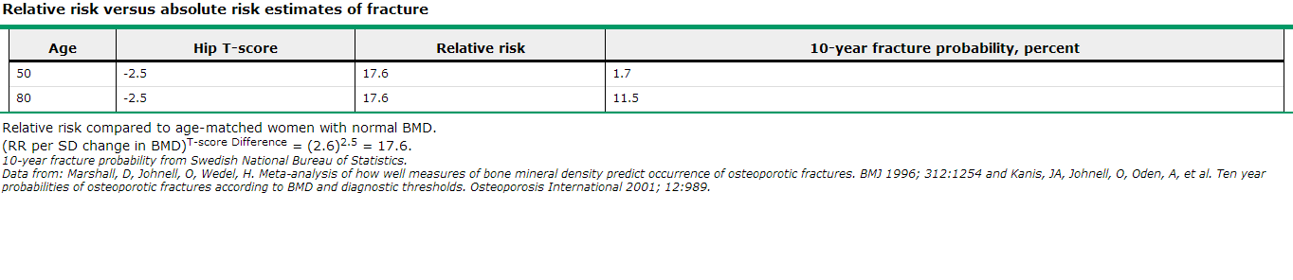

Slide 24
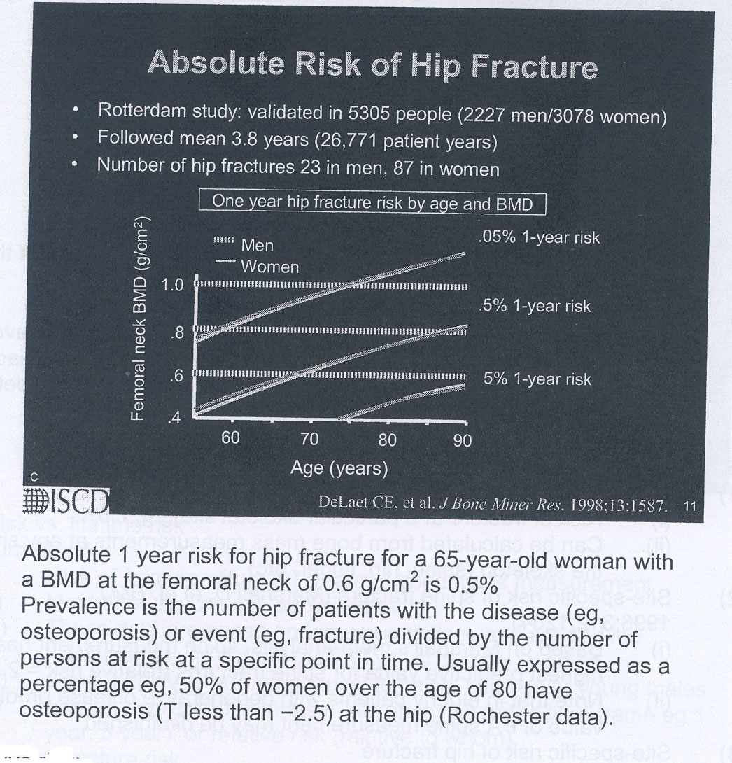

Slide 26
Baseline DXA Report: Minimum Requirements
A statement about fracture risk. Any use of relative fracture risk must specify the population of comparison (e.g., young- adult or age-matched)
The ISCD favors the use of absolute fracture risk prediction when such methodologies are established
2015 ISCD Official Positions – Adult

Slide 27
FRAX
WHO Absolute Fracture Risk Model

Slide 28
Toward a risk calculator
BMD
PRE OR POSTMENOPAUSAL
SURVIVAL
Obesity
INDEPENDENT RF
PROTECTIVE FACTORS
BONE LOSS
SITE
TREATMENT
RISK OF FRACTURE>10%
LDL
AGE
FH
HDL
DM
SMOKING
HTN
SEX,…
RISK OF CVD>10%

Slide 29
FRAX
FRAX involved extensive analysis of data from 12 large prospective epidemiological studies involving about 60,000 men and women in different world regions, with over 250,000 person-years of observation and >5000 fractures
The models have been validated in an additional 11 cohort studies with 230,000 men and women and more than 1.2 million person-years of observation

Slide 30
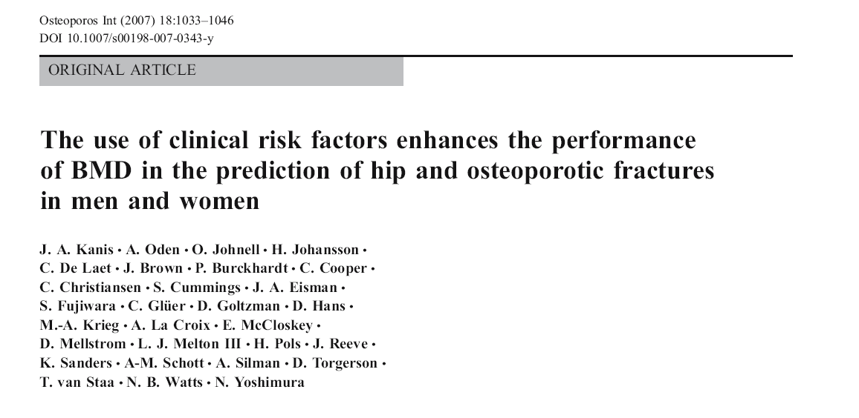

Slide 32
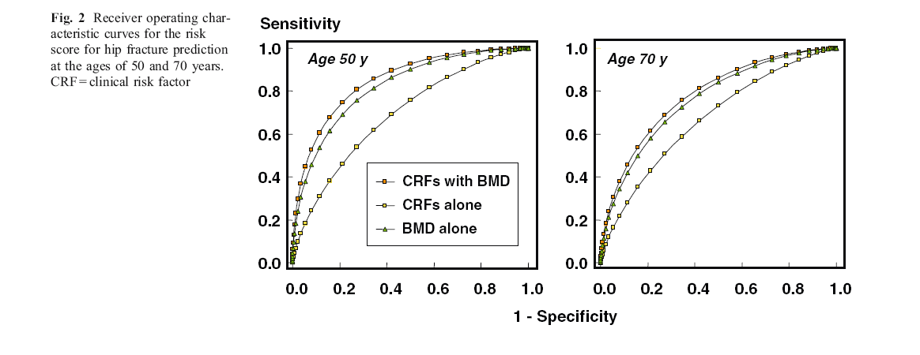

Slide 33
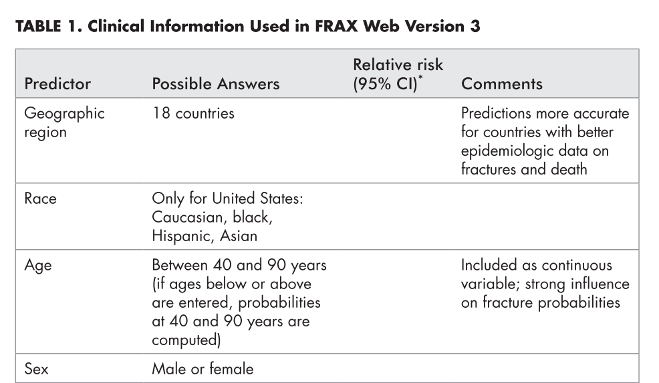

Slide 34
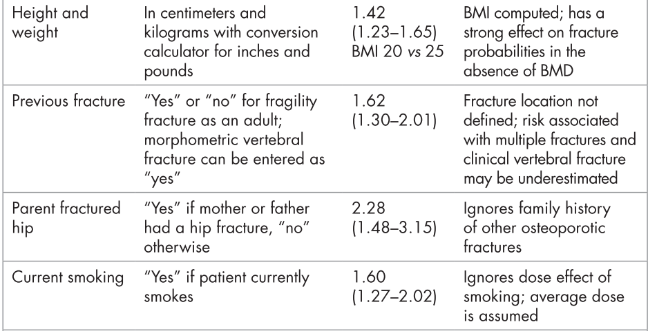

Slide 35
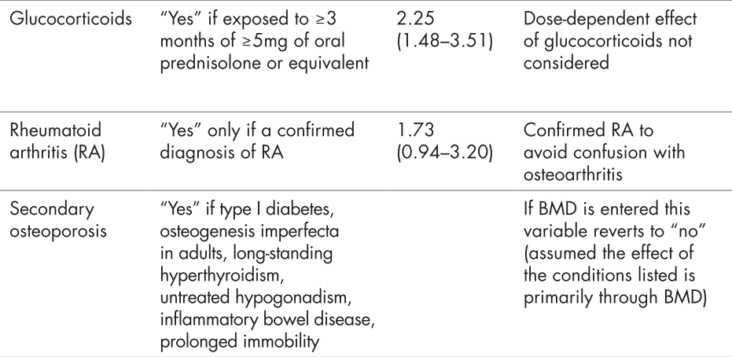

Slide 36
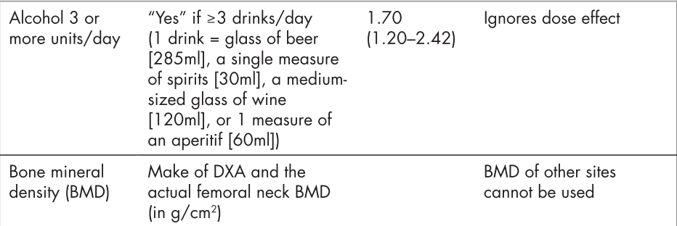

Slide 37
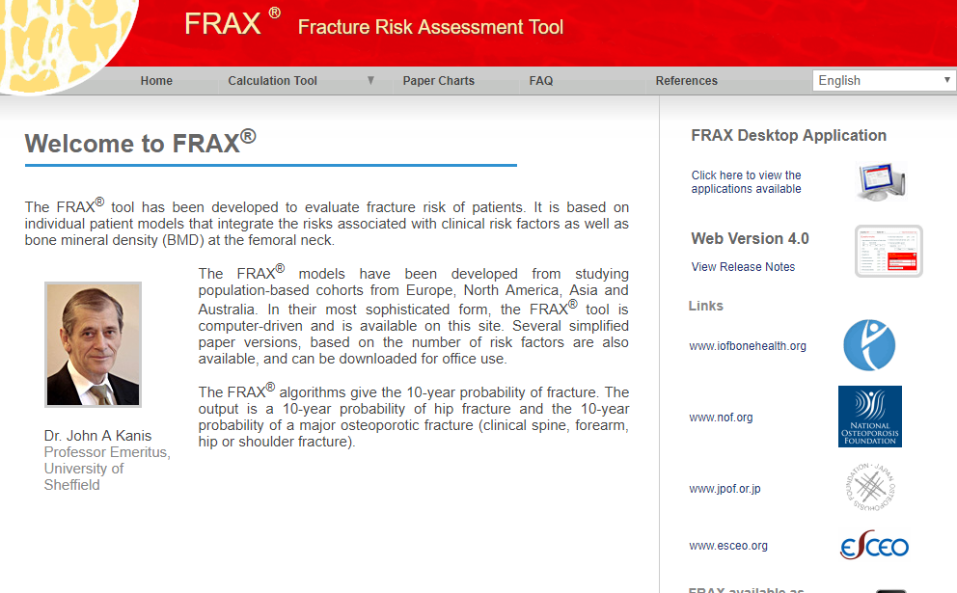
https://www.sheffield.ac.uk/FRAX

Slide 38
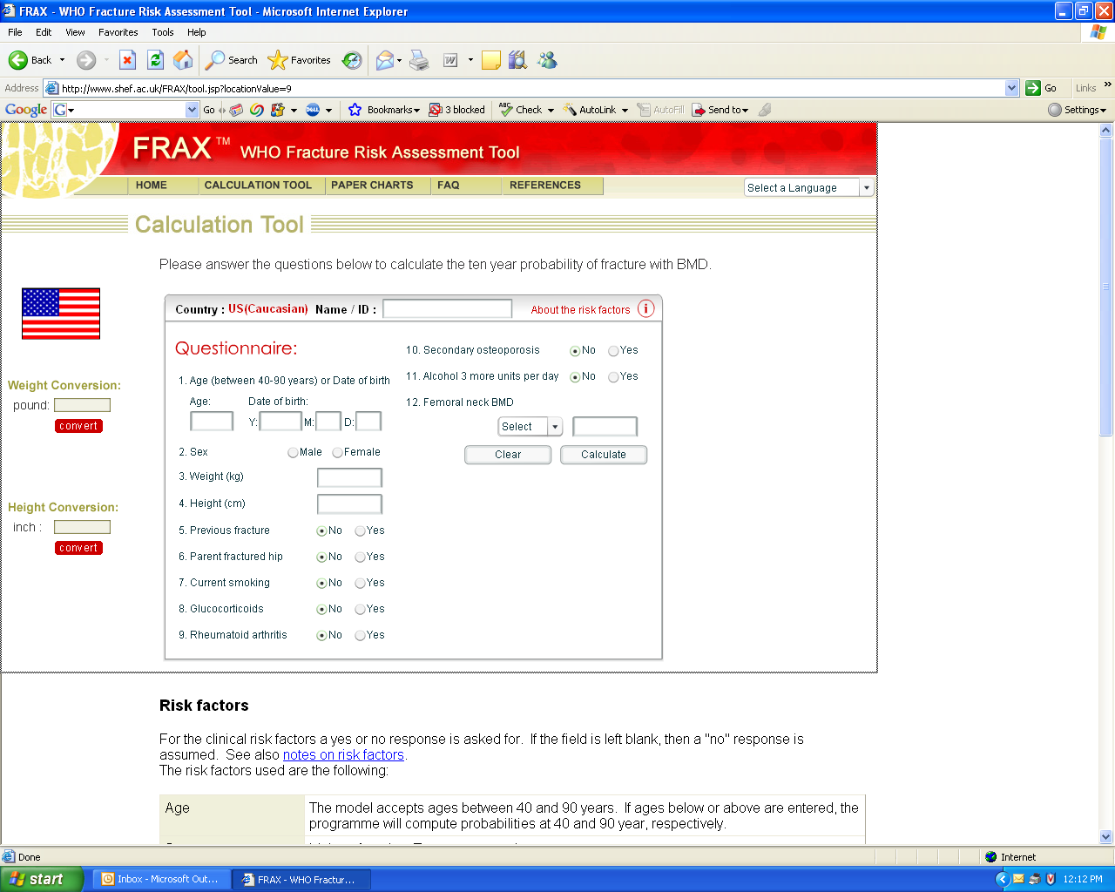

Slide 39
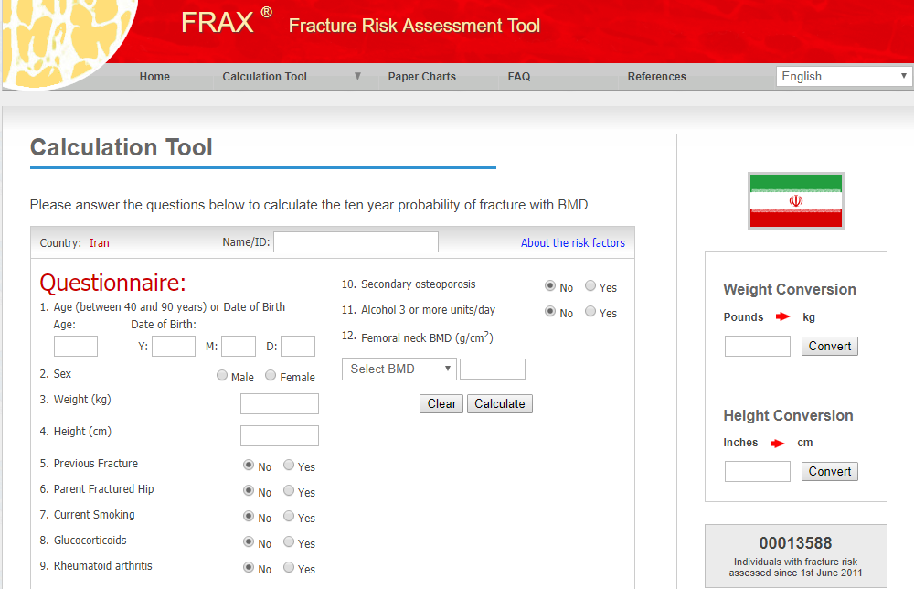

Slide 40
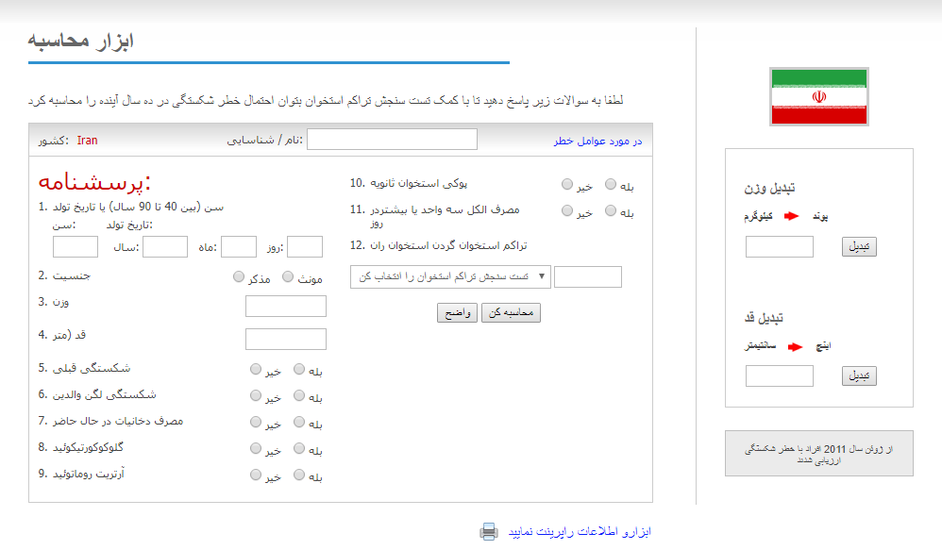

Slide 41
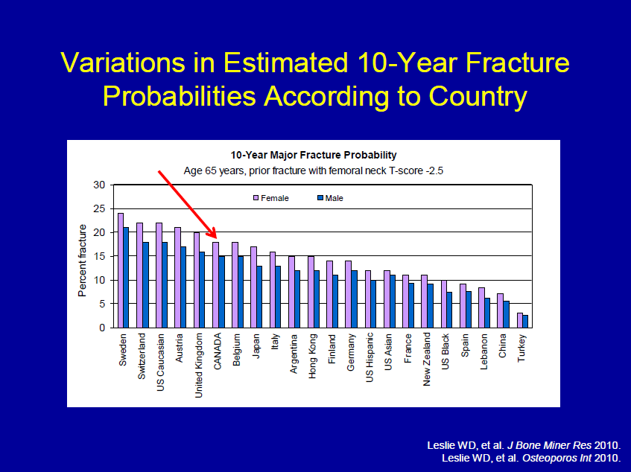

Slide 42
Limitations of FRAX

Slide 43
1
While there is evidence that duration and dose of tobacco smoking may impact on fracture risk, quantification of this risk is not possible
Falls are a risk factor for fractures but are not accommodated as an entry variable in the current FRAX model.
Fracture probability may be underestimated in individuals with a history of frequent falls, but quantification of this risk is not currently possible

Slide 44
2
There is a relationship between number of prior fractures and subsequent fracture risk. FRAX underestimates fracture probability in persons with a history of multiple fractures
There is a relationship between severity of prior vertebral fractures and subsequent fracture risk. FRAX may underestimate fracture probability in individuals with prevalent severe vertebral fractures

Slide 45
3
While there is evidence that hip, vertebral, and humeral fractures appear to confer greater risk of subsequent fracture than fractures at other sites, quantification of this incremental risk in FRAX is not possible

Slide 46
4
A parental history of non-hip fragility fracture may be a risk factor for fracture. FRAX may underestimate fracture probability in individuals with a parental history of non-hip fragility fracture
Evidence that bone turnover markers predict fracture risk independent of Bone Mineral Density (BMD) is inconclusive. Therefore, bone turnover markers are not included as risk factors in FRAX

Slide 47
5
There is a dose relationship between glucocorticoid use of greater than 3 months and fracture risk. The average dose exposure captured within FRAX is likely to be a prednisone dose of 2.5-7.5 mg/day or its equivalent.
Fracture probability is under-estimated when prednisone dose is greater than 7.5 mg/day and is over-estimated when prednisone dose is less than 2.5 mg/day.

Slide 48
6
Frequent intermittent use of higher doses of glucocorticoids increases fracture risk. Because of variability in the dose and dosing schedule, quantification of this risk is not possible.
High dose inhaled glucocorticoids may be a risk factor for fracture. FRAX may underestimate fracture probability in users of high dose inhaled glucocorticoids.

Slide 49
7
Appropriate glucocorticoid replacement in individuals with adrenal insufficiency has not been shown to increase fracture risk
In such patients , use of glucocorticoids should not be included in FRAX calculations

Slide 50
Aim :To estimate the adjustment for fracture probability based upon the dose of glucocorticoids
Methods: Dose responses for fracture risk during exposure to glucocorticoids were taken from the General Practice Research Database and used to adjust the relative risks for glucocorticoids in FRAX
Osteoporos Int (2011) 22:809–816

Slide 53
8
FRAX may underestimate or overestimate major osteoporotic fracture risk when lumbar spine T-score is much lower or higher (>1 Standard Deviation discrepancy) than femoral neck T-score

Slide 54
Aim: To describe a simple procedure for using lumbar spine BMD to enhance fracture risk assessment under the FRAX system.
The Manitoba BMD database was used to identify baseline LS and FN DEXA examinations (33,850 women and 2,518 men age 50 and older) with FRAX estimates for a major osteoporotic fracture categorized as low (<10%), moderate (10–20%),and high (>20%).
Fracture outcomes were assessed from population-based administrative data
An approach was developed and internally validated using a split-cohort design
Osteoporos Int (2011) 22:839–847

Slide 55
lumbar spine–femoral neck “offset”
The lumbar spine–femoral neck “offset” was calculated as the numeric difference in the respective T-scores (lumbar spine T-score minus femoral neck T-score)
A negative offset indicated that the T-score of the lumbar spine was lower than that of the femoral neck
A positive offset indicated the T-score of the lumbar spine was higher than that of the femoral neck

Slide 57
Results
Using the derivation subgroup, the FRAX probability for major osteoporotic fractures was strongly predictive of major osteoporotic fractures (P<0.001).
When adjusted for FRAX probability, the offset variable was also independently predictive of major osteoporotic fractures [HR 1.12 (95% CI, 1.06–1.18, P<.001) for every SD lumbar spine below femoral neck].

Slide 59
Simple procedures
“Increase/decrease osteoporotic FRAX estimate by one tenth for each rounded T-score difference between the lumbar spine and femoral neck.”

Slide 60
Practical example
Consider an individual with a femoral neck T-score of −1.7 and a major osteoporotic FRAX probability of 18%.
If the lumbar spine T-score is −3.5 then this indicates an offset of −1.8 (−3.5 minus −1.7). This is rounded to the nearest whole number(−2)
One tenth of the FRAX estimate based upon the femoral neck is 1.8%, which is multiplied by the rounded offset value (giving 3.6%).
This is then added (because lumbar spine T-score is worse than femoral neck T-score) to the original FRAX estimate (18%) giving a final (rounded) probability of 22% (18%+3.6%)

Slide 61
9
FRAX with BMD predicts fracture risk better than clinical risk factors or BMD alone
Use of FRAX without BMD is appropriate when BMD is not readily available or to identify individuals who may benefit from a BMD measurement

Slide 62
10
It is not appropriate to use FRAX to monitor treatment response
Evidence that rate of bone loss may be an independent risk factor for fracture is conflicting. Therefore, rate of bone loss is not included as a FRAX risk factor

Slide 63
11
There is significant variability in hip fracture rates throughout the world
The minimum requirement for construction of a country-specific FRAX model is hip fracture incidence data that are of high quality and representative of that country

Slide 64
12
The accuracy of FRAX models is improved by the inclusion of country-, age- and sex-specific rates of other major osteoporotic fractures (clinical vertebral, humerus, distal forearm)
In the absence of high quality, national hip fracture data, a country-specific FRAX model can be built using hip fracture incidence rates from a surrogate country, but with incorporation of country-specific mortality rates

Slide 65
To provide an overview of existing valid and reliable risk assessment tools for prediction of osteoporotic fractures.
Additionally, we aimed to determine if the performance of each tool was sufficient for practical use, and last, to examine whether the complexity of the tools influenced their discriminative pwer
J Bone Miner Res 2013 Aug;28(8):1701-17

Slide 66
Risk assessment tools
Risk assessment tools predicting low BMD
Risk assessment tools predicting fractures

Slide 67
Sensitivity ranged from 50% to 100%, with most between 80% and 90%
Specificity ranged from 10% to 88%, with most around 50%

Slide 68
12 tools were developed to identify individuals with an increased risk of fractures
Only six tools (OST, ORAI, SCORE, Garvan, FRAX, and Qfracture) were externally validated in a population‐based setting with proper methodological quality
None of the tools performed consistently better than others when tested in external validation studies
Simple tools with fewer risk factors often did as well or better (i.e., OST, ORAI, Garvan) than more complex tools with more risk factors (i.e., SCORE, FRAX, Qfracture)

Slide 69
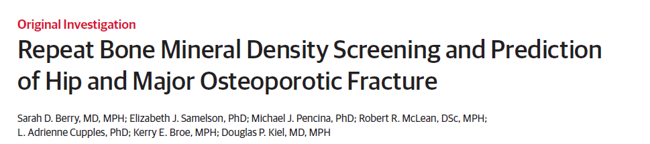
To determine whether changes in BMD after 4 years provide additional information on fracture risk beyond baseline BMD
310 men and 492 women from the Framingham Osteoporosis Study with 2 measures of femoral neck BMD taken from 1987 through 1999
Risk of hip or major osteoporotic fracture through 2009 or 12 years following the second BMD measure
JAMA. 2013;310(12):1256-1262

Slide 70
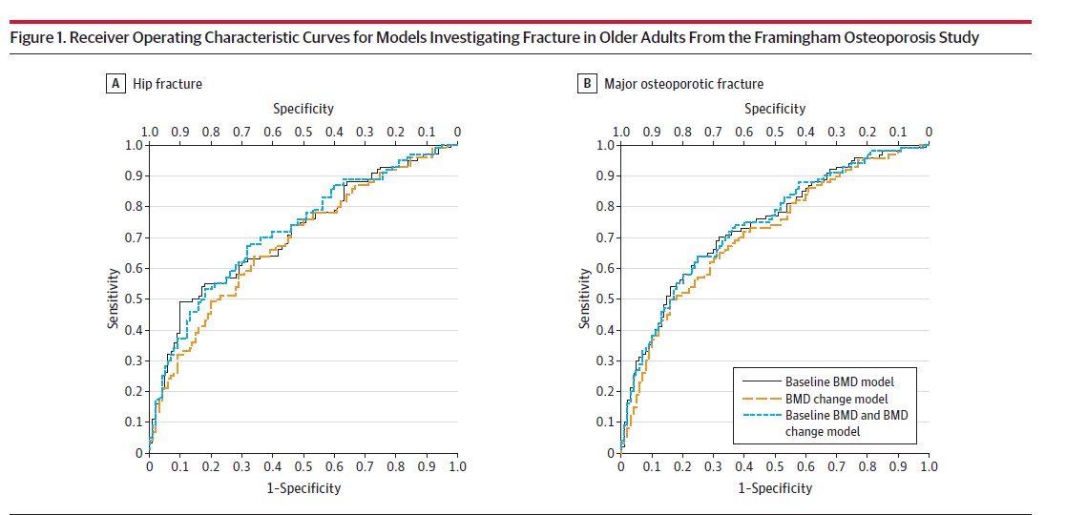
In ROC curve analyses, the addition of BMD change to a model with baseline BMD did not meaningfully improve performance

Slide 71
Key message
In untreated men and women of mean age 75 years, a second BMD measure after 4 years did not meaningfully improve the prediction of hip or major osteoporotic fracture

Slide 72
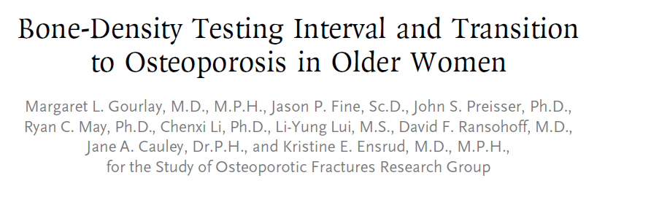
To determine how the BMD testing interval relates to the timing of the transition from normal BMD or osteopenia to the development of osteoporosis before a hip or clinical vertebral fracture occurs
4957 women, 67 years of age or older, who did not have osteoporosis at baseline and who were followed longitudinally for up to 15 years in the SOF.
The BMD testing interval was defined as the estimated time during which osteoporosis developed in 10% of women before they had a hip or clinical vertebral fracture and before they received treatment for osteoporosis.
N Engl J Med 2012;366:225-33

Slide 73
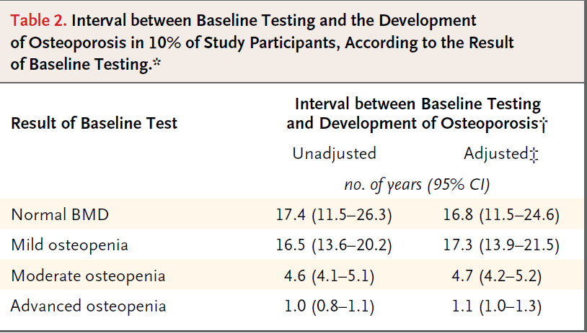
Normal BMD was defined as a T score of −1.00 or higher, mild osteopenia as a T score between −1.01 and −1.49, moderate osteopenia as a T score between −1.50 and −1.99, and advanced osteopenia as a T score between −2.00 and −2.49

Slide 74
 | T score | Recommended interval
At any age or clinical RF | -2.00 to -2.49 | every 2 years
Over than 65 and no RF | -1.50 to -1.99 | every 3 to 5 years
Over than 65 and no RF | -1.01 to -1.49 | every 10 to 15 years

Slide 75
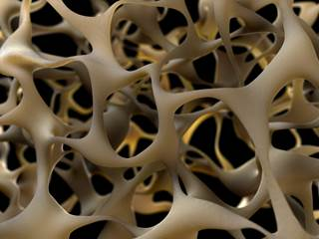
Trabecular bone score
(TBS)
This novel method is entirely noninvasive and, in fact, requires no further patient testing
It consists of gray-scale textural analysis of anteroposterior LS-DXA images previously obtained for BMD assessments. It also, by assessing the micro-architectural texture of trabecular bone, contributes to the evaluation of bone strength, thereby aiding in the diagnosis of osteoporosis and the prediction of future osteoporotic fractures
Silva BC, et al. Trabecular bone score: a noninvasive analytical method based
upon the DXA image. J Bone Miner Res. 2014

Slide 76
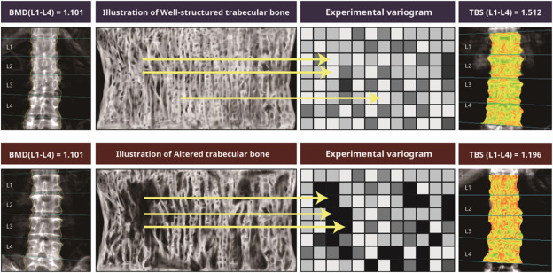
TBS: 1.512
TBS:1.196
TBS greater than or equal to 1.350 is considered normal

Slide 77
65-year Old Woman
Osteopenic BMD Low TBS
Jane Doe is a 65-year old white female who is concerned about fracture risk, as her mother recently fell and sustained a hip fracture. Her mother had previously sustained three vertebral fractures, the first of which occurred at age 68. Ms. Doe is generally healthy, taking only a statin for hyperlipidemia. Her diet provides ~1,000 mg of calcium and she takes 1,000 IU of supplemental vitamin D3 daily. She does not smoke, drinks one glass of wine daily and walks for ~30 minutes three to five times a week. Her menopause was at age 48, and she never received estrogen therapy. She has no personal history of fragility fracture, rheumatoid arthritis or glucocorticoid use.
Laboratory evaluation included serum calcium, creatinine, phosphorous, PTH, and 25 (OH)D, all of which were normal.
Dr Neil Binkley, Geriatrics University of Wisconsin Hospital and Clinics, Madison, WI, USA

Slide 78
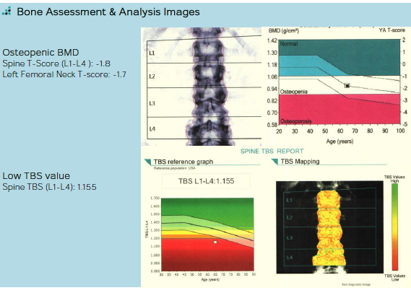

Slide 79
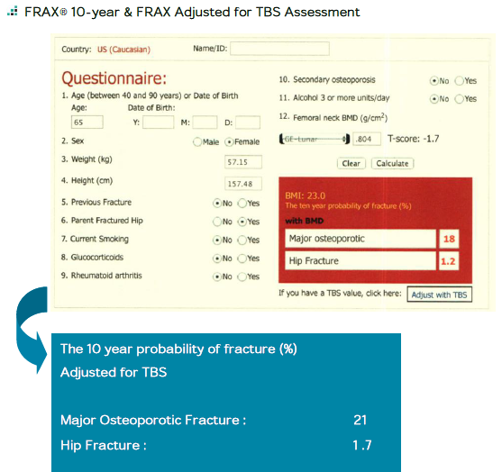
18%
1.2

Slide 80
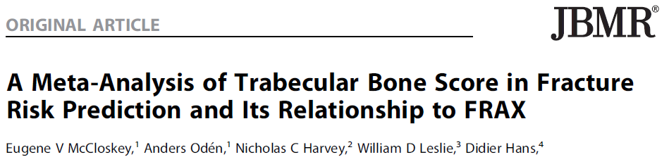
Journal of Bone and Mineral Research,2016

Slide 81
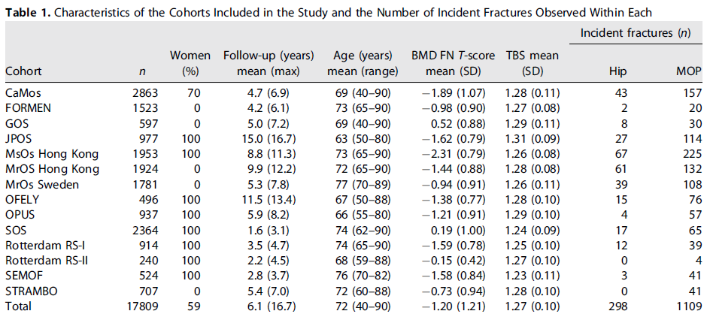

Slide 82
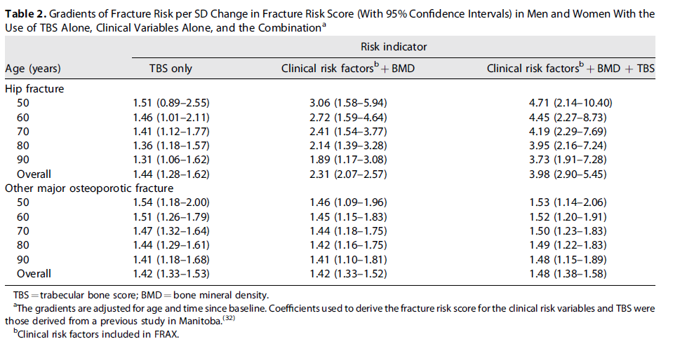

Slide 83
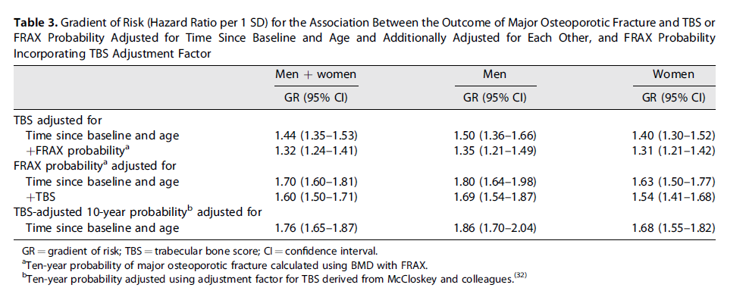

Slide 84
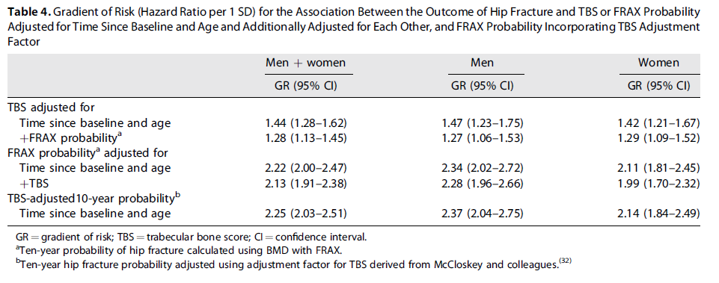

Slide 85
Key messages
The findings of the study support the use of TBS, not only as a standalone assessment of fracture risk but also, more importantly, as an independent contributor to a more global risk assessment that could permit its use along side established risk assessment tools such as FRAX.
This was reflected in the higher GRs and AUCs when TBS was combined with the FRAX clinical risk factors and BMD, particularly for hip fracture outcomes

Slide 86
ISCD Official Position
TBS is associated with vertebral, hip, and major osteoporotic fracture risk in postmenopausal women
TBS should not be used alone to determine treatment recommendations in clinical practice.
TBS can be used in association with FRAX and BMD to adjust FRAX-probability of fracture in postmenopausal women and older men.
TBS is not useful for monitoring bisphosphonate treatment in postmenopausal women with osteoporosis.
TBS is associated with major osteoporotic fracture risk in postmenopausal women with type 2 diabetes.
Adult Official Positions of the ISCD as updated in 2015

Slide 87
Conclusion
Bone density is important determinate of fracture risk
Relationship between BMD and fracture risk is exponential
There are many non BMD risk factors that contribute to fracture risk
Age and prior fragility fracture are strongest non BMD risk factors
Combination of BMD and clinical risk factors improves the risk assessment
TBS seems to be an useful tool when decision to treat is equivocal

Slide 88

Thank You

