Slide 1
Azizi Trainee Program Dyslipidemia A Case-based Discussion
Siamak Habibi Moini, MD
Endocrine Department
Taleghani Hospital
Shahid Beheshti University of Medical Sciences
Nov 21, 2023

Slide 2
Presentation of Case
A 31-year-old married woman with hypercholesterolemia
She is planning for pregnancy (history of two abortions).
Skin lesions from the age of 5 years diagnosed as tuberous xanthoma at the age of 12.
Diagnosis of hypercholesterolemia at the age of 12

Slide 3
Medications
Atorvastatin 40 mg bid + Colestyramine 4 g daily for 8 years
Rosuvastatin 40 mg daily + Ezetimibe 10 mg daily for 2 years
Rosuvastatin 40 mg bid ± Ezetimibe 10 mg daily for 8 years
Serum cholesterol levels did not change significantly!
She tells about taking Evolocumab injections for 2 months in two years ago resulting in reduction of serum cholesterol and LDL-C concentrations.

Slide 4
Lipid Parameters
Lipids (mg/dL) | 1383 | 1385 | 1388 | 1391 | 1396
Cholesterol | 509 | 479 | 482 | 518 | 744
LDL-C |  |  | 428 | 466 | 694
HDL-C |  |  | 26 | 34 | 35
TG | 188 | 163 | 139 | 88 | 73
1399 | 1400 | 1401 | 1402 | 1402.08
438 | 531 | 529 | 528 | 690
408 | 395 | 349 | 480 | 398
55 | 45 | 31 | 30 | 39
144 | 69 | 99 | 84 | 113

Slide 5
Other Laboratory
 | 98.8 | 98.10 | 99.5 | 99.12 | 00.1 | 00.9 | 02.08
Hb (g/dL) | 13 |  |  |  | 13.5 | 14.6 | 15
PLT (x10³) | 144 |  |  |  | 156 | 136 | 203
ALT (IU/L) | 190 | 355 | 21 | 84 | 38 | 26
AST (IU/L) | 101 | 133 | 14 | 55 | 20 | 15
ALP (IU/L) | 152 | 156 | 209 | 190 | 168 | 126
Bil total (mg/dL) | 2.5 | 1.5 | 3.9 | 4.9 | 2.4 | 1.1 | 4.7
Bil direct (mg/dL) | 1 | 0.4 | 0.5 | 0.5 | 0.34 | 0.3 | 0.64
LDH (IU/L) |  |  |  |  |  |  | 263

Slide 6
Family Lipid Profile
Lipids (mg/dL) | Mother | Father | Brother | Sister
Cholesterol | 228 | 174 | 168 | 162
LDL-C | 132 | 99 | 76 | 83
HDL-C | 68 | 30 | 50 | 48
TG | 140 | 111 | 210 | 153

Slide 7
Physical Examinations
Height: 159 cm; weight: 54 kg; BMI: 21.6 kg/m²
BP: 120/70 mmHg; PR=76/min; RR=14/min
Tuberous xanthomas
No arcus cornealis, xanthelasma, or tendon xanthoma
No splenomegaly
Others: Unremarkable

Slide 8
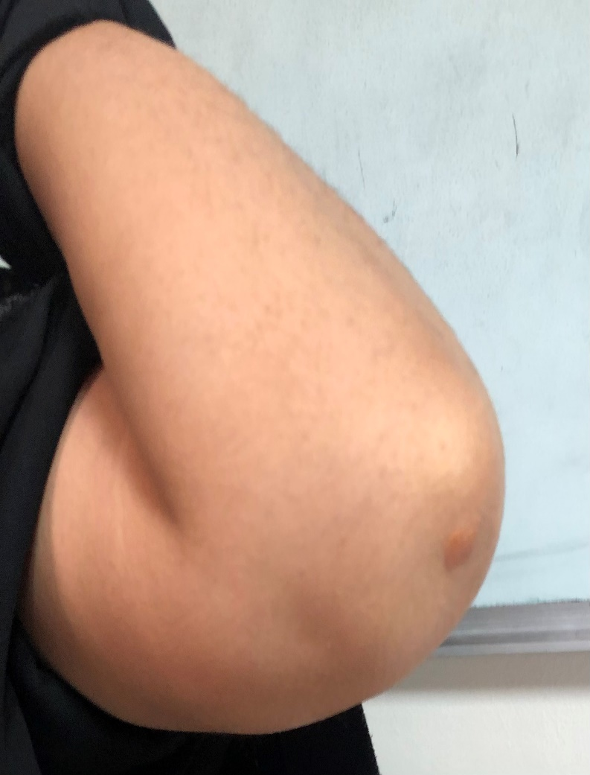
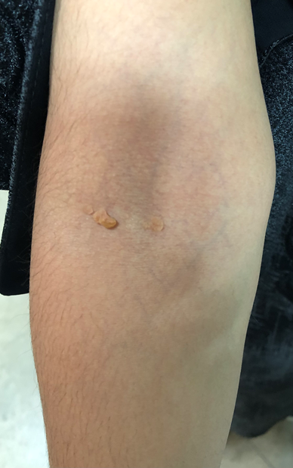
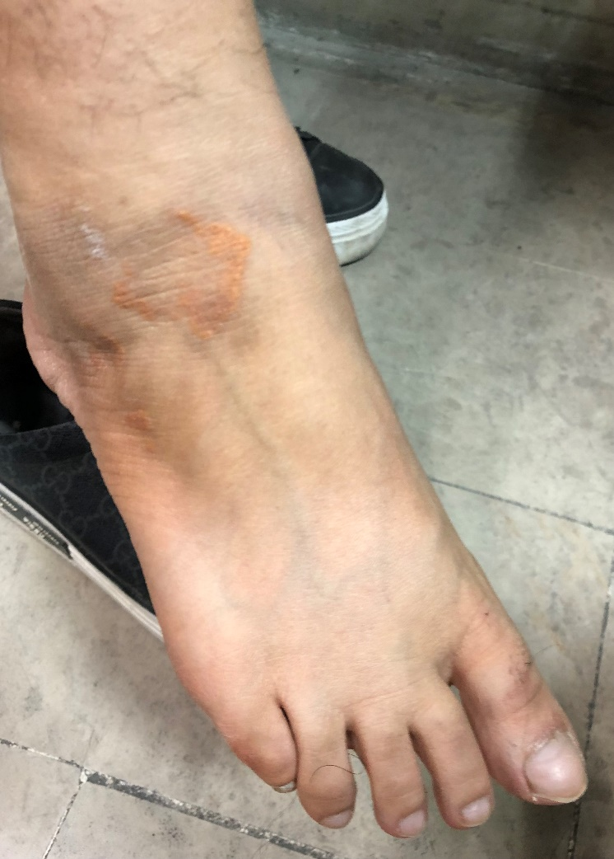
Tuberous xanthomas

Slide 9
Problem List:
A 31-year-old woman
Skin lesions (tuberous xanthomas) from the age of 5 years
Diagnosis and initiation of treatment of hypercholesterolemia at the age of 12
Different cholesterol-lowering drugs were not effective for serum cholesterol reduction during past years.
Unremarkable lipid profile of her family members
Tuberous xanthomas

Slide 10
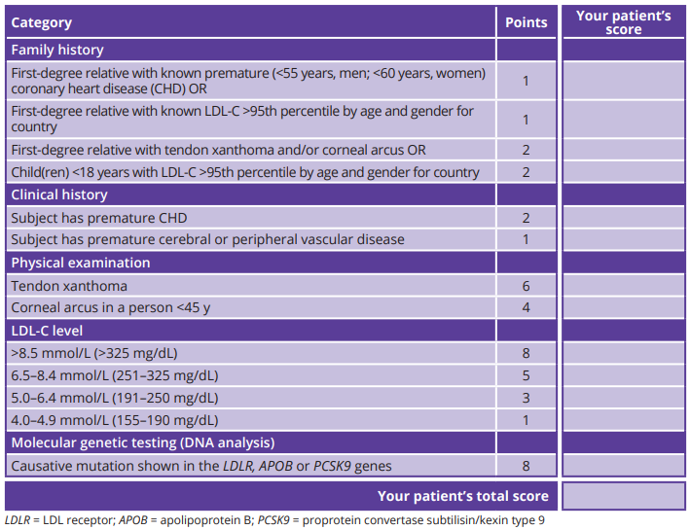
Dutch Lipid Clinic Network (DLCN) Criteria for Diagnosing
Heterozygous Familial Hypercholesterolemia in Adults

Slide 11
Dutch Lipid Clinic Network (DLCN) Criteria for Diagnosing
Heterozygous Familial Hypercholesterolemia in Adults

Slide 12
Differential Diagnosis

Slide 13
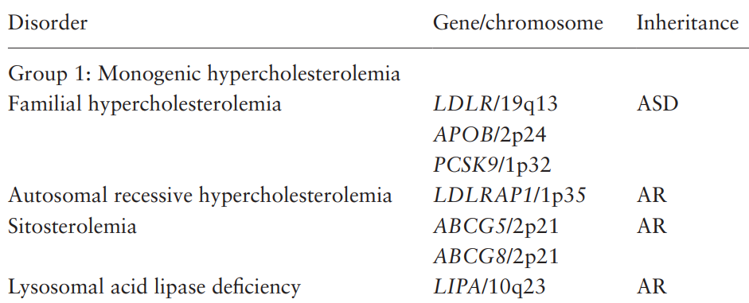
AD
ApoE/19q13

Slide 14
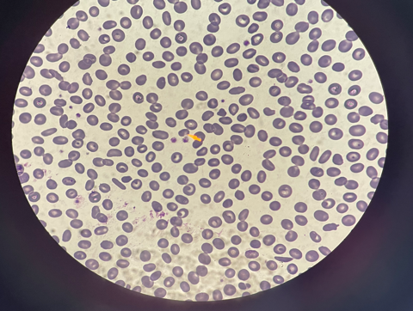
Peripheral Blood Smear (our patient)

Slide 15
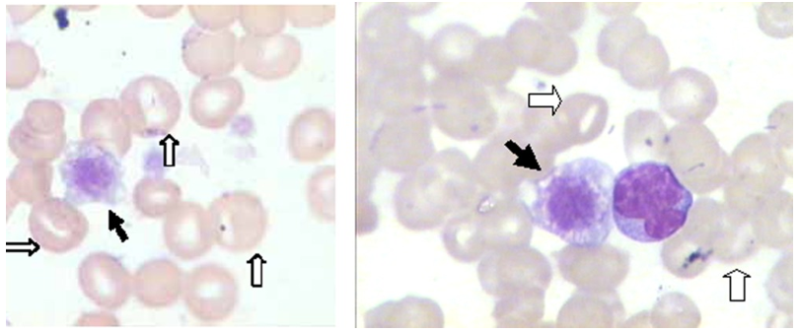
Peripheral Blood Smear
Wang Z, et al. Am J Hematol 2014;89(3):320-324.

Slide 16
Sonography of abdomen
Liver: normal size and echogenicity
Spleen: 9 cm
Cardiovascular evaluations:
ECG: Unremarkable
Echocardiography: Normal
CT angiography: Normal coronary arteries
Doppler US of carotid & vertebral arteries: Normal

Slide 17
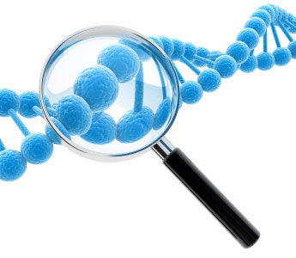
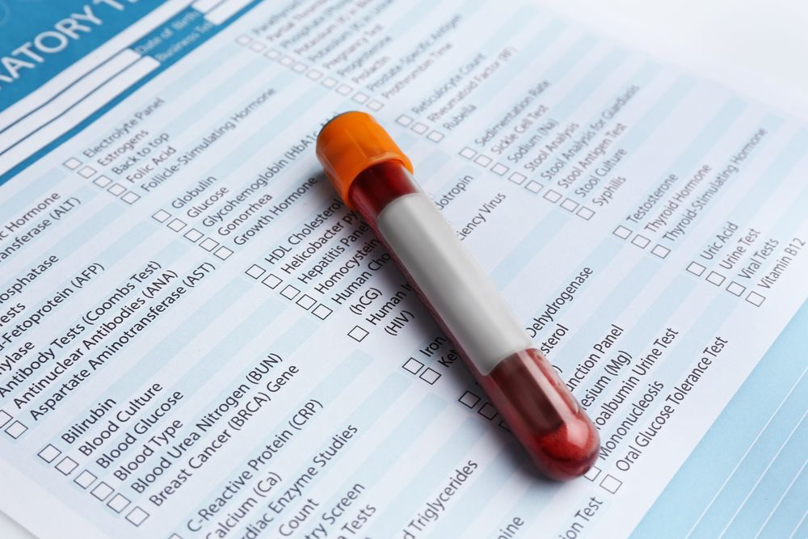
Further Diagnostic Work-ups

Slide 18
Final Diagnosis Sitosterolemia (phytosterolemia)

Slide 19
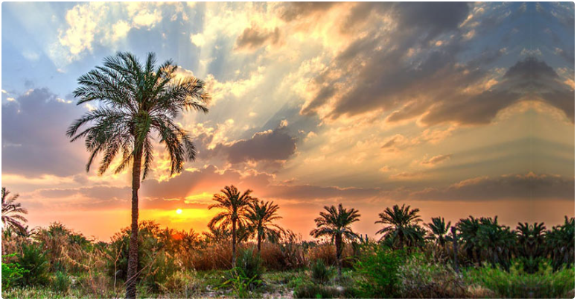
Thank you

