Slide 2
Cushing Syndrome
L.Mahmoudieh MD

Slide 3
Agenda
What is the diagnostic utility of High Dose Dex. Suppression test?
Does 6mm pituitary tumor size cut-off value exclude ectopic ACTH syndrome?
What is the characteristics of ACTH-producing carcinoid tumors?
What imaging modalities are available for ectopic causes?

Slide 4
A diagnosis of suspected Cushing disease involves 3 major steps:
Confirmation of hypercortisolism
Differentiation between corticotropin independent and corticotropin-dependent causes of Cushing syndrome
Distinction between pituitary and ectopic corticotropin production

Slide 5
Agenda
What is the diagnostic utility of High Dose Dex. Suppression test?
Is IPSS useful for tumor localization in our patient?
What is the principles of ACTH-producing cushing syndrome?
What imaging modalities are available for ectopic causes?
What is the outcome of bilat. Adrenalectomy?

Slide 7
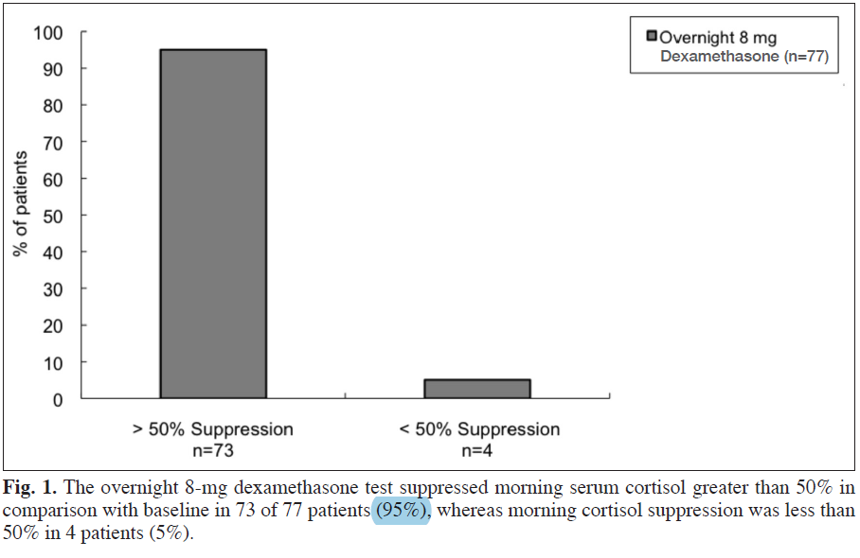
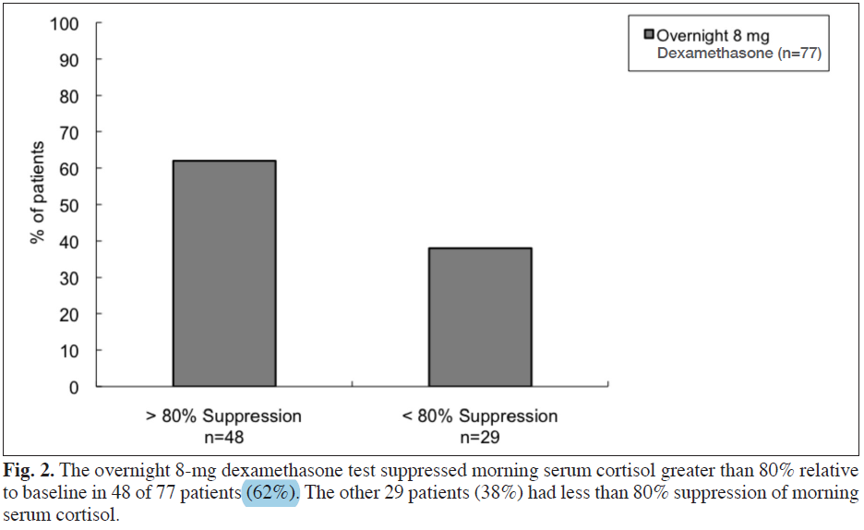

Slide 8
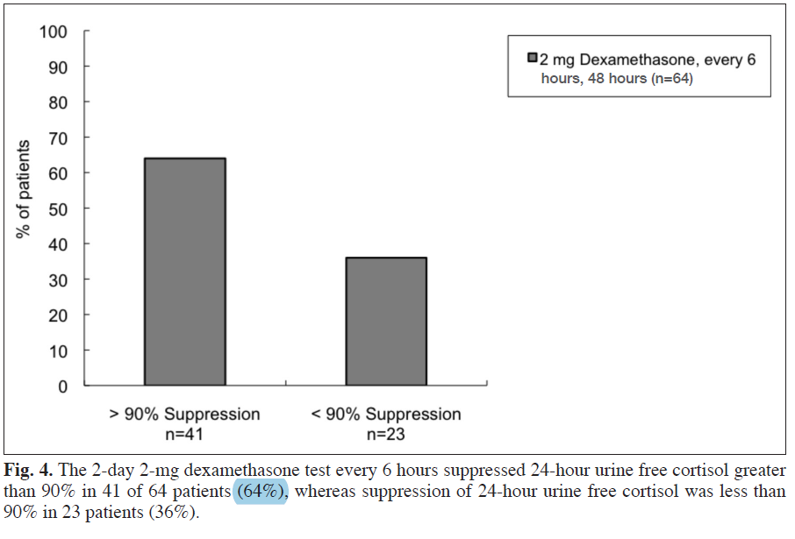

Slide 9
Agenda
What is the diagnostic utility of High Dose Dex. Suppression test?
Does 6mm pituitary tumor size cut-off value exclude ectopic ACTH syndrome?
What is the principles of ACTH-producing cushing syndrome?
What imaging modalities are available for ectopic causes?
What is the outcome of bilat. Adrenalectomy?

Slide 11
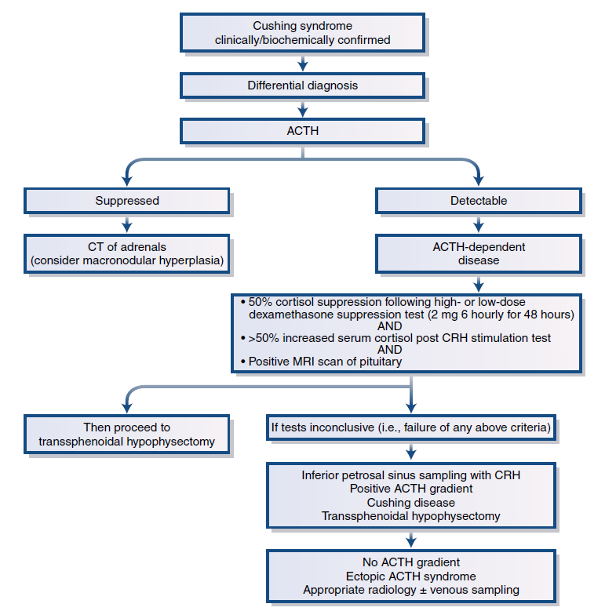

Slide 12
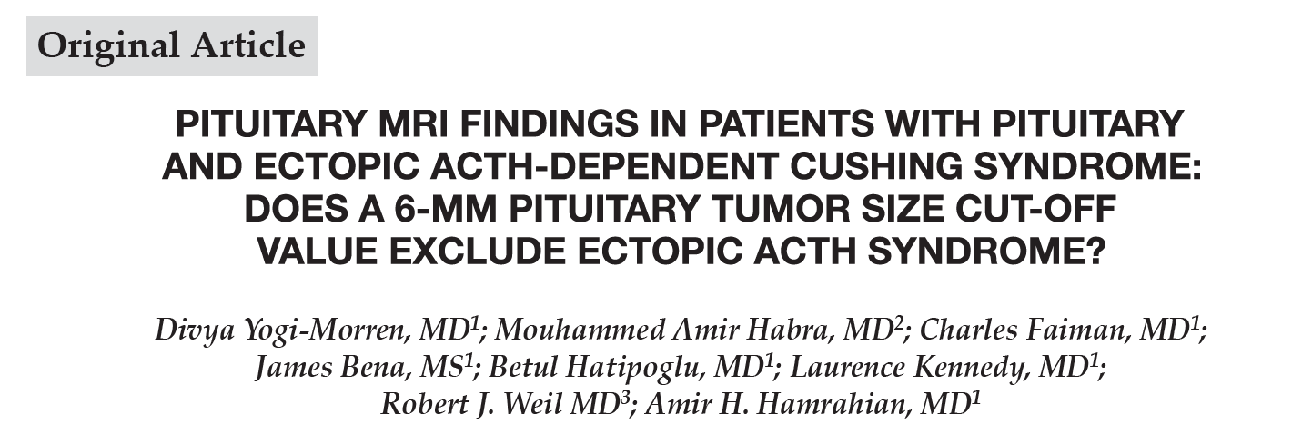

Slide 13
The diagnosis of ACTH-dependent CS was based on:
the clinical presentation and
plasma ACTH level >20 pg/mL, and
1 or more abnormal biochemical tests including elevated 24-hour UFC and/or a late night salivary cortisol, a lack of cortisol suppression after an LDDST and/or a dexamethasone suppression/CRH stimulation test.

Slide 14
The diagnosis of CD was confirmed by :
the presence of positive ACTH staining on pituitary pathology specimens
or
development of hypocortisolemia after pituitary surgery
The diagnosis of EAS was based on 1 or more of the following:
the presence of ACTH staining on primary tumor histopathology
development of hypocortisolemia after resection of a nonpituitary tumor
IPSS results indicative of an ectopic source of ACTH production.
All patients with ACTH staining on histopathology had improvement in hypercortisolism unless they had metastatic disease
Notes:
Sreum cortisol less than 3 micg/dl

Slide 15
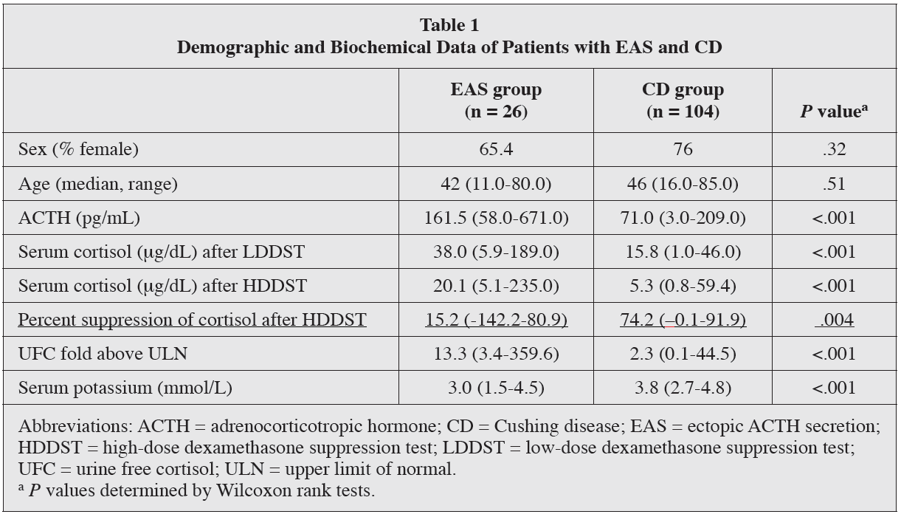
Notes:
HDDST findings were was available in only 28 and 8 patients with CD and EAS, respectively, and the test performed as either an overnight 8-mg test or a 2-day test.
Considering the relatively limited number of patients who underwent HDDST, diagnostic sensitivity or specificity was not calculated.

Slide 16
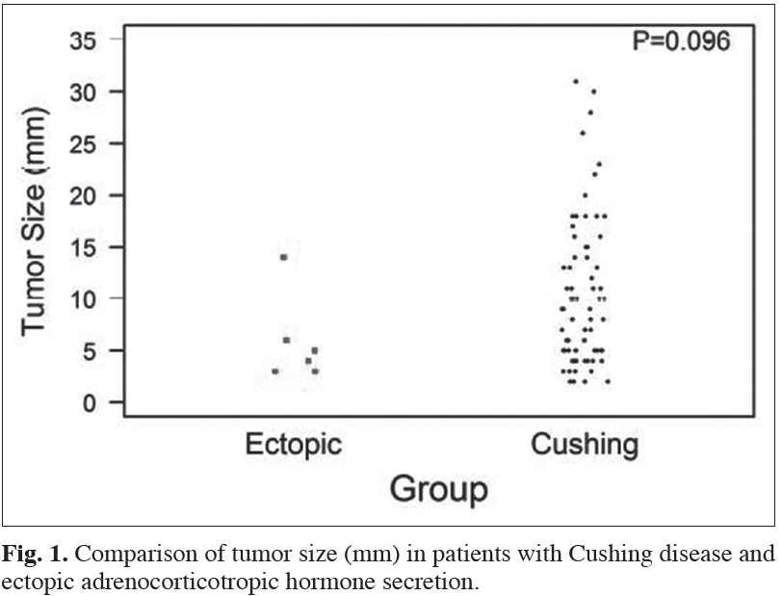
A pituitary lesion was identified in 73/105 (68.6%) patients in the CD group and 6/26 (23.1%) patients in the EAS group; they measured 8 mm (2-31) and 5 mm (3-14), respectively.
All tumors in the EAS group measured ≤6 mm except for 1 which measured 14 mm.
The presence of a pituitary tumor >6 mm
in size had 40% sensitivity and 96%
specificity for the diagnosis of CD.

Slide 17
The patient with EAS and a 14-mm sellar mass had a potassium level of 3.5 mmol/L, ACTH of 71 pg/mL, and 24-hour UFC 7.8 × ULN.
The patient did not undergo an HDDST or standard CRH test.
The pituitary adenoma was surgically resected at an outside hospital and was not immunohistochemically positive for ACTH.
Moreover, continuation of hypercortisolism occurred postoperatively, which was strongly suggestive of an ectopic ACTH source.
Upon referral to the MD Anderson Cancer Center, she underwent IPSS that was suggestive of an ectopic source with a lack of a significant central-to-peripheral ACTH ratio.
The patient underwent bilateral adrenalectomy and was later found to have liver metastases of an ACTH-producing endocrine tumor; the primary site of ectopic ACTH remained occult.

Slide 18
Agenda
What is the diagnostic utility of High Dose Dex. Suppression test?
Is IPSS useful for tumor localization in our patient?
What is the principles of ACTH-producing carcinoid tumors?
What imaging modalities are available for ectopic causes?
What is the outcome of bilat. Adrenalectomy?

Slide 20
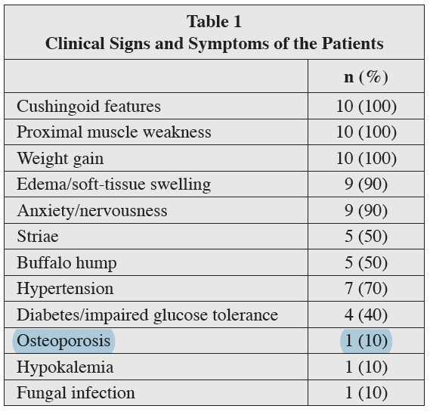

Slide 21
All patients exhibited no cortisol or ACTH response after CRH administration.
In 2 patients, no suppression of cortisol levels after the HDDST was noted, whereas a suppression of >50% of the morning cortisol levels was revealed in 4 patients. In 4 patients, HDDST was not performed.
BIPSS performed in 8 patients revealed no ACTH gradient before and after CRH stimulation (less than 2:1 basal or less than 3:1 stimulated central to peripheral ACTH gradient).
BIPSS was not performed in 2 patients because the source of ectopic ACTH production was obvious by chest CT scan and/or octreotide scintigraphy and pituitary MRI was negative.
All patients with ACTH-dependent CS underwent pituitary MRI, which was negative in all cases except for one, which showed a microadenoma
Specifically, the ectopic source of ACTH-dependent CS was identified with CT or MRI scans in all cases. However, 2 patients needed to undergo chest CT imaging twice, 1 patient 4 times and another 5 times over a 28-month period since diagnosis, in order to achieve positive localization of the tumor.
Eight patients had pathologic uptake in an 111Indium-octreotide scan. One patient demonstrated positive uptake on the second 111Indiumoctreotide scan, and in 2 patients, octreotide imaging became positive after 3 repetitive scans.

Slide 22
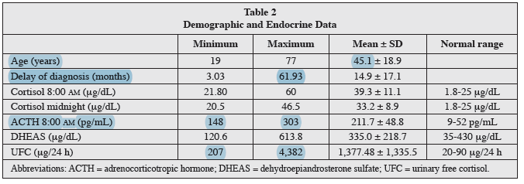

Slide 23
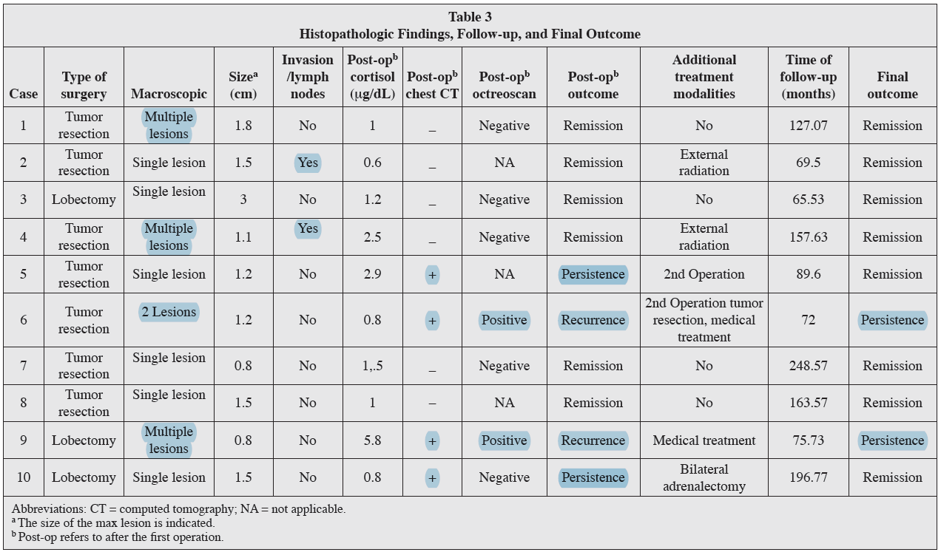

Slide 24
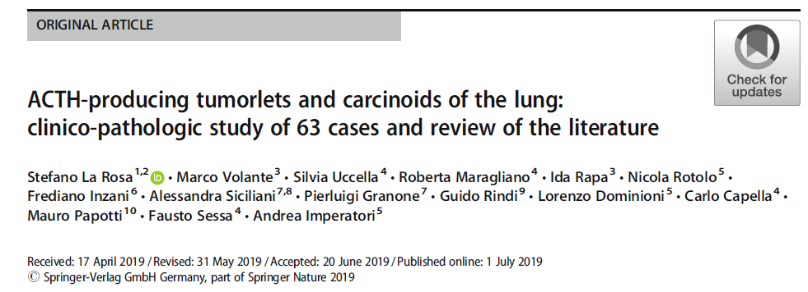

Slide 25
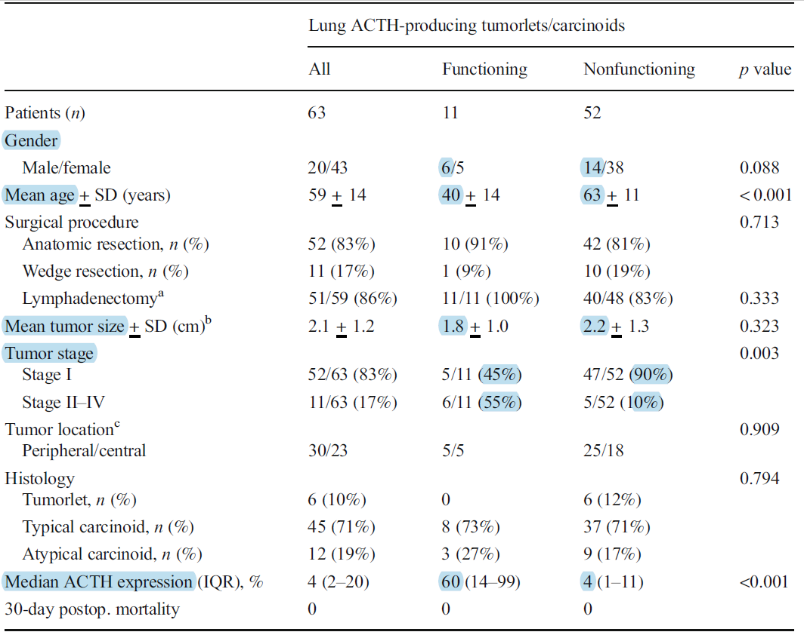

Slide 26
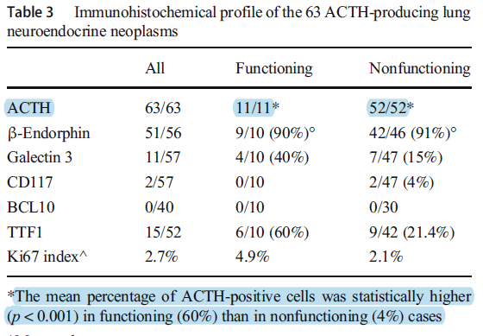

Slide 27
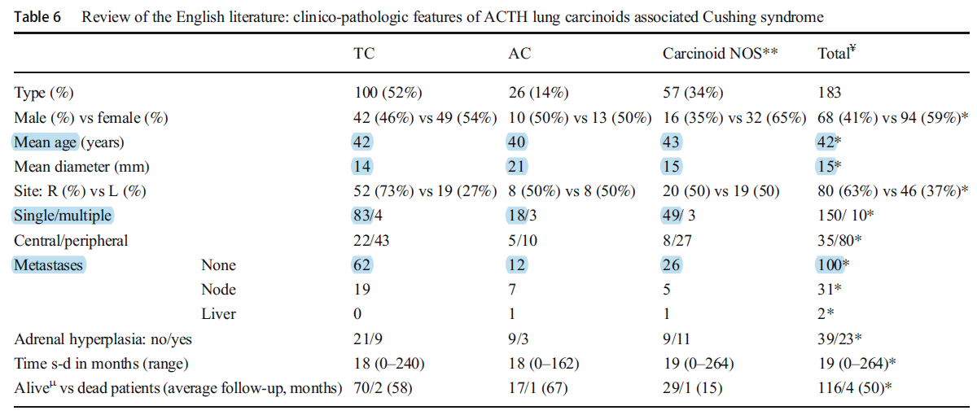
Notes:
83 articles, published between 1961 and 2018, were retrieved from the PubMed database. 58 were single case reports and the remaining 25 were small series. A total of 183 CS-associated carcinoids, tumorlets and diffuse idiopathic pulmonary neuroendocrine cell hyperplasia (including our 11 cases) have been reported

Slide 29
Agenda
What is the diagnostic utility of High Dose Dex. Suppression test?
Is IPSS useful for tumor localization in our patient?
What is the principles of ACTH-producing carcinoid tumors?
What imaging modalities are available for ectopic causes?
What is the outcome of bilat. Adrenalectomy?

Slide 31
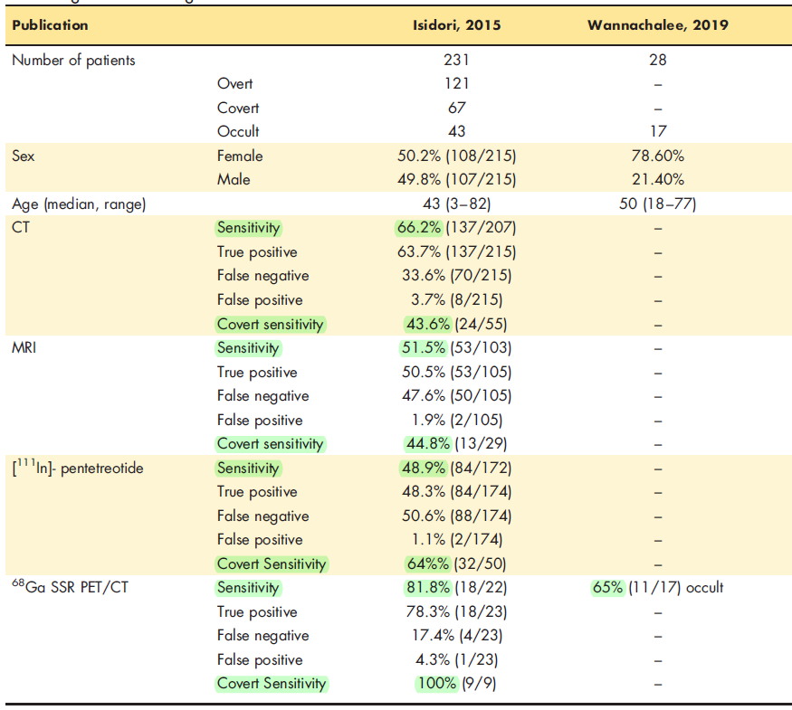
Table 1. Summary of retrospective review studies comparing the performance of [68Ga]-DOTATATE imaging in detecting ACTH-secreting tumors

Slide 32
