Slide 1
Case Presentation Thyroid and pregnancy
A Amouzegar, MD
Endocrine Research Center
Research Institute for Endocrine Sciences
Shahid Beheshti University
ICED
Tehran 23 October 2018

Slide 2
Panelists
Fereidoun Azizi,MD
Full professor of Endocrinology. Endocrine Research Center, Research Institute for Endocrine Sciences.
Fahimeh Ramezani Tehrani,MD
Full professor of Obstetrics and Gynecology, Reproductive Endocrinology Research Center, Research Institute for Endocrine Sciences.
Farzaneh Sarvgadi,MD
Associate professor of Endocrinology, Endocrine Research Center ,Research Institute For Endocrine Sciences.
Atieh Amouzegar,MD
Associate professor of Endocrinology, Endocrine Research Center, Research Institute for Endocrine Sciences.

Slide 3
Objective
Cases regarding:
Screening
Hypothyroidism
Subclinical hypothyroidism
Hyperthyroidism

Slide 4
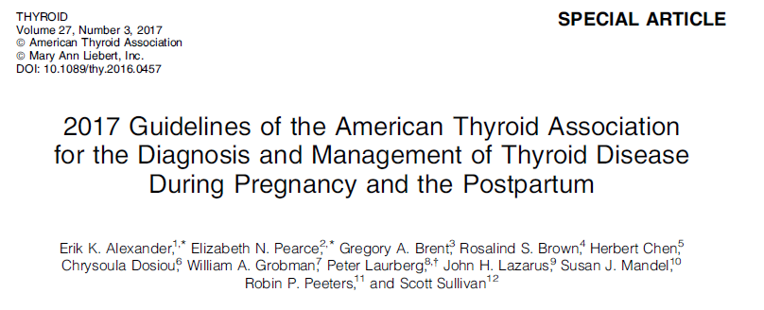

Slide 5
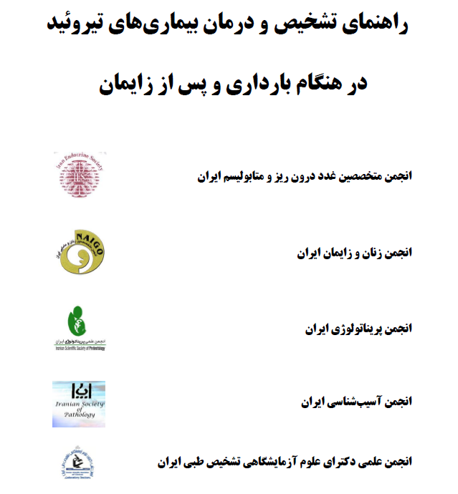

Slide 6
Iranian normal reference range

Slide 7
Iranian reference range
Reference intervals for TPOAb 1.5-32.8 and 2.1-35 IU/mL in males and females, respectively.
Reference intervals in the first, second, and third trimesters were as follows (respectively): TSH-0.2-3.9, 0.5-4.1, and 0.6-4.1 mIU/L.
TT4-8.2-18.5, 10.1-20.6, and 9-19.4 μg/dL. FT4I-8.5-19, 9.7-21, and 8.7-20.4.

Slide 8
Case 1
A 26 years woman presents for routine antenatal care at 8 weeks gestation. This is her first pregnancy.
She feels well apart from some fatigue and mild nausea. She has no history of thyroid disease. No family history of thyroid disease.
What thyroid testing would you order?
A. None
B. TSH
C. TSH and free T4
D. TSH, free T4, and TPO antibody
1

Slide 9
Screening for Thyroid Dysfunction in Pregnancy Worldwide opinions and guidelines
Recommendation | Group
test only for symptoms or known history | American College of Obstetrics and Gynecology 2002
selective testing of high-risk women | Endocrine Society 2007
selective testing of high-risk women | ATA 2017
majority support universal screening | Endocrine Society 2012
selective testing of high-risk women | Indian National Guidelines
universal screening | Spanish Society of Endocrinology and Nutrition
universal screening | Indian Thyroid Society
universal screening Screening of high risk women | China Iranian Endocrine Society
2

Slide 10
ATA guideline 2017
There is insufficient evidence to recommend for or against universal screening for abnormal TSH concentrations in early pregnancy.
(No recommendation; Insufficient evidence)
There is insufficient evidence to recommend for or against universal screening for abnormal TSH concentrations preconception, with the exception of women planning assisted reproduction.
(No recommendation; Insufficient evidence)
Universal screening to detect low free thyroxine concentrations in pregnant women is not recommended.
(Weak recommendation; moderate-quality evidence)
ATA Guideline 2017 Alexander EK, Pearce EN, et al. Thyroid 2017;27(3):315-389
3

Slide 11
High risk group
1. A history of hypothyroidism/hyperthyroidism or current symptoms/signs of thyroid dysfunction
2. Known thyroid antibody positivity or presence of a goiter
3. History of head or neck radiation or prior thyroid surgery
4. Age >30 years
5. T1DM or other autoimmune disorders
6. HX of pregnancy loss, preterm delivery, or infertility
7. Multiple prior pregnancies
8. FMHx of autoimmune thyroid disease or thyroid dysfunction
9. Morbid obesity (BMI ± 40 kg/m2)
10. Use of amiodarone or lithium, or recent administration of iodinated radiologic contrast
11. Residing in an area of known moderate to severe iodine insufficiency
Strong recommendation, moderate-quality evidence.

Slide 12
Case2
A 33-year-old woman was diagnosis as primary hypothyroid when she was 23 years of age and had been taking LT4 (0.1 mg/d) for at least 2 years. The patient began taking folic acid supplements (1 mg/d) 2 months before a natural, planned conception occurred.
Serum TSH was 3.1mU/L, 6 mo before this visit.
8 weeks before becoming pregnant, her TSH level was 5.95 mU/L.
4

Slide 13
Questions
Why has the level of TSH increased?
If you saw her TSH at 8 weeks before pregnancy what you would do for her?
3-When do you check her serum TSH levels after conception?
4- what level is optimal?
5

Slide 14
Case , Cont’d
The levothyroxine dose was increased to 150 mcg/d. Pregnancy was confirmed by means of a pregnancy test.
Her TSH level was rechecked 8 weeks after her last menstrual period and was found to be 8.75 mU/L, with a normal T4 level.

Slide 15
Questions
What do you do at this visit?
What possibilities do justify TSH rises?
When must be the next visit and how do you follow her?

Slide 16
Case, Cont’d
The dose of LT4 was increased to 225 mcg/D. Throughout her pregnancy, the dose of levothyroxine was adjusted multiple times in response to her TSH levels which was kept between 1 – 1.7 mU/L.
She gave birth to a normal 39 weeks gestaion baby girl .

Slide 17
Question
1-How do you adjust levothyroxine dose after delivery?
When do you check serum TSH level?

Slide 18
Case Cont’d
Post partum, she resumed levothyroxine therapy (0.150 mg/d).
Subsequent TSH level, was 2.1 mU/L.

Slide 19
Case 3
A 32-year-old pregnant (7-weeks) woman was found to have a serum TSH level of 7 mU/L on screening .
Her only symptoms are mild fatigue, which has been present for more than 10 years.
The results of the physical examination are normal, except for the finding of a small, firm thyroid with a slightly irregular surface.

Slide 20
Question
What is the definition of hypothyroidism during pregnancy?
What adverse pregnancy outcomes are associated to this level of TSH?
What adverse pregnancy outcomes are seen in neonate,offspring?
What do you do for the patient?
How do you decide to treat or not to treat according to serum TPOAb level?

Slide 21
Adverse outcomes related to SCH
Study | Method | design of study | result
Negro et al | TSH 2.5-5mU/L compared to below 2.5 in TPOAb - | observational | Higher pregnancy loss rate 6.1 Vs 3.6
Negro et al | TSH>2.5 mIU/L TPO+ | Interventional arm-LT4 treatment | Significant reduction in a composite endpoint compared to no treat
Casey et al | SCH | cohort | Increased risk of premature delivery
Cleary-Goldman | SCH | cohort | No association with preterm labour
Nazarpour et al | SCH,TPOAb- (TSH 2.4 - 4 mIU/L) women were randomly assigned LT4 treatment and Placebo | A single-blind RCT | No beneficial effect of LT4 therapy in reducing preterm delivery for TSH< 4, decrease this complication for TSH ≥4.0 mIU/L.

Slide 22
Adverse neurocognitive effect on the offspring
Study | Design | Intervention | Result
CATS study 2012 | RCT 21,846 SCH and hypothyroxinemia | LT4 150 mcg at 13 w Vs placebo | No improvement in cognitive function when children of treated mother were evaluated at 3 years of age
Casey et al 2017 | RCT (97,228) SCH (677) and hypothyroxinemia (526) | LT4 treatment versus placebo 17 w | No sig effect of treatment on offspring IQ at the age of 5 years
CATS II study 2018 | RCT SCH and hypothyroxinemia | LT4 150 mcg at 13 w Vs placebo | Maternal thyroxine during pregnancy did not improve child cognition at age 9.5 years

Slide 23
Recommendation
Subclinical hypothyroidism in pregnancy should be approached as follows:
a) LT4 therapy is recommended for:
TPO antibody positive women with a TSH greater than the pregnancy specific reference range.
(Strong recommendation, Moderate quality evidence)
TPO antibody negative women with a TSH greater than 10.0 mU/L.
(Strong recommendation, Low quality evidence)
b) Levothyroxine therapy may be considered for:
TPO antibody positive women with TSH concentrations > 2.5 mU/L and below the upper limit of the pregnancy specific reference range.
(Weak recommendation, Moderate quality evidence)
TPO antibody negative women with TSH concentrations greater than the pregnancy specific reference range and below 10.0 mU/L.
(Weak recommendation, Moderate quality evidence)

