Slide 1
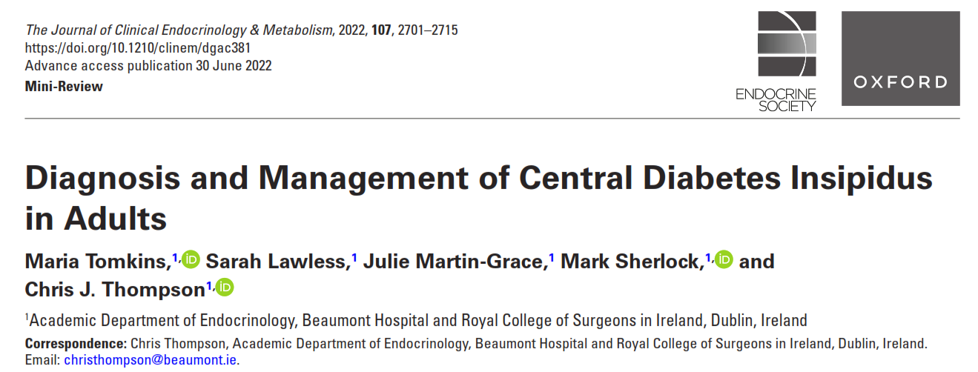
Amir Hossein Shokravi
1401/10/12

Slide 2
Case 1
A 42-year-old female was diagnosed with a non-functioning pituitary tumor after presenting with bitemporal hemianopia and fatigue. She had secondary AI, secondary hypothyroidism, hypogonadotropic hypogonadism, and mild hyperprolactinemia. MRI demonstrated a 33 * 22 * 22 mm pituitary tumor with suprasellar extension and compression of the optic chiasm. Hydrocortisone and LT4 replacement were commenced, and she underwent TSS
. On day one post-operatively, she developed increased polydipsia and polyuria. Urine output exceeded 400 mL/hour and the fluid balance record showed a 24-hour intake of 4390 mL and urine output of 5685 mL. Urine specific gravity was 1.005, urine osmolality 210 mOsmol/kg, plasma osmolality 304 mOsmol/kg and plasma sodium 142 mmol/L

Slide 3
Case 2 : A 23-year-old male presented with headaches and bitemporal hemianopia. He had signs of active acromegaly, and elevated growth hormone of 142 ug/L (reference 0.05-3.0) and IGF-1 of 150 nmol/L (reference 15-41). The remainder of his pituitary profile showed mild hyper prolactinemia, hypogonadotropic hypogonadism, and normal adrenal and thyroid function. MRI demonstrated a large pituitary tumor measuring 37 x 25 x 21 mm with suprasellar extension and optic chiasm compression. Trans sphenoidal surgery was performed. The patient had significant polyuria on the first post-operative day, with urine output exceeding 500 mL/hour. Urine output measured 6300 mL and fluid intake measured 3500 mL within the first 24 hours post-operatively. The patient was not thirsty, and biochemistry was not consistent with DI, with urine osmolality 243 mOsmol/kg, plasma osmolality 285 mOsmol/kg and plasma sodium 137 mmol/L.

Slide 4
Central diabetes insipidus (CDI) is a clinical syndrome which results from loss or impaired function of vaso pressinergic neurons in the hypothalamus/posterior pituitary, impairing the synthesis and/or secretion of the antidiuretic hormone, arginine vasopressin (AVP)
Garrahy A, Moran C, Thompson CJ. Diagnosis and management of central diabetes insipidus in adults. Clinical Endocrinology 2019;90(1):23-30.

Slide 5
clinical manifestation of CDI :
Diagnosis of CDI is a composite of clinical, laboratory, and radiological information
hypotonic polyuria:
Hypo tonic Polyuria (>50cc/kg/d )(>3000 cc/24 h)
& ( low urine SG<1005) and serum osm>300
Poly dypsia
Normal osmoregulated Thirst ( Intact thirst)
excluded confounding conditions such as : diabetes mellitus, renal impairment, hyperglycemia, hypercalcemia, and hypokalemia
Dipstick urine may reveal evidence of renal disease or infection

Slide 6
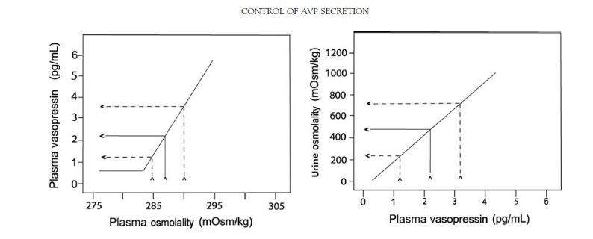
Basal plasma vasopressin : 0/5 to 2 pg/ml
Liner association between plasma osmalirity and AVP
Increasing plasma osmolality is the principal stimulus for AVP release.

Slide 7
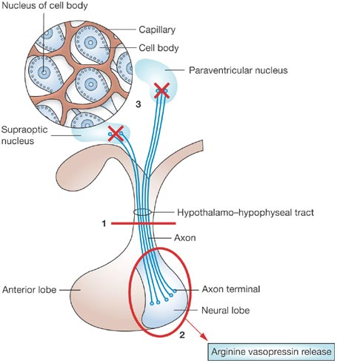
Osmoreceptors project to magnocellular neurons ( PVN & SON) that Hypertonic state set point due to stimulate release of AVP.
threshold of approximately 280-285 mOsmol/kg results in a linear increase
The actions of AVP are mediated by binding to one of three receptors (V1 to V3) on target cells

Slide 9
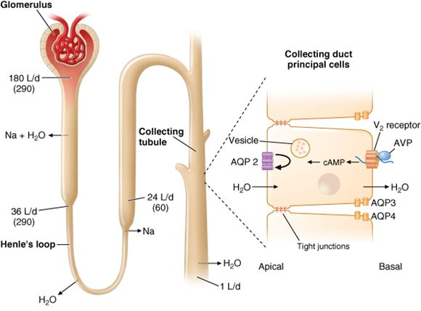
Regulation of water balance is mediated via AVP binding to V2 receptors on renal collecting tubular cells, leading to increased tubular fluid permeability via aquaporin-2 water channels, water retention and urinary concentration

Slide 10
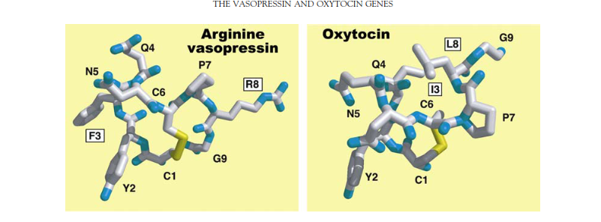
Half life AVP : 5-15 min
No binding protein but attach to Plt
AVP secration in P osm : 285
Thirst threshold : 295

Slide 11
q 1 mmol rise in plasma osm
0/38 pg/ml 100 mmol/kg
AVP urine osm
Max Antidiuretic Effect of AVP : 5-6 pg/ml
Plasma AVP : 0/3( P osm – 280)

Slide 16
Older series reported that 25% to 50% of CDI were idiopathic but better investigative techniques revealed that many “idiopathic” cases are autoimmune .
Pituitary adenomas do not present with CDI, and the syndrome only manifests after surgical intervention. If CDI occurs in the presence of a sellar mass, an alternative diagnosis, such as craniopharyngioma, germinoma, or a granulomatous process should be considered.

Slide 17
Pathophysiology of water balance disorders after pituitary surgery
Acute DI post pituitary surgery(TSS) is relatively common, although the reported incidence is variable, ranging from 0/3-45 %
SIAD also can occur in isolation, with incidences up 28%
Risk factors for development of transient DI vary between studies and have included; tumor size >1 cm, craniopharyngioma , intraoperative cerebrospinal fluid leak, Cushing’s Disease, visual abnormalities on presentation, suprasellar tumor extension and previous non endoscopic lesion resection.

Slide 18
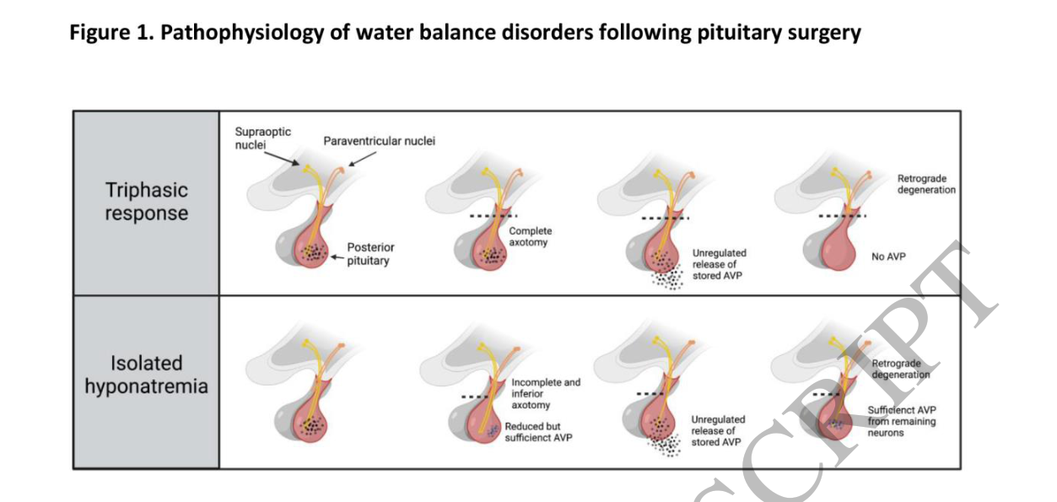
a biphasic phenomenon, where an initial polyuric phase is followed by an antidiuretic phase : 1.1% and 3.4%
**triphasic phenomenon**
Isolated phase 2 : 10-25%

Slide 19
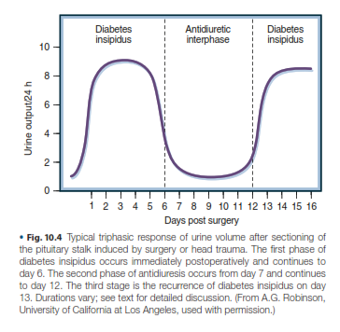

Slide 21
Most cases of early DI are transient and resolve within three to five days postoperatively
Given glucocorticoid deficiency increases AVP secretion, administration of physiological doses of glucocorticoids in the setting of adrenal insufficiency can also unmask DI .

Slide 22
Patients should have free access to fluids and be encouraged to drink to thirst as water balance may be maintained in some patients with increased fluid intake alone. If urine output is excessive, and especially if hypernatremia is developing, the patient is sedated or unable to maintain adequate oral fluid intake, desmopressin
In the early post-operative period, desmopressin should be administered on an “as required” basis via subcutaneous or intravenous injection (not nasal)
If DI persists beyond 48 hours, regular desmopressin is prescribed
monitoring of urine output
Over treatment of DI increases the risk of precipitating hyponatremia,

Slide 23
Permanent Diabetes Insipidus
However prolonged DI, present for two weeks to six months, or chronic (persistent) DI, present for more than six months following surgery can occur in 0/9 -10% of patients
age younger than 50 years
large intrasellar masses
intraoperative CSF leak
elevated plasma sodium >145 mmol/L within five days post-operatively
craniopharyngioma
development of early DI within 24 to 48 hours post-operatively

Slide 24
Back to cases

Slide 25
Case 1 – Triphasic response
This patient demonstrated a triphasic phenomenon post-pituitary surgery, with early DI followed by delayed hyponatremia, and finally developing permanent DI. She maintained symptomatic control of polyuria with up-titration of desmopressin tablets to 200 µg in the morning, and 300 µg at night. Delaying one desmopressin dose each week was recommended, both to assess for ongoing need of desmopressin and prevent hyponatremia. Two years later, she remains on desmopressin for permanent diabetes insipidus but has had full recovery of her anterior pituitary function.

Slide 26
Case 2
This patient had active acromegaly with significant growth hormone excess and experienced marked diuresis secondary to a sudden decrease in growth hormone post-operatively. His polyuria settled by day two post-operatively and he experienced no further water imbalance. This case demonstrates the significant fluid off-loading which can occur in the setting of active acromegaly post-operatively, which is important to differentiate from DI. An absence of thirst should raise clinical suspicion against DI, and biochemical assessment of urine and plasma osmolality and plasma sodium should help determine the etiology of polyuria.

Slide 27
CDI occurs in 20% of moderate or severe cases of TBI and in 15% of non-traumatic sustained SAH.
CDI is almost always transient, but persistent CDI following TBI may indicate increasing intracranial pressure with the risk of cerebellar herniation and is a poor prognostic sign .Careful follow-up of TBI shows that CDI persists in only 7% of patients, most of whom have partial CDI
Permenant CDI after TBI : Poor prognostic indicator
Triphasic management is important post TBI

Slide 28
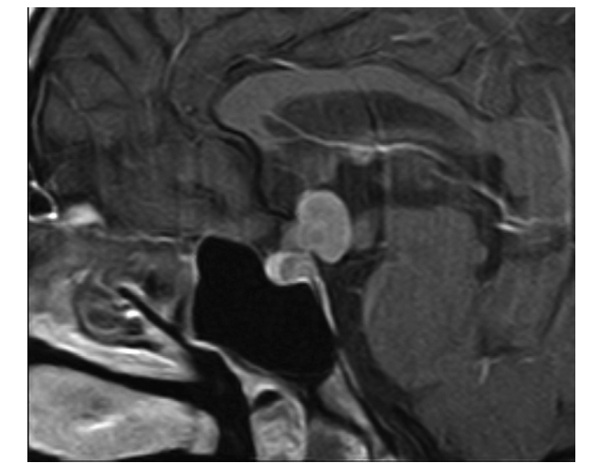
Metastases from distant tumors, particularly breast and lung, may be found in the pituitary, or more often the pituitary stalk. In most cases there are no endocrine sequelae, but occasionally CDI (rapid growth size) may manifest

Slide 29
Adipsic Diabetes Insipidus
The majority of patients with CDI have intact thirst sensation
Loss of thirst, which is the key homeostatic mechanism, predisposes to significant hypernatremia and volume depletion
In a small number of patients, the lesion causing AVP deficiency also damages the osmoreceptors in the anterior hypothalamus, leading to ADI.
More athrotrombotic event in Adipsic DI

Slide 30
Rare disorser
High morbidity and mortality
neurosurgical clipping of anterior communicating artery (ACOM) aneurysms following Subarachnoid Haemorrhage (SAH) and resection of craniopharyngioma and supra sellar pituitary tumors
post-operative DI in 96% of patients with craniopharyngiomas, compared to 30% with suprasellar pituitary tumors and 14% with intra sellar pituitary tumors.
31% of patients with a craniopharyngioma had an altered thirst mechanism

Slide 31
Evaluation Of CDI

Slide 34
Water Deprivation Test (WDT)
The physiological basis for the WDT is that dehydration causes an elevation in plasma sodium concentration, which stimulates AVP release. AVP is carried from the circulation to the kidneys, where it binds to V2 receptors, causing elevation in urine osmolality. If the stimulus to AVP secretion is sufficient (plasma osmolality >295 mOsm/kg), urine osmolality should rise to over 700 mOsm/kg.

Slide 40
While the WDT may differentiate between PP, complete CDI, and severe NDI, differentiation may be difficult in a number of clinical scenarios:
1-Subjects with PP may not maximally concentrate urine despite a rise in plasma AVP concentration, as overdrinking suppresses AVP secretion and intracellular aquaporin-2 stores are depleted. Patients with PP may thus be misclassified as partial diabetes insipidus
2. In partial CDI, residual AVP secretion can induce urinary concentration (possibly due to upregulation of V2 receptors. This makes partial CDI difficult to distinguish from PP.
3. In NDI, the elevation in plasma AVP concentrations in response to water deprivation can be sufficient to partially overcome renal resistance to AVP, resulting in diagnostic confusion

Slide 41
A number of clinical symptoms raise the possibility of primary polydipsia (PP) rather than CDI :
If the patient has daytime symptoms but has an uninterrupted night’s sleep without nocturia
2. If the patient wakes at night with the need to drink rather than to pass urine
3. Associated psychiatric disease; polydipsia occurs in 20% of patients with schizophrenia

Slide 42
Measurement of AVP
poorly sensitive
inaccurate at low physiological plasma concentrations.
unstable in plasma at room temperature, and needs careful sample handling and storage at –70°C.
diagnostic accuracy of only 46%
plasma AVP concentrations is not a practical solution to the limitations of the WDT.

Slide 43
Hypertonic saline infusion
When the results of WDT are inconclusive, direct measurement of plasma AVP responses to osmotic stimulation with the intravenous infusion of hypertonic (3-5%) sodium chloride solution can reliably distinguish between CDI and NDI or PP
Patients with NDI or PP respond to osmotic stimulation with normal plasma AVP concentrations, while subnormal AVP responses are diagnostic of CDI, with distinction between complete and partial CDI

Slide 44
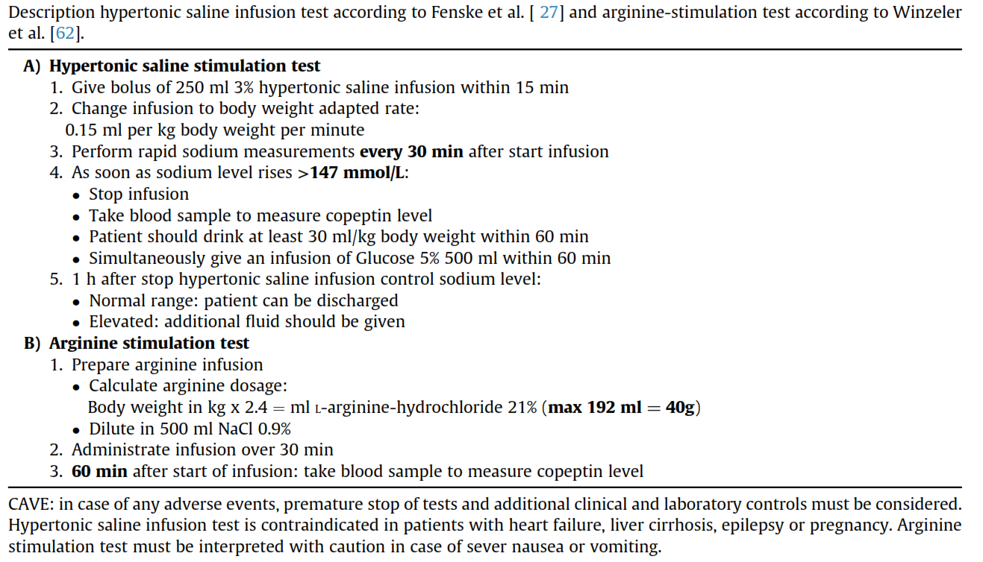

Slide 46
Many clinicians are reluctant to use the hypertonic saline infusion test. Patients with complete CDI may develop significant hypernatremia, which emphasizes the need for pretest hydration, particularly in patients with severe polyuria. The test should be performed in a specialized unit and the patient closely supervised. The infusion should be into a large, antecubital vein, and the patient should be kept warm with a space blanket. Unpleasant effects such as hypernatremia and thrombophlebitis were much commoner with 5% saline infusion than the more commonly used 3% saline infusion. The test is contraindicated in patients with seizure disorder and needs to be very carefully used in patients with neurocognitive disorders.

Slide 47
Measurement of plasma copeptin
Copeptin is the biologically inert C-terminal locus, enzymatically cleaved from the AVP precursor, provasopressin, and co-secreted from the posterior pituitary, in response to osmotic and baro receptor stimuli

Slide 49
The same group have also demonstrated, in a prospective multicenter study, that a post-trans sphenoidal surgery copeptin concentration of <2.5 pmol/L had a predictive value of 81% for CDI with a specificity of 97%
If copeptin >30 pmol/lit : CDI was excluded
Single copeptin >21/4 pmol/lit : NDI
Single copeptin < 2/6 pmol/lit : CDI complete

Slide 52
Measurement of thirst
Thirst responses in CDI show a physiological pattern of linear elevation during osmotic stimulation and suppression after drinking which demonstrates that the control of thirst is maintained in CDI
Measurement of thirst is simple and cheap and a useful diagnostic adjunct to the investigation of polyuric states. Absent osmoregulated thirst during WDT or hypertonic saline infusion is the gold standard for the diagnosis of adipsic CDI and reset osmostat syndromes

Slide 54
Newer Tests
Christ Crain et al have recently published data showing that a plasma copeptin cut off of 3.5 pmol/L after 60 minutes of intravenous infusion of arginine had a diagnostic accuracy of 93% in the differential of CDI and PP

Slide 56
MRI
The posterior pituitary ordinarily shows as a hyperintense area on T1 weighted images, which has been attributed to the presence of AVP secretory granulesth :
the posterior pituitary “bright spot.”
The classical MRI appearance in CDI is loss of the posterior pituitary bright spot, which represents depletion or absence of stored AVP granules

Slide 58
up to 25% of older healthy individuals have been estimated to have loss of the bright spot, despite intact AVP secretion , with a smaller number of younger healthy individuals having a loss of the bright spot
a recent study using modern imaging showed that 20% of patients with assay-proven complete CDI and 40% with partial CDI had persistence of the posterior pituitary bright spot, while 40% of patients with PP had loss of the hyperintense posterior pituitary signal

Slide 59
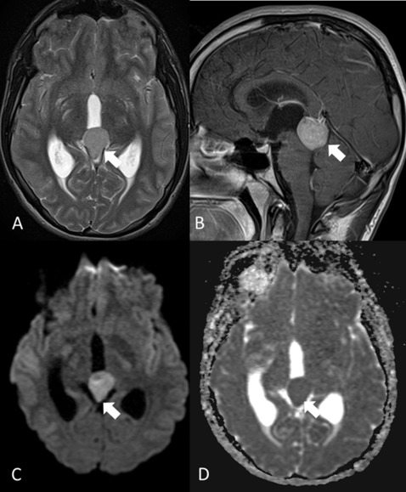
Germinomas can occur in the posterior pituitary, but more often in the infundibulum or suprasellar region , which are iso- or hyperintense on both T1 and T2 weighted images It is important to note that the initial MRI scan may be normal in patients with germinoma

Slide 60
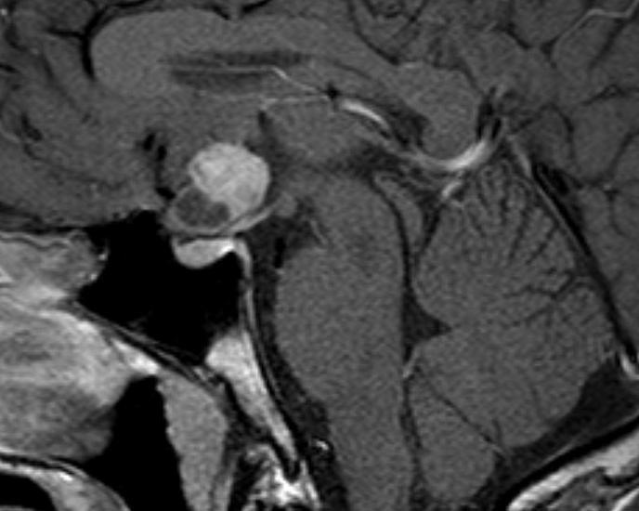
Pituitary gliomas rarely cause diabetes insipidus, and manifest on MRI as hypointense on T1 weighted images and markedly hyperintense on T2 weighted images

Slide 61
Patients with CDI usually undergo dynamic testing for anterior pituitary hormone deficiencies. Patients with craniopharyngioma and CDI are very likely to have coincidental anterior hypopituitarism but, in contrast, patients with idiopathic/autoimmune diabetes insipidus usually have intact anterior pituitary function

Slide 62
Management of Central Diabetes Insipidus

Slide 63
Pharmacological Management of CDI
AVP is a nonapeptide hormone, with a short plasma half-life of 5 to 10 minutes.
dDAVP [deamino D-arginine vasopressin, desmopressin] has been modified by the removal of the amino group of the cysteine amino acid to prolong half-life from 5 minutes to 6 to 8 hours
This allows dDAVP to be administered twice or 3 times daily. In addition D-arginine has been substituted for L-arginine, which eradicates the vasopressor actions of AVP

Slide 64
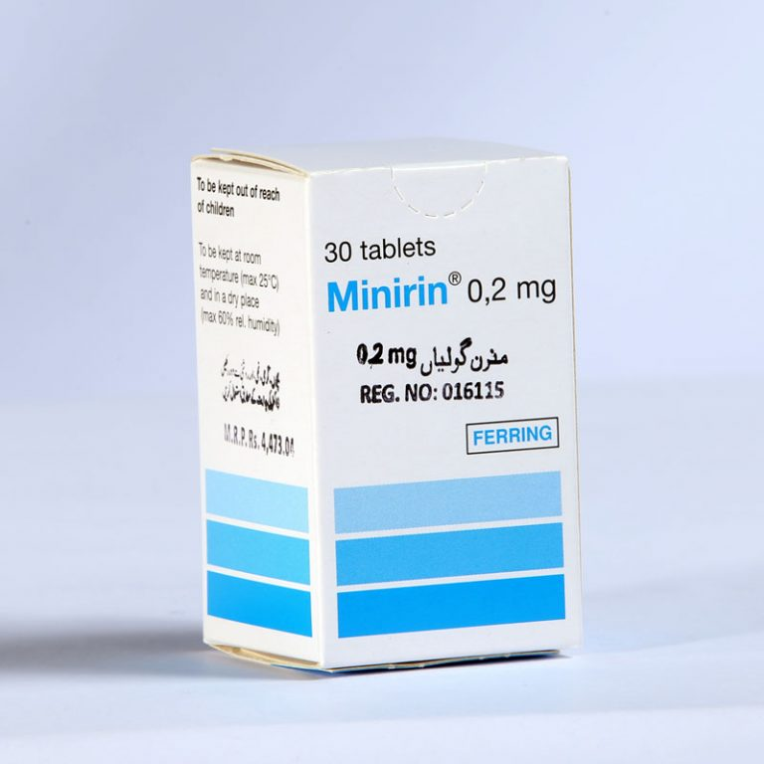
dDAVP is available in a parenteral, oral, and nasal forms:
Oral dDAVP : tab 0/1 & 0/2
Peak clinical act : 2 hours
40% reduction in absorption within
90 min of a standard meal

Slide 65
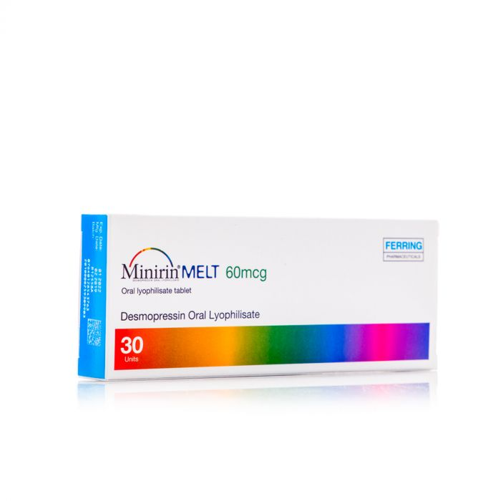
sublingual preparations “desmotabs melt”

Slide 66
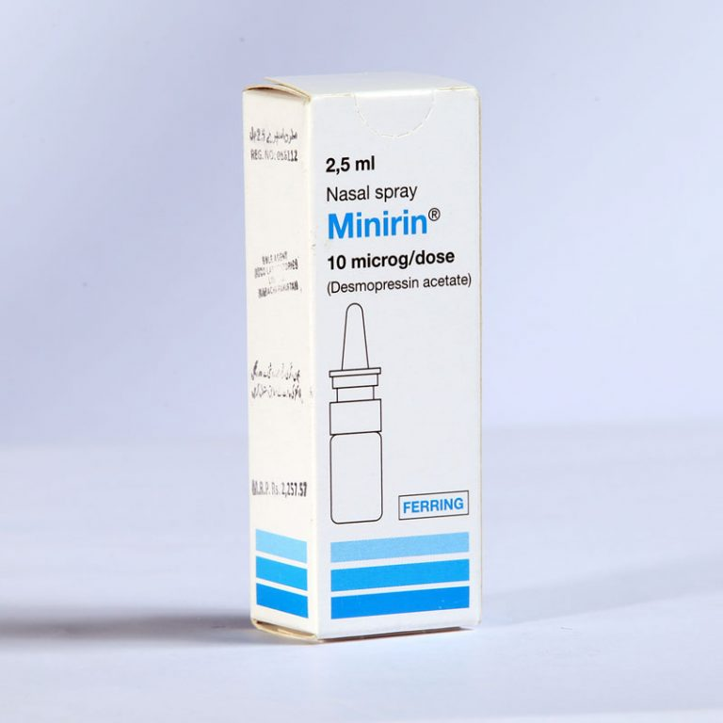
Nasal DDAVP
The intranasal formulation of dDAVP was the earliest treatment for chronic CDI
duration of antidiuretic effect is more variable than the oral dose at 5 to 21 hours
The effectiveness of nasal dDAVP is reduced by nasal mucosa inflammation, congestion, or scarring, and it cannot be used after transsphenoidal surgery,

Slide 67
Parenteral DDAVP
dDAVP is available for administration via the intravenous or subcutaneous route.
The peak antidiuretic response after an intravenous dose of 1 μg occurs within 12 hours, with dosage increase to 8 μg prolonging duration of the action to 48 hours
Parenteral dDAVP is useful perioperatively and in the management of transient CDI after TBI or trans sphenoidal surgery

Slide 68
Other treatments
Carbamazepine acts directly on V2 receptors to stiulate synthesis of aquaporin 2 expression
Chlorpropamide potentiates AVP action by upregulation of the V2 receptors
Clofibrate stimulates AVP release from the neurohypophysis
Safety of DDAVP is more than all of them

Slide 69
Acute CDI after TSS is usually transient and may recede after a single dose of parenteral dDAVP. Further parenteral doses are only required if polyuria persists; a recent survey of pituitary endocrinologists found a strong consensus for the use of “on-demand” postoperative dDAVP rather than regular dosage

Slide 70
Management of Chronic Diabetes Insipidus
in partial CDI, a single nocturnal dose will control nocturia allowing unbroken sleep, providing daytime symptoms are tolerable
Patients with complete CDI may need oral or nasal dDAVP 2 to 3 times daily
When dDAVP is prescribed, there is constant antidiuresis and any fluid intake is retained, and hyponatremia is consequently a common side effect of dDAVP therapy .It has been suggested that dDAVP-induced hyponatremia is commoner in women

Slide 71
Chronic mild hyponatremia is associated with gait abnormalities, increased risk of falls, osteoporosis and increased fracture risk, and increased mortality so avoidance of water overload is important
A postmarketing therapy review has reported that oral formulations were less associated with hyponatremia than nasal sprays
Most hyponatremia associated with dDAVP therapy is mild, transient and asymptomatic and withholding a dose of dDAVP allows restoration of normonatremia (Drug holiday)

Slide 72
During Fasting : Parenteral dDAVP is supervised perioperatively by the endocrine team, and isotonic fluids and regular electrolyte monitoring are continued while fasting. The return to oral fluids and dDAVP should also be planned with endocrine input.
Care with alcohol intake is recommended for patients with CDI. Chronic alcohol consumption is associated with chronic hyponatremia

Slide 73
Diabetes Insipidus in Pregnancy
Normal pregnancy is associated with downward resetting of the osmotic thresholds for AVP secretion and thirst, so that basal plasma sodium concentration is typically lower by 5 mmol/L than the prepregnancy state
CDI may develop de novo during pregnancy due to conditions such as lymphocytic hypophysitis
pre-existing partial CDI may become clinically apparent due to the metabolic actions of placental cysteine aminopeptidase, an enzyme which increases metabolic clearance of oxytocin and AVP
Tx : DDAVP category B

Slide 74
As dDAVP is modified to remove vasoconstrictor activity of dDAVP, there should be no effects on maternal blood pressure or risk of pre-eclampsia, and as dDAVP has no affinity for V1 receptors on uterine myometrium there is no association with preterm labor. There is minimal transfer of dDAVP to breastmilk, and no effect on water balance in the infant

Slide 75
Adipsic Diabetes Insipidus
Treatment of ADI compromises twice daily dDAVP to fix urinary output along with a fixed fluid intake
daily fluid intake of 1.5 to 2 L
advised to weigh themselves daily
Sudden weight gain make reflect fluid overload and the risk of hyponatremia
frequent measurement of plasma sodium
The prognosis with ADI is poor

Slide 76
Thank you

