Slide 2
Well Differentiated Thyroid Cancer
Hamidreza Zakeri ,MD
Associated Proffessor
TUMS

Slide 3
Examined trends in incidence & mortality of thyroid cancer in U.S.
↑ incidence from 3.6/100,000 in 1973 to 8.7/100,000 in 2002; a 2.4 fold increase
All of ↑ due to PTC – 2.9 fold increase
49% of PTC <1 cm & 87% <2 cm
Mortality was stable 0.5/100,000
Increased incidence in the U.S. is predominantly due to increased detection of small papillary cancers not ↑ in true occurrence of thyroid cancer
JAMA: May 10, 2006

Slide 4
Surveillance, epidemiology, end results (SEER-9) data base
1974 to 2013
77,276 patients; 75% women; mean age 48
↑ incidence 3.6% per year
↑ mortality from 1.1% to 2.9%
JAMA 317:1338, 2017

Slide 5
Conclusions
Dramatic ↑ in thyroid cancer in past 40 years
Some attributed this to ‟overdiagnosis”
This landmark study provides strong evidence for a true ↑ in occurrence
Mortality also ↑ probably
Causes: radiation, endocrine-disrupting chemicals, obesity and smoking
JAMA 317:1338, 2017

Slide 6
Goals of initial therapy of DTC
Improve overall and disease-specific survival
Reduce the risk of persistent/recurrent disease and associated morbidity
Permit accurate disease staging and risk stratification
minimizing treatment-related morbidity and unnecessary therapy

Slide 7
preoperative staging with diagnostic imaging and laboratory tests
Neck imaging
Ultrasound
CT/MRI/PET

Slide 8
Neck ultrasound
Preoperative neck US for cervical (central and especially lateral neck
compartments) lymph nodes is recommended for all patients
undergoing thyroidectomy for malignant or suspicious for malignancy
cytologic or molecular findings
US-guided FNA of sonographically suspicious lymph nodes ≥8–10mm
in the smallest diameter should be performed to confirm malignancy
if this would change management

Slide 9
Neck—CT/MRI/PET
Preoperative use of cross-sectional imaging studies (CT, MRI) with
intravenous (IV) contrast is recommended as an adjunct to US for
patients with clinical suspicion for advanced disease, including
invasive primary tumor, or clinically apparent multiple or bulky lymph
node involvement.
Routine preoperative 18FDG-PET scanning is not recommended

Slide 10
Measurement of serum Tg and anti-Tg antibodies
Routine preoperative measuremen of serum Tg or anti-Tg
antibodies is not recommended.

Slide 11
Operative approach for a biopsy diagnostic for follicularcell–derived malignancy

Slide 12
Near-total or total thyroidectomy
Thyroid cancer >4 cm
Gross extrathyroidal extension (clinical T4)
Clinically apparent metastatic disease to
Nodes (clinical N1)
Distant sites(clinical M1)

Slide 13
Bilateral procedure (near total or total thyroidectomy) or A unilateral procedure(lobectomy)
Thyroid cancer >1 cm and <4 cm
without extrathyroidal extension
without clinical evidence of any lymph node metastases (cN0)

Slide 14
36-Year-Old Woman
Evaluated for a thyroid nodule. US shows a 3.2 x 1.6 x 2.2 cm solid, right thyroid mass; no abnormal adenopathy. FNA → PTC
Which of the following is an appropriate surgical treatment?
Right lobectomy
Total thyroidectomy (TTx)
Total Tx plus CCND
Either A or B

Slide 15
Thyroid lobectomy alone may be sufficient initial treatment for low-risk papillary and follicular carcinomas; however, the treatment team may choose total thyroidectomy to enable RAI therapy or to enhance follow up based upon disease features and/or patient preferences

Slide 16
Thyroid lobectomy
Thyroid cancer <1 cm without extrathyroidal extension and cN0
Thyroid lobectomy alone is sufficient treatment for small, unifocal, intrathyroidal carcinomas in the absence of prior head and neck radiation, familial thyroid carcinoma, or clinically detectable cervical nodal metastases.

Slide 17
22-Year-Old Woman
Found to have a left thyroid nodule on pre-employment exam. US showed a 9 mm solid left lobe nodule without suspicious adenopathy. FNA was positive for PTC. TSH is 2.8 mIU/L
What is her optimal management?
Left lobectomy
TTX
TTX plus lateral neck dissection
Begin T4 suppressive Rx and follow

Slide 18
22-Year-Old Woman
Lobectomy showed a solitary 0.9 cm PTC; no abnormal nodes were identified.
What further Rx do you recommend?
Rx with 30 mCi ¹³¹I
Rx with 100 mCi ¹³¹I
Follow & start LT4 if TSH ↑
Completion thyroidectomy

Slide 19
PTMC
Lobectomy alone seems adequate Rx for most pt
No central neck dissection is necessary
¹³¹I Rx is not required
LT4 Rx with partial TSH suppression
Outcome is excellent with recurrence <5% & mortality <1%
Follow with TSH, Tg & US

Slide 20
Lymph Node Metastasis

Slide 21
Surgical Levels of the Neck

Slide 22
Cervical Lymph Nodes
Approximately 300 lymph nodes in the normal neck
Typically can identify 6-20 nodes by ultrasound
Nodes are more prominent with infections, mononucleosis, dental procedures and Hashimoto thyroiditis

Slide 23
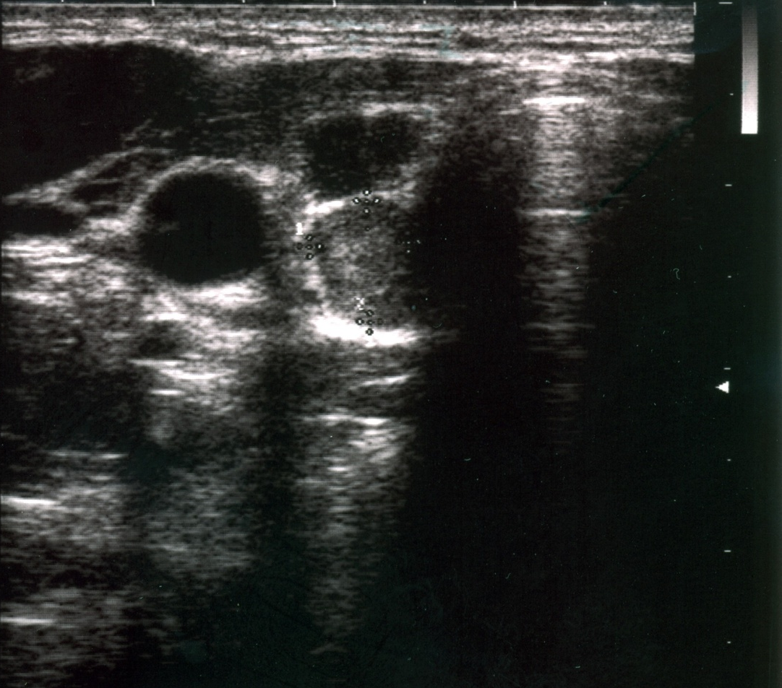
Pre-op Evaluation of Central Compartment
Thyroid nodule
Carotid
Metastatic paratrachael lymph node

Slide 24
Preop Imaging
DTC clinically involves lymph nodes in 20-50% of patients (micrometastasis in up to 90%)
Pre-op US identifies suspicious nodes in 20-30% of cases
Surgical management is altered in the presence of lateral neck metastasis to include total thyroidectomy plus lateral neck dissection

Slide 25
Points to Consider Before Lymph Node Dissection
Central neck dissection (CND)
Elective vs therapeutic
Unilateral vs bilateral
First op vs Reop
FNA confirmed?
RLN & PTH function
Lateral neck
Always therapeutic
Must be compartmental & not “berry picking”

Slide 26
Lymph node dissection
Thyroidectomy without prophylactic central neck dissection is appropriate for small (T1 or T2), noninvasive, clinically node-negative PTC (cN0) and for most follicular cancers.
Therapeutic lateral neck compartmental lymph node dissection should be performed for patients with biopsy-proven metastatic lateral cervical lymphadenopathy.

Slide 27
Lymph node dissection
Therapeutic central-compartment (level VI) neck dissection for patients with clinically involved central nodes should accompany total thyroidectomy to provide clearance of disease from the central neck.
Prophylactic central-compartment neck dissection (ipsilateral or bilateral) should be considered in patients with papillary thyroid carcinoma with clinically uninvolved central neck lymph nodes (cN0) who have advanced primary tumors (T3 or T4) or clinically involved lateral neck nodes (cN1b), or if the information will be used to plan further steps in therapy.

Slide 28
What is the appropriate perioperative approach to voice and parathyroid issues?

Slide 29
What are the basic principles of histopathologic evaluation of thyroidectomy samples?
Status of resection margins
The presence of vascular invasion and the number of invaded vessels
Number of lymph nodes examined and involved with tumor
Size of the largest metastatic focus to the lymph node
Presence or absence of extranodal extension of the metastatic tumor

Slide 30
Histopathologic variants of thyroid carcinoma associated with
More unfavorable outcomes
(tall cell, columnar cell, and hobnail variants of PTC; widely invasive FTC; poorly differentiated carcinoma)
More favorable outcomes
(encapsulated follicular variant of PTC without invasion, minimally invasive FTC)

Slide 31
What initial stratification system should be used to estimate the risk of persistent/recurrent disease?
Low-risk patients
Intrathyroidal DTC with no evidence of extrathyroidal extension,
vascular invasion, or metastases.
Intermediate-risk patients
Microscopic extrathyroidal extension, cervical lymph node
metastases, RAI-avid disease in the neck outside the thyroid bed,
vascular invasion, or aggressive tumor histology
High risk patients
Gross extrathyroidal extension, incomplete tumor resection, distant
metastases, or inappropriate postoperativeserum Tg values

Slide 32
AJCC 7th Edition/TNM Classification System for Differentiated Thyroid Carcinoma

Slide 33
AJCC 7th Edition/TNM Classification System for Differentiated Thyroid Carcinoma

Slide 34
TNM Classification

Slide 35
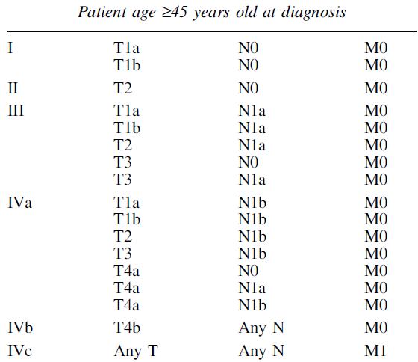
TNM Classification

Slide 36
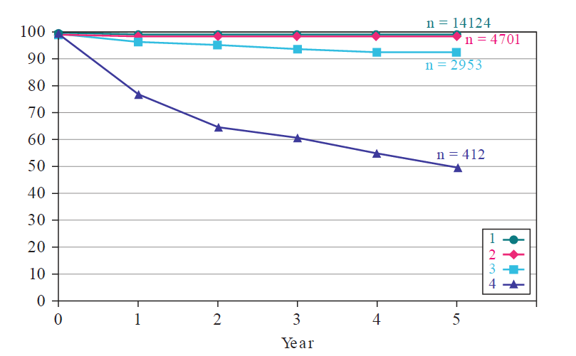
Survival rates of patients with different stages of papillary cancer.]: AJCC Cancer Staging Manual, 7th ed. New York, Springer, 2010, pp 87–92.)

Slide 37
Should postoperative disease status be considered in decision-making for RAI therapy for patients with DTC?
Evaluation of postoperative disease status may be performed by a number of means including:
Serum Tg
Neck ultrasonography
Iodine radioisotope scanning
There are currently no RCTs comparing any particular postoperative diagnostic strategy with the intention of modulating decision-making on RAI remnant ablation or RAI treatment for DTC.

Slide 38
RAI (including remnant ablation, adjuvant therapy) after thyroidectomy
Not routinely recommended after thyroidectomy for ATA low-risk DTC patients
Not routinely recommended after lobectomy or total thyroidectomy for patients with unifocal or multifocal papillary microcarcinoma in the absence of other adverse features
Should be considered after total thyroidectomy in ATA intermediate-risk level DTC patients
Routinely recommended after total thyroidectomy for ATA high risk DTC patients

Slide 39
RAI for Low Risk PTC
Remnant ablation does not improve (favorable) outcome
Recurrences and deaths are both low
Most recurrences are locoregional, readily detected by US and best Rxd surgically
RAI is not effective Rx for neck recurrence
Consider alcohol ablation as a good alternative when recurrence is local & limited

Slide 40
Radioiodine Scan & Treatment

Slide 41
Postop ¹³¹I scan
THW | LT4 withdrawal x 6 wks; administer T3 x 4 wks; stop T3 x 2 wks; measure TSH (≥30 mIU/L); perform WBS
rhTSH | Continue LT4 Rx; administer 0.9 mg rhTSH IM x 2 days; measure TSH & Tg & perform WBS

Slide 42
Can rhTSH (Thyrogen) be used as an alternative to thyroxine withdrawal for remnant ablation or adjuvant therapy in patients who have undergone near-total or total thyroidectomy?
In patients with:
ATA low-risk
ATA intermediate risk DTC without extensive lymph node involvement
(T1–T3, N0/Nx/N1a,M0)
DTC of any risk level with significant comorbidity

Slide 43
Postop ¹³¹I Ablation
Remnant ablation with 30 to 50 mCi ¹³¹I
Adjuvant therapy 100-150 mCi ¹³¹I
Optimal TSH >30 mIU/L
Ablation equally effective after THW or rhTSH
Obtain Post-Rx WBS 3-5 days after Rx

Slide 44
What is the appropriate degree of initial TSH suppression?
High-risk thyroid cancer patients, initial TSH suppression to below 0.1 mU/L is recommended
Intermediate-risk thyroid cancer patients, initial TSH suppression to 0.1– 0.5 mU/L is recommended
Low-risk patients who have undergone remnant ablation and have
Undetectable serum Tg levels, TSH(0.5–2mU/L)
low-level serum Tg levels, TSH (0.1–0.5 mU/L)

Slide 45
Conclusions – 1
Recent ↑ in thyroid cancer incidence is associated with a true ↑ in occurrence as well as mortality
PTMC is common, usually incidentally detected, best Rxd with lobectomy & has great outcome
Lymph node metastasis are common in PTC but the value of prophylactic CND is debated
Postop neck US can detect nodal mets & permit US-guided FNA & Tg washout
Pt with micronodules, even with high suspicion for PTC, should be monitored rather than surgery

Slide 46
Conclusions – 2
Postop ¹³¹I scan can be obtained by rhTSH or THW; RAI remnant ablation is preferred with smaller doses
Most low risk PTC pt do not require RAI remnant ablation
Tg determination is valuable in FU of thyroid cancer; but TgAbs limit its use
FDG PET/CT is useful imaging when Tg+, WBS-, especially when Tg ≥10 ng/mL
FDG positive mets are not iodine avid

Slide 47
65-Year-old Man
Referred because of a recent thyroid incidentaloma. Chest CT, performed for evaluation of metastatic colon cancer, revealed a left thyroid nodule. US shows a single, 10 mm, solid, hypoechoic nodule with microcalcifications. He has CAD, DM, HTN, and DJD
Which of the following would be an appropriate next step?
Order isotope scan
Proceed with FNA
Perform lobectomy
Ignore nodule & dismiss pt
Monitor

Slide 48
Active Surveillance (Deferred Intervention)
No need for FNA if you plan to follow
Patients with known or highly suspected cancer
Therapeutic delay (deferred intervention) has no clinically significant impact
Therapy, when indicated, still effective
Not palliative care or watchful waiting
Classic example
Small volume prostate cancer

