Slide 1
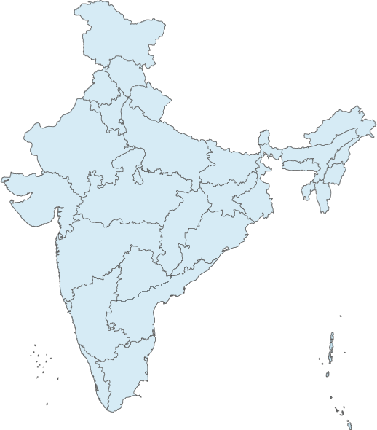
DR. PRADEEP CHOWBEY
MS, MNAMS, FRCS (London), FIMSA,
FAIS, FICS, FACS, FIAGES, FALS
Laparoscopic Surgeon to the President of India
Surgeon to His Holiness Dalai Lama
President – International Federation for the Surgery of Obesity &
Metabolic Disorders (IFSO) (2012 – 2013)
President – IFSO - Asia Pacific Chapter (2011 – 2013)
President - Obesity Surgery Society of India (OSSI) (2006 – 2010)
Founder President - Asia Pacific Hernia Society
Trustee & Past President – Indian Assoc. of Gastrointestinal Endo-Surgeons
Chairman
Max Institute of Minimal Access, Metabolic & Bariatric Surgery
New Delhi, India

Slide 2
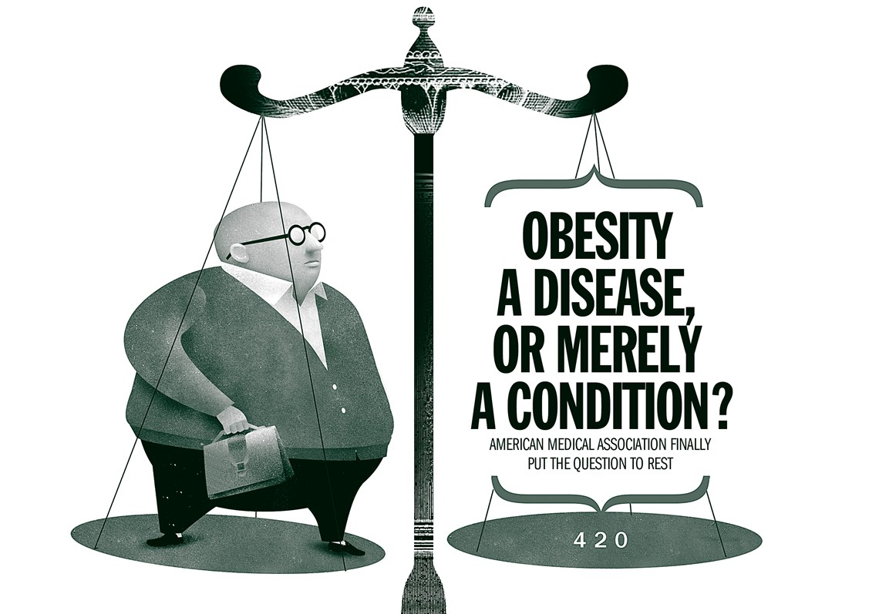

Slide 3
Does it matter
?

Slide 4
Disease
A departure from state of health, especially when caused by a structural change
Oxford

Slide 5
Disease
A condition in which bodily health is seriously attacked, deranged or impaired
Webster’s

Slide 6
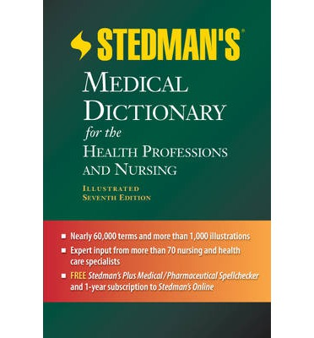
Disease
An interruption, cessation or disorder of body functions, systems or organs
Stedman’s

Slide 7
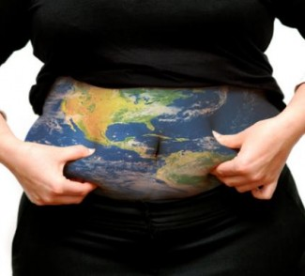
Global nature of obesity epidemic was formally recognized by WHO consultation in 1997

Slide 8
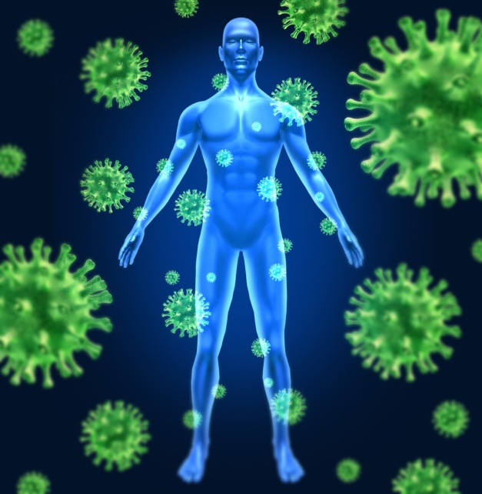

Slide 9
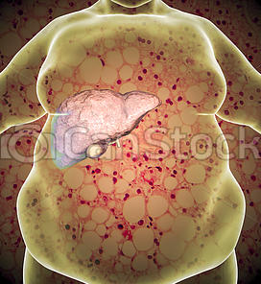

Slide 10
Obesity is a complex disease condition mediated through the interplay of multiple
Genetic
Biologic
Metabolic
Social
Behavioral
Economic
Cultural

Slide 11
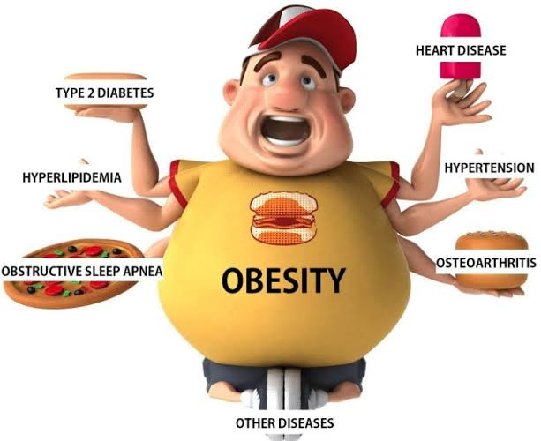

Slide 12
The Reality

Slide 13
Obesity Increases Risk For Diabetes Most (BMI > 35)
Field AE, Arch Intern Med 2001;161:1581-6
77,690 females and 46,060 males adjusted for age, smoking, race, 10-year risk

Slide 14
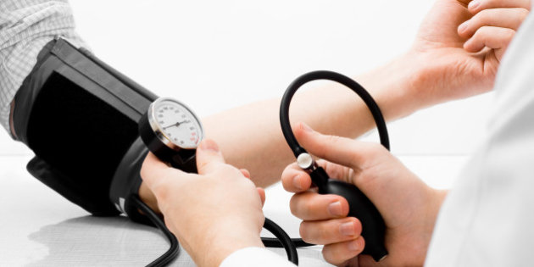
Hypertension & obesity
Men 78%
Women 64%
Framingham offspring study
Garrison RJ et al
Prev Med 1987

Slide 15
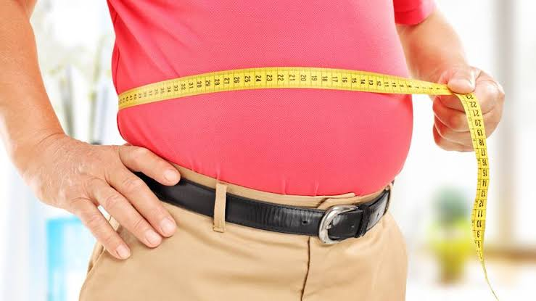
High waist circumference increases risk of death by 35%

Slide 16
Increased risk of cancer and obesity
Kidney
Endometrial
Colorectal
Gall Bladder
Post menopausal breast cancer
Manick SD et al
QJM - 1999

Slide 17
Consequences
Obese people die 8 – 10 yrs sooner than those of normal weight, similar to smokers.
With every 15 extra kgs, death risk increases by 30%
Obesity is responsible for 1 – 3% of total health expenditure in most countries.
OECD – organisation for economic co-peration & development

Slide 18
Growth in Obesity related lost DAYs slowed in developed economies but almost doubled in developing economies
+ 17%
+ 90%
2895
2985
2542
727
985
518
WHO Global burden of disease database McKinsey Global Institute analysis

Slide 19
Healthcare cost rise as BMI increases
1447
1493
1274
1052
805
W.W. Tigbe et al A patient centred approach to estimate total annual healthcare cost by body mass index in the UK counterweight prog” Int. Journal of Obesity Aug, 2013

Slide 20
Social burdens
(created by human beings)
WHO Global Burden of disease database McKinsey Global Institute analysis, Nov 2014

Slide 21
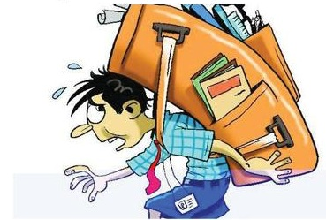
Generalized poor health of Nations both ‘Medically & Economically’

Slide 22
2013
Obesity is a disease

Slide 23
Diagnosis and treatment of Obesity becomes Physician’s professional obligation

Slide 24
Health Insurance companies to reimburse physicians for Obesity
Screening
Treatment
Referral

Slide 25
Improved training in residency program

Slide 26
Reduced stigma

Slide 27
Improved insurance benefits

Slide 28
Increased research funding

Slide 29
Bariatric surgery is the best known approach to CONTAIN obesity

Slide 30
Plateau progress
Increasing Obesity Incidence

Slide 31
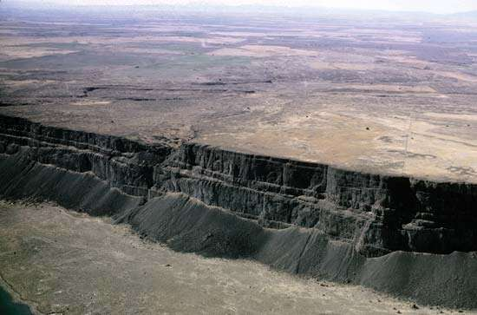
Plateau progress
Increasing Obesity Incidence
Arrested growth of surgeries

Slide 32
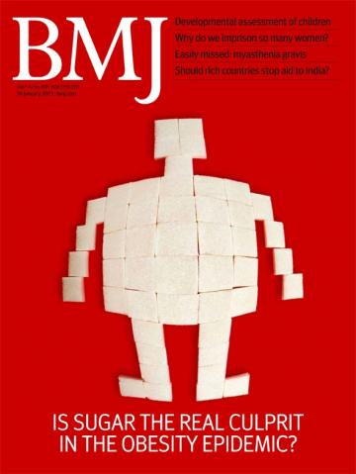
Currently less than 1% of those satisfying the qualifying criteria actually chose to go forward with surgery
Kai Rabenstein
BMJ 2014

Slide 33
Fear of operative complications
Poor knowledge of obesity / bariatric surgery amongst GPs and Physicians
*greatest barriers to wider access of bariatric surgery
Kai Rabenstein
BMJ 2014

Slide 34
Introspection

Slide 35
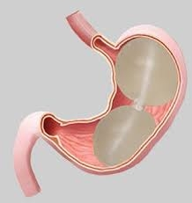
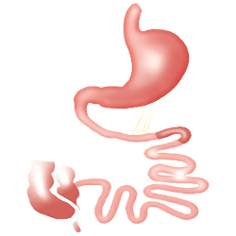
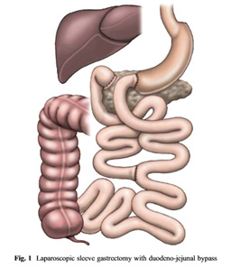
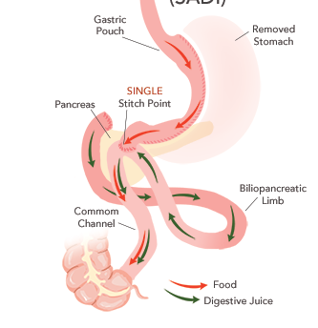
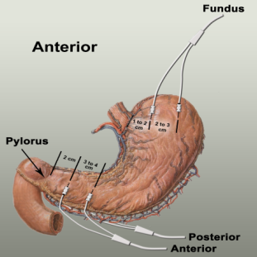
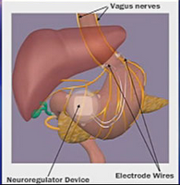
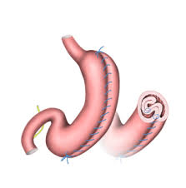
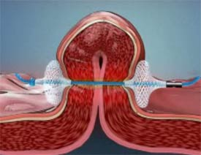
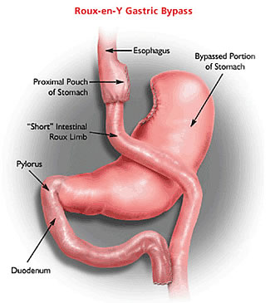
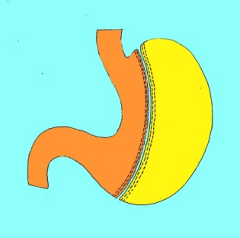
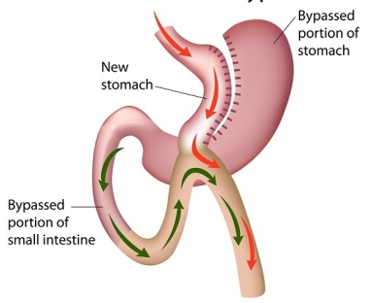
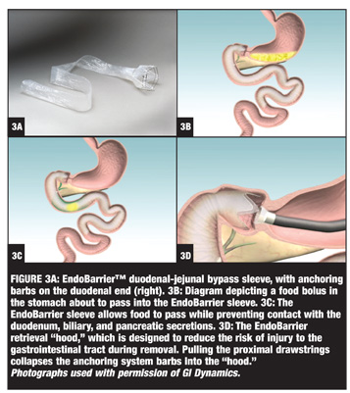
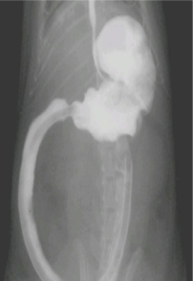
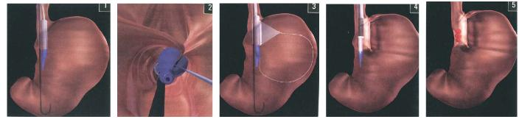
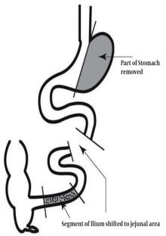
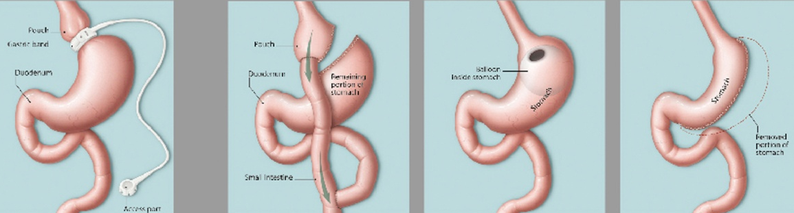
A dilemma for surgeons !
Excised stomach
Obesity

Slide 36
Lack of uniformity

Slide 37
Ethics of treatment and guidelines

Slide 38
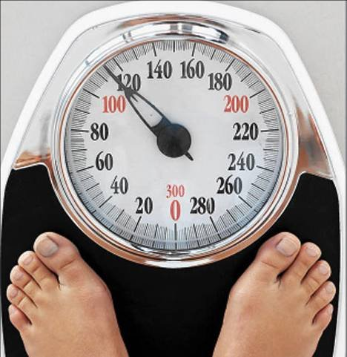
Failure of Bariatric surgery
Inadequate wt. loss
Weight regain
Insufficient co-morbidity
Remission / Resolution

Slide 39
Surgeon perspective
Patient perspective

Slide 40
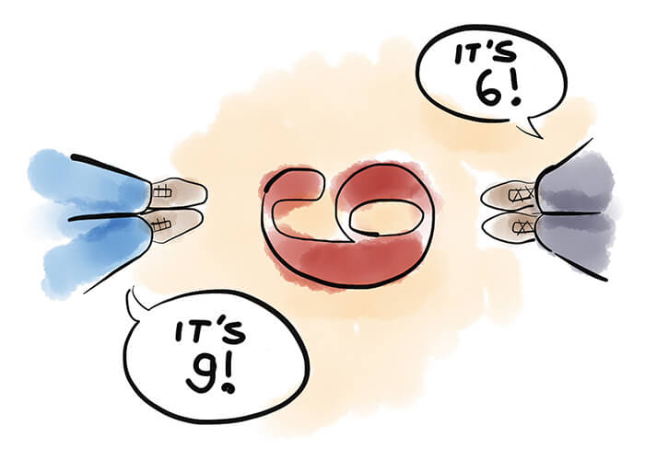
Surgeon perspective
Surgeon
Patient
Patient perspective

Slide 41
Surgeons perspective
< 50% EWL
>50% wt. regain of primary loss
Insufficient co-morbidity
resolution
Resurgence of disease

Slide 42
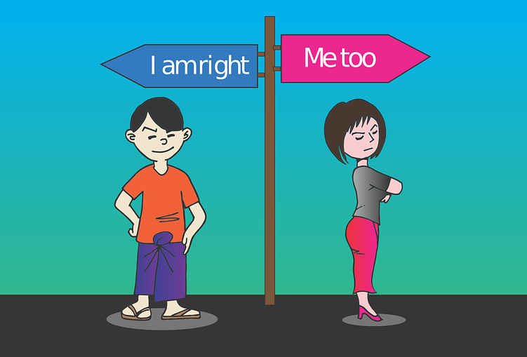
Patients perspective
Unrealistic expectations i.e
Ideal wt. (100% EWL)
Complete remission
without medication
Or may be better !

Slide 43
Are we responsible !

Slide 44
Has the procedure failed ?
or
Has the patient failed the procedure ?

Slide 45
Evolution of a surgeons mind
Give your best the first time (BPD, RYGB)
Give the simplest the first time (LAGB, LSG)
Bypasses or sleeve plus

Slide 46
Purely malabsorptive procedures are dead?
Combined procedures are restricted to high volume centres.
SG & MGB are gaining popularity.

Slide 47
There is an increasing appetite amongst patients and surgeons for less risky procedures even if it comes at a cost of less weight loss / outcome
!
Notes:
Safety first
Good short term results
Long term?

Slide 48
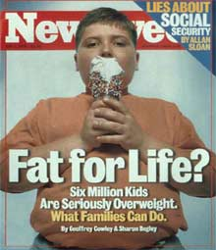
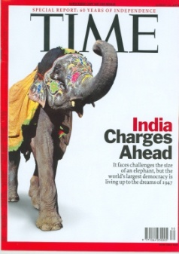
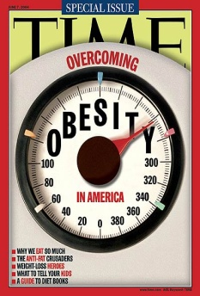
Differentiate between awareness and media glare

Slide 49
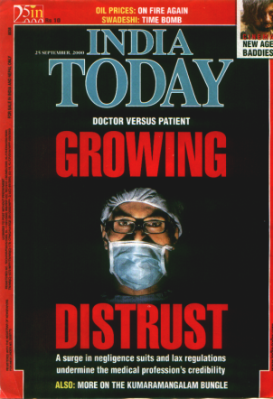
Differentiate between awareness and media glare

Slide 51
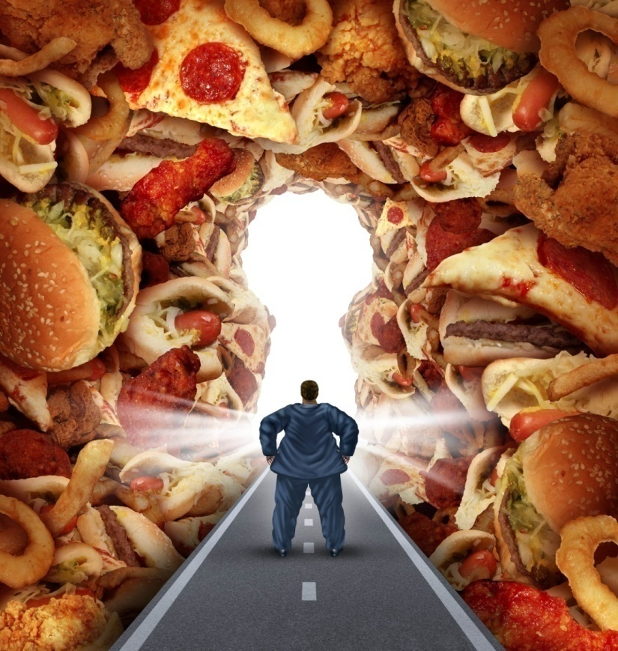
What lies ahead depends on what we do today!

Slide 52
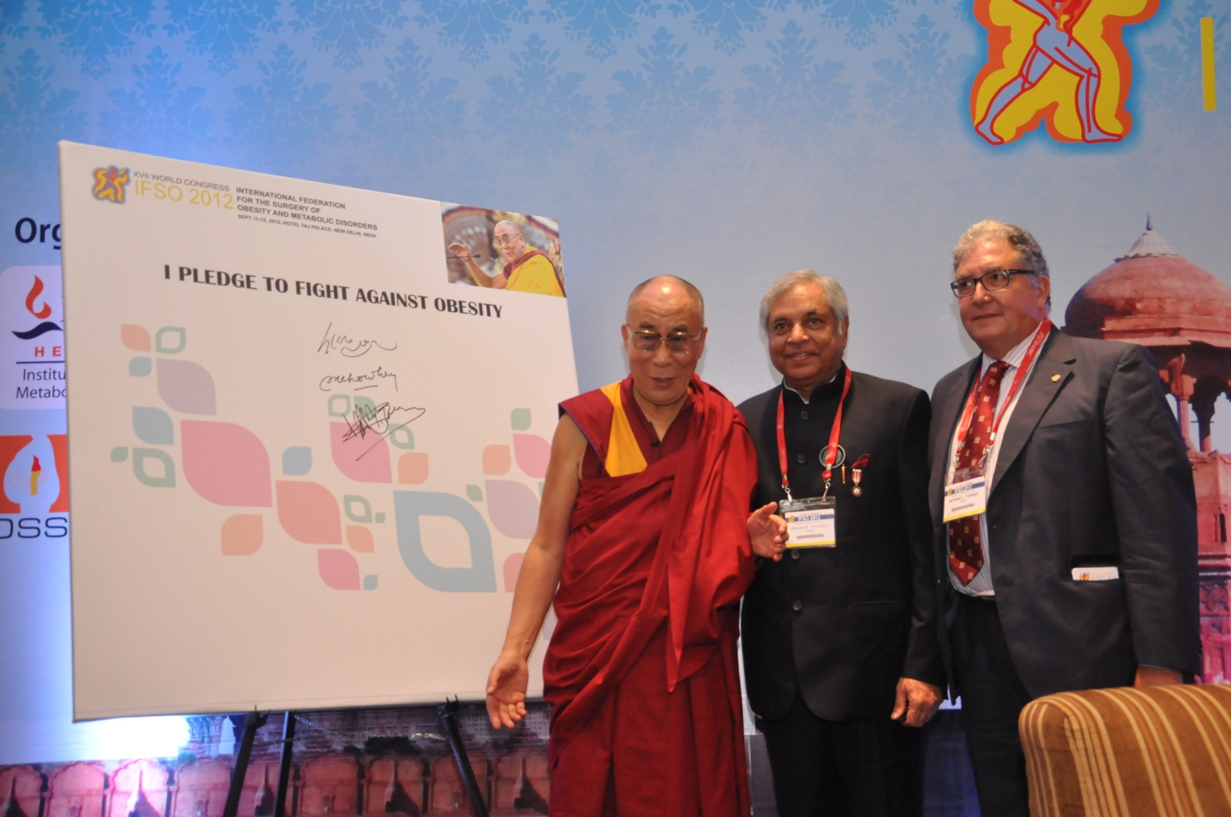

Slide 53
Wishes from Max Team

Slide 55
