Slide 2
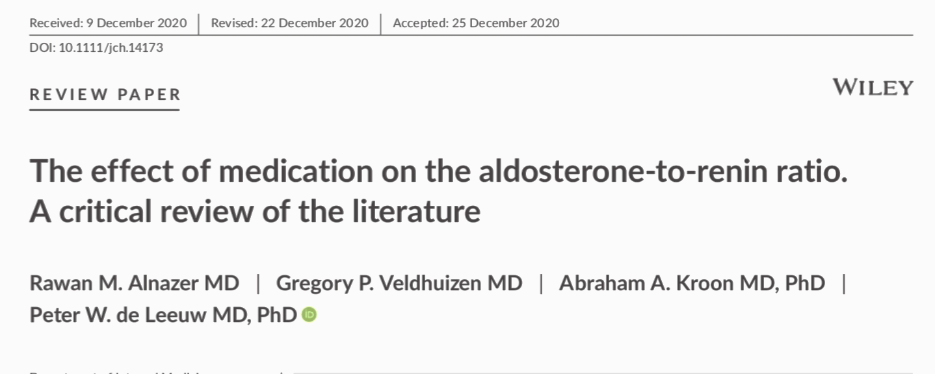
Alnazer RM, Veldhuizen GP, Kroon AA, de Leeuw PW. The effect of medication on the aldosterone-to-renin ratio. A critical review of the literature. J Clin Hypertens (Greenwich). 2021 Feb;23(2):208-214. doi: 10.1111/jch.14173. Epub 2021 Jan 18. PMID: 33460525.

Slide 3
AGENDA
▪︎ AAR test , cut off , interfering factors.︎
▪︎what do the guidelines recommend in the washout period?
▪︎Do these guidelines provide valid evidence? ︎
▪︎What is the purpose of this study?︎

Slide 4
AGENDA
▪︎Review of different drug classes and ARR?
1•Drag with an effect on autonomic nervous system
2•Drugs which interfere with the renin–angiotensin system
3•Calcium channel blockers
4•Vasodilator drugs
5•Diuretics
▪︎Studies in normotensives?
▪︎conclusions?

Slide 5
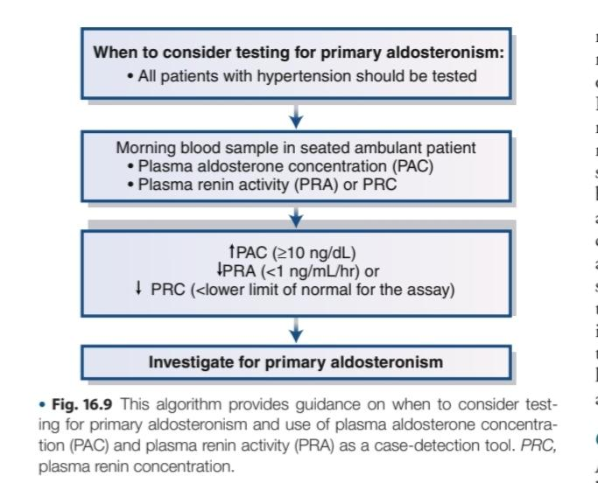
The aldosterone-to-renin ratio (ARR) is a widely used screening test for primary aldosteronism (PA)

Slide 6
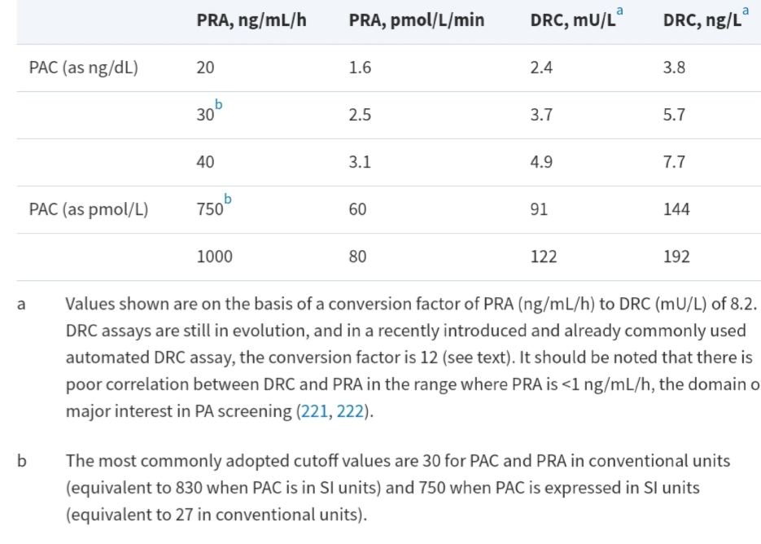
cut off
John W. Funder, Robert M. Carey, Franco Mantero, M. Hassan Murad, Martin Reincke, Hirotaka Shibata, Michael Stowasser, William F. Young, Jr, The Management of Primary Aldosteronism: Case Detection, Diagnosis, and Treatment: An Endocrine Society Clinical Practice Guideline, The Journal of Clinical Endocrinology & Metabolism, Volume 101, Issue 5, 1 May 2016, Pages 1889–1916, https://doi.org/10.1210/jc.2015-4061

Slide 7
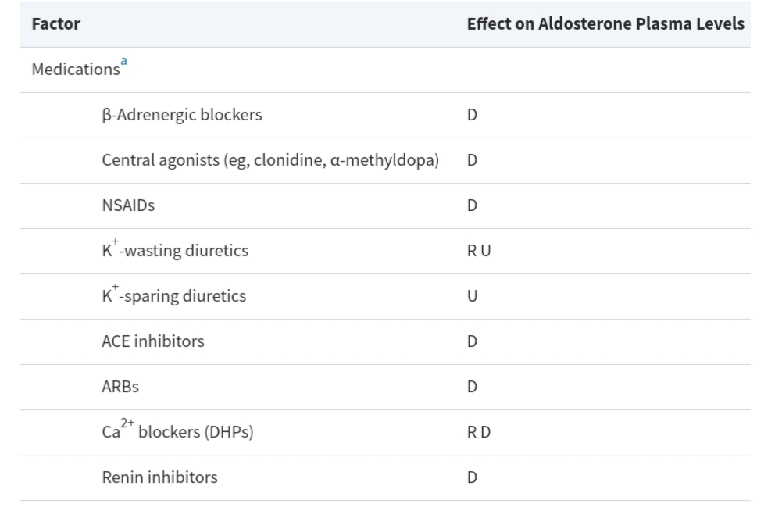
John W. Funder, Robert M. Carey, Franco Mantero, M. Hassan Murad, Martin Reincke, Hirotaka Shibata, Michael Stowasser, William F. Young, Jr, The Management of Primary Aldosteronism: Case Detection, Diagnosis, and Treatment: An Endocrine Society Clinical Practice Guideline, The Journal of Clinical Endocrinology & Metabolism, Volume 101, Issue 5, 1 May 2016, Pages 1889–1916, https://doi.org/10.1210/jc.2015-4061

Slide 8
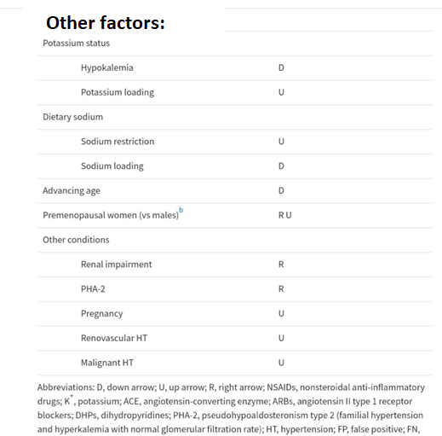
John W. Funder, Robert M. Carey, Franco Mantero, M. Hassan Murad, Martin Reincke, Hirotaka Shibata, Michael Stowasser, William F. Young, Jr, The Management of Primary Aldosteronism: Case Detection, Diagnosis, and Treatment: An Endocrine Society Clinical Practice Guideline, The Journal of Clinical Endocrinology & Metabolism, Volume 101, Issue 5, 1 May 2016, Pages 1889–1916, https://doi.org/10.1210/jc.2015-4061

Slide 9
AGENDA
▪︎ AAR test , cut off , interfering factors .︎
▪︎what do the guidelines recommend in the washout period?
▪︎Do these guidelines provide valid evidence? ︎
▪︎What is the purpose of this study?︎

Slide 10
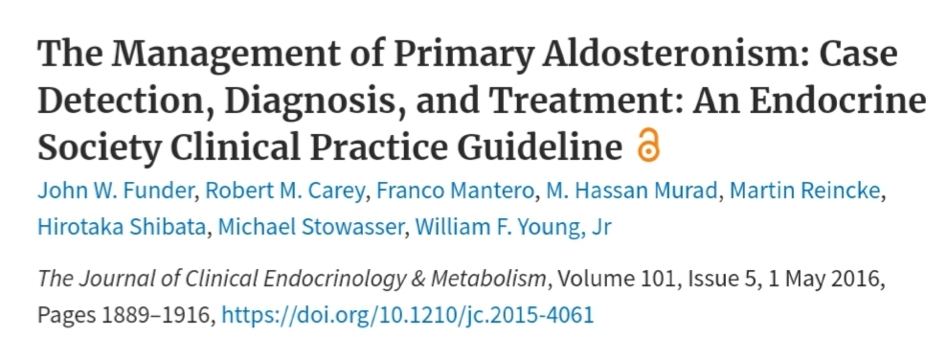
John W. Funder, Robert M. Carey, Franco Mantero, M. Hassan Murad, Martin Reincke, Hirotaka Shibata, Michael Stowasser, William F. Young, Jr, The Management of Primary Aldosteronism: Case Detection, Diagnosis, and Treatment: An Endocrine Society Clinical Practice Guideline, The Journal of Clinical Endocrinology & Metabolism, Volume 101, Issue 5, 1 May 2016, Pages 1889–1916, https://doi.org/10.1210/jc.2015-4061

Slide 11
John W. Funder, Robert M. Carey, Franco Mantero, M. Hassan Murad, Martin Reincke, Hirotaka Shibata, Michael Stowasser, William F. Young, Jr, The Management of Primary Aldosteronism: Case Detection, Diagnosis, and Treatment: An Endocrine Society Clinical Practice Guideline, The Journal of Clinical Endocrinology & Metabolism, Volume 101, Issue 5, 1 May 2016, Pages 1889–1916, https://doi.org/10.1210/jc.2015-4061

Slide 12
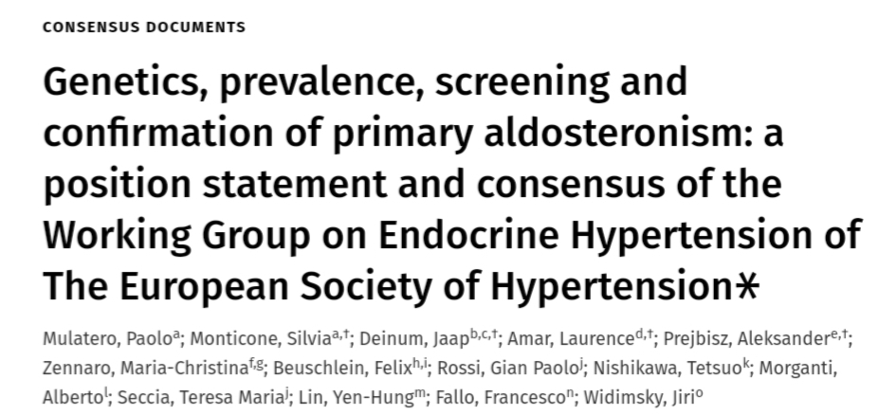
Mulatero, P., Monticone, S., Deinum, J., Amar, L., Prejbisz, A., Zennaro, M.C., Beuschlein, F., Rossi, G.P., Nishikawa, T., Morganti, A. and Seccia, T.M., 2020. Genetics, prevalence, screening and confirmation of primary aldosteronism: a position statement and consensus of the Working Group on Endocrine Hypertension of The European Society of Hypertension∗. Journal of hypertension, 38(10), pp.1919-1928.
Mulatero P, Monticone S, Deinum J, Amar L, Prejbisz

Slide 13
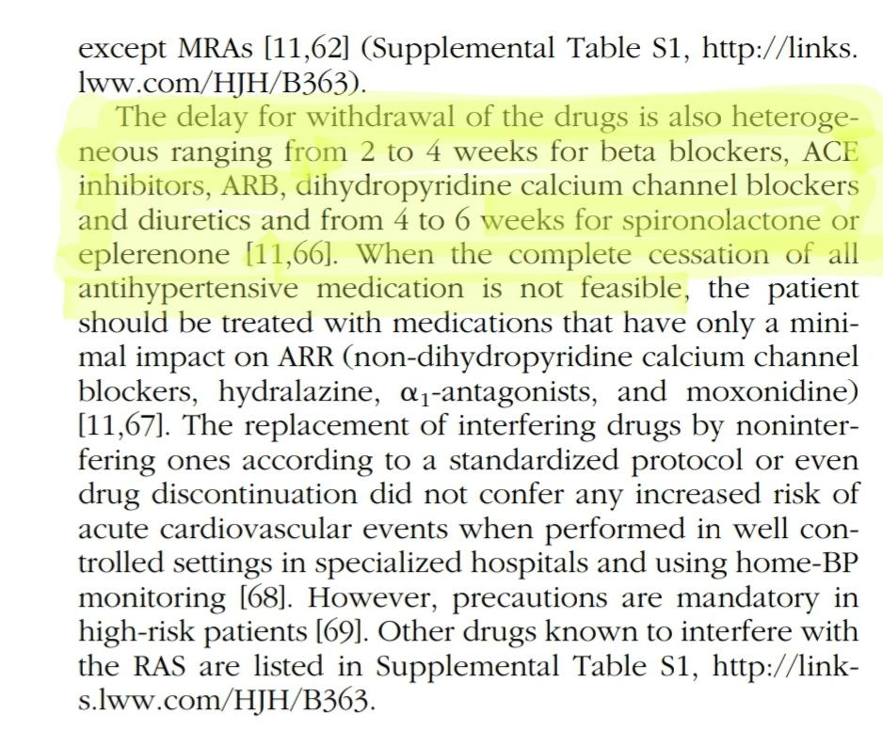
Seifarth C, Trenkel S, Schobel H, Hahn EG, Hensen J. Influence of antihypertensive medication on aldosterone and renin concentration in the differential diagnosis of essential hypertension and primary aldosteronism. Clin Endocrinol 2002; 57:457–46

Slide 14
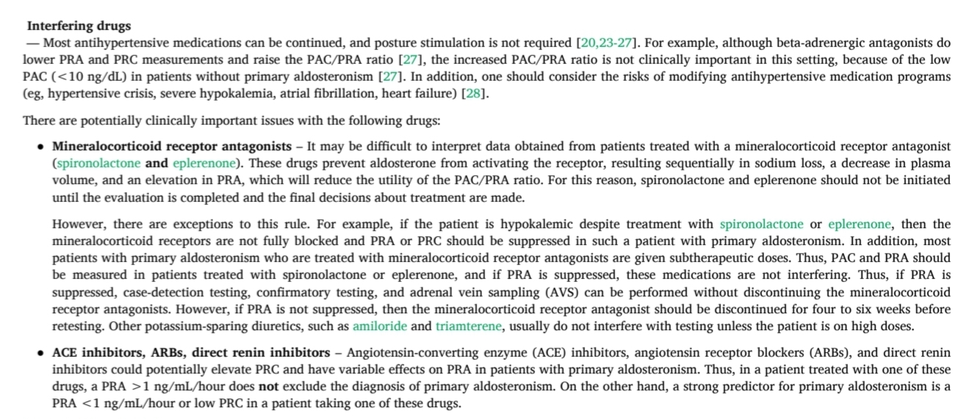
William F Young, Jr, MD, MSc
Section Editors:
Lynnette K Nieman, MD
George L Bakris, MD
Deputy Editor:
Kathryn A Martin, MD

Slide 15
AGENDA
▪︎ AAR test , cut off , interfering factors .︎
▪︎what do the guidelines recommend in the washout period?
▪︎Do these guidelines provide valid evidence? ︎
▪︎What is the purpose of this study?︎

Slide 16
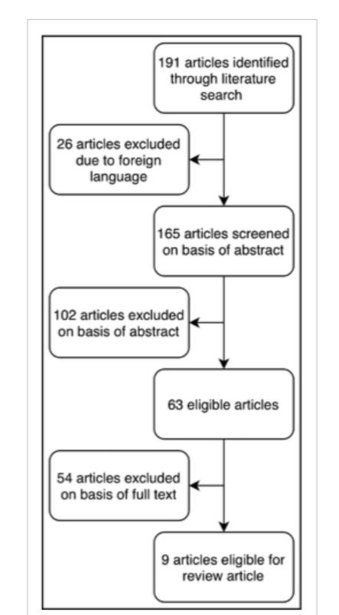

Slide 17
▪︎ Had a clearly described and reproducible method for the determination of renin and aldosterone,
▪︎ Only studied hypertensive patients with or without PA
▪︎ The ARR for all individual participants was calculated at baseline and at follow-up.

Slide 18
AGENDA
▪︎Review of different drug classes and ARR?
Drag with an effect on autonomic nervous system
Drugs which interfere with the renin–angiotensin system
Calcium channel blockers
Vasodilator drugs
Diuretics
▪︎Studies in normotensives?
▪︎conclusions?

Slide 19
Drugs with an effect on the autonomic nervous system
● Beta-blockers
● Alpha-blocker
● Centrally acting agents

Slide 20
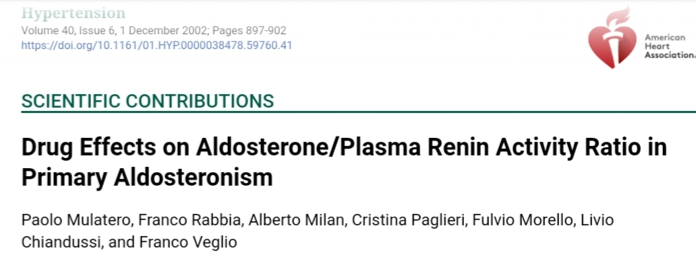
Mulatero, P., Rabbia, F., Milan, A., Paglieri, C., Morello, F., Chiandussi, L. and Veglio, F., 2002. Drug effects on aldosterone/plasma renin activity ratio in primary aldosteronism. Hypertension, 40(6), pp.897-902.

Slide 21
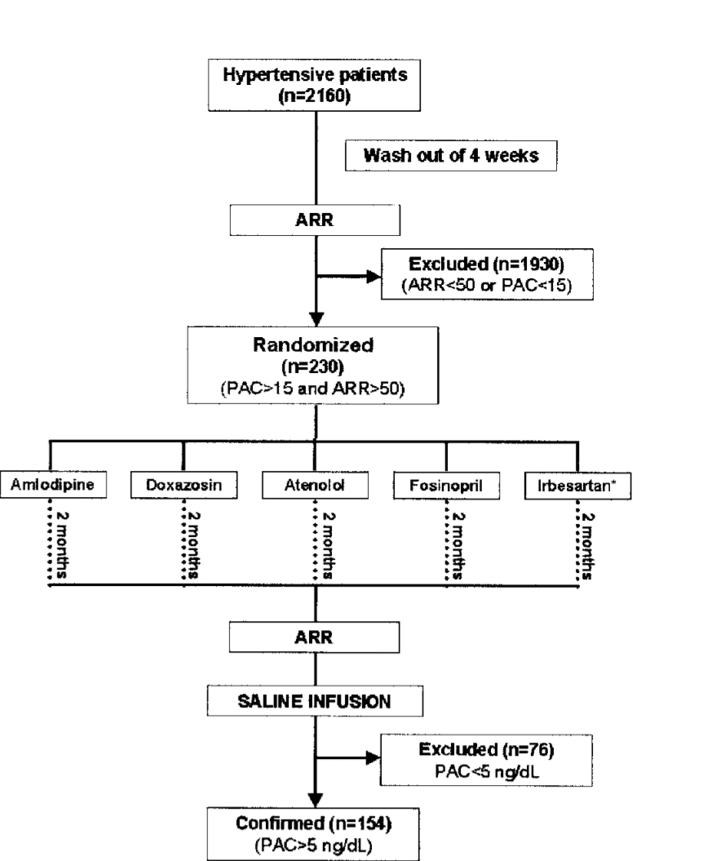

Slide 22
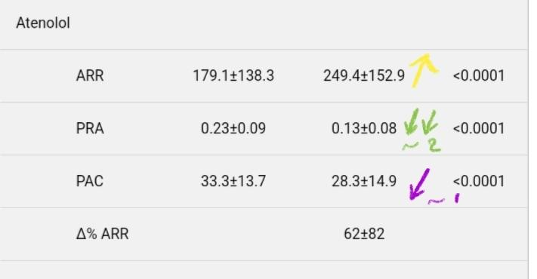
After 2 months of treatment with atenolol in a dose of 100 mg per day, aldosterone and renin values had fallen significantly, while the resulting ARR was significantly elevated as compared to baseline measurements. As there was no placebo control group in this study, the observed changes could still, at least in part, be due to spontaneous changes in hormonal levels.

Slide 23
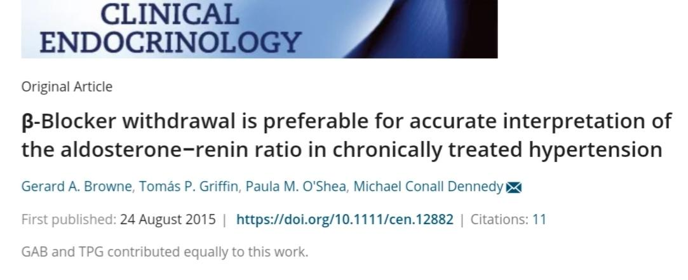
Browne, G.A., Griffin, T.P., O'Shea, P.M. and Dennedy, M.C., 2016. β‐Blocker withdrawal is preferable for accurate interpretation of the aldosterone–renin ratio in chronically treated hypertension. Clinical endocrinology, 84(3), pp.325-331.

Slide 24
In this study, we selected a clinical population chronically treated with antihypertensive polypharmacy. Rather than investigating the effect of b-blocker initiation on renin and aldosterone, we have investigated the effects of b-blocker withdrawal. The reasons for this approach were twofold.
Firstly, it was our objective to investigate the false-positive rate for the diagnosis of PA in the context of b-blocker therapy in order to direct clinical decision-making.
Secondly, we aimed to estimate an optimum time course for b-blocker withdrawal, prior to sampling to provide a more interpretable ARR.

Slide 25
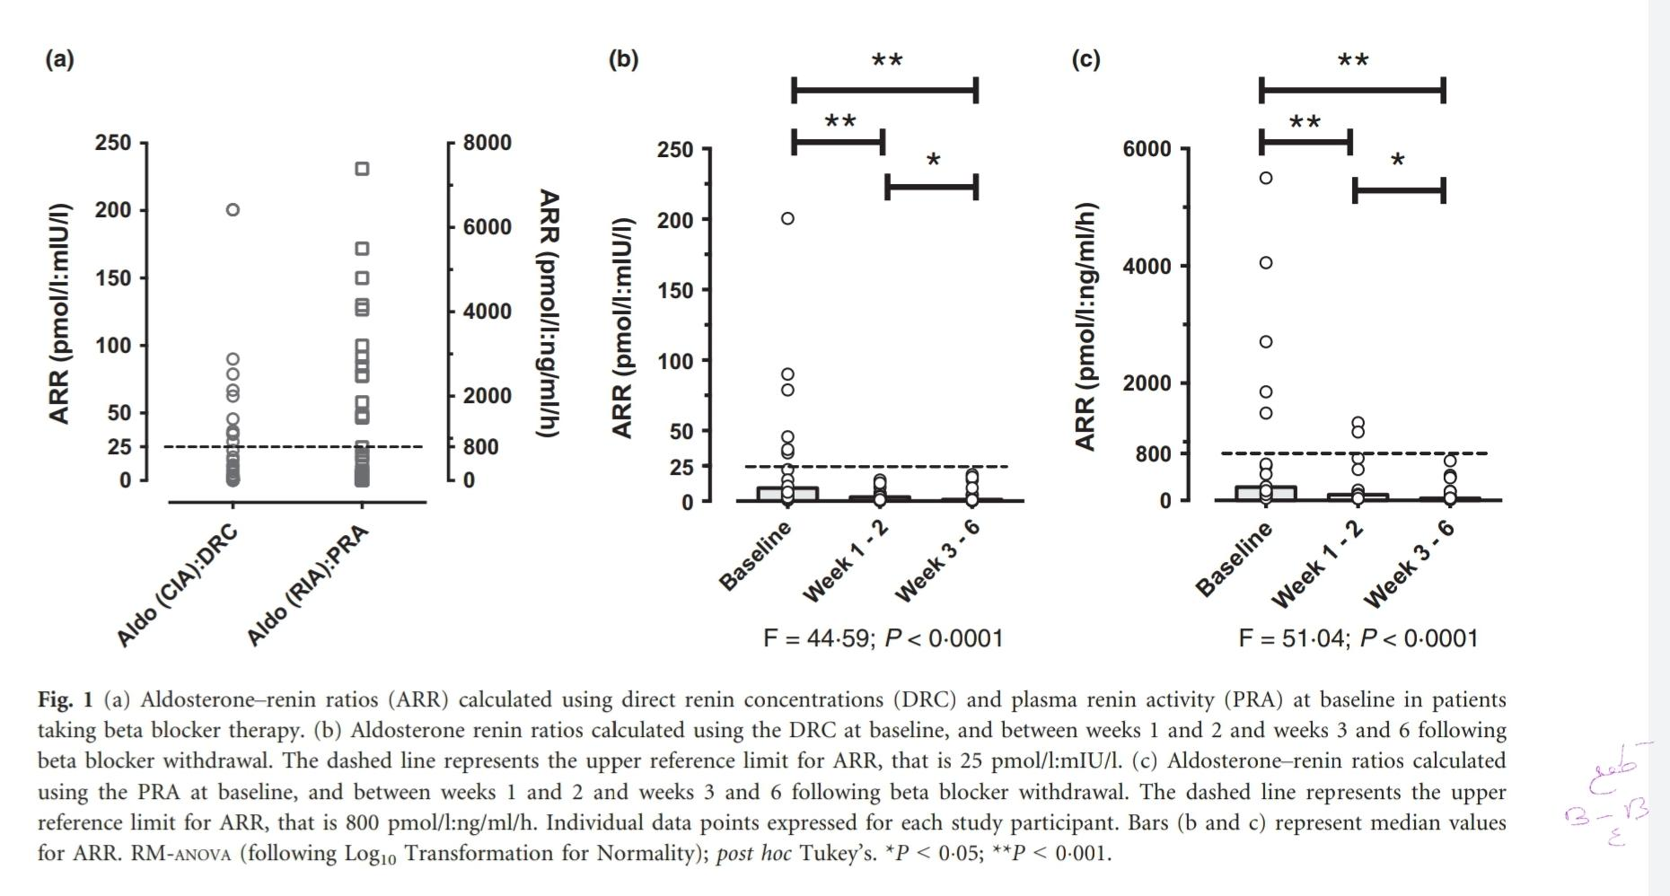

Slide 26
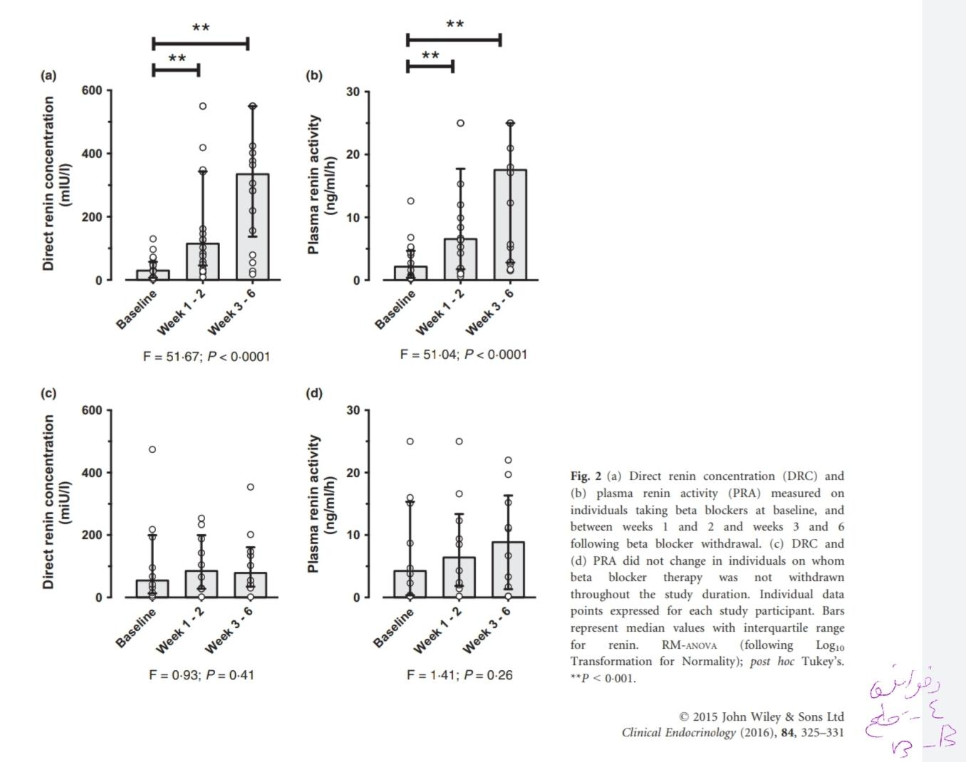

Slide 27
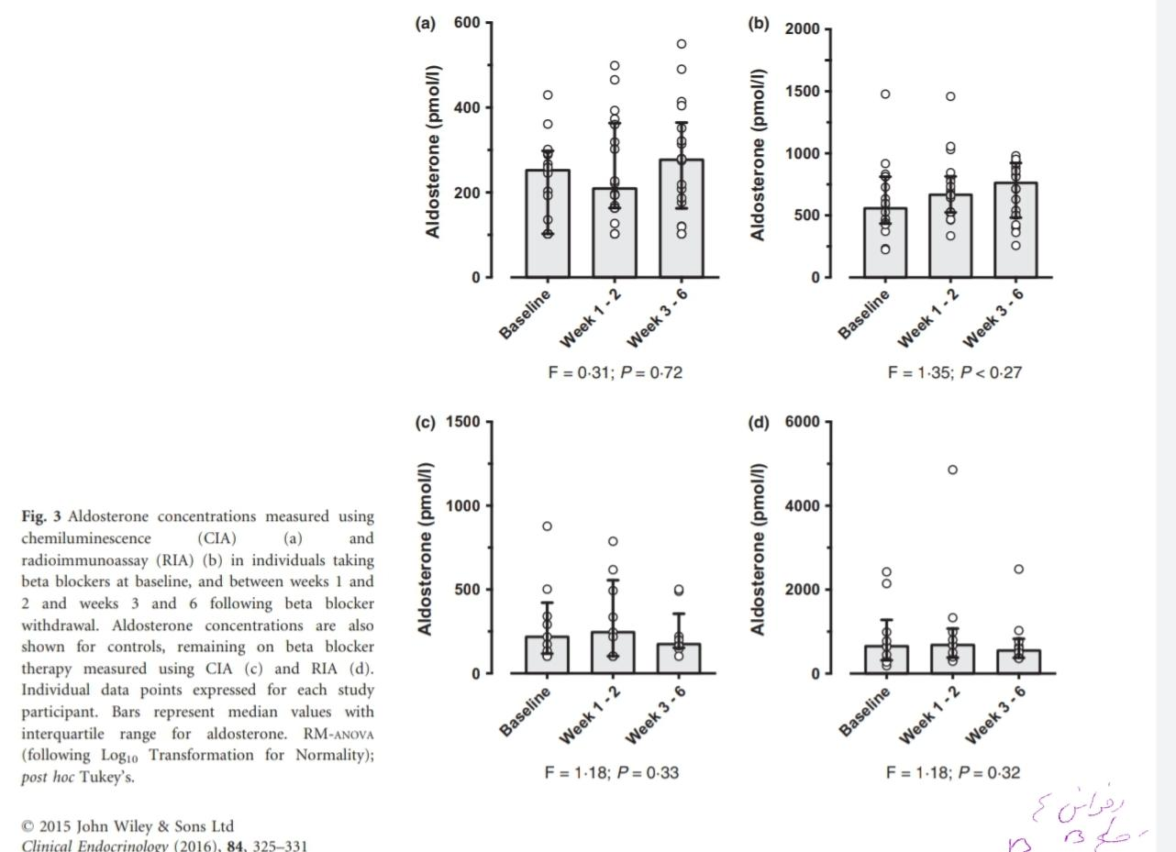

Slide 28
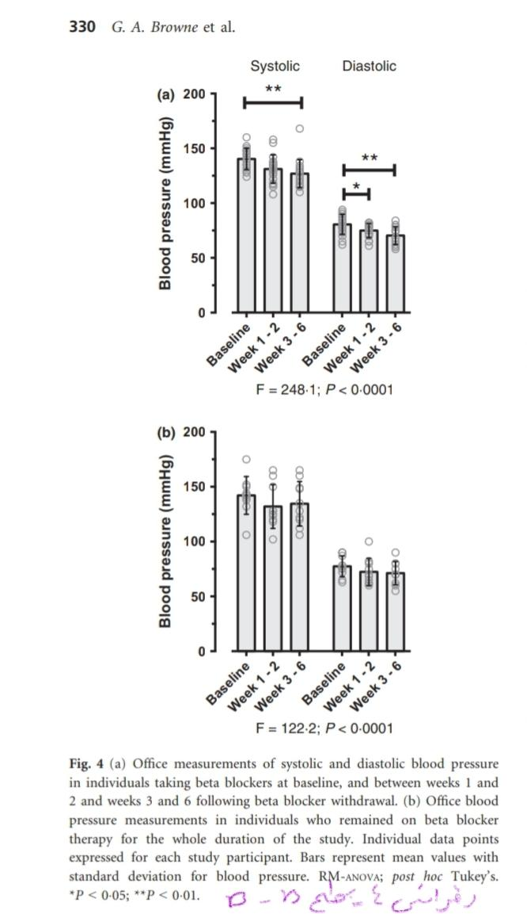

Slide 29
Alpha blockers

Slide 30
With respect to the recommended drugs prazosin and terazosin, we found no studies that measured the ARR in individual patients before and during treatment with either of these two drugs.
Only a single study looking at alpha-blockers met our criteria, namely the doxazosin treatment arm in the trial of Mulatero et al3 mentioned above. In the 55 patients, who received doxazosin in a dose of 8 mg per day, aldosterone values were significantly lower after 8 weeks, while no significant change in PRA occurred.
Although the resulting ARR was significantly lower when compared with baseline measurements, the lack of a control group again precludes drawing firm conclusions.

Slide 31
Mرulatero, P., Rabbia, F., Milan, A., Paglieri, C., Morello, F., Chiandussi, L. and Veglio, F., 2002. Drug effects on aldosterone/plasma renin activity ratio in primary aldosteronism. Hypertension, 40(6), pp.897-902.

Slide 32
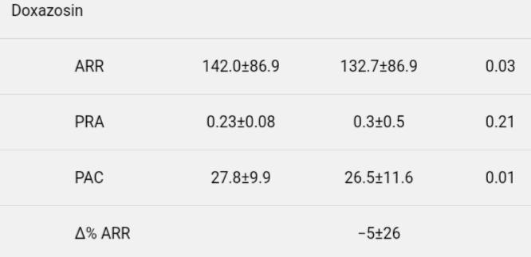

Slide 33
Centrally acting againsts

Slide 34
Although moxonidine has occasionally been recommended as a drug with minimal effects on the ARR, there are no studies in hypertensive patients where this has been tested. The same is true for other centrally acting antihypertensives.

Slide 35
Ahmed, A.H., Gordon, R.D., Ward, G., Wolley, M., McWhinney, B.C., Ungerer, J.P. and Stowasser, M., 2017. Effect of moxonidine on the aldosterone/renin ratio in healthy male volunteers. The Journal of Clinical Endocrinology & Metabolism, 102(6), pp.2039-2043.

Slide 36
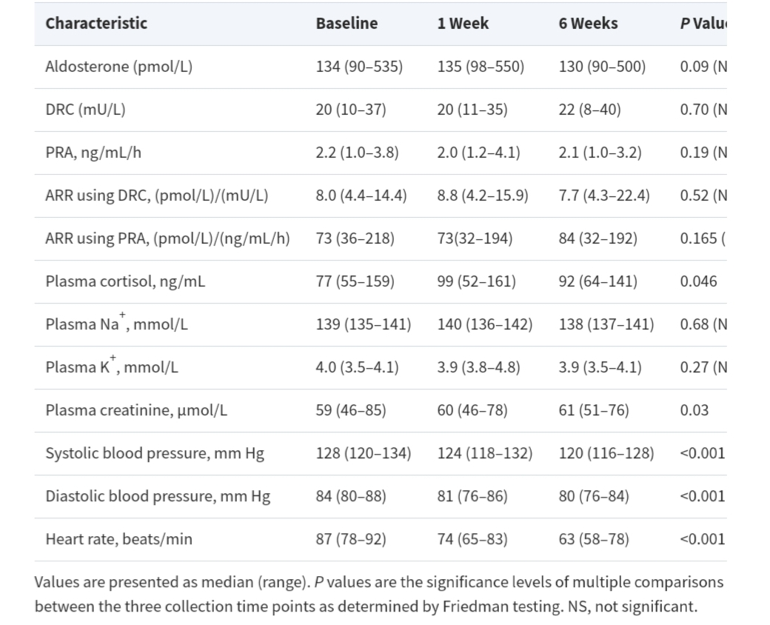

Slide 37
Limitations of this study include a relatively small number of participants and use of healthy volunteers rather than hypertensive patients with normal baseline ARR.
However, this approach enabled us to avoid the potentially confounding effects of other antihypertensive medications and of restricted sodium intake. Study participants had normal blood pressure, imposing a safety-based requirement for doses to have a modest pharmacodynamic effect

Slide 38
Drugs which interfere with the renin–angiotensin system
●ACE-INHIBITORS
●ARBs

Slide 39
Mulatero, P., Rabbia, F., Milan, A., Paglieri, C., Morello, F., Chiandussi, L. and Veglio, F., 2002. Drug effects on aldosterone/plasma renin activity ratio in primary aldosteronism. Hypertension, 40(6), pp.897-902.

Slide 40
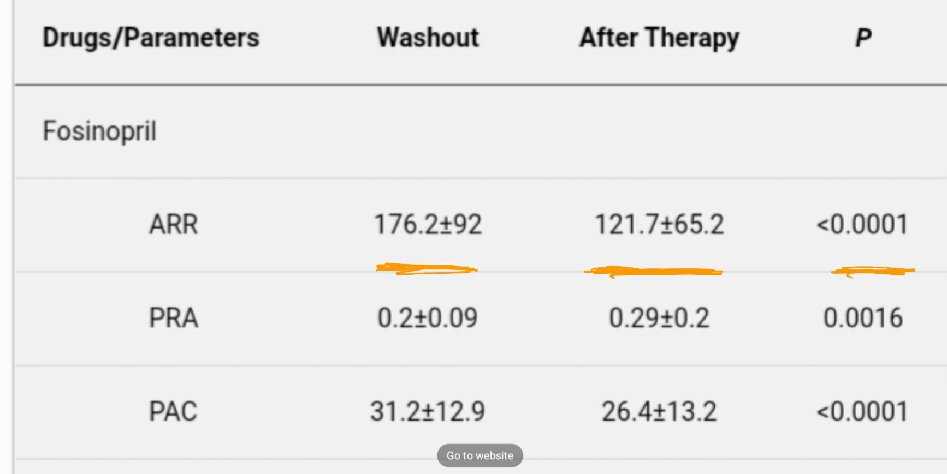

Slide 41
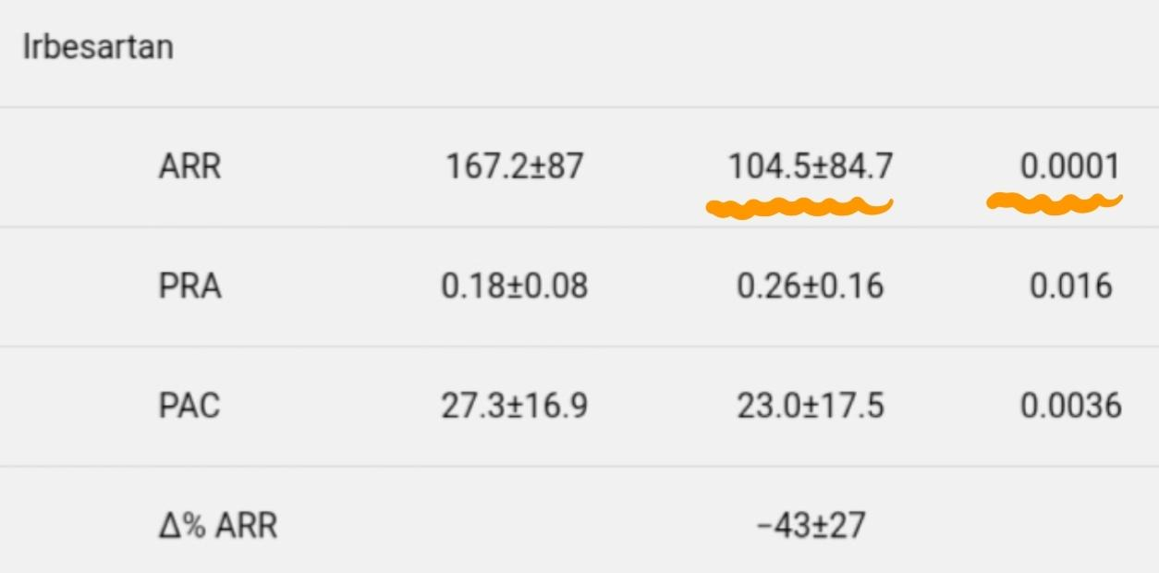

Slide 42
On of 55 patients from the group taking amlodipine (1.8%) and 4/17 of the patients taking irbesartan (23.5%) gave a false-negative ARR compared with the washout period.
None of the patients of the groups taking fosinopril, doxazosin, and atenolol displayed a false-negative ARR compared with the washout period.
Considering only the patients with confirmed PA, 1/40 (2.5%) of the patients taking amlodipine and 4/11 (36%) taking irbesartan would be misdiagnosed as essential hypertensives.
This means a reduction in the sensitivity for the patients under amlodipine treatment from 100% to 98% and for patients under irbesartan treatment from 100% to 76%.

Slide 43
Conclution of mulatero study
Taken together our data indicate that b-blockers, such as doxazosin, and ACE-inhibitors, such as fosinopril, can be used in patients for whom anti-hypertensive treatment cannot be stopped and need to undergo aldosterone and PRA measurement for the diagnosis of PA
Amlodipine, a dihydropyridine CCB, gave a very small percentage of false-negative diagnoses for PA, suggesting that it could be used if strictly necessary to control blood pressure
B-blockers also do not interfere with the diagnosis of PA, but because they could be responsible for an increased rate of false-positive ARR and therefore of an increased necessity for the confirmatory PA test, should be avoided before ARR measurement.

Slide 44
The high rate of false-negative diagnoses in patients undergoing irbesartan treatment requires confirmation in a higher number of patients; however, our data suggest that ARB should be avoided in hypertensive patients before the diagnosis of PA is excluded
In conclusion, our study demonstrates that doxazosin and fosinopril can be used in patients in whom the diagnosis of PA has not been excluded, thus avoiding the washout period before the measurement of ARR.

Slide 45
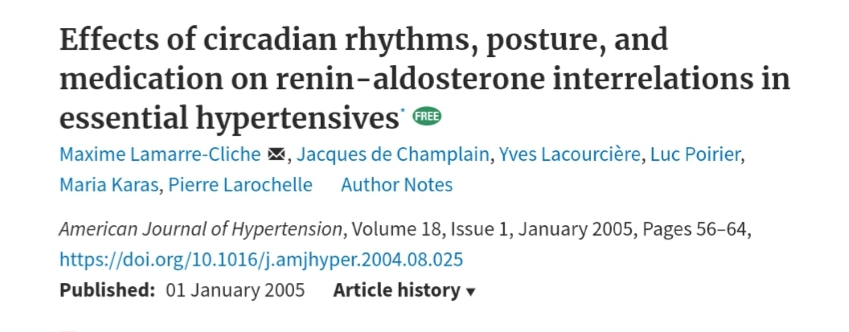
Lfamarre-Cliche, M., Champlain, J.D., Lacourcière, Y., Poirier, L., Karas, M. and Larochelle, P., 2005. Effects of circadian rhythms, posture, and medication on renin-aldosterone interrelations in essential hypertensives. American journal of hypertension, 18(1), pp.56-64.

Slide 46
Calcium channel blockers, ACE inhibitors, and angiotensin II receptor blockers can decrease the ARR, and this has been confirmed in this study. It is frequently suggested that patients be taken off these drugs before measuring the ARR, but this is still being debated. In our study, ramipril, telmisartan, and amlodipine significantly reduced the ARR.
Telmisartan and ramipril did so by elevating renin and decreasing aldosterone, whereas amlodipine did so by increasing renin despite an increase in aldosterone. Of the three drugs used in this study, telmisartan clearly had the most significant effect on the ARR throughout the 24-h period. In recent clinical work comparing various drug classes, another angiotensin II receptor antagonist, irbesartan, induced the greatest decrease in the ARR,
Lamarre-Cliche, M., Champlain, J.D., Lacourcière, Y., Poirier, L., Karas, M. and Larochelle, P., 2005. Effects of circadian rhythms, posture, and medication on renin-aldosterone interrelations in essential hypertensives. American journal of hypertension, 18(1), pp.56-64.

Slide 47
Calcium channel blockers
Non-Dihydropyridine : Our search yielded no studies that investigated the effects of slow-release verapamil or diltiazem, the only two clinically available non-dihydropyridine calcium channel blockers on the ARR in individual patients.
Dihydropyridines

Slide 48
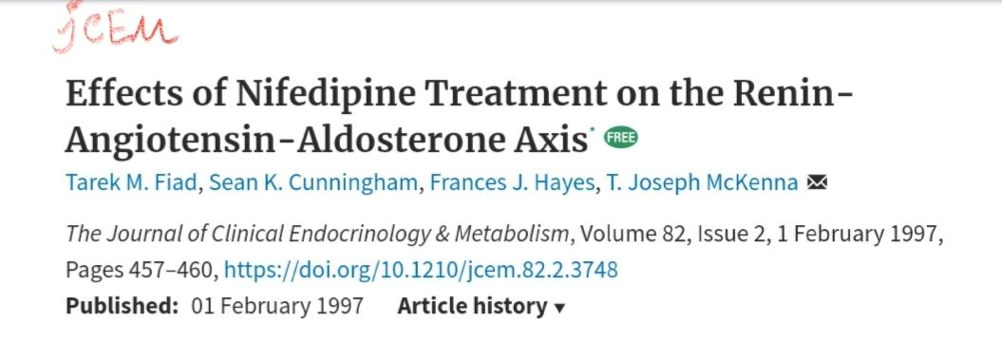

Slide 49
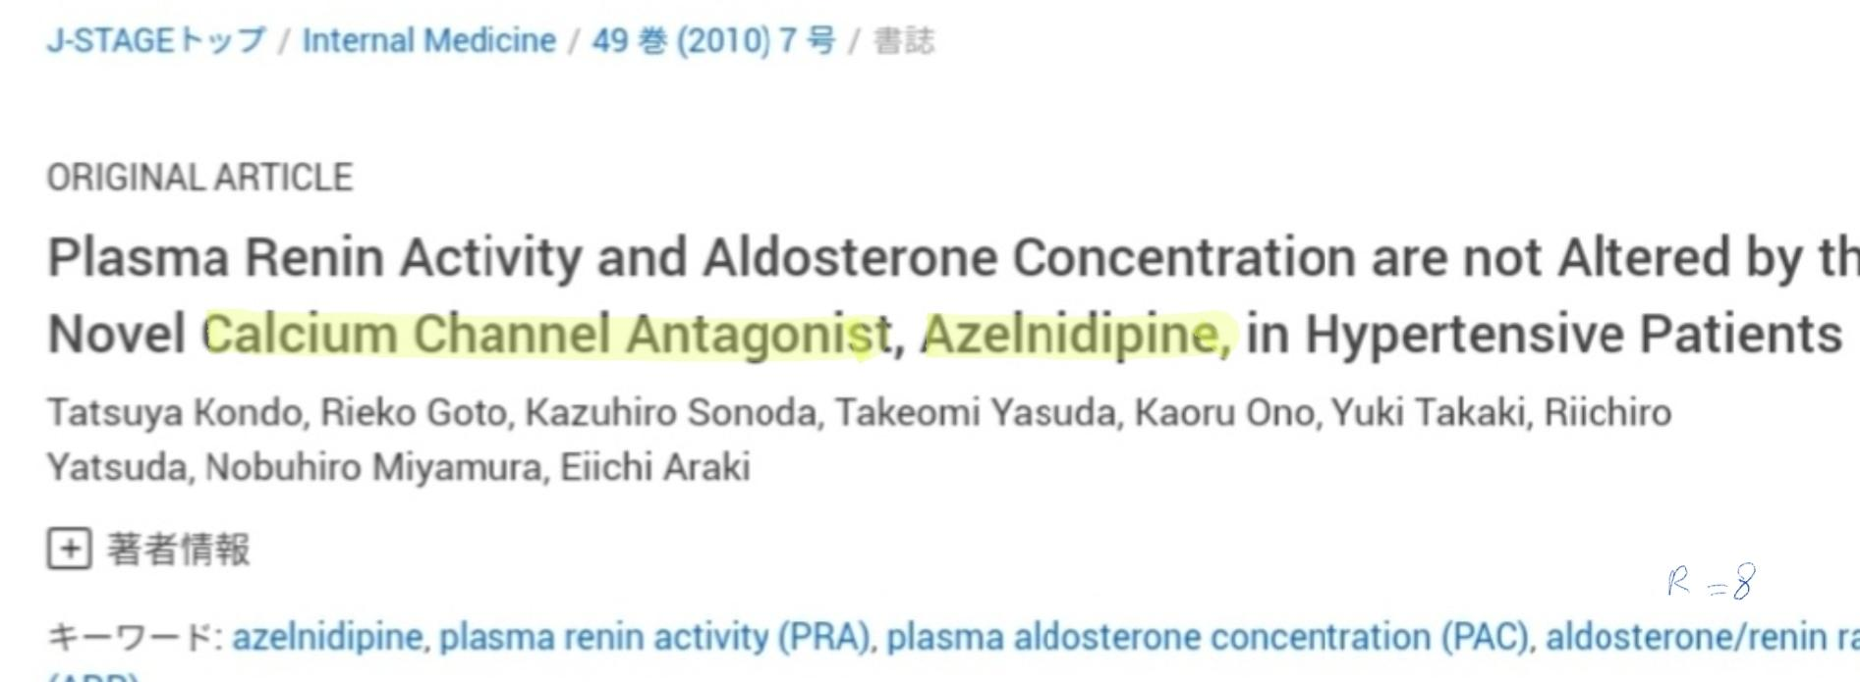
Kondo, T., Goto, R., Sonoda, K., Yasuda, T., Ono, K., Takaki, Y., Yatsuda, R., Miyamura, N. and Araki, E., 2010. Plasma renin activity and aldosterone concentration are not altered by the novel calcium channel antagonist, azelnidipine, in hypertensive patients. Internal Medicine, 49(7), pp.637-643.

Slide 50
Conclusion
These data indicate that azelnidipine does not affect PRA or PAC, suggesting that azelnidipine could be a useful antihypertensive CCB while undergoing PA screenig.

Slide 51
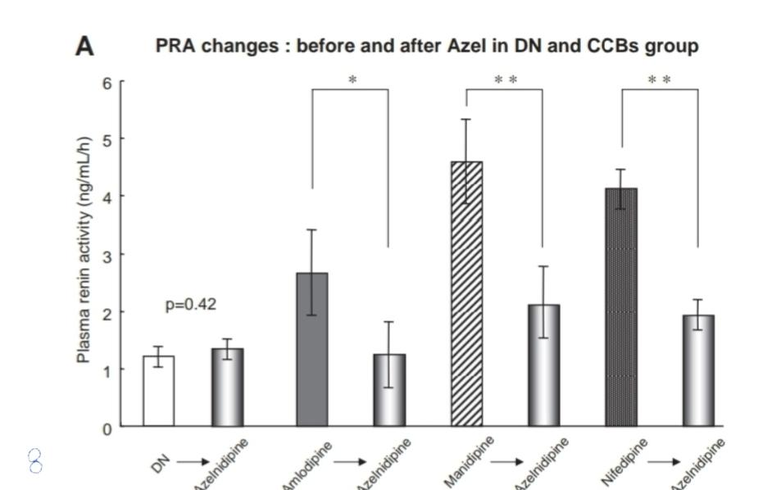

Slide 52
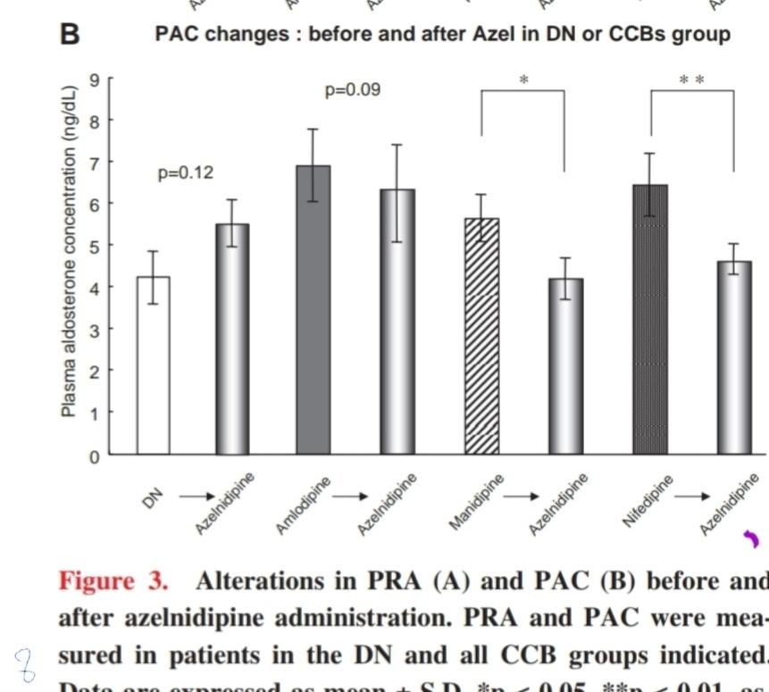

Slide 53
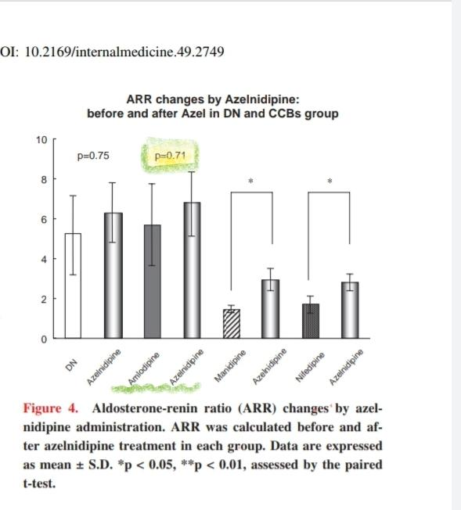

Slide 54
There were no significant studies on vasodilators

Slide 55
Diuretics
Thiazides/amiloride
Mineralocorticoid receptor blockers

Slide 56
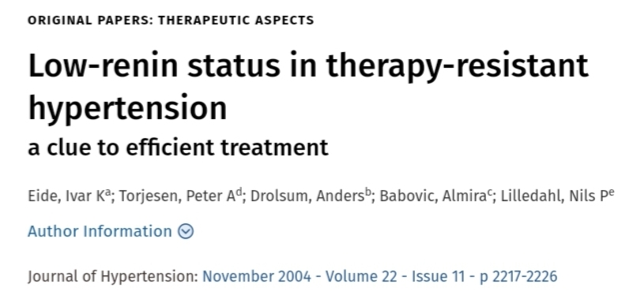
Eide, Ivar Ka; Torjesen, Peter Ad; Drolsum, Andersb; Babovic, Almirac; Lilledahl, Nils Pe Low-renin status in therapy-resistant hypertension, Journal of Hypertension: November 2004 - Volume 22 - Issue 11 - p 2217-2226

Slide 57
Thiazides/amiloride
In two studies, the effect of amiloride was assessed. In one of these, therapy-resistant low-renin hypertensives using multiple antihypertensive medications were placed on amiloride and hydrochlorothiazide. In this group, aldosterone and renin both significantly rose, but the resulting ARR was significantly reduced. In the other study, hypertensives using amiloride at baseline in addition to multiple other drugs had their amiloride usage stopped for a period of 4 weeks. In this group, aldosterone and renin significantly fell, but the resulting ARR did not significantly change from baseline.

Slide 58
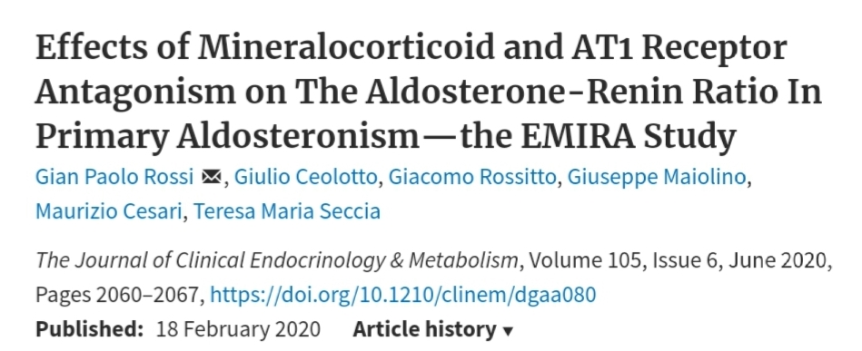
Gian Paolo Rossi, Giulio Ceolotto, Giacomo Rossitto, Giuseppe Maiolino, Maurizio Cesari, Teresa Maria Seccia, Effects of Mineralocorticoid and AT1 Receptor Antagonism on The Aldosterone-Renin Ratio In Primary Aldosteronism—the EMIRA Study, The Journal of Clinical Endocrinology & Metabolism, Volume 105, Issue 6, June 2020, Pages 2060–2067, https://doi.org/10.1210/clinem/dgaa080

Slide 59
MRAs
Recently, Rossi et al studied the effect of canrenone, which is a Mineralocorticoid receptor (MR) antagonist and the main active metabolite of spironolactone, in patients with confirmed PA who had been scheduled to undergo either surgical or medical treatment.
Participants received 100 mg/day of canrenone over the course of a 1-month period. In both groups, renin, aldosterone, and the ARR were not significantly affected by the antagonist.

Slide 60
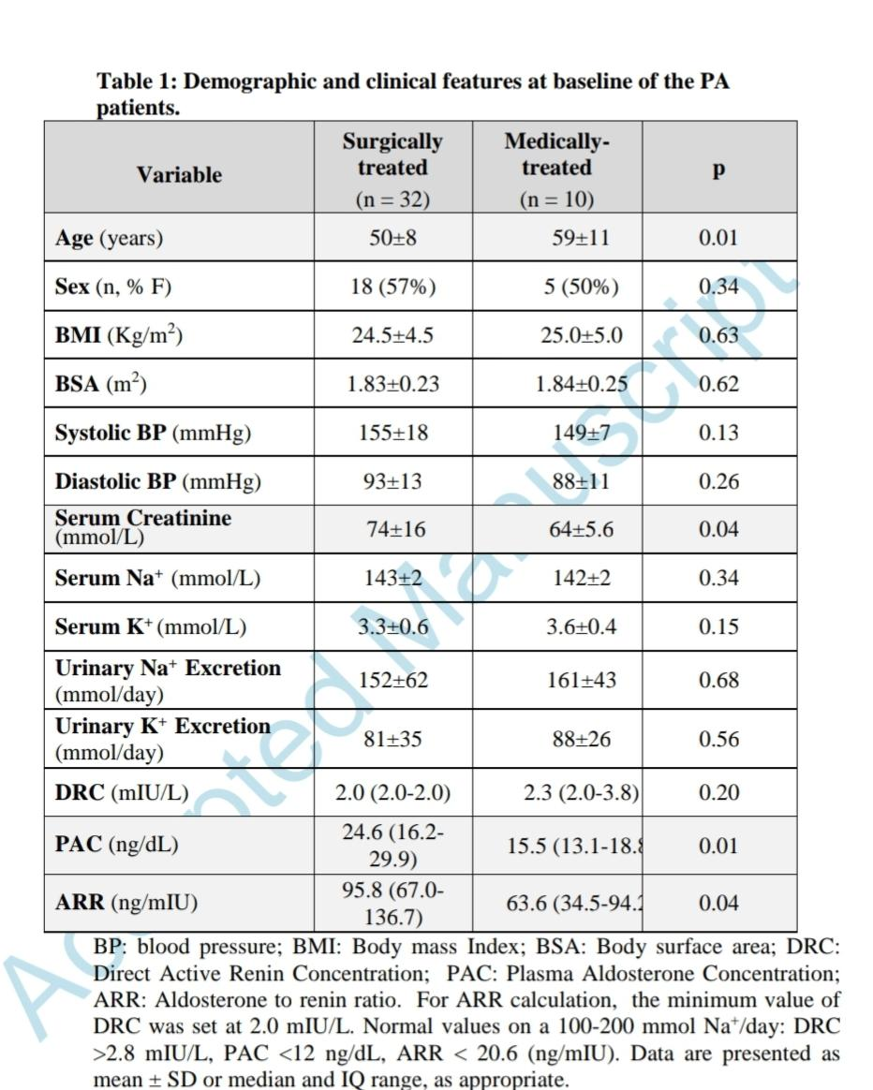

Slide 61
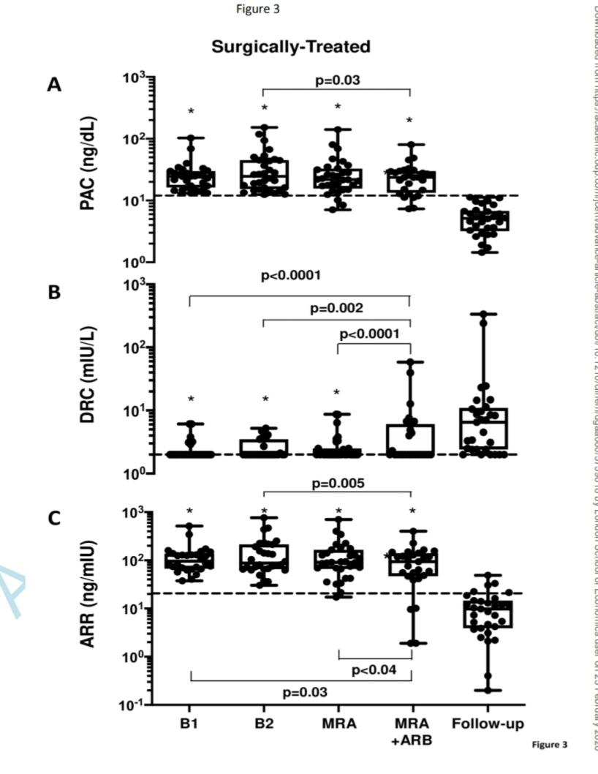
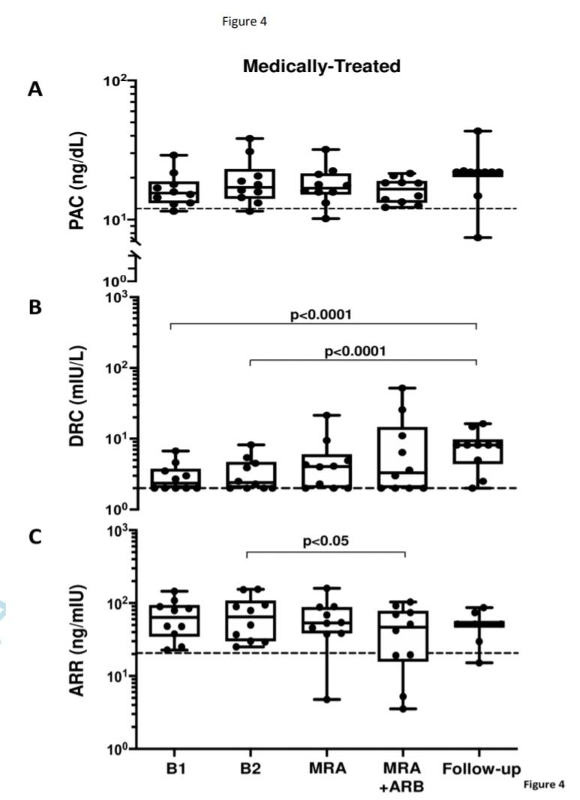

Slide 62
At this stage of research the following conclusion seems reasonable: MRA treatment with canrenone at doses that allow to control hypertension and hypokalemia does not preclude the diagnosis in the patients with PA .
Based on these results, at our institution we now allow use of MRA during the case detection of PA and even at subtyping by means of AVS.
This allowed a remarkable simplification of the work-up and a considerable advancement toward widening the case detection of the most common curable form of arterial hypertension in the population of hypertensive patients.

Slide 63
Conclusions
It is also important to point out that our findings are in contrast to the Endocrine Society Guidelines, which state that the ARR in many cases can be confidently interpreted despite the effect of medication with the exception of mineralocorticoid receptor blockers.
As we have shown here, many drugs, including those without a direct mechanism of action on the RAAS, could potentially have a significant effect on the ARR. It is an important finding that little to no strong evidence exists for many widely used antihypertensives such as non-dihydropyridine Calcium channel blockers (CCB's)

Slide 64
conclusions
Conclusions
In conclusion, a wide variety of drugs may influence the ARR. There is a clear and pressing need for more high-quality prospective trials looking into the effects of antihypertensive agents on the ARR and these trials should look at both essential hypertensive and PA participants separately.
It may not always be necessary to discontinue the MRA, and the pre test probability and dosage of the drug are important

