Slide 1

In the name of GOD

Slide 2
Diabetes Mellitus
Definition , Classification & Treatment goals
F . Sarvghadi M.D Endocrinologist.
Associate professor . Research institute for endocrine sciences. SBUM.
98.05.15

Slide 3
Agenda
Definition.
Classification.
Treatment targets.
Diabetes and cardiovascular system.
Screening for diabetes.
Prevention or Delay of Type 2 Diabetes
Conclusion.

Slide 4

Diabetes mellitus history
Diabetes has been with us for a long time.
1552 BC – Written on a 3rd Dynasty Egyptian papyrus, physician Hesy-Ra mentions frequent urination as a symptom. This is the earliest known record of diabetes.

Slide 5
Diabetes mellitus history
1869 First description of clusters of cells in the pancreas, Islets of Langerhans
1889 Minkovsky and Mehring described signs of Diabetes after removal of the pancreas of a dog
1921 Banting, Best, Collip and Mcleod discovered Insulin
1922 Leonard Thompson was the first diabetic treated with insulin
1923 Insulin became commercially available in North America and Europe

Slide 6

Summer 1921, Banting and Best:
Isolation of pancreatic extracts (Isletin) from dog pancreas, administration of Isletin to diabetic dogs.
Leonard Thompson
(1908-1935)

Slide 7
Definition
Diabetes mellitus (DM) refers to a group of common metabolic
disorders that share the phenotype of hyperglycemia.
Depending on the etiology of the DM, factors contributing to hyperglycemia include:
Reduced insulin secretion.
Decreased glucose utilization.
Increased glucose production.
Diabetes Care Volume 41, Supplement 1, January 2018

Slide 8
The IDF 2017

Slide 11
Disease burden
the prevalence of diabetes in individuals aged 20–79 ranged from 7.2–11.4%.
In Iran :11.3%
The overwhelming burden of the disease continues to be shouldered by low- and middle income countries ( 80% ).
.
The new estimates show an increasing trend towards younger and younger people developing diabetes, a trend that is very worrisome for future generations and premature death.
it is estimated that as many of 50% of individuals with diabetes may be undiagnosed
diabetes was responsible for almost 5 million deaths worldwide, accounting for 14.5% of global all-cause mortality in adults aged 20–79 years of age.
Davies MJ et al, Diabetes care 2018 Dec;41(12):2669-2701

Slide 12
EPIDEMIOLOGY AND GLOBAL CONSIDERATIONS
The worldwide prevalence of DM has risen dramatically over the past two decades, from an estimated 30 million cases in 1985 to 415 million in 2015.
Based on current trends, the International Diabetes Federation projects that 642 million individuals will have diabetes by the year 2040.
Up to 80% of individuals with diabetes live in low-income or medium-income countries.
Centers for Disease Control and Prevention (CDC) estimated that 9.3% of the population had diabetes.
In Iran :11.3%
Worldwide, most individuals with diabetes are between the ages of 40 and 59 years. DM increases with age. In individuals age >65 years, the prevalence of DM was 26.9%.
Globally, it is estimated that 50% of individuals may be undiagnosed.
The IDF Diabetes Atlas 6^{h} Edition. 2013

Slide 13
Classification of Diabetes:
1. Type 1 diabetes (due to Immune-mediated b-cell destruction, usually leading to absolute insulin deficiency).
2. Type 2 diabetes (due to a progressive loss of insulin secretion on the background
of insulin resistance).
3. Gestational diabetes mellitus (GDM) (diabetes diagnosed in the second or third
trimester of pregnancy that is not clearly overt diabetes prior to gestation ).
4. Specific types of diabetes due to other causes, e.g., monogenic diabetes syndromes
(such as neonatal diabetes and maturity-onset diabetes of the young [MODY])diseases of the exocrine pancreas (such as cystic fibrosis), and drug- or
chemical-induced diabetes (such as with glucocorticoid use, in the treatment of
HIV/AIDS or after organ transplantation).
Diabetes Care Volume 41, Supplement 1, January 2018

Slide 14
Criteria for the diagnosis of diabetes
FPG ≥ 126 mg/dL. Fasting is defined as no caloric intake for at least 8 h.*
OR
2-h PG ≥ 200 mg/dL during an OGTT. The test should be performed as described by the WHO, using a glucose load containing the equivalent of 75 g anhydrous glucose dissolved in water.*
OR
A1C ≥ 6.5% . The test should be performed in a laboratory using a method that is NGSP certified and standardized to the DCCT assay.*
OR
In a patient with classic symptoms of hyperglycemia or hyperglycemic crisis, a random plasma glucose ≥ 200 mg/dL.
*In the absence of unequivocal hyperglycemia, diagnosis requires two abnormal test results from the same sample or in two separate test samples.
Diabetes Care Volume 41, Supplement 1, January 2018

Slide 15
Diabetes related complications
Microvascular
Nephropathy (up to 37%)
Retinopathy (up to 50%)
Neuropathy ( up to 60%)
Macrovascular
Overall CVD (2-3 x risk)
MI (3-6 x risk)
Stroke (up to 12%)
Amputation (up to 12%)
Eastman RC and Garfield RA.. Prim Care 1999;26:791-807.

Slide 16
Improving control reduces risks of long-term complications
Every 1% drop in HbA_{1c} can reduce long-term diabetes complications
43%
37%
19%
16%
14%
12%
Stroke
Myocardial infarction
Heart failure
Cataract extraction
Microvascular disease
Lower extremity amputation or fatal peripheral vascular disease
UKPDS 35: Stratton et al. BMJ 2000;321:405–12.
Notes:
And more importantly, the risk of long term complications was reduce with better glycaemic control. Here we see the outcome results from the UKPDS demonstrating that for every 1% drop in HbA1c, there was a signficant reduction in particularly microvascular complications with a 43% reduction in lower extremity amputation or fatal PVD, a 37% decrease in microvasular disease, a 19% reduction in cataract extraction and so forth.
16

Slide 17
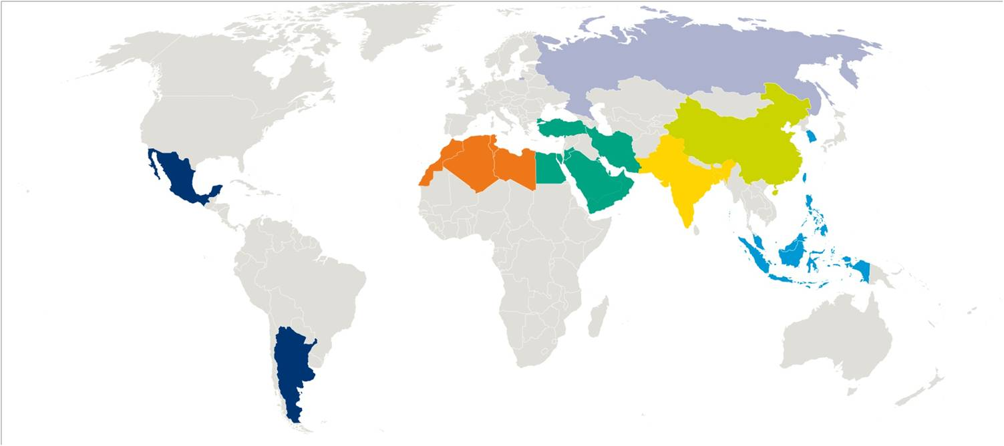
A₁chieve baseline results
Average HbA_{1c} 9.5 %
A₁chieve baseline results
Average HbA_{1c} 9.5 %
HbA_{1c}: 9.6%
n= 3074
HbA_{1c}: 9.7%
n= 14976
HbA_{1c}: 9.7%
n= 11020
HbA_{1c}: 9.8%
n= 1138
HbA_{1c}: 9.5%
n= 4039
HbA_{1c}: 9.3%
n= 22447
HbA_{1c}: 9.8%
n= 10032
Home et al. Diabetes Res Clin Pract. 2011;94:352–63
Notes:
17
17
17

Slide 18
Achievement of goals in U.S.
33–49% of patients still do not meet targets for glycemic, blood pressure, or cholesterol control, and only 14% meet targets for all three measures and nonsmoking status.
Ali MK et al N Engl J Med 2013 Apr 25;368(17):1613-24

Slide 19

Diabetes Mellitus
management

Slide 20
The goals of therapy
Eliminate symptoms related to hyperglycemia.
Reduce or eliminate the long-term microvascular and macrovascular complications.
Allow the patient to achieve as normal a lifestyle as possible.
The care of an individual with either type 1 or type 2 DM requires a multidisciplinary team:
Endocrinologist or diabetologist, a certified diabetes educator, a nutritionist, and a psychologist, neurologists, nephrologists, vascular surgeons, cardiologists, ophthalmologists, and podiatrists.
Diabetes Care Volume 41, Supplement 1, January 2018

Slide 21
Guidelines for Ongoing, Comprehensive Medical Care
Optimal and individualized glycemic control.
SMBG (individualized frequency).
HbA1c testing (2–4 times/year).
Patient education in diabetes management (annual).
Medical nutrition therapy and education (annual).
Eye examination (annual or biannual).
Foot examination (1–2 times/year by physician; daily by patient).
Screening for diabetic nephropathy (annual).
Blood pressure measurement (quarterly).
Lipid profile and serum creatinine (estimate GFR) (annual).
Influenza/pneumococcal/hepatitis B immunizations.
Consider antiplatelet therapy.
Diabetes Care Volume 41, Supplement 1, January 2018

Slide 22
ASSESSMENT OF GLYCEMIC CONTROL
Self-monitoring of Blood Glucose ( SMBG) :
Useful tool for guiding medical nutrition therapy and physical activity, preventing hypoglycemia, and adjusting medications.
Continuous Glucose Monitoring (CGM):
Real-time CGM measures interstitial glucose (which correlates well with plasma glucose) and includes sophisticated alarms for hypo- and hyperglycemic excursions.
A1C testing:
Reflects average glycaemia over several months and has strong predictive value for diabetes complications.
Diabetes Care Volume 41, Supplement 1, January 2018

Slide 23
Optimal Management
PPG
The peak
glucose level
FPG
The basal
glucose level
HbA_{1c}
The long-term average glucose level
Notes:
23
Fasting glucose levels are currently central to diabetes management in all international guidelines.
However, if hyperglycaemia directly increases mortality and the risk of CV disease, should management be guided by:
fasting glucose – the basal level of glucose during the day
postprandial glucose – the peak glucose level
Or…
HbA_{1c} - the long-term average glucose level?

Slide 24
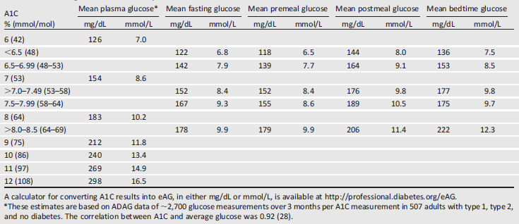
Mean glucose levels for specified A1C levels
Diabetes Care Volume 41, Supplement 1, January 2018

Slide 25
Treatment goals

Slide 26


Recommendations for adults with diabetes.
*More or less stringent glycemic goals may be appropriate for individual patients. Goals should be individualized based on duration of diabetes, age/life expectancy, comorbid conditions, known CVD or advanced microvascular complications, hypoglycemia unawareness, and individual patient considerations.
†
Diabetes Care Volume 41, Supplement 1, January 2019

Slide 27
Current glycaemic targets
Current HbA_{1c} goals include:
  ADA, EASD: <7%
  AACE, JDS ,IDF ≤6.5%
Current pre- and postprandial glucose goals include:
ADA
  Pre-meal: 80–130 mg/dL (5.0–7.2 mmol/L)
  Peak: <180 mg/dL (<10 mmol/L)
IDF
  Pre-meal: <110 mg/dL (<6.0 mmol/L)
  1–2-h peak: <160 mg/dL (<9.0 mmol/L)

Slide 28
A1C and Glycemic Targets
Numerous aspects must be considered when setting glycemic targets. The ADA proposes optimal targets, but each target must be individualized to the needs of each patient and his or her disease factors.
The Goal of Therapy is to achieve an HbA₁c level as close to normal as possible, without subjecting the patient to excessive risk of hypoglycaemia.

Slide 29
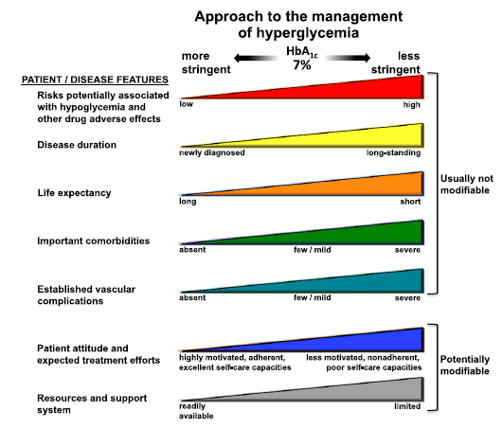
Approach to the management of hyperglycemia
Individualization of treatment is the cornerstone of success
Bio-
Patient-centred care
Psycho
-social
Diabetes Care Volume 41, Supplement 1, January 2019

Slide 30


Personalized Goals balancing Risks and Benefits
More Stringent Control
No Hypoglycemia
Less complexity /Poly pharmacy
Lifestyle or metfonmin only
Short disease duration
Long Life expectancy
No CVD
Less Stringent Control
History of severe Hypoglycemia
High burden of Therapy
Longer disease duration
Limited life expectancy
Extensive Co-morbidity
CVD
Individualization of treatment is the cornerstone of success
Notes:
This slide begins with “written financial plan”, which is a critical step in being able to navigate any path towards retirement.
In any financial presentation, it is important to help the audience establish and understand their goals. Understanding this process is to “chart the course” for each individual in the room. Every financial professional should have a different take on this, but typically there will be between two and three planning phases for a given audience/client. If three goals are needed, you can simply add to the graphic.
Financial professionals should feel free to customize the language labeled in bullet points for each phase.
Note: To add another goal to the SmartArt graphic on this slide, click in the graphic to activate the SmartArt text pane. Click at the end of the last bullet in the pane, press Enter, and the press Shift+Tab to start another first-level bullet. A new section will be added to the graphic automatically and existing elements automatically resized. To add the items under the new goal, press Enter in the text pane to create a new paragraph and then press Tab to demote the new paragraph to the second level.

Slide 31
ADA / EASD consensus
“The selection of glycaemic targets and glucose-lowering treatments should be individualised on the basis of patient specific factors (age, stage of diabetes, cardiovascular risk factors, weight, risk associated with hypoglycaemia, etc.) and of effects on multiple pathophysiological aspects of type 2 diabetes”
ADA, American Diabetes Association; EASD, European Association for the Study of Diabetes
Diabetes care 2015; 35:1364 -1379
ADA/EASD. Position statement. 2012. http://care.diabetesjournals.org/content/early/2012/04/17/dc12-0413.full.pdf

Slide 32
More Stringent HbA1c Targets <6.5%
Short disease duration.
Long life expectancy.
No significant CVD .
Type 2 diabetes treated with lifestyle or metformin only.
If this can be achieved without significant hypoglycemia or other adverse effects of treatment.

Slide 33
Less Stringent HbA1c Targets < 8.0:
History of severe hypoglycemia.
Limited life expectancy.
Advanced complications.
Extensive comorbid conditions.
In whom the target is difficult to attain despite intensive self-management education, repeated counseling, and effective doses of multiple glucose-lowering agents, including insulin.
Diabetes Care Volume 41, Supplement 1, January 2018

Slide 34
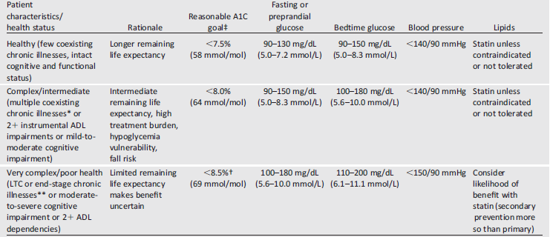
Recommendations for older adults with diabetes.
About 26% of patients over the age of 65 years have diabetes
Diabetes Care Volume 41, Supplement 1, January 2019

Slide 35
Recommendations for pediatric age with diabetes.
Goals should be individualized, and lower goals may be reasonable based on a benefit risk assessment.
Blood glucose goals should be modified in children with frequent hypoglycemia or hypoglycemia unawareness.
Diabetes Care Volume 41, Supplement 1, January 2019

Slide 36
Recommended glycaemic control targets for pregnant women with type 1, type 2 or gestational diabetes
Recommended that women with GDM monitor pre- and 1 h post-meals and at bedtime; occasional sample during night
Pre-prandial glucose | <95 mg/dL (5.3 mmol/L)
1-h postprandial glucose | <140 mg/dL (7.8 mmol/L)
2-h postprandial glucose | 120 mg/dL (6.7 mmol/L)
Diabetes Care Volume 41, Supplement 1, January 2019
ADA. Diabetes Care 2010;33(Suppl. 1):S11–S61; Kitzmiller et al. Diabetes Care 2008;31:1060–79

Slide 37
Decision cycle for patient-centred glycaemic management in type 2 diabetes
ASSESS KEY PATIENT CHARACTERISTICS
Current lifestyle
Comorbidities, i.e. ASCVD, CKD, HF
Clinical characteristics, i.e. age, HbA_{1c}, weight
Issues such as motivation and depression
Cultural and socio-economic context
REVIEW & AGREE MANAGEMENT PLAN
Review management plan
Mutual agreement on changes
Ensure agreed modification of therapy is implemented in a timeline fashion to avoid clinical inertia
Decision cycle undertaken regularly (at least once/twice a year)
ASSESS KEY PATIENT CHARACTERISTICS
REVIEW & AGREE MANAGEMENT PLAN
REVIEW & AGREE MANAGEMENT PLAN
CONSIDER SPECIFIC FACTORS THAT IMPACT ON CHOICE OF TREATMENT
Individualised HbA_{1c} target
Impact on weight and hypoglycaemia
Side-effect profile of medication
Complexity of regimen i.e. frequency, mode of administration
Choose regimen to optimise adherence and persistence
Access, cost and availability of medication
CONSIDER SPECIFIC FACTORS WHICH IMPACT ON CHOICE OF TREATMENT
ONGOING MONITORING AND SUPPORT INCLUDING:
Emotional well-being
Check tolerability of medication
Monitor glycaemic status
Biofeedback including SMBG, weight, step count, HbA_{1c}, BP, lipids
ONGOING MONITORING AND SUPPORT
Goals of care
Prevent complications
Optimise quality of life
IMPLEMENT MANAGEMENT PLAN
Patients not meeting goals generally should be seen at least every 3 months as long as progress is being made; more frequent contact initially is often desirable for DSMES
SHARED DECISION MAKING TO CREATE A MANAGEMENT PLAN
Involves an educated and informed patient (and their family/caregiver)
Seeks patient preferences
Effective consultation includes motivational interviewing, goal setting and shared decision-making
Empowers the patient
Ensure access to DSMES
IMPLEMENT MANAGEMENT PLAN
SHARED DECISION MAKING TO CREATE A MANAGEMENT PLAN
IMPLEMENT MANAGEMENT PLAN
AGREE MANAGEMENT PLAN
AGREE MANAGEMENT PLAN
Specify SMART goals:
Specific
Measurable
Achievable
Realistic
Time limited
Diabetes care January 2019 Volume 42, Supplement 1

Slide 38
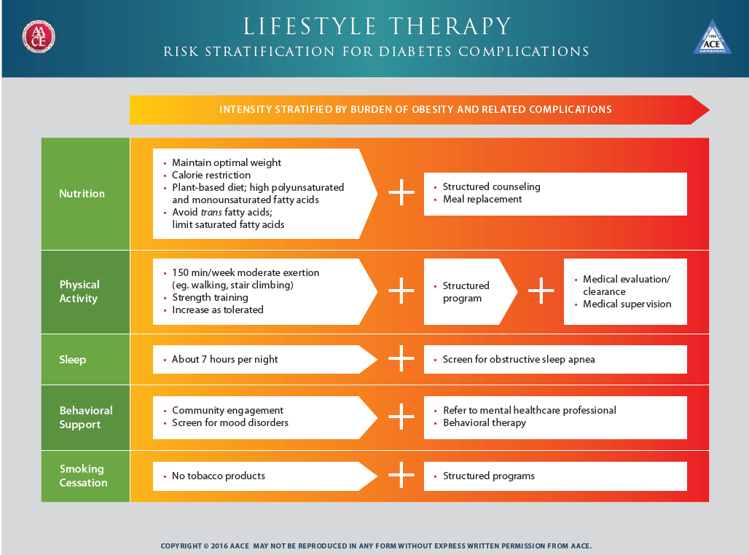
ENDOCRINE PRACTICE Vol 22 No. 1 January 2016

Slide 39
Diabetes care January 2019 Volume 42, Supplement 1

Slide 40
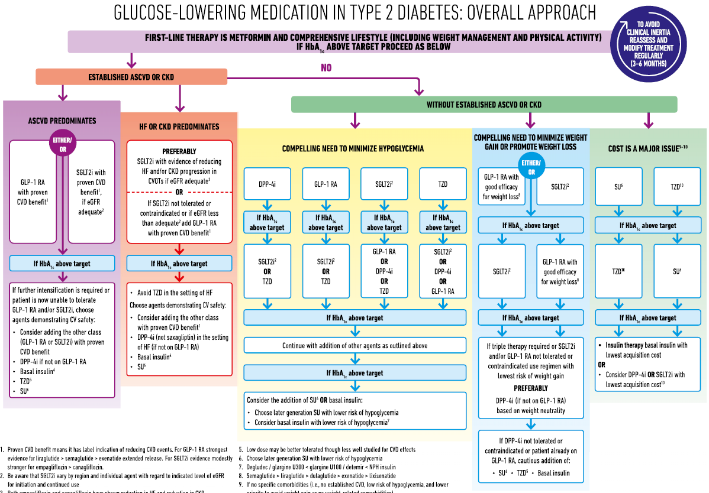

Diabetes care January 2019 Volume 42, Supplement 1

Slide 41
Consensus recommendation :
Metformin is the preferred initial glucose-lowering medication for most people with type 2 diabetes.
Consensus recommendation :
The selection of medication added to metformin is based on patient preference and clinical characteristics. Important clinical characteristics include the presence of established ASCVD and other comorbidities such as HF or CKD; the risk for specific adverse medication effects, particularly hypoglycemia and weight gain; as well as safety, tolerability, and cost
Davies MJ et al, Diabetes care 2018 Dec;41(12):2669-2701

Slide 42
The choice of medication
Antihyperglycemic efficacy.
Mechanism of action.
Risk of inducing hypoglycemia.
Risk of weight gain.
Other adverse effects.
Tolerability.
Ease of use, likely adherence.
Cost.
Safety in heart, kidney, or liver disease.
Diabetes Care Volume 40, Supplement 1, January 2017

Slide 43
Diabetes care January 2019 Volume 42, Supplement 1

Slide 44
Consensus recommendation :
Among patients with type 2 diabetes who have established ASCVD, SGLT2 inhibitors or GLP-1 receptor agonists with proven cardiovascular benefit are recommended as part of glycemic management.
Consensus recommendation :
Among patients with ASCVD in whom HF coexists or is of special concern, SGLT2 inhibitors are recommended.
Consensus recommendation :
For patients with type 2 diabetes and CKD, with or without CVD, consider the use of an SGLT2 inhibitor shown to reduce CKD progression or, if contraindicated or not preferred, a GLP-1 receptor agonist shown to reduce CKD progression.
Davies MJ et al, Diabetes care 2018 Dec;41(12):2669-2701

Slide 45
Diabetes care January 2019 Volume 42, Supplement 1

Slide 46
Consensus recommendation :
In patients who need the greater glucose-lowering effect of an injectable medication, GLP-1 receptor agonists are the preferred choice to insulin. For patients with extreme and symptomatic hyperglycemia, insulin is recommended.
Consensus recommendation :
Patients who are unable to maintain glycemic targets on basal insulin in combination with oral medications can have treatment intensified with GLP-1 receptor agonists, SGLT2 inhibitors, or prandial insulin.
Consensus recommendation :
Access, treatment cost, and insurance coverage should all be considered when selecting glucose lowering medications.
Davies MJ et al, Diabetes care 2018 Dec;41(12):2669-2701

Slide 47
Diabetes care January 2019 Volume 42, Supplement 1

Slide 48
Diabetes care January 2019 Volume 42, Supplement 1

Slide 49
Diabetes care January 2019 Volume 42, Supplement 1

Slide 50
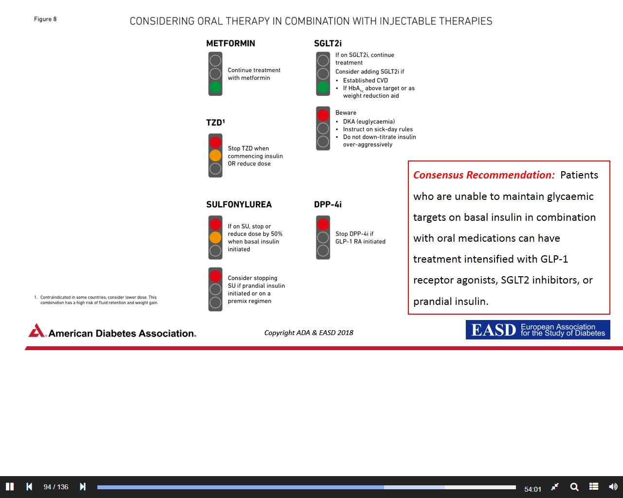
Considering Oral Therapy In Combination With Injectable Therapies
Diabetes care January 2019 Volume 42, Supplement 1

Slide 51
Diabetes care January 2019 Volume 42, Supplement 1

Slide 52
Intensifying to injectable therapies
HbA_{1c} above target despite dual/triple therapy
Consider GLP-1RA in most prior to insulin*
If already on GLP-1RA OR if GLP-1RA not appropriate OR insulin preferred†
If HbA_{1c} is above target
For patient on GLP-1RA and basal insulin
Consider fixed ratio combination (FRC) of
GLP-1RA and insulin
Add basal insulin
If HbA_{1c} is above target despite adequately titrated basal insulin
If HbA_{1c} is above target despite additional basal insulin or additional prandial insulin
Add prandial insulin usually one dose │ Consider: initiation and titration
If HbA_{1c} is above target
Consider twice-daily or thrice-daily premix insulin regimen
Caution higher risk of hypoglycaemia and/or
weight gain
Stepwise additional injections of prandial insulin
If HbA_{1c} is above target
Proceed to FULL basal bolus regimen
IF HbA_{1c} DOES NOT IMPROVE NEED FOR BASAL BOLUS REGIMEN
Diabetes care January 2019 Volume 42, Supplement 1
Notes:
GLP-1RAs are the preferred choice compared to insulin in patients who need the greater glucose-lowering effect of an injectable medication. For patients with HbA_{1c} >11% (97 mmol/mol), signs of catabolism (weight loss, polyuria, polydipsia) or if type 1 diabetes is a possibility insulin is recommended.
GLP-1RAs are now considered to be the first choice due to similar effects on HbA_{1c} lowering, lower risk of hypoglycaemia, and beneficial effects on weight compared to insulins (as shown in several head-head studies and in meta-analysis).
When insulin is the medicine of choice basal insulin with a low risk of hypoglycaemia should be preferred. The recommended hierarchy for basal insulins is degludec/glargine U300 > glargine U100/detemir > NPH insulin.
As stated above a GLP-1RA is the preferred injectable of choice. However, fixed ratio combination of GLP-1RA and basal insulin is recommended as an alternate option in patients who are already on GLP-RA and basal insulin separately.
Premixed insulin is recommended as one of the intensification option in patients uncontrolled on basal insulin plus OADs.
It is recommended that patients who are unable to maintain glycaemic targets on basal insulin in combination with oral medications can have treatment intensified with GLP-1RAs, SGLT2is or prandial insulin.

Slide 53
Standards of Medical Care in Diabetes - 2018. Diabetes Care 2018; 41 (Suppl. 1): S73-S85
Diabetes care January 2019 Volume 42, Supplement 1

Slide 54
COMPREHENSIVE DIABETES CARE
Optimal diabetes therapy involves more than plasma glucose management
and medications. Although glycemic control is central to optimal diabetes therapy, comprehensive diabetes care of both type 1 and type 2 DM should also detect and manage DM-specific complications and modify risk factors for DM-associated diseases.
Diabetes Care Volume 41, Supplement 1, January 2018

Slide 55

Diabetes and ASCVD
15-35%
Diabetes (together with lipid abnormalities, smoking and hypertension) is 1 of the top 4 independent risk factors for MI.
Approximately 15% to 35% of patients admitted with ACS have known diabetes and as many as 15% have undiagnosed diabetes.
Patients admitted with ACS
have known diabetes
Up to
15%
Diabetes is
1 of the top 4
Undiagnosed
diabetes
independent risk
factors for MI
Can J Diabetes 2013;37(suppl 1):S119-S123
Notes:
Reference:
Canadian Diabetes Association 2013 clinical practice guidelines for the prevention and management of diabetes in Canada: management of acute coronary syndromes. Can J Diabetes 2013;37(suppl 1):S119-S123.

Slide 56
Dysglycemia
Dyslipidemia
Inflammatory
cytokines
T2DM
&
CVD
Oxidative
stress
Hyper coagulation
Endothelial
dysfunction

Slide 57






Diabetes and Life expectancy
60
yrs
End of life
No diabetes
Diabetes
–6
yrs
–12
yrs
Diabetes + MI
Diabetes + MI + stroke
15
yrs
The Emerging Risk Factors Collaboration. JAMA 2015;314:52
Notes:
Abbreviations
CVD, cardiovascular disease; MI, myocardial infarction
Reference
The Emerging Risk Factors Collaboration. JAMA 2015;314:52

Slide 58
Death for any cause
Acute MI
Stroke
Heart failure

Slide 59
How do we modify CV risk in T2DM?
Lifestyle modification
Multifactorial approach
Glycaemic control
Management of
dyslipidaemia
Blood pressure control
Platelet inhibition
Notes:
NOTE: In their 2016 update, the ESC guidelines recommend the use of ACE inhibitors or angiotensin receptor blockers in patients with hypertension and microalbuminuria
All guidelines emphasise the importance of a multifactorial approach to reducing cardiovascular risk in patients with T2DM by addressing all modifiable risk factors,
This approach is evidence based and the STENO-2 study¹ in particular established the benefits of a multi-factorial approach to the management of patients with type 2 diabetes.
STENO-2 study investigated the effect of intensive treatment, on death from any cause and from CV causes, in T2DM patients with persistent microalbuminuria. The study showed that at-risk T2DM patients receiving intensive intervention with multiple drug combinations and behaviour modification had sustained beneficial effects with respect to vascular complications and on rates of death from any cause and from cardiovascular causes.
STENO-2 study details:
160 white Danish patients with type 2 diabetes (defined according to the criteria of the World Health Organization)
All had persistent microalbuminuria
Patients randomly assigned to receive either conventional multifactorial treatment or intensified, target-driven therapy
Treatment targets: Hb_{A1c} <6.5%; fasting serum total cholesterol level <4.5 mmol/L; fasting serum triglyceride <1.7 mmol/L; systolic blood pressure <130 mm Hg; diastolic blood pressure <80 mm Hg
1. Gæde P et. al. N Engl J Med 2008; 358:580-591

Slide 60
In at-risk patients with type 2 diabetes, intensive intervention with multiple drug combinations and behavior modification had sustained beneficial effects with respect to vascular complications and on rates of death from any cause and from cardiovascular causes.
Gæde P et al, N Engl J Med 2008;358:580-91.

Slide 61

Testing for diabetes or pre-diabetes in asymptomatic adults

Slide 62
Criteria for testing for diabetes or prediabetes in asymptomatic adults
Diabetes care January 2019 Volume 42, Supplement 1

Slide 63
ADA risk test
Diabetes Care Volume 41, Supplement 1, January 2018

Slide 64

Prevention or Delay of Type 2 Diabetes

Slide 65
Patients with pre-diabetes should be referred to:
Intensive diet counseling program (a loss of 7% of body weight )
Physical activity and Exercise :moderate-intensity physical activity (such as brisk walking) to at least 150 min/week.
58% reduction after 3 years
27% reduction at 15 years
Screening for and treatment of modifiable risk factors ( obesity, hypertension, and dyslipidemia) for cardiovascular disease is suggested.
Diabetes care January 2019 Volume 42, Supplement 1

Slide 66
Pharmacologic agents including:
Metformin.
α-glucosidase inhibitors.
Orlistat.
Glucagon-like peptide 1 (GLP-1) receptor agonists.
Thiazolidinediones.
have each been shown to decrease incident diabetes to various degrees in
those with prediabetes, though none are approved by the U.S.
Food and Drug Administration specifically for diabetes prevention.
Diabetes care January 2019 Volume 42, Supplement 1

Slide 67
Metformin therapy for prevention of type 2 diabetes should be considered in those with pre-diabetes:
BMI ≥ 35 kg/m2 .
Those aged < 60 years.
Women with prior gestational diabetes mellitus.
Follow-up counseling and maintenance programs should be offered for long term success in preventing diabetes.
At least annual monitoring for the development of type 2 diabetes in those with prediabetes is suggested.
Diabetes care January 2019 Volume 42, Supplement 1

Slide 68
Summary
Diabetes is a complex, chronic illness requiring continuous medical care with multifactorial risk-reduction strategies beyond glycemic control.
Treatment decisions should be timely, rely on evidence-based guidelines, and be made collaboratively with patients based on individual preferences, prognoses, and comorbidities.
Clinical practice guidelines are key to improving population health; however, for optimal outcomes, diabetes care must be individualized for each patient.

Slide 69

The Changing Landscape of Diabetes Therapy
Improving outcomes in T2DM
Focus on cardiovascular & renal safety

Slide 70

State of the art
Treat the patient Not his sugar
Reduce the CV risk Not only the HbA1c
The Changing Landscape of Diabetes Therapy
Improving outcomes in T2DM
Focus on cardiovascular & renal safety

Slide 71

Thank you

