Slide 1
Case Peresentation: Adrenal Incidentaloma
Presented by:Dr.Rezvankhah
Dr.Zabandan

Slide 2
مشخصات بیمار :
خانم 41 ساله
متاهل
بدون فرزند
اهل اصفهان
ساکن تهران
کارشناسی ارشد
شاغل

Slide 3
شکایت اصلی :
توده اتفاقی ادرنال
بیمار خانم 41 ساله به دنبال علایم غیر اختصاصی شامل Bloating and Hurt burn با شک به سنگ کیسه صفرا تحت سونوگرافی قرار گرفته که بصورت اتفاقی ضایعه با ابعاد 44*36 میلی متر در محل آناتومیک آدرنال راست گزارش شده است.

Slide 4
کاهش یا افزایش وزن Significant (-) تب(-)
ضعف عضلانی وخستگی(-) گرگرفتگی(-)
افزایش فشار خون (-)
تعریق (-) طپش قلب (-) سردرد (-)
پلی اوری (-) پلی دیپسی (-) درد شکم (-) کمردرد(-)
طاسی مردانه (-) تغییر صدا (-) عضلانی شدن (-)
easy bruising(-) آکنه (-) تغییرات لیبیدو(-)
سیکل های قاعدگی منظم با فواصل 30 روزه
هیرسوتیسم از حدود سن 23 سالگی که در حال حاضر Distribution و
تراکم آن تغییری نداشته است

Slide 5
PMH =
در سن 27 سالگی به علت هیرسوتیسم در هندوستان تحت بررسی قرار گرفته که با توجه به تستوسترون بالا(170 ng/dl)جهت بیمار سونوگرافی انجام شده
سونوگرافی شکم ولگن :
رحم وضمایم نرمال بوده اما توده به ابعاد 8*6*3 سانتی متر در ادرنال چپ گزارش شده که تحت جراحی قرار گرفته که گزارش پاتولوژی آن
Adrenocortical Adenoma بوده است(جراحی در ایران )
در آن زمان شواهدی دال بر Virilization و اختلال Menstruation نداشته و تنها شکایت بیمار هیرسوتیسم بوده
که از سن 23 سالگی به تدریج ایجاد شده و در زمان تشخیص در حد FGS 17 بوده است
علایم بالینی و بررسی ها ی آزمایشگاهی از نظر فیوکروموسیتوما منفی بوده است.

Slide 6
بررسی های آزمایشگاهی
Testosterone | 170 ng/dl
DHEA_S | 355 mcg/dl (80-560)
Prolactin | 18.95 ng/ml
FSH | 10.4 mIU/ml
LH | 3.5 mIU/ml
epinephrine | mcg (0_15)
norepinephrine | 130 mcg (0_100)
Vol | 1250 cc
Cr | 1312 mg

Slide 9
سن تلارک را به یاد ندارد
منارک در سن 13 سالگی HTN (-) DM (-)
سیکل های قاعدگی منظم همراه با تخمک گذاری
ناباروری که به گفته بیمارmale factor بوده است.
FH = والدین خویشاوند،هیرسوتیسم با Score مشابه در خواهران
HH= سیگار (-) الکل (-)
DH= کلومیفن

Slide 10
Ph/E =
خانم جوانی با قد 173 و وزن 70 BMI:23
پوست : نازکی پوست (-) اکیموز (-)
آکنه (-) FGS قابل محاسبه نبود
در حال حاضر تنها Terminal Hair در ناحیه شکم قابل مشاهده است
BP:100/70 ،تغییرات ارتوستاتیک ندارد،تاکی کارد نمی باشد.
H&N = ملتحمه pale (-) moonface (-)
Supraclavicular fatpad(-)
Acantosis nigricans(-)
لنفادنوپاتی(-)
معاینه تیرویید نرمال

Slide 11
Chest = تلارک stage 5
قلب وریه نرمال
Abdomen = اسکار جراحی در LUQ
استریا (-)
تندرنس CVA (-)
ارگانومگالی (-)
Ext = آتروفی عضلانی(-)
کاهش force عضلانی (-)
نبض ها پر و قرینه

Slide 12
: Problem list
خانم۴۱ساله مورد توده اتفاقی آدرنال راست بدون علایم همراه
سابقه ی هیرسوتیسم و جراحی توده آدرنال چݒ ١٢سال قبل با جواب پاتوتوژی آدنوم adrenocortical

Slide 13
Approach to an Incidentaloma:
Is the mass functional or not?
Is the mass malignant or benign?

Slide 14
۴/۷/۹۵
24h free U cortisol | 85 mcg ( 50-190)
Total volume | 2250
24h urine cr | 1.4 gr
Cortisol 8am | 21.74 (mcg/dl)
Cortisol(overnight) | 1.49 (mcg/dl)
ACTH | 55 (pm/ml)

Slide 15
VMA | 7.2 mg <136
24h U Metanephrine | 6.9 mcg <350
24h U Normetanephrine | 106 <600
T volume | 2350
24h U creatinine | 1.4 gr
Testosterone | 1.02 ng/ml (0.06-0.8)
DHEAS | 551.1 mcg/dl (60-337)
17OH-Progesterone | 1.9 ng/ml (0.2-1.3)
TSH | 2.04 mcIU/ml
K | 4.5
ESR | 3

Slide 16
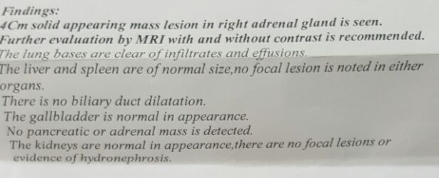
Abdominal CT w/o contract

Slide 17
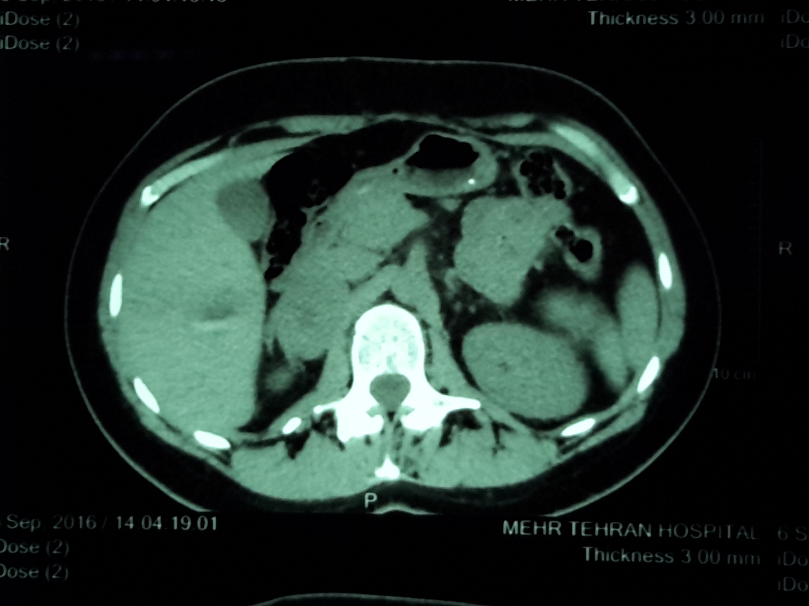
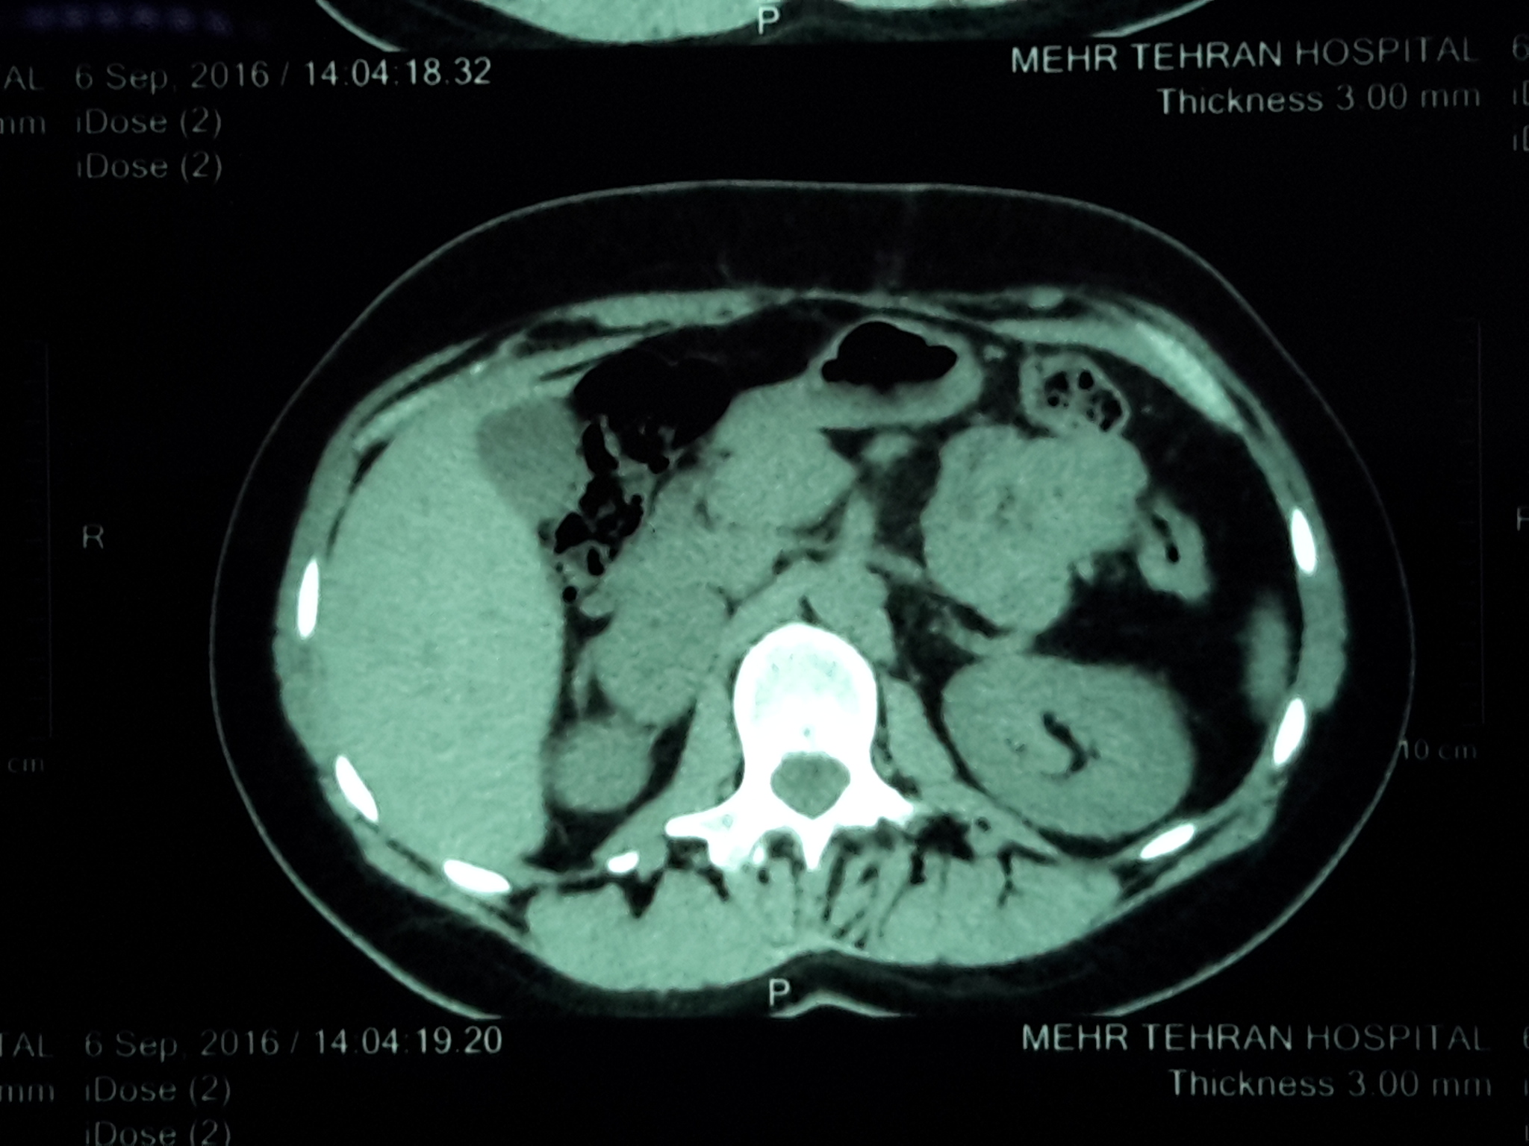

Slide 18
MRI+/- GAD

Slide 19
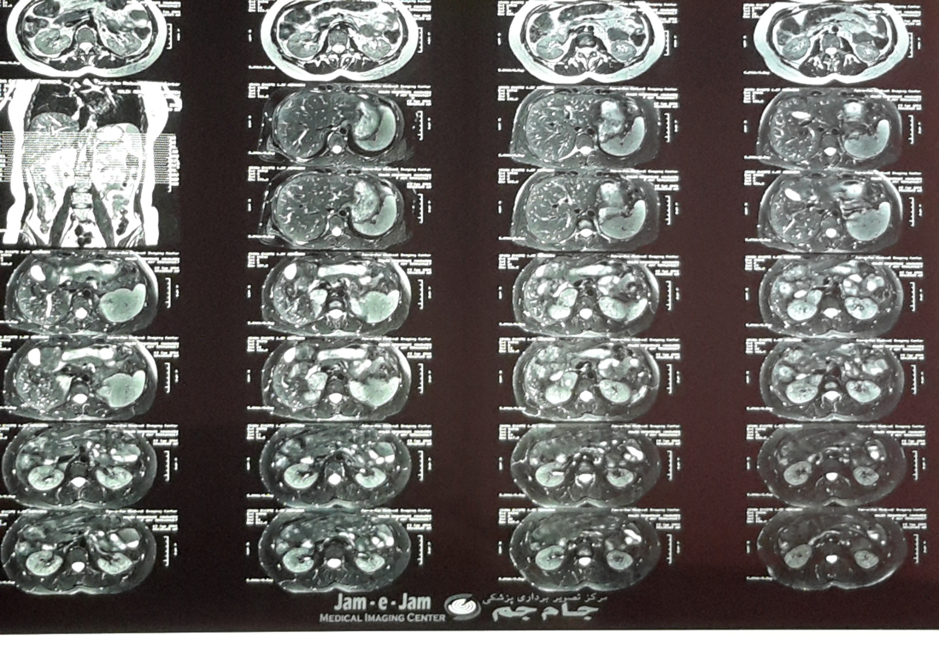

Slide 20
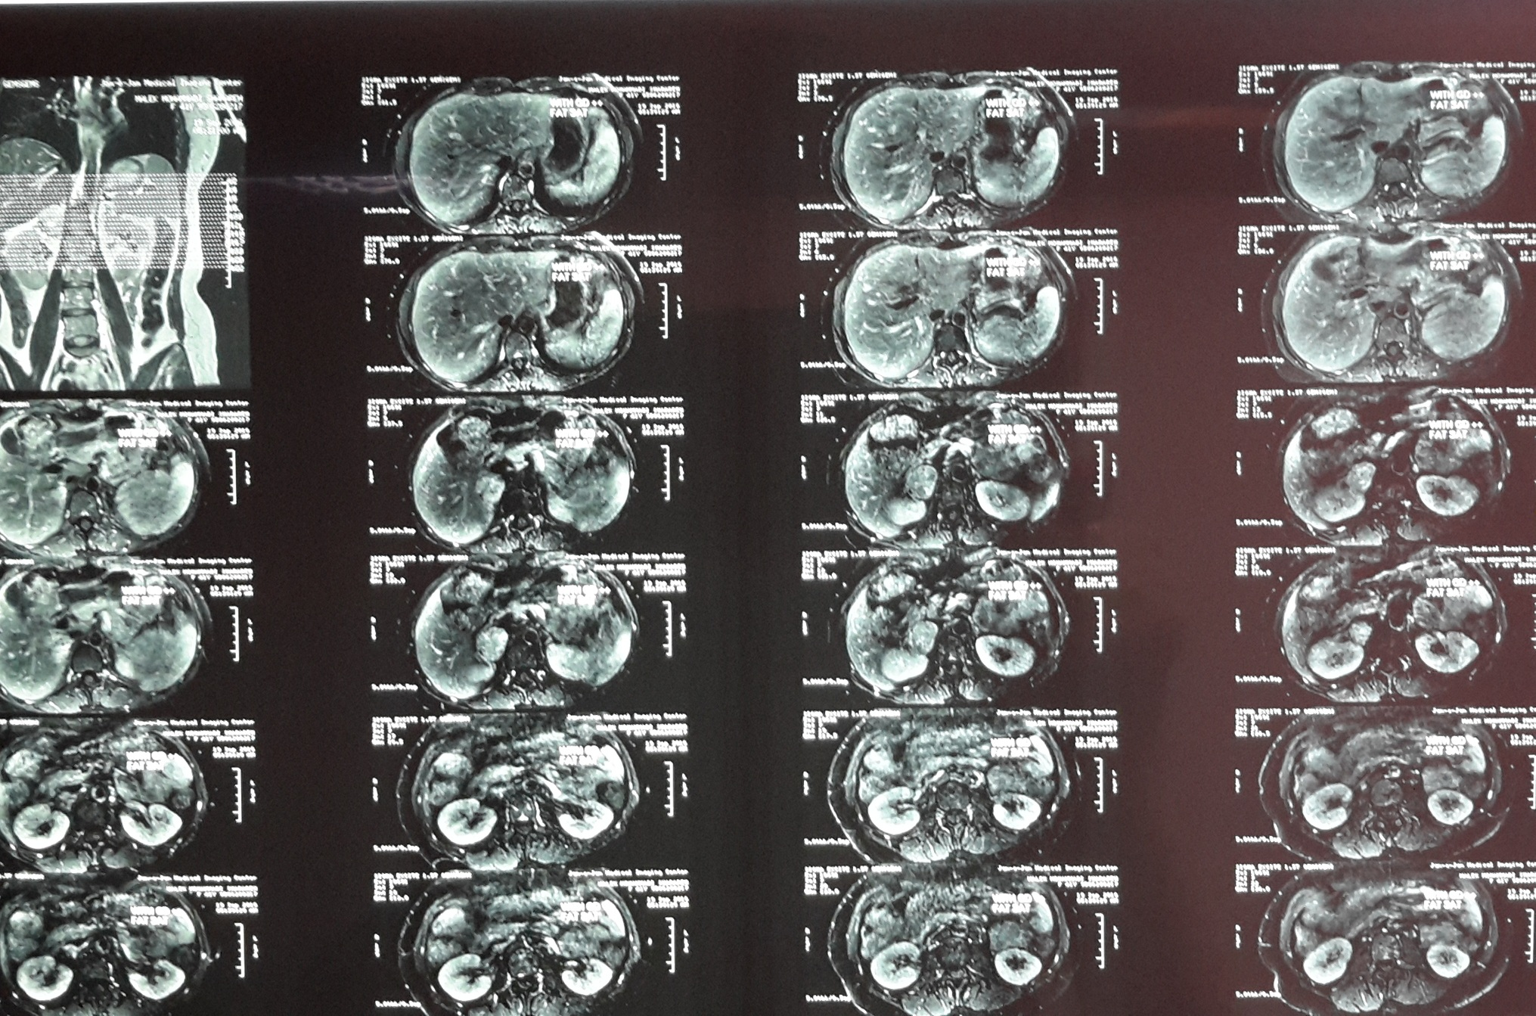

Slide 21
 | 82/12/25 Pre op | 83/3/18 Post op | 84/4/9 | 93/8/29 | 95/7/4
Testosterone (ng/dl) | 170 | 50 | 70 | 59 | 102
DHEA-S (Mcg/dl) | 355 | 214 | 174 | 396 | 555
Prolactin (ng/ml) | 18.95 |  | 30 | 20
FSH (mIU/ml) | 10.4 |  | 11.8
LH (mIU/ml) | 3.5 |  | 9.7
Androstenedion (mIU/L)
TSH (mIU/ml) | 0.5 | 1.2 | 2.6 |  | 2.04
17-OH Prog ng/ml |  |  |  |  | 1.9

Slide 22
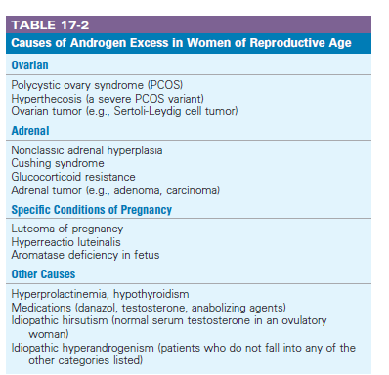
Hirsutism: excessive male-pattern hair growth
affects 5-10% of women in reproductive age
The prevalence of IH & PCOS,13% & 8.5% respectively in reproductive Iranians females

Slide 23
European Journal of Obstetrics & Gynecology and Reproductive Biology
Method:The study was conducted among 1000 reproductive-age women recruited from the Tehran Lipid and Glucose Study, using random systematic sampling. It had two phases: (1) the discovery phase, which aimed at developing a simpler method according to the modified Ferriman–Gallwey (mFG) system and a new cut-off point to assess hirsutism, and (2) the validation phase, aimed at assessing the sensitivity and specificity of the simplified method in a non-dependent study, the Iranian PCOS Prevalence Study.

Slide 24
The present study assessed the combination of all nine body areas and findings revealed that the subset of lip, lower abdomen and thighs (cut-off point 4), had the acceptable sensitivity, specificity and concordance percentage with the total score

Slide 25
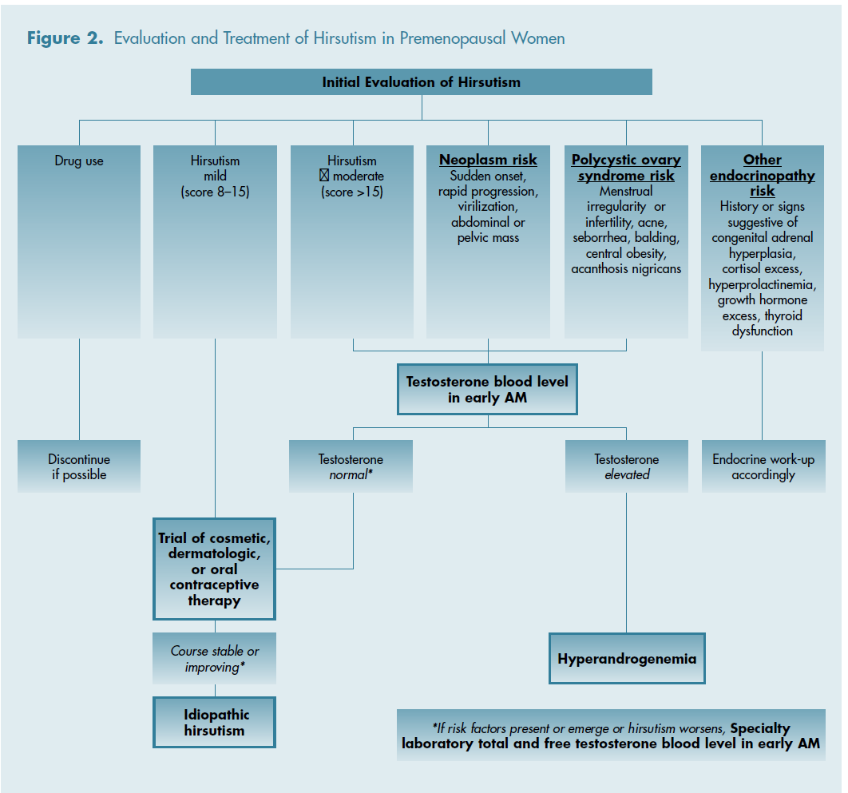
J Clin Endocrinol Metab.2008

Slide 26
(J Clin Endocrinol Metab.2012)

Slide 29
Androgen-secreting adrenal tumors
Pure virilizing benign adrenal adenomas are rare(approximately 50 cases reported in the literature)
almost uniquely found in females (in males the disorder is restricted to childhood with sexual precocity)
characteristically present with a combination of hirsutism, virilization, and menstrual irregularities
Testosterone strikingly elevated
Benign adrenocortical tumors very often show low DHEAS concentrations, whereas highly elevated DHEAS is suggestive of ACC
Hormone concentrations are of limited value in predicting malignancy
Cosecretion of glucocorticoids and sex hormones are indicative of a malignant adrenal lesion
Similarly, high levels of steroid precursors such as 17a-hydroxyprogesterone or androstenedione are often observed in seemingly hormonally inactive ACCs

Slide 30
Purely testosterone-secreting adrenal adenama
Givens et al., had proposed that the excess serum testosterone with low 17-KS is due to increased enzymatic activity in virilizing adrenal tumors converting the androstenedione into testosterone
Aguirre and Scully’o theorized that the pure testosterone secreting adrenal tumors might have originated from gonadal cells displaced within the adrenal gland
Vasiloff et al., further supported the above theory by finding crystalloids specific for gonadal Leydig cells in three cases of virilizing adrenal tumors

Slide 31
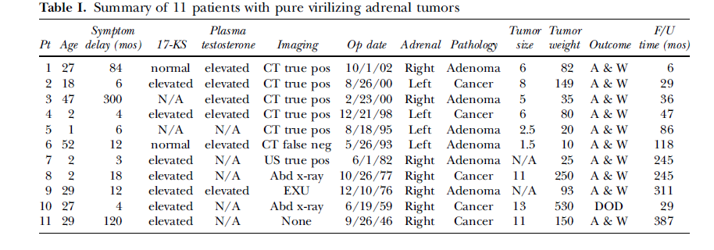
Method:A retrospective chart review was performed of all patients with androgen excess symptomatology associated with an adrenal tumor between 1946 _ 2002.

Slide 32
Methods. In a review of 801 adrenal operations from 1970 through 2003, 21 women with PASATs were divided into 2 groups, benign and undetermined tumors (Weiss score # 3) (BT = 11) and malignant tumors (Weiss $4 or nonresectable) (MT = 10).

Slide 33
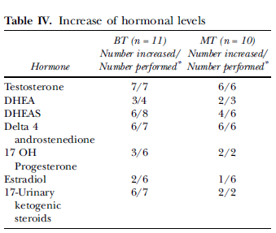
Conclusion:No qualitative biochemical
profile is suggestive of malignancy,
but testosterone levels greater than 12-fold normal do suggest malignancy.
Imaging studies allow a diagnosis of
malignancy in 40% of patients.

Slide 34
A 32 year old married female presented with infertility since 2 years and hirsutism, irregular menses, masculine voice since 1 year.
Testosterone level 1.76 ng/ml (0.09-1.09 ).
DHEA-S : 1082.2 ug/dl (74-410)
Abdomenal CT: a 9*8 cms moderately enhancing heterogenous suprarenal mass on left side

Slide 35
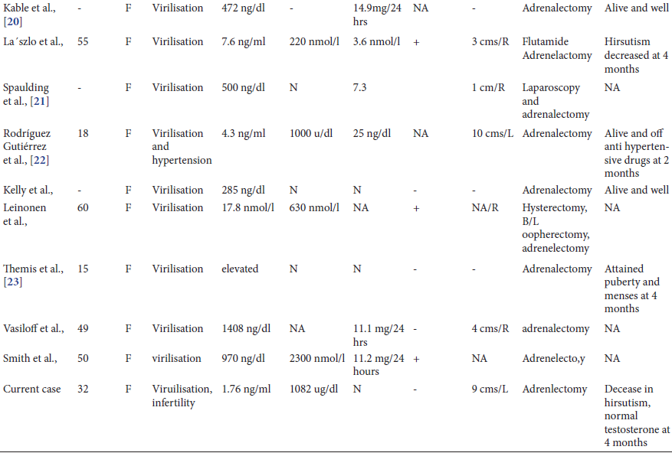

Slide 36
European Journal of Endocrinology2016

Slide 37
Incidentaloma
An adrenal mass detected on imaging not performed for suspected adrenal disease
The incidence and prevalence of adrenal incidentalomas can only be extrapolated from imaging or autopsy studies.
prevalence of adrenal masses around 2% (range1.0–8.7%) in autopsy studies, which increases with age .
frequency of around 3% in the age of 50 years in radiological studies which increases up to 10% in the elderly

Slide 38
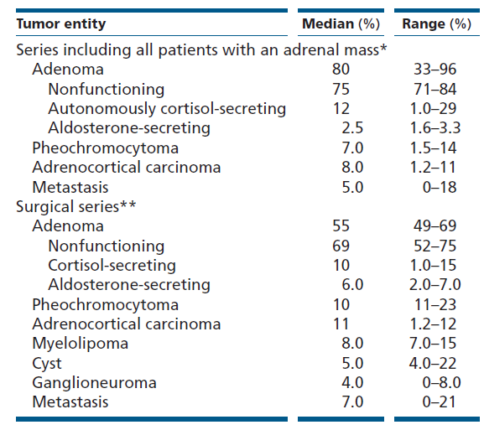
Table 1 Adrenal incidentalomas – frequency of the different underlying tumor types

Slide 39
R 2.2. We recommend that all adrenal incidentalomas undergo an imaging procedure to determine if the mass is homogeneous and lipid-rich and therefore benign (⊕OOO). For this purpose, we primarily recommend the use of noncontrast CT (⊕OOO).
R 2.3. We suggest that if the noncontrast CT is consistent with a benign adrenal mass (Hounsfield units ≤10) that is homogeneous and smaller than 4 cm, no further imaging is required (⊕OOO). R 5.1.
We suggest against further imaging during follow-up in patients with an adrenalmass <4 cm with clear benign features on imaging studies (⊕OOO).

Slide 40
R 2.4. If the adrenal mass is indeterminate on noncontrast CT and the results of the hormonal work-up do not indicate significant hormone excess, there are three options that should be considered by a multidisciplinary team acknowledging the patient’s clinical context: immediate additional imaging with another modality, interval imaging in 6–12 months (noncontrast CT or MRI) or surgery without further delay.

Slide 42
non-contrast CT scan
Informative about the smoothness of contour, the homogeneity and the possible invasion or mass extension to adjacent tissues
The risk of malignancy increases with mass diameter
(≤4 cm: 2%, >6 cm: 25%), and decreases with greater lipid content.
A threshold of <10 Hounsfield units (HU) is indicative of high lipid content.
in patients with extra-adrenal malignancy,7% of cases with noncontrast HU ≤10 turned out to be malignant.

Slide 43
Intravenous contrast-enhanced CT
High contrast washout, definedas
>60% absolute
[100 × (HU60s− HU15min)/(HU60s− HU0s]
or
>40%relative
[100 × (HU60s− HU15min)/HU60s), at 15 min is indicative of the benign nature of an incidentaloma

Slide 44
Methods: Between January 2004 and November 2012, 43 non-oncologic patients with 43 adrenal masses [31 large adenomas, and 12 carcinomas] underwent unenhanced CT, early contrast-enhanced CT, and delayed contrast enhanced CT scans prior to adrenalectomy. Three types of region-of-interest (ROI) were used on early contrastenhanced CT images:aROI (large ROI) covering more than half of a mass and two small ROIs fitted to the highest (high ROI) or lowest (low ROI) attenuation area. These ROIs were also placed in the same area on the other CT images. Adenoma was diagnosed if a mass measured £10 HU on unenhanced CT image, or if it
had ‡60% absolute percentage washout (APW)or ‡40%
relative percentage washout (RPW).Carcinoma was
diagnosed if a mass had <60% APW and <40%
RPW. CT sensitivities for large adenoma and carcinoma
were compared.

Slide 47
Results: CT sensitivities for large adenoma vs. carcinoma were 64.5% (20/31) vs. 100% (12/12) using a large ROI, 100% (31/31) vs. 50.0% (6/12) using a high ROI, and 51.6% (16/31) vs. 100% (12/12) using a low ROIs respectively.

Slide 48
The ScientificWorld Journal2013
Methods: Fifty patients with adrenal masses were prospectively evaluated. CT scans were performed by using a 320-row MDCT device, before and after injection of contrast material. In 25 cases,delayed scans were performed at 5’ and 10’ (group 1), while in the remaining 25, at 5’and 15’(group 2). Absolute and relative washout percentage values (APW and RPW) were calculated

Slide 49
the unenhanced scans were significant for the differential diagnosis between adenomas and nonadenomas in 75% of cases
In no case of nonadenomas, a basal density value of less than 10HU was found.
The morphological criteria represent, an important parameter of evaluation but have some limitations.
(i) They do not allow a diagnostic orientation in case of lipid-poor adenomas (approximately 30% of cases), which have a density greater than 10HU.
(ii) Unenhanced CT scans are often not used in the followup of cancer, and therefore the histological criteria cannot be evaluated.
(iii) The possibility exists that an adrenal carcinoma contains foci of intracytoplasmic lipids, as well as exceptionally metastatic from clear cell renal carcinoma and hepatocellular carcinoma

Slide 50
Results:Differential diagnosis between adenomas and nonadenomas was obtained in 48/50 (96%) cases, with sensitivity, specificity, and accuracy values of 96%, 95%, and 96%, respectively
In group 1,APW and RPW values were, respectively, 69.8% and 67.2% at 5’ and 75.9% and 73.5% at 10’ for adenomas and 25.1% and 15.8% at 5’ and 33.5% and 20.5% at 10’ for nonadenomas. In group 2, APW and RPW values were 63% and 54.6% at 5’ and 73.8% and 65.5% at 15’ for adenomas and 22% and 12.5% at 5’and 35.5% and 19.9% at 15’for nonadenomas.

Slide 51
MRI
Benign cortical adenomas appear hypo or isointense to liver on T1-weighted images, and hyper or isointense to liver on T2-weighted images
Quantitative assessment of loss in signal intensity is not well standardized between the different studies and, therefore, evidence base for performance of MRI in the diagnosis of malignancy is insufficient to make strong recommendations.
Moreover, the interpretation of the images might be more dependent on the experience of the radiologist than for CT assessment.
The meta-analysis was not able to determine the diagnostic value of MRI due to the low number and quality of eligible studies.
MRI should be the first choice only where a CT is less desirable (e.g. pregnancy,children).

Slide 52
FDG-PET
False negative results is quite low, and this refers mainly to a few subtypes of extra-adrenal malignancies with low uptake (Prostate cancer,BAC,low-grade sarcomas,low grade non-hodgkin lymphoma).
Several benign adrenal tumors (e.g. functional adenomas or benign pheochromocytoma) may be FDG-positive.

Slide 53
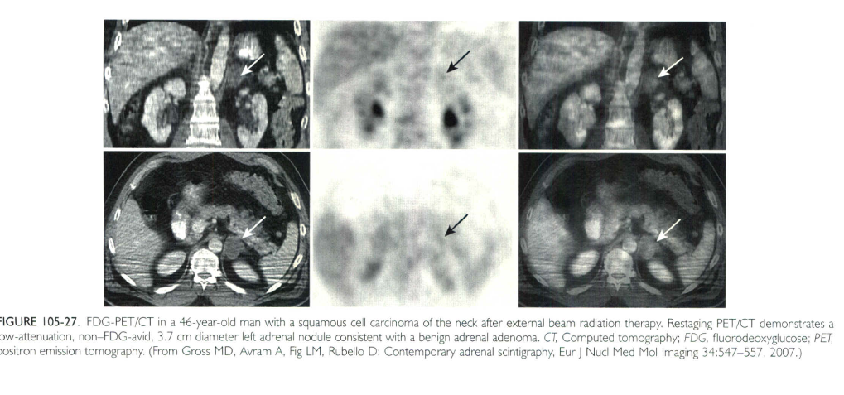

Slide 54
R 5.2. In patients with an indeterminate adrenal mass (by imaging), opting not to undergo adrenalectomy following initial assessment, we suggest a repeat noncontrast CT or MRI after 6–12 months to exclude significant growth (⊕OOO). We suggest surgical resection if the lesion enlarges by more than 20% (in addition to at least a 5 mm increase in maximum diameter) during this period. If there is growth of the lesion below this threshold, additional imaging again after 6–12 months might be performed

Slide 55
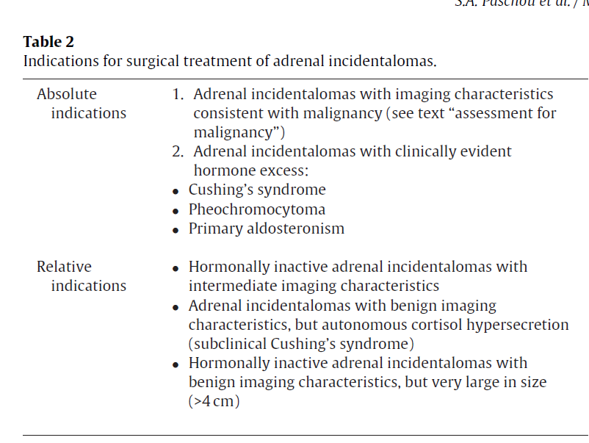

Slide 56
European Journal of Endocrinology(2016)
A systematic review and meta-analysis

Slide 57
In cancer patients, the likelihood of an adrenal nodule being malignant is approximately 20% (only 70% of adrenal lesions surgically removed on the basis of imaging results are confirmed as metastasis by histology)
Larger clinical and surgical adrenal incidentaloma series report an ACC prevalence of 1.4–12%
at least a third of benign adrenal adenomas have been shown to be lipid-poor
Unnecessary surgery in 30–55% of patients

Slide 58
despite the wide spread use of imaging tests in the workup of adrenal incidentalomas, the optimal choice, sequence and performance of imaging tests to distinguish benign from malignant adrenal masses is uncleaand
clinical practice remains more expert-based than evidence-based.
published reports are often unconvincing due to small sample sizes, heterogeneity of included populations and different imaging techniques or cut-offs as well as poor reference standards.

Slide 60
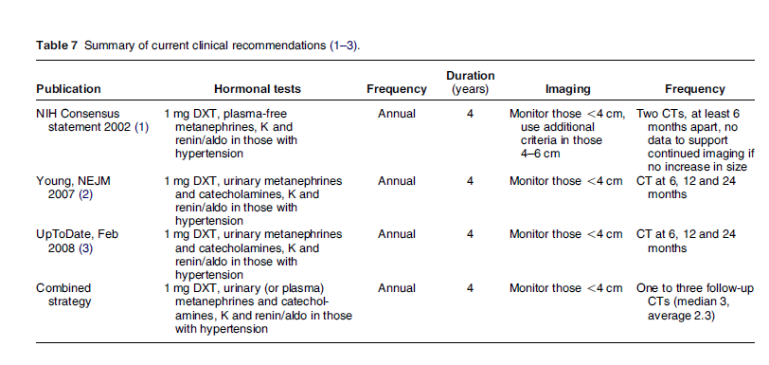

Slide 61
At initial evaluation, the false-positive rate for functional or malignant lesions is typically 5 times greater than the true-positive rate, and during followup
of adrenal incidentalomas initially considered to be
benign and non-functional, the false-positive rate is typically 50 times greater than the true-positive rate

Slide 63
The new guidelines recommend that after the initial evaluation, no further follow-up, either hormonal evaluation or repeat scanning, is necessary for patients with homogeneous-appearing non-secreting incidentalomas <4 cm in diameter on non-contrast CT ≤10 HU
For patients with possible autonomous cortisol secretion (low risk) and no comorbidities (such as hypertension, diabetes mellitus or vertebral fractures), adrenalectomy is not indicated
In the absence of published evidence and in accordance with the recentESE/ENEA guidelines, we recommend that follow-up should bestopped after 2–4 years if no changes are detected

