Slide 1
Complementary alternative therapy for obesity
Alireza Esteghamati ,M.D
Professor of Endocrinology and Metabolism
Tehran University of Medical Sciences
DECMBER , 2013

Slide 2
outline
Introduction
Supplements
Homeopathy
Yoga , Ayurveda
Hypnosis
Acupuncture
Body Contouring

Slide 3
Introduction
Complementary and alternative medicine is defined as :
‘‘the use and practice of therapies or diagnostic techniques that may not be part of any current Western health care system, culture, or society.’’
Examples of CAM include :
Acupuncture, chiropractic, herbal medicine, homeopathy, and naturopathy

Slide 4
Introduction
34% of the US population was using at least 1 form of CAM in 1990
By 1997 that number had grown to 42%.
This amounts to 629 million office visits to alternative practitioners in 1997
Compared with 386 million office visits to primary care providers

Slide 5
Introduction
With the increasing prevalence of obesity, there are a large number of alternative treatments touted for weight loss.
Dietary supplements are the most commonly used complementary therapy for weight loss.
A recent study showed that 34% of a representative sample used a dietary supplement for weight loss sometime in their lives, and nearly 1 in 10 have done so in the past year

Slide 6
DIETARY SUPPLEMENTS
Caffeine/Ephedrine/Ephedrine Alkaloids
About 80% of supplements used contain naturally occurring stimulants, such as caffeine and ephedrine.
The combination of caffeine and ephedrine has thermogenic properties that increase energy expenditure and promote weight loss.

Slide 7
DIETARY SUPPLEMENTS
Caffeine/Ephedrine/Ephedrine Alkaloids
Numerous studies have evaluated the effects of caffeine and ephedrine on weight loss in overweight and obese subjects with the typical dose being 200mg caffeine/20mg ephedrine 3 times daily.
Ephedrine is the primary active ingredient of herbal ephedra, also known as ma huang.
In herbal products, caffeine is often derived from guarana or kola nut.

Slide 8
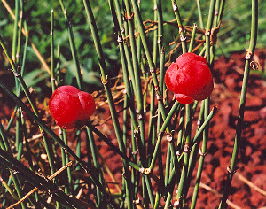
Ma huang

Slide 9
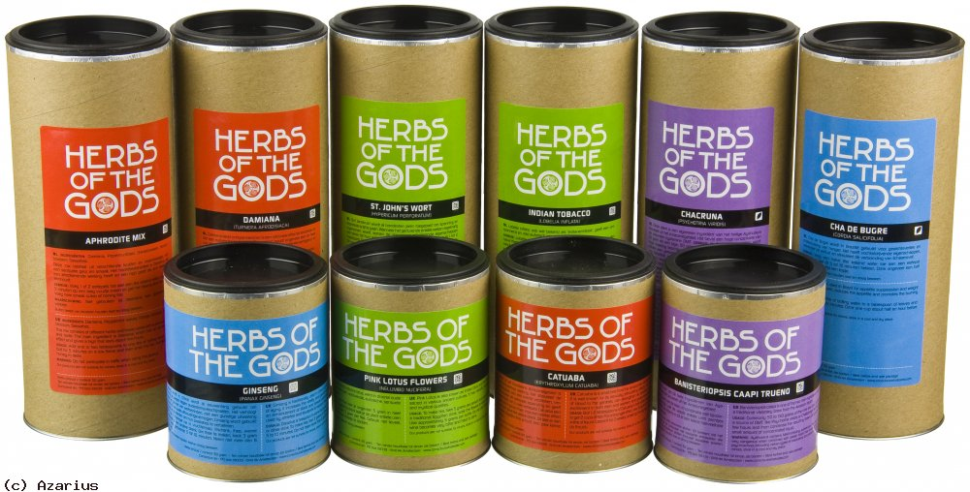
Guarana or kola nut

Slide 10
Kola nut
Kola nut was the main ingredient in Coca-Cola after cocaine became illegal.
Whether or not it is still an ingredient in Coca-Cola is a secret, but it can be found in Pepsi cola.
In Jamaica and Colombia Kola nut is consumed as a sexual stimulant similar to cocaine

Slide 11
Caffeine/Ephedrine RCT
8-week double-blind, RCT of 67 overweight subjects
Combination of ma huang and guarana, 72 mg/240 mg/d, effectively decreased weight, with an average lo of 4 kg compared with 0.8 kg in the placebo group.
Percentage of body fat, W/H circumferences, and TG decreased
significantly more in the active treatment group.
There were no differences in BP or blood chemistries
HR increased in the active treatment group, 7 bpm.
There were 8 dropouts

Slide 12
Caffeine/Ephedrine RCT
A prospective, double-blind, RCT by Boozer
Long-term safety and efficacy of a ma huang/kola nut supplement for weight loss.
About 167 healthy, adult volunteers were randomized to receive 30 mg ephedrine alkaloids/64 mg caffeine or placebo 3 times daily

Slide 13
Caffeine/Ephedrine RCT
At 6 months, subjects in the herbal treatment group lost significantly more weight and body fat than that of placebo, 5.3 kg versus 2.6 kg (P<.001) and 4.3 kg versus 2.7 kg (P<.020), respectively.
Other significant differences in favor of the herbal group included decreased waist and hip circumferences.

Slide 14
Caffeine/Ephedrine RCT
BP was not significantly different between the 2 groups, but HR increased significantly in the herbal group and decreased in the placebo group, (+ 4 bpm vs 3 bpm)
Dry mouth, heartburn, and insomnia were reported significantly more in the active treatment group

Slide 15
Meta-analysis of the efficacy and safety of ephedrine for weight loss / athletic performance
The estimate of the rate of weight loss was 1 kg/mo more than weight loss with placebo.
Subjects receiving ephedrine had a 2.2 to 3.6 increased odds of psychiatric symptoms, autonomic hyperactivity, UGI symptoms, and palpitations.
There is sufficient evidence to support the effectiveness of up to 6 months of ephedrine/ caffeine for weight loss.
Side effects may preclude its use in patients with chronic cardiovascular or psychiatric illnesses

Slide 16
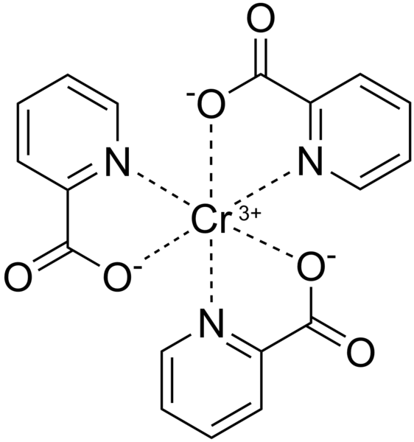
Chromium
Chromium picolinate is advocated in both medical and lay literature for reducing body weight.
Chromium is an essential trace mineral that enhances insulin activity and has shown some benefit for the control of diabetes.
Picolinic acid is a naturally occurring derivative of tryptophan.
Effects of chromium picolinate include an increase in lean body mass, decrease in percentage of body fat, and increase in metabolic rate

Slide 17
Chromium meta-analysis on RCT
Ten trials (489 participants) were included in the analysis, which showed a statistically significant reduction in body weight in chromium-treated patients compared with placebo (mean difference, 1.1 kg).
The data also suggested a significant effect for percentage of body fat (mean difference, 1.2%) but not lean mass.
Only 3 of the trials reported on adverse events, all of which demonstrated a lack of adverse events in participants receiving chromium picolinate.

Slide 18
Chromium
The clinical relevance is debatable due to the small size of the effect.
Additionally, the methodology of the included studies was variable, thus decreasing the robustness of the meta-analysis
There have been case reports of adverse effects due to chromium picolinate, including rhabdomyolysis and severe renal impairment

Slide 19
Supplements
Fish Oil : cannot be recommended for weight loss
Calcium Supplements: There is no conclusive evidence that calcium supplementation results in weight loss
Diacylglycerol : DG is a minor component of dietary oils and fats , The FDA is reviewing it
Conjugated Linoleic Acid : it appears that supplementation with CLA cannot be recommended at this time for weight loss in obese patients.

Slide 20
Supplements
Pyruvate: Pyruvic acid is a by-product of glucose metabolism. It is an alpha-keto acid, which is converted to lactic acid
More evidence is needed before pyruvate can be recommended for weight loss.
Garcinia : Hydroxycitric acid comes from the fruit and rind of garcinia and interferes with lipogenesis.
There is insufficient evidence to support the effectiveness of garcinia extract for weight loss

Slide 21
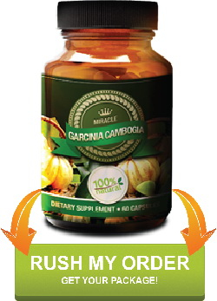
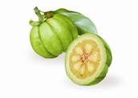
Garcinia Cambogia Is The Strongest Fat Buster

Slide 22
Suppress your appetite, start burning

Slide 23
Garcinia Cambogia

Slide 24
Supplements
Hoodia : is a succulent herb that grows in the Kalahari Desert
Reports that native Africans use hoodia to reduce hunger during long hunts.
There are no RCT evaluating the effectiveness of hoodia supplements on weight loss

Slide 25
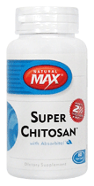
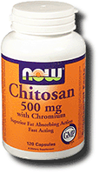
Chitosan
Chitosan is derived from crustaceans.
It is promoted as a remedy to reduce fat absorption
The meta-analysis concluded that the effectiveness of chitosan for body weight reduction is not established beyond reasonable doubt

Slide 26
Botanicals in the Treatment of Obesity Tea (Green, Black)
Green tea is created when tea leaves are processed soon after collection, and black tea leaves are crushed before fermentation.
Tea is believed to induce thermogenesis through actions of polyphenol constituents
called catechins, which inhibit the breakdown of norepinephrine.
This results in a rise in mitochondrial oxidation and lowered coupling with ATP synthesis, producing heat.
Alternatively, catechins may impair angiogenesis and retard the development of adipose tissue.

Slide 27
Green tea
Green tea catechins, and epigallocatechin gallate (EGCG) have been demonstrated in cell culture and animal models of obesity to reduce :
Adipocyte differentiation and proliferation, lipogenesis, fat mass, body weight, fat absorption, triglycerides, free fatty acids, cholesterol, glucose, insulin and leptin, as well as to increase beta-oxidation and thermogenesis.
Since EGCG is regarded as the most active component of green tea, its specific effects on obesity should also be investigated in human trials.

Slide 28
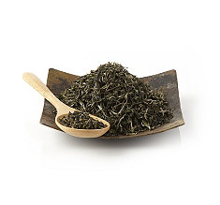
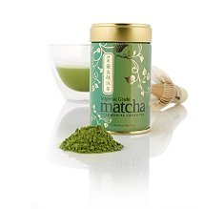
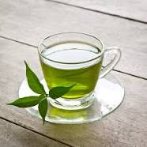
Green tea

Slide 29
The Probable Reasons for Obese Person to Prefer Herbal Products for Weight Management
1) Health benefits of weight loss without any side effects.
2) Less demanding than accepted lifestyle changes, such as exercise and diet.
3) Easily available without a prescription.
4) More easily accepted than a professional consultation with a physician or a nutritionist.
5) 100% natural origin and perception that natural means safe.

Slide 30
Herbal Approach for Obesity Management
An ideal herbal anti obesity product should reduce the weight by 10% over placebo of treatment
Showing an evidence of improvement of bio markers like BP , lipids and glycemia without any side effects.

Slide 31
Ayurveda
In Ayurveda, the five elements of space, air, earth, fire and water make up everything in the universe including the human body.
These elements come together to create three different constitutional types, or doshas,
known as Vata (airy), Pitta (fiery), and Kapha (earthy).

Slide 33
Plants in ayurveda
There are several plants described in ayurveda for weight management.
But so far, no systematic and well designed screening is attempted to come up with an effective herbal weight loss product.
A better understanding in the existing evidence based science on herbs will further guide a qualitative research in obesity management that will attract the end users by the effective benefits.

Slide 34
Plants in ayurveda
True randomized, double blinded, placebo-controlled clinical trials using herbal products will demonstrate their potential benefits.
Significant weight loss after placebo sub-traction along with known mechanism of action are required in order to generate conviction amongst users as effective agent for weight management.

Slide 35
Homeopathy
Homeopathy is ‘‘a system of therapy based on the concept that disease can be treated with drugs (In minute doses) thought capable of producing the same symptoms in healthy people as the disease itself
doctrine of like cures like
Samuel Hahnemann, the founder of homeopathy

Slide 36
Homeopathy
Two studies on homeopathy for the treatment of obesity have been identified.
In the first trial, Helianthus tuberosus D1 was used in patients with an average BMI of 28 kg/m2.
After 12 weeks, it was found that the treatment group had lost significantly more weight than that of the control group.
In the second study, it was found that Thyroidinum 30cH was no more effective than placebo when used as an appetite suppressant.
Based on this conflicting evidence, the use of homeopathic remedies for the treatment of obesity cannot be recommended.

Slide 37
Hypnosis
Hypnotherapy is ‘‘the induction of trance states and the use of therapeutic
Suggestion
Your hypnotherapist ,guide you into a state of deep relaxation
Over time you will learn how to replace your negative habits and eating patterns with positive ones suggested by your hypnotherapist

Slide 38
Hypnosis
Hypnosis, also referred hypnotic suggestion, is a trance-like state in which you have heightened focus and concentration.
Hypnosis is usually done with the help of a therapist using verbal repetition and mental images.
When you're under hypnosis, you usually feel calm and relaxed, and are more open to suggestions.
It's important to know that although you're more open to suggestion during hypnosis, you don't lose control over your behavior.

Slide 39
Hypnosis
There have been 2 meta-analyses conducted that look at the effect of hypnosis on weight loss.
In a meta-analysis Kirsch and colleagues compared 6 RCT , which compared cognitive-behavioral therapy alone versus cognitive behavioral therapy with hypnosis.
They concluded that adding hypnosis as an adjuvant increased the amount of weight loss.
As described by Allison, a second group of authors found several transcription and computing errors in the Kirsch meta analysis.
Upon correcting these, it was concluded that hypnosis resulted in, at best, a small improvement in the treatment effect

Slide 40
Yoga and Weight Control
Yoga is a mind-body practice that people use to improve relaxation, fitness and health
In 15,500 healthy, middle-aged adult
in a retrospective study
overweight people who practiced yoga for four or more years lost 5 pounds,
while overweight people who did not practice yoga during the same period of time gained 14 pounds.

Slide 41
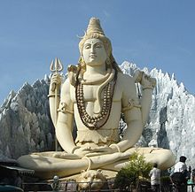
Yoga and Weight Control
People who eat mindfully are more aware of the reasons they eat and their feelings of hunger or fullness
Further research is needed on the impact of yoga on mindful eating, as well as other factors that alter energy balance
Statue of Shiva in Bangalore, India, performing yogic meditation in the Padmasana posture

Slide 42
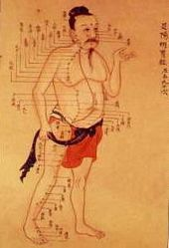
Acupuncture
Acupuncture is defined as, ‘‘the insertion of very fine needles (sometimes in conjunction with electrical stimulus), on the body’s surface, in order to influence physiological functioning of the body.’’
Old Chinese medical chart on acupuncture meridians

Slide 43
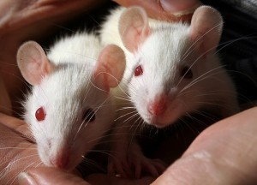
Acupuncture In a rat model
Affected the ventromedial nucleus of the hypothalamus.
In this area of the brain, rats that were stimulated with acupuncture needles demonstrated:
Decreased tyrosine and dopamine
Increased 5-hydroxytryptamine and 5-hydroxyindoline.
Thus, acupuncture appears to work on neurotransmitters within the brain to suppress appetite levels and thus help with weight loss.

Slide 44
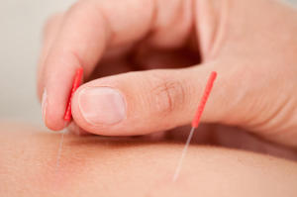
Mechanisms of acupuncture on weight loss
TCM holds that obesity belongs to the mixture of root-deficiency (mainly qi deficiency) and symptoms excess (excess of phlegm-dampness).
Acupuncture acts to strengthen the function of spleen, stomach, 1iver and kidney, supplement antipathogenic qi and remove pathogenic qi
By stimulating points and regulating meridians

Slide 45
Auricular acupuncture
Shiraishi et al. (1995) reported that auricular acupuncture applied to rats produced :
1- Reduction of the neural activity of lateral hypothalamus (LH, considered as the ‘‘feeding center’’)
2-increase of the neural activity of ventral medial hypothalamus (VMH, considered as the ‘‘satiety center’’).
Because of this, it could help to control the sense of hunger.
3- suppresses the appetite by stimulation of the auricular branch of nervous vagus, which has been shown to increase tone in the smooth muscle of the stomach, thus suppressing appetite (Richards& Marley, 1998).

Slide 46
In sum, the weight loss function of acupuncture might work through the following three means
1-Regulating nerve system
It is believed that when needling certain acupoints
peripheral nerves were stimulated to regulate the autonomic nerve of the internal organs
and make coordination between sympathetic and parasympathetic nerve
Which can inhibit gastric emptying and correct abnormal appetite on one side
and promote intestinal peristalsis and reduce the food absorption on the other side

Slide 47
In sum, the weight loss function of acupuncture might work through the following three means
1- Regulating nerve system
Acupuncture causes changes in K+, Na+, and Ca+ in the neurons (Deng, 1995), and the amount of neuropeptides like beta endorphin, leucine, encephalin, and neurotransmitters like aspartate in CNS (Fu, 2000).
Researchers strongly support the opinions that the effect of acupuncture is arranged by the
brain (Futaesaku et al., 1995) and that EA application causes a great change in the action
potential of nerve cells

Slide 48
2-Regulating endocrine system
Acupuncture can restore normal endocrine by regulating the two systems of “hypothalamus-pituitary-adrenal cortex” and “sympathetic adrenal cortex” (Shi & Zhang, 2005).
It has been determined that endomorphin-1, beta endorphin, encephalin, and serotonin levels increase in plasma and CNS through acupuncture application.
Encephalins as well as serotonin has an effect on feeling well, producing happiness, being pleased, producing a normal level of appetite, and achieving psychomotor balance.
These effects play a role in the arrangement of psychological behaviors, including dietary behavior

Slide 49
3- Regulating lipid metabolism
Increases of endomorphin-1, beta endorphin, encephalin, serotonin, and dopamine cause lipolitic effects on metabolism.
Needling certain points can reduce the content of lipid peroxide in the blood and accelerate the fat decomposition.
In addition, acupuncture can regulate water and salt metabolism and thus correct the condition of water-salt retention

Slide 50
A systematic review on use of Chinese medicine and acupuncture for treatment of obesity
obesity reviews (2012) 13, 409–430

Slide 51
A systematic review on use of Chinese medicine and acupuncture for treatment of obesity
Obesity is a major health hazard and despite lifestyle modification, many patients frequently regain any lost body weight.
The use of western anti-obesity drugs has been limited by side effects including :
Mood changes, suicidal thoughts, and GI or cardiovascular complications
obesity reviews (2012) 13, 409–430

Slide 52
A systematic review on use of Chinese medicine and acupuncture for treatment of obesity
The effectiveness and safety of traditional Chinese medicine including Chinese herbal medicine (CHM) and acupuncture provide an alternative established therapy for this medical challenge.
obesity reviews (2012) 13, 409–430

Slide 53
A systematic review on use of Chinese medicine and acupuncture for treatment of obesity
In this systematic review, we used standard methodologies to search, review, analyze and synthesize published data on the efficacy, safety and relapse of weight regain associated with use of CHM and acupuncture
obesity reviews (2012) 13, 409–430

Slide 54
A systematic review on use of Chinese medicine and acupuncture for treatment of obesity
The Jadad scale to assess methodological qualities, the random effect model in the pooled analysis of therapeutic efficacy to adjust for heterogeneity and funnel plots to explore publication bias was used.

Slide 55
Results
After screening 2545 potential articles from the electronic databases,
96 RCTs identified
49 trials on CHM treatment
44 trials on acupuncture treatment
3 trials on combined therapy for appraisal.
There were 4861 subjects in the treatment groups and 3821 in the control groups
treatment duration ranging from 2 weeks to 4 months.

Slide 56
Results
Efficacy was defined as body weight reduction 2 kg or BMI reduction 0.5 kg/m2.
Compared with placebo or lifestyle modification, CHM and acupuncture exhibited respective ‘risk ratio’ (RR) of 1.84 and 2.14 in favor of body weight reduction, with a
Mean difference in body weight reduction of 4.03 kg and 2.76 kg
Mean difference in BMI reduction of 1.32 kg/m2 and 2.02 kg/m2, respectively.

Slide 57
Results
Compared with the pharmacological treatments of sibutramine, fenfluramine or orlistat
CHM and acupuncture exhibited an RR of 1.11 and 1.14 in body weight reduction
mean difference in body weight reduction of 0.08 kg and 0.65 kg
mean difference in BMI reduction of 0.18 kg/m2 and 0.83 kg/m2, respectively

Slide 58
Results
There were fewer reports of adverse effects and relapses of weight regain in CHM intervention studies conducted in China than studies conducted outside China.
CHM and acupuncture were more effective than placebo or lifestyle modification in reducing body weight.
They had a similar efficacy as the Western anti-obesity drugs but with fewer reported adverse effects.
However, these conclusions were limited by small sample size and low quality of methodologies

Slide 59
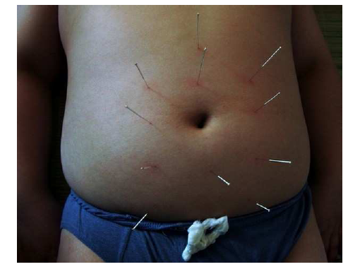
Acupuncture being applied to the abdomen

Slide 60
Electroacupuncture

Slide 61
Warming needle

Slide 62
Noninvasive Body Contouring with Radiofrequency, Ultrasound, Cryolipolysis, and Low-Level Laser Therapy
In 2009, the global market for all body-shaping platforms was expected to
reach $361.9 billion with more than 9 million procedures performed.
The annual growth in noninvasive body-contouring procedures is estimated to expand by 21% per year

Slide 63
Body Contouring
Historically and currently, the gold standard for body contouring still
remains the various techniques of liposuction
Suction: Massage Devices
Suction-Massage: Thermal Devices
Radiofrequency Energy Devices
High-Frequency Focused Ultrasound Energy Devices
Cryolipolysis Energy Devices
Low-Level Light Laser Therapy Devices

Slide 64
Indications and contraindications of noninvasive Body Contouring
Indications include realistic expectations of a modest reduction of localized fat, modest cellulite improvement, compliance with multiple visits, reasonable BMI and lifestyle, and are opposed to a surgical procedure, which would get a better result.
Contraindications include if the patient is pregnant, has a pacemaker, is medically unwell, has unrealistic expectations, or has a large BMI.

Slide 65
Indications and contraindications of noninvasive Body Contouring
The best candidates and indications for noninvasive body contouring are those patients who are very accepting of a mild to moderate result; in fact, the best candidates are those who state they will be happy with any measurable reduction in fat.

Slide 66
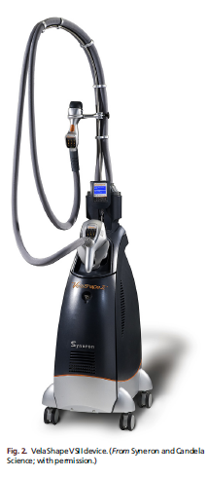
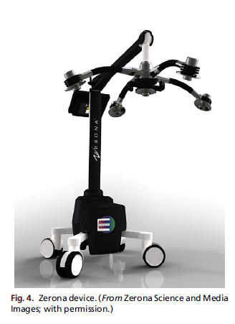

Slide 67
Conclusion
For most complementary therapies there is little convincing evidence.
For hypnotherapy, and chromium picolinate small effects compared with placebo were identified.
For chromium picolinate, the debatable clinical relevance of the effect and the lack of robustness mean that the findings have to be interpreted with caution.
For dephedrine-containing supplements an increased risk of AEs

Slide 68
Conclusion
Researchers concluded that since acupuncture is a generally safe treatment, obese patients who want to try it should not be discouraged, if they can afford to pay for it out of pocket.
Given the current state of the science, insurers are unlikely to reimburse for it as a weight loss treatment.
Long-term, well-designed clinical trials, with details of acupuncture procedures, are needed to determine if acupuncture can be recommended as a primary strategy for weight loss.

