Slide 1
Shifting Paradigms in the Selection of Antidiabetes Medications: Cardiovascular Benefits
Hengameh Abdi
Endocrine Research Center
Research Institute for Endocrine sciences
Shahid Beheshti University of Medical Sciences
13 December 2018
22 Azar 1397
Tehran

Slide 2
Agenda
Background
Pre 2008 FDA antidiabetes drug approval guidance era
Overview of major cardiovascular outcomes trials (CVOTs) of new antidiabetes medications:
Dipeptidyl peptidase-4 (DPP-4) inhibitors
Glucagon like peptide-1 (GLP-1) receptor agonists
Sodium glucose transporter-2 (SGLT2) inhibitors
Conclusions

Slide 3
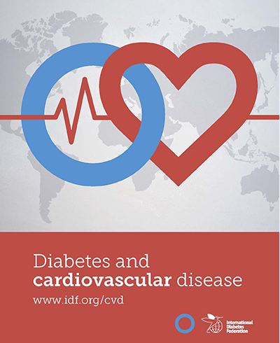
www.idf.org/cvd

Slide 4
www.idf.org/cvd

Slide 5
American Diabetes Association recommendation-2018
In patients with type 2 diabetes and established atherosclerotic cardiovascular disease, antihyperglycemic therapy should begin with lifestyle management and metformin and subsequently incorporate an agent proven to reduce major adverse cardiovascular events and cardiovascular mortality (currently empagliflozin and liraglutide), after considering drug-specific and patient factors. (A)

Slide 6
Agenda
Background
Pre 2008 FDA antidiabetes drug approval guidance era
Overview of major cardiovascular outcomes trials (CVOTs) of new antidiabetes medications:
Dipeptidyl peptidase-4 (DPP-4) inhibitors
Glucagon like peptide-1 (GLP-1) receptor agonists
Sodium glucose transporter-2 (SGLT2) inhibitors
Conclusions

Slide 7
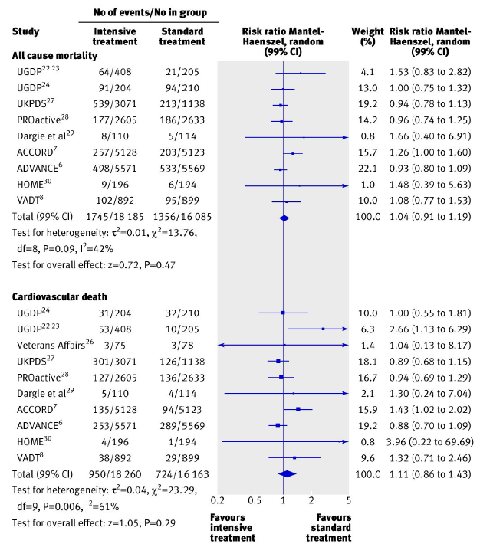
Early major trials evaluating the effects of intensive glycemic control
Boussageon R, et al. BMJ 2011;343:d4169.

Slide 8
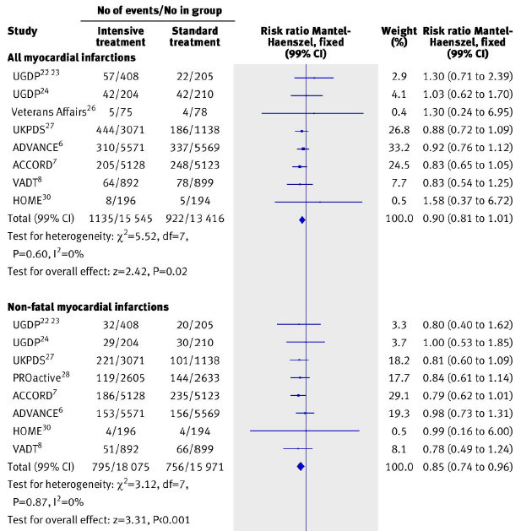
Early major trials evaluating the effects of intensive glycemic control
Boussageon R, et al. BMJ 2011;343:d4169.

Slide 9
Effects of metformin compared with sulfonylurea monotherapy on long-term all-cause mortality and cardiovascular mortality and morbidity
Overall, metformin is preferred.
Maruthur NM, et al. Ann Intern Med. 2016;164:740-751.

Slide 10
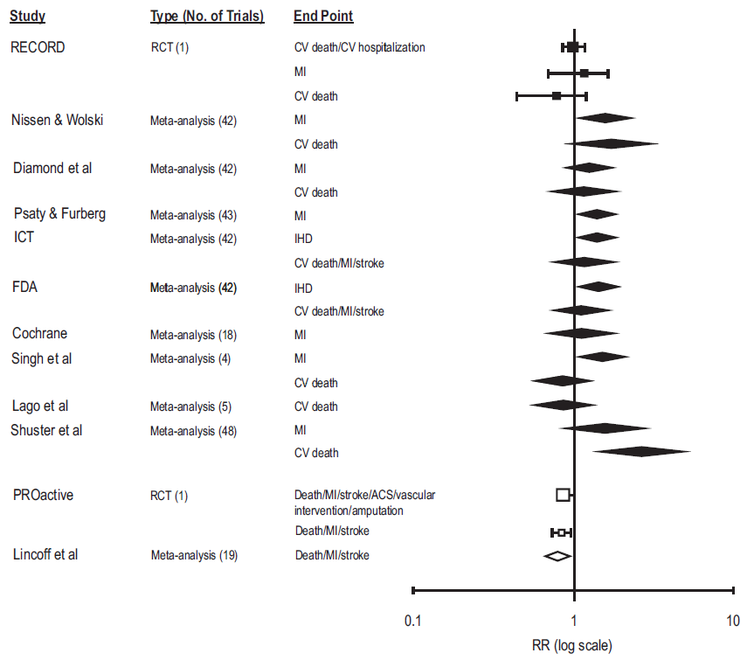
Thiazolidinediones and risk of ischemic heart disease
Kaul S, et al. Circulation 2010;121:1868-1877.

Slide 11
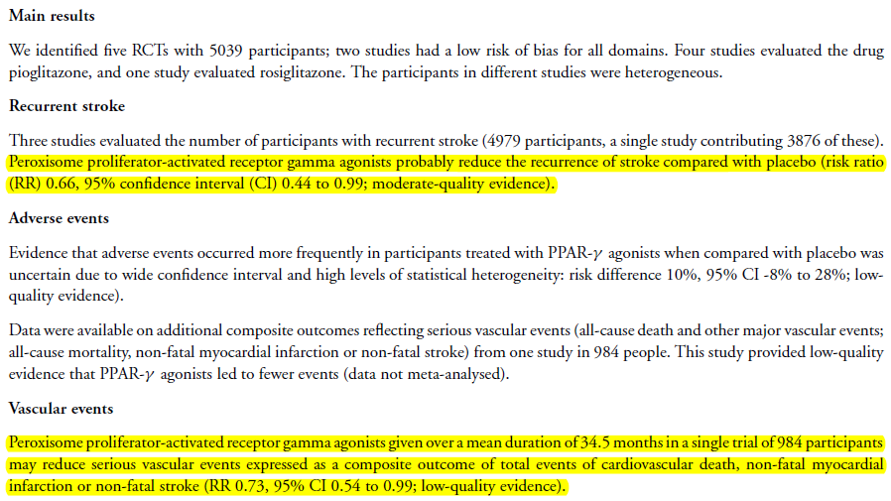
Thiazolidinediones and risk of stroke
Liu J, Wang LN. Cochrane Database of Syst Rev 2017, Issue 12. Art. No.:CD010693.

Slide 12
Thiazolidinediones and risk of heart failure
Nesto RW, et al. Diabetes Care 2004;27(1):256-263.

Slide 13
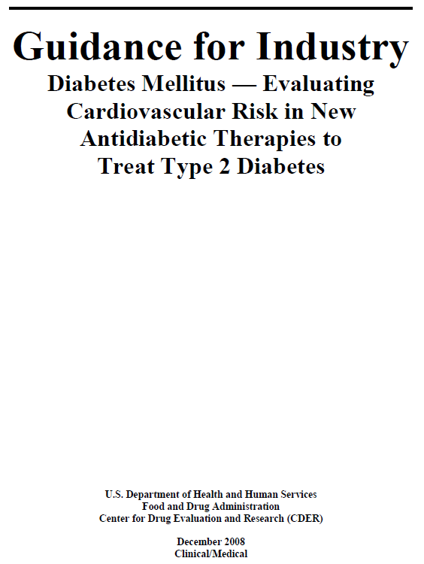
US Food and Drug Administration (FDA) issued an updated guidance for industry in 2008 requiring that preapproval and postapproval studies for all new antidiabetic drugs rule out excess cardiovascular risk.
Upper limit of a two-sided 95% CI of the estimated risk ratio:
> 1.8: a separate large safety trial is needed.
1.3-1.8: completion of a postmarketing trial or continuation of a premarketing trial after approval may be needed to conclusively show that the upper limit of the two-sided 95% CI is <1.3 with a “reassuring” point estimate of overall CV risk.
www.fda.org

Slide 14
Major Adverse Cardiovascular Events (MACE)
3-point MACE: cardiovascular death, nonfatal MI, and nonfatal stroke.
4-point MACE (MACE-plus): Composite of 3-point MACE + any additional cardiovascular events (hospitalization for acute coronary syndrome, urgent revascularization procedures, heart failure hospitalization)

Slide 15
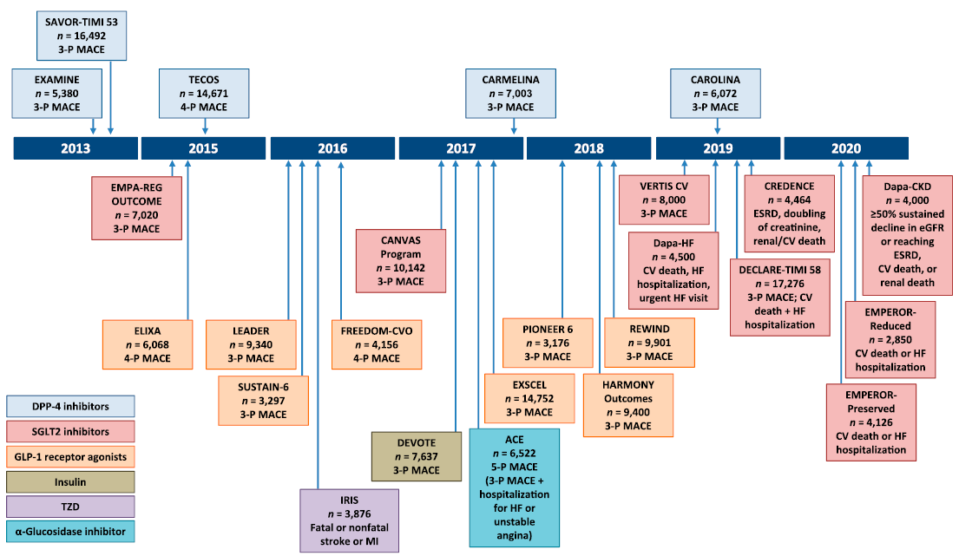
Completed and ongoing cardiovascular outcomes trials in type 2 diabetes
Cefalu WT, et al. Diabetes Care 2018;41:14-31.

Slide 16
Agenda
Background
Pre 2008 FDA antidiabetes drug approval guidance era
Overview of major cardiovascular outcomes trials (CVOTs) of new antidiabetes medications:
Dipeptidyl peptidase-4 (DPP-4) inhibitors
Glucagon like peptide-1 (GLP-1) receptor agonists
Sodium glucose transporter-2 (SGLT2) inhibitors
Conclusions

Slide 17
DPP-4 Inhibitors

Slide 18
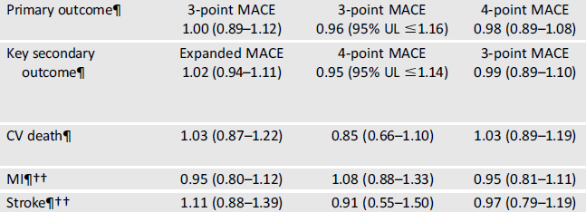
Findings from three large DPP-4 inhibitors CVOTs
Cefalu WT, et al. Diabetes Care 2018;41:14-31.

Slide 19
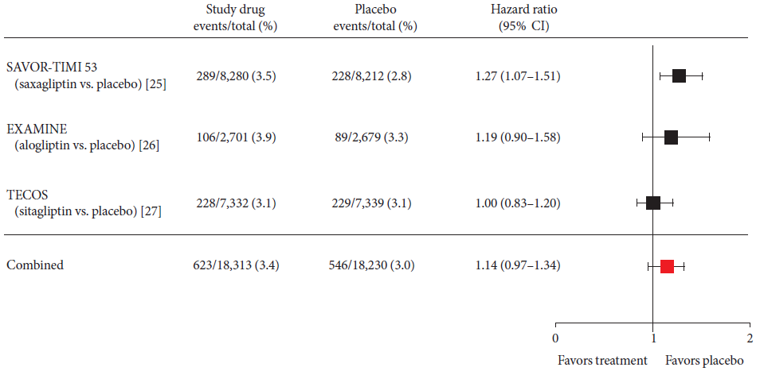
DPP-4 inhibitors and risk of hospitalization for heart failure
Son JW, Kim S. Diabetes Metab J 2015;39:373-383.

Slide 20
Conclusions regarding DPP-4 inhibitors
Data from DPP-4 inhibitors CVOTs show their major adverse cardiovascular event (MACE) safety.
We are awaiting results of the CAROLINA (Cardiovascular Outcome Study of Linagliptin Versus Glimepiride in Patients With Type 2 Diabetes) trial.

Slide 21
GLP-1 receptor Agonists

Slide 22
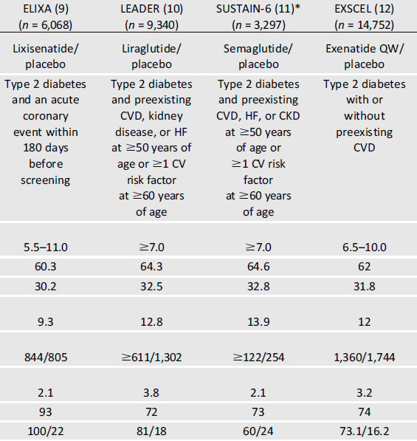
Characteristics of four large GLP-1R agonists CVOTs
Cefalu WT, et al. Diabetes Care 2018;41:14-31.

Slide 23
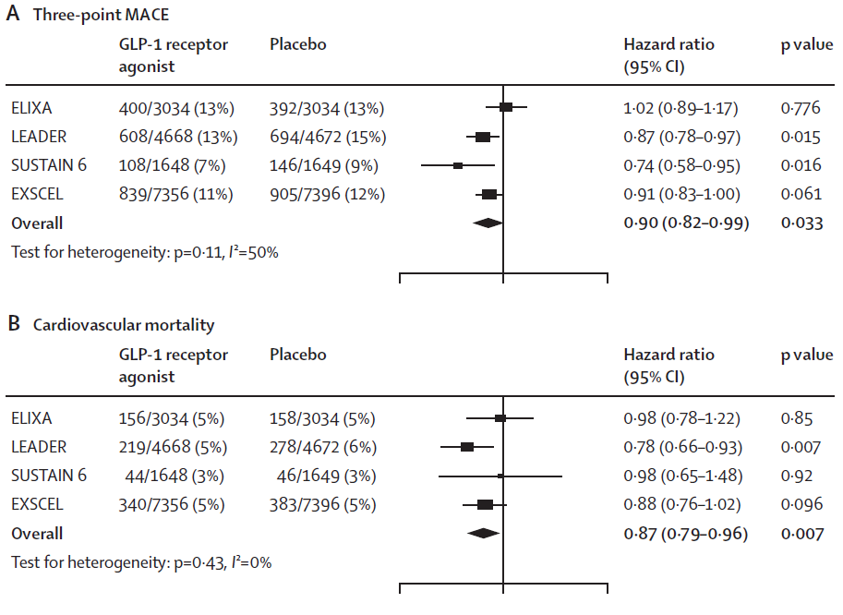
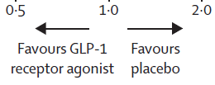
Findings of four large GLP-1R agonists CVOTs
Bethel MA, et al. Lancet Diabetes Endocrinol 2018;6:105-13.

Slide 24
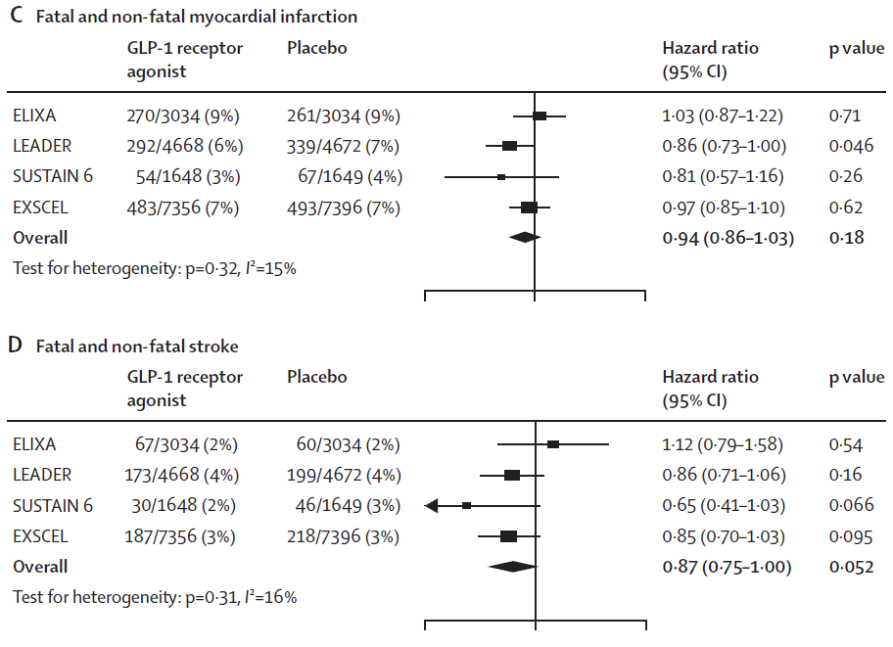
Findings of four large GLP-1R agonists CVOTs
Bethel MA, et al. Lancet Diabetes Endocrinol 2018;6:105-13.

Slide 25
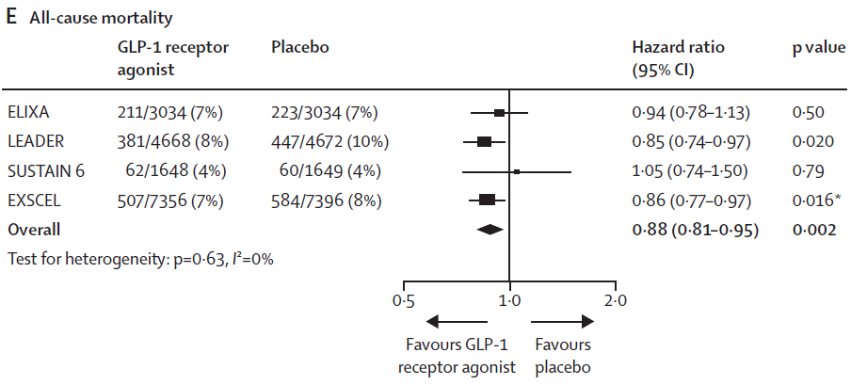
Findings of four large GLP-1R agonists CVOTs
Bethel MA, et al. Lancet Diabetes Endocrinol 2018;6:105-13.

Slide 26
Conclusions regarding GLP-1 receptor agonists
Data from different GLP-1 receptor agonists CVOTs are heterogen i.e., null effects with lixisenatide and exenatide and favorable effects with liraglutide and semaglutide.
What is clear so far is that drugs in this class, if tolerated, are safe, and, if affordable, should be considered more often for type 2 diabetes management.
We are awaiting results of ongoing trials.

Slide 27
SGLT2 Inhibitors

Slide 28
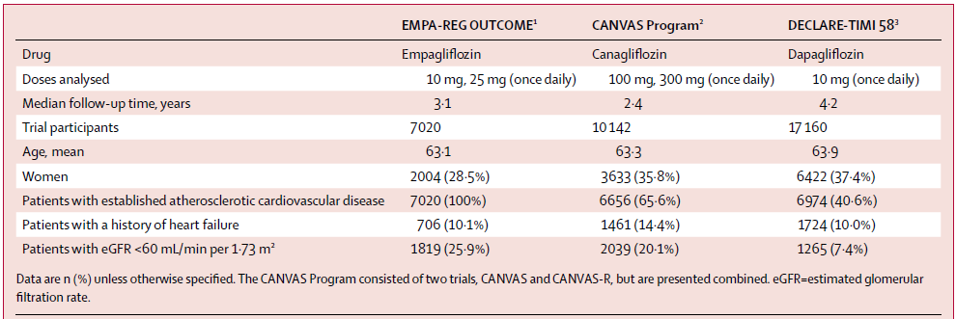
Characteristics of three large SGLT2 inhibitors CVOTs
Zelniker TA, et al. Lancet 2018 Nov 9. pii: S0140-6736(18)32590-X.

Slide 29
Findings of three large SGLT-2 inhibitors CVOTs (composite of myocardial infarction, stroke, and cardiovascular death)
Zelniker TA, et al. Lancet 2018 Nov 9. pii: S0140-6736(18)32590-X.

Slide 30
Findings of three large SGLT2 inhibitors CVOTs (hospitalization for heart failure and cardiovascular death)
Zelniker TA, et al. Lancet 2018 Nov 9. pii: S0140-6736(18)32590-X.

Slide 31
Conclusions regarding SGLT2 inhibitors
SGLT2 inhibitors have moderate benefits on atherosclerotic major adverse cardiovascular events and robust benefits on reducing hospitalisation for heart failure that seem confined to patients with established atherosclerotic cardiovascular disease.
We are awaiting results of ongoing trials.

Slide 32
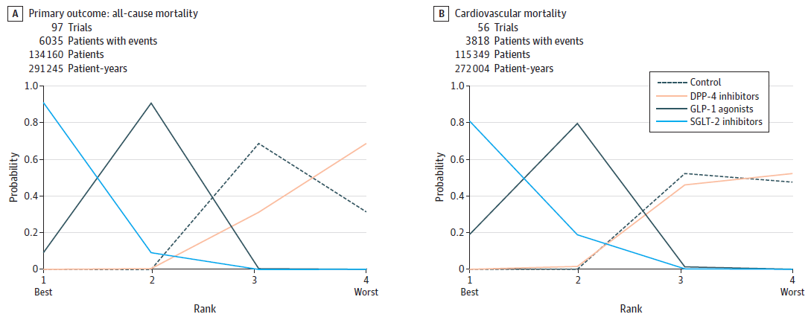
Network meta-analysis of DPP-4 inhibitors, GLP-1R agonists and SGLT2 inhibitors
Zheng SL, et al. JAMA 2018;319(15):1580-1591.

Slide 33
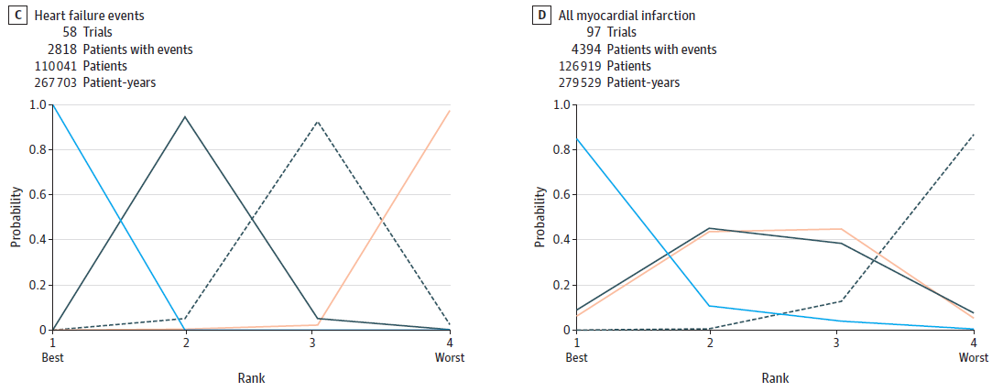
Network meta-analysis of DPP-4 inhibitors, GLP-1R agonists and SGLT2 inhibitors
Zheng SL, et al. JAMA 2018;319(15):1580-1591.

Slide 34
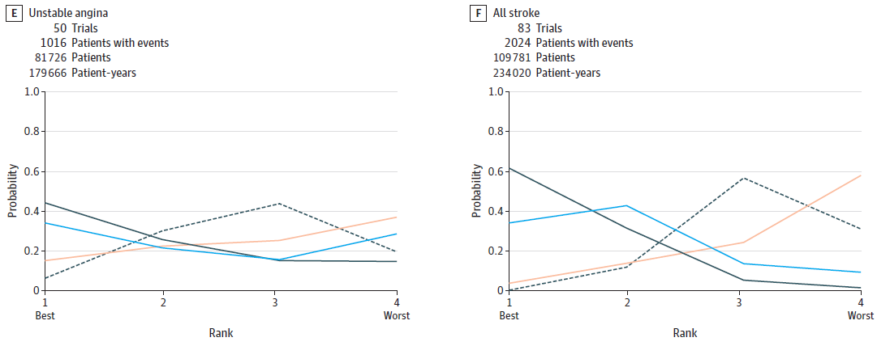
Network meta-analysis of DPP-4 inhibitors, GLP-1R agonists and SGLT2 inhibitors
Zheng SL, et al. JAMA 2018;319(15):1580-1591.

Slide 35
Conclusions

Slide 36
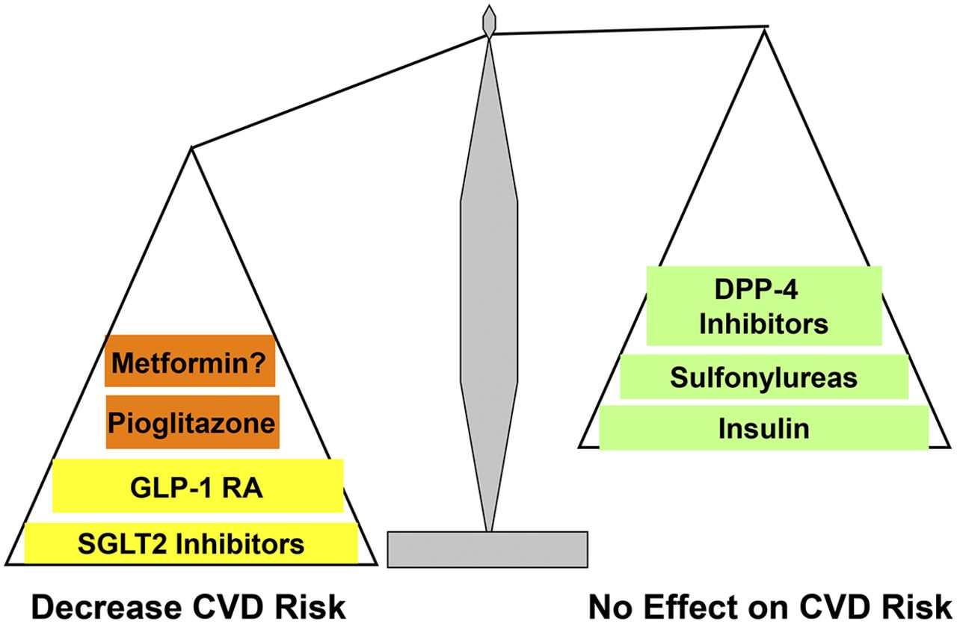
Cardiovascular risk profile of antidiabetes medications
?
Abdul-Ghani M, et al. Diabetes Care 2017;40:813-820.

Slide 37
Concluding remarks
Despite improved risk factor control, however, adults with type 2 diabetes continue to experience substantial excess cardiovascular risk.
Over the last several years, trials designed first to demonstrate safety of newer antidiabetic agents demonstrated superiority for CVD risk reduction among adults with T2D with a history of or at high risk for recurrent CVD events.
Newman JD, et al. J Am Coll Cardiol 2018;72:1856-69.

Slide 38
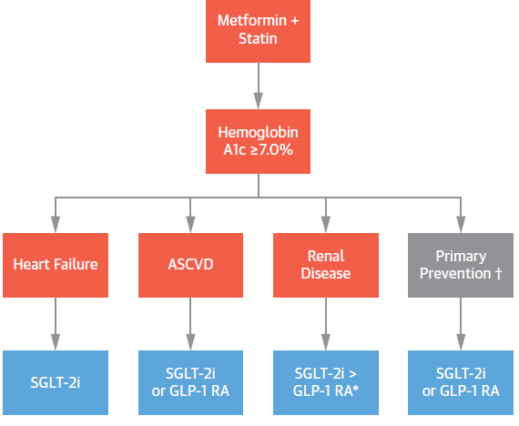
Proposed algorithm to reduce cardiovascular risk with glucose-lowering agents in patients with type 2 diabetes
?
?
Adapted from Newman JD, et al. J Am Coll Cardiol 2018;72:1856-69.

Slide 39
Thanks for your attention.
Photo by Majid Valizadeh, MD.

