Slide 1
Malignant pheochromocytoma

Slide 2
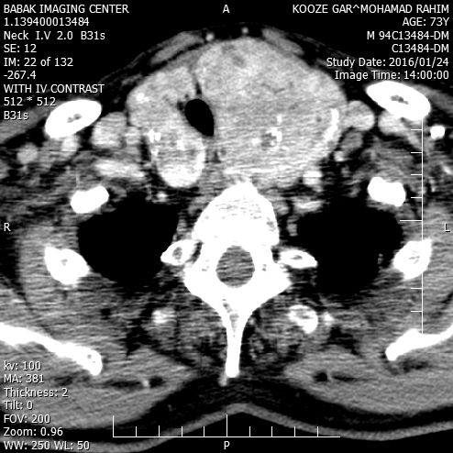
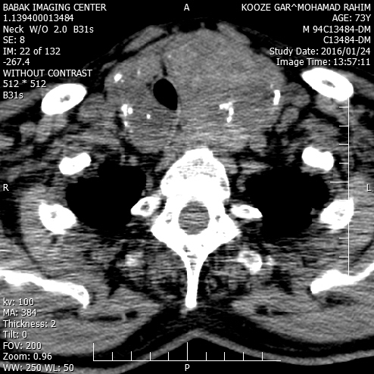
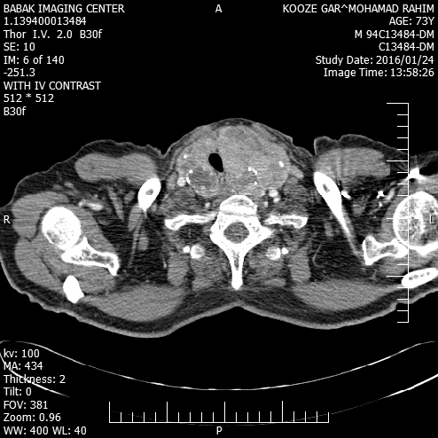
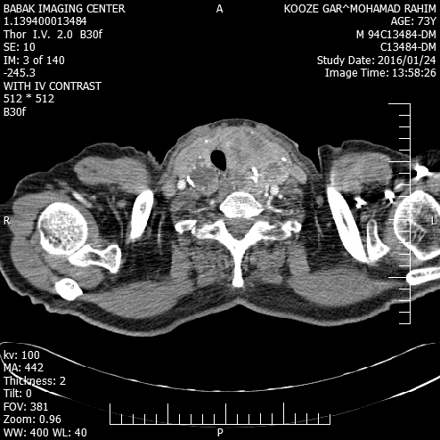

Slide 3
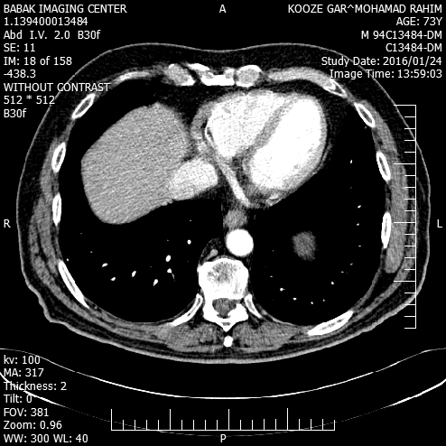
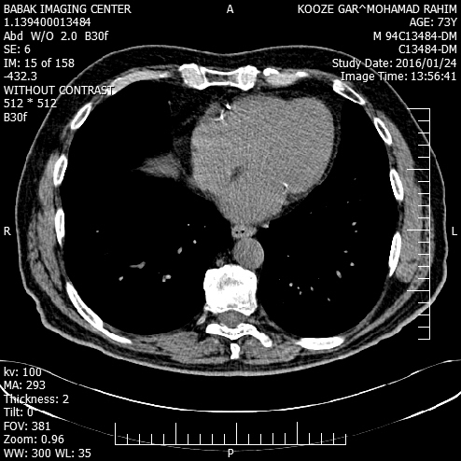

Slide 4
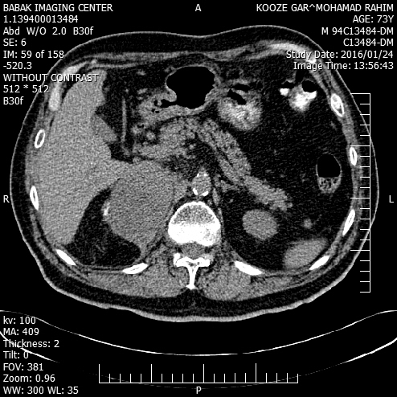
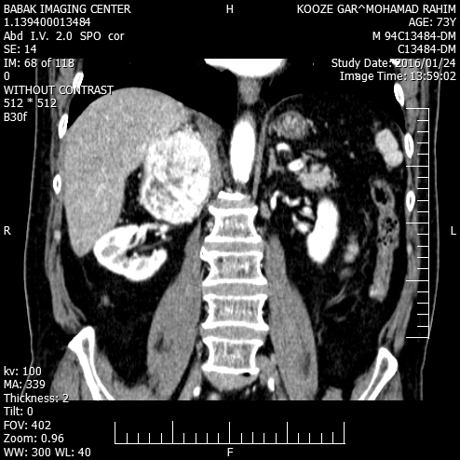

Slide 5
Pheochromocytomas are tumors arising from chromaffin cells, mainly of the adrenal gland, that synthesize, store, metabolize, and usually but not always secrete catecholamines.
prevalence of malignancy is commonly cited at about 10%, other estimates suggest rates of between 5–26% depending on how malignancy is defined
Endocrine-Related Cancer (2004) 11 423–436

Slide 6
Currently, there is no effective cure for malignant pheochromocytoma.
There are also no reliable histopathological methods for distinguishing benign from malignant tumors.
malignancy requires evidence of metastases at non-chromaffin sites distant from that of the primary tumor.
Although extensive invasion of adjacent tissues can be considered an indicator of malignant potential, local invasiveness and malignant disease are not necessarily associated.
Endocrine-Related Cancer (2004) 11 423–436

Slide 7
Imaging Studies
We suggest CT rather than MRI as the first-choice imaging modality because of its excellent spatial resolution for thorax, abdomen, and pelvis. (2+++○ )
CT with contrast :sensitivity between 88 and 100%(nonionic contrast is safe)
Pheochromocytoma and Paraganglioma: An Endocrine Society Clinical Practice Guideline.J Clin Endocrinol Metab, June 2014, 99(6):1915–1942

Slide 8
We recommend MRI in:
patients with metastatic PPGLs
for detection of skull base and neck paragangliomas
surgical clips causing artifacts when using CT
allergy to CT contrast
radiation exposure should be limited (children, pregnant women, patients with known germline
mutations, and those with recent excessive radiation exposure). (1+++○)
Pheochromocytoma and Paraganglioma: An Endocrine Society Clinical Practice Guideline.J Clin Endocrinol Metab, June 2014, 99(6):1915–1942

Slide 9
We suggest the use of 123I metaiodobenzylguanidine (MIBG) scintigraphy as a functional imaging modality:
in patients with metastatic PPGLs detected by other imaging modalities when radiotherapy using 131I-MIBG is planned
occasionally in some patients with an increased risk for metastatic disease due to:
large size of the primary tumor
extra-adrenal, multifocal (except skull base and neck PPGLs),
recurrent disease.(2+○○○)
Pheochromocytoma and Paraganglioma: An Endocrine Society Clinical Practice Guideline.J Clin Endocrinol Metab, June 2014, 99(6):1915–1942

Slide 10
advantage of 123I- over 131I-labeled MIBG:
better sensitivity
its utility for imaging by SPECT.
up to 50% of normal adrenal glands demonstrate physiological uptake of 123I-MIBG, false positive results can be a problem.
Asymmetric uptake in normal adrenal glands can further lead to misinterpretation.
Pheochromocytoma and Paraganglioma: An Endocrine Society Clinical Practice Guideline.J Clin Endocrinol Metab, June 2014, 99(6):1915–1942

Slide 11
for pheochromocytomas: 123I-MIBG
Sensitivity: ranges between 85 and 88%
specificity ranges from 70– 100%
Sensitivity for metastatic PPGLs: between 56 and 83%
Sensitivity for recurrent PPGLs: approximately 75%
Sensitivity for SDHx-related PPGLs:less than 50%).
meta-analysis of 15 studies of 123I-MIBG scintigraphy, sensitivity was 94% and specificity 92%
Pheochromocytoma and Paraganglioma: An Endocrine Society Clinical Practice Guideline.J Clin Endocrinol Metab, June 2014, 99(6):1915–1942

Slide 12
Accumulation of 123I-MIBG can be decreased by several drugs:
1) sympathomimetics
2) agents that block catecholamine transport via the norepinephrine transporter, such as cocaine and tricyclic antidepressants
3) calcium channel blockers and some combined - and -adrenergic receptor blockers such as labetalol
Therefore, most of these drugs should be withheld for about 2 weeks before 123I-MIBG scintigraphy.
Accumulation of 123I-MIBG is also profoundly decreased in necrotic tumors.

Slide 13
Recommendation
2.5Wesuggest the use of 18F-FDG PET/CT scanning in patients with metastatic disease. 18F-FDG PET/CT is the preferred imaging modality over 123I-MIBG scintigraphy in patients with known metastatic PPGLs. (2+++○)
Sensitivity:between 74 and 100%
highest performance for metastatic, particularly SDHB-related, PPGLs
Pheochromocytoma and Paraganglioma: An Endocrine Society Clinical Practice Guideline.J Clin Endocrinol Metab, June 2014, 99(6):1915–1942

Slide 14
We suggest measuring plasma or urine levels of metanephrines on follow-up to diagnose persistent disease.
We suggest lifelong annual biochemical testing to assess for recurrent or metastatic disease. (2++○○)
To document successful tumor removal, biochemical testing should be performed upon recovery of the patient from surgery (eg, 2–4 wk after surgery).
Pheochromocytoma and Paraganglioma: An Endocrine Society Clinical Practice Guideline.J Clin Endocrinol Metab, June 2014, 99(6):1915–1942

Slide 15
We recommend minimally invasive adrenalectomy
(eg, laparoscopic) for most adrenal pheochromocytomas. (1++○○)
We recommend open resection for large (eg, 6 cm) or invasive pheochromocytomas to ensure complete tumor resection, prevent tumor rupture, and avoid
local recurrence. (1+ ○○○)
Pheochromocytoma and Paraganglioma: An Endocrine Society Clinical Practice Guideline.J Clin Endocrinol Metab, June 2014, 99(6):1915–1942

Slide 16
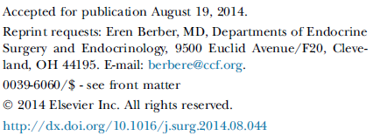

Slide 17
The recurrence rate of pheochromocytoma after adrenalectomy is 6.5–16.5%
local in the adrenal bed
distantly
Methods. retrospective analysis of 155 patients who underwent operation for adrenal pheochromocytoma at Cleveland Clinic from January 1, 2000, to July 31, 2013.

Slide 18
Results: Eight patients (6%) developed recurrent disease.
The median time from initial operation to diagnosis of recurrence was 35 months.
On multivariate analysis, tumor size >5 cm was an independent predictor of recurrence.

Slide 20
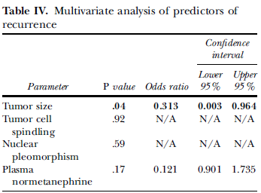

Slide 21
The optimal protocol, in our opinion, is measurement of metanephrines at 1, 6, and 12 months postoperatively and then annually thereafter.
Because up to 25% of our patients with recurrence had normal laboratory results with recurrence of disease, we also recommend annual cross-sectional imaging, preferably computed tomography, to look for recurrence.
Recurrence can occur many years after adrenalectomy, necessitating long-term monitoring.

Slide 23
Patients with metastatic PCC/PGL have a 50% 5-year overall survival.
A retrospective analysis of 100 PCCs found that tumors with a PASS less than 4 were always clinically benign, whereas tumors with a PASS of 4 or more had the potential to become metastatic.
GAPP :classifying tumors as well differentiated (score: 0–2), moderately differentiated (score: 3–6), and poorly differentiated (score: 7–10).

Slide 25
Treatments for Metastatic Pheochromocytomas and Paragangliomas:
full surgical resection
chemotherapy, 131I-MIBG, and/or radiation can offer disease control.
Given the often indolent nature of disease, therapies usually are reserved for patients with clear progression or severe symptoms.
There are no studies to direct the timing or order of treatments.
Alpha-blockade is required during any treatment to prevent hypertensive crisis from catecholamine release during tumor cell lysis.

Slide 26
Chemotherapy:
Cyclophosphamide, vincristine, and dacarbazine (CVD) chemotherapy is the standard regimen for treating metastatic PCC/PGL despite no prospective clinical trials.
systematic review and meta-analysis :
a complete or partial tumor response rate in 4% and 37% of patients, respectively
a complete or partial biochemical response rate of 14% and 40% of patients, respectively.
Of note, 14% of patients had stable disease.
Tumor responses usually occurred after 2 to 4 cycles of CVD therapy, and the median duration of response for the 2 studies that reported it was 20 months and 40 months.
The most common toxicities :
myelosuppression, peripheral neuropathy and gastrointestinal toxicity, (sometimes severe but usually transient)

Slide 27
123I-Metaiodobenzylguanidine
Sixty percent of PCCs/PGLs are MIBG avid, and therefore, are susceptible to systemic 131I-MIBG therapy.
MIBG is transported into cells by the norepinephrine transporter and causes cell death by emitting ionizing radiation from the decaying 131I radionuclide.

Slide 28
A systematic review and meta-analysis:
total of 243 patients of varying ages who may or may not have had previous therapies and received 131I-MIBG :
complete or partial tumor response in 3% and 27% of patients, respectively,
complete or partial hormonal response in 11% and 40% of patients, respectively.
Of note, 52% of patients had stable disease, but given the often indolent nature of metastatic PCC/PGL, it is unclear if this is due to treatment effects or the natural history of disease.

Slide 29
Two studies within the cohort reported mean progression-free survival times of 23.1 and 28.5 months.
most commonly reported side effects:
toxicity with severe grade 3 to 4 neutropenia(87%)
thrombocytopenia (83%)

Slide 30
Free iodine from the treatment will accumulate in the thyroid gland; therefore, patients require potassium iodide before and after treatment to prevent a thyroiditis and subsequent hypothyroidism.
Despite appropriate blockade, hypothyroidism can occur in 11% to 32% of patients.

Slide 31
Targeted Therapies
mammalian target of rapamycin (mTOR) inhibitor everolimus: disappointing in this disease.
Sunitinib:
retrospective report of 17 patients with metastatic PCC/PGL.
There was a partial response (n = 3) or stable disease (n = 4) in 47% of patients.
The median progression-free survival was only 4.1 months.

Slide 32
External Beam Radiotherapy
controversial
Malignant PCCs/PGLs were believed to be resistant to radiation, but recent work suggests that EBRT can affect long-term local control in most cases.
The largest retrospective cohort examined EBRT in 24 patients with metastatic PCC/ PGL :
Symptomatic control or stable disease by imaging was seen in 81% and 87% of the lesions, respectively.

Slide 33
retrospective review of 17 patients with non–head and neck malignant PCC/PGL treated with various EBRT regimens to a median dose of 40 Gy:
Seventy-six percent of patients had local control (attributable to disease stabilization and/or symptom control).
EBRT appears to offer symptomatic control in patients with limited burden of metastases.
Because metastatic PCC/PGL can be an indolent disease, prospective studies are needed to determine if EBRT truly contributes to disease stability in terms of tumor growth.

Slide 35
MPPs are defined by their endocrine tumor morphology and positive immunohistochemical staining for chromograninA and synaptophysin; negative staining for keratins allows MPPs to be differentiated from the metastases of gastroenteropancreatic NETs

Slide 36
Patients with pheochromocytomas:
larger than 5 cm
paragangliomas of any size
and/or carriers of SDHB mutations
need radiographic studies that can detect metastases in the thoracic, abdominal, and pelvic cavities and the skeletal tissue or recurrences in the primary tumor bed.
The usual sites of metastatic involvement:
lymph nodes (80%), bones (71%), liver (50%), and lungs (50%)

Slide 37
Treatment
Surgery may be considered to:
relieve the compression of neurological structures
resect the primary tumors
if other approaches fail to remove them, resect macroscopic tumors.

Slide 38
MIBG therapy:

Slide 39
Differences in MIBG activity, endpoints, and imaging modalities and insufficient clinical characterization of MPP patients make it impossible to compare these studies.
tumor responses :range from 22 to 48%.
biochemical response: 35–67%
Main safety issues :
asthenia, nausea, vomiting, hematologic and thyroid dysfunction
to a lesser extent:
second cancer, hypertensive crisis, sepsis, and pulmonary toxicity.

Slide 40
Patient deaths have also been reported (mainly due to bone marrow insufficiency/dysplasia).
The ideal candidates for MIBG therapy as a first-line therapy are patients with:
significant tumor burden
slowly progressive disease
adequate MIBG uptake on diagnostic imaging
acceptable blood tests (absolute neutrophil count ≥1500/mm3, platelet count ≥ 100 000/mm3, hemoglobin levels ≥ 9 g/dl, bilirubin levels ≤1.5×the upper limit of normal (ULN), serum albumin levels ≥ 2.8 g/dl, serum creatinine levels ≤ 1.5×ULN, and alanine aminotransferase and aspartate aminotransferase levels ≤ 3.0×ULN), and good performance status.

Slide 41
Experience using 90Y-DOTATOC and 177Lu- DOTATOC, the two most often used radiolabeled agents that target somatostatin receptors, for targeted radiotherapy in MPP patients is limited.
Two studies have shown that targeted radiotherapy with these agents elicits response rates of <10%
This contrasts with the higher sensitivity of somatostatin receptor scintigraphy as a diagnostic imaging study compared with MIBG scintigraphy .
The inappropriate expression of somatostatin receptor subtypes in MPP cells or processing errors may explain the lack of response to octreotide

Slide 42
Chemotherapy :
In the first study carried out by Averbuch et al. the CVD regimen elicited partial or complete responses in 10 (55%) of the 18 patients.
Patel et al. reported that a modified CVD regimen that included the optional use of vincristine combined with doxorubicin elicited a similar partial response rate (46%) in 13 MPP patients.
Recently, a group from the MD Anderson Cancer Center has reported a 25% objective response rate using cyclophosphamide and dacarbazine and the optional use of vincristine or doxorubicin in 52 MPP patients.
In a recent report from Japan, 8 (47%) of the 17 evaluable MPP patients who received CVD therapy exhibited a complete or partial biochemical and/or tumor response.
However, variations in endpoints and imaging modalities and insufficient patient characterization make comparing these studies impossible.
No single prospective study has confirmed the results of any of these studies.

Slide 44
One alternative to the CVD regimen may be temozolomide, a 3-methyl analog of mitozolomide that was developed as an oral alternative to i.v. dacarbazine
less toxicity than the CVD regimen
Recent reports:
response rates of MPP patients on temozolomide therapy are similar to those on the CVD regimen.
Median progression-free survival was longer in SDHB mutation carriers (19.7 months) compared with non-mutation carriers (2.9 months) (P =.007).

Slide 45
Ideal candidates for the use of chemotherapy as a first-line therapy are:
rapidly progressive and/or symptomatic disease and adequate performance status and blood tests
for patients with multiple bone metastases, chemotherapy may have less toxicity compared with radiopharmaceutical agents.

Slide 46
Molecular targeted therapies
In three different series, 11 patients treated with everolimus and two patients receiving imatinib exhibited no response to targeted therapy.
another study reported that one of three patients exhibited an objective response to thalidomide, an antiangiogenic agent, combined with oral dacarbazine.
Case reports have described objective responses to sunitinib with manageable toxicity in a few MPP patients.
More importantly, two large cancer referral centers’ combined experience in treating 17 patients who had rapidly progressive MPPs with sunitinib revealed that 21 and 54% of these patients exhibited responses based on the Response Evaluation Criteria in Solid Tumors or FDGPET findings respectively.
In addition, 43% blood pressure under control, and some of them discontinue antihypertensive medications.

Slide 47
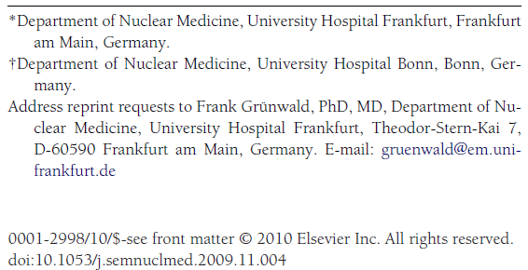

Slide 48
131I-MIBG Therapy of Adult Neuroendocrine Tumors
131I-MIBG has been successfully used for:
advanced neuroendocrine tumors (NET) of the adult :
Pheochromocytoma and paraganglioma (Pheo)
gastroenteropancreatic NET, predominantly in carcinoid tumors of the enterochromaffin (EC) cell type
less frequently in medullary thyroid carcinoma (MTC)

Slide 49
Results in Pheochromocytoma and Paraganglioma:
The typical indication :
multilocular or disseminated metastatic disease with no curative—ie, surgical-treatment option.
Tumor progression and/or uncontrollable function should be present when applying an aggressive treatment approach such as 131I-MIBG.

Slide 50
The response rates are ranging between 30% and 47% for morphologic response and 75%-90% for symptomatic response.
Biochemical response is usually less frequently seen than profound symptomatic relief, similar to the observations made in carcinoid tumors.

Slide 51
Safford et al found a survival benefit for patients treated with higher initial doses of 131I-MIBG, that is, 400-500 mCi, and concluded to use 500 mCi as the routine initial dose in metastatic pheochromocytoma.
university center from San Francisco:
Their treatment schedule of single doses between 500 and 1200 mCi (median 12 mCi/kg), administered after peripheral stem-cell collection, achieved solid tumor response rates in a prospective study setting and most notably a high survival rate.
toxicity—not only hematologic should be considered.

Slide 53
Objectives:
The primary end point was:
progression-free survival determined
by RECIST 1.1 criteria or positron emission tomography with [18F]fluorodeoxyglucose/computed tomography ([18F]FDGPET/CT)
Secondary endpoints were:
tumor response according to RECIST criteria version 1.1 or FDG uptake, blood pressure control, and safety.

Slide 54
Design:
retrospective review of medical records of patients with metastatic PHEO/SPGL treated with sunitinib from December 2007 through December 2011.
Most patients were initially given sunitinib 50 mg/d, 4 wk on and 2 wk off. In some of these patients, to mitigate side effects, the dosage of sunitinib was later decreased at the discretion of the treating clinician to 37.5 mg/d, continuously or 3 wk on and 1 wk off.
Three patients were initially given sunitinib 37.5 mg/d continuously.

Slide 56
Results:
According to RECIST 1.1, eight patients experienced clinical benefit; three experienced partial response, and five had stable disease, including four with predominant skeletal metastases that showed a 30% or greater reduction in glucose uptake on [18F]FDG-PET/CT.
Of 14 patients who had hypertension, six became normotensive and two discontinued antihypertensives.
One patient treated with sunitinib and rapamycin experienced a durable benefit beyond 36 months.
The median overall survival from the time sunitinib was initiated was 26.7 months with a progression-free survival of 4.1 months (95% confidence interval 1.4 –11.0).
Most patients who experienced a clinical benefit were carriers of SDHB mutations.

Slide 57
Conclusion:
Sunitinib is associated with:
tumor size reduction
decreased [18F]FDG-PET/CT uptake
disease stabilization
hypertension improvement in some patients with progressive metastatic PHEO/PGL.
Prospective multi-institutional clinical trials are needed to determine the true benefits of sunitinib.

