Slide 2
Endocrinology Grand Round
Date:99/07/14
Dr.Alizade
Dr.Hoseini

Slide 3
ID:
A 37 y/o female
Source of history: patient and reliable
Job: housewife
From Kashan.
Married, 3 children (A 15 y/o and 4-yr twin)

Slide 4
Chief complaint: headache and palpitation
Present illness
A 37 y/o woman presented with headache, sweating, palpitation and pallor since 4 years ago.
In about 4 years ago, she developed HTN crises during C/S and after C/S the symptoms sometimes occurred more when waking up and were not related to urination.
The symptoms gradually increased.

Slide 5
Present illness
She was treated with Losartan to control BP, but she was taking medication irregularly and during this time her BP has never been controlled.
She had no menstrual disorders, no hirsutism, no GI or skin symptoms.
She has not significant weight loss in recent years; just in the last 2 months she has lost 2kg.
During this time she didn’t have any F/U to check for symptoms and treatment.
Finally because of severe headache and blurred vision and SBP>200 mmHg she went to a doctor and was worked up.

Slide 6
99/1/31
99/1/31
Lab data:
WBC:12.3 Hb:17.5 plt:420000
K:3.8 Na:139
Ca:11.5 Ph:3.9
Cr:1.3 urea:40
U.A: G+ Pro+ granular cast

Slide 7
99/1/31
99/1/31
سونوگرافی:
کلیه راست 98*34 mm
کلیه چپ 99*35mm
توده اکوژن با تغییرات کیستیک ظریف 66*56 mm در مجاورت پل فوقانی کلیه چپ و احتمالا ادرنال چپ و دو توده مشابه به ابعاد 56*63mm و 39*38mm در ادرنال راست

Slide 8
99/2/7
Cr:0.8 Ca:10.7 Ph:2.7 Mg:1.9 LFT:NL Na:138 K:3.8
Free plasma : metanephrin:1933 pg/ml <65
normetanephrin:5102 pg/ml <196
Urine 24 hr: volum:2 lit
metanephrin>4000 mcg/24hr <350
normetanephrin>6000 mcg/24hr <600
UFC:145 mcg/24hr 50-190
24h.urine Aldosterone: 38.6 mcg/24hr 1.19-28.1
ACTH:10.6 pg/ml up to 46
Ald:671 pg/ml=67.1 ng/dl <432
17OH Prog: 1.13ng/ml 0.39-3.6

Slide 9
99/2/16 آدرنال چپ: mass 68×60×60 آدرنال راست: mass40×50×54 و 61×63×55 حاوی نواحی کیستیک داخلی

Slide 10
99/2/17
She was admitted to Shohadaye Tajrish hospital for more evaluation.

Slide 11
PMH and Social History:
HTN since twin pregnancy (4 years ago)
No smoking
No alcohol consumption
No history of Allergies

Slide 12
FH
She has 5 brothers and 5 sisters (the seventh child of the family)
Mother: Hypothyroidism and HTN(controlled)
Father: Gout
A brother: kidney stones
A sister: Hypothyroidism

Slide 13
ROS:
Constitutional symptoms: sweating, weight loss (2kg)
Head and neck: headache, blurred vision, no diplopia, dizziness
Skin: no rash, no itching, no hair loss, no mucocutaneous lesion
Cardiovascular: high BP, palpitation
Respiratory: no dyspnea

Slide 14
ROS:
Gastrointestinal: no abdominal pain, no constipation or diarrhea
Endocrine: regular mense, no nipple discharge, no hirsutism
Neuromascular: no weakness, no paresthesia, no tremor
Genitourinary: no hematuria, no dyspareunia, no dysuria

Slide 15
Ph/Ex:
V/S:
BP: 220/100 mmHg HR:115 RR:18 T:37.5 No orthostatic change
W:48kg H:160cm BMI: 18.7

Slide 16
Ph/Ex:
Skin: no sign of rash, no acanthosis nigricans , no skin tag
Head and neck: no any sign of moon face or buffalo hump, no LAP
Thyroid: nodules in both lobes
Eye fundoscopy : optic disc was normal.no sign of hypertensive retinopathy or vascular lesion
Breast: normal
Lung: normal
Heart: s1 and s2 was heard, tachycard, no suffles

Slide 17
Ph/Ex:
Abdomen: scar of C/S was seen, no tenderness or gardening, no splenomegaly or hepatomegaly.
Extremity limb: no deformity or edema, force of upper and lower extremity was 5/5
Pulse of both brachial,radial,dorsalis pedis and posterior tibialis were symmetric and 2+,pulse of each popliteal and carotid arteries were normal.
Neuromuscular exam: normal

Slide 18
DH:
Losartan 25 mg twice daily
(Phenoxybenzamin:10 mg TDS
Inderal: 20 mg TDS
Ins: NPH & Reg)

Slide 19
99/2/17
سونوگرافی تیروئید:
ندول سالید کیستیک23*10*7.8mm ماکروکلسیفیه با پریفرال واسکولاریته و مارژین لبوله TIRADs4 در لوب چپ
ندول کیستیک هایپو اکو4.5*6mm در مدیال لوب چپ با حاشیه منظم بدون کلسیفیکاسیون TIRADs2
ندول سالید هایپواکو با مارژین لبوله 34*16*17mm حاوی ماکرو و میکرو کلسسیفیه همراه با فلوی پریفرال و سنترال در سمت راست TIRADs5که با توجه به سونو تحت FNA قرار گرفت.
گزارش پاتولوژی: suspicious for MTC

Slide 20
99/2/19
TSH:1.24 T4:7.7 T3:0.8
25(OH)D:10 Ca:10.5 Alb:4.7 Ph: 2.7 PTH:82.7
HbA1c:7.6 FBS:161

Slide 21
99/2/23

Slide 22
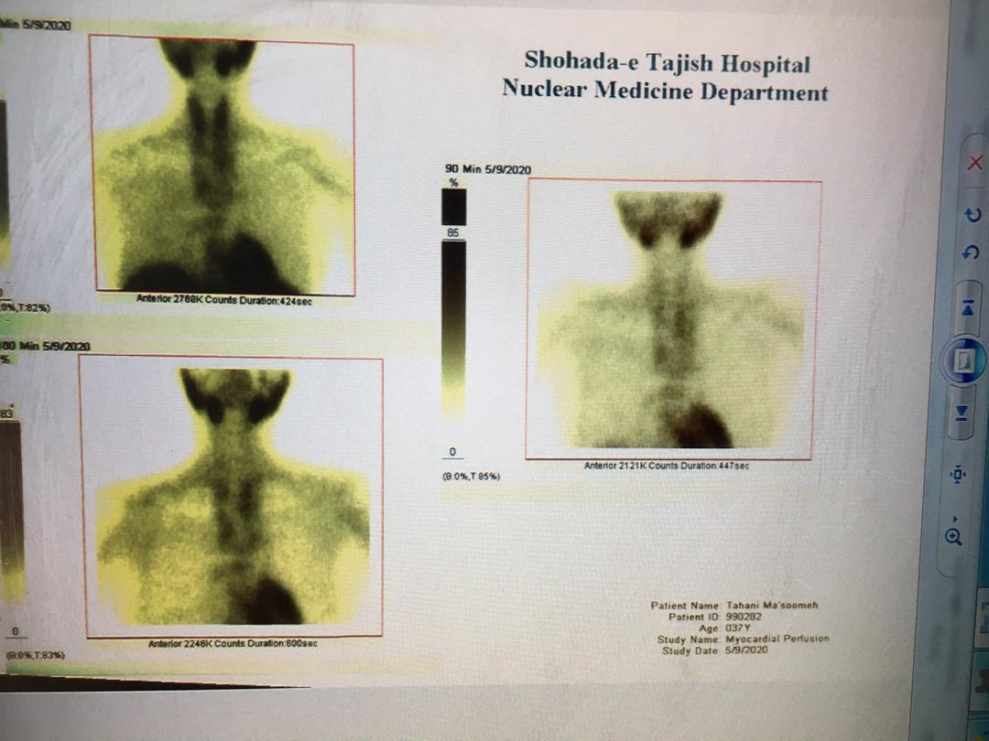
99/2/23 multinodular goiter with multiple cold nodules in both lobes
No evidence of functioning parathyroid adenoma, parathyroid hyperplasia can not be excluded.

Slide 24
99/2/24 mass در هر دو آدرنال با اثر فشاری بر پروگزیمال IVC و اینتراهپاتیک

Slide 25
99/2/31
Calcitonin:1888 pg/ml up to 11.8
CEA:86.8 ng/ml up to3.4
بیمار در تاریخ 99/3/3 تحت جراحی ادرنال دو طرفه قرار گرفت.
پاتولوژی:
ادرنالکتومیR: توده 116 grو 10*6.5 Cm و بدون شواهد تهاجم و وبدون افزایش میتوز و نکروز
ادرنالکتومیL: توده 128grو 6.5*5 Cm و بدون شواهد تهاجم و بدون افزایش میتوز و نکروز

Slide 27
99/3/10
TSH:2.3 T4:10 PTH:92 Ca:9.9 Ph:4.2
Urine 24 hr: volum:2 lit
metanephrin:8.8 mcg/24hr <350
normetanephrin:436 mcg/24hr <600
Free plasma:metanephrin:7.5 pg/ml <65
normetanephrin:71.3 pg/ml <196
HbA1c:5.7 FBS:82 Alp:69

Slide 28
99/4/13
بیمار تحت توتال تیروییدکتومی و پاراتیروییدکتومی هر 4 طرف قرار گرفت
یک غده پاراتیرویید در ساعد دست راست در عضله براکیو رادیالیس کاشته شد
RLND گردن انجام شد
نمونه تیرویید و پاراتیرویید جهت فروزن فرستاده شد.

Slide 30
شرح عمل:
بیمار تحت توتال تیروییدکتومی قرار گرفت.
با توجه به کنسر مدولاری تیرویید برای بیمار سنترال لنف نود دایسکشن به طور کامل در سمت چپ و راست انجام شد و در خلف لوب چپ پاراتیرویید رویت شد که بخشی از آن برای فروزن فرستاده شد و بخشی برای کاشت در ساعد نگه داشته شد.
سپس نمونه توتال تیرئییدکتومی و پاراتیرویید جهت فروزن ارسال شد که جواب فروزن مدولاری تیرویید کارسینوما در هر دو لوب تیرویید گزارش شد و همراه نمونه تیرویید یک پاراتیرویید نیز گزارش شد(در سمت چپ)

Slide 31
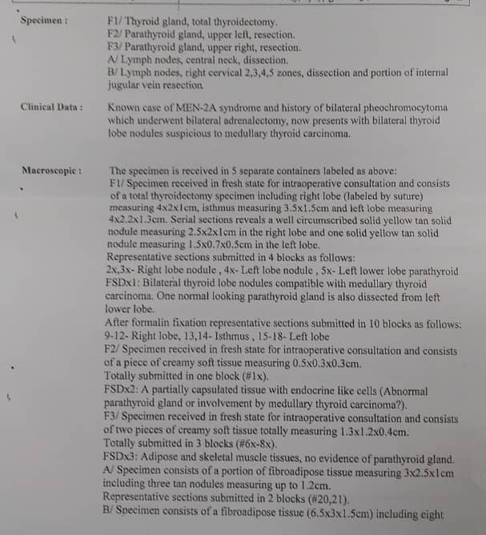

Slide 32
Pathology:
Thyroid gland:
Total thyroidectomy: medullary thyroid carcinoma
Tumor is bifocal(in both lobes the histologic type of tumor is similar)
One RT lobe nodule: 2.5*2*1 cm
One LT lobe nodule: 1.5*0.7*0.5 cm
Surgical margine is tumor free.
no Angioinvasion,lymphatic vessel invasion and perineural invasion.
No extrathyroidal extension.
2 normal looking parathyroid glands(one of them dissected from left lower lobe)
No regional lymph node.

Slide 33
Pathology:
Parathyroid gland:
upper left resection: Abnormal parathyroid gland suggestive of parathyroid adenoma
Upper right resection: unremarkable adipose and skeletal muscle tissues,no evidence of parathyroid gland.
Left lower lobe: normal looking parathyroid gland dissected.
A partially capsulated tissue with endocrine like cells(abnormal parathyroid gland or involvement by medullary thyroid carcinoma?)
2 Lymph nodes central neck dissection: both of them are involved by tumor, angioinvasion and lymphatic vessel invasion in surrounding blood vessels is identified.
Pathologic stage: mpT2 N1a M1

Slide 34
Pathology:
Comment: The histologic features in this parathyroid gland is focally atypical and some amyloid-like deposition are also present.
So IHC study for calcitonin is highly recommended for definite exclusion of parathyroid involvement by medullary thyroid carcinoma.

Slide 35
99/4/28
Na:140 K:4.8
Ca:9.2 P:5.2 Alb:4.2 PTH:17.5(11-67) 25(oh)vit D:39
Alp:46
T4:8.5(mcg/dl) T.Uptake:1.10 (0.8-1.3)
Free Thyroxine Index:7.73(4.8-12.7) TSH:24
Plasma renin activity upright(PRA):1.26(0.06-4.69)
CEA:27.7 (Up to 3.4) Calcitonin:11.9(Up to 11.8)

Slide 36
با تشکر از توجه شما

