Slide 1
INSULIN AND RDIOVASCULAR MORTALITY
DR Bahri

Slide 2
QUESTION
Insulin management is associated with adverse cardiovascular outcomes or not?

Slide 3
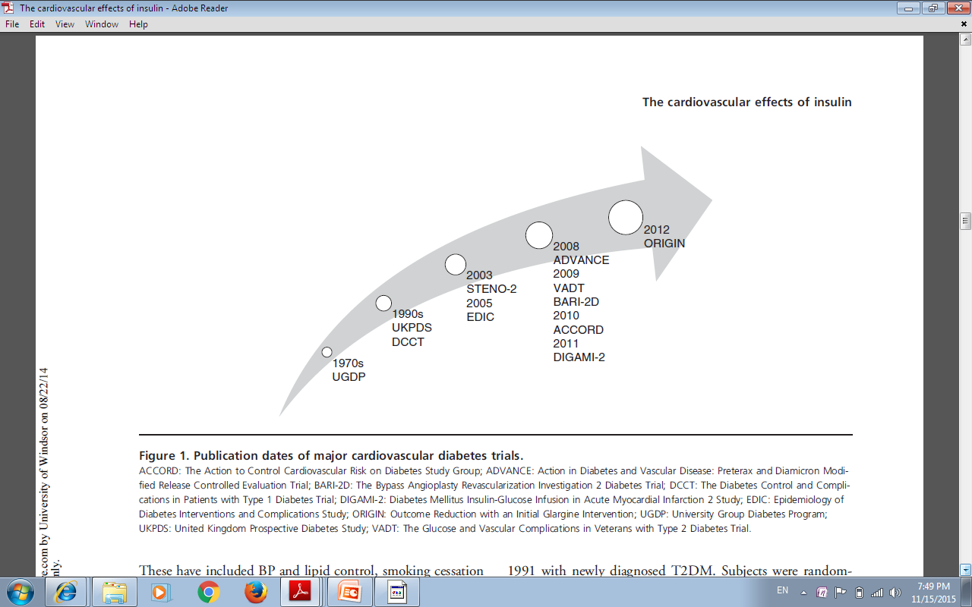

Slide 4
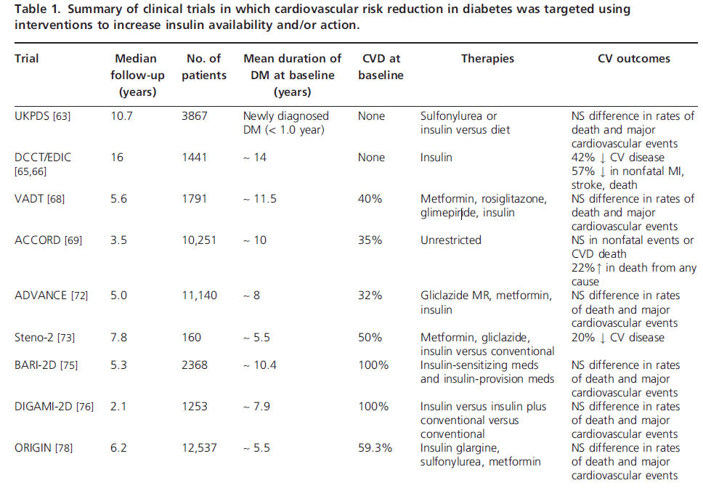

Slide 5
Insulin use and increased risk of mortality in type 2 diabetes: a cohort study
Diabetes, Obesity and Metabolism 12: 47–53, 2010.

Slide 6
OBJECTIVE
To compare population-based rates of all-cause and cardiovascular (CV) mortality in newly treated patients with type 2 diabetes according to levels of insulin exposure
Diabetes, Obesity and Metabolism 12: 47–53, 2010.

Slide 7
Study population
12 272 new users of oral anti diabetic therapy
between 1991 and 1996 (5 year)
grouped according to cumulative insulin exposure based on total insulin dispensations per year
Diabetes, Obesity and Metabolism 12: 47–53, 2010.

Slide 8
Exposures
low exposure
received less than three dispensation records for insulin per
year
moderate exposure
received between 3 and 12 dispensations per year (< 1 vial/month)
high exposure.
>12 dispensation per year (>1 vial/month)

Slide 9
outcome
The primary outcome:
all-cause mortality
Secondary outcome
CV- and non-vascular-related mortality.

Slide 10
Mean (s.d.) age of oral antidiabetic agents was 65.0 (13.9) years, 55% were male, 46% had a
previous history o fmicro- and macrovascular disease and 1443(12%) subjects started insulin therapy over an average (s.d.)

Slide 11
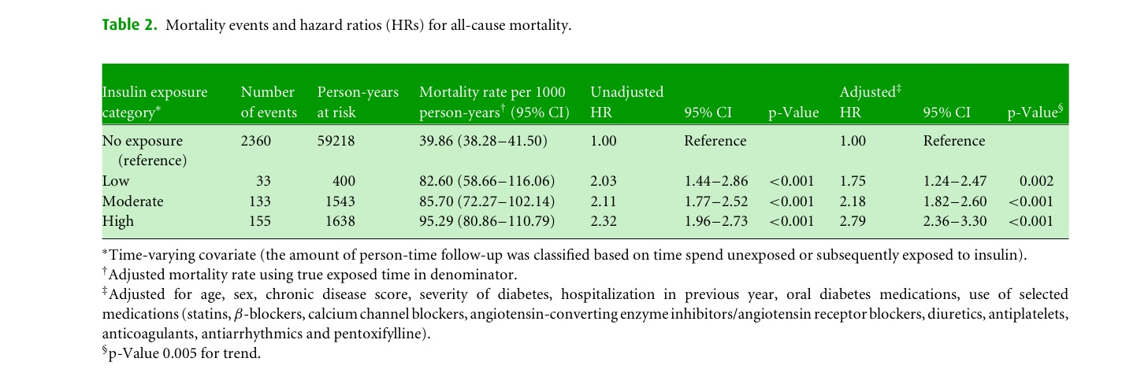

Slide 12
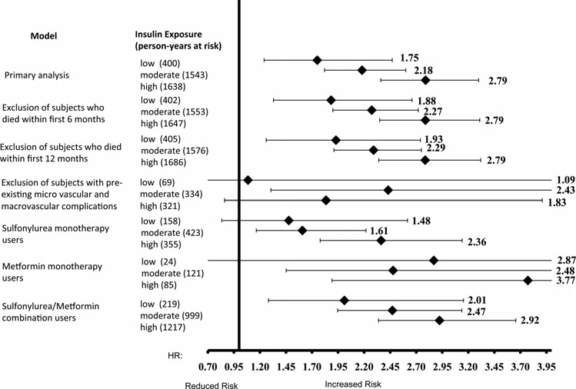

Slide 13
Key message
increasing levels of insulin exposure
are associated with higher mortality in older patients with type 2 diabetes.

Slide 14
Mortality and Other Important Diabetes-Related Outcomes With Insulin vs Other Antihyperglycemic Therapies in Type 2 Diabetes
(J Clin
Endocrinol Metab 98: 668–677, 2013)

Slide 15
OBJECTIVE
To characterize the risk of adverse events associated with glucose-lowering therapies ( Insulin vs Other Anti hyperglycemic) in people with T2DM.
Retrospective cohort study
Using data from the UK General Practice Research Database, 2000–2010.
J Clin Endocrinol Metab, February 2013, 98(2):668–677

Slide 16
Patient selection
84 622 primary care patients with T2DM treated with
Metformin monotherapy
Sulfonylurea monotherapy
Insulin monotherapy
Metformin plus sulfonylurea combination therapy
Insulin plus metformin combination therapy.

Slide 17
Exclusion criteria
Cases with a prior history of large-vessel disease (LVD) and/or cancer
patients with baseline serum creatinine above the normal range were excluded

Slide 18
Clinical end points
Primary outcomes:
All cause mortality, incident cancer, or MACE(major adverse cardiac events).
Secondary outcomes: Primary outcomes and the micro vascular complications.

Slide 19
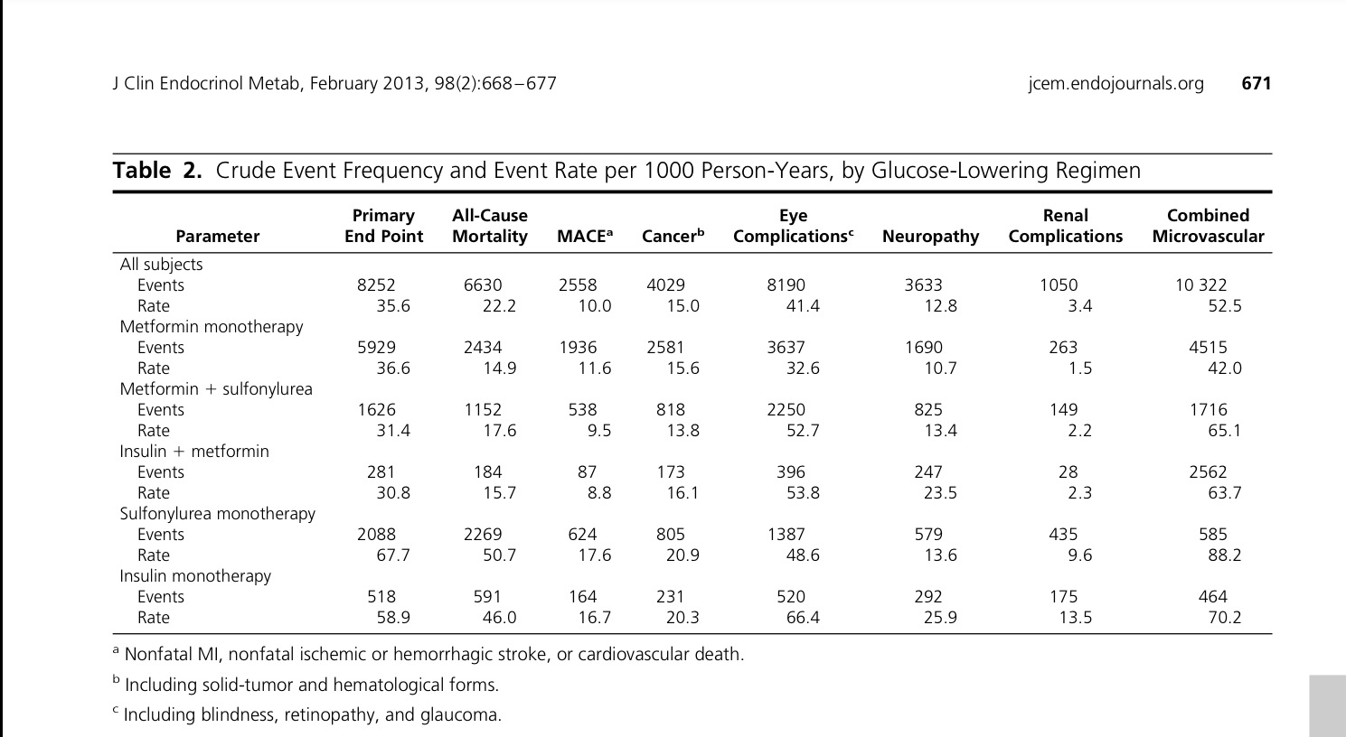
mortality rate was 22.2 deaths per 1000 person-years, the rates for MACEand incident cancer were 10.0 and 15.0 events per 1000 person-years, Therate for the primary end point was 35.6 events per 1000 person-years. crude mortality rates were notably higher for sulfonylurea monotherapy (50.7deaths per 1000 person-years) and insulin monotherapy(46.0 deaths per 1000 person-years). This was also true for the primary end point, with respective rates of 67.7 and58.9 events per 1000 person-years.

Slide 20
For the primary end, point, there were significantly increased aHRs for sulfonylurea mono therapy
insulin mono therapy and insulin plus metformin combination therapy:For mortality,
there were increased aHRs for insulin monotherapy and insulin plus metformin
combination therapy

Slide 21
For MACE, there were increased hazard ratios for all therapies vs metformin:For MI, all therapies had higher aHRs: For cerebrovascular events, sulfonylurea metformin plus sulfonylurea and insulin monotherapy all had increasedaHRs vs metformin. For cancer, there were increased aHRs for sulfonylurea

Slide 23
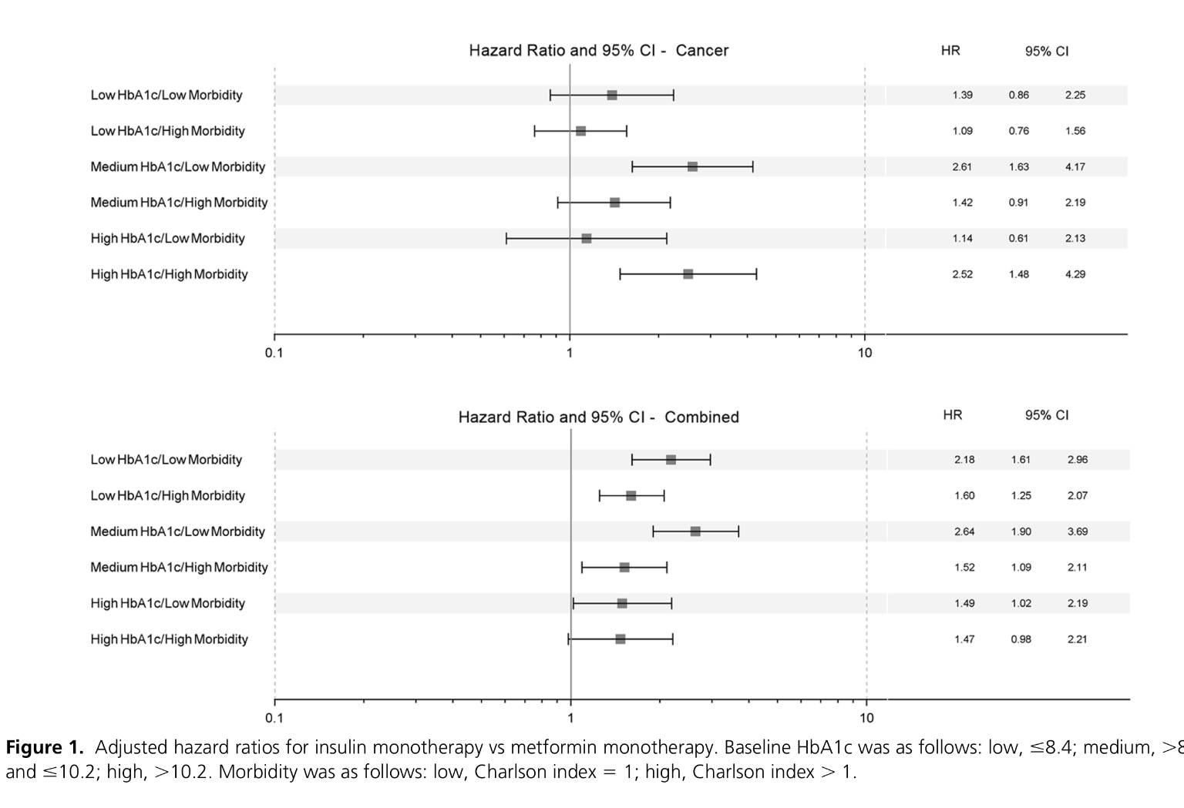

Slide 24
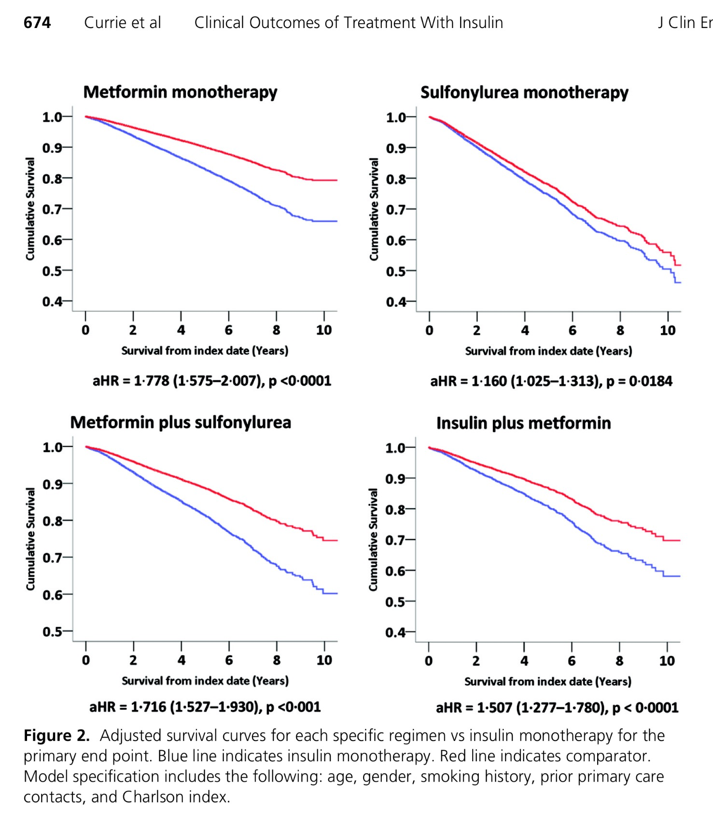

Slide 25
Key message
In people withT2DM,exogenous insulin therapy was associated with an increased risk of
diabetes-related complications,
cancer
all-cause mortality.
But differences in baseline characteristics
between treatment groups should be considered

Slide 27
Objective
To compared time to acute myocardial infarction stroke, or death in a cohort of metformin initiators
who added insulin
or a sulfonylurea.
Design
Retrospective cohort study
Participants Veterans initially treated with metformin from 2001 through 2008
subsequently added either insulin or sulfonylurea.
JAMA. Author manuscript; available in PMC 2014 December 11.

Slide 28
Duration
Patients were followed through
September, 2011 for primary analyses
September, 2009 for cause of death analyses
Exposures
insulin (long acting, premixed, or short/fast acting)
sulfonylurea (glyburide, glipizide or glimeperide) as metformin co-therapies.
JAMA. Author manuscript; available in PMC 2014 December 11

Slide 29
Primary Outcome:
(AMI)
stroke hospitalization
all-cause death
Secondary outcomes
CVD events (AMI and stroke combined)
all-cause deaths;
composite of AMI, stroke and cardiovascular death

Slide 30
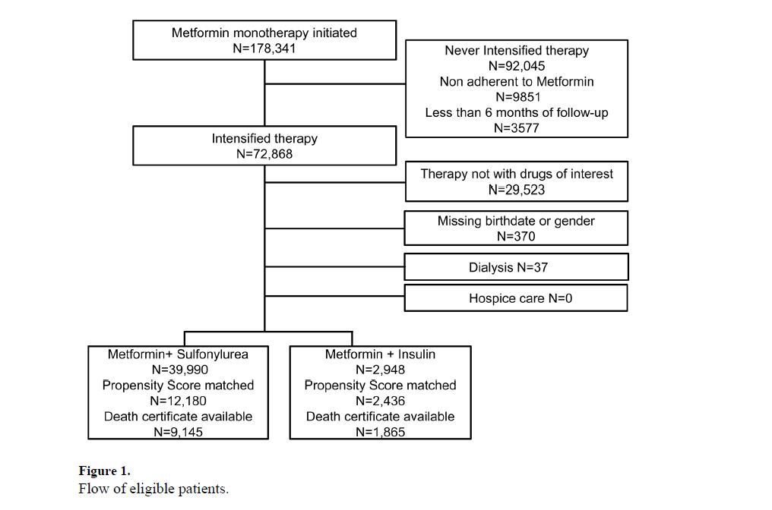

Slide 31
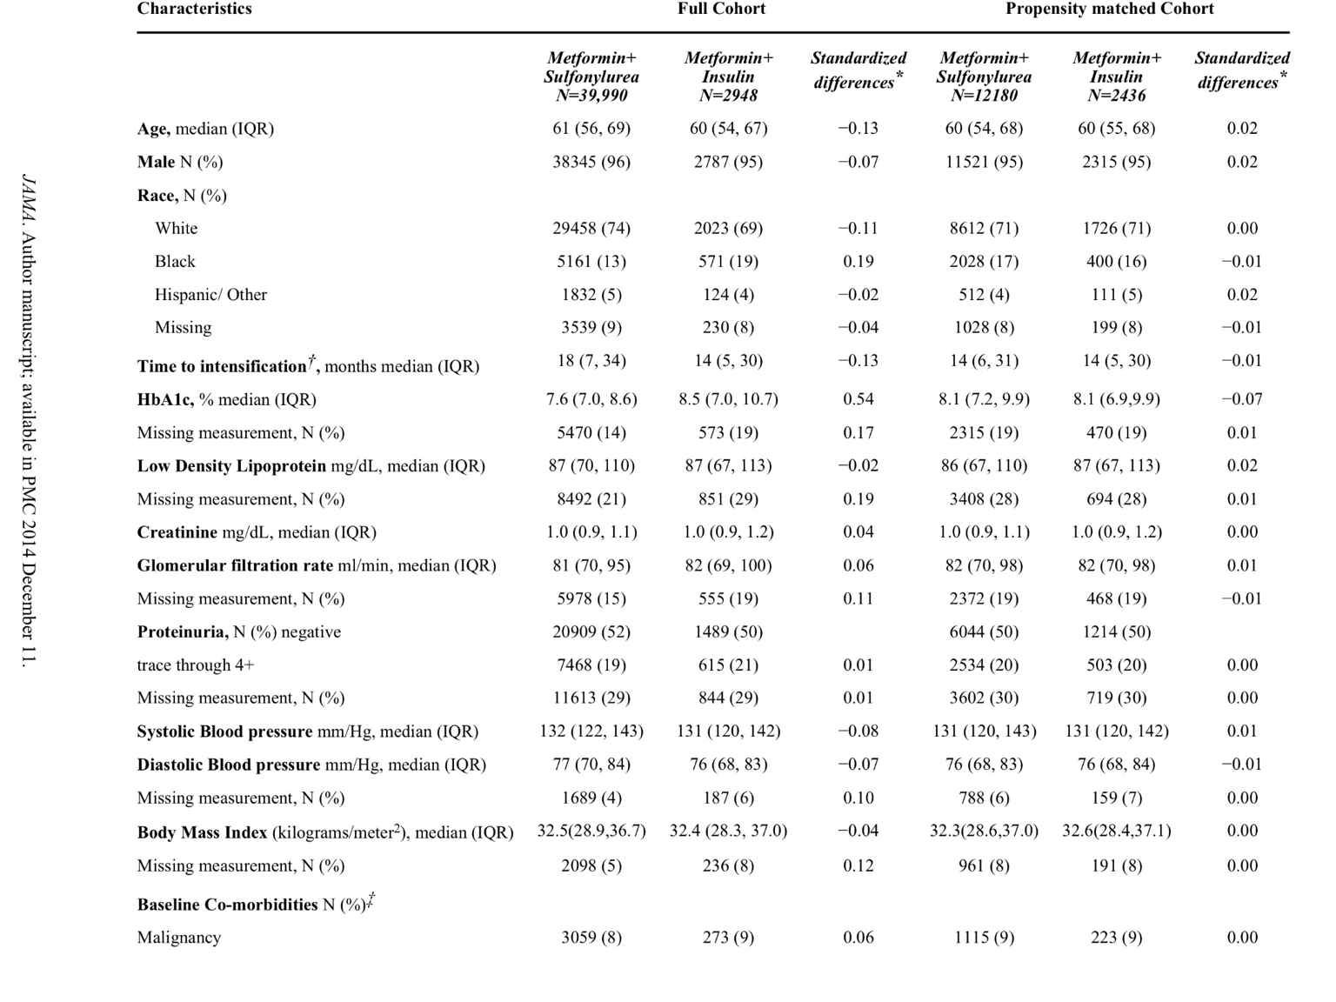

Slide 32
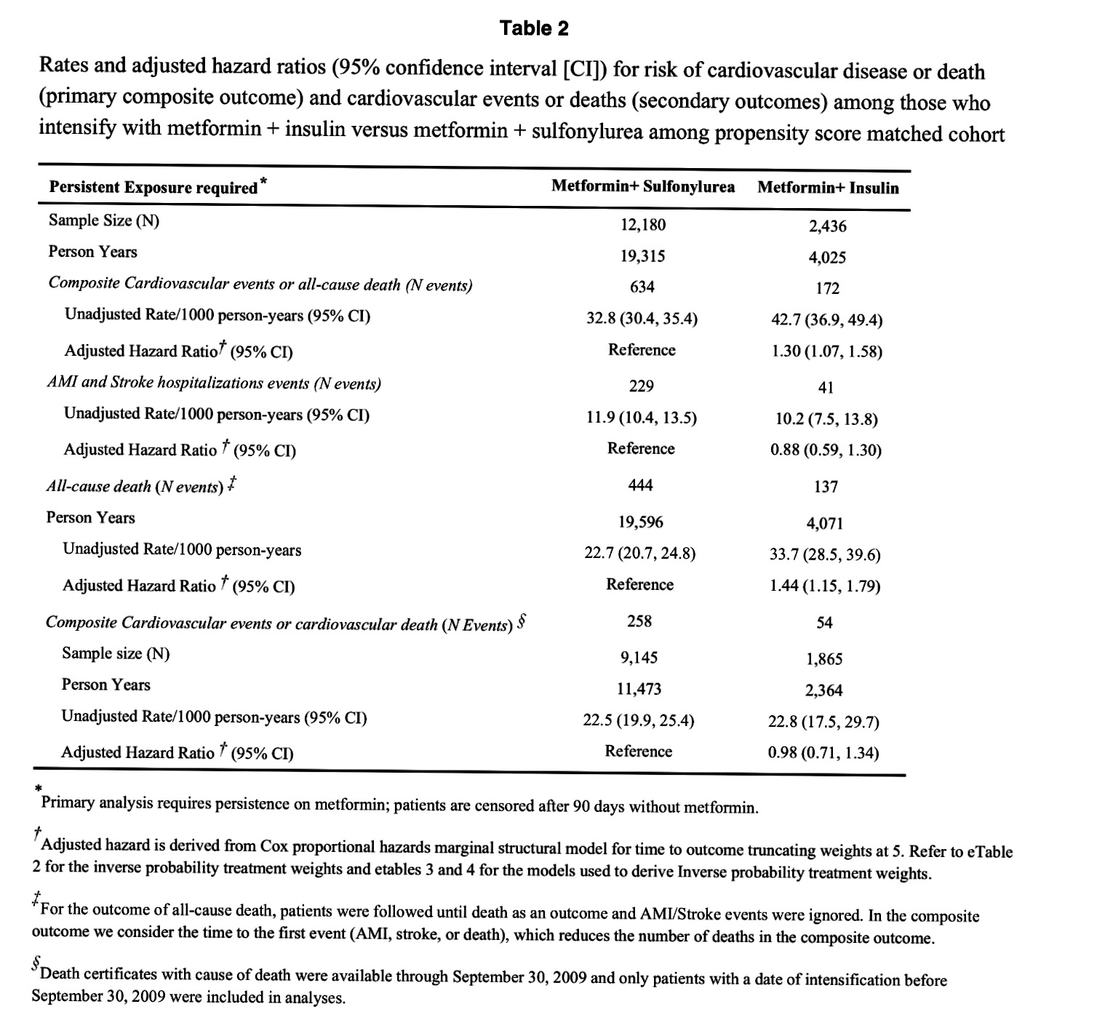

Slide 33
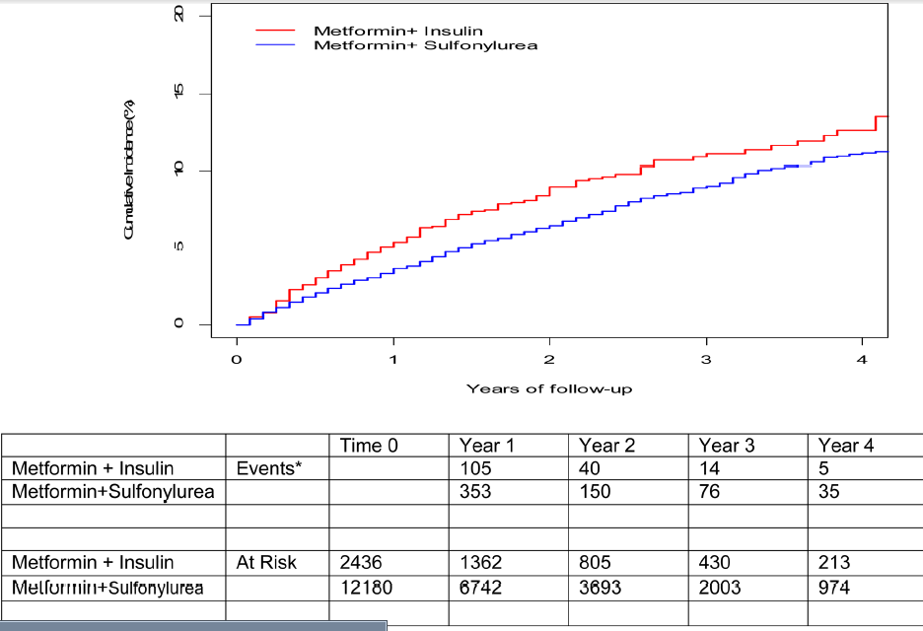

Slide 34
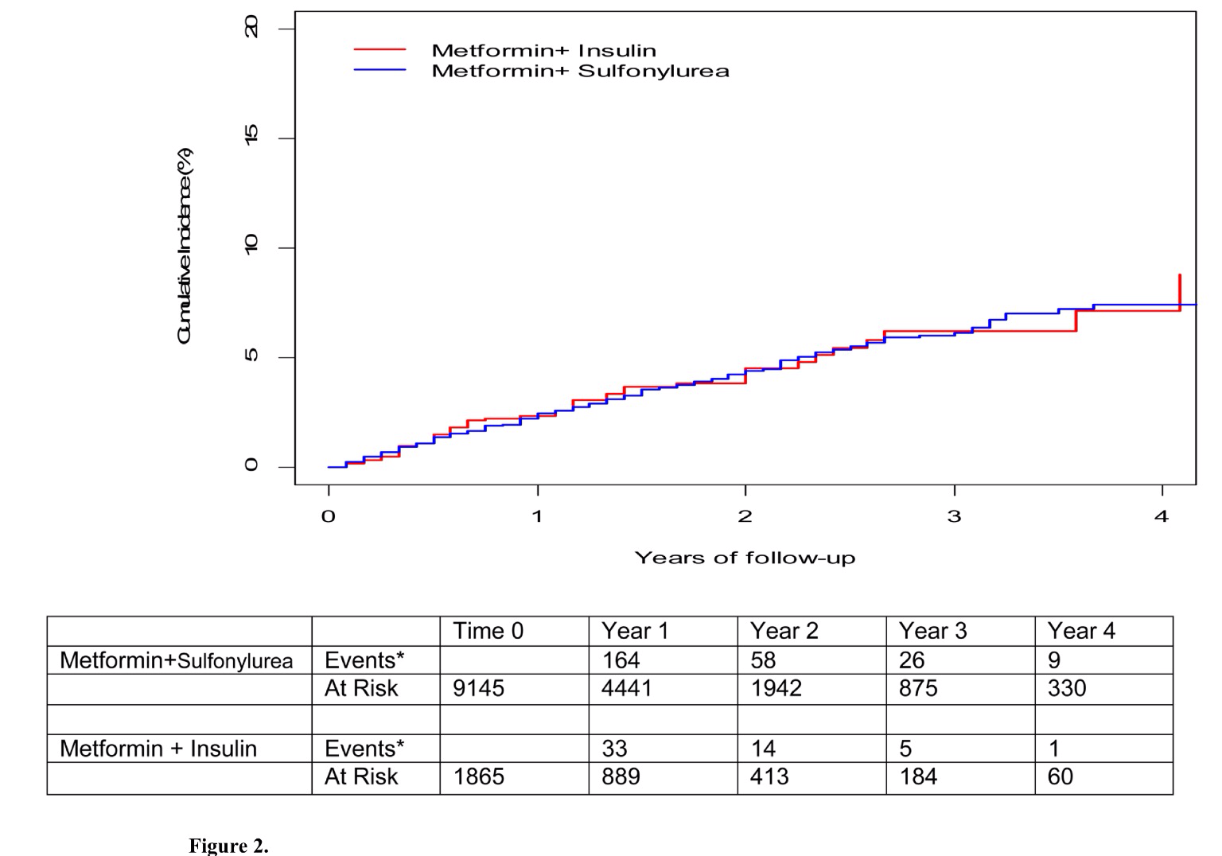

Slide 35
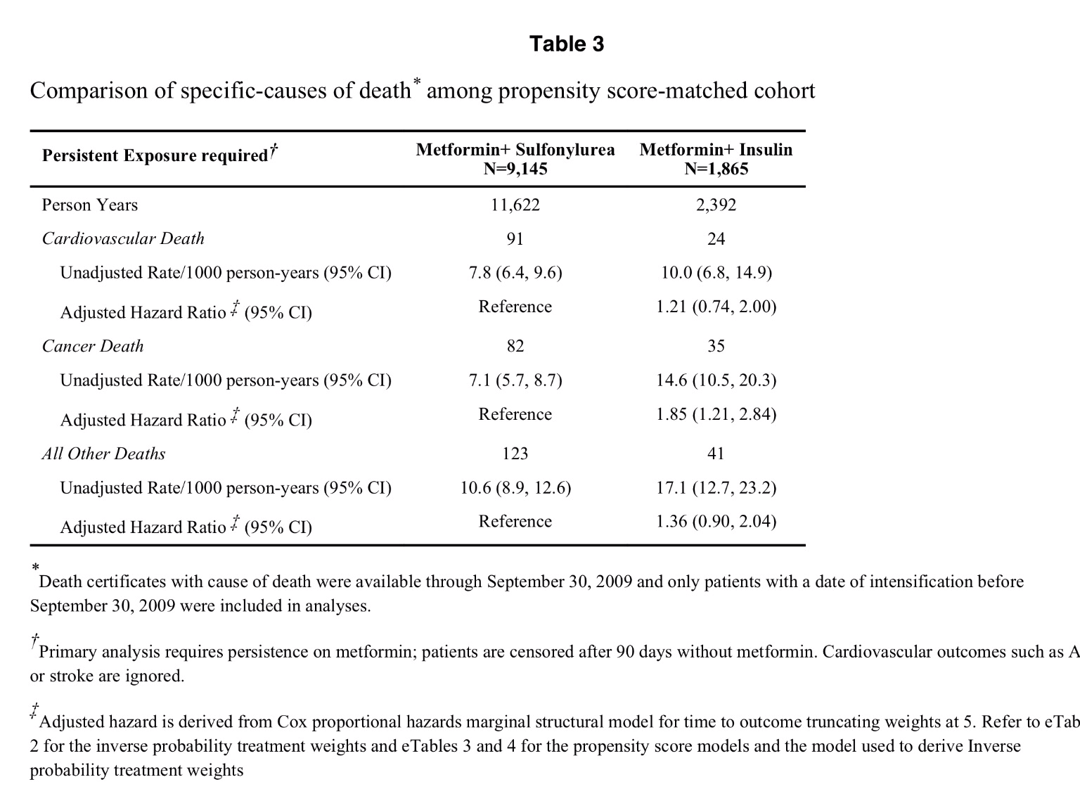

Slide 36
limitations
Follow-up in last study was relatively short (approximately three years)
Indication bias
Patients treated with insulin had higher HbA1c than other groups, indicating increased insulin resistance, which would predict worse outcomes.

Slide 37
Insulin Dose and Cardiovascular Mortality in the ACCORD Trial
Study population
examined insulin exposure data from 10,163 participants with a mean follow up of 5 years
Objective
explored associations between CV mortality and total, basal, and prandial insulin dose over time
Diabetes Care Publish Ahead of Print, published online October 13, 2015

Slide 38
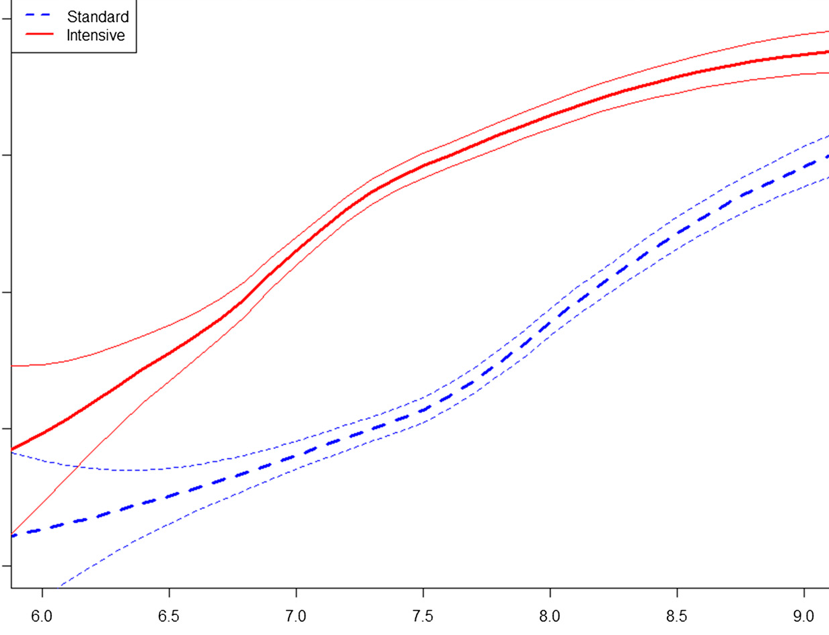
primary end point
Composite of CV mortality
nonfatal myocardial infarction,
nonfatal stroke
Secondary end point:
All-cause mortality

Slide 39
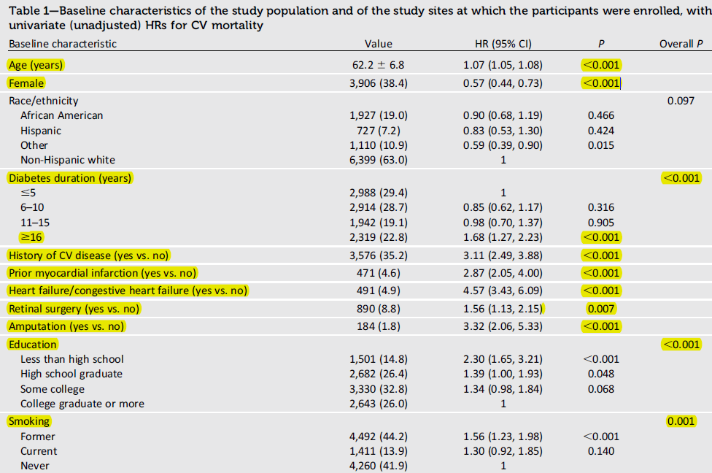

Slide 40
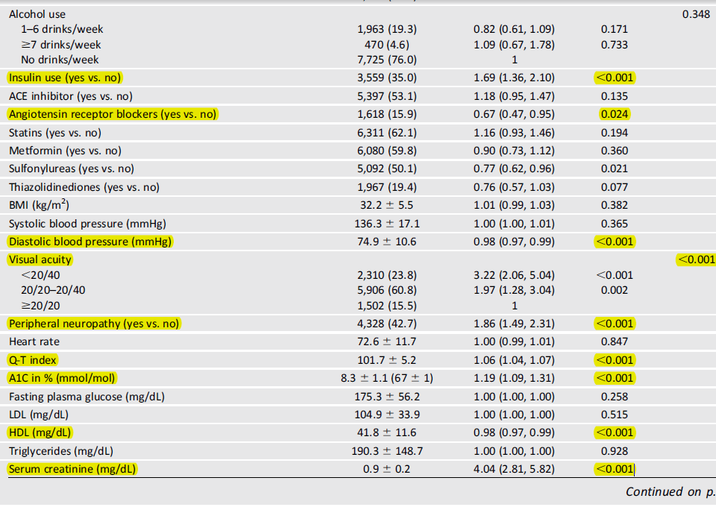

Slide 42
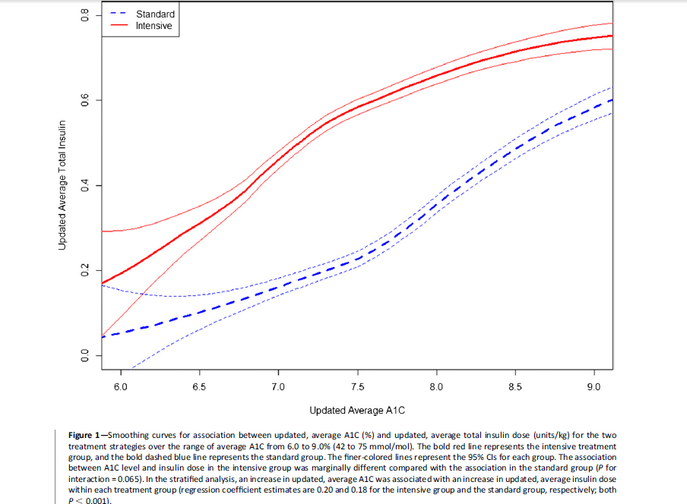

Slide 43
RESULTS

Slide 44
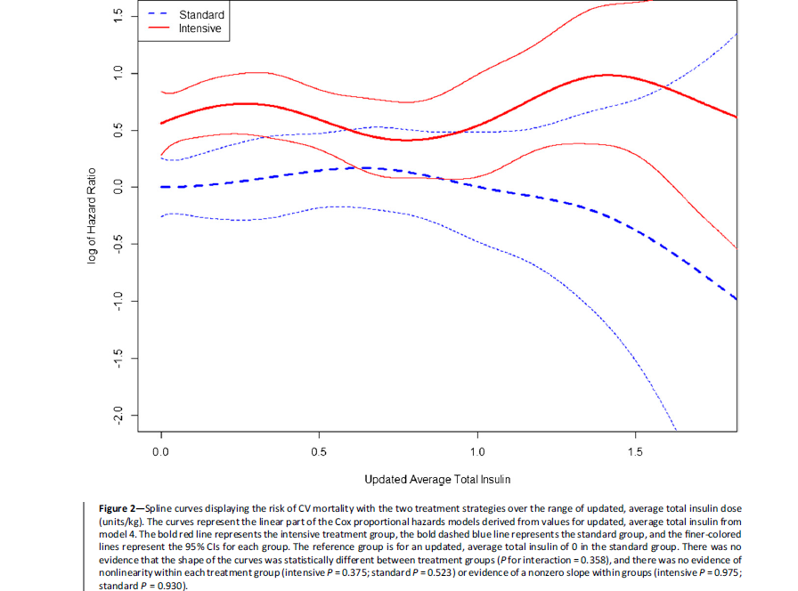

Slide 45
Key message
average daily insulin dose was not associated with increased CV mortality after adjustment for baseline covariates.
injected insulin is not an independent risk factor for CV mortality.
Do not exclude the possibility of adverse effects of insulin in vulnerable individuals.
Diabetes Care Publish Ahead of Print , published online October 13, 2015

Slide 46
CONCLUSION
Insulin dose not increases the cardiovascular
risk of death in diabetic patients
pathologic mechanisms
Hyperglycemia
insulin resistance
and endothelial dysfunction
contribute to macrovascular disease.

Slide 47
CONCLUSION
Insulin resistance, not insulin, appears to increase adverse cardiovascular outcomes.
Optimal control of multiple risk factors for CVD is necessary to prevent morbidity and mortality in the diabetic population.

