Slide 1
Thiazolidinediones TZD
MOJTABA MALEK
Associate Professor of Endocrinology
Tehran University of Medical Sciences
Endocrine research center(firozgar)

Slide 2
Agenda:
TZDs Overview
Pioglitazone Studies
Rosiglitazone Studies
TZDs and Cardiovascular Risks
TZDs Fracture Data
TZDs and Cancer
Summary

Slide 3
TZDs Action
Selective binding at the peroxisome proliferator activated receptor- gamma (PPAR-γ),which is found in adipose tissue, skeletal muscle, pancreatic beta-cells, vascular endothelium ,macrophages and the liver.
Decrease in insulin resistance at peripheral sites and in the liver that results in increased insulin-dependent glucose disposal and decreased hepatic glucose output.

Slide 4
Pioglitazone [Actos] : 15/30/45 mg
Rosiglitazone [Avandia]: 4mg/bid
Troglitazone (Rezulin) : Withdrawn from the U.S market in 2000 due to hepatotoxicity.
Peak Concentration : 2 to 4 hours
Initial Response : 4 weeks

Slide 5
Adverse Effects
Weight gain : dose-dependent and time-dependent
fluid retention & proliferation of new adipocytes
Fluid retention : more prominent with concomitant insulin therapy
Decreased bone density
Hepatotoxicity
Macular edema
Eczema

Slide 6
Dose adjustment : NOT necessary in
renal insufficiency or elderly
Should not be used in:
active liver disease or serum ALT > 2.5 times

Slide 7
DREAM trial
A decrease in diabetes in subjects with IFG or IGT who were treated with rosiglitazone was reported.
Metformin and thiazolidinediones had similar efficacy as monotherapy.
The cost and side effects of thiazolidinediones make them less appealing as initial therapy and do not suggest for diabetes prevention.

Slide 8
Pioglitazone for type 2 diabetes mellitus
Richter B, Bandeira-Echtler E, Bergerhoff K, Clar C, Ebrahim SH. Cochrane Database of Systematic Reviews 2006, Issue 4. Art. No.: CD006060. DOI: 10.1002/14651858.CD006060.pub2.

Slide 9
Objectives
To assess the effects of pioglitazone in the treatment of type 2 diabetes.
Selection criteria
RCTs in adult people with type 2 diabetes mellitus and a trial duration of at least 24 weeks.
22 trials , randomised approximately 6200 people

Slide 10
Results
No convincing evidence that patient-oriented outcomes like mortality, morbidity, adverse effects, costs and health-related quality of life are positively influenced by this compound.
HbA1c : not demonstrate clinically relevant differences to other oral antidiabetic drugs.
Occurrence of oedema was significantly raised.

Slide 11
Conclusion
Until new evidence becomes available, the benefit-risk ratio of pioglitazone remains unclear.

Slide 12
Rosiglitazone for type 2 diabetes mellitus
Richter B, Bandeira-Echtler E, Bergerhoff K, Clar C, Ebrahim SH.Cochrane Database of Systematic Reviews 2007, Issue 3. Art. No.: CD006063. DOI: 10.1002/14651858.CD006063.pub2.

Slide 13
Objectives
To assess the effects of rosiglitazone in the treatment of type 2 diabetes.
Selection criteria
RCTs in adult people with type 2 diabetes mellitus and a trial duration of at least 24 weeks.
18 trials, randomised 3888 people

Slide 14
Results:
No evidence that patient-oriented outcomes like mortality, morbidity, adverse effects, costs and health-related quality of life are positively influenced by this compound.
HbA1c as a surrogate endpoint did not demonstrate clinically relevant differences to other OADs
Occurrence of oedema was significantly raised (OR 2.27, 95% confidence interval : 1.83 to 2.81)

Slide 15
Thiazolidinedione Drugs and Cardiovascular Risks

Slide 16
Rosiglitazone and IHD Risk

Slide 18
Rosiglitazone and IHD Risk
In summary, an association between rosiglitazone and IHD outcomes has not yet been firmly established.
These uncertainties were reflected in the vote of the FDA Advisory Panel, who on July 30, 2007, voted 20 to 3 in favor of an increased risk for ischemic cardiac events with rosiglitazone but voted 22 to 1 against removing rosiglitazone from the market.
The FDA’s decision on November 14, 2007, to allow rosiglitazone to remain on the market with an additional boxed warning about the risk of IHD events further reflects these uncertainties.
Circulation 2010, 121:1868-1877

Slide 19
Pioglitazone and IHD Risk

Slide 20
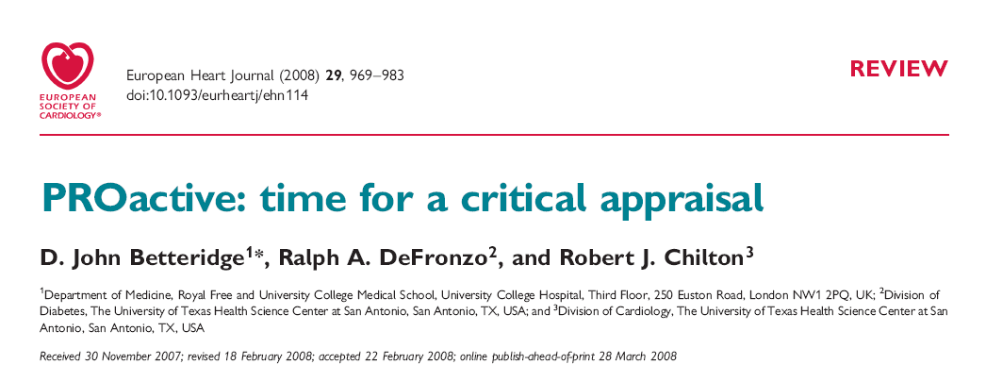

Slide 21
Pioglitazone and IHD Risk
A large clinical trial designed to assess the effect of pioglitazone on ischemic cardiovascular outcomes, the PROactive trial (PROspective pioglitAzone Clinical Trial In macroVascular Events),
showed no statistically significant effect of pioglitazone on the primary composite outcome (HR 0.90, 95% CI 0.80 to 1.02)
However, pioglitazone treatment significantly reduced a secondary composite outcome of all-cause mortality, nonfatal MI, and stroke (HR 0.84, 95% CI 0.72 to 0.98).

Slide 22
Circulation 2010, 121:1868-1877

Slide 23
Pioglitazone and IHD Risk
A meta-analysis of 19 trials reported a significant reduction in the composite end point of all- ause death, MI, or stroke with pioglitazone compared with control (HR 0.82, 95% CI 0.72 to 0.94).
Observational studies suggest no increased IHD risk with pioglitazone compared with other oral hypoglycemic agents.

Slide 24
Pioglitazone and IHD Risk
In summary, the majority of published studies do not suggest an increased hazard for IHD events in pioglitazone-treated patients.
Accordingly, there is no boxed warning

Slide 25
Thiazolidinediones and Heart Failure Risk
A metaanalysis by Lago et al demonstrated a 1.7-fold increase in risk of CHF with thiazolidinediones
a slightly greater increase in risk with rosiglitazone (2.2-fold) than with pioglitazone (1.3-fold)
Despite the increase in risk of CHF, no increase in risk of cardiovascular death was observed with either thiazolidinedione
Lancet.2007;370:1129 –36.

Slide 26
Thiazolidinediones and Heart Failure Risk
caution is urged for the use of rosiglitazone or pioglitazone in all patients with signs and symptoms suggestive of CHF
Initiation of either agent is contraindicated in patients with class III or IV CHF
US Food and Drug Administration. August 14, 2007

Slide 27
TZDs and Bone

Slide 28
Reported Effects of TZDs on Bone Metabolism
Inhibited bone formation and mineralization (Johnson et al., 1999)
Decreased osteoblastogenesis, increased bone marrow adiposity in men and women (Okazaki et al., 1999; Watanabe et al., 2003)
Induced bone loss in older diabetic women (Schwartz et al., 2006)
Decrease in bone osteoblast markers pro-collagen type-1 N-terminal pro-peptide (P1NP) and osteocalcin, but no change in type 1 collagen N-telopeptide (NTX) (Grey et al., 2007)
ADOPT trial reported a higher risk of fractures in diabetic women randomized to rosiglitazone compared to metformin and glyburide (Kahn et al., 2006)

Slide 29
Effects of Thiazolidinediones on Aromatase Activity
Inhibitory effects on aromatase enzyme activity by interfering with the androgen substrate binding to aromatase (Seto-Young et al., 2007; Avtanski et al., 2007)
Reduced estrogen biosynthesis in human granulosa cells (Seto-Young et al., 2007; Avtanski et al., 2007)

Slide 30
Hypothesis
TZDs may inhibit aromatase enzyme activity in human granulosa cells, possibly leading to reduced estrogen synthesis and consequently increased risk of osteoporosis.

Slide 31
Arch Intern Med. 2008;168(8):820-825

Slide 32
The association between the use of thiazolidinediones or other oral antidiabetic drugs and the risk of fracture.
A case-control analysis uses 1020 case patients with an incident low-trauma fracture aged 30 to 89 years with an incident fracture diagnosis between January 1994 and December 2005 and 3728 matched controls.
Assessed the odds ratios (ORs) of having a fracture associated with the use of rosiglitazone maleate, pioglitazone hydrochloride, other oral antidiabetic agents, or insulin.

Slide 33
Results
After adjustment for age, body mass index, other antidiabetic drugs, comedication, and comorbidities:
Rosiglitazone (OR, 2.38; 95% CI, 1.39-4.09)
pioglitazone (OR, 2.59; 95% CI, 0.96- 7.01)
predominantly hip and wrist fractures
The association was independent of patient age and sex and tended to increase with thiazolidinedione dose.
No altered relative fracture risk with other OADs

Slide 34
Conclusion
Possible association between long-term use of thiazolidinediones and fractures, particularly of the hip and wrist, in patients with diabetes mellitus.

Slide 35
Long-term use of thiazolidinediones and fractures in type 2 diabetes: a meta-analysis
Yoon K. Loke MBBS MD, Sonal Singh MD MPH, Curt D. Furberg
CMAJ 2009;180(1):32-9

Slide 36
Selected long-term (≥ 1 year) RCTs involving patients with type 2 diabetes and controlled observational studies that described the risk of fractures or changes in bone density with thiazolidinediones

Slide 37
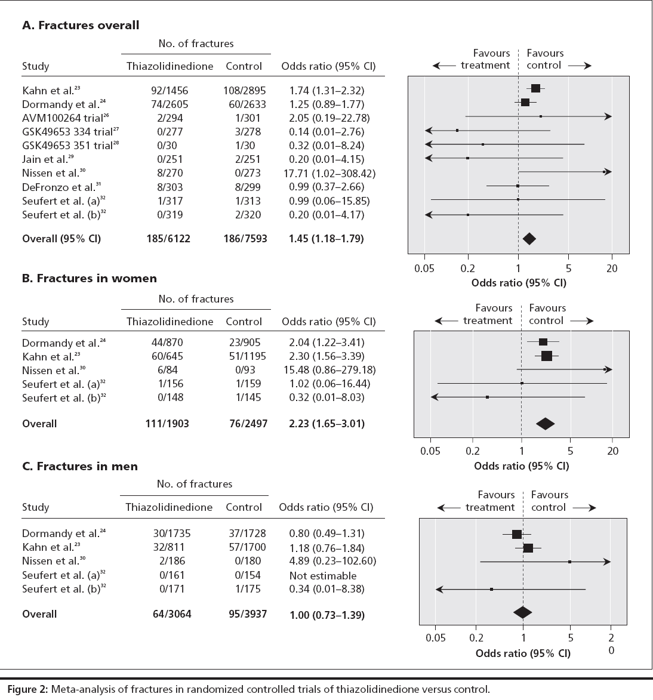

Slide 38
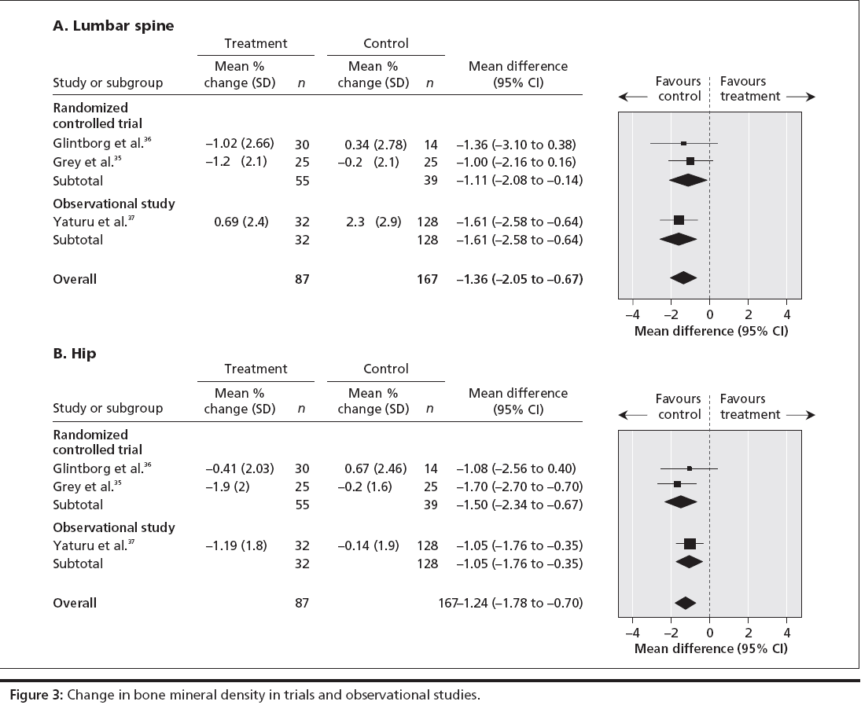

Slide 39
Interpretation
Long-term thiazolidinedione use doubles the risk of fractures among women with type 2 diabetes, without a significant increase in risk of fractures among men with type 2 diabetes.

Slide 40
Cohort study of pioglitazone and cancer incidence in patients with diabetes Diabetes care, 34 : 923-929,2011

Slide 41
10 most common sites (prostate, female breast, lung/bronchus, endometrial, colon, non-Hodgkin lymphoma [NHL], pancreas, kidney/renal pelvis, rectal, and melanoma)
Cohort study of 252,467 patients
age ≥ 40 & max F/U duration six years

Slide 42
Conclusion
No clear evidence of an association between use of pioglitazone and risk of the incident cancers

Slide 43
Risk of bladder Cancer among diabetic patients treated with pioglitazone Interim report of a longitudinal cohort study Diabetes care,22,2011

Slide 44
Preclinical in vivo studies :
possible increased risk of bladder cancer with pioglitazone
193,099 patient ≥ 40 years of age
prior bladder cancer was excluded

Slide 45
Pioglitazone group : 30,173 patients
90 cases of bladder cancer among pioglitazone users
791 cases of bladder cancer among nonpioglitazone users
Pioglitazone : not associated with risk of bladder cancer:
Hr 1.2 [95% CI: 0.9-1.5]
≥ 24months of therapy : increased risk (1.4 [1.03-2.0])

Slide 46
Conclusions
Short-term use of pioglitazone
not associated with an increased incidence of bladder cancer
use for more than 2 years, weakly associated with increased risk.

Slide 47
summary
Thiazolidinediones : A possible second step option in the algorithm for management of patients with type II diabetes who are not well controlled on diet/lifestyle/metformin, as an alternative to insulin (most effective) and sulfonylureas (cheapest)
TZDs : Similar effects on glycemic control

Slide 48
summary
Increased caution with the use of rosiglitazone,especially in patients with CHF
Patients with type 2 diabetes should probably not be started on rosiglitazone.
Except for CHF;other cardiac outcomes are better with pioglitazone.

Slide 49
summary
Long-term thiazolidinedione use doubles the risk of fractures among women with type 2 diabetes.
use for more than 2 years, weakly associated with increased risk
Benefits on a surrogate measure such as HbA1C should be balanced against their complex actions elsewhere in the body, including a doubling of the risk of bone fractures among women

