Slide 1
In The Name Of God

Slide 2
Cushing Syndrome Epidemiology and Clinical Presentation
Mahtab Niroomand M.D.
Assistant Professor of Endocrinology
SBUMS
Shohada Tajrish Hospital

Slide 3
Lecture Outline
Definition
Epidemiology
Etiology
Clinical Features
Cushing syndrome in Iran

Slide 4
Cushing Syndrome
In 1912, Harvey Cushing first described a 23-year-old female with obesity, hirsutism, andamenorrhea, 20years later :
1932: Harvey Cushing described a series of seven pts with basophilic adenomas of the pituitary --- CD

Slide 5
Definition
Cushing’s syndrome:
Symptoms and signs associated with prolonged exposure to inappropriately elevated levels of free plasma GC from either an exogenous or endogenous source
Cushing’s disease:
Cushing’s Syndrome due to pituitary ACTH hypersecretion

Slide 6
Etiology
ACTH-dependent
Pituitary (CD) (70%)
Microadenomas (95%)
Macroadenomas (5%)
Ectopic ACTH or CRH(10%)
Small cell lung ca
Carcinoids: lung, pancreas, thymus
ACTH-independent
(Factitious)
Unilateral
Adrenal adenoma (10%)
Adrenal carcinoma (5%)
Bilateral
Macronodular Hyperplasia (AIMAH) (<2%)
Primary pigmented Micronodular Adrenal disease (PPNAD) (<2%)
McCune Albright Syndrome (<2%)

Slide 7
Exogenous Hydrocortisone
CRH
Iatrogenic
Cushing’s Syndrome
(+)
(-)
ACTH (-)
(-) Cortisol

Slide 8
CRH
ACTH-dependent Cushing’s disease
(+)
Autonomous ACTH
secreting tumour
ACTH (+)
(-) Cortisol

Slide 9
CRH
Adrenocortical tumour
(+)
ACTH (-)
(-) Cortisol
Autonomous cortisol
secreting tumour

Slide 10
CRH
Ectopic ACTH
syndrome
(+)
Ectopic ACTH
secreting tumour
(-) Cortisol
ACTH (+)

Slide 11
Ectopic CRH
producing tumour
CRH
(+)
Ectopic CRH secreting tumour
ACTH (+)
(-) Cortisol

Slide 12
Epidemiology of Cushing’s syndrome
Relatively rare: approx. 10-15 of every million people each year
Most commonly affects adults aged 20-50.
Increased risk of developing the disorder in:
Obese people
Those with type 2 diabetes, along with poorly controlled blood glucose
Those with high blood pressure

Slide 13
Epidemiology (Cont’d)
Estimates of the incidence of Cushing's syndrome are imprecise and underestimate the incidence of:
Iatrogenic Cushing's syndrome
Undiagnosed mild hypercortisolism
Ectopic ACTH syndrome

Slide 14
Epidemiology (Cont’d)
Iatrogenic Cushing's syndrome :
More than 10 million Americans receive pharmacologic doses of GC each year
It must be more common than any other cause
Is seldom reported

Slide 15
Epidemiology (Cont’d)
Ectopic ACTH syndrome :
Probably the second most common cause of Cushing's syndrome, but it is often not diagnosed.
About 1% of patients with small-cell lung cancer have ectopic ACTH syndrome
There are approximately 30,000 new cases of SCLC annually in the United States
Therefore, one could expect approximately 300 new cases of ectopic ACTH syndrome per year

Slide 16
Epidemiology (Cont’d)
Cushing's disease :
CD is five to six times more common than Cushing's syndrome caused by benign and malignant adrenal tumors combined
The incidence of Cushing's disease may be 5 to 25 per million per year.

Slide 17
Epidemiology (Cont’d)
Adrenal tumors :
Adrenal carcinoma and adenoma cause a similar number of cases of Cushing's syndrome in most series.
The incidence of adrenal carcinoma is unknown but is estimated to be 0.2 to 2 per million per year
Other causes of Cushing's syndrome:
Extremely rare, including:
Cushing's syndrome during pregnancy
Cushing’s syndrome due to either ACTH-independent macronodular adrenal hyperplasia or primary pigmented nodular adrenocortical disease

Slide 18
Epidemiology (Cont’d)
Sex-related incidence :
Ectopic ACTH syndrome: M/F ratio: 3/1
Cushing's disease: F/M ratio:3-8/1
Cushing's syndrome associated with an adrenal tumor: F/M ratio: 4-5/1

Slide 19
Epidemiology (Cont’d)
Age-related incidence :
Ectopic ACTH syndrome due to lung carcinoma, increasing rapidly after age 50 yrs.
Ectopic ACTH secretion due to carcinoid tumors can occur at earlier ages but is rare in children
CD occurs mainly in women aged 25 to 45 years. It is unusual in children
CD still accounts for about one-third of cases of childhood Cushing's syndrome(mostly after puberty).

Slide 20
Epidemiology (Cont’d)
Age-related incidence :
Adrenal tumors have a bimodal age distribution:
Small peaks in the first decade of life for both adenomas and carcinomas
Major peaks at about 50 years for adenomas and 40 years for carcinomas
Adrenal carcinoma is the cause of one-half of all cases of childhood Cushing's syndrome
Adrenal adenoma accounts for another one-sixth
Girls are affected slightly more often than boys

Slide 21
Clinical Manifestation
Establishing the diagnosis of Cushing syndrome is often difficult because none of the symptoms or signs are pathognomonic of the syndrome.

Slide 22
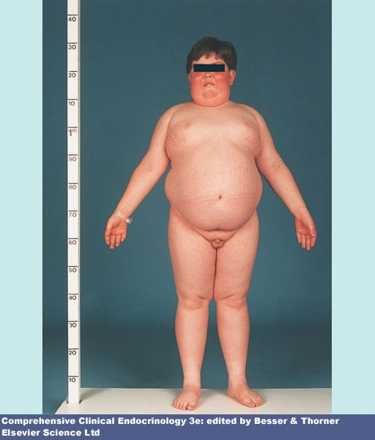
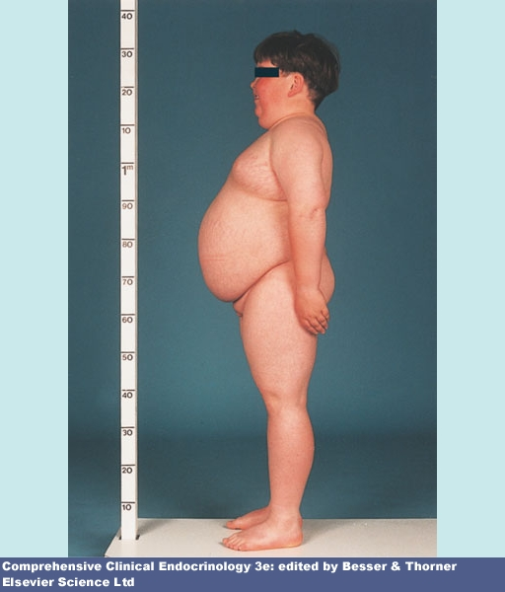
Clinical Manifestation
Progressive central (centripetal) obesity:
The most common feature
Usually involving the face, neck, trunk,abdomen ,internally, spinal canal and mediastinum
The extremities are usually spared and may be wasted.
Generalized obesity

Slide 23
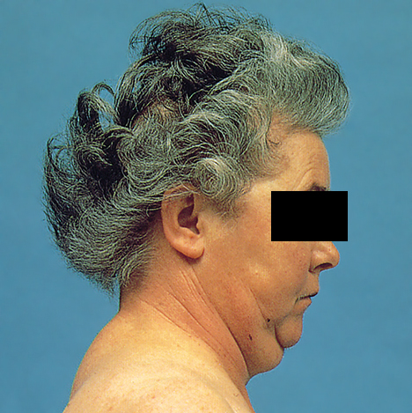
Facial Plethora i.e. “Moon Facies”
Dorsocervical fat pad i.e. “buffalo hump”

Slide 24
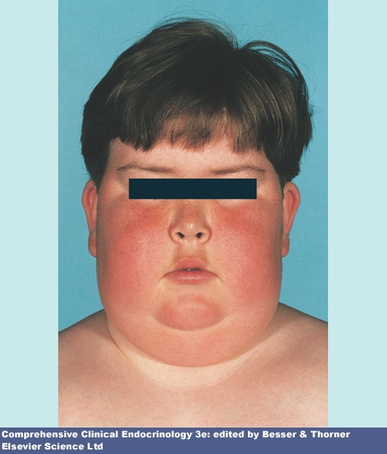

Slide 25
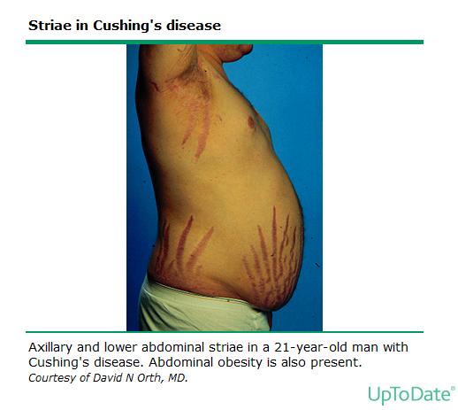
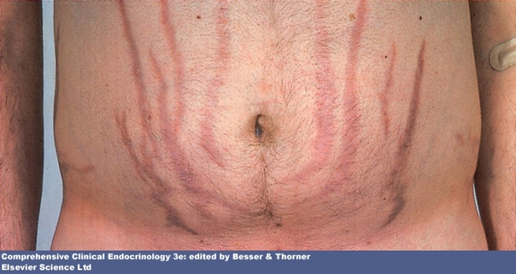
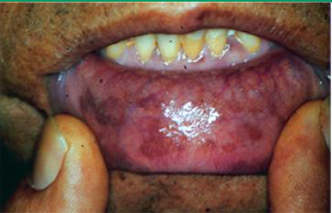
Clinical Manifestation
Dermatologic manifestations:
Skin atrophy
Easy bruisability
Purple striae
Fungal infections
Hyperpigmentation

Slide 27
Pigmented Scar

Slide 28
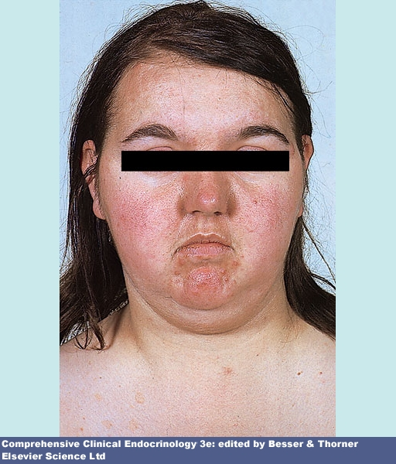
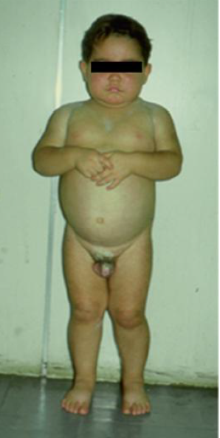
Clinical Manifestation
Menstrual irregularities
Signs of adrenal androgen excess:
Hirsutism
Oily facial skin and acne
(face, neck,shoulders)
Increased libido
Virilization:
Temporal balding, Deepening voice,
Male body habitus, male escutcheon,
Clitoral hypertrophy in girls,
Premature puberty in Prepubertal males

Slide 29
Clinical Manifestation
Proximal muscle wasting and weakness

Slide 30
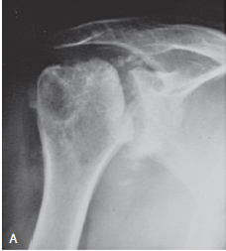
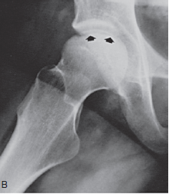
Clinical Manifestation
Bone :
Osteoporosis and pathologic fracture
(Pathologic rib and long bone fractures)
Osteonecrosis (aseptic necrosis) of the femoral heads and rarely the humeral heads
Low back pain (osteoporosis, vertebral compression, muscle wasting)
Lordotic posture
resulting from weight gain

Slide 31
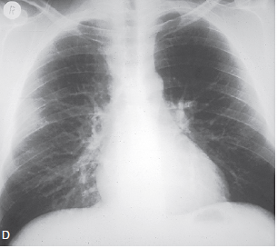
Rib fracture
Osteoprosis and vertebral collaps

Slide 32
Clinical Manifestation
Glucose intolerance due to:
Stimulation of gluconeogenesis by cortisol
Peripheral insulin resistance caused by obesity
Direct suppression of insulin release
Overt hyperglycemia (in 10 to 15% of pts, usually those with a family history of DM-2)
Cardiovascular disease:
Patients with endogenous CS are at increased risk of death from cardiovascular disease :
MI (HR=4.38),
stroke (HR=1.91),
Thromboembolism(HR=2.03)

Slide 33
Clinical Manifestation
Neuropsychological changes and cognition:
Symptoms of psychiatric disease occur in over one-half of patients with Cushing's syndrome of any etiology
Presenting symptom
The most common psychologic symptoms :
Emotional lability
Agitated depression(two-thirds of patients with CS)
Irritability
Anxiety
Panic attacks
Mild paranoia
Insomnia

Slide 34
Clinical Manifestation
Cognition :
Impaired:
Learning
Cognition
Memory (short-term memory)

Slide 35
Clinical Manifestation
Infection and immune dysfunction:
Increased frequency of infections due to:
Fall in circulating CD4 cells
Decline in natural killer-cell activity
Inhibit synthesis of almost all cytokines
Bacterial infections were most common (74%)
opportunistic pathogens (42.1%)
both (13.8%)

Slide 36
Clinical Manifestation
Ophthalmologic findings :
Increased intraocular pressure
Cataracts
Central serous chorioretinopathy
Occur rarely as a result of endogenous CS and are more common with exogenous GC (particular,topical steroids)

Slide 37
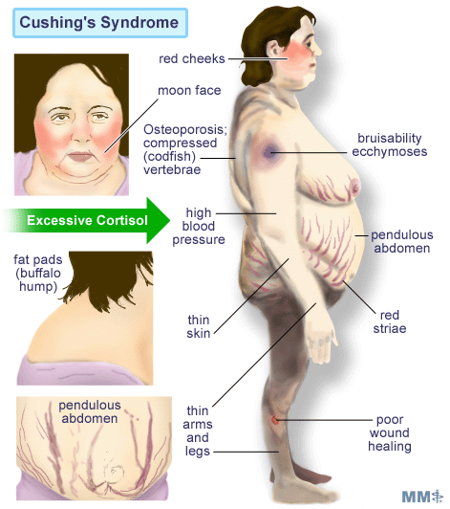

Slide 38
Clinical features
General
Central obesity
Proximal muscle weakness
HTN
Headaches
Dermatologic
Wide purple striae
Spontaneous ecchymoses
Facial plethora
Hyperpigmentation
Acne, hirsutism
Fungal skin infections
Endocrine/Metabolic
Hypokalemic alkalosis
Hypokalemia
Osteopenia
Hypogonadism
Glucose intolerance
Hyperlipidemia
Hyperhomocysteinemia
Kidney stones
Polyuria
Hypercoagulability
Neuropsychiatric
Insomnia
Depression, frank psychosis
Impaired cognition and short-term memory
Notes:
Depr us/ agitated

Slide 39
+ Likelihood ratio’s
Ecchymoses 10 - 11.3
Osteopenia or fracture 8 - 13.8
Weakness, prox muscles 8 - 12.6
Hypertension 4.35 – 5.29
Edema 2.82 – 3.88
Striae (purple; > 1 cm) 2.72 – 2.91
Plethora 2.51 – 3.03
Hirsutism 2.21 – 2.90
Gen. Obesity/weight ↑ 1.75 - 3.10
Headache 1.27 - 1.57
L. Nieman, Handbook of Diagnostic Endocrinol

Slide 40
Cushing syndrome in Iran
77-82 ، مجله دانشكده پزشكي، دانشگاه علوم پزشكي تهران، دوره 65 ، شماره 7، مهر 1386

Slide 41
Cushing syndrome in Iran
بررسي تشخيصي و درماني 253 بيمار مبتلا به سندرم كوشينگ در بيمارستان امام خميني (78-1370)
Mean age: 11±32 سال
F/M: 6/1
علایم بالینی شایع:
ميوپاتي پروگزیمال 84%
فشار خون بالا در 66 % (هيپرتانسيون شديد 6%)
اكيموز(Easy bruising) در 66 %
ادم در 58 %
استرياي تيپيك 53%
اختلال تحمل گلوكز ناشتا در 30 % موارد
ديابت قندي در 15 %
در خانمها، 83 % پرمويي و 55 % آمنوره
77-82 ، مجله دانشكده پزشكي، دانشگاه علوم پزشكي تهران، دوره 65 ، شماره 7، مهر 1386

Slide 42
Cushing syndrome in Iran
اتیولوژی درمطالعه :
Cushing disease: 64.8% (95% میکروآدنوما، 5% ماکروآدنوما)
Adrenal mass: 32.8%
Ectopic Cushing: 2.4%
77-82 ، مجله دانشكده پزشكي، دانشگاه علوم پزشكي تهران، دوره 65 ، شماره 7، مهر 1386

Slide 43
Thanks for your attention

