Slide 2
Endocrine Grand Rounds
By Dr Rahmani And Dr Salehi

Slide 3
Endocrine Grand Rounds
Chief complaint : Acne & Oily skin
Present Illness : The patient is a 29 year-old Girl with history of Acne & Oily skin ,2 years ago (95/12/14)

Slide 6
Present Illness ( continued.)
Due to High Prolactin Level -> referred to Neurologist
The Neurologist -> Requested the “Pituitary MRI with Contrast “

Slide 7
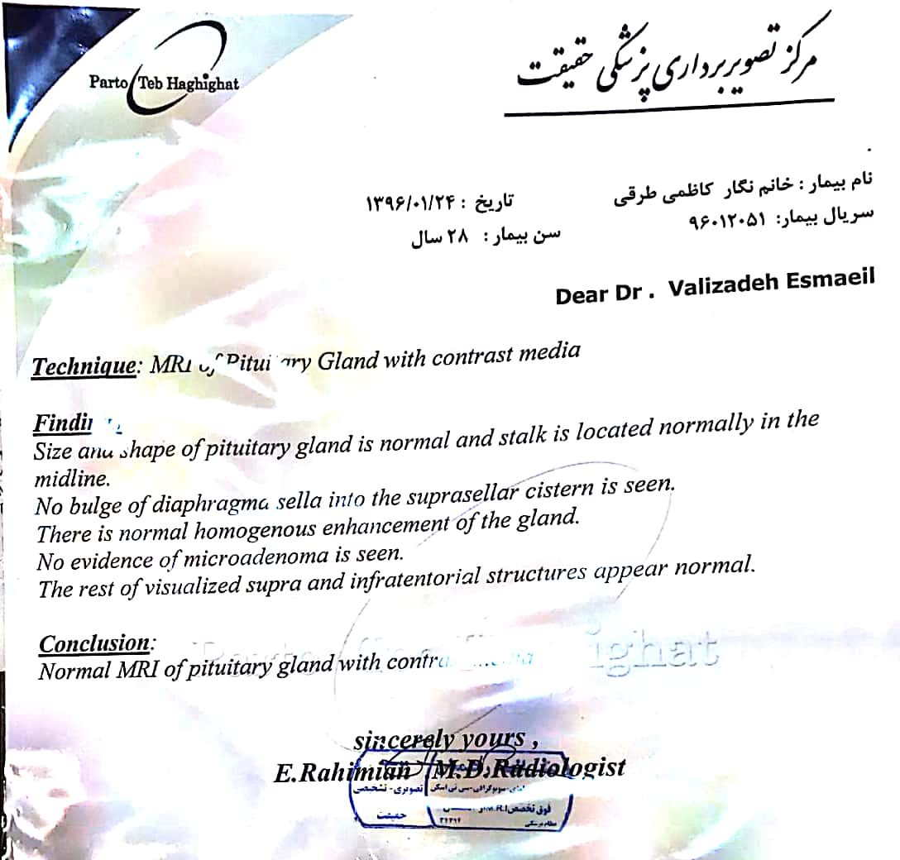

Slide 8
Present Illness ( continued.)
Although the Pituitary MRI was Normal -> DOSTINEX was started as 0.5 mg twice a week
The Patient took the Drug for 2 week ->
reduced DOSTINEX to 0.25 mg twice a week, Due to drug-side-effect (nausea ,vomiting & dizziness ).

Slide 9
Present Illness ( continued.)
3 months later - during drug consumption -The prolactin level was repeated.

Slide 10
Present Illness ( continued.)
3 month laters - during drug consumption -The prolactin level was repeated

Slide 11
Present Illness ( continued.)
Due to Normal Prolactin level -> DOSTINEX was tapered and discontinued ( in 1396/05)
The Patient was neither treated nor F/U for 6 months (96/05 – 96/10 )

Slide 14
Present Illness ( continued.)
Regarding the high prolactin level -> DOSTINEX was started again ( 0.25 mg twice a week ) AND “Pituitary MRI with & without Contrast “ was requested again .

Slide 16
Present Illness ( continued.)
The Patient was referred to neurosurgeon Due to Multiple Pituitary microadenoma in Brain MRI
Neurosurgeon ,discontinued DOSTINEX and requested other additional tests (hypothalamic-pituitary-adrenal axis)

Slide 20
Present Illness ( continued.)
Tab spironolactone, 50 mg daily Due to facial
acne (97/6/21)
The Patient complained of missed period, 5 months ago ( for 3 months , from 97/8 to 97/11 ) treated with Progesterone and already she has regular period since 2 months ago.
The abdominal (ovarian) sonography was normal .

Slide 22
Present Illness ( continued.)
Not history of : weight gain or weight loss
Not history of : weakness or fatigue
No complaints of : galactorrhea or hirsutism

Slide 23
Past medical History : Not significant
Past surgical History : Not significant
Habit History : Negative (Smoking ,Alcohol ,opioid or drug abused )
Gyn. History : The onset of menstruation has been regular since at 12 years-old (except for a three-month-period that was said)
Familial History : 2 sister 38 & 39 y/o married and without prior history of diseases or medical problem
Drug History : spironolactone, 50 mg daily , DOSTINEX (which does not currently used) , progesterone ( as above)

Slide 24
Review of Systems
Constitutional symptoms: Negative( Lack of energy, unexplained weight gain or weight loss, loss of appetite, fever, sweats,
Skin : Acne (+) only in face , oily skin (+) , hyperhidrosis(-)
Head and neck (and Ears, nose, mouth, throat) : Negative ( frontal bossing , mandibular enlargement with prognathism , widened space between the lower incisor teeth , characteristic coarse facial features , a large fleshy nose , Difficulty with hearing a deep and hollow-sounding voice)
Limbs , back and Joints : : Negative (increased hand and foot size, increased heel pad thickness, increased shoe or glove size , ring tightening , kyphosis )
Cardiovascular: Negative(Irregular heartbeat, palpitation, chest pains, swelling of feet or legs, pain in legs with walking ).
Respiratory: Negative (Shortness of breath, night sweats, prolonged cough, wheezing, sputum production, prior tuberculosis, pleurisy, oxygen at home, coughing up blood, abnormal chest x-ray).
Gastrointestinal: Negative (Heartburn, constipation, intolerance to certain foods, diarrhea, abdominal pain, difficulty swallowing, nausea, vomiting, blood in stools, unexplained change in bowel habits, incontinence).
Genitourinary: Negative (Painful urination, frequent urination, urgency, prostate problems, bladder problems, impotence, regular mensuration from 12 years-old).

Slide 25
Review of Systems
Musculoskeletal : Negative (proximal muscle weakness and fatigue )
Integumentary: Negative (Persistent rash, itching, new skin lesion, change in existing skin lesion, hair loss or increase, breast changes).
Neurological: Negative(weakness, change in sensation, problems with walking or balance, dizziness, tremor, loss of consciousness, uncontrolled motions).
Psychiatric: Negative (Insomnia, irritability, depression, anxiety, recurrent bad thoughts, mood swings, hallucinations, compulsions).
Endocrine: Negative (Intolerance to heat or cold, menstrual irregularities(-already no), frequent hunger/urination/thirst).
Hematologic/Lymphatic: Negative (Easy bleeding, easy bruising, anemia, abnormal blood tests, leukemia, unexplained swollen areas).
Allergic/Immunologic: Negative (Seasonal allergies, hay fever symptoms, itching, frequent infections).

Slide 26
Physical Examination
GENERAL APPEARANCE: 29 y/o female who is awake and alert.
BMI=20.6 kg/m2 ,( Height : 154 cm , weight : 49 kg)
VITAL Signs → PR: 75/min, BP: 115/70 mmHg, RR: 16/min, oT: 36.3
SKIN : Facial Acne , Hirsutism scoring scale of Ferriman & Gallwey (4-5 )
HEENT : Normal
Head and NECK : Negative (frontal bossing , characteristic coarse facial features ,mandibular enlargement with prognathism, widened space between the lower incisor teeth, a large fleshy nose ,moon face, plethora , acanthosis nigricanse, supraclavicular fat pad )
Thyroid was normal size without nodule
BREASTS : Normal
THORAX & BACK :Normal , Palpable mass in right flank
LUNGS : Normal breathing sound
HEART : Normal ,S1 & S2 sound ,no murmur
ABDOMEN : Normal ,Soft , without any striae

Slide 27
Physical Examination
Extremities : Negative ( for increased heel pad thickness
Upper & Lower Limbs : Normal (range of motion , muscle tone , pulses )
Neurologic Exams and muscles : Negative ( for Double vision , episode of visual loss , Mental status , Cranial nerve and Reflexes was normal and Babinski was downward.
No fasciculation or atrophy ,Normal muscle tone, Force of muscles : 5/5

Slide 28
Lab. Data ( summary )
98/1/20 | - 97/8/22 | 97/6/15 | 97/3/12 | 96/12/20
239 (108 – 247 ng/ml) | 339 (108 – 247 ng/ml) | 280 (108 – 247 ng/ml) | 242 (108 – 247 ng/ml) | 394 (115-340 ng/ml ) | IGF-1
- | 0.62 (0.10-6.88 ng/ml) | 1.6 (0.10-6.88 ng/ml) | 1.4 (0.10-6.88 ng/ml) | - | GH (basal)
- | 0.06 ng/ml | - | 0.11 ng/ml | - | 60 min | GH/GTT
- | 0.06 ng/ml | - | 0.07 ng/ml | - | 120 min
- | 82 mg/dl | - | 87 mg/dl | - | FBS | GTT
- | 71 mg/dl | - | 123 mg/dl | - | 60 min
- | 64 mg/dl | - | 110 mg/dl | - | 120 min

Slide 29
Lab. Data ( summary )
98/1/20 | - 97/8/22 | 97/6/15 | 97/3/12 | 96/12/20
239 (108 – 247 ng/ml) | 339 (108 – 247 ng/ml) | 280 (108 – 247 ng/ml) | 242 (108 – 247 ng/ml) | 394 (115-340 ng/ml ) | IGF-1
- | 0.62 (0.10-6.88 ng/ml) | 1.6 (0.10-6.88 ng/ml) | 1.4 (0.10-6.88 ng/ml) | - | GH (basal)
- | 0.06 ng/ml | - | 0.11 ng/ml | - | 60 min | GH/GTT
- | 0.06 ng/ml | - | 0.07 ng/ml | - | 120 min
- | 82 mg/dl | - | 87 mg/dl | - | FBS | GTT
- | 71 mg/dl | - | 123 mg/dl | - | 60 min
- | 64 mg/dl | - | 110 mg/dl | - | 120 min

Slide 30
Lab. Data ( summary )
98/1/20 | - 97/8/22 | 97/6/15 | 97/3/12 | 96/12/20
239 (108 – 247 ng/ml) | 339 (108 – 247 ng/ml) | 280 (108 – 247 ng/ml) | 242 (108 – 247 ng/ml) | 394 (115-340 ng/ml ) | IGF-1
- | 0.62 (0.10-6.88 ng/ml) | 1.6 (0.10-6.88 ng/ml) | 1.4 (0.10-6.88 ng/ml) | - | GH (basal)
- | 0.06 ng/ml | - | 0.11 ng/ml | - | 60 min | GH/GTT
- | 0.06 ng/ml | - | 0.07 ng/ml | - | 120 min
- | 82 mg/dl | - | 87 mg/dl | - | FBS | GTT
- | 71 mg/dl | - | 123 mg/dl | - | 60 min
- | 64 mg/dl | - | 110 mg/dl | - | 120 min

Slide 31
Problem list
History of Acne and oily skin since 2 years ago
Missed periods for 3 months (5 months ago) treated with progesterone and already she has regular period (since 2 months ago)
High IFG-1 and prolactin level and normal GH suppression test within 1-2 hours of an oral glucose load (75 gr)
Normal other biochemical relevant tests
Multiple pituitary microadenoma in brain MRI

Slide 32
Thanks for Your Attention

