Slide 1
A patient with severe HTN

Slide 2
Age:53
Gender:Female
Job:Housewife
Nationality:Iran/Arak
Marital status:Married

Slide 3
HTN
From 5 years ago
Some episodes of HTN crisis(up to 240/100 mmhg)
on 3 HTN drugs
Some episodes of flushing/anxiety/sweating , lasting from 5 min to 45 min.
Some episodes of epistaxis(5 times in 5 years)

Slide 4
A lot of various HTN drugs has been used by the patient like Triamterene H, Atenolol,Lasix …
When refer to this centre(93/11/12)
Losartan 100 mg/day
Metoral 100 mg/day
HCTZ 50 mg/day

Slide 5
NOT headache
NOT pallor
NOT diplopia/ophthalmic disorder
NOT nausa/vomiting
NOT diarrhea/costipation/abdominal pain
NOT mucle/bone pain
NOT weakness
NOT weight gain/loss
NOT skin rash/acnea/fagility of skin/itching
NOT emotional lability/depression

Slide 6
PMH
Hypothyroidism
from 5 yeas ago
on LT4 150 mcg/day
Nephrolithiasis
from 20 years ago
NOT any intervention
NOT any symptoms or complaint from 4 years ago
TAH/BSO :
14 months ago( menorrhagia due uterus/ovarian fibroma)

Slide 7
LAST YEAR
Coronary angiography:Nl
echocardiography:Nl

Slide 8
Family History
HTN in parents(old age)
NOT early onset of stroke

Slide 9
PH/EXAM
BP(both arms)
supine 170/100 upright:170/100
PR:85(regular/symmetric)
Weight:80 kg height:1.63 BMI:30

Slide 10
NOT rounded face/fat pad on neck and back
NOT facial plethora/brittle skin/striae
NOT proximal myopaty/weakness
NOT abdominal murmur
NOT hyperpigmentation lesion on skin

Slide 11
Taleghani clinic(93/11/12)
for lab evaluations
Metoral/losartan/HCTZ:DC
Start
Diltiazem:240mg/day
Prazoscin:0.5 mg/day
5 days later,due to uncontrolled BP
Diltiazem:360 mg/day
prazoscin:1 mg/day

Slide 12
93/12/9
Renal,Urinary tract sonogarphy/Doppler:Nl

Slide 13
Lab test(Markazi center)(93/12/2)
TSH:0.02(ulU/ml)(0.17-8.9)
WBC:3400 Hb:15
Cr:0.8 GFR:74
Uric acid:5.2 FBS:122
Cholestrol:159 LDL:96 HDL:41 TG:122
Ca:9.9 ph:3.3 Na:143 K:4 ALT:34 ALT:26
PTT:30 INR:1.1
25 OH VIT D:9.3 ng/ml

Slide 14
93/12/2
24 hrs urine:
Cr:800
Ca:188 mg/24h(50-300)
Metanephrin:48 ug/24h (Nl<300)
Normetanephrin:328 ug/24h (Nl<600)
VMA:6.2mg/24h Nl<6.2
U .Free Cortisol:218 ug/24h(50-190)

Slide 15
93/12/2
Aldosterone(up right):1214pg/ml(30-350)
Direct Renin(CLIA)(up right):4.9uIU/ml(4.4-46.1)

Slide 16
93/12/16(Markazi)
Cortisol morning(ECL):22.9ug/dl(upright)(6.2-19.4)
Cortisol morning(ECL):10.3ug/dl(supine)(6.2-19.4
Aldosterone(upright)EIA:406 pg/ml(30-350)
Aldosterone(Supine)EIA:272pg/ml(20-180)
Direct Renin(upright)CLIA:14.3uIU/ml(4.4-46.1)
Direct Renin(Supine):3uIU/ml(2.8-39.9)

Slide 17
93/12/16(markazi )
Cortisol.morning(ECL):11.9ug/dl(6.2-19.4)\
Cortisol:17.4(Following salin infusion)
Aldosterone(Supine)EIA:223(20-180)
Aldosterone:224pg/ml(Following salin infusion)
Direct Renin(Supine)CLIA:14.9uIU/ml(2.8-39.9)
Direct Renin(supine)CLIA:2.3(Following salin infusion)
k:4.2……k:3.8 (Following salin infusion)

Slide 18
Adrenal CT Scan(babak)(93/12/18)
Round solid ,soft tissue density nodule,18*16mm in left adrenal
Attenuation on non-contrast phase:30 HU
Liver cyst(45mm)

Slide 19
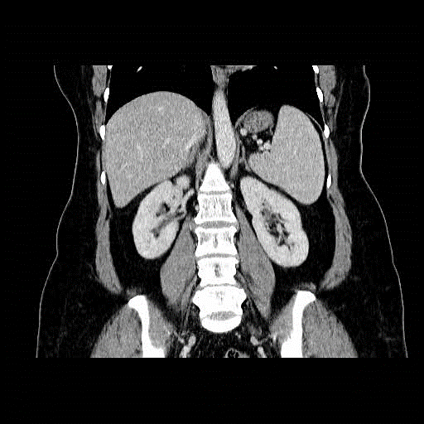

Slide 20
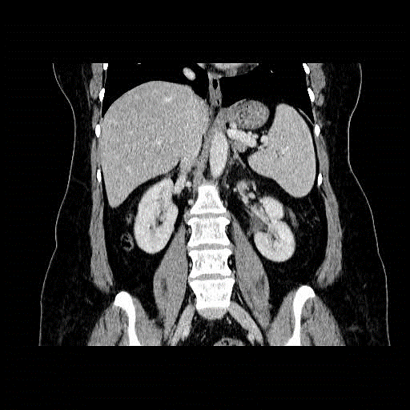

Slide 21
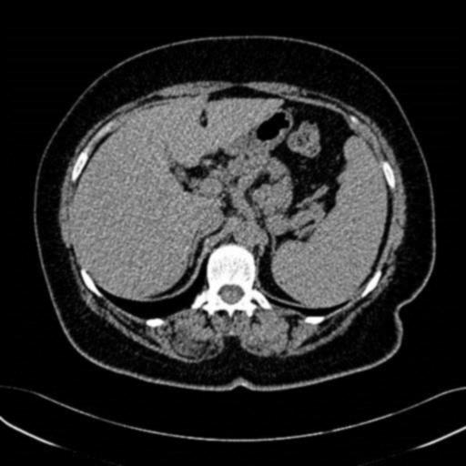

Slide 22
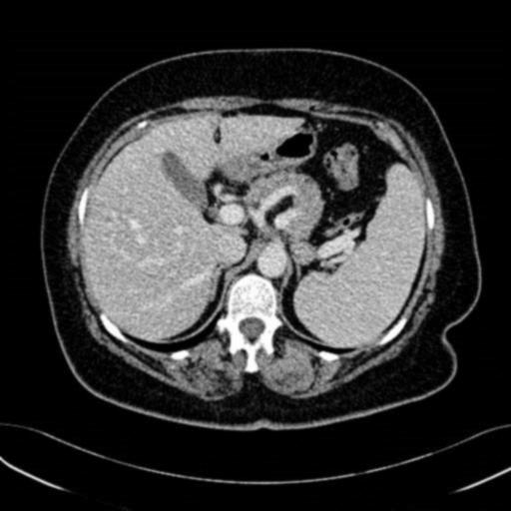

Slide 23
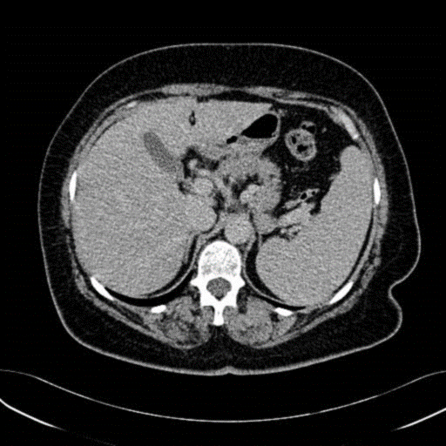

Slide 24
