Slide 2
Current
Management of
osteoporosis
H.Delshad M.D
Endocrinologist
Research Institute for Endocrine Sciences

Slide 3
The burden of osteoporosis
►The most common metabolic bone disease
►The most common cause of Fx. in older adults
►2 million fracture each year :
• 300,000 hip Fx.
• 547,000 Vert. Fx.
• 135,000 Pelvic Fx.
• 20% end up in nursing homes
• 20% mortality within 1 year of fracture
• 2/3 never return to pre-fracture functional level

Slide 4
Comparative annual incidence of osteoporotic fractures and other disease end-point in women
-
2,500,000
-
2,050,000
2,000,000
-
1,500,000
Annual incidence of common diseases
-
1,000,000
425,000
370,000
-
192,000
500,000
0
-
Osteoporotic
fractures
Stroke
Heart attack
Breast cancer

Slide 5
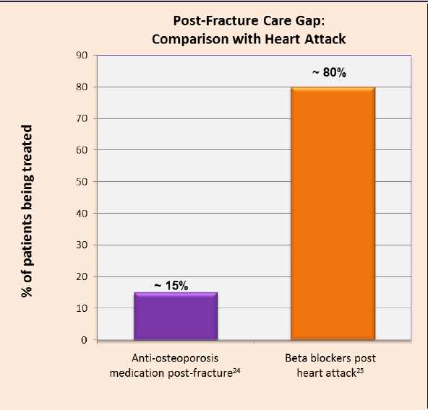
A huge care gap exists after a fracture
The vast majority of men and women presenting at Canadian hospitals with fragility fractures are neither screened nor treated for their underlying osteoporosis to prevent future fractures.

Slide 6
Osteoporosis : Key points
♦ Despite a substantial burden of disease and the availability of treatments for osteoporosis, problems remain in identifying patients in whom treatment should be considered .
♦ Global strategies to improve BMD in the general population are untested.
♦ Screening and case-finding strategies using BMD testing are specific (they identify high-risk patients) but lack sensitivity (they miss many who will experience fractures) .
♦ Case finding can be enhanced by the consideration of clinical risk factors that provide information on fracture risk over and above that provided by BMD measurements .
♦ The FRAX® tool integrates information on fracture risk from clinical risk factors with or without BMD, and can be used to improve the targeting of treatment to individuals at high fracture risk.

Slide 7
Risk Factors : Validated in 8 international Cohorts ( n= 60,000) over 10 years
• Femoral neck T-score
• Age
• Previous low trauma fracture
• Low BMI
• Current cigarette smoking
• Steroid exposure at any time
• Rheumatoid arthritis high alcohol intake
• Familial history of hip fracture

Slide 8
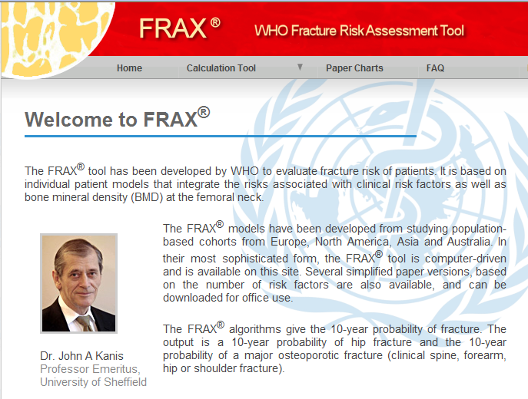
FRAX was developed to calculate the 10-year probability of a hip and a major
Osteoporotic Fx.
www.nof.org or www.shf.ac.uk/FRAX

Slide 9
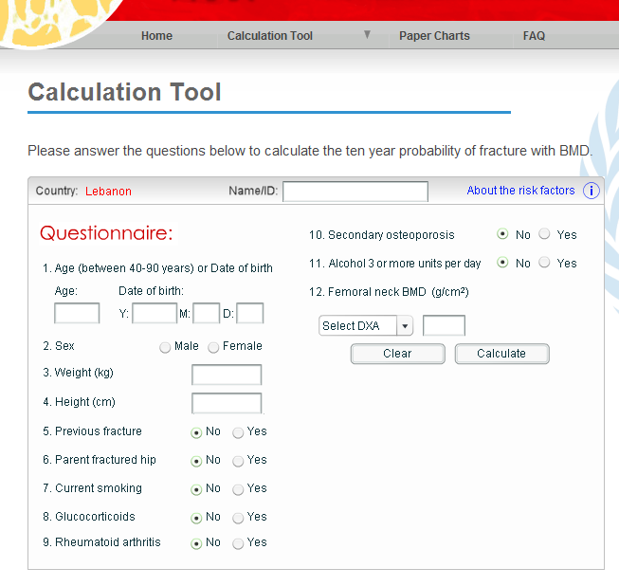

Slide 10
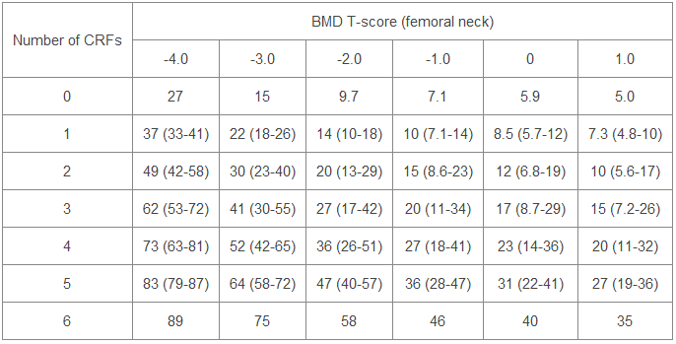
Ten-year probability of osteoporotic fractures (%) according to BMD T-score at the femoral neck in women aged 65 years from the UK

Slide 11
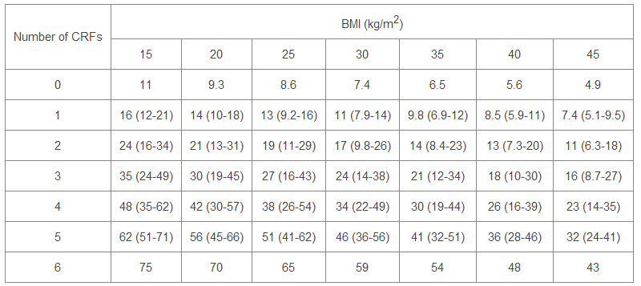
Ten-year probability of osteoporotic fractures (%) according to body mass index (BMI) in women aged 65 years from the UK.

Slide 12
FDA-approved medical therapies in postmenopausal women
and men aged 50 years and older, based on the following:
•A hip or vertebral (clinical or morphometric) fracture
•T-score ≤ -2.5 at the femoral neck or spine after
appropriate evaluation to exclude secondary causes
•Low bone mass :
T-score between -1.0 and -2.5 at the femoral neck or spine AND :
a 10- year probability of a hip fracture ≥ 3% OR :
a 10-year probability of a major osteoporosis-related fracture ≥ 20%
based on the US-adapted WHO algorithm

Slide 13
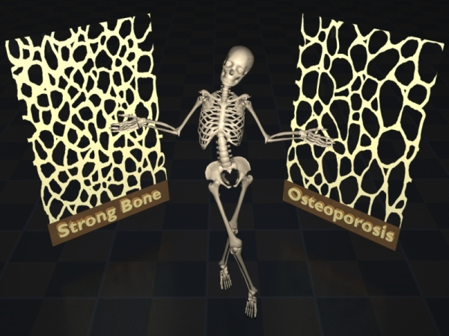
Universal
Recommendation for
all patients

Slide 14
1
Adequate intake of dietary calcium (1200 mg/d)
Intakes in excess of 1,200 to 1,500 mg per day have limited potential for benefit and may increase the risk of developing kidney stones or cardiovascular disease
2
800 to 1,000 IU of vitamin D / day for adults age 50 and older
This intake will bring the average adult’s serum 25(OH)D concentration to the 30 ng/ml
3
Regular weight-bearing exercise
walking, jogging, Tai-Chi, stair climbing, dancing and tennis, weight training and other resistive exercises.
4
Fall Prevention
5
Avoidance of Tobacco use and excessive alcohol intake

Slide 15
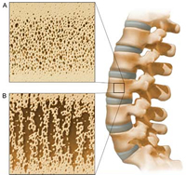
Pharmacotherapy
► Biphosphonates • Alendronate • Risedronate • Ibandronate • Zoledronic acid
► Calcitonins
►Denosumab
► Eestrogens
► rPTH
► SERMs
► Strontium ranelate

Slide 16
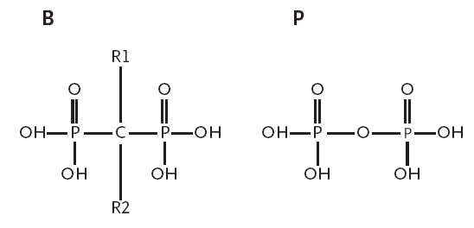
Bisphosphonates
The molecular structure of the bisphosphonates (P-C-P) is analogous to that of the naturally occurring pyrophosphates (P-O-P), with two short side chains (R1 and R2) attached to the C core.

Slide 17
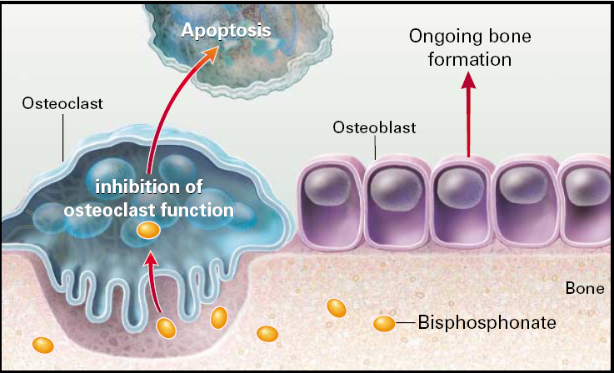
Bisphosphonates
• In bone, bisphosphonates accumulate in the hydroxyapatite mineral phase,
its concentration is increased by a factor of 8 at sites of active bone resorption.
• Bisphosphonates enter osteoclasts and reduce resorption and promotes early cell death.
• Osteoclasts inhibition allows Osteoblasts to slightly increase BMD
1st line therapy for osteoporosis
• Alendronate • Risedronate • Ibandronate • Zoledronic acid

Slide 18
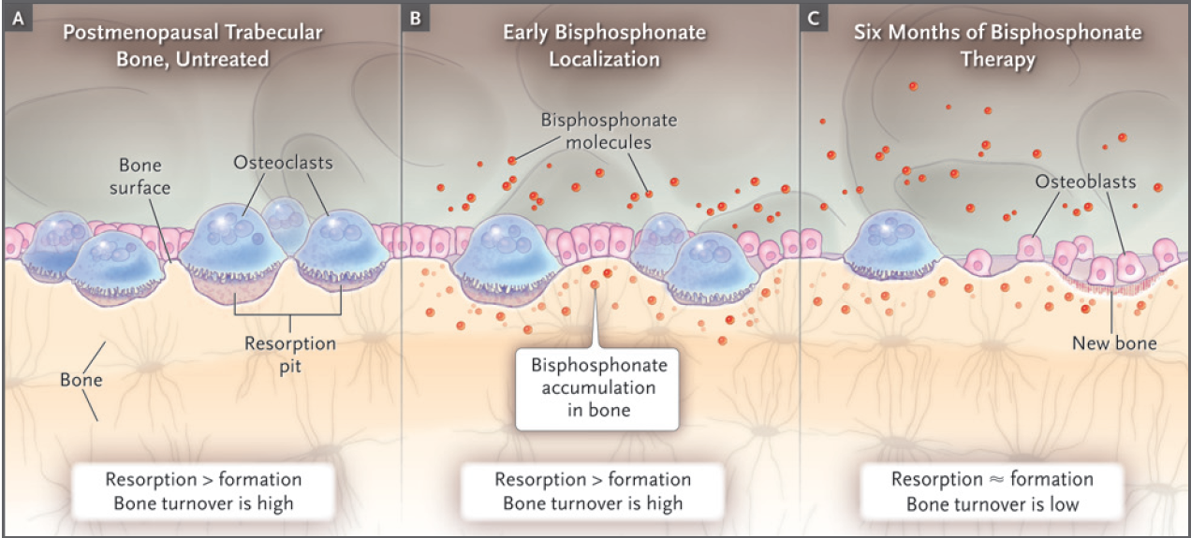
Proposed Mechanism of Action of Bisphosphonates
The effects of bisphosphonates after 6 months of therapy
The number of osteoclasts has decreased owing to early apoptosis.
As a result, bone resorption is decreased, and osteoblasts and bone formation are also decreased.

Slide 19
Bisphosphonates :Clinical Evidence
•Fracture Intervention Trial (FIT)
Black DM, Cummings SR, Karpf DB, et al.
Randomised trial of effect of alendronate on risk of fracture in women with
existing vertebral fractures. Lancet 1996; 348:1535-41.
• Vertebral Efficacy with Risedronate Therapy (VERT) trial
Harris ST, Watts NB, Genant HK, et al.
Effects of risedronate treatment on vertebral and nonvertebral fractures in
women with postmenopausal osteoporosis: a randomized controlled trial.
JAMA 1999;282:1344-52.
• Health Outcomes and Reduced Incidence with Zoledronic Acid Once Yearly trial
(HORIZON)
Black DM, Delmas PD, Eastell R, et al. Once-yearly zoledronic acid for treatment
of postmenopausal osteoporosis. N Engl J Med 2007;356:1809-22.

Slide 20
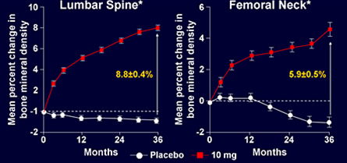
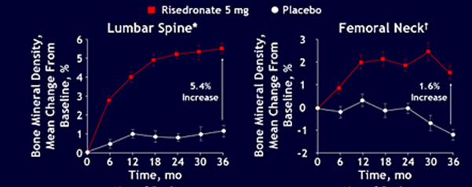
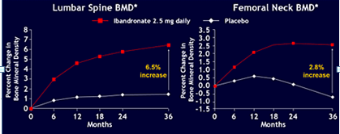
Bisphosphonates :Clinical Evidence
Effect on Lumbar Spine and Femoral Neck BMD in Postmenopausal Women
Alendronate :
Residronate
Ibandronate

Slide 21
Bisphosphonates
Drug |  | Dose | Decrease Fx risk Vertebral | Over 3-year Non-vertebral
Alendronate (Fosamax) | Tab. 5 , 10 , 75 mg | For prevention: 5mg/d or 35mg/week For treatment : 10mg/d or 70mg/week | 50% | 50%
Ibandronate (Bonivia) | Tab. 2.5 , 150 mg Amp. 3mg /3ml | For treatment : 2.5mg/d or 150mg/mon. 3mg/IV every 3- month | 50% | -
Residronate (Actonel ) | Tab. 5 , 35 , 150 mg | For prevention & treat. 5mg/d ay 35mg/week 150mg/month | 41 – 49% | 36%
Zoledronic Acid (Reclast) | Amp. 5 mg | For prevention & treat. 5mg/100 ml IV infusion Once yearly for treatment Once every 2-y for preven. | 70% | 25 – 41 %

Slide 22
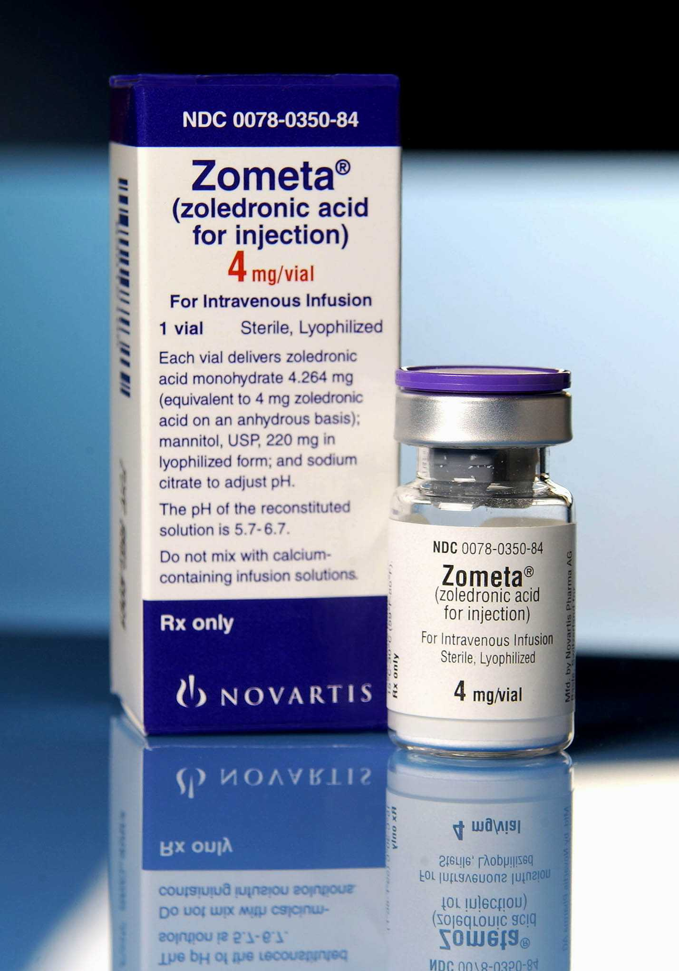
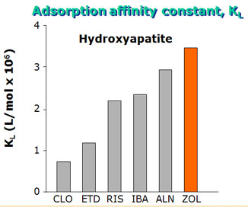
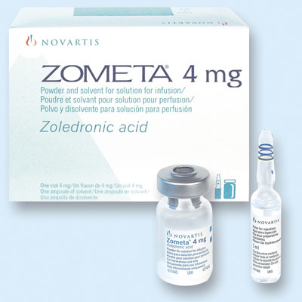
Solution
Zoledronic Acid
( Reclast , Zometa )
$ 1315.71
Powder for Solution
Zoledronic acid has a high binding affinity for hydroxyapatide

Slide 23
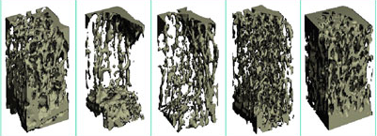
Single IV injection of human equivalent dose of zoledronic acid
preserve bone micoartictecure in adult Rats
4 µ/kg 20 µ /kg 100 µ /kgµ
Micro-CT image of adult s Rats proximal tibial metaphysis ( at 32 weeks)

Slide 24
Bisphosphonates :Side Effects
• An acute-phase reaction:
Fever, Myalgia, Bone pain, Influenza-like symptoms , Headache, Arthralgia
and Weakness occurs in 20% of patients after an initial intravenous infusion
of Zoledronic Acid. ( Usually lasts 2 – 3 days )
• Atrial fibrillation :
Zoledronic acid compared with placebo (1.3 percent vs 0.4 percent); the effect of other bisphosphonates on the incidence of atrial fibrillation is uncertain.
HORIZON PFT trial – 2.4% increased incidence of AF seen in ZA group, but this was not found in the 2nd large trial HORIZON RFT, nor in the clinical trials with Zometa in over 20,000 patients
• GI Problems :
Erosive esophagitis, ulceration, and bleeding with daily oral alendronate or risedronate , but occur rarely with current (nondaily) regimens.
• Bone Problems:
Osteonecrosis of the jaw (particularly following IV bisphosphonate for cancer)
Atypical fractures of the femoral shaft

Slide 25
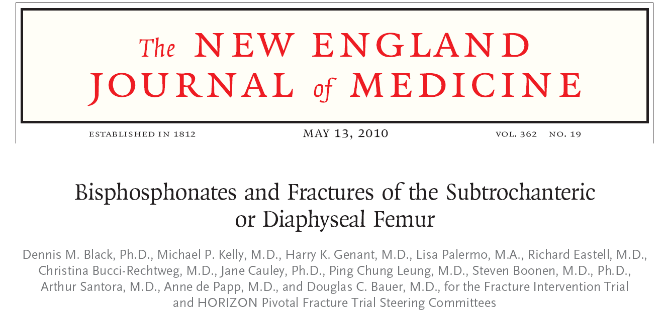
A number of recent case reports and series have identified a subgroup of atypical
fractures of the femoral shaft associated with Bisphosphonate use.
A population based study did not support this association. Such a relationship has
not been examined in randomized trials.
Secondary analyses of three large, randomized bisphosphonate trials:
the Fracture Intervention Trial (FIT), the FIT Long-Term Extension (FLEX) trial, and the Health Outcomes and Reduced Incidence with Zoledronic
Acid Once Yearly (HORIZON) Pivotal Fracture Trial (PFT).
The occurrence of fracture of the subtrochanteric or diaphyseal femur was very rare, even among women who had been treated with bisphosphonates for as long as 10 years.

Slide 26
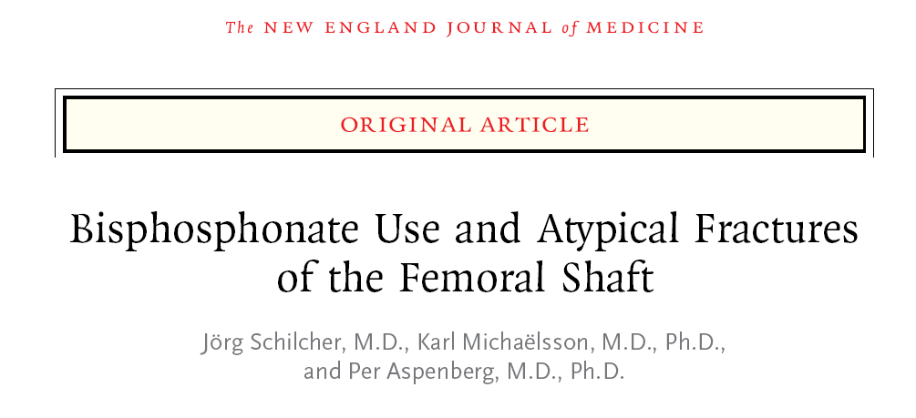
In Sweden, 12,777 women 55 years of age or older sustained a fracture of the femur
in 2008.
1271 women had a subtrochanteric or shaft fracture and 59 patients with atypical fractures.
The relative and absolute risk of atypical fractures associated with bisphosphonate use
was estimated
Although there was a high prevalence of current bisphosphonate use among patients with atypical fractures, the absolute risk was small.
Conclusions
These population-based nationwide analyses may be reassuring for patients who receive bisphosphonates.

Slide 27
Calcitonin
• Salmon’s calcitonin :
○ Prolonge action and greater potency compared to mammalian source.
○ Inhibits osteoclast activity and osteoclast lifespan ○ Analgesic effect ○ Not appropriate as 1st line treatment ○ Only use as 2nd or 3rd line treatment in patients who cannot tolerate
bisphosphonates
Calcitonin 200 IU , Intra-nasal spray :
○ 33% reduction in new vertebral fractures ○ 36% reduction in those with history of previous fractures (PROOF study) ○ No effect on non-vertebral fractures

Slide 28
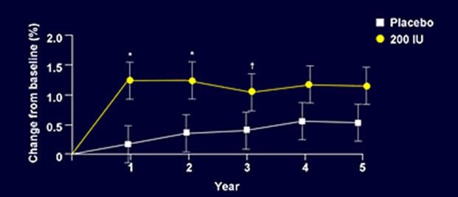
Nasal Calcitonin :
Effect on lumbar spine BMD ( PROOF : 5 –Y analysis )
PROOF : Prevent Recurrence Of Osteoporotic Fractures
Am J Med , 2000 ; 109: 267- 276

Slide 29
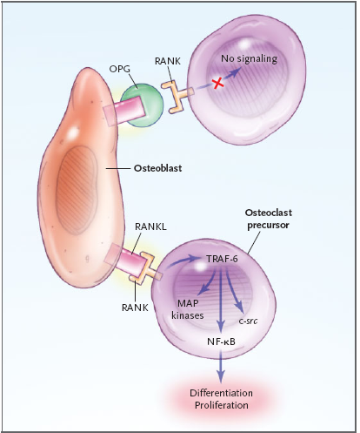
Roles of RANK and RANKL, in Osteoclast Differentiation and Function
•Receptor activator of nuclear factor-kB (RANK) is activated by
the cytokine RANK ligand (RANKL), which is produced by other cells, primarily osteoblasts.
• Signaling occurs following the association of RANK and RANKL , which influences the differentiation of osteoclasts through several pathways.
• RANK signaling is also thought to exert anti-apoptotic effects.

Slide 30
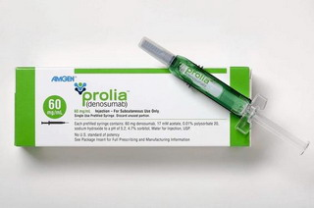
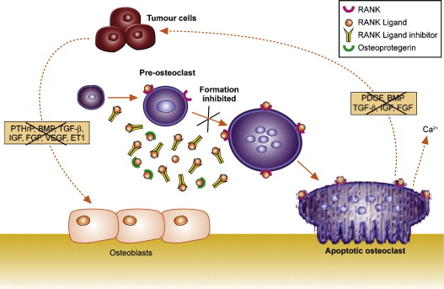
Denosumab
Is a fully human monoclonal antibody to the receptor activator of nuclear factor-κB ligand (RANKL) that blocks its binding to RANK, inhibiting the development and activity of Osteoclasts, decreasing bone resorption, and increasing bone density.

Slide 31
Denosumab :Clinical Evidence
The approval was based on two 3-year clinical trials :
• Fracture REduction Evaluation of Denosumab in Osteoporosis every six Months (FREEDOM) study included 7,808 postmenopausal women with osteoporosis.
At the end of 3 years, the women receiving a shot of Prolia every six months had far fewer fractures then those given an inactive placebo shot. The researchers observed:
- 68% reduction in risk of suffering a spine fracture
- 40% reduction in risk of suffering a hip fracture
- 20% reduction in risk of suffering a non-spine fracture.
• Hormone Ablation Bone Loss Trial ( HALT) study in men, evaluated percent change in bone mineral density at the lumbar spine in 1,468 men with metastatic prostate cancer undergoing hormone therapy called androgen deprivation therapy ( ADT).
At the end of two years, bone mineral density (BMD) increased in men taking Prolia shots every six months by 5.6%.
At the end of three years, patients treated with Prolia experienced:
- 62% reduction in risk of suffering a spine fracture
- Increases of bone mineral density at the spine, hip and forearm

Slide 32
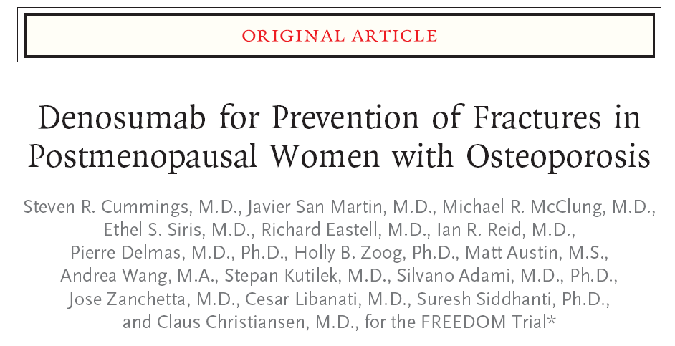
N Engl J Med 361;8: 2009
Methods
7868 women between the ages of 60 and 90 years who had a bone
mineral density T score of less than −2.5 but not less than −4.0 at the lumbar spine
or total hip were enrolled . Subjects were randomly assigned to receive either 60 mg of denosumab or placebo subcutaneously every 6 months for 36 months.
The primary end point was new vertebral fracture. Secondary end points included nonvertebral and hip fractures.

Slide 33
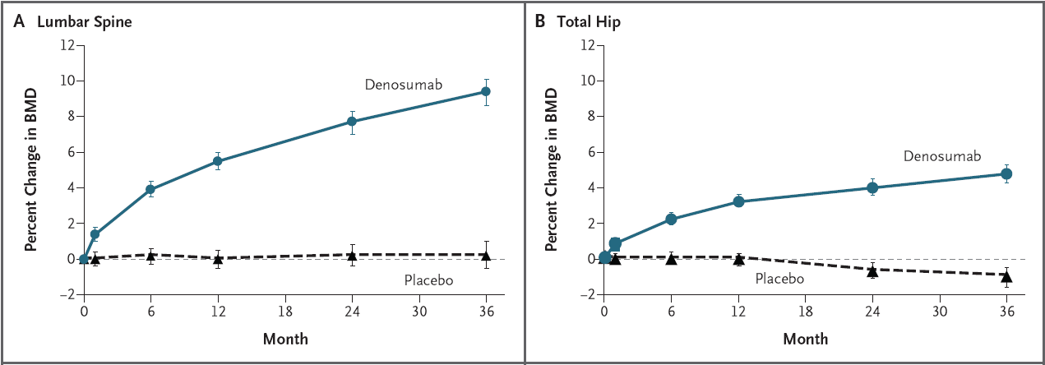
FREEDOM Trial :
9.2%
6.0%
As compared with subjects in the placebo group, subjects in the denosumab group had a relative increase of 9.2% in bone mineral density at the lumbar spine and 6.0% at the total hip

Slide 34
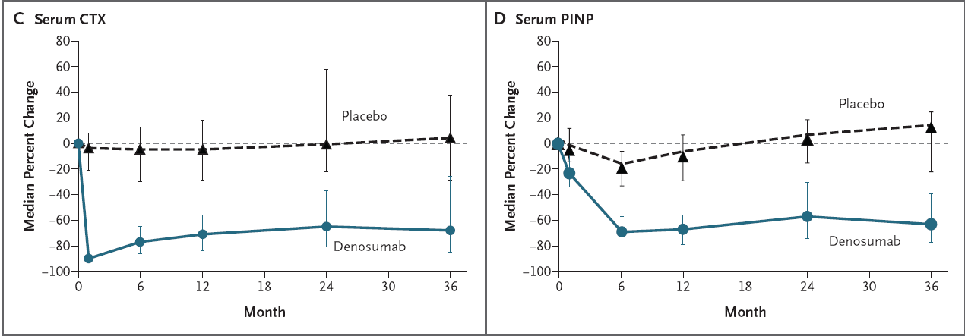
FREEDOM Trial :
Changes in mean values for serum C-telopeptide of type I collagen (CTX) and serum
pro-collagen type I N-terminal propeptide (PINP) are shown for 160 subjects who were included in a sub-study of bone-turnover markers

Slide 35
Prolia : Adverse effects
Back pain, muscle pain, pain in the arms or legs
Constipation
Skin inflammation
Severe allergic reactions (rash; hives, itching, difficulty breathing, tightness in the chest, swelling of the mouth, face, lips, or tongue)
Bladder infection
Ear pain
Severe stomach pain
Hypocalcemia
swelling or pain in jaw.

Slide 36
Estrogen Therapy or HT
Estrogens :
○ Bind to estrogen receptors on bone
○ Block production of cytokines and inhibit bone resorption
and increase BMD
○ Many different formulations and applications
○ Reduced vertebral (33%) and non-vertebral (27%) fractures

Slide 37
Women Health Initiative ( WHI) :
Large investigation of prevention strategies for cancer ,CVD and osteoporotic fracture
initiated in 1992. It was a very, very large study sponsored by the National Institutes of Health (NIH), in total enrolling more than 64,000 people in a clinical trial and 100,000 people in an observational study. It is a huge federally funded study.
n=16,608
Postmenopausal women 50 -79 years
n= 8506
Conjugated Estrogen= 0.625 mg/d
MPA = 2.5 mg/d
n=8102
Placebo

Slide 38
HRT component of the WHI
Summary of results at 5.2 years ( early termination)
In post-menopausal women with an intact uterus, HRT was associated with :
Cpolorectal
cancer
Hip and clinical
Vertebral fractures
-37%
-34%

Slide 39
HRT component of the WHI
Summary of results at 5.2 years ( early termination)
In postmenopausal women with an intact uterus, HRT was associated with :
• 29 % increase in CHD events
• 22% increase in total CVD
• 26% increase in invasive breast cancer
• 41% increase in stroke
• 111% increase in venous thrombosis
Current Indications for HT
○ 2nd line treatment due to risk for breast and endometrial cancers ○ Only for post-menopausal women who cannot tolerate non-estrogen medications ○ To be used with the lowest dose possible and for the shortest period of time to
achieve treatment goals

Slide 40
Women,s Health Initiative
Risk
Benefit
29% increase CAD
41% increase Stroke
26% increase BC
EARLY STOP
Clear harm : VTE
FRACTURE REDUCTION
COLON CANCER
Notes:
40
Etiology of Obesity
Obesity occurs when the body’s energy intake is out of balance with its expenditure over an extended period.
The balance can be upset either by increased intake (eg, through a high-fat, high-calorie diet) or decreased expenditure (eg, through a sedentary lifestyle). A genetic predisposition to obesity accelerates the process.
Treating obesity involves shifting the balance so that expenditure exceeds intake.

Slide 41
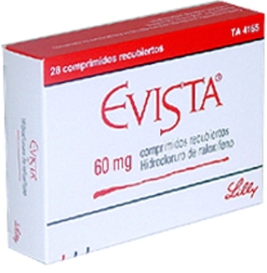
SERMs
Raloxifene : an alternative to HRT
• Selective estrogen receptor modulators • Binds to estrogen receptors • Estrogen agonist activity on bone and circulating lipoproteins • Estrogen antagonist activity on breast and endometrial tissues • Increased risk for DVT • Does not block vasomotor symptoms of menopause
• Increased spine BMD by 2.3% and hip BMD by 2.5% after 3 years 50% reduction in spine fractures • No effect on hip or other non-vertebral fractures
• 60mg coated tablets taken once daily • Must be stopped 72 hours prior to and during prolonged
immobilisation • Decreased absorption with Ampicillin.

Slide 42
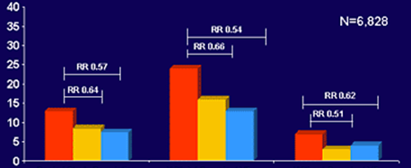
Effect of Raloxifene on vertebral fractures after 4 years of treatment
The Multiple Outcomes of Raloxifene Evaluation (MORE) study (6800 subjects)
Pbo
Ral. 60 mg
Ral. 120 mg
% of women with incident
vertebral fracture
Pooled study population
With ≥ 1 previous V. fracture
Without previous V. fracture
J Clin Endocrino Metab. 2002, 87 : 3609-3617

Slide 43
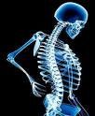
SERMs
Adverse reactions • Headaches
• Dizziness
• Sweating
• Nausea
• Stuffy nose
• Various pains
• General weakness

Slide 44
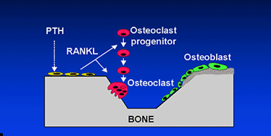
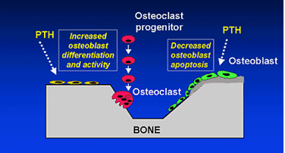
Mechanism of action of PTH on Osteoblasts
Recombinant PTH
Continuous high-dose PTH increases Osteoclast-mediated bone resorption
Intermittent low-dose PTH increases bone formation

Slide 45
Recombinant PTH
rPTH is anabolic agent
• Low dose , daily SC injection : enhance bone remodelling
• Bone formation begins within the first month of treatment
• Bone resorption begins after 6 months
• During the first year of treatment bone remodelling is in a
positive balance.

Slide 46
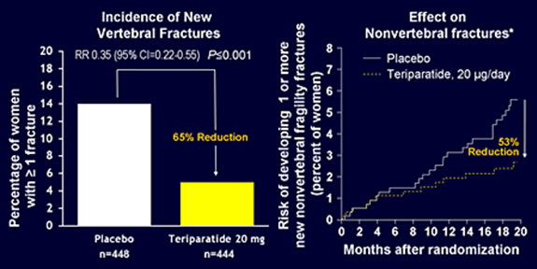
20mcg Teriparatide daily :
• 83% reduction in moderate to severe vertebral fracture in men • 65% reduction in new vertebral fractures in women • 53% reduction in non-vertebral fracture risk
Neer et al.
Effect of PTH (1-34) on fractures and bone mineral density in postmenopausal women with osteoporosis.
N Engl J Med 2001 ,344: 1434

Slide 47
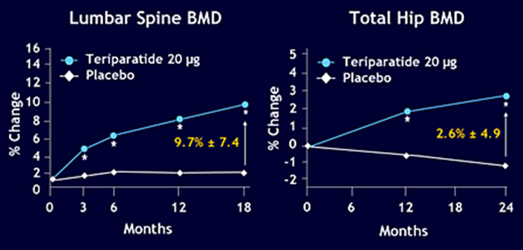
Teriparatide :
Effect on Lumbar Spine and Hip BMD in postmenopausal women
P< 0.05
Neer et al.
Effect of PTH (1-34) on fractures and bone mineral density in postmenopausal women with osteoporosis
N Engl J Med 2001 ,344: 1434

Slide 48
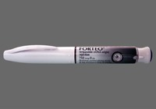
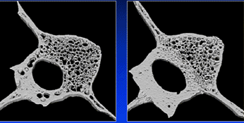
Teriparatide :
(Forteo )
Increases bone mass and improves architecture in ovarectomized monkeys
Control
Teriparatide

Slide 49
►T score ≤ -3.5 without fracture ►T score ≤ -2.5 with fragility fracture ►Any T score with fragility fracture
Recombinant PTH
The changes in BMD seen with PTH are early and of greater magnitude than those seen with other treatment and is therefore plays a role in the treatment of patients with sever established disease who are at particularly high risk of fragility fractures :

Slide 50
• Is well tolerated • Leg cramps & dizziness • It caused an increase in the incidence of osteosarcoma in rats ►Contrindications: Paget,s , Prior bone radiation, Bone metastases, Hypercalcemia ► The safety and efficacy of Teriparatide has not been demonstrated beyond two years ►Teriparatide is used for a maximum of two years , follow with bisphosphonate
Recombinant PTH

Slide 51
Agent | Doseing & Administration | Monthly average cost
Alendronate | Oral Tab. 70 mg / week | $ 87
Ibandronate | Oral Tab. 150 mg / month | $ 100
Ibandronate | IV Injection 3mg /3 month | $ 161
Residronate | Oral Tab. 150 mg / month | $ 100
Zoledronic acid ( Reclast , Zometa ) | IV Infusion 5mg / year | $ 1315 / year
Calcitonin | Nasal spray 200 IU/ day | $ 126
Estrogen | Oral Tab. 0.3 mg / day | $ 35
Raloxifen ( Evista ) | Oral Tab. 60 mg / day | $ 108
Teriparatide ( Forteo) | Injection 20 µg /day | $ 675
Denosumab ( Prolia ) | Injection SC 60 mg/ 6 month

Slide 52
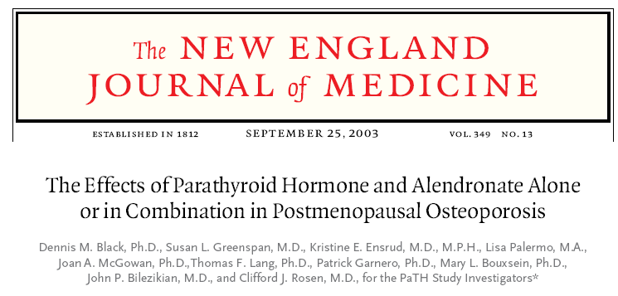
Combination therapy
Can provide additional small increase in BMD
The impact of combination therapy on fracture rates is unknown.
The added cost and potential side effects should be weighted against potential gains.

Slide 53
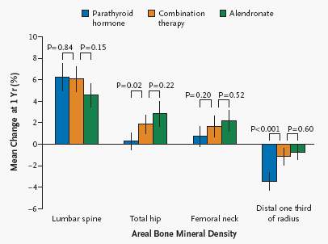
Mean Percent Changes in BND
The BMD of the lumbar spine increased significantly within each treatment group.
Changes were similar in the PTH group and the combination-therapy group (6.3 % and 6.1 %) and were somewhat smaller in the alendronate group (4.6% ).
At the total hip and the femoral neck, the bone mineral density remained essentially
unchanged in the parathyroid hormone group but increased in the combination-therapy group and the alendronate group.
The increase at the total hip in the combination-therapy group was significantly greater than that in the parathyroid hormone group
The bone mineral density at the distal radius decreased significantly in the parathyroid hormone group

Slide 54
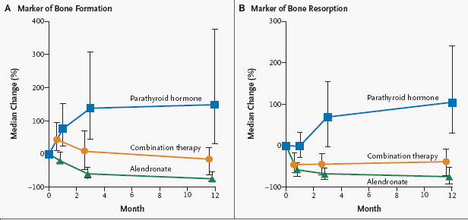
Median Percent Changes in Serum Concentrations of
Biochemical Markers of Bone Formation
N-Propeptide of Type I Collagen C-Terminal Telopeptide of Type I Collagen
The differences between the combination-therapy group and the parathyroid hormone group at 12 months and between the combination-therapy group and the Alendronate group at 12 months were significant (P<0.001).

Slide 55
Combination therapy
Conclusions:
•There was no evidence of synergy between parathyroid hormone and Alendronate
• Concurrent use of Aendronate may reduce the anabolic effects of parathyroid
hormone.
• Taken together, these results do not support the concurrent initiation of
Alendronate with parathyroid hormone treatment.

Slide 56
Non-FDA-Approved Drugs for Osteoporosis
Calcitriol :
Has been approved by the FDA for managing hypocalcemia and metabolic bone disease in renal dialysis patients. It is also approved for use in hypoparathyroidism, No reliable data demonstrate a reduction of risk for osteoporotic fracture.
Other bisphosphonates (etidronate, pamidronate, tiludronate):
None is approved for prevention or treatment of osteoporosis.
Most are currently approved for Paget's disease, hypercalcemia of malignancy and myositis ossificans
Parathyroid hormone PTH(1-84) :
Is approved in some countries in Europe for treatment of osteoporosis in women. In one clinical study PTH(1-84) effectively reduced the risk of vertebral fractures at a dose of 100mcg/d.
Sodium fluoride :
Through a process that is still unclear, sodium fluoride stimulates the formation of new bone. The quality of bone mass thus developed is uncertain, and the evidence that fluoride reduces fracture risk is conflicting and controversial.

Slide 57
Strontium Ranelate “Protos”
• Act on osteoblasts to increase bone formation • Increases osteoprotegerin which reduces the number and activity of
osteoclasts to decrease bone resorption
• 41% reduction in vertebral fractures over 3 years Seeman 2008 (Pooled data from SOTI & TROPOS Trials)‏ • 43% reduction in hip fractures over 5 years Reginster 2007 (TROPOS Trial)‏
• 41-59% fracture risk reduction in patients with osteopenia with or without a
prevalent fracture.
• Taken 1 satchet daily at bed-time

Slide 58
Agents in development for the prevention and /or treatment
of osteoporosis
Agent | Mechanism of action
Bazedoxifene | Estrogen Agonist/ Antagonist
Lasofoxifene | Estrogen Agonist/ Antagonist
Odanacatib | Cathepsin K inhibitor
Ostabolin-C | PTH analogous

Slide 59
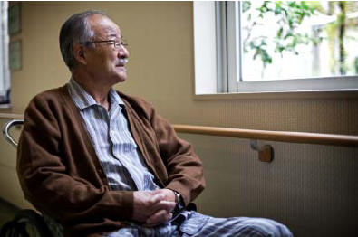
اللهم اشف کل مریض
Towards a Fracture-Free Future

Slide 60
BMD - Who Needs It ?
•All women > 65 years
•Post-menopausal woman with major risk factors
•All individuals > 50 years with history of osteoporotic
fracture
•All individuals on long term steroids
•Men with hypogonadal conditions
•Men > 70 years
•Patients with diseases a/w bone loss and fracture

