Slide 1
Calcium and Bone Metabolism Disorders During Pregnancy
Dr. Mitra Niafar
Professor of Endocrinology and Metabolism
Tabriz University of Medical Sciences

Slide 2
Pregnancy and Ca-P homeostasis
Pregnancy is associated with substantial changes in calcium-phosphate homeostasis, resulting from pregnancy induced alterations in:
Synthesis, Tissue effects & Excretion of hormones related to calcium-phosphate metabolism.

Slide 3
Adaptations During Pregnancy
The human fetus accretes about 30 g of calcium by term, with 80% of it obtained during the third trimester.
Intestinal calcium absorption more than doubles during pregnancy to meet this increased demand for calcium.
This upregulation is mediated by calcitriol , prolactin , placental lactogen, and possibly by other factors.

Slide 4
Bone & Mineral Metabolism During Pregnancy
Increased intestinal calcium absorption
Normal ionized or albumin-corrected calcium
High calcitriol
Low PTH
Gradually increasing PTHrP
Hypercalciuria

Slide 5
Calcium homeostasis in human pregnancy and lactation, compared with normal

Slide 6
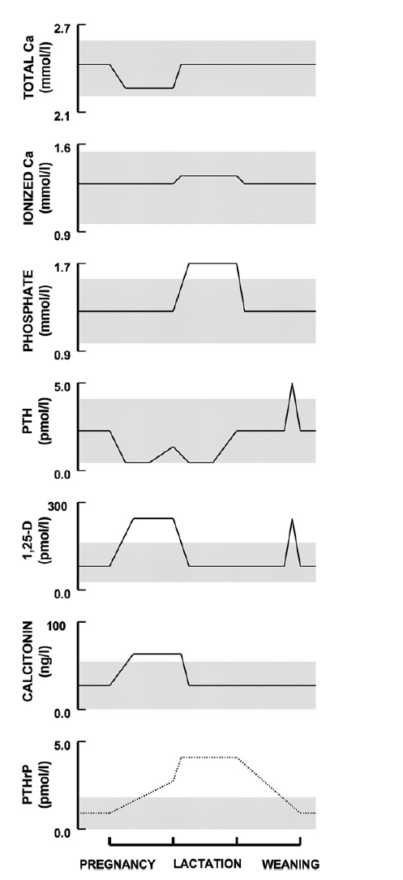
Changes in calcium, phosphorus, and calcitropic hormone levels that occur during pregnancy and lactation

Slide 7
Characteristic of the parathyroid glands disorders during pregnancy
Is often atypical
Symptoms are not specific
Diagnosis may be sometimes very difficult

Slide 8
Disoders of parathyroid gland during pregnancy
Primary Hypoparathyroidism
Primary Hyperparathyroidism
Familial Hypocalciurc Hypercalcemia

Slide 9
Note
If improperly treated, parathyroid disorders may pose a significant risk to the mother and fetus associated with the increased maternal and fetal morbidity and mortality.

Slide 10
Hypoparathyroidism during pregnancy
Usually presents as a preexisting condition that the clinician is challenged to manage it.
Acquired hypoparathyroidism secondary to surgery in neck
Idiopathic hypoparathyroidism
Congenital hypoparathyroidism

Slide 11
Risks of maternal hypocalcemia
Maternal hypocalcemia must be avoided because it increases the risk of:
Premature labor
Fetal and neonatal secondary hyperparathyroidism, which in turn causes:
- Skeletal demineralization
- Subperiosteal bone resorption
- Osteitis fibrosa cystica

Slide 12
Management of hypoparathyroidism during pregnancy
An initial approach is increased dose of calcitriol or equivalent.
In early pregnancy, the majority of hypoparathyroid women have fewer hypocalcemic symptoms and require less calcium salts administration.
Then, as pregnancy progresses, the calcitriol dose can be adjusted based on the ionized calcium level.
Circulating calcium levels must be maintained in the lower normal range.
Notes:
to consider that because calcitriol levels normally double in the first trimester, therefore hypoparathyroid women should initially receive an

Slide 13
Complications of Mismanagement
Inadequate calcium supplementation can produce:
Hyperparathyroidism in the fetus
Abortion
Preterm labour
Dysfunctional labour
Over-treatment with calcium can lead to
Hypercalciuria
Nephrolithiasis
Renal impairment
Neonatal seizures

Slide 14
Time for calcium monitoring
Monitor calcium levels every three to four weeks throughout pregnancy
Within one week post-partum to ensure normocalcaemia in both mother and baby

Slide 15
Recommended dose
Recommended daily dose of
Calcitriol between 0.5 and 3 µg/day
Calcium is up to 9 g/day
In case reports, oral elemental calcium varies from 800 to 1,500 mg at the beginning of pregnancy to 2,000 to 3,200 mg in the third gestational trimester

Slide 16
Treatment with recombinant PTH
Hypoparathyroidism is the only endocrine disorder where substitution of the deficient hormone is not well studied.
Few case reports have mentioned continuous recombinant PTH infusion during pregnancy of iatrogenic hypoparathyroidism, and further trials are needed for safety of use.

Slide 17
Learning points
Calcium requirement increases in pregnancy, more so in the presence of maternal hypoparathyroidism.
If hypercalcemia is noted, reduction in calcium and vitamin D dosage is warranted.
Careful clinical observation and laboratory monitoring are critical in the successful management of such patients.

Slide 18
Primary Hyperparathyroidism
Incidence and epidemiology
Fewer than 200 cases of primary hyperparathyroidism during pregnancy have been reported in the English literature.
Maternal hypercalcemia can result in significant maternal and fetal morbidity and mortality.
Complications have been found in up to 67% of mothers and 80% of their babies.

Slide 19
Fetal complications of Hypercalcemia
Stillbirth
Miscarriage
Neonatal tetany
Hypocalcemia in the neonate and tetany in the perinatal period as a result of suppression of the parathyroid glands in utero, and which remain suppressed for weeks afterward.

Slide 20
Etiology of PHP during pregnancy
Among 100 cases of pregnancy-associated primary hyperparathyroidism, the histology was:
Adenomas in 89%
Hyperplasia in 9%
Carcinoma in 2%

Slide 21
Clinical features of PHP in pregnant woman
Normal pregnancy is associated with many nonspecific symptoms that overlap with symptoms of hypercalcemia, such as:
Nausea
Hyperemesis
Constipation
Fatigue
Weakness
Mental symptoms
Notes:
The overlap of symptoms may delay the diagnosis of hyperparathyroidism.
Severe hypercalcemia or parathyroid crisis can occur during the third trimester or especially post partum.

Slide 22
Difficulty in Diagnosis
Besides the rarity of the disease in pregnancy, the diagnosis of PHPT may be confounded by the normal pregnancy-related changes in calcium metabolism.
Hypoalbuminemia
Increased glomerular filtration rate
Transplacental transfer of calcium
Increased levels of estrogen
All contribute to lowering gestational serum calcium levels and masking PHPT.

Slide 23
Localization During Pregnancy
Localizing the adenoma preoperatively is difficult because the radioisotopes needed for parathyroid and thyroid scans must be avoided.
Ultrasonography of the neck is the investigation of choice during pregnancy for localization of parathyroid adenomas with a:
Sensitivity of 69%
Specificity of 94%

Slide 24
Management of PHP
Hyperparathyroidism in first trimester should be managed medically.
A minimally invasive parathyroidectomy during second trimester (if serum calcium > 11.5 mg/dl) is the therapeutic gold standard management of PHP during pregnancy because the organogenesis is complete and the risk of anesthesia induced preterm delivery is least.
Surgery in 3rd trimester is associated with significant neonatal complications and mortality.

Slide 25
Medical management
Hydration & correction of electrolyte abnormalities
Calcitonin [category B]
Oral phosphate [category C]
Bisphosphonates [category C,D]
Cinacalcet[category C]
High-dose magnesium
Notes:
Calcitonin is a pregnancy category B medication of the FDA that does not cross the placenta and has been used safely in pregnancy to suppress bone resorption and promote urine calcium excretion.

Slide 26
Note
The clinical experience with any of these pharmacologic therapies is at the level of individual case reports and so the relative benefits and risks of each option are unknown.

Slide 27
Note
Surgical intervention should be done at any time regardless of the gestational age, if the patient becomes hypercalcemic or symptomatic despite medical management.

Slide 28
Familial Benign Hypocalciuric Hypercalcemia
Inactivating mutations in the calcium-sensing receptor cause autosomal-dominant hypercalcemia and hypocalciuria.
Maternal hypercalcemia is fully adapted , asymptomatic, and free of the complications associated with hypercalcemia caused by primary hyperparathyroidism .

Slide 29
FBHH (continued)
Pregnancy seems to be uneventful in women with this condition.
However, the maternal hypercalcemia can cause suppression of the fetal parathyroids, followed by neonatal hypocalcemia and tetany.
Women with FBHH have more marked skeletal resorption during lactation and lower calcium content of milk.

Slide 30
References
Endocrinology and Metabolism Clinics of North America 40 (2011) 795–826
Physiological Reviews 96: 449–547, 2016
J Clin Endocrinol Metab, May 2015, 100(5):
2115–2122
International Journal of Women’s Health and Reproduction Sciences Vol. 3, No. 4, October 2015, 217–219
BMJ Case Rep 2015
Arch Endocrinol Metab. 2018;62/1

