Slide 1
In the name of god

Slide 2
2016 American Thyroid Association Guidelines for Diagnosis and Management of Hyperthyroidism and Other Causes of Thyrotoxicosis
Amiodarone-induced thyrotoxicosis:
type 1 AIT:
an iodine-induced form of hyperthyroidism due to the high iodine content of amiodarone , tends to occur in
patients with underlying thyroid autonomy in a nodular goiter, or GD
type 2 AIT:
A destructive thyroiditis, due to occurs as a result of direct damage or induction of apoptosis in thyrocytes by amiodarone

Slide 3
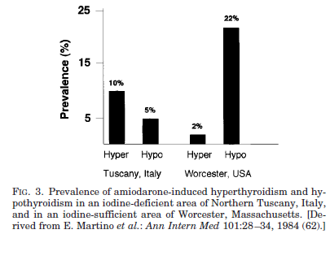
Amiodarone-induced thyrotoxicosis (AIT) appears to occur more frequently in geographical areas with low iodine intake
in a study carried out simultaneously in Western Tuscany (moderately low iodine intake) and Massachusetts (normal
iodine intake), it was found that the incidence of AIT was about 10% in Italy and 2% in the United States

Slide 4
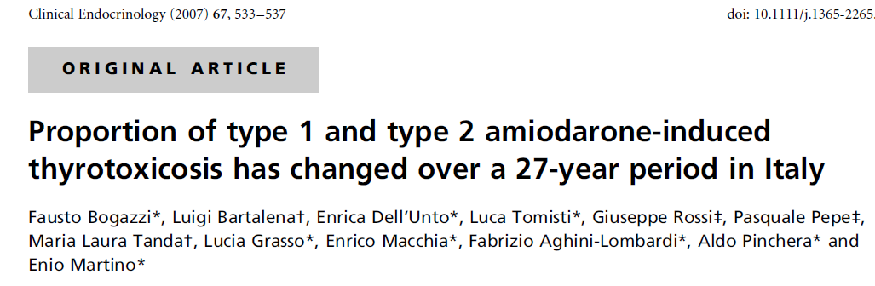
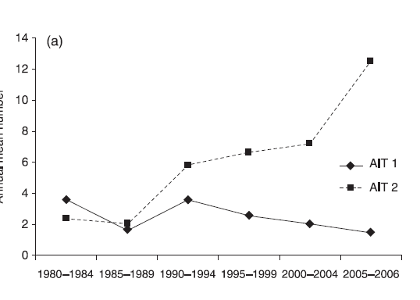
The annual mean number of type 1 AIT patients was 3·6 at the beginning of the study period, and 2·5 during the later years. In contrast, the mean annual number of new cases of type 2 AIT progressively increased from 2·4 to 12·5. currently accounting for 89% of AIT cases.
recently most AIT cases has been due to destructive thyrotoxicosis, perhaps because patients with preexisting thyroid disease were not treated with amiodarone

Slide 5
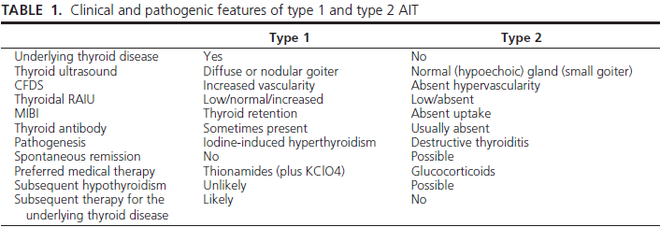
How to differentiate AIT1 from AIT2?

Slide 6
Thyroidal 131I uptake (RAIU) is useful diagnostic tool
RAIU is usually very low (3%) in type 2 AIT and low-normal, normal, or even increased (despite the iodine load) in type 1 AIT.

Slide 7
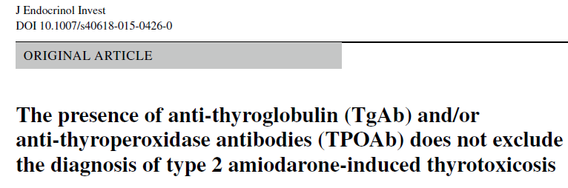
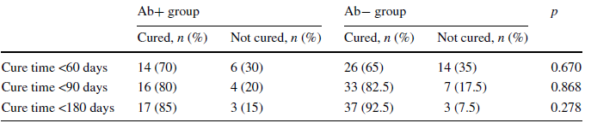
comparing the response to glucocorticoid therapy between 20 AIT patients with a normal thyroid gland, low radioiodine uptake, undetectable TSH receptor antibodies and positive TgAb and/or TPOAb (Ab+ group), and 40 patients with the same features and absent thyroid antibodies (Ab− group)
But The occurrence of permanent hypothyroidism was higher in the Ab+ group than in the Ab− group (26.3 vs 5.13 %, p = 0.032).

Slide 8
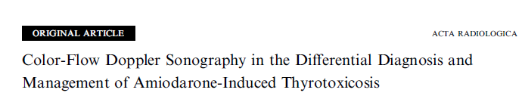
Qualitative CFDS patterns of the thyroid parenchyma (P) were classified as follows:
a) P1: minimal parenchymal blood flow as in a normal thyroid ;
b) P2: mild increase of parenchymal blood flow with patchy distribution;
c) P3: marked increase with diffuse homogenous distribution
Thyroid nodules (N) were classified in terms of the following CFDS patterns:
a) N1: absence of peri- and intranodular blood flow;
b) N2: perinodular and absent or slight intranodular blood flow
c) N3: intranodular blood flow

Slide 9
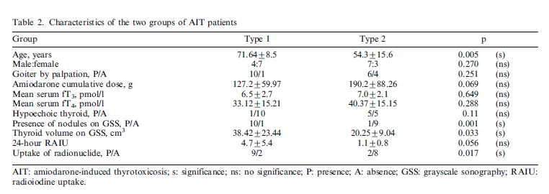
11 patients with increased blood flow were considered as type 1, and 10 with low/no blood flow as type 2. Ten of the 11 patients in the first group showed a hypervascular nodular pattern, while one showed a hypervascular parenchymal pattern.
Of the 10 patients with low/no blood flow, six had normal thyroid volume, three small diffuse goiter, and one small multinodular goiter..

Slide 10
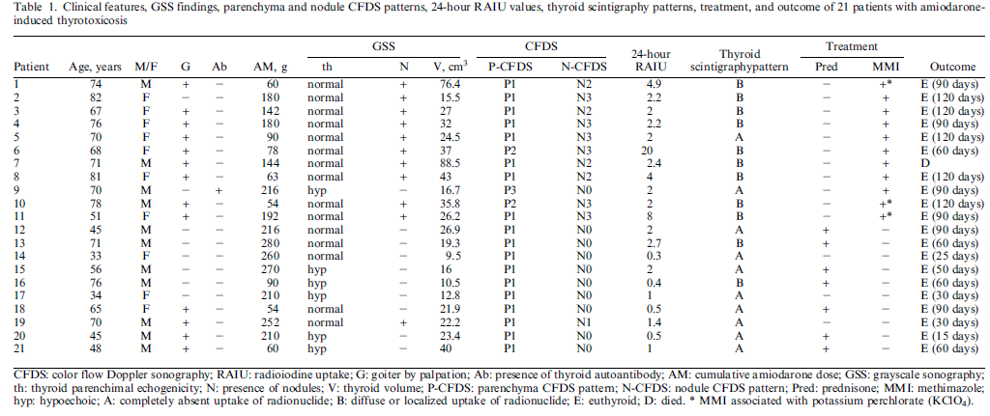

Slide 11
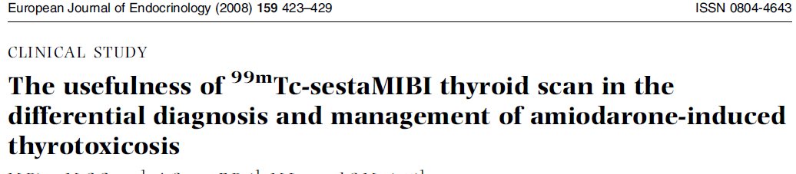
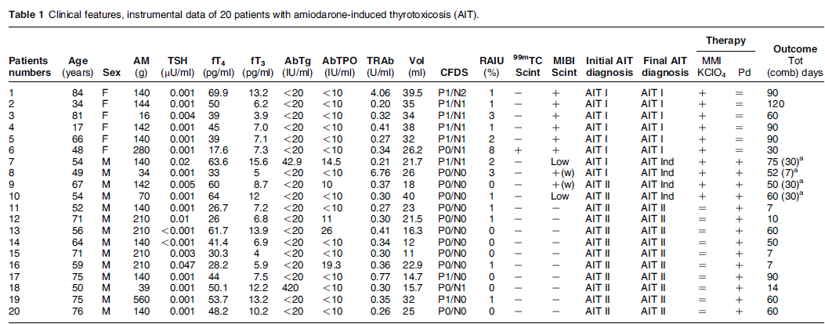
the four patients with mixed/indefinite AIT had either a faint persistent MIBI uptake or a quick washout of the tracer

Slide 12
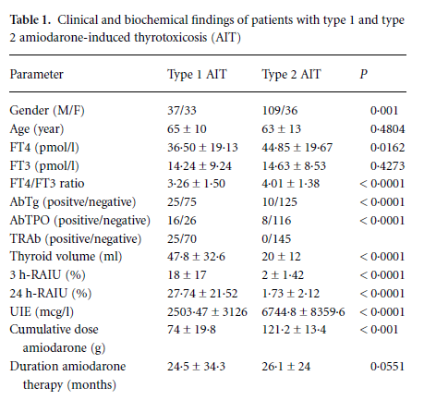
Type 2 AIT patients showed a male preponderance, higher serumFT4/FT3 ratio (P < 0·002), lower 3-h and 24-h thyroidal radioactive iodine uptake values ( P < 0·0001), and received a higher cumulative dose of amiodarone ( P < 0·0001) than type 1 AIT patients
Proportion of type 1 and type 2 amiodarone-induced
thyrotoxicosis has changed over a 27-year period in Italy. Clinical Endocrinology (2007)

Slide 13
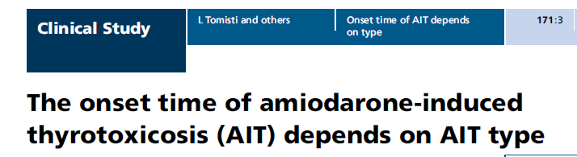
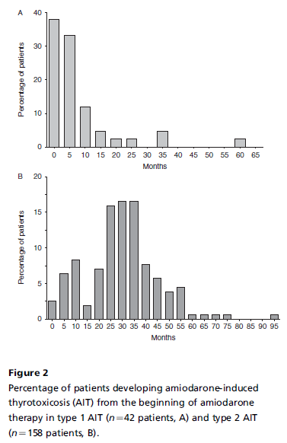
The median onset time of thyrotoxicosis was 3.5 months (95% CI 2–6 months) in patients with type 1 AIT (AIT1) and
30 months (95% CI 27–32 months, P!0.001) in those with type 2 AIT (AIT2).

Slide 14
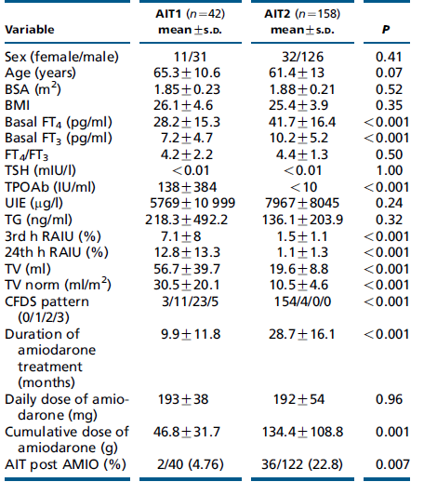

Slide 15
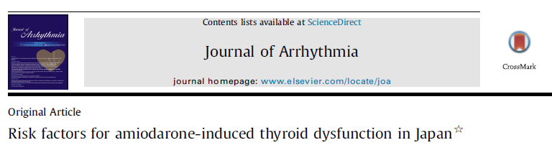
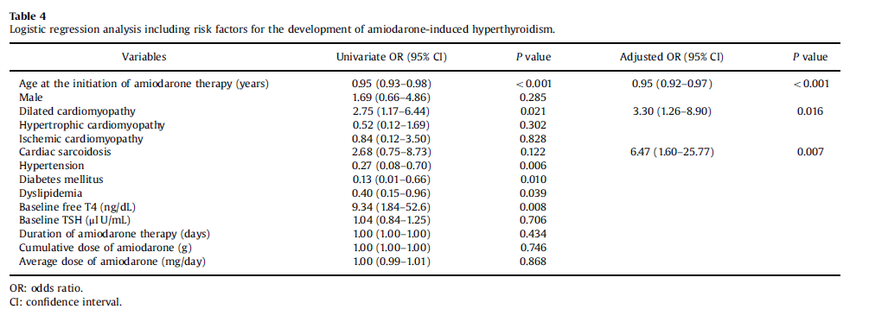

Slide 16
Treatment of AIT type1
best treated by anti thyroid drugs
higher drug dosages and longer periods of therapy are required before euthyroidism methimazole (40–60 mg) or propylthiouracil (600–800 mg) are often necessary
potassium perchlorate, which decreases thyroid iodine uptake, is added for 2–6 wk .
The limitation of potassium perchlorate is its toxicity, particularly agranulocytosis and aplastic anemia, and renal side effects
To minimize the adverse effects of the drug doses of 1 g/d or lower of potassium perchlorate should be used..
Approach to the Patient with Amiodarone-Induced ThyrotoxicosisJ Clin Endocrinol Metab, June 2010

Slide 17
Treatment of amiodarone associated thyrotoxicosis by simultaneous administration of potassium perchlorate and methimazole. 1986 J Endocrinol Invest 9:201–207
Twenty-three patients with amiodarone induced thyrotoxicosis were either not treated, treated with 40 mg methimazole daily or with methimazole and 1 gm potassium perchlorate daily for up to 40 days and then with methimazole alone. Thyrotoxicosis was more likely to spontaneously remit in patients without goiter. Therapy with methimazole alone was unsuccessful in inducing euthyroidism in 5 patients with gOiter. However, combined therapy with methimazole and potassium perchlorate rapidly alleviated hyperthyroidism in almost all patients with goiter.

Slide 18
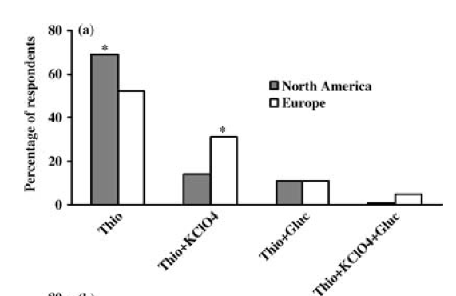
potassium perchlorate
The use of the combined thionamide-potassium perchlorate treatment seems to be more popular in Europe than in North America, where most thyroidologists employ thionamides alone as first-line treatment for type 1AIT
Diagnosis and management of amiodarone-induced thyrotoxicosis: similarities and differences between North American and European thyroidologist Clinical Endocrinology (2008)

Slide 19
Type 2 AIT
Type 2 AIT, a form of drug-induced destructive thyroiditis caused by amiodarone itself, is best treated by steroids
Type 2 AIT may be self-limiting, and continuation of amiodarone has been suggested by some authors not to influence the effectiveness of steroids .
Initial prednisone dose is about 0.5– 0.7 mg/kg body weight per day, and the treatment is usually continued for 3 months
Although the response to treatment often is dramatic, and 50% of patients are cured within 4wk a delayed response is sometimes observed.

Slide 20
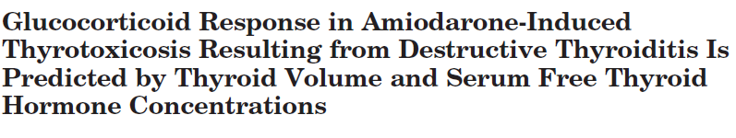

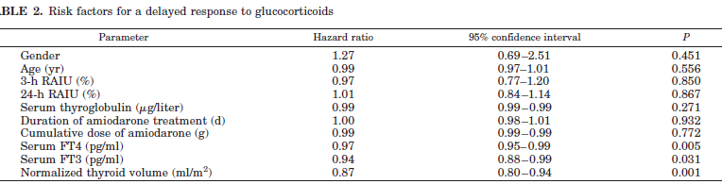
the study included 66 untreated patients with type 2 AIT ,All patients were treated with prednisone.
The median cure time was 30 d (95% confidence interval, 23–37 d)
euthyroidism was reached in 30 d or less in 60% of patients but in more than 90 d in 16%. A prompt control of thyrotoxicosis (30 d of treatment) was more frequent (77%) in patients with serum basal free T4 concentration no greater than 50 pg/ml and thyroid volume (normalized for body surface area) no greater than 12 ml/m2. Serum free T4 concentration and thyroid volume at diagnosis were the main determinants of response to glucocorticoids, with a cure hazard ratio of 0.97 (95% confidence interval, 0.95–0.99; P 0.005) and 0.84 (95% confidence interval, 0.77–0.91; P 0.000) for unit of increment, respectively

Slide 21
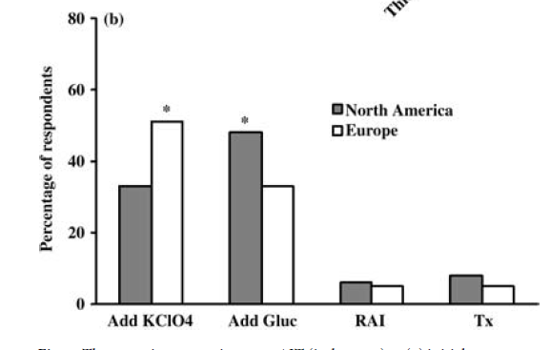
mixed/ indefinite forms
The most difficult challenge
both pathogenic mechanisms.
the best treatment is represented by a combination of thionamides (with or without potassium perchlorate) and oral glucocorticoids
If a patient initially treated with thionamides alone (because of a diagnosis of type 1 AIT) does not respond within 4 wk, most thyroidologists usually add potassium perchlorate and/or oral glucocorticoids
Approach to the Patient with Amiodarone-Induced ThyrotoxicosisJ Clin Endocrinol Metab, June 2010

Slide 22
2016 American Thyroid Association Guidelines for Diagnosis and Management of Hyperthyroidism and Other Causes of Thyrotoxicosis
RECOMMENDATION
Combined ATD and corticosteroid therapy should be used to treat patients with overt AIT who are too unstable clinically to allow a trial of monotherapy or who fail to respond to single modality therapy, or patients in whom
the etiology of thyrotoxicosis cannot be unequivocally determined.

Slide 23
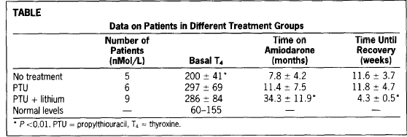
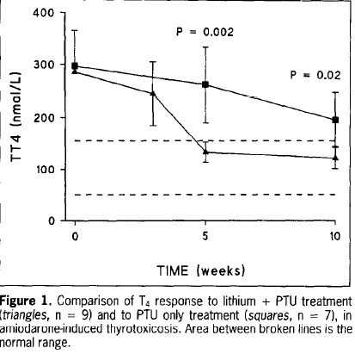
Lithium Treatment in Amiodarone-induced Thyrotoxicosis G. Dickstein, MD, C. Shechner, MD, F. Adawi, MD, J. Kaplan, MD, E. Baron, MD, S. Ish-Shalom, MD, Haifa, Israel .1997
The use of lithium has been proposed for AIT , but the evidence is too limited to support its effectiveness

Slide 24
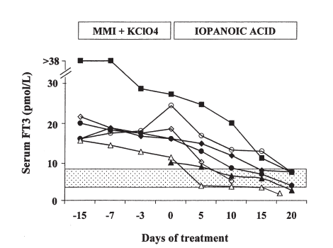
Preparation with iopanoic acid rapidly controls thyrotoxicosis in patients withamiodarone-induced thyrotoxicosis before thyroidectomy, Surgery2002
Iopanoic acid is very effective in reducing 5’- deiodinase activity, and serum FT3 concentrations dramatically decreased in a few days and normalized in about 2 weeks
The main advantage: is in the preparation of AIT patients for thyroidectomy,

Slide 25
RAI therapy
not feasible in AIT patients because of the low RAIU values either due to the iodine load or the destructive process .
0.1 mg rhTSH on two consecutive days increased 24-h thyroidal radioiodine uptake (RAIU) (from 3.5% to 25.4% in one patient), making RAI therapy suitable for AIT patients
This approach may be risky, because recombinant human TSH administration in these patients may be followed by a sustained increase in serum thyroid hormone concentrations, which is obviously harmful for patients with underlying cardiac abnormalities
Recombinant humanTSH as an adjuvant to radioiodine for the treatment of type 1amiodarone-induced thyrotoxicosis. Clinical Endocrinology (2009)

Slide 26
Total thyroidectomy
is not the first-line treatment for AIT,also inview of the potential surgical risk in these patients with underlying cardiac disorders.
may be necessary in patients who are resistant to other treatments To obtain a better (although transient) control of thyrotoxicosis before surgery, a short course of iopanoic acid (in association with antithyroid drugs) can be used

Slide 27
Total Thyroidectomy in Patients with Amiodarone-Induced Thyrotoxicosis and Severe Left Ventricular Systolic Dysfunction J Clin Endocrinol Metab, October 2012

Slide 28
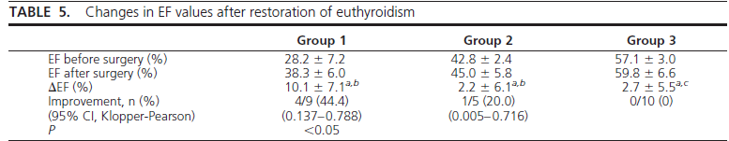
Total Thyroidectomy in Patients with Amiodarone-Induced Thyrotoxicosis and Severe Left Ventricular Systolic Dysfunction J Clin Endocrinol Metab, October 2012,
All AIT patients (n24; 9 patients with type 1 AIT, 15 patients with type 2 AIT)
Patients with moderate to severe LV systolic dysfunction (EF40%, group 1,n9) or with mild systolic dysfunction(40%EF50%, group 2,n5) were compared with patients with normal systolic function (EF50%, group 3, n10
The mean follow-upwas67+-42 months.No death occurre during and 2 month safter surgery. One death occurred in one patient of group 1, 30 months after the thyroidectomy, due to acute myocardial infarction.

Slide 29
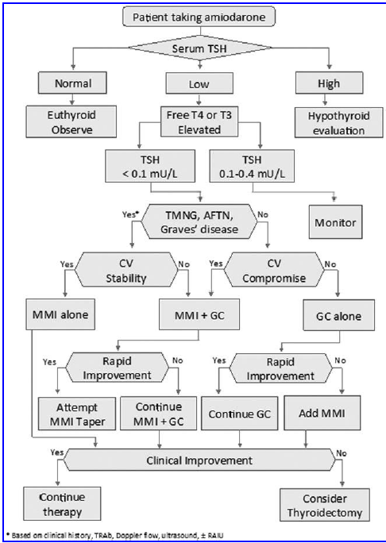

Slide 30
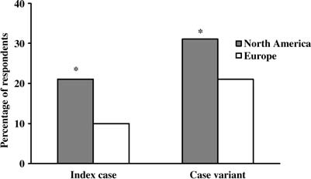
AMIODARONE WITHDRAWAL
drug withdrawal might not influence the response to medical therapy in the short term because of long half life
withdrawal was considered necessary by 90% of Europeans and 79% of North Americans in the case of type 1 AIT; this proportion decreased to 80 and 66 respectively, in the case of type 2 AIT

Slide 31
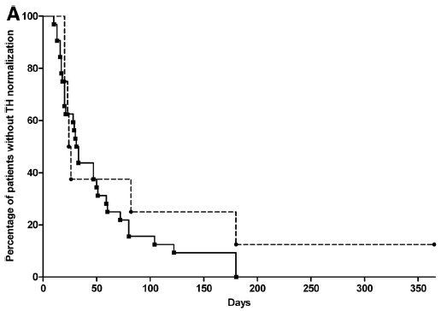
The normalization time was similar in the two groups (log rank, P 0.326); the proportion of non normalized patients did not significantly differ in the two groups (P 0.200). median time for stably restoring euthyroidism was 140 d in AMIO-ON patients and 47 d in AMIOOFF patients (log rank, P 0.011).
In fact, AIT recurred in five of seven AMIO-ON patients (71.4%) and in only three of 32 AMIO-OFF patients (9.4%, P 0.002), requiring readministration of prednisone
(AMIO-ON, n 8
(AMIO-OFF, n 32
Continuation of Amiodarone Delays Restoration of Euthyroidism in Patients with Type 2 Amiodarone-Induced Thyrotoxicosis Treated with Prednisone: A Pilot Study J Clin Endocrinol Metab, November 2011

Slide 32
WHAT SHOULD WE DO AFTER EUTHYROIDISM ACHIEVEMENT
thyroid ablation was recommended for the underlying thyroid disorder in type 1 AIT, particularly if thyrotoxicosis recurred;
a wait and- see strategy was suggested in the majority of type 2 AIT cases, unless relapse occurred.

Slide 33
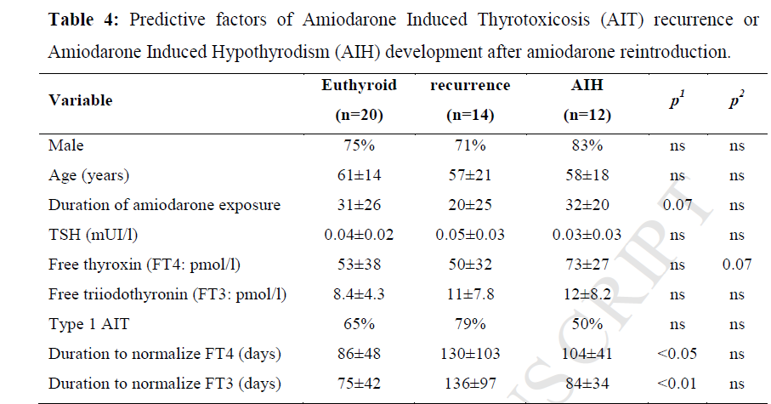
Amiodarone-Induced Thyrotoxicosis Recurrence After Amiodarone Reintroduction.
Am J Cardiol. 2016

Slide 34
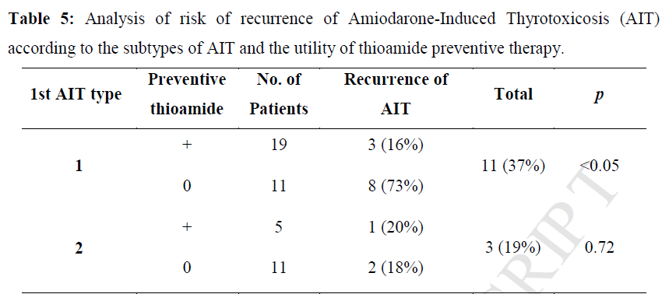
Amiodarone-Induced Thyrotoxicosis Recurrence After Amiodarone Reintroduction. Am J Cardiol. 2016

Slide 35
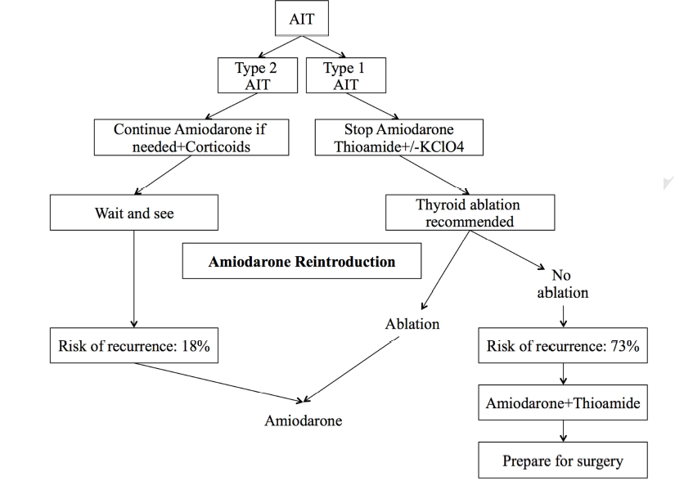
Amiodarone-Induced Thyrotoxicosis Recurrence After Amiodarone Reintroduction. Am J Cardiol. 2016

Slide 36
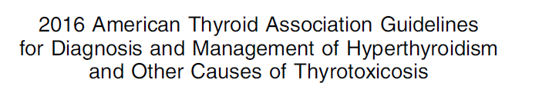
RECOMMENDATION
We suggest monitoring thyroid function tests before and within the first 3 months following the initiation of amiodarone therapy, and at 3- to 6-month intervals thereafter.

Slide 37


During a median follow-up of 2.8 (1.0–25) years, 44 patients from303 (
200 men and 103 women )developed AIT and 33 AIH. In 42 (55%) patients who developed AIT/AIH, earlier thyroid function tests showed no subclinical AIT or subclinical AIH. In 35 (45%) patients, AIT/AIH was preceded by subclinical AIT or subclinical AIH (16/44 for AIT and 19/33 for AIH).
regular testing of thyroid function to predict overt thyroid dysfunction in amiodarone treated patients

