Slide 1
(AUB) Abnormal uterine bleeding during perimenopause and post menopause
Marzieh Ghafarnejad, OB & GYN
Tehran University of Medical Sciences

Slide 2
Agenda:
Defnitions:
Perimenopause
Menopause
AUB
AUB in peri-menopause
AUB after Menopause
Causes
Diagnostic tools
Management: 1- expectant
2- Medical
3- Surgical

Slide 3
Definition of Menopause and Perimenopause
Menopause is defined as the absence of menstrual periods for 1 year.
The average age of menopause is 51 years. But the normal range is 45 to 55 year
The years leading up to this point are called peri-menopause. This term means "around menopause". This phase may last to 10 years.
During peri-menopause , shift in hormone levels can affect ovulation and cause changes in the menstrual cycle.

Slide 4
Common changes in the menstrual cycles during perimenopause:
During a normal menstrual cycle, the levels of estrogen and progesterone increase and decrease in a regular pattern. Ovulation occurs in the middle of the cycle, and menstruation occurs about 2 weeks later.
During peri-menopause, hormone levels may not follow this regular pattern, and as a result irregular bleeding or spotting may occurs.
Some months, period may be longer and heavier. Other months, it may be shorter and lighter.
The number of days between periods may increase or decrease
AUB in peri-menopause period include: very heavy bleeding, bleeding that last s longer than normal, bleeding that occurs between periods or after sex

Slide 5
Common causes of abnormal uterine bleeding
durnig perimenopaus and post menopause:
Polyps: polyps are usually noncancerous growth that develop from tissue similar to the endometrium, they either attach to uterine wall or develop on the endometrial surface . They may cause irregular or heavy bleeding. Polyps can grow on the
cervix or inside the cervical canal. Polyps may cause bleeding after sex
Endometrial atrophy: after menopause, the endometrium may become too thin as a result of low estrogen levels, called atrophic endometrium, may cause abnormal bleeding.
Endometrial hyperplasia: most often is caused by excess estrogen without enough progesterone. The lining of the uterus thickens, it can cause
irregular or heavy bleeding.
In some case, the cells of lining become abnormal. This condition, called atypical hyperplasia, can lead to cancer of the uterus. Early diagnosis and treatment of endometrial hyperplasia can prevent endometrial cancer.
Bleeding is the most common sign of endometrial cancer in post menopause women

Slide 6
Postmenopausal uterine bleeding: is defined as uterine bleeding after permanent cessation of menstruation resulting from loss of ovarian follicular activity. Bleeding can be spontaneous or related to ovarian hormone replacement therapy(HRT) or to use of selective estrogen receptor modulators (eg, tamoxifen adjuvant therapy).
PMB, is a common clinical condition with an incidence of 10% immediately after menopause.
Patients with PMB have a 10–15% chance of having endometrial carcinoma.
The clinical approach to PMB requires prompt and effective evaluation to
exclude cancer in the genital tract or precancerous lesions of the endometrium. However, endometrial atrophy, and benign focal lesions such as endometrial polyps and fibroids, are common. The prevalence of endometrial polyps and hyperplasia is estimated to be 40%
Endometrial cancer is the most common gynaecological malignancy.
Risk factors include: obesity, unopposed estrogens, polycystic ovary syndrome and nulliparity.
Ninety percent of women with endometrial carcinoma present with vaginal bleeding.

Slide 7
During HRT following definitions are suggested for (PMB):
Bleeding is common, frequency and timing depends on scheduling of gonadal steroids used particularly progestational agent
Breakthrough bleeding: unscheduled uterine bleeding, occurs in women receiving estrogen alone or both estrogen and progestin therapy, it is different from the withdrawal bleeding that occurs following cyclic withdrawal of progestin treatment.
50% of women using continuous estrogen- progestin combined regimen experience breakthrough bleeding, most cases resolving 6 month after initiation of therapy
1- For women using cyclically administered progestins in combination with a cyclical or continuous estrogen: 1) BTB occurs at an unscheduled time or 2) occurs at the anticipated time after progestin withdrawal but is heavy or prolonged
2- For women using continuous combined estrogen and progestin- containing regimens: BTB commences six months or more after initiation or- commences after amenorrhea has been established.

Slide 8
Postmenopausal bleeding and HRT
The occurrence of uterine bleeding or spotting after the initiation of HRT is not unusual. More than half of HRT users will have some spotting or bleeding at the beginning of therapy.
Usually such bleeding is lighter than a menstrual period and lessens with time; after 6 months, it stops completely in most women.

Slide 9
Tamoxifen use
Risk assessment
Tamoxifen therapy is associated with a two- to threefold increased risk of endometrial cancer in postmenopausal women. TVUS of patients on this therapy typically shows an increased endometrial thickness.
Risk appears to increase with higher cumulative doses of tamoxifen and longer duration of treatment.

Slide 10
Clinical Investigation of Women with Postmenopausal Vaginal bleeding
Physical Examination
Trans-vaginal Ultra-sonography
Evaluation of the Endometrium by Office-Based
Sampling System and Dilation and Curettage
(D&C), are Blind method
Hysteroscopy guided directed Biopsy with
curettage

Slide 11
Diagnostic tools
Vaginal ultrasonography.
Hydrosonography.
Endometrial biopsy.
Office biopsy.
D/C biopsy.
Hysteroscopic guided biopsy.

Slide 12
Endometrial evaluation
As TVUS is a non invasive test with 91 % sensitivity and 96 % specificity . it should be done for all women with postmenopausal bleeding.
if the endometrial thickness is >5mm. and if the patient pre test probability is low, office endometrial biopsy and SIS should be done to determine whether the endometrium is symmetrically thickened.
BUT if the patient pre test probability is high, a fractional curettage biopsy or a hysteroscopic guided biopsy is recommended.

Slide 13
The endometrial thickness cut-off
TVS can reliably assess thickness and morphology of the endometrium and can thus identify a group of women with PMB who have a thin endometrium (4 mm) and are therefore unlikely to have endometrial cancer. Endometrial sampling is therefore not recommended below this cut-off value.
4 meta-analyses have been published; each has used different methods to determine the accuracy of TVS in diagnosing endometrial abnormalities in women with PMB. The most cited meta-analysis by Smith-Bindman et al included 5892 women from 35 prospective studies that compared endometrial thickness measured at TVS to presence or absence of endometrial carcinoma on histology.
At 5 mm cut-off, the overall summary mean weighted estimates of the sensitivity for detecting endometrial 96% for a 39% false-positive rate

Slide 14
Cut- off point
There is only one study that looked at follow-up of women with PMB and an endometrial thickness of <4 mm. It showed that none of the women with the expectant management developed cancer over 1 year of follow-up.
Timmermans et al. conducted meta-analytic strategies. 79 primary investigators were contacted to obtain the individual patient data of their reported studies, of which 13 could provide data. Data on 2896 individuals, of whom 259 had cancer, were analysed.
Meaningful assessment of the endometrium (thickness and morphology) by ultrasonography is not possible in all patients. In such cases or if bleeding persists despite negative initial evaluation, alternative methods are indicated.

Slide 15
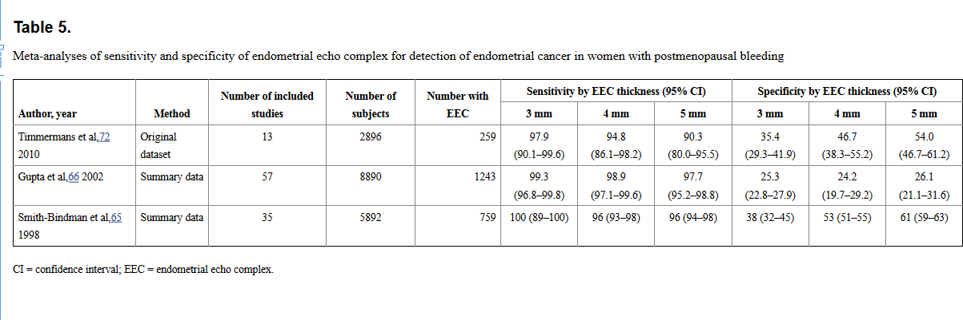

Slide 16
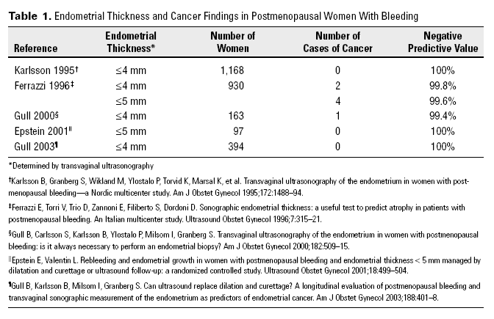

Slide 17
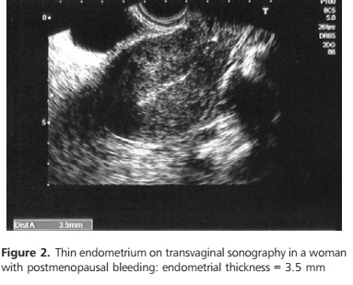

Slide 18
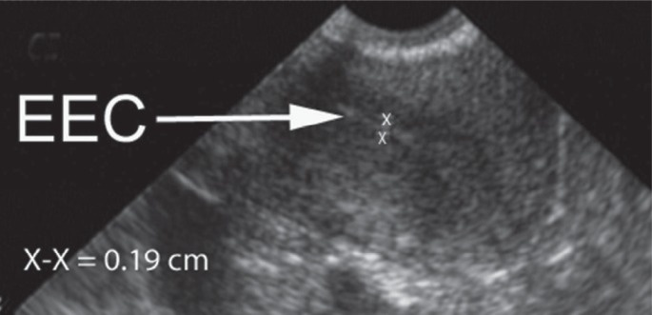
Typical measurement of normal postmenopausal endometrial echo complex (EEC) (< 4 mm) (arrowhead).

Slide 19
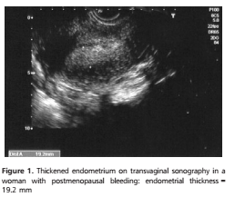

Slide 20
Saline infusion sonography
Saline infusion sonography (SIS) involves the infusion of saline into the uterine cavity during ultrasound to separate the two walls of the endometrium, which allows their thicknesses to be measured. It also allows the evaluation of intracavitary lesions such as fibroids or polyps.
There are no large studies evaluating the accuracy of SIS in the assessment of women with PMB. However, in their meta-analysis, de Kroon et al. conclude that SIS is accurate in the evaluation of the uterine cavity in pre and post menopausal women with abnormal uterine bleeding.
The authors also conclude that the feasibility of SIS is high, although it is significantly better in premenopausal women compared with postmenopausal women. Therefore outpatient biopsy and hysteroscopy are still the methods of choice.

Slide 21
saline-infusion sonography
At transvaginal US, when the endometrium cannot be accurately measured or when there is a nonspecific thickened central endometrial complex, sonohysterography can provide additional information and can be used to direct the patient to a visually guided hysteroscopic procedure rather than a potentially unsuccessful blind biopsy procedure.

Slide 22
Endometrial fluid detected by transvaginal sonography
Curcic´ et al. concluded that the presence of endometrial fluid detected by TVS is a good marker for pathological changes of the endometrium in postmenopausal women if the endometrial thickness is >4 mm.
If the endometrial thickness is <4 mm, the presence of endometrial fluid is not an indication for further invasive investigation.

Slide 23
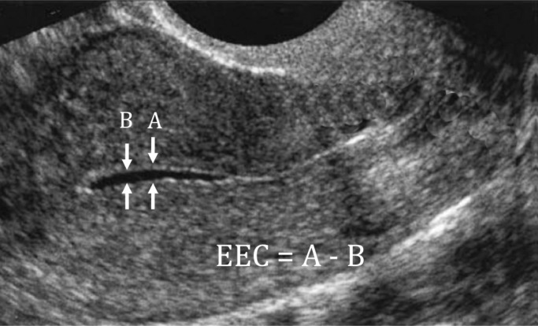
Measurement of endometrial echo complex (EEC) when there is fluid in the cavity.

Slide 24
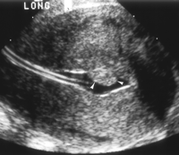
The Thickened endometrium may be a polyp
catheter
POLYP
With polyps the endometrial-myometrial interface is preserved

Slide 25
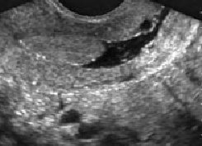
The Thickened endometrium may be a polyp
CYST
POLYP
With polyps the endometrial-myometrial interface is preserved
well-defined, homogeneous, isoechoic to the endometrium

Slide 26
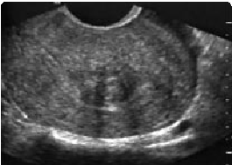
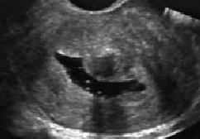
The Thickened endometrium may be a Submucosal leiomyomas
With myomas the endometrial-myometrial interface is distorted
broad-based, hypoechoic,

Slide 27
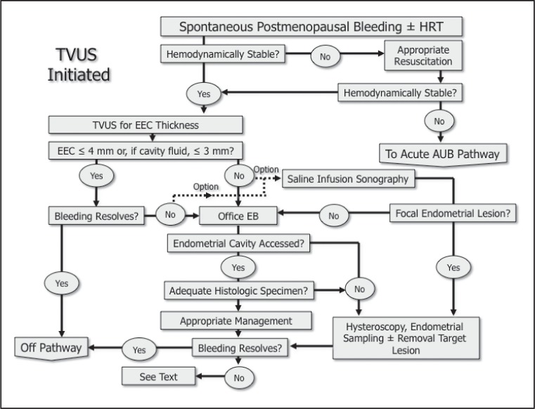

Slide 28
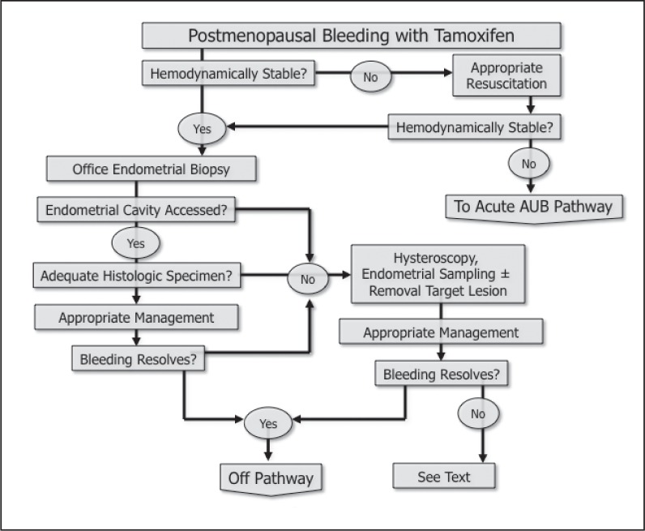

Slide 29
TVUS
endometrial thickness is > 4mm
endometrial thickness is < 4mm
If low risk
If high risk
follow
office endometrial
biopsy and SIS
D/C biopsy OR
hysteroscopy
But symptoms
persist
In women with continued bleeding after a negative initial evaluation, further testing
with hysteroscopically directed biopsy is essential,

Slide 30
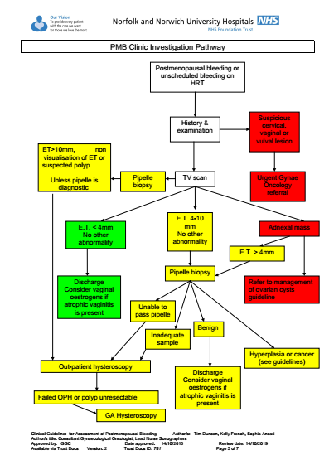

Slide 31
Endometrial sampling methods
Patients with an increased endometrial thickness should undergo further invasive testing. Dilatation and curettage is now considered to be an outdated practice and is replaced by less invasive outpatient evaluation using endometrial biopsy devices and outpatient hysteroscopy-guided biopsies.
In the meta-analysis of Dijkhuizen et al. different endometrial biopsy devices were compared. In postmenopausal women endometrial sampling with both the Pipelle device (Pipelle de Cornier, Paris, France) and the Vabra device (Berkeley Medevices, Inc., Richmond, CA, USA) were very sensitive techniques for the detection of endometrial carcinoma, with detection rates of 99.6% and 97.1%, respectively

Slide 32
Endometrial biopsy
Dilatation and curettage
The role of the formal D&C probably is very limited because the diagnosis usually can be made in the office.

Slide 33
Insufficient sampling
The amount of tissue obtained by office sampling is sometimes insufficient for a histological diagnosis. In those cases, the clinician is in doubt whether or not to proceed with more invasive testing or to rely on the negative biopsy. In a prospective study performed by Van Doorn et al., four (6%) out of 66 patients with insufficient tissue at office endometrial sample were subsequently diagnosed with endometrial cancer (n = 3) or atypical hyperplasia (n = 1). This finding implies that women with an insufficient sample and an endometrial thickness of 5 mm or more should not be reassured.
It would appear from the controlled regression analysis by Bakour et al. that clinicians can be confident in reassuring women with an insufficient sample on outpatient endometrial biopsy, provided that the hysteroscopic and sonographic endometrial assessment is consistent with endometrial atrophy. This means that it is reasonable to reassure and discharge women with an insufficient endometrial sample with negative scan 4 mm or less without the need to expose them to hysteroscopy and curettage. The need for reinvestigation on recurrence of symptoms should be borne in mind; for example, a small polyp in an atrophic endometrium may not be detected because the endometrial sampling does not yield enough cells.

Slide 34
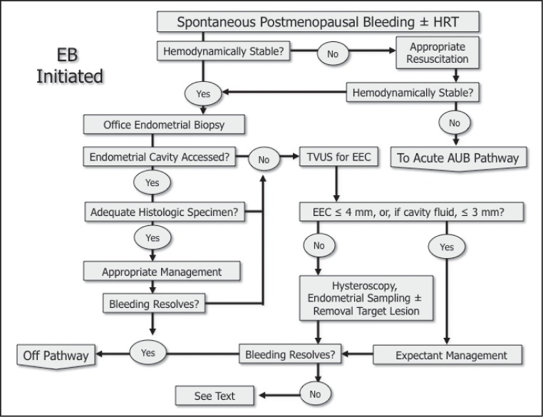

Slide 35
Key content:
Patients with postmenopausal bleeding(PMB) have a 10-15% chance of having endometrial carcinoma; they should therefore be seen within 2 weeks of referral.
Cervical and vulval cancers remain important component of the differential diagnosis and can only be assessed by clinical examination

Slide 36
Relationship to Hereditary Nonpolyposis Colonic Cancer
A number of other factors are associated with an increased risk of endometrial cancer. Hereditary nonpolyposis colorectal cancer is a relatively common, autosomal dominant syndrome originally described by Henry Lynch, and it is still known in some quarters by the name Lynch syndrome, particularly if there is a known DNA mismatch pair. Endometrial cancer is the most common extracolonic cancer found in women with this syndrome. The estimated lifetime risk of endometrial cancer in women with Lynch syndrome is 42% to 60% and, unlike spontaneous endometrial cancer, these malignancies often present in the premenopausal years.
Other Risk Factors for Endometrial Cancer
The evidence linking other risk factors to the development of endometrial cancer is relatively weak. These include obesity, hypertension, diabete and a history of either endogenous or exogenous hyperestrogenism.

Slide 37
Risk factors for endometrial cancer
conditions typically associated with chronic elevations of endogenous estrogen levels or increased estrogen action at the level of the endometrium. These include
Obesity.
history of chronic anovulation.
diabetes mellitus.
estrogen-secreting tumors.
exogenous estrogen unopposed by progesterone .
tamoxifen use.
a family history of Lynch type II syndrome (hereditary nonpolyposis colorectal, ovarian, or endometrial cancer).

Slide 38
Endometrial biopsy
Hysteroscopic-directed biopsy
Hysteroscopic visualization has several advantages:
immediate office evaluation,
visualization of the endometrium and endocervix,
the ability to detect minute focal endometrial pathology and to perform directed endometrial biopsies.

Slide 39
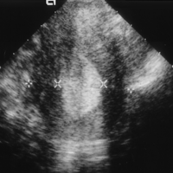
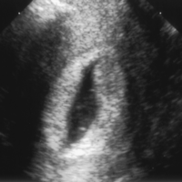
The Thickened endometrium may be an endometrial hyperplasia
Endometrium thickness = A-B
A
B
diffuse thickening of the echogenic endometrial stripe without focal abnormality

Slide 40
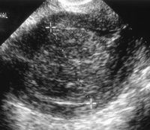
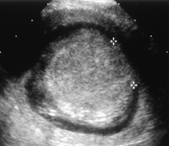
Endometrial cancer
Endometrial cancer is typically a diffuse process, but early cases can appear as a polypoid mass

Slide 41
Take home message
PMB is a common clinical condition with an incidence of 10% immediately after menopause.
Patients with PMB have a 10–15% chance of having endometrial carcinoma.
The prevalence of endometrial atrophy is estimated to be about 59-88%
The prevalence of Endometrial polyps and hyperplasia is estimated to be 40%
Ninety percent of women with endometrial carcinoma present with vaginal bleeding.
ACOG cut off point for ET in TVUS is 4mm or less for AUB in PMB

Slide 42
Thank you for your attention

