Slide 1
Management Of Hyperglycemia In Hospitalized Patients
Dr. Zahra Ghasemzade
Endocrine Fellow
Research Institute Of Endocrine Sciences
Shahid Beheshti University Of Medical Science
Tir 1394 – July 2015

Slide 2
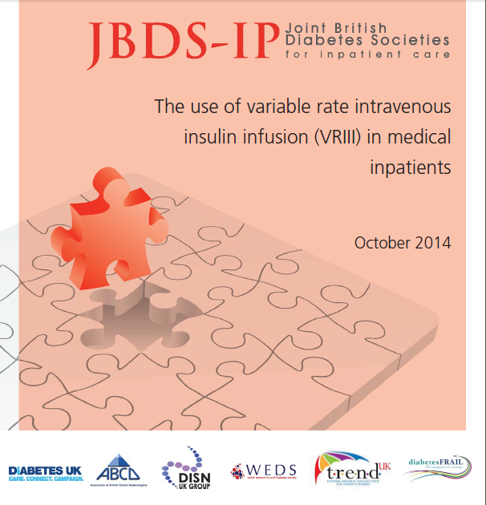

Slide 3
Background and definitions
Approximately 15% of hospital inpatients have diabetes of whom 70% are admitted as medical emergencies, the majority with diabetes as a secondary diagnosis.
There is evidence from both medical and surgical settings to indicate that if the blood glucose is not controlled the outcomes, measured by mortality, morbidity or length of stay, are worse.
method of choice in an unwell or fasting patient is a VRIII – previously known as a sliding scale
The infusion of intravenous insulin at a variable rate according to regular capillary blood glucose measurements with the aim of controlling serum glucose levels within a specified range.

Slide 4
Evidence base for recommendations
2.1 Evidence for adverse effect of hyperglycaemia on outcomes during illness
Hyperglycaemia in hospital is associated with a significantly increased risk of mortality
2.2 Evidence for specific blood glucose targets
Intensive Care units (ICU)
Hospitalised Medical Patients in Non-ICU Settings (Rabbit 2)
Acute Myocardial infarction
Acute Stroke

Slide 5
Glycemic control for acute myocardial infarction in patients with and without diabetes mellitus
type 2 diabetic patients without a prior MI have the same risk of developing an MI as nondiabetic patients who have already had an MI
Maintenance of strict glycemic control improves long-term microvascular outcomes in patients with both type 1 and type 2 diabetes
Intensive glycemic control aiming for near-normal levels has been shown to have a substantial beneficial effect (58 percent reduction in major CVD events) on macrovascular outcomes in type 1 diabetes,
In the setting of type 2 diabetes, any beneficial effects of intensive glycemic control on macrovascular disease are likely to be less than those from similarly stringent control of blood pressure and lipid levels.
Poor glycemic control in diabetic patients and stress hyperglycemia in nondiabetic patients is associated with worse outcomes after acute MI but it is not fully understood as to whether strict glycemic control during AMI hospitalizations improves outcomes.

Slide 6
Studies of patients with acute MI
DIGAMI trial
620 diabetic patients with an acute MI were randomly assigned to an insulin glucose infusion for 24 hours followed by subcutaneous insulin four times daily for ≥3 months or standard treatment with insulin therapy only if clinically indicated
Mortality was significantly lower in the group assigned to more aggressive insulin therapy at one year (19 versus 26 percent) and at 3.4 years (33 versus 44 percent)
DIGAMI-2 trial
HI-5 trial
240 such patients were randomly assigned to conventional therapy or to an insulin/dextrose infusion to maintain the blood glucose between 72 and 180 mg/dL for at least 24 hours. After 24 hours, the patients were managed with standard care by their own physicians with a recommend HbA1c of less than 7 percent.
There was no difference in the primary end point of mortality in-hospital or at three or six months

Slide 7
Prospective randomised study of intensive insulin treatment on long term survival after acute myocardial infarction in patients with diabetes mellitus DIGAMI (Diabetes Mellitus Insulin Glucose Infusion in Acute Myocardial Infarction)
Patients with diabetes mellitus and acute myocardial infarction were randomly allocated standard treatment plus insulin-glucose infusion for at least 24 hours followed by multidose insulin treatment or standard treatment (controls).
Conclusion: Insulin-glucose infusion followed by intensive subcutaneous insulin in diabetic patients with acute myocardial infarction improves long term survival, and the effect seen at one year continues for at least 3.5 years, with an absolute reduction in mortality of 11%.
This means that one life was saved for nine treated patients. The effect was most apparent in patients who had not previously received insulin treatment and who were at a low cardiovascular risk.

Slide 8
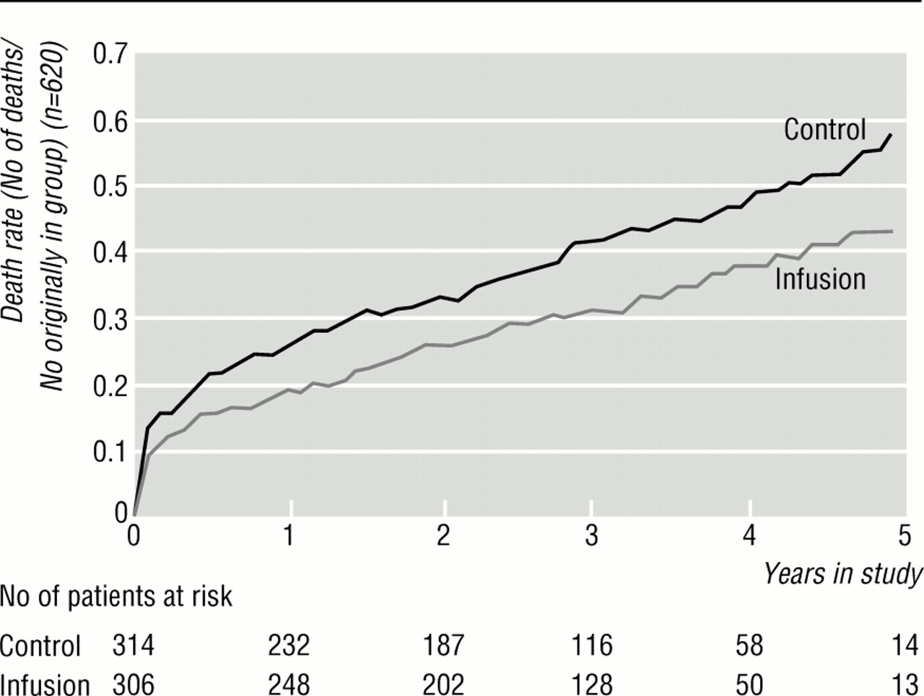
Actuarial mortality curves during long term follow up in patients receiving insulin-glucose infusion and in control group among total DIGAMI cohort.
Klas Malmberg BMJ 1997;314:1512
©1997 by British Medical Journal Publishing Group

Slide 9
Observational evidence
7820 hyperglycemic patients (admission blood glucose ≥140 mg/dL) hospitalized with acute MI.
After multivariable adjustment, lower mean postadmission glucose levels were associated with better all-cause in-hospital mortality.
There was no difference in mortality rates between insulin-treated and non-insulin treated patients irrespective of mean postadmission glucose level.
Glucose control should be initiated when serum glucose values are above 180- 200 mg/dL (10-11 mmol/L).

Slide 10
A review of 4224 patients in trials of fibrinolysis or primary PCI in patients with STEMI found a U-shaped relationship between the serum glucose (mostly admission values) and the 30-day rate of death or recurrent MI
blood glucose | 30-day mortality rate | 30-day rate of recurrent MI or death | odds ratio
hypoglycemia, <81 mg/dL | 4.6 | 10.5 | 3.3
euglycemia, 81 to 99 mg/dL | 1 | 4.2 | 1
severe hyperglycemia, >199 mg/dL | 4.7 | 7.2 | 3.09

Slide 11
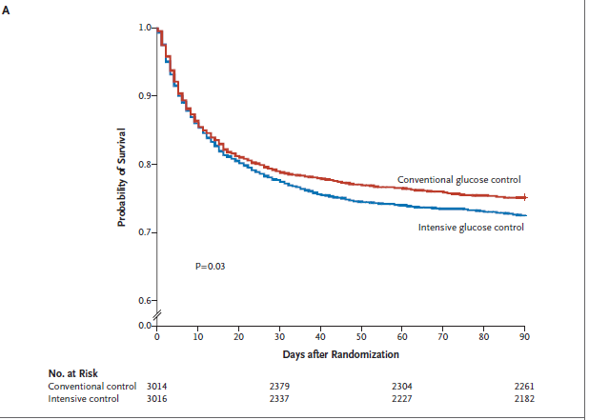
In this large, international, randomized trial, we found that intensive glucose control increased mortality among adults in the ICU: a blood glucose target of 180 mg or less per deciliter resulted in lower mortality than did a target of 81 to 108 mg per deciliter.

Slide 12
Randomized Study of Basal-Bolus Insulin Therapy in the Inpatient Management of Patients With Type 2 Diabetes Undergoing General Surgery (RABBIT 2 Surgery)
This randomized multicenter trial compared the safety and efficacy of a basal-bolus insulin regimen with glargine once daily and glulisine
before meals (n = 104) to sliding scale regular insulin (SSI) four times daily (n = 107) in patients with type 2 diabetes mellitus undergoing general surgery.
Outcomes included differences in daily BG and a composite of postoperative complications including wound infection, pneumonia, bacteremia, and respiratory and acute renal failur.
CONCLUSIONS—Basal-bolus treatment with glargine once daily plus glulisine before meals improved glycemic control and reduced hospital complications compared with SSI in general surgery patients. Our study indicates that a basal-bolus insulin regimen is preferred over SSI in the hospital management of general surgery patients with type 2 diabetes.

Slide 13
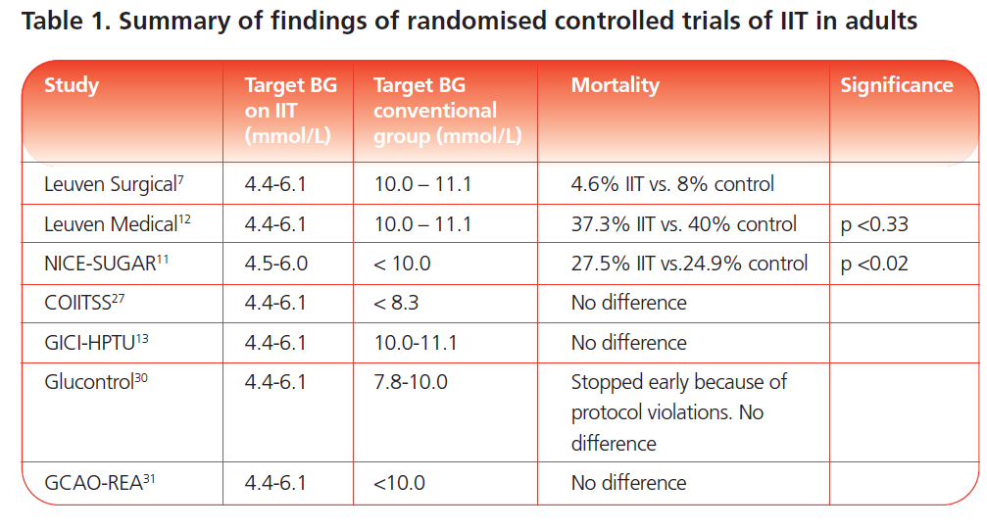

Slide 14
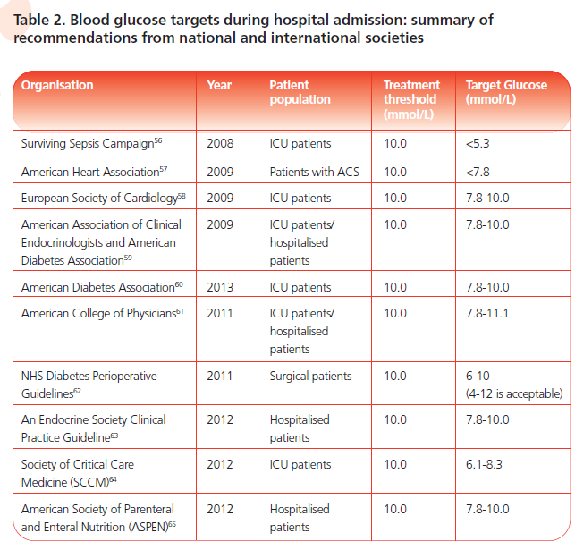

Slide 16
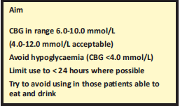
Recommendations for use of VRIII

Slide 17
3.1 Indications for VRIII in medical Patients
3.2 Advantages of VRIII
3.3 Disadvantages of a VRIII
3.4 Potential Risks of a VRIII
3.5 Practical aspects of setting up a VRIII
3.5.1 How to set up a VRIII
Draw up 50 units of prescribed Human Actrapid insulin* and add to 49.5 ml of 0.9% sodium chloride in a 50 ml luer lock syringe
Insulin must be infused at a variable rate aiming for a glucose of 6-10 mmol/L (acceptable range4-12 mmol/L)
3.5.2 Suggested insulin infusion rates
3.5.3 Treatment of hypoglycaemia * during a VRIII
Treat Hypoglycaemia and once CBG >4.0 mmol/L restart IV insulin within 20 minutes. The half life of intravenous insulin is very short (7-8 minutes) and restarting the VRIII promptly minimises the risk of ketosis.
Give 75-100 ml of 20% glucose over 15 minutes, (i.e. 300-400 ml/hr)
Give 150-200 ml of 10% glucose (over 15 minutes, i.e. 600-800 ml/hr).
Repeat capillary blood glucose measurement 15 minutes later. If it is still less than 4.0 mmol/L,repeat.

Slide 18
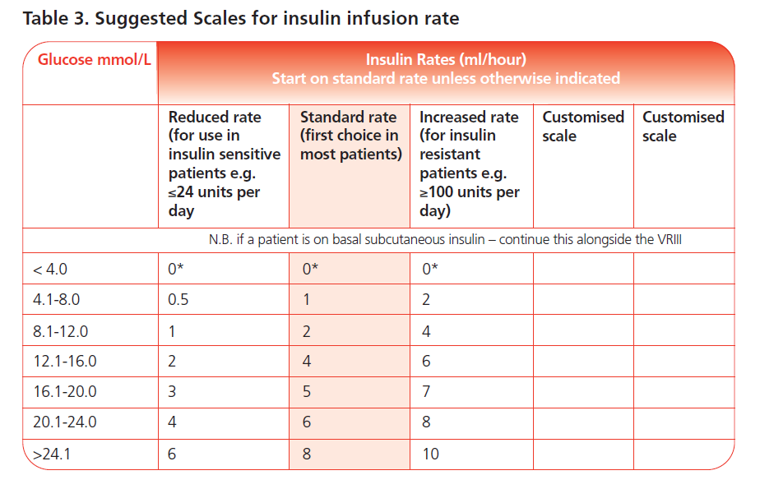

Slide 19
CBG above target (greater than 12 mmol/L and not falling* on two or more consecutive occasions):
Increase the insulin infusion rate to the next scale
CBG consistently ‘too tight’ (CBG levels between 4 and 6 mmol/L on two or more consecutive occasions).
Consider reducing to a lower insulin infusion rate

Slide 20
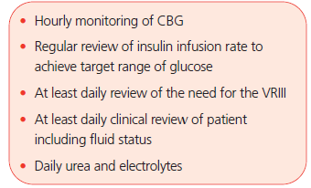
3.6 Maintaining safety during the use of a VRIII
3.7 Choice of Concurrent Fluids
0.45% NaCl with 5% glucose and 0.15%KCl (20mmol/L)
3.8 Duration of the VRIII
The aim should be to convert back to standard (oral or subcutaneous) medication as soon as patients are able to eat and drink, provided the VRIII can be discontinued safely.

Slide 21
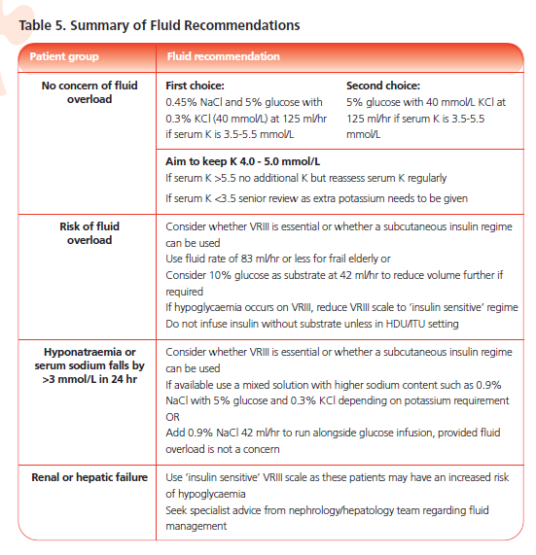

Slide 22
3.9 Management of other diabetes medications during a VRIII
Withhold usual diabetes treatment during VRIII
Continue basal long-acting analogues* or isophane insulin** in patients usually taking multiple daily injections of insulin (MDI or basal-bolus insulin therapy).
3.10 Transferring from a VRIII to subcutaneous insulin and/or oral treatment

Slide 23
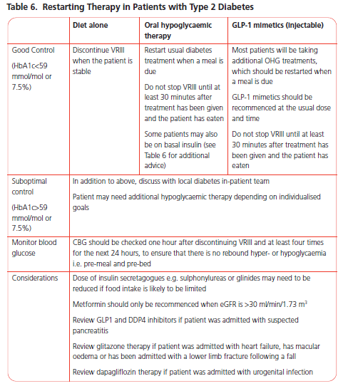

Slide 24
Restarting insulin in patients according to previous regime.
Basal insulin
Once or twice daily mixed insulin
Multiple daily insulin injections(MDI or basal bolus)
Insulin pump (CSII)
Calculating subcutaneous insulin dose in insulin-naïve patients, or where insulin regime needs altering because of sub-optimal control
Method A - weight based calculation
Frail elderly patients, renal failure (CKD stage 4 or 5), severe hepatic failure, newly diagnosed Type 1 diabetes: Total daily insulin dose = 0.3 x body weight in kg
All other adult patients: Total daily insulin dose = 0.5 x body weight in kg
Method B - based on insulin requirements during the stable phase of the VRIII
Divide the total dose of insulin administered in last 6 hours of the VRIII by 6 to calculate average hourly dose of insulin.
Multiply this by 20 (not 24, to reduce risk of hypoglycaemia) to estimate the patient’s total daily insulin requirement.
A further correction may be needed in some patients, depending on individual
insulin sensitivity, previous degree of glycaemic control and severity of intercurrent illness.

Slide 27
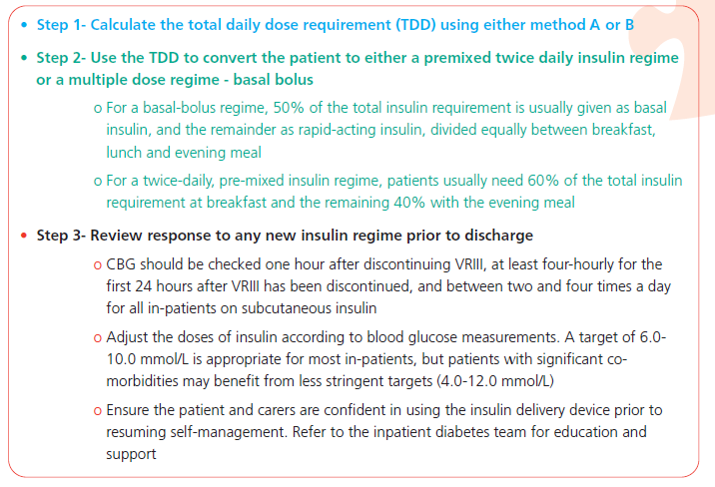

Slide 28
Management of hyper following discontinuation of the VRIII
Blood glucose greater than 12.0 mmol/L with blood ketones less than 3.0 mmol/L or urine ketones no more than ++
Type 1 diabetes: give subcutaneous rapid acting analogue insulin *. Assume that 1 unit will drop blood glucose by 3 mmol/L BUT wherever possible take advice from the patient about the amount of insulin normally required to correct high blood glucose.
Recheck the blood glucose 1 hour later to ensure it is falling. Repeat the subcutaneous insulin dose after 2 hours if the blood glucose is still above 12.0 mmol/L. In this situation the insulin dose selected should take into account the response to the initial dose – consider increasing the dose if the response is inadequate.
Recheck the blood glucose after 1 hour. If it is not falling consider re-introducing VRIII.
Type 2 diabetes: give 0.1 units/kg of subcutaneous rapid acting analogue Insulin *, and recheck blood glucose 1 hour later to ensure it is falling.
Repeat the subcutaneous insulin after 2 hours if the blood glucose is still above 12.0 mmol/L. In this situation the insulin dose selected should take into account the response to the initial dose – consider doubling the dose if the response is inadequate.
Repeat the blood glucose after another hour. If it is not falling consider re-introducing VRIII

Slide 30
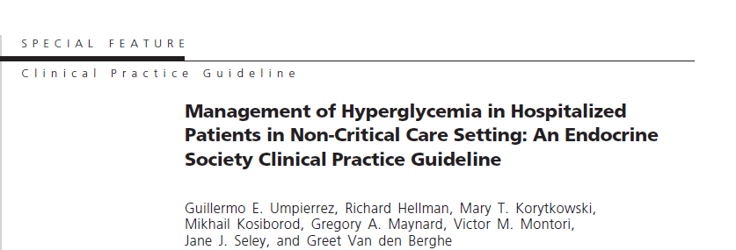
8.3% of the population, have diabetes .
Diabetes represents the seventh leading cause of death.
DM the fourth leading comorbid condition among hospital discharges in the United States .
Approximately one in four patients admitted to the hospital has a known
diagnosis of diabetes.
among non-critically ill patients admitted to general medicine and surgery services hyperglycemia is associated with prolonged hospital stay, increased incidence of infections, and more disability after hospital discharge and death .

Slide 31
1.0 Diagnosis and recognition of hyperglycemia and diabetes in the hospital setting
2.0 Monitoring glycemia in the non-critical care setting
We suggest the following schedules for POC testing: before meals and at bedtime in patients who are eating, or every 4–6 h in patients who are NPO or receiving continuous enteral feeding. (2,very low )
3.0 Glycemic targets in the non-critical care setting
3.1Werecommend a premeal glucose target of less than 140 mg/dl (7.8 mmol/liter) and a random BG of less than 180 mg/dl (10.0 mmol/liter) for the majority of hospitalized patients with non-critical illness. (1,low)
4.0 Management of hyperglycemia in the non-critical care setting
4.1 Medical nutrition therapy
4.2 Transition from home to hospital
4.3 Pharmacological therapy
4.4 Transition from hospital to home

Slide 32
TABLE 1. Example of a basal bolus insulin regimen for the management of non-critically ill patients with type 2 diabetes
A)Basal insulin orders
Discontinue oral diabetes drugs and non-insulin injectable diabetes medications upon hospital admission.
Starting insulin: calculate the total daily dose as follows:
0.2 to 0.3 U/kg of body weight in patients: aged 70 yr and/or GFR <60 ml/min.
0.4 U/kg of body weight per day for patients not meeting the criteria above who have BG concentrations of 7.8– 11.1 mmol/liter (140–200 mg/dl).
0.5 U/kg of body weight per day for patients not meeting the criteria above when BG concentration is 11.2–22.2 mmol/liter (201–400 mg/dl).
Distribute total calculated dose as approximately 50% basal insulin and 50% nutritional insulin.
Give basal insulin once (glargine/detemir) or twice (detemir/ NPH) daily, at the same time each day.
Give rapid-acting (prandial) insulin in three equally divided doses before each meal. Hold prandial insulin if patient is not able to eat.
Adjust insulin dose(s) according to the results of bedside BG measurements.

Slide 33
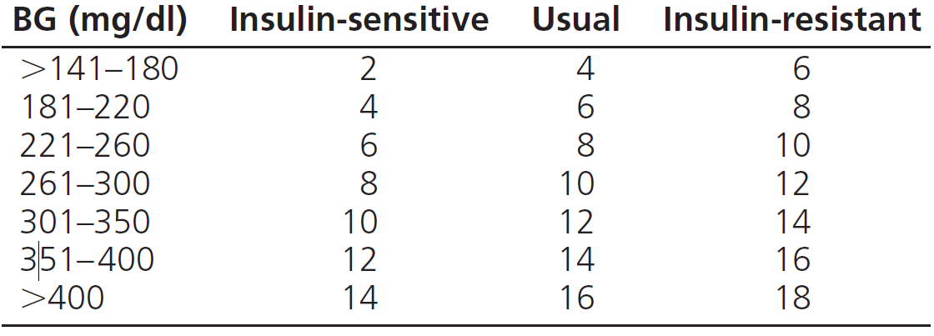
Supplemental (correction) rapid-acting insulin analog or regular insulin Supplemental insulin orders.
If a patient is able and expected to eat all or most of his/her meals, give regular or rapid-acting insulin before each meal and at bedtime following the usual column .
If a patient is not able to eat, give regular insulin every 6 h(6–12–6–12) or rapid-acting insulin every 4 to 6 h following the sensitive column (Section C below).
Supplemental insulin adjustment.
If fasting and premeal plasma glucose are persistently above 7.8 mmol/liter (140 mg/dl) in the absence of hypoglycemia, increase insulin scale of insulin from the insulin-sensitive to the usual or from the usual to the insulin-resistant column.
If a patient develops hypoglycemia BG 3.8 mmol/liter (70 mg/dl), decrease regular or rapid-acting insulin from the insulin-resistant to the usual column or from the usual to the insulin-sensitive column.

Slide 34
Correction dose insulin should not be confused with “sliding scale insulin,” which usually refers to a set amount of insulin administered for hyperglycemia without regard to the timing of the food, the presence or absence of preexisting insulin administration, or even individualization of the patient’s sensitivity to insulin.
The practice of discontinuing diabetes medications and writing orders for SSI at the time of hospital admission results in undesirable levels of hypoglycemia and hyperglycemia .
In one study, the risk for hyperglycemia (BG 11.1 mmol/liter or 200 mg/dl) increased 3-fold in patients placed on aggressive sliding-scale regimens.

Slide 35
5.0 Special situations
5.1 Transition from iv CII to sc insulin therapy
5.2 Patients receiving EN or PN
5.3 Perioperative BG control
5.4 Glucocorticoid-induced diabetes

Slide 38
Thanks.

