Slide 1
Overview of Anti-resorptive Agents in Treatment of Osteoporosis
Mahtab Niroomand, M.D
Assistant professor of Endocrinology
Shahid Beheshti University of medical sciences
Dec,11, 2014
Tehran

Slide 2
Anti-resorptive Agents
Bisphosphonates
Selective estrogen receptor modulators
Hormone replacement therapy
Calcitonin
Denosumab

Slide 3
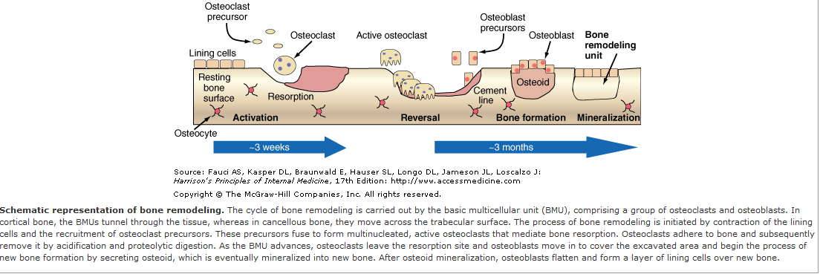
Bone remodeling

Slide 4
Bisphosphonates

Slide 5
Generations of Bisphosphonates
Generation
Chemical
modification
Examples
Antiresorptive
potency
Short alkyl or halide
side chain
Etidronate
Clodronate
1
10
First
Second
Cyclic side chain
Amino-terminal group
Tiludronate
Pamidronate
Alendronate
10
100
100-1000
Third
Cyclic side chain
Risedronate
Ibandronate
Zoledronate
1000- 10,000
1000-10,000
10,000+

Slide 6
Pharmacology
The oral bioavailability is low(1% to 3%), and is impaired by:
  Food, calcium, iron, coffee, tea, orange juice
Quickly cleared from plasma:
  with about 50% deposited in bone and
  50% excreted in urine
N Engl J Med 1998;338:736-746

Slide 7
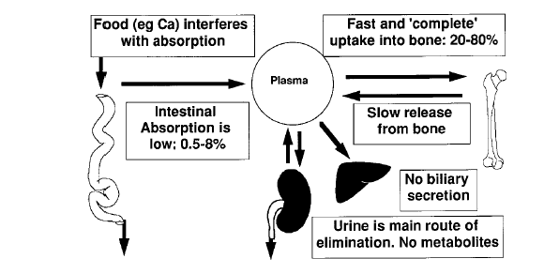

Slide 8
Mechanism of action
Reduce activity of individual osteoclasts
Reduce activation frequency
Increase osteoclast apoptosis
Indirectly and more slowly, decreased osteoblast function and bone formation

Slide 9
Mechanism of action
Spine
Bone Turnover
Bone Mineral Density
Fracture Rate
BF
Femur
PreMP Range
BR
Time
Time
Rapid decrease in bone
resorption (BR), followed
by a decrease in bone formation
Refill remodeling space
+ secondary mineralisation ↑
→ Increase in BMD
spine > hip
Reduction in
fracture risk
HOWEVER: trabecular thickness does not increase

Slide 10
Alendronate

Slide 11
FIT 1
Randomised trial of effect of Alendronate on risk of fracture in women with existing vertebral fractures
  Lancet 1996; 348:1535-41

Slide 12
Fracture Intervention Trial (FIT)
2027 women (1022 alend.,1005 plac.)
Age: 55-81 yrs with :
  Low femoral-neck BMD and
  At least one vertebral fracture
Follow up: 36 months
F/U > % 98

Slide 13
Fracture Intervention Trial (FIT)
Methods:
  Alendronate 5mg daily increased to 10mg at 24 months
  82% received supplementation with calcium and vitamin D
Primary endpoint :
  new vertebral fractures

Slide 14
Effect of Alendronate on BMD in Women With Existing Vertebral Fractures

Slide 15
Morphometric Fracture :
New morphometric vertebral fractures :
  78 (8%) in the Alendronate group
  145 (15%) in the placebo group
RR= 0.53(0.43-0.68) :
  47% relative risk reduction ( p<0.001)
  7% absolute risk reduction
NNT : 14 over 3 years

Slide 16
Clinical vertebral Fracture :
23 (2.3%) in the Alendronate group vs 50 (5.0%) in the placebo group had clinically apparent vertebral fractures
RR=0.45(0.27-0.72) , 54% RRR: PV=0.001 2.7% ARR
NNT : 37 over 3 years

Slide 17
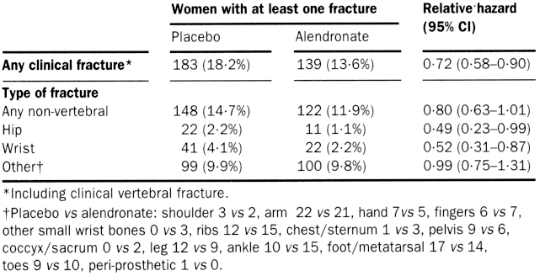
ARR =(18.2-13.6) /100 = 0.046
NNT = 22

Slide 18
2,027 women with low femoral neck BMD one or more vertebral fracture
6
5
Percent
of
patients
4
5.0
Placebo
4.1
Alendronate
3
**
*
2
2.3
2.2
*
1
2.2
0
1.1
Clinically apparent
Vertebral fracture
Hip fractures
Wrist fracture
% reduction
55%
51%
48%
**P< 0.001; *P< 0.05
Black DM et al, Lancet 1996;348:1535. © by The Lancet Ltd 1996. Reprinted with permission.
Fracture Intervention Trial (FIT)

Slide 19
FIT 2
Effect of Alendronate on Fracture Risk in Women With Low BMD and No Prior Vertebral Fracture
JAMA,December,1998-Vol 280,No,24

Slide 20
FIT-2
4432 women (2214 alend.,2218 plac.)
Age: 55-81 yrs with :
  Low femoral-neck BMD and
  No prior vertebral fracture
Follow up: 48 months

Slide 21
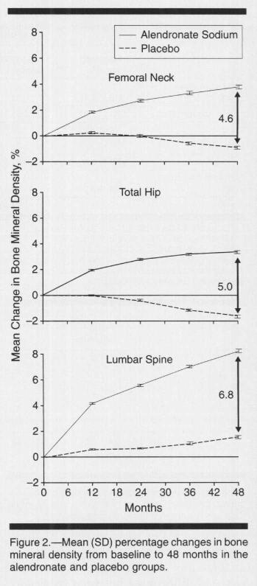

Slide 22
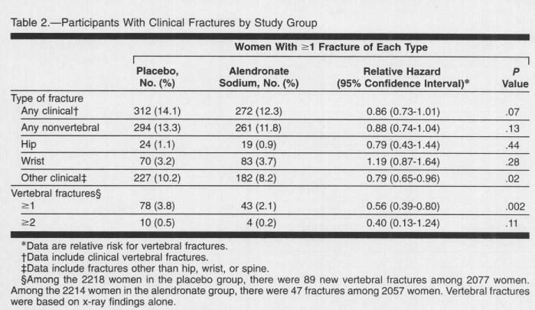

Slide 23
Effect of Alendronate on Fracture Risk in Women With Low BMD and No Prior Vertebral Fracture

Slide 24
Effect of alendronate on hip fx depends on baseline hip BMD
Baseline BMD T-score
-1.6 – -2.5
1.84 (0.7, 5.4)
< - 2.5
0.44 (0.18, 0.97)
NNT= 81
Overall
0.79 (0.43, 1.44)
0.1
1
10
Relative Hazard (± 95% CI)

Slide 25
Effect of alendronate on non-spine fx depends on baseline hip BMD
Baseline BMD T-score
-1.6 – -2.0
1.14 (0.82, 1.60)
-2.0 – -2.5
1.03 (0.77, 1.39)
< - 2.5
0.64 (0.50, 0.82)
Overall
0.86 (0.73, 1.01)
0.1
1
10
Relative Hazard (± 95% CI)

Slide 26
Results of meta-analysis of Alendronate trials
Vertebral fractures reduced by 48%
Nonvertebral fractures reduced by 49%
Pooled estimate of difference in % change in BMD (Alenedronate vs. placebo)
    7.48% for the lumbar spine
    5.6% for the femoral neck
  Endocrine Rev.2002:23:506-16

Slide 27
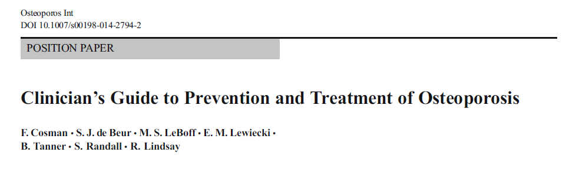
Alendronate reduces the incidence of spine and hip fractures by about 50 % over 3 years in patients with a prior vertebral fracture or in patients who have osteoporosis at the hip site .
Reduces the incidence of vertebral fractures by 48% over 3 yrs in patients without a prior vertebral fracture.

Slide 28
Indication
FDA-approved for :
  Prevention (5 mg/d ,35 mg weekly tablets)
  Treatment (10mg/d tablet, 70 mg weekly tablet, 70 mg weekly tablet with 2,800 or 5,600 IU of vitamin D3, and 70 mg effervescent tablet) of postmenopausal osteoporosis.
  Treatment to increase bone mass in men with osteoporosis
  Treatment of osteoporosis in men and women taking glucocorticoids

Slide 29
Ibandronate

Slide 30
Ibandronate
FDA-approved for:
  Treatment of postmenopausal osteoporosis (tab 150mg monthly ,3mg every3 months /IV).
  Prevention of postmenopausal osteoporosis (oral preparations )
Clinical effect:
  Reduces the incidence of vertebral fractures by about 50 % over 3 years, without reduction in risk of non-vertebral fracture.

Slide 31
Risedronate

Slide 32
Risedronate
FDA-approved for:
prevention and treatment of postmenopausal osteoporosis.
Dose: (5mg/d tablet; 35 mg weekly tablet; 35 mg weekly delayed release tablet; 35 mg weekly tablet packaged with six tablets of 500 mg caco3; 75 mg tablets on two consecutive days/month; and 150 mg monthly tablet)
Treatment to increase bone mass in men with osteoporosis
prevention and treatment of osteoporosis in men and women who are either initiating or taking glucocorticoids .
Clinical effect:
  Reduces the incidence of vertebral fractures by 41 to 49 %
  Reduces nonvertebral fractures by 36 % over 3 years,
  Significant risk reduction occurring within 1 year of treatment in patients with a prior vertebral fracture
Osteoporos Int, 24 june 2014

Slide 33
Zoledronic Acid

Slide 34
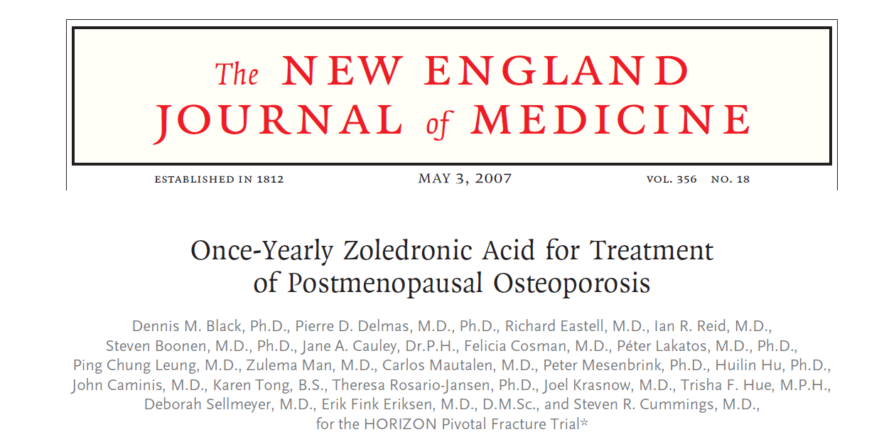
7765 postmenopausal women with osteoporosis
Randomly assigned to 5 mg of ZA or placebo
(IV once yearly for three consecutive years )

Slide 35
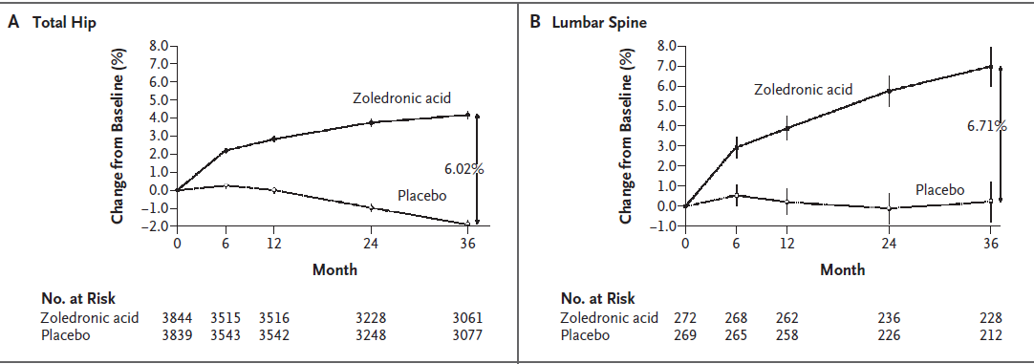
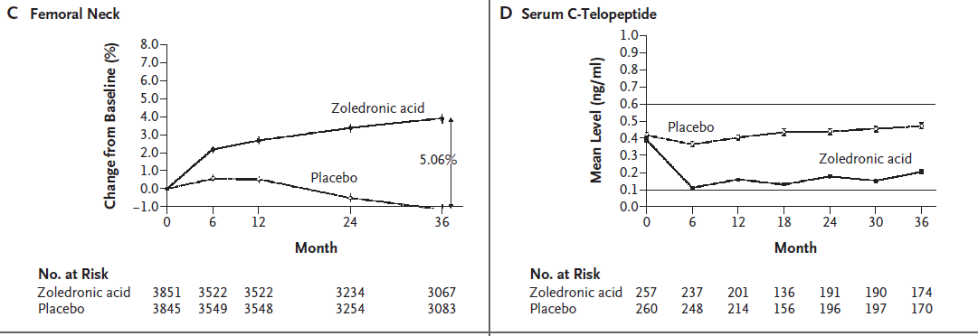

Slide 36
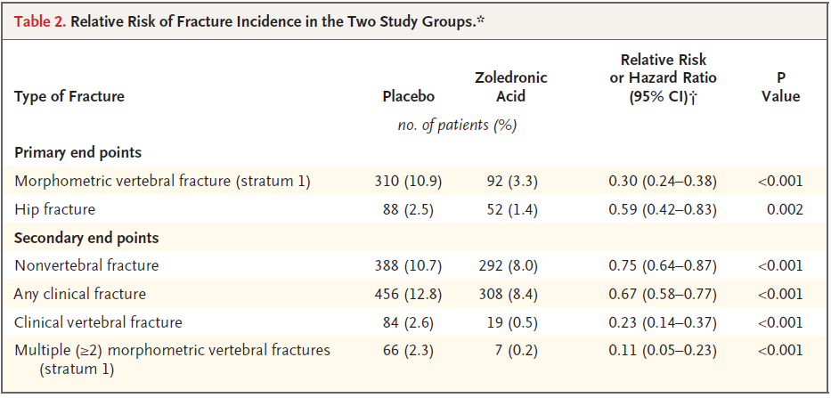
Results

Slide 37
Key message
A once-yearly infusion of zoledronic acid during a 3-year period significantly reduced the risk of vertebral, hip, and other fractures

Slide 38
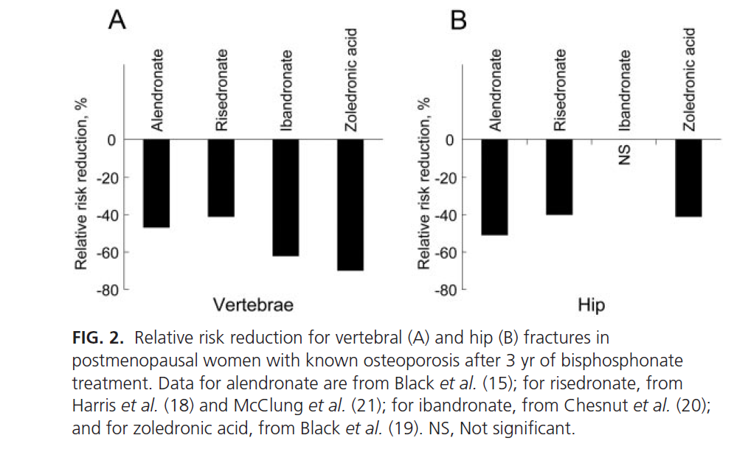
J Clin Endocrinol Metab 97: 2272–2282, 2012

Slide 39
Drug administration
Alendronate and risedronate tablets:
  Must be taken on an empty stomach, first thing in the morning, with 8 oz of plain water (no other liquid).
Delayed release risedronate (Atelvia) tablets:
  Must be taken immediately after breakfast with at least 4 oz of plain water (no other liquid).
After taking these medications, patients must wait at least 30 min before eating, drinking, or taking any other medication.
Patients should remain upright (sitting or standing) during this interval.

Slide 40
Drug administration
Ibandronate tablet:
  Must be taken on an empty stomach, first thing in the morning
  with 8 oz of plain water (no other liquid).
  After taking that, patients must remain upright and wait at least 60 min before eating, drinking, or taking any other
Ibandronate ( 3 mg/3 ml prefilled syringe):
  IV injection over 15 to 30 s, once every 3 months.
  Serum creatinine should be checked before each injection
Osteoporos Int, 24 june 2014

Slide 41
Bisphosphonate Side effects
GI problems: (OR=1.07 ,CI: 1.01-1.14)
  Difficulty swallowing and inflammation of the esophagus and stomach
AF :
  there was non clear association” between bisphosphonate use and atrial fibrillation.
Esophageal cancer:
  is not well supported by current data
  metaanalysis that included 7 studies found no association of risk for esophageal cancer with bisphosphonate use
Acute phase reaction :
  (with IV formulations)
Affect renal function:
  Contraindicated in eGFR<30–35 ml/min
Eye inflammation
Osteonecrosis of the jaw (ONJ):
  With long-term use for osteoporosis (> 5 yrs)
Osteoporos Int, 24 june 2014

Slide 42
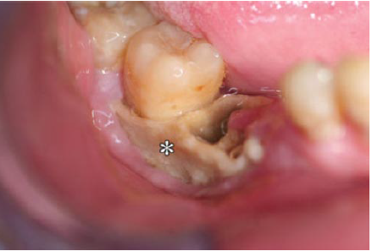
Approximately 1 in 10,000 to 1 in 100,000 patient-years in patients taking oral bisphosphonates for osteoporosis
Oral Maxillofac Surg 65:415–423,2007. NEJM355:2278,2006

Slide 43
Side effects (cont’d)
Low-trauma atypical femur fractures:
  with the long-term use (>5 years of use)
  Pain in the thigh or groin area(can be bilateral) often precedes these unusual fractures
  Subtrochanteric or femoral shaft of the femur
  Diagnosis by:
    Bilateral X-ray of the femurs
    followed by an MRI or a radionuclide bone scan
  Treatment:
    Surgical fixation is required in some cases
    Medical conservative treatment
    Bisphosphonates should be stopped

Slide 44
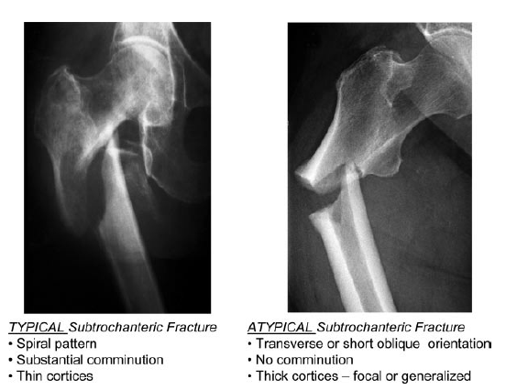
Atypical fracture

Slide 45
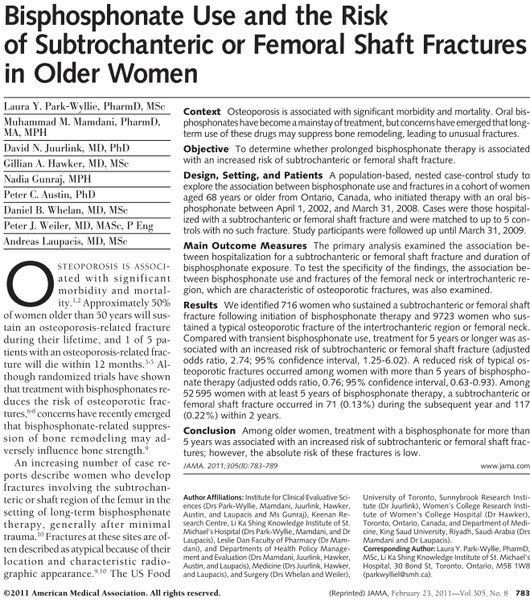
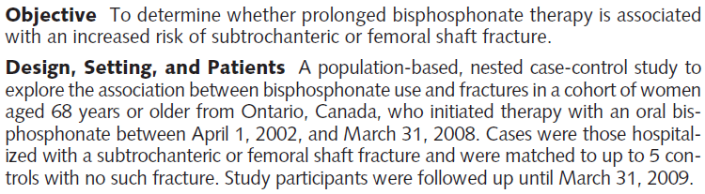
JAMA, febreury , 2011 :305

Slide 46
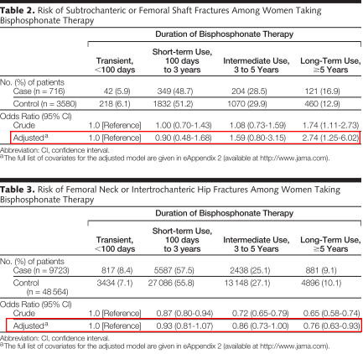

Slide 47
Contraindications
Hypersensitivity
Hypocalcemia
Inability to remain upright for at least 1/2 hour
Esophageal abnormalities ( achalasia or stricture)
Active upper gastrointestinal disease
Severe renal insufficiency. (creatinine clearance less than 30-35 mL/min)

Slide 48
SERM
Selective Estrogen Receptor Modulator

Slide 49
SERM
Non hormonal
Binds to estrogen receptor
Has estrogen-like effects in some tissues (agonist):
  Bone, serum lipids, vascular endothelium,CNS
Block estrogen effects in some tissues (antagonist):
  Uterus
  Breast

Slide 50
MORE
Multiple Outcomes of Raloxifene Evaluation
Multicenter, double-blind, placebo-controlled trial
    25 countries, 180 centers, 3 years with 1 year extension
7705 postmenopausal women with osteoporosis
    Mean age 66.5 years
Raloxifene 60 mg =Evista, 120 mg, or placebo
  All patients given daily calcium (500 mg) and vit - D (600 IU)
Ettinger B et al. JAMA 282:637-45, 1999 .Cummings SR et al. JAMA 281:2189-97, 1999

Slide 51
MORE Study (cont’d)
Primary endpoints:
  Radiographic vertebral fracture
  BMD
Secondary endpoints:
  All osteoporotic fractures
  Cardiovascular events
  Breast cancer
Ettinger B et al. JAMA 282:637-45, 1999 .Cummings SR et al. JAMA 281:2189-97, 1999

Slide 52
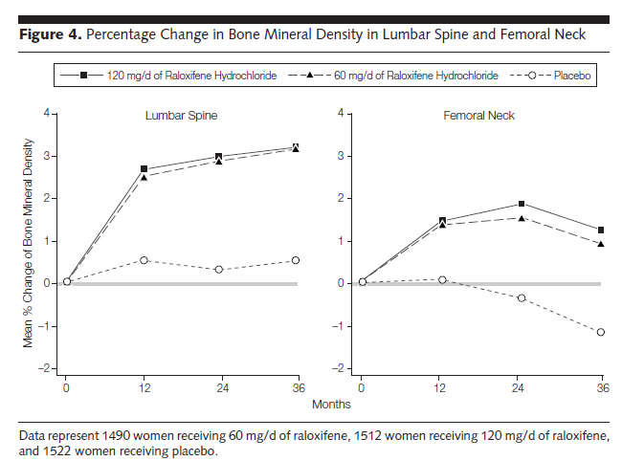
P<0.001
P<0.001

Slide 53
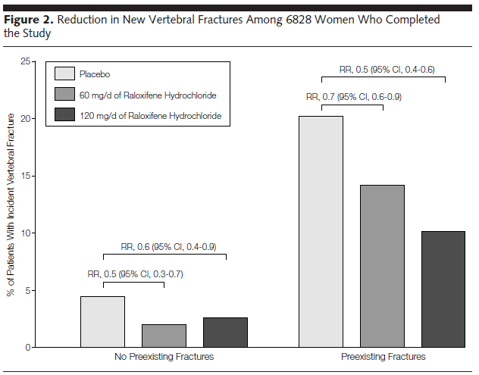

Slide 54
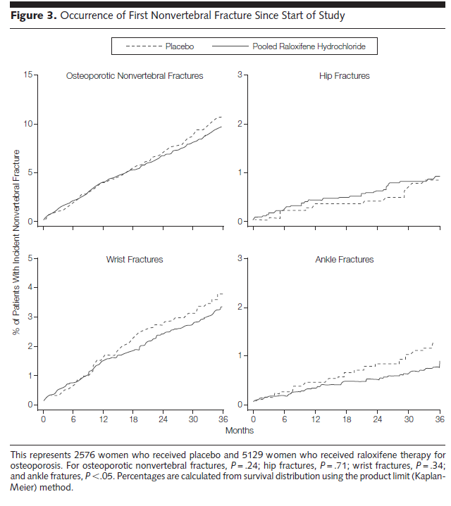
P = 0.24
P=0.71
P = 0.34
P<0.05

Slide 55
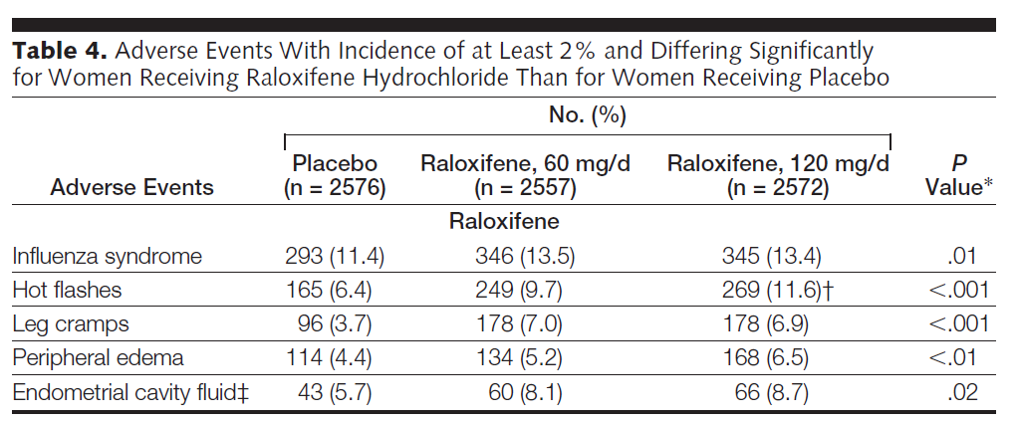

Slide 56
Key messages
In postmenopausal women with osteoporosis, raloxifene increases BMD in the spine and femoral neck and reduces risk of vertebral fracture.
Raloxifene therapy for 4 yrs did not significantly affect the risk of CV events in the overall cohort but did significantly reduce the risk of CV events in the subset of women with increased CV risk.

Slide 57
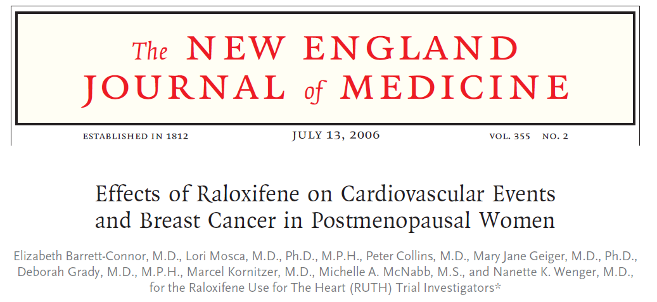

Slide 58
Methods
Methods: RUTH was an international, multicenter, randomized, double-blind, placebo-controlled trial
Subjects: 10,101 postmenopausal women (mean age: 67.5 yrs) with CHD or multiple RF for CHD
(Randomized to 60 mg of Raloxifene daily or placebo)
Follow up: median of 5.6 years.

Slide 59
Primary outcomes
Coronary events (death from coronary causes, MI,hospitalization for an ACS)
Invasive breast cancer

Slide 60
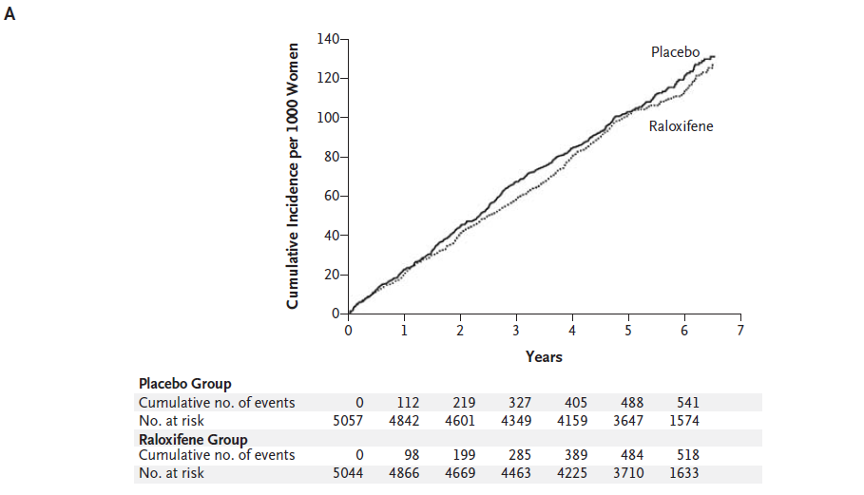
P Value
0.40
Cumulative Incidence of the coronary events (Death from Coronary Causes, Nonfatal Myocardial Infarction, or Hospitalization for an ACS Other Than MI)

Slide 61
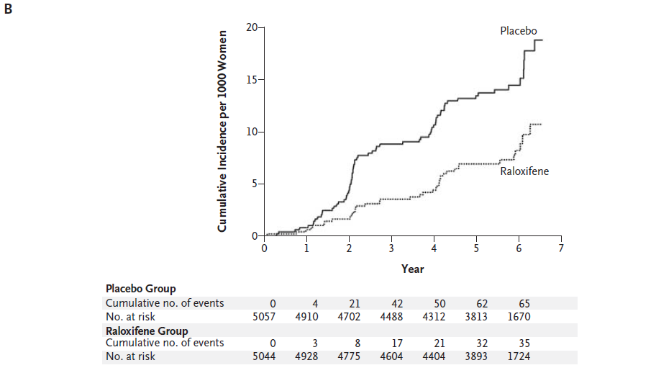
P Value
0.003
Invasive Breast Cancer

Slide 62
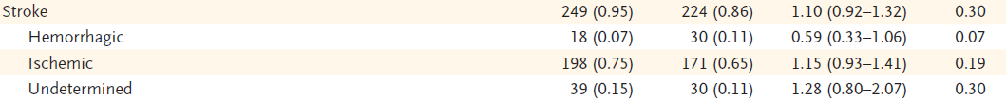
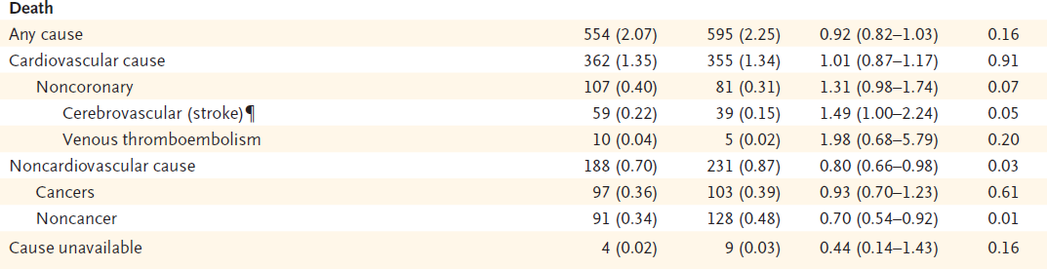

Slide 63
Key messages
Raloxifene did not significantly affect the risk of CHD
The benefits of Raloxifene in reducing the risks of invasive breast cancer and vertebral fracture should be weighed against the increased risks of venous thromboembolism and fatal stroke

Slide 64
Hormone Replacement Therapy
(HRT)

Slide 65
Hysterectomy
YES
N=10,739
NO
N=16,608
CEE*
0.625 mg/d
Placebo
CEE 0.625 mg/d + MPA** 2.5 mg/d
Placebo
Adapted from: Writing Group for the Women’s Health Initiative. JAMA. 2002;288:321-333.
*Conjugated Equine Estrogen
**Medroxyprogesterone Acetate
Women’s Health Initiative (WHI)
ERT/HRT Program Design

Slide 66
NNT 2000 1666 256
-23%
-34%
-34%
WHI, JAMA 2002

Slide 67
Clinical Outcomes of the WHI trial (Estr.+Progestin)
16700 women with 5.2 yrs follow-up
NNH 1429 1250 555 1250 1666
160
+112%
120
80
+29%
+41%
% difference vs. placebo
+26%
40
0
n.s.
-40
-37%
-80
VTD
CHD
Stroke
Breast Cancer
Endom.Cancer
Colorectal Cancer
WHI, JAMA 2002

Slide 68
Calcitonin

Slide 69
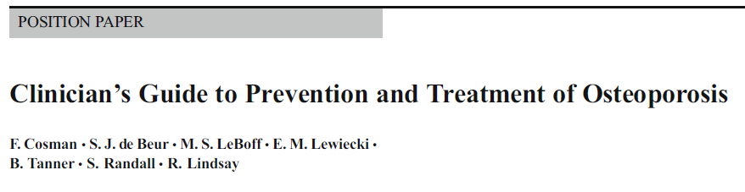
Osteoporos Int, 24 june 2014

Slide 70
Calcitonin
FDA-approved for the treatment of osteoporosis in women who are at least 5 yrs postmenopausal when alternative treatments are not suitable
Has not increase BMD in early postmenopausal women
Calcitonin :
  Reduces vertebral fracture by about 30 % in those with prior vertebral fractures
  Has not reduce non-vertebral fractures

Slide 71
Nasal Calcitonin: Efficacy at the Spine and Hip
(PROOF: 5-Year study of 1255 women, average age 68, with 1-5 prevalent vertebral fractures)
Percent Reduction in
New Vertebral Fractures
compared with placebo
0
25
10
Number of Hip Fractures
by Treatment Group
20
20
30
100 IU
15%
(NS)
400 IU
16%
(NS)
40
15
50
200 IU
33%
(P=0.03)
9
7
(NS)
60
10
5
(NS)
70
1
80
RR= 0.67, 95%CI: 0.47–0.97, P=0.03
5
90
100
0
Placebo
100 IU
200 IU
400 IU
.
RR=0.1 (0.01–0.9)*
Chesnut CH III et al. Am J Med. 2000;109:267-276.
Notes:
The only significant reduction of a 5-year analysis of the effectiveness of nasal calcitonin was at 200 IU.
No statistical differences could be demonstrated in the number of hip fractures by the treatment group.
The dose that fracture risk was decreased (200 IU) is not the same dose that bone turnover was affected.

Slide 72
Calcitonin in vertebral fracture pain
In four RCTs :
  Calcitonin reduces the pain associated with acute vertebral fractures.
Response: 3-7 days later
Daily dose of :
  100 IU/SC
  200 IU/nasal
Calcif Tissue Int 1991;49:369-72
Osteoporos Int, 24 june 2014

Slide 73
Side effects
Flushing (nasal spray: <1%; injection: 2% to 5%),
Rash
Epistaxis
Allergic reactions (particularly in history of allergy to salmon)
Nausea (injection: 10%; nasal spray: 1% to 3%)
Rhinitis:
  in 15% of nasal salmon calcitonin users over a 5-year period.
Malignancies (4.1 % in calcitonin vs 2.9% in placebo)
Serious side effects are rare (< 1%).
Osteoporos Int, 24 june 2014

Slide 74
Denosumab

Slide 75
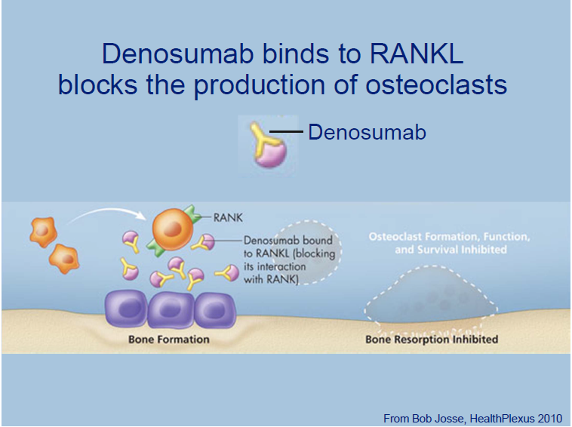
Denosumab
Mechanism of action

Slide 76
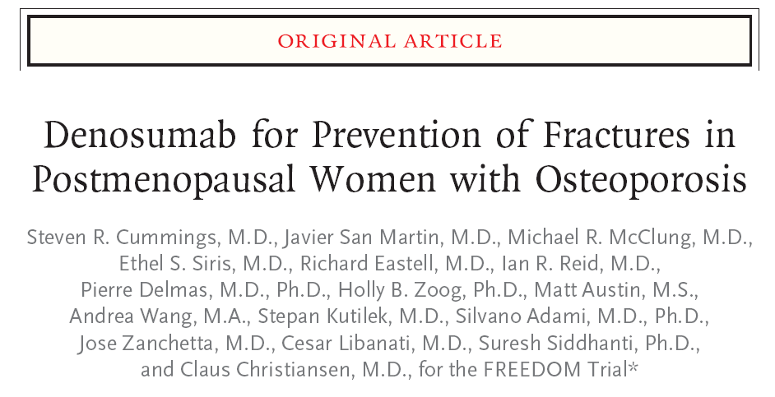
N : 2009
Participants:
  7868 women (ages : 60 and 90 years)
  BMD T-score of <−2.5 but >−4.0 at the lumbar spine or total hip
Intervention:
  Randomly assigned to receive either 60 mg of denosumab or placebo SC every 6 months
Length of F/U: 36 months
Primary end point : new vertebral fracture
Secondary end points : nonvertebral and hip fractures
N Engl J Med 361;8: 2009

Slide 77
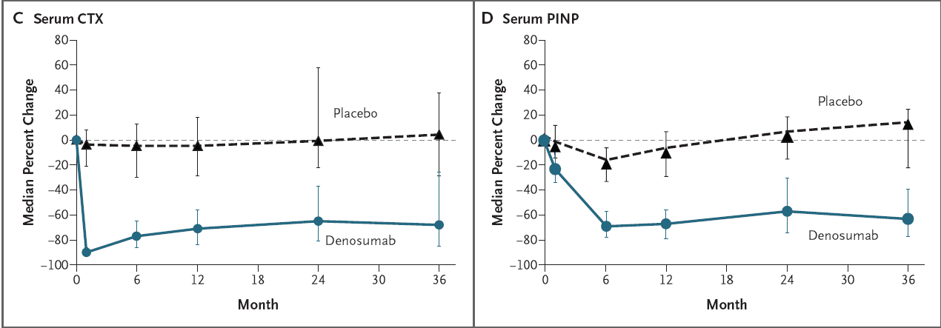
Denosumab
significant reductions (P<0.001) in markers of bone turnover, C-telopeptide, and intact serum procollagen type I N-terminal propeptide, over 3 years

Slide 78
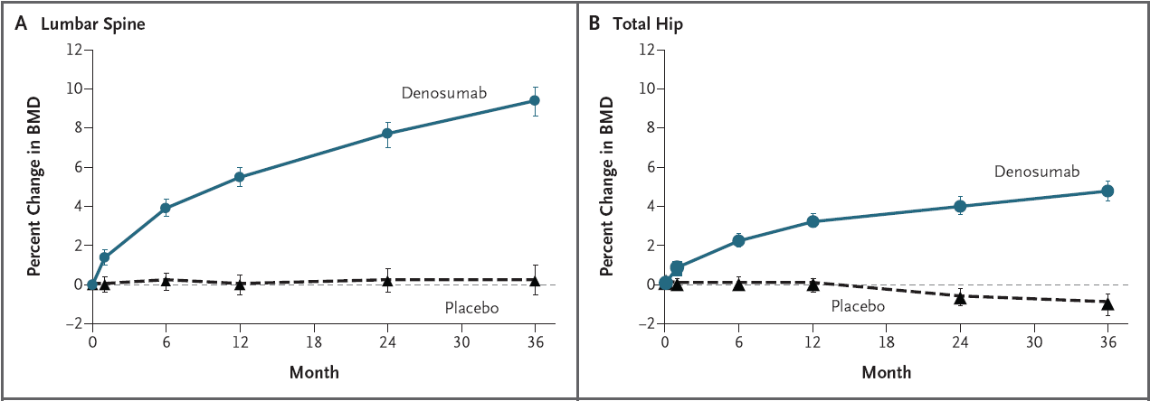
Denosumab
9.2%
6.0%
As compared with placebo group, subjects in the denosumab group had a relative increase of 9.2% in BMD at the lumbar spine and 6.0% at the total hip

Slide 79
20%
P = 0.01
68%
P < 0.001
Placebo
Denosumab
40%
P = 0.04
Effect of denosumab on fractures (FREEDOM)
Cummings SR, et al. N Engl J Med. 2009 Aug 20;361(8):756-65

Slide 80
Side effects
No increases in risk of :
ONJ, CVD, cancer, atypical femur fracture
Increased risk of :
  Infections: (RR=1.3, NNH=118)
  Hypocalcemia (must be corrected before starting denosumab)
  Cellulitis :(0.3% vs. <0.1% P=0.002 )
  Atopic dermatitis:(10.8% vs. 8.2%; P< 0.0001)
  Rapid bone loss when treatment is stopped and alternative agents should be considered to maintain BMD.
Osteoporos Int, 24 june 2014

Slide 81
Denosumab indications
FDA-approved for:
Treatment of osteoporosis in postmenopausal women at high risk of fracture.
Increase BMD in men at high risk of fracture
Treatment of bone loss in women with breast cancer on aromatase inhibitor therapies
Treatment of bone loss in men receiving gonadotropin-reducing hormon treatment for prostate cancer
Osteoporos Int, 24 june 2014

Slide 82
Denosumab Features
  At least comparable efficacy to bisphosphonates
  More profound, but reversible inhibition of bone resorption
  Very convenient dosing
  Different safety profile
  Denosumab does not require renal clearance, and may be given to patients with renal impairment without dose adjustment
  Price

Slide 83
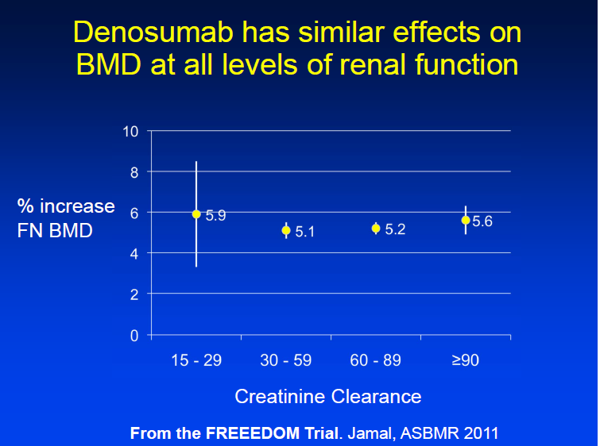

Slide 84
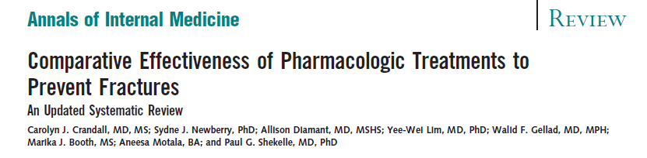
Annals of Internal Medicine, September 2014
Annals of Internal Medicine, September 2014

Slide 85
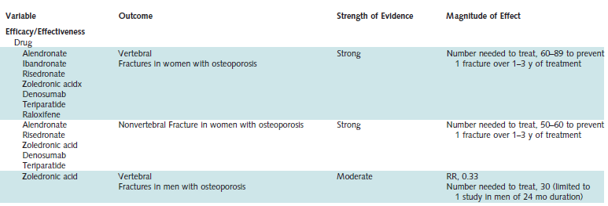
Annals of Internal Medicine, September 2014

Slide 86
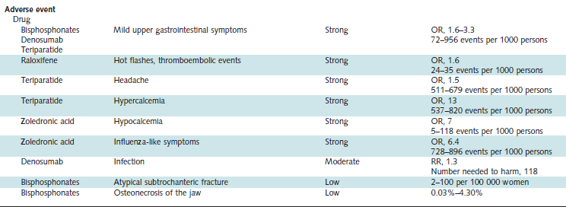

Slide 87
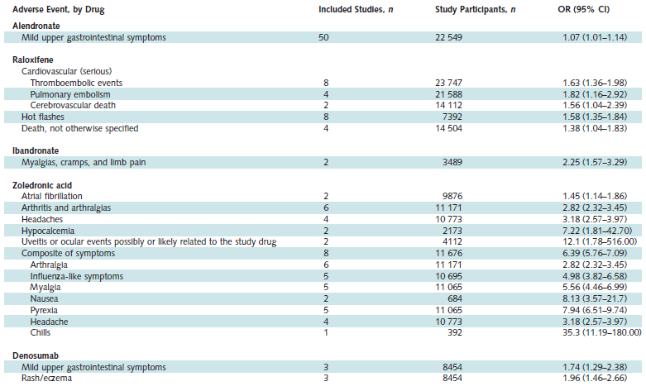
Annals of Internal Medicine, September 2014

Slide 88
Conclusion
Alendronate , Risedronate , Zolendronate reduce vertebral and non-vertebral fractures compared with placebo
Etidronate , ibandronate , and raloxifene reduce vertebral fractures, but have not been shown to reduce non-vertebral fractures.
Calcitonin may reduce vertebral fractures over 1–5 years, but has not been shown to reduce non-vertebral fractures

Slide 89
Conclusion…
Hormone replacement therapy may reduce fractures, but it increases the risk of breast cancer and cardiovascular events
Denosumab reduces the risk of vertebral, nonvertebral, and hip fractures in women with osteoporosis

Slide 90

Thank for your attention

