Slide 2
داروهاي ضد تيروئيد
دكتر فريدون عزيزي
استاد دانشگاه علوم پزشكي شهيد بهشتي

Slide 3
Introduction
Treatment of basic pathogenic factors in thyrotoxicosis is only possible in rare conditions, such as thyrotropin secreting pituitary tumors, iatrogenic thyrotoxicosis and struma ovarii; existing therapies are only palliative. Treatment of thyrotoxicosis is designed to restrain thyroid hormone synthesis (antithyroid drugs) or to reduce the quantity of thyroid tissue (radioiodine and surgery).

Slide 4
Drugs with antithyroid action
Thiocyanate and percholorate inhibit thyroid iodine transport.
Iodine and iodine-containing agents and lithium inhibit hormone release
The iodine-containing contrast agent sodium ipodate also inhibits peripheral T3 production from thyroxine T4
Dexamethasone inhibits the glandular secretion of thyroid hormones and the peripheral conversion of T4 to T3
However, their use in the treatment of thyrotoxicosis is limited.

Slide 5
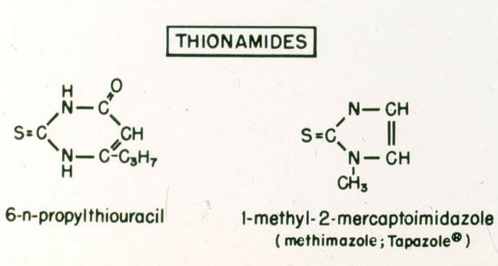

Slide 6
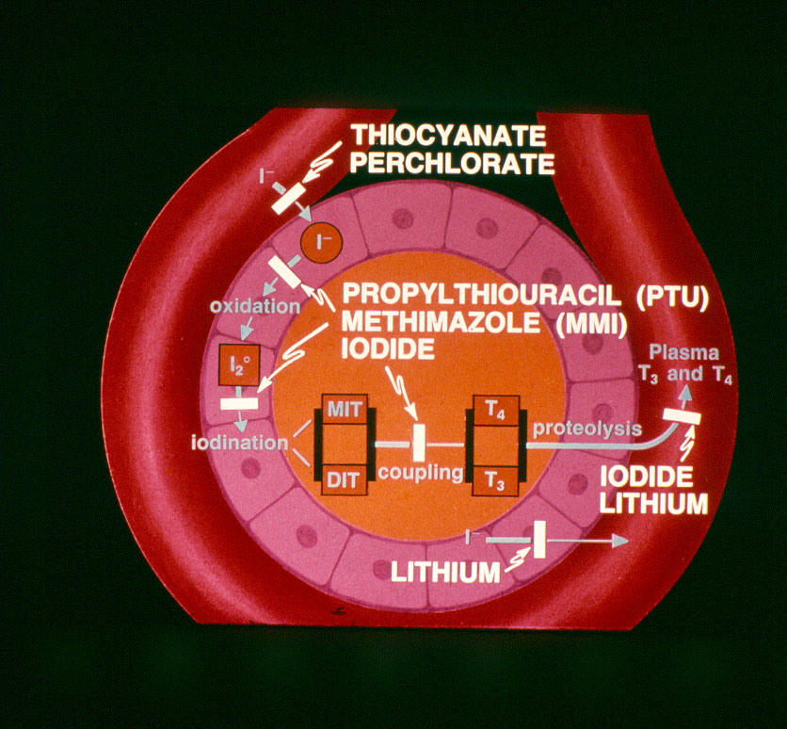

Slide 7
Selected Pharmacologic Features of ATD
Feature | Methimazole | Propylthiouracil
Serum protein binding | None | 75%
Serum half-life | 4-6 h | 1-2h
Metabolism of drug Liver disease Kidney disease | Decreased Normal | Normal Normal
Transplacental passage | + | +
Concentration in breast milk | Higher | Low

Slide 8
Causes of Thyrotoxicosis
Diffuse toxic goiter
Toxic multinodular goiter
Toxic adenoma
Iatrogenic Subacute thyroiditis
Iodine excess Spontaneously resolving
Postpartum thyroiditis Trophoblastic tumors
Strauma overaii Hashitoxicosis
TSH- secreting Metastatic thyroid ca

Slide 9
Notes:
Number 16

Slide 11
Factors favoring relapse of thyrotoxicosis after treatment of Graves’ disease with thionamides
More consistent factors:
Severe degree of thyrotoxicosis
Large goiter
Lack of decrease of goiter size during therapy
High T3 to T4 ratio in serum
Higher baseline levels of anti-TSH receptor antibodies
Lack of normalization of serum TSH
Inconsistent factors:
Sex, age, cigarette smoking, duration of symptoms before diagnosis, presence of ophthalmopathy, psychiatric disorders, (depression, hypochondriasis, paranoia, mental fatigue) and problems of daily life
Azizi F. Exper Opin Drug Saf 2006; 5: 107-116

Slide 12
Duration of therapy with thionamides
1. Preparation for ablation of the thyroid: the duration of therapy is up to the time that patient attains euthyroidism. Methimazole is the preferred agent for attaining euthyroidism before radioiodine therapy.
2. Treatment of diffuse toxic goiter.

Slide 13
Frequently seen adverse reactions to thionamide agents*
Adverse reaction | Thionamide drug responsible | Frequency (%)
Major
Polyarthritis Agranulocytosis | Methimazole and propylthiouracil Propylthiouracil Methimazole | 1-2 0.37-0.4 0.1-0.35
Immunoallergic Hepatitis | Propylthiouracil | 0.1-1.0
Minor
Skin reactions Arthralgias GI discomfort | Methimazole and propylthiouracil Methimazole and propylthiouracil Methimazole and propylthiouracil | 4-6 1-5 1-5
Adverse reactions to methimazole are dose related; those of propylthiouracil are less clearly
related to dose
Azizi F. Exper Opin Drug Saf 2006; 5: 107-116

Slide 14
The interval until agranulocytosis and /or neutropenia developed after starting antithyroid drug treatment
Takata K, et al. Thyroid 2009; 19: 559

Slide 15
Comparison of various properties of common thianomid drugs
Property | Methimazole | propylthiouracil
Longer half life | 
Once or twice daily administration | 
More speedy improvement is serum T4 and T3 | 
Better patient compliance | 
Lower treatment failure with radioiodine treatment | 
Major side effects:
Agranulocytosis | + | +
Polyartritis | + | +
Immunoallergic hepatitis | - | +
Safety in pregnancy | + | +
Safety in lactation | + | +
Azizi F. Exper Opin Drug Saf 2006; 5: 107-116
Notes:
Azizi F. Exper Opin Drug Saf 2006; 5: 107-116

Slide 16
Major adverse reactions to propylthiouracil
22 serious liver injury over the past 20 years
(FDA Adverts Event Reporting System)
9 death
5 liver transplants
16 adults liver transplants for PTU-related liver failure
(United Network for Organ Sharing)
Ocurrence:
1: 10,000 adults
1: 2,000 children
Liver failure can occur any time over the course of therapy
Bahn et al. Thyroid 2009; 19: 673

Slide 17
Number and proportion of unique reports for severe and mild liver injury by age group
Type of liver injury by age group (yr) |  | Propylthiouracil |  |  | Methimazole |  |  | Total reported in AERS
 |  | Reports (n) | % |  | Reports (n) | %
Severe
<17 |  | 23 | 0.86 |  | 0 | 0.00 |  | 2,668
≥ 17-40 |  | 23 | 0.28 |  | 4 | 0.05 |  | 8,242
≥ 41-60 |  | 11 | 0.09 |  | 9 | 0.08 |  | 11,622
≥ 61 |  | 7 | 0.06 |  | 6 | 0.05 |  | 11,245
Unknown |  | 13 | 0.11 |  | 4 | 0.03 |  | 11,760
Total |  | 76a | 0.17 |  | 23 | 0.05 |  | 45,537
Mild
<17 |  | 4 | 0.08 |  | 1 | 0.02 |  | 5,273
≥ 17-40 |  | 14 | 0.08 |  | 21 | 0.13 |  | 16,590
≥ 41-60 |  | 4 | 0.02 |  | 26 | 0.11 |  | 23,812
≥ 61 |  | 6 | 0.02 |  | 22 | 0.09 |  | 25,822
Unknown |  | 5 | 0.02 |  | 15 | 0.07 |  | 20,401
Total |  | 33 | 0.04 |  | 85 | 0.09 |  | 91,898
Rivkees SA, et al. J Clin Endocrinol Metab 2010; 95: 3260

Slide 18
Total number of prescriptions dispensed for MMI and PTU from outpatient retail pharmacies, 1991–2008, according to Surveillance Data, Vector One: National Database, extracted March 2009
Emiliano AB, et al. J Clin Endocrinol Metab 2010; 95: 2227

Slide 19
Patients with Graves’ disease (no.=249). Survival analysis with respect to relapse of thyrotoxicosis comparing younger vs older patients (column 1) and comparing patients who discontinued methimazole treatment (group D) vs patients who maintained treatment throughout the observation period (group M), either in younger patients (column 2) or in older ones (column 3)
E. Massa, et al. J Endocrinol Invest 2008; 31: 866-72

Slide 20
Kaplan-Meyer curves of relapse of thyrotoxicosis in 42 patients with Graves’ disease (age below 35 yr); 29 patients who discontinued methimazole treatment (D) vs 13 patients who maintained treatment throughout the observation period (M)
E. Massa, et al. J Endocrinol Invest 2008; 31: 866-72

Slide 21
Kaplan-Meyer curves of relapse of thyrotoxicosis in 207 patients with Graves’ disease (age above 35 yr); 92 patients who discontinued methimazole treatment (D) vs 105 patients who maintained treatment throughout the observation period (M)
E. Massa, et al. J Endocrinol Invest 2008; 31: 866-72

Slide 22
“In patients with recurrent hyperthyroidism after disontinution of antithyroid drugs, long term (mean 10 years) continuous treatment with methimazole (MMI) was safe, and had comparable expense and complications with radioiodine treatment”
Azizi F, et al. Europ J Endocrinol 2005; 152: 695
`

Slide 23
Special considerations
Thionamide agents have been the treatment of choice for thyrotoxicosis during the pregnancy and postpartum periods. However use of these drugs during these important periods of woman’s life needs special considerations.

Slide 25
Antithyroid Treatment in Pregnancy
First trimester:
PRU
(? MMI)
Second trimester:
Dc PTU
Change to MMI
PTU: Propylthiouracil
MMI: Methimazole

Slide 26
Why PTU has been preferred by some specialists?
Fractional transfer to the fetus less than MMI?
Aplasia cutis with MMI and not PTU?
Choanal/esophagheal atresia with MMI
“MMI in an acceptable alternative to
PTU and is used in pregnant women in
many parts of the world”.

Slide 27
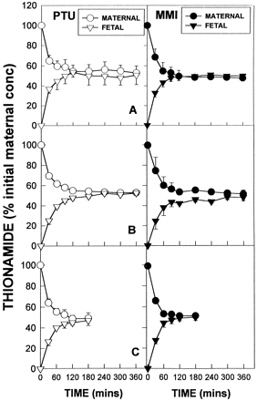
PTU and MMI levels (± SD), expressed as a percentage of initial concentration in maternal (circles) and fetal (triangles) circuits of the perfused human placental lobule.
Mortimer et al.JCEM 1997;82:3099

Slide 28
Mean cord TSH in PTU and MMI and Control groups
P<0.01
NS
NS
Momotani et al. JLEM 82;3633:1997

Slide 29
Literature review of aplasia cutis congenita after exposure to methimazole in utero
Case | Reference | Size of scalp defect | Skull defect
1* | Milhan and Elledge, 1972 | Unknown | -
2* | Milhan and Elledge, 1972 | Unknown | -
3† | Mujtaba and Burrow, 1975 | Unknown | Unknown
4‡ | Mujtaba and Burrow, 1975 | Unknown | Unknown
5 | Kalb and Grossman, 1986 | 6 cm | Skull hypoplasia
6 | Van Dijke et al., 1987 | Multiple | -
7 | Vogt et al., 1995 | 30 cm2 | -
8 | Martin-Denavit et al., 2000 | 3-5 cm | -
9 | Izhar and Ghani, 2002 | Small, multiple | -
10 | Ferraris et al., 2003 | Small, multiple | -
11‡ | Ferraris et al., 2003 | Small, single | -
12 | Karg et al., 2004 | 3 × 4 cm, multiple | +
13 | Nakamura et al., 2005 | 1.4 × 0.7 cm, multiple | +
14 | Shivakumar et al., 2006 | 4 × 3.5 cm, multiple | -
15# | Iwayama et al., 2007 | 5 × 7 cm | +
* Dizygotic twins. † Siblings ‡ A dizygotic twin # A monozygotic twin

Slide 30
Congenital anomalies
Two epidemiological studies: no increase in the frequency of congenital anomalies in children prenatally exposed to MMI.
Momotani et al 1984; (243 MMI, 400 control)
Gianantonio et al 2001;(241 MMI,1089 control)
Aplasia Cutis
Baseline occurrence rate of aphasic cutis: 1 in 33,000 births
Rate associated with MMI not different from baseline rate:
Van Dijke et al. Ann Inter Med 1987; 106: 60
Momotani et al. Clin Endocrinol 1994; 20: 695
Azizi F. Int J Endoc Metab 2008; 4: 109
Multiple (15) case reports
Increased rate of aplasia cutis in an area where MMI was used in animal feed
Martinez-Firas et al. Lancet 1992; 339: 742

Slide 31
Reports of Choanal Atresia and Gastro-infstinal Anomalies with Methimazol/Carbimazole
Author, Year | Choanal Atresia | GI anomaly
Greenberg, 1987 | Bilateral | ___
Ramirez et al, 1992 | ___ | EA/TEF
Johnsson et al, 1997 | Bilateral | EA/TEF
Hall, 1997 | Bilateral | ___
Wilson et al, 1998 | Bilateral | ___
Clementi et al, 1999 | Bilateral | EA/TEF
Di Gianantonio et al, 2001 | + | EA
Karlsson et al, 2002 | ___ | Omphalocele, EA/TEF
Barwell, et al, 2002 | Bilateral | ___
Babero et al, 2004 | Bilateral | ___
Foulds et al, 2005 | + | ___
Myers & Reardon, 2005 | + | ___
Wolf et al, 2006 | + | ___
General incidence | 1:10,000 | EA: 1,2500-4,500
EA; esophageal atresia; TEF: tracheo-esophageal fistula

Slide 32
Expected yearly occurance of congenital anomalies in hyperthyroid pregnancies in the world
No of birth / year | 140,000,000
No of pregnant hyperthyroids (0.2%) | 28,000,000
Expected anomalies
Aplasia cutis (1:33,000) | 8
Choanal atresia (1:10,000) | 24
Esophageal atresia (1:3,500) | 80

Slide 33
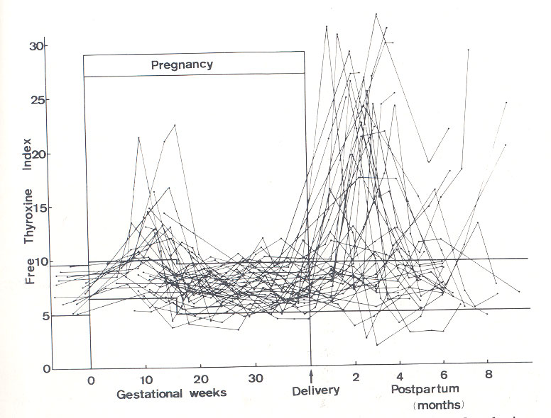
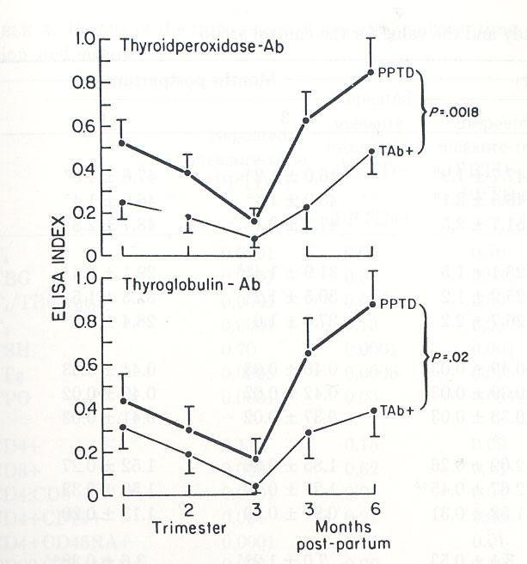
Amino et al. JCEM 55;108,1982
Stgnaro-Green et al. JCEM 74:645,1992

Slide 34
Management of Postpartum thyrotoxicosis
Postpartum, subacute, sporadic silent
No treatment for thyrotoxicosis
Graves’ disease
Antithyroids
Radiiodine
Thyroidectomy
Notes:
Number 21

Slide 35
Thionamides and Lactation
For many years breast-feeding was forbidden if antithyroid drugs were being used, because both methimazole (MMI) and propylthiouracil are transferred into the breast milk.
It was shown that only small amounts of propylthiouracil are found in milk, therefore, lactating women with Graves’ disease receiving propylthiouracil have been advised that breasd-feeding is safe.
Notes:
Number 27

Slide 36
Antithyroid drugs and breast-feeding
Author | Year | Findings
Williams et al. | 1944 | High concentration of thiouracil in milk
Low et al. | 1979 | Only 0.077% of PTU in breast milk
Kampmann et al. | 1980 | Only 0.025% of PTU in breast milk
Lamberg et al. | 1984 | Safety of carbimazole (5-15mg) , 11 infants
Nomotani et al. | 1990 | Safety of PTU (50-300 mg), 8 infants
Azizi | 1996 | Safety of methimazole, 35 infants 5 mg/d 13 10 mg/d 17 20 mg/d 6
Azizi | 2000 | Safty of methimazole, 139 infants 5 mg/d 51 10 mg/d 46 20 mg/d 42 intellectual development 14
Notes:
Number 30

Slide 37
Verbal (A) and performance (B) components of were Wechsler test score in children breast-fed while mothers taking methimazole and in controls
Control
MMI
100
Block design
Sentences
80
60
Comprehension
Geometric design
Scores
40
Similarities
Mazes
20
Mathematic
Picture completion
Vocabulary
0
Information
Animal house
Verbal
Performance
IQ
IQ
Azizi F et al. J Pediat Endocrinol Metab 2003; 16: 18
Notes:
Number 45

