Slide 1
به نام خدا
فیزیولوژی هموستاز گلوکز و علل هیپوگلیسمی

Slide 2
Classification of Hypoglycemia in Individuals with Diabetes
Severe | Requiring the assistance of another individual to administer rescue therapy
Symptomatic | Typical symptoms, plasma glucose <70 mg/dl
Asymptomatic | No symptoms, plasma glucose <70 mg/dl
Probable | Typical symptoms, no plasma glucose available
Pseudohypoglycemia | Typical symptoms, plasma glucose >70 mg/dl

Slide 3
Etiology and possible mechanisms of hypoglycemia
Increase insulin | Impaired gluconeogenesis/ glycogenolysis | Counter-regulatory failure
Exogenous insulin Sulfonylurea Meglitinides Quinine Trimethoprim-sulfamethoxazole Alcohol Insulinoma Insulin or insulin receptor antibodies | Salicylates Beta-adrenergic blockers Hepatic failure Renal failure Alcohol | Autonomic dysfunction Exercise Addison‘s disease Pan-hypopituitrism Growth hormone deficiency Hypothyroidism

Slide 4
Etiology and possible mechanisms of hypoglycemia
Increased insulin sensitivity | Increase glucose utilization/peripheral tissue uptake | Complex mechanisms | Beta –cell toxicity | Decreased insulin clearance | Reactive hypoglycemia
Exercise Weight loss fasting | Exercise sepsis | Mesenchymal tumors(IGF2) Islet cell hyperplasia Inborn errors of metabolism Inherited enzyme defects | Pentamidine | Renal failure | Idiopathic Dumping syndrome

Slide 5
Epidemiology of Hypoglycemia
A 1-year study included 8500 people with diabetes
7.1% of patients with T1DM and 7.3% insulin treated T2DM expected at least 1 episode of severe hypoglycemia
Incidence of severe hypoglycemia in T2DM patients treated with sulfonylureas was 0.8% per year

Slide 6
Epidemiology of Hypoglycemia
In pregnant women with diabetes severe hypoglycemia increases nearly 3-fold during the first trimester compared to prepregnancy
Rates of hypoglycemia decline with each successive trimester from 5.3 to 2.4 to 0.5 events per patient-year in the first, second, and third trimesters, respectively

Slide 7
Epidemiology of Hypoglycemia: Critically Ill Patients
For critically ill patients treated with intensive insulin therapy in the ICU, rates of hypoglycemia range fro 2.1% to 11.5%.

Slide 8
Epidemiology of Hypoglycemia: Mortality
25-13% of deaths in patients with T1DM are attributable to hypoglycemia
Hypoglycemia may be involved in “dead in bed” syndrome

Slide 9
Anatomy of Body Fuels
 | Kg | Kcal
Adipose tissue | 14
Triglyceride | 12 | 111000
Muscle | 30 | -
Protein | 6 | 24000
Glycogen, liver | 0.07 | 280
Glycogen, muscle | 0.4 | 1600
Glucose | 0.02 | 80
 |  | Total:135,960

Slide 10
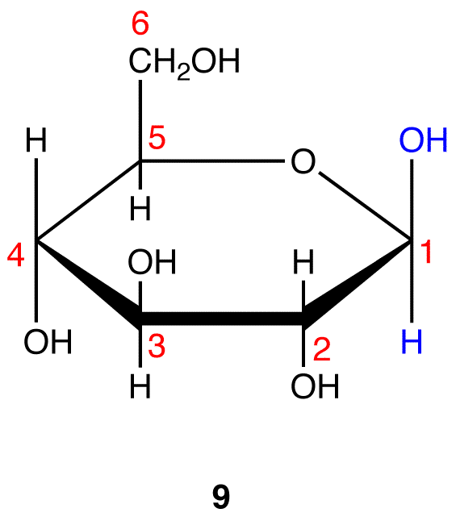
Glucose traverse from plasma membrane
is rate limiting in muscle and adipose tissue.
Plasma membrane of liver, brain, and
erythrocytes are freely permeable to glucose

Slide 11
Fuel Flux in Postabsorptive Period 8-12 hour after last meal
Plasma insulin levels | 8-15 micro U/ml
Glucagon levels | 60-150 pg/ml
Liver glucose output | 2-3 mg/glucose/kg/min
Liver glucose output | 150-180 mg glucose/min
Liver glycogen | 100 g 12 hour after a meal provides 85-90 % of hepatic glucose output
Hepatic glucose output | Dynamic interaction between basal insulin and glucagon in the portal vein

Slide 13
Systemic Glucose Balance
Glucose influx into the circulation | Glucose efflux out of the circulation
In liver | Ongoing brain glucose utilization
In kidneys | Variable glucose utilization by muscle, fat, liver, kidneys

Slide 14
Fuel Flux in Intact Man
The low level of insulin peripherally during the postabsorptive period directs distribution of glucose to noninsulin sensitive tissues principally the barin

Slide 15
Glucose Utilization by Tissues in the Postabsorptive State
Brain and nervous system | 100 mg/min
RBC, Renal medulla | Relatively small but important
Skeletal muscles | 30 mg (less than 20%)

Slide 16
Lipolysis
Concentration of FFAs in the plasma: 10-25 mg/dl
Turnover is rapid
50% of FFA released from adipose tissue is taken up by the liver for oxidation or recycling as triglyceride

Slide 17
Lipolysis
Turnover of FFAs 150 g/day
Supply 1050 kcal or about 70% of basal metabolic energy requirements
Glycerol released during lipolysis can serve as a gluconeogenic precursor

Slide 18
Efflux of Amino Acids in Postabsorptive State
Net efflux of about 0.9 g/kg/min from skeletal muscle
Alanine and glutamine constituting two-thirds of the total alpha-amino-nitrogen
The loss of potassium from skeletal muscle is about 10-12 mEq/hr during morning hours

Slide 19
Experiments: Controlled insulin-induced hypoglycemia in T2DM
Bradycardia
Ventricular ectopic beats
ST-segment depression
T-wave flattening

Slide 20
Experiments: Single and repeated hypoglycemic events
Acute inflammation
Oxidative stress
Leukocytosis
Endothelial dysfunction
Prothrombogenic and atherogenic mechanisms

Slide 21
Experiments: Repeated mild and severe hypoglycemic events
Increased inflammation
Oxidative stress
Intima-media thickness
Endothelial dysfunction
Reduced flow-mediated arterial dialatation

Slide 22
Glucose Measurements
Plasma glucose samples are up to 15% higher than mixed venous whole blood samples
Glucose meters may be imprecise at low blood glucose levels

Slide 23
Glucose Measurements
Mixed venous blood glucose
Collection in a nonfluoride and/or oxalate containing tube
Long duration till testing the sample
High triglyceride content
Altitude
Temperature
Humidity
Hemoglobin level

Slide 24
Physiology of Glucose Metabolism
In healthy humans, multiple mechanisms have evolved to defend against a falling plasma glucose.

Slide 25
Physiology of Glucose Metabolism: Plasma Glucose balance in Postabsorptive State
Glucose release from the liver: initially glycogenolysis and then gluconeogenesis
Uptake by peripheral tissues

Slide 26
Physiology of Glucose Metabolism: Plasma Glucose balance in Postabsorptive State
Glucose release from the liver: Inhibitory action of insulin, stimulatory signals of glucagon and ANS
Uptake by peripheral tissues: insulin levels, insulin resistance, catecholamine levels

Slide 27
Physiology of Glucose Metabolism: Falling Glucose Levels
< 80 mg/dl: Inhibition of endogenous insulin release
~ 70 mg/dl; glucagon, epinephrine, cortisol, GH are released in concerto

Slide 28
Physiology of Glucose Metabolism: Falling Glucose Levels and Epinephrine
Glycogenolysis
Gluconeogenesis
Lipolysis
Skeletal muscle glycogenolysis and proteolysis
Inhibiting glucose uptake by insulin-responsive tissues

Slide 29
Physiology of Glucose Metabolism: Falling Glucose Levels
Hyperinsulinemia, even during euglycemic conditions, stimulate ANS activity and norepinephrine release

Slide 30
Physiology of Glucose Metabolism: Prolonged Hypoglycemia
>4 hour: GH and cortisol stimulate gluconeogenesis and inhibit glucose uptake
Contribution of both of these hormones is only about 20% that of epinephrine

Slide 31
Physiology of Glucose Metabolism: Lipolysis
Provides ~25% of the defense against hypoglycemia by providing glycerol and free fatty acids (FFAs) as substrate for gluconeogenesis and energy
Elevated FFA levels provide an alternative fuel for muscle

Slide 32
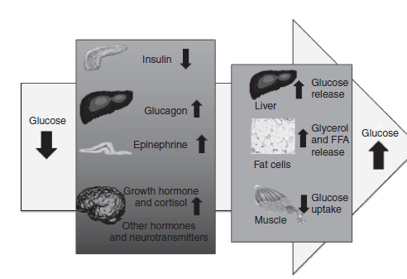
Normal counter-regulatory hormonal and metabolic responses to declining blood glucose level

Slide 33
Physiology of Glucose Metabolism: Gender Difference
Hormonal counter-regulatory responses and hypoglycemic symptoms occur at similar thresholds in men and women
In women peak counter-regulatory hormone levels are lower

Slide 34
Pathophysioloy of glucose metabolism in DM
In type1DM and insulin deficient type2DM pathophysiological defects reduce the defense to hypoglycemia

Slide 35
Pathophysioloy of glucose metabolism in DM
First defense :
The first physiologic defense against hypoglycemia, inhibition of insulin secretion, is lost .

Slide 36
Pathophysioloy of glucose metabolism in DM
Secondary defense:
There is a loss of glucagon response to hypoglycemia in type1DM after about 5 years, Despite the presence of otherwise functional alpha cells.
It may be as a result of a signaling defect within the pancreatic alpha cell due to beta cell failure.
Without adequate glucagon secretion, rapid response of glucose production from the liver is reduced.
Glycogenolysis and later gluconeogenesis may also be impaired.

Slide 37
Pathophysioloy of glucose metabolism in DM
Third defense:
Epinephrine response to hypoglycemia typically attenuated.
In the glucagon deficient state epinephrine mediated mechanisms promote glucose recovery from hypoglycemia.
Without adequate epinephrine stimulation glycogenolysis and gluconeogenesis are impaired and lypolysis is also blunted
Effect of epinephrine to inhibition of glucose uptake in skeletal muscle is lost.

Slide 38
Pathophysioloy of glucose metabolism in DM
Signs and symptoms:
Autonomic and neuroglycopenic symptom become blunted together with reduced hormonal counter-regulatory responses.
In patient with recurrent episodes of hypoglycemia, counter regulatory response occurs in a lower plasma glucose level.
Hypoglycemia unawareness, affecting ~ 20-25% of type1DM and icreasingly recognized in type2DM, elevates the risk of severe hypoglycemia 6 fold.

Slide 39
Treatment

Slide 40
Thank you for your attention

