Slide 1
In The Name of GOD
Adrenocortical Carcinoma
Fatemeh Rahmani.MD
Research Institute for Endocrine Sciences
Shahid Beheshti University of Medical Sciences

Slide 2
Questions
•Clinical presentation of ACC
•Pathologic work up
•Staging classification
•Surgical treatment
•Adjuvant therapy
•Follow up

Slide 3
Clinical Presentation
•For 40% to 60% of patients ,the major presenting complaints are symptoms
and signs of hormone excess
•Hypercortisolism is the most common presentation (50%–80% ),high cortisol
saturate the renal HSD11B2 system, resulting in MR activation ,causing HTN
and hypokalemia
•The second commonly produced hormones are adrenal androgens (40%–60%)
•Concurrent androgen and cortisol production is evident in half of patients with
hormonal excess

Slide 4
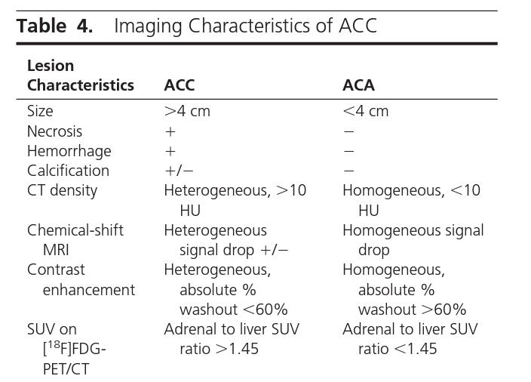

Slide 5


Slide 6
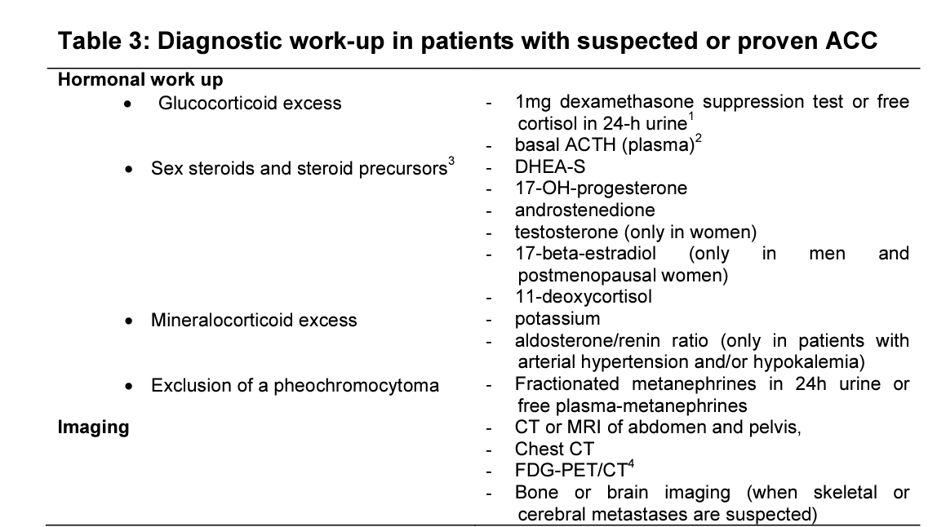
Diagnostic workup in patients with suspected or proven ACC

Slide 7
Surgery for suspected localized ACC
•Recommend that adrenal surgery for ACC should be performed only by
surgeons experienced in adrenal and oncological surgery.
•Recommend complete en bloc resection of adrenal tumors suspected ACC
including peritumoral/periadrenal retroperitoneal fat.
•If adjacent organs are suspected to be invaded, recommend en bloc resection,
however suggest against the routine resection of the ipsilateral kidney in the
absence of direct renal invasion.

Slide 8
•Recommend open surgery for all tumors with radiological findings suspicious of
malignancy and evidence for local invasion.
•For tumors <6 cm without evidence of local invasion,laparoscopic surgery is
reasonable if the surgeon has sufficient experience in these types of surgery
•Suggest that routine locoregional lymphadenectomy should be performed with
adrenalectomy for highly suspected ACC including (as a minimum) the renal
hilum and periadrenal
•If first surgery was suboptimal and macroscopically incomplete(R2), suggest to
discuss repeat surgery in a multidisciplinary expert team.

Slide 9
pathological work up
• Weiss score (including the exact mitotic count)
• Ki67 index
• resection status
• pathological tumor stage (indicating invasion or not of the capsule
and/or surrounding tissue and organs) and nodal status

Slide 10
Weiss score
• High nuclear grade
• >5 mitoses per 50 high-power field
• Atypical mitotic figures
• <25% of tumor cells are clear cells
• Diffuse architecture(>33% of tumor)
• Necrosis
• Venous invasion(smooth muscle in wall)
• Sinusoidal invasion(no smooth muscle in wall)
• Capsular invasion

Slide 11
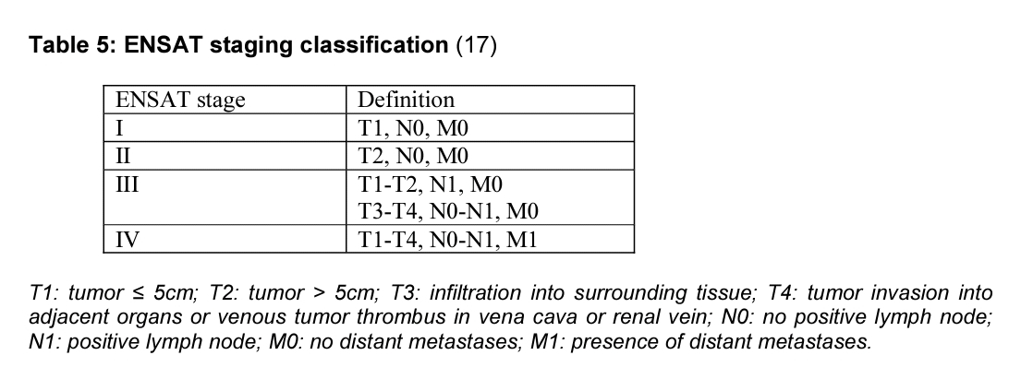
Staging classification and prognostic factors

Slide 12
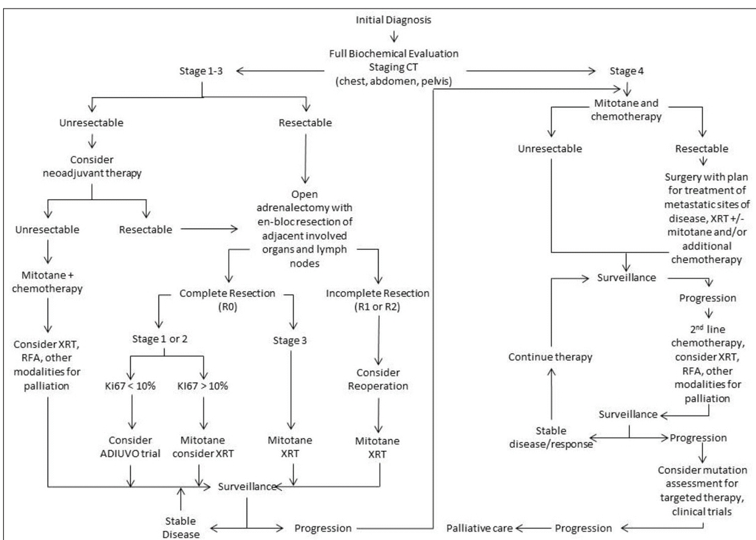

Slide 13
Adjuvant therapy
•We suggest adjuvant mitotane treatment in patients w/o macroscopic residual
tumor after surgery but who have a perceived high risk of recurrence
•We cannot suggest for or against adjuvant therapy for patients at low/moderate
risk of recurrence (stage I-II, R0 resection and Ki67 ≤ 10%)and adjuvant therapy
options should be discussed on an individual basis
•Once the decision for mitotane treatment is established,starting mitotane as
soon as clinically possible after surgery(starting within six weeks is ideal, and
would not initiate later than 3 months)

Slide 14
Radiation therapy
•Suggest against the routine use of radiation therapy in patients with stage
I-II and R0 resection
•Suggests considering radiation in addition to mitotane therapy on an
individualized basis therapy in patients with R1 or Rx resection or in stage III
•If radiotherapy is administered,we recommend starting as soon as possible
after surgery

Slide 15
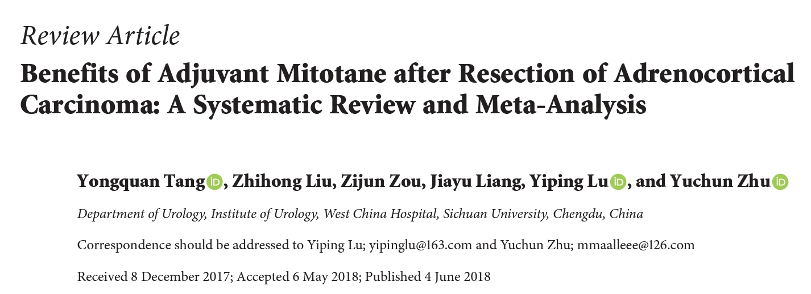

Slide 16
Inclusion criteria:RCT & cohort studies compared RFS and /or OS in patients
with and w/o adjuvant mitotan after resection of ACC from 1979-2017.
( provided adjusted HR with 95%CI & at least 14year f/u)
Exclusion criteria:case report,editorial and review articles,patients with distant
metastasis,no resection of ACC,any adjuvant therapy before surgery,
combination adjuvant therapy,unadjusted outcome measure
Risk of bias: used the Newcastle-Ottawa Scale (NOS) for the quality assessment of
nonrandomized controlled studies, Studies with scores ≥7 were supposed to
have a low risk of bias

Slide 17
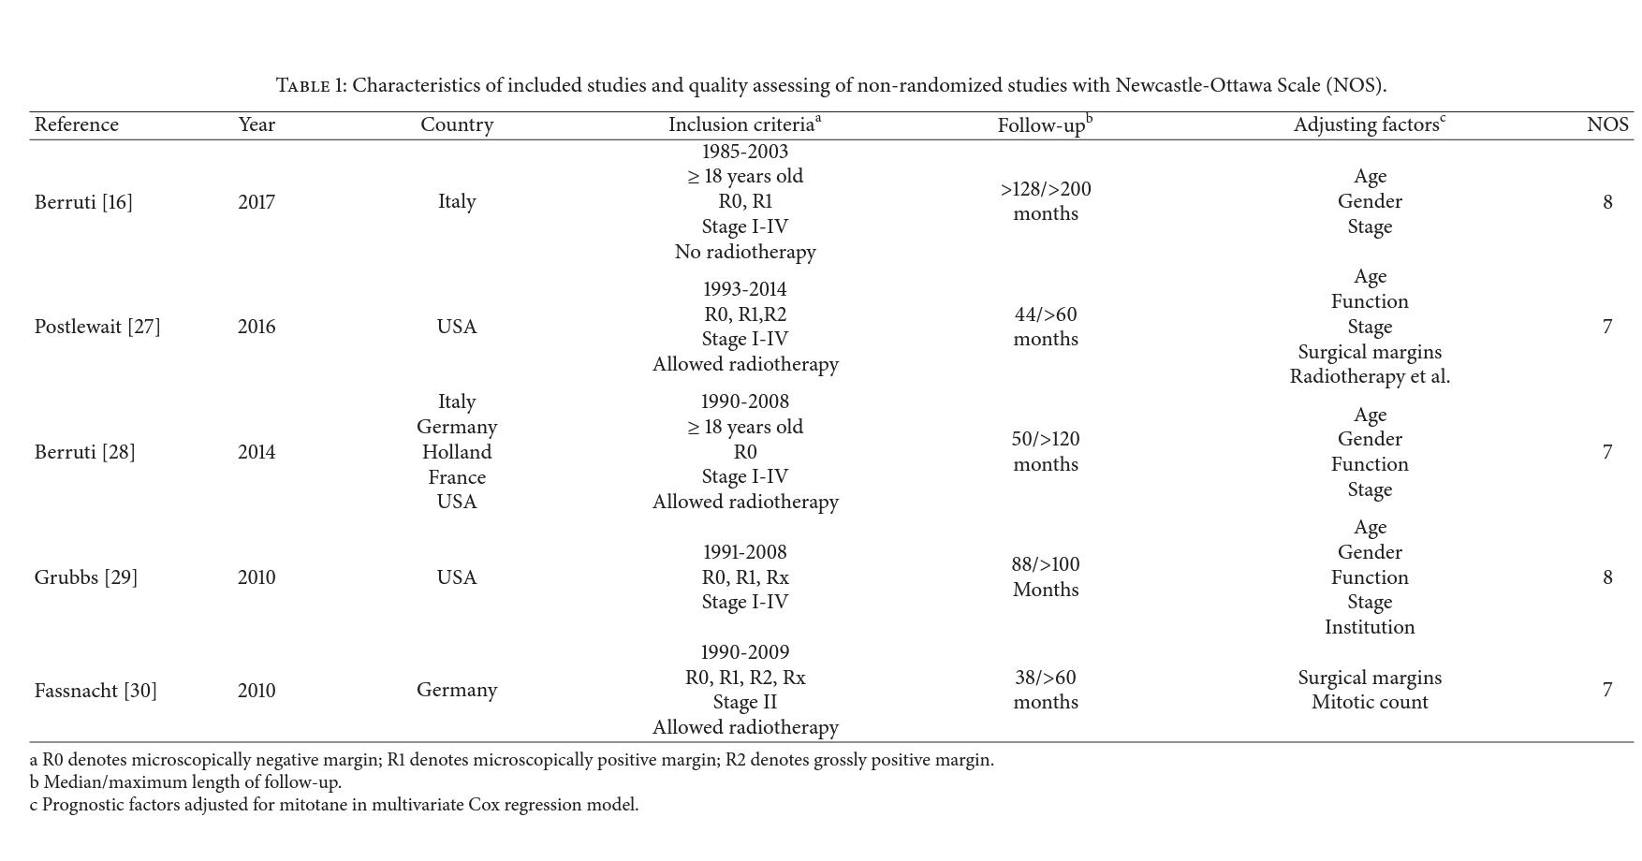

Slide 18
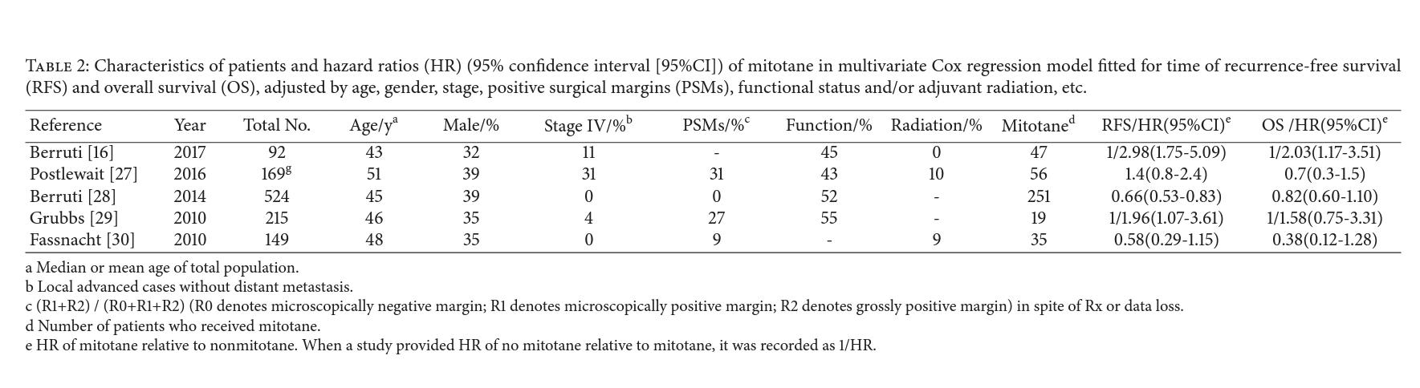

Slide 19
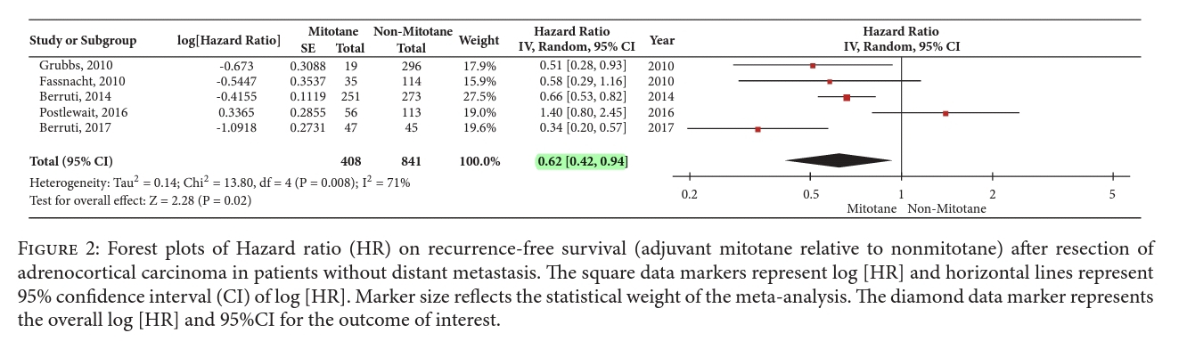

Slide 20
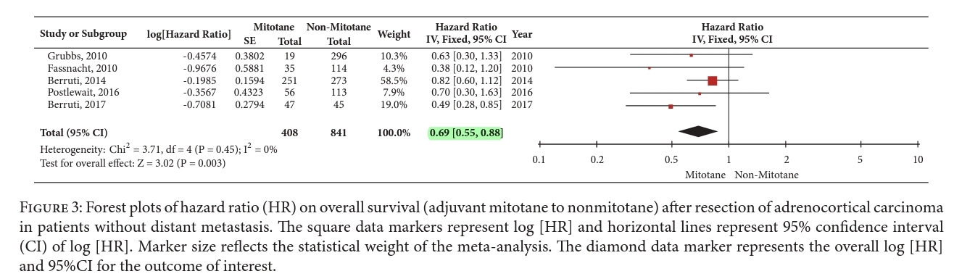

Slide 21
Conclusion
•adjuvant mitotane was significantly associated with prolonged RFS and OS
after resection of ACC in patients without distant metastasis.
•It indicates that adjuvant mitotane tends to reduce 38% of postoperative
recurrences and 31% of postopertive deaths
•we recommend adjuvant use of mitotane after resection of ACC if well
tolerated, because adjuvant mitotane was associated with significantly
prolonged RFS and OS on these patients

Slide 22
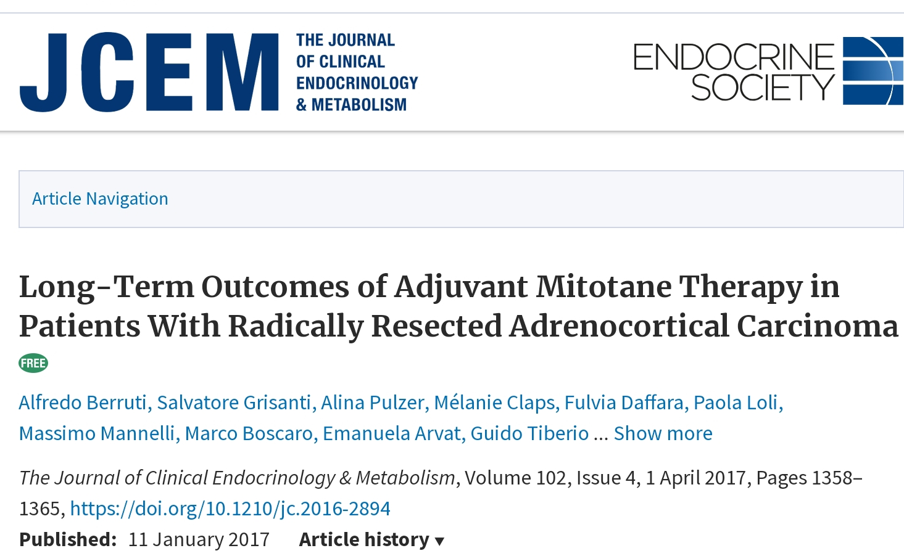

Slide 23
•Method: retrospective analysis among >18 years patients with ACC and radical surgery
between 1985-2003 at 8 tertiary referral centers in Italy and Germany
Adjuvant mitotane was adminstrated to 47 Italian patients after surgery(mitotane
group)whereas 55 Italian patients and 75 German patients (control group 1 & 2 )
didn’t received mitotan
•Exclusion criteria:macroscopic incomplete resection,incomplete tumor staging ,
concomittant cancer,adjuvant therapy other than mitotan after surgery
•Primary aim:evaluate the efficacy of adjuvant mitotan in prolonging recurrent free survival
•Secondary aim: assessment of overall survival and adverse events with mitotan therapy

Slide 24
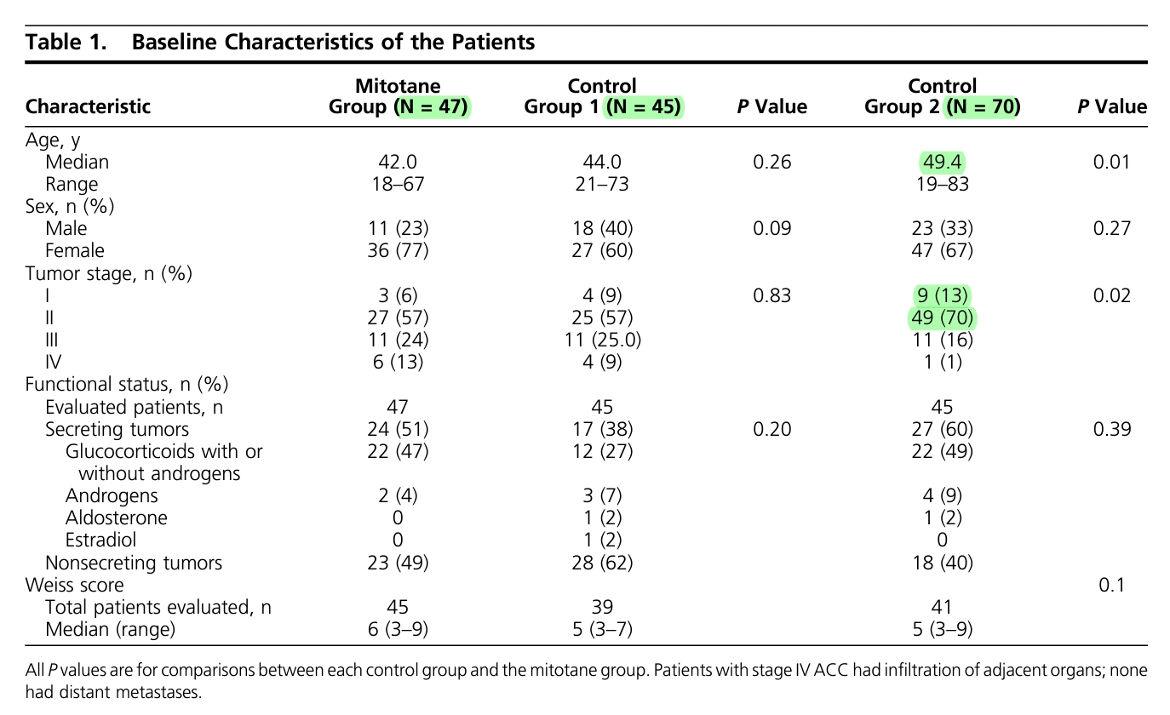

Slide 25
Results
•Recurrence was documented in 25 patients in the mitotane group (53%), 40 in control group
1 (89%), and 56 in control group 2 (80%)
•The median RFC was 42 months in mitotane group, 17 months in control group 1 (P<0.001) ,
and 26 months in control group 2 (P=0.005)
•Death from ACC was reported for 23 patients in the mitotane group (49%), 36 in control
group 1 (90%), and 41 in control group 2 (59%)
•Median OS was 161 months in the mitotane group, as compared with 65 months in control
group 1 (P=0.007) and 92 months in control group 2 (P=0.28)

Slide 26
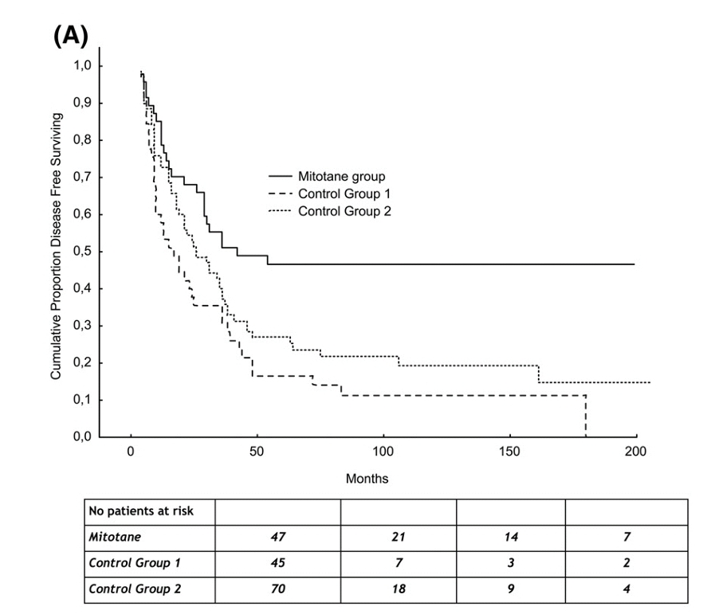
RFS of adjuvant mitotane group and control groups

Slide 27
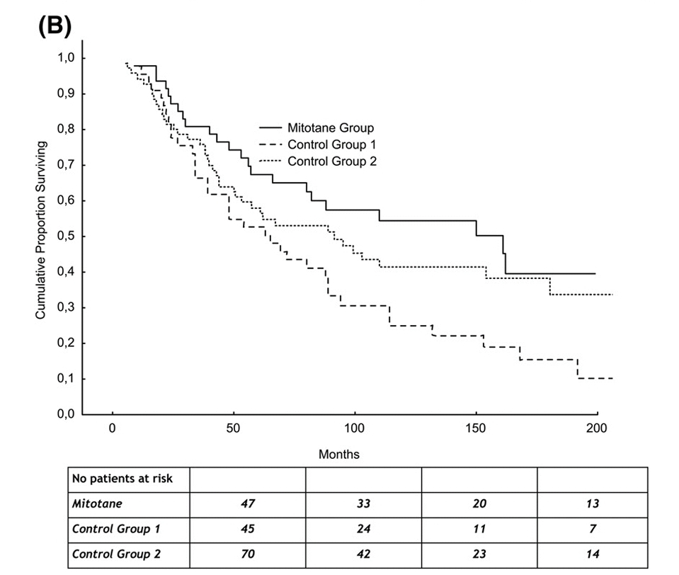
OS of adjuvant mitotane group and control groups.

Slide 28
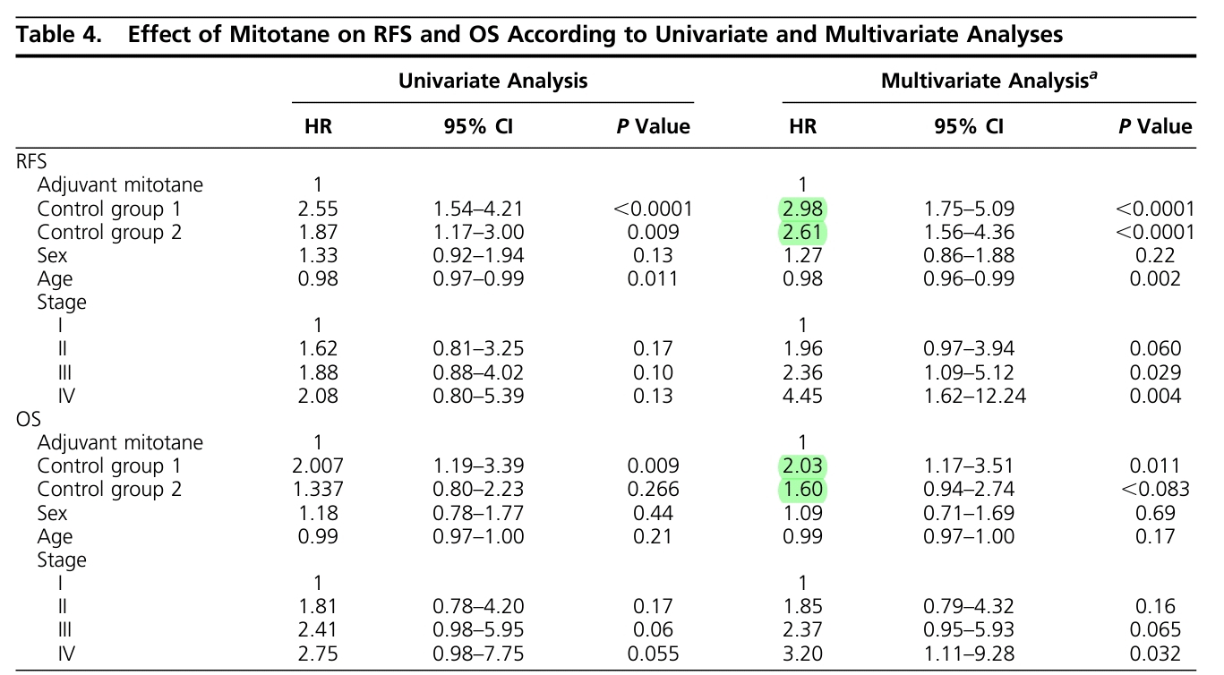

Slide 29
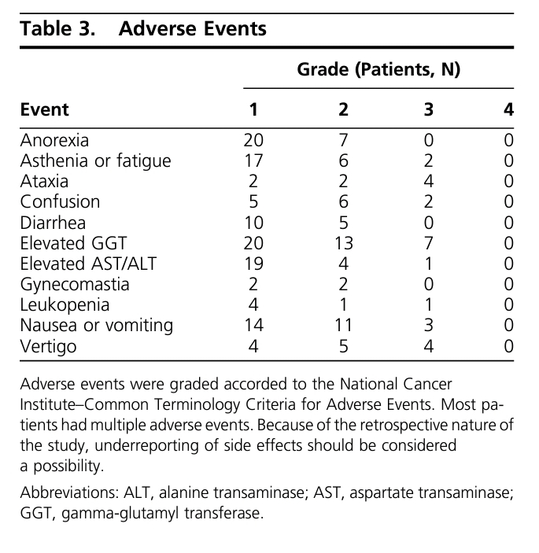

Slide 30
Methods and time interval for imaging & hormonal assessment during followup
•After complete resection, we suggest radiological imaging every 3 months for 2
years,then every 36 months for a further 3 years
•The majority of the panel suggests continuation of F/u imaging beyond 5y
•In all patients,we recommend regular screening for hormone secretion

Slide 31
Thanks for your attention

