Slide 1
Advanced Medullary Thyroid Cancer
(Case Discussion)
Mashhad University of Medical Sciences
Endocrine Research Center
Dr Z.Mousavi
Professor of Endocrinology . MUMS

Slide 2
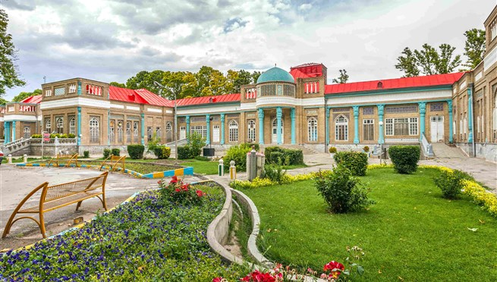

Slide 3
Disclousure and Thanks
Noting to disclose
My sincere thanks for the invitation

Slide 4
Epidemiology
< 5% of all thyroid Cancer
1-2% of thyroid cancers in the US
1500-2000 cases/year in Europe
Distant metastases requiring systemic treatment
(~50 cases/year in France)

Slide 5
Medullary Thyroid Carcinoma: Demographics
Hundahl,et.al.,studied 53,856 patients with thyroid cancer from the National Cancer Data Base:
Survival was predicted by tumor stage and patient age at diagnosis.
Options for treating metastatic disease are not curative

Slide 6
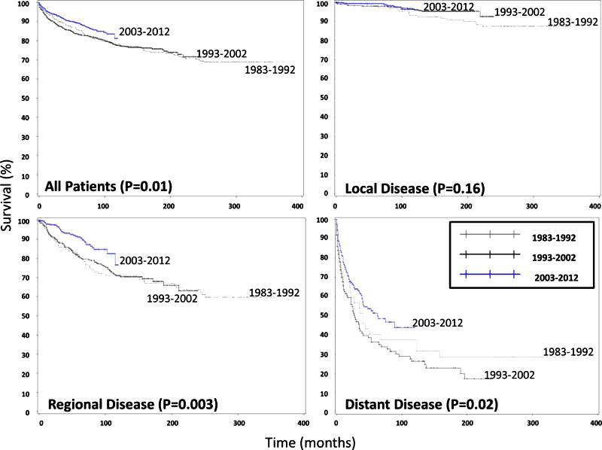
MTC Trends over time 2940 patients : SEER data base
Disease Specific Survival for patients with Medullary Thyroid Cancer based on Time IntervalThe four Kaplan-Meier survival curves demonstrate improved disease specific survival (DSS) for all patients (top left) and for those patients with regional (bottom left) and distant (bottom right) disease, but not with localized disease (top right).
Randle, et al Surgery 2017(1) 137-146
Notes:
There have been several recent advances in the molecular biology, diagnosis, imaging, and treatment options for MTC. Downstaging and treating metastatic disease more effectively may improve overall survival of MTC patients. Dissemination of standardized guidelines is important for optimal treatment with less variation in quality of care

Slide 7
Sporadic
80% of all cases of medullary thyroid cancer: most common 30-50 yrs
70% present with lymph node mets
10% present with DM
All sporadic cases should be tested for germline RET mutation
One third will present with intractable diarrhea.
Diarrhea is caused by increased gastrointestinal secretion and hypermotility due to the hormones secreted by the tumor (calcitonin, prostaglandins, serotonin, or VIP).
Notes:
Medullary Thyroid Cancer Occurs in Four Clinical Settings

Slide 8
MTC
10 yr survival: Stage 1 100% Stage 2 93% Stage 3 71% Stage 4 21%
Modigliani et al.GETC 1998;48:265-73

Slide 9
Focus on advanced MTC
Stage IVb: T4b (tumor invades prevertebral fascia or encases carotid artery or mediastinal vessels), Any N, M0.
Stage IVc: Any T, Any N, M1
Boostrom et al. Arch Surg 2009;144(7):663-669
Notes:
Locally advanced Medullary Thyroid Cancer
Distant Metastases

Slide 10
Need careful work –up including
Serum calcitonin + CEA &doubling times
Comperhensive imaging : -Extent of the disease -Agressiveness

Slide 11
Case Presentation
Notes:
Hypercortisolism or Cushing’s syndrome (CS) is a rare condition; effective treatments are necessary because of an increased morbidity and mortality if left untreated

Slide 12
A 63-YEAR-OLD MAN WITH THYROID MASS

Slide 13
Physical exams
BP : 120/70 mm Hg
BMI : 21
Temporal atrophy
Thyroid ; Right lobe nodule 3 cm , hard,
Multiple lymph nodes from 1 t0 2 cm in right & left cervical ( levels 4 & 6 bilaterally)
Pitting edema 2+

Slide 14
FNA from nodule & lymph node was done
pseudo papillary changes
Nuclear changes
Molding & pseudo inclusion
nuclear grooves
DX:
Malignancy : Suspicious for PTC ? ( pseudo inclusion, nuclear groove)

Slide 15
Surgery( Total thyroidectomy ,MRND ) : in 2015
Biopsy
Medullary Thyroid Cancer , bilateral
Sizes 35x25x20 mm & 5 mm
12/18 lymph nodes were positive for MTC
T2 N1b M x = stage IV a
IHC demonstrated MTC (positive calcitonin & chromogranin / negative thyroglobulin)

Slide 16
Complementary lab data
Calcitonin > 2000 pg/ml ( up to 11)
CEA : 56 ng/ml ( < 5 )
Normal metanephrines
Calcium 8.5

Slide 17
How to find Distant Metastasis in MTC?
How much do we look for Distant Metastasis?

Slide 18
Postoperative Surveillance
CTN levels ≥150 pg/mL: imaging techniques to evaluate for distant metastases
– If negative, should be repeated when Ctn level increases by >20-100%
Giraudet AL et al. J Clin Endocrinol Metab 2007;92:4185–4190

Slide 19
Distant metastasis workup
Neck CT: paratracheal & supra sternal adenopathy 20-25mm
Brain CT : normal
Chest CT : micro nodule & Mild pleural effusion in left lower lobe ( inflammation & atelectasis )
Axial MRI ; focal non significant abnormal signal at T11- L2 bodies .
Whole body Bone scan : negative finding

Slide 20
Abdominal ultra sonography :2cm hyper echoic liver nodule
Abdominal CT & MRI : liver nodules in right , mild elevation of left diaphragm
RBC Scan was negative
Three-phasic contrast CT : Cavernous hemangioma
Gastroenterologist advised needle biopsy : pathology result was cavernous hemangioma

Slide 21
3 months later ( DEC 2015)
Ultra sonography :
About 15 abnormal lymph nodes in bed & other levels ..retrosternal, near to jugular v. & Trachea
Calcitonin : 2000 pg/ml
Re FNA : MTC
Re surgery was done

Slide 22
In 2016
Calcitonin decreased to 1700
CEA : 27 ( decreased)
Ultrasonography : 8 mass/abnormal Lymph nodes 10-20mm
The third surgery was done for same reasons

Slide 23
After third surgery
Ultra sonography : 5 abnormal lymph nodes in neck remained
Calcitonin 681 pg/ml ( decreased)
CEA: 8.6 (decreased)
Third surgery complication : Hoarseness

Slide 24
After 2 y of first visit
Increased lymph nodes from 8 to 10
Calcitonin raised from 1012 to 2000 pg/ml
CEA 10.3 ng/ml

Slide 25
Re evaluations for distant metastasis:
Negative

Slide 26
Re evaluations for distant metastasis:
Brain CT : normal
Chest CT : 4mm nodule in LLL
Axial MRI : Normal
Whole body Bone scan : negative finding
Abdominal CT & MRI : liver nodule in right ( old hemangioma )

Slide 27
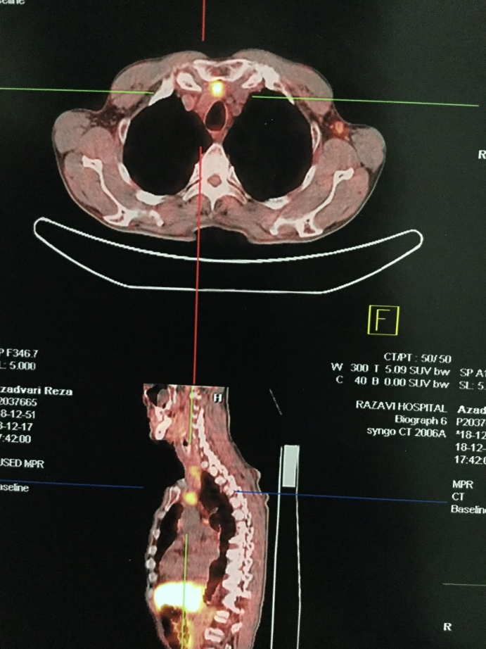
PET 68Ga-DOTA-TATE
Uptakes
Neck
Mediastinal
Liver

Slide 28
PET 68Ga-DOTA-TATE findings:
Neck & mediastinal involved lymph nodes
Liver spot ; hemangioma
Anterior to spleen : collections in colonic loop

Slide 29
Calcitonin chart

Slide 30
Carcinoembryonic Antigen (CEA) & number of lymph nodes (reported by radiologist)

Slide 31
What is the best Next strategy ?
Summary :
1- presence of 10 lymph nodes in neck ,paratracheal & retrosternal ( increasing ?)
2- high calcitonin & CEA ( rising) ) doubling time: 9 months (Ct),53 months(CEA)
He has HOARSENESS
But does not feel any PROBLEM.
;

Slide 32
Management of persistent/recurrent disease
observation/active surveillance
surgical resection
external beam radiation therapy (EBRT)
and other directed therapies (such as radiofrequency ablation, cryoablation, embolization)
systemic therapies

Slide 33
The recommended treatment depends upon a variety of clinical factors, including:
Whether or not the disease can be localized
The volume of disease
The precise location(s) of the metastatic disease
Whether or not the disease is causing symptoms
The rate (or likelihood) of clinically significant structural disease progression

Slide 34
Small volume, Asymptomatic

Slide 35
Observation
The extent and frequency of cross-sectional imaging is dependent on the magnitude and doubling time of calcitonin and CEA . In the absence of structurally identifiable disease, we do not suggest additional surgery or systemic therapies
Notes:
The extent and frequency of cross-sectional imaging is dependent on the magnitude and doubling time of calcitonin and CEA (see 'Persistent hypercalcitoninemia' above). In the absence of structurally identifiable disease, we do not suggest additional surgery or systemic therapies

Slide 36
Observation/active surveillance
Biochemical evidence of disease without structural correlate
The extent and frequency of cross-sectional imaging is dependent on the magnitude and doubling time of calcitonin
EBRT :selected patients with extensive preoperative gross extrathyroidal extension or large volume, multicompartment macroscopic lymph node involvement
Notes:
In the absence of gross residual disease, we also do not recommend routine use of postoperative EBRT as adjuvant therapy, even if the postoperative calcitonin and CEA values are abnormal. We reserve adjuvant EBRT for very select patients with extensive preoperative gross extrathyroidal extension or large volume, multicompartment macroscopic lymph node involvement The lack of randomized prospective trials makes it difficult to provide definitive recommendations with regard to the use of EBRT as adjuvant therapy. We feel that EBRT in this setting may improve loco-regional control but are not convinced that there is an overall survival benefit [41]. Furthermore, the potential benefits of improved loco-regional control must be weighed against the wide range of acute and chronic toxicities associated with EBRT

Slide 37
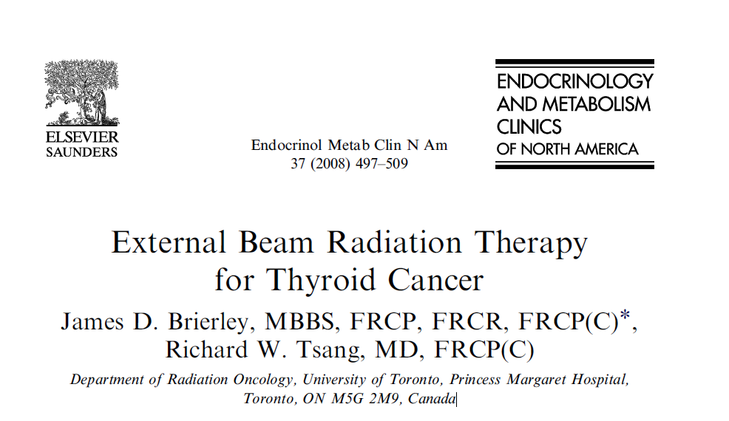
The Benefit Of EBRT adjuvant to thyroidectomy in patients with MTC are difficult to evaluate because there have been no prospective trials in which patient have been randomized to EBRT compared to observation alone.

Slide 38
In a retrospective study of 51 patients with persistently elevated calcitonin (ranging from 540 to 400,000 pg/mL) and no evidence of residual disease, the local relapse rate was significantly lower in those who were treated with radiation therapy because of advanced local disease at presentation (29 versus 59 percent). There was no difference in 10-year survival between the two groups (72 versus 60 percent).
Fersht N,et al,2001 Thyroid 11:1161

Slide 39
Small volume residual disease outside of cervical lymph nodes
High risk of loco-regional recurrence
EBRT
In one retrospective series, the 10-year rate of control of local and regional disease was 86% in patients who received postoperative radiotherapy versus 52% in those who were not treated ( 86% vs 52%) .
Brierley J. et al. 1996 Thyroid;6:305
Notes:
thyroid bed or soft tissue metastases) Small volume disease outside of cervical lymph nodes is usually the result of gross extrathyroidal extension into major structures in the neck, and it often reflects microscopic disease remaining after all macroscopic disease has been surgically Structurally identifiable small volume disease can also be a manifestation of an early soft tissue recurrence of MTC, in which case the initial treatment option would be surgical resection, which is then usually followed by EBRT (or occasionally EBRT alone if surgery is unlikely to be successful or likely to result in unacceptable morbidity

Slide 40
Small volume lymph node metastases
Subcentimeter lymph node metastases: active surveillance
Serial cross-sectional imaging at 6 to 12 month
Surgery : structural disease progression
Notes:
we suggest active surveillance as the best management option. Reoperation is frequently not curative and can be associated with morbidity (ie, hypoparathyroidism, injury to recurrent laryngeal nerve or accessory nerve). In addition, observation of asymptomatic, stable lymph node metastases is nearly always recommended if the basal serum calcitonin is >1000 pg/mL or if more than five metastatic lymph nodes were removed with a previous surgery, as reoperation is almost never curative in these settings Patients are followed with serial cross-sectional imaging at 6 to 12 month intervals, and surgical intervention is reserved for patients that have documented structural disease progression

Slide 41
Small volume distant metastases (subcentimeter metastatic foci)
Observation It is not uncommon for small pulmonary and liver metastases to remain asymptomatic and progress very slowly (or not all) over many years.
Notes:
Similar to asymptomatic small volume lymph node metastases, small volume distant metastases (subcentimeter metastatic foci) are usually followed with observation. It is not uncommon for small pulmonary and liver metastases to remain asymptomatic and progress very slowly (or not all) over many years.

Slide 42
Large volume or symptomatic
Macroscopic gross residual disease in the thyroid bed or cervical soft tissue metastases : 1. Surgery
2. EBRT
3. Systemic therapy
Notes:
If the gross residual disease is confirmed to be unresectable or if the patient/treatment team agree that a complete surgical resection would produce unacceptable morbidity, we suggest external beam irradiation to improve loco-regional control. While systemic therapy (such as tyrosine kinase inhibitors) can be considered in this setting, our preference is to use EBRT to achieve local regional control as the initial treatment unless there are other pressing indications to begin systemic therapy

Slide 43
Symptomatic or large volume loco-regional lymph node disease
Surgery
cautious observation or systemic therapies
Notes:
Resection of large volume loco-regional lymph node disease may be necessary to prevent invasion into surrounding major structures. Occasionally, lymph node metastases can present as painful lesions that can be readily palliated with surgical resection. However, since additional surgery rarely achieves a biochemical cure if the basal serum calcitonin is >1000 pg/mL or if more than five metastatic lymph nodes were removed with a previous surgery, cautious observation or systemic therapies (tyrosine kinase inhibitors) can be considered for asymptomatic large volume lymph node metastases detected in this setting.

Slide 44
Symptomatic or large volume distant metastasis
Surgry
EBRT
Embolization
Radiofrequency ablation
Systemic treatment
Notes:
Rather than immediately initiating systemic therapy, we prefer to treat individual (or a few) isolated symptomatic or large volume distant metastases with locally directed therapies such as surgical resection, external beam irradiation, embolization, or radiofrequency ablation. For patients with symptomatic or progressive metastatic disease that cannot be effectively treated by locally directed therapies, systemic treatmentRather than immediately initiating systemic therapy, we prefer to treat individual (or a few) isolated symptomatic or large volume distant metastases with locally directed therapies such as surgical resection, external beam irradiation, embolization, or radiofrequency ablation. For patients with symptomatic or progressive metastatic disease that cannot be effectively treated by locally directed therapies, systemic treatment

Slide 45
Back to the case

Slide 46
Medullary thyroid cancer
Stage I
T1, N0, M0
Stage II
T2, N0, M0
Stage III
T3, N0, M0
T1, N1a, M0
T2, N1a, M0
T3, N1a, M0
Stage IVA
T4a, N0, M0
T4a, N1a, M0
T1, N1b, M0
T2, N1b, M0
T3, N1b, M0
T4a, N1b, M0
Stage IVB
T4b, any N, M0
Stage IVC
Any T, any N, M1

Slide 47
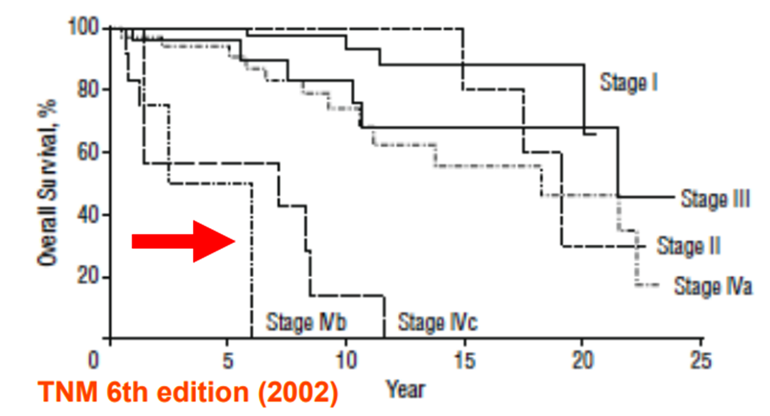
Focus on advanced MTC
Stage IVb: T4b (tumor invades prevertebral fascia or encases carotid artery or mediastinal vessels), Any N, M0.
Stage IVc: Any T, Any N, M1
Boostrom et al.Arch Surg 2009;144(7):663-669

Slide 48
Postoperative Surveillance
CTN levels ≥150 pg/mL: imaging techniques to evaluate for distant metastases
– If negative, should be repeated when Ctn level increases by >20-100%
Giraudet AL et al. J Clin Endocrinol Metab 2007;92:4185–4190

Slide 49
Brierley JD, 2008 Endocrinol Metab Clin North Am 37:497–509, xi.¹
Fife KM, 1996 Eur J Surg Oncol 22:588–591. ²
Martinez SR, 2010 .J Surg Oncol 102:175–178. ³
Schwartz DL 2008 Head Neck 30:883–888. ⁴
Brierley J, 1996.Thyroid 6:305–310.6.⁵
Call JA 2013 Rare Tumors 5:e37.⁶

Slide 50
MTC: initial surgery
Surgery consists for all :MTCs
– Total thyroidectomy
– Bilateral dissection of lateral and central compartments
Success is mainly dependent upon the adequacy of the initial operation (complete protocol/skilled hands).
Notes:
Medullary carcinoma of the thyroid (MTC) represents a unique and complex surgical challenge Randalph GW 2000 surgery

Slide 51
Surgical Consideration: Thyroid
Total thyroidectomy with central compartment dissection(minium)
Ctn ≤ 20 pg/ml: no risk of LN mets
Ctn 20-50 pg/ml: ipsilateral central & Lat neck
Ctn 50- 200pg/mln: contralateral central neck
Ctn 200-500 pg/ml: contralateral Lat neck
Ctn ≥ 500 pg/ml: mediastinal LN Machens et al.World J Surg 2007;31:1960-5
Machens et al.World J Surg 2007;31:1960-5

Slide 52
Surgical Consideration: Lateral neck
Elective ND may be done even if imaging is neg, based on Ctn levels
Lateral neck Diss(II-V) for positive imaging

Slide 53
Surgical Consideration: Presence of distant mets
Surgical plan is dependent on life expectancy and other medical comorbidities
In patients with distant metastasis or advanced local disease, less aggressive neck surgery that preserves speech and swallowing function may be appropriate

Slide 54
What about external beam radiation?
Consider therapeutic EBRT/IMRT for grossly incomplete tumor resection when additional attempts at surgical resection have been rule out
Adjuvant EBRT/IMRT is rarely recommended
NCCN Version 1 .2018
Notes:
Currently, the American Thyroid Association suggests that EBRT be used in patients post-operatively who are at high risk for locoregional recurrence, as well as be offered to patients with extensive M1 disease as a palliative treatment

Slide 55
Locally Advanced MTC
Unfortunately, patients who present with locally advanced MTC invariably have metastatic disease , and therefore, although EBRT can improve local control, survival is not improved.
Currently we recommend in unresectable or gross ETE disease who after resection relapse result in uncontrollable disease
Giuliani M, Brierley J ,current opinion 2013, indication for EBRT in thyroid cancer

Slide 56
The NCCN recommends the following diagnostic procedures when FNAB results indicate MTC
Basal serum calcitonin level
CEA level
Pheochromocytoma screening
Serum calcium assay
Consider genetic counseling
Screen for RET proto-oncogene mutations (exons 10, 11, 13-16)
Thyroid and neck ultrasound (including central and lateral compartments), if not previously done
Consider contrast-enhanced CT of chest and mediastinum and liver MRI or 3-phase CT of liver
Version 2018
Notes:
Preoperative evaluation
Liver imaging is seldom needed if ctn is less than 400
Consider contrast-enhanced CT of chest and mediastinum and liver MRI if N1 disease or calcitonin >400 pg/mL

Slide 57
Is completion thyr indicate
YES; for all with hereditary MTC
YES; for elevated Ctn
YES; for RET+
YES; for positive imaging

Slide 58
Brierly et al 2013
We also recommend EBRT in patients who have repeated surgery for recurrent nodal involvement and in whom surgery would be problematic
Giuliani M, Brierley J ,current opinion 2013, indication for EBRT in thyroid cancer

Slide 59
Overall survival of patients with medullary thyroid carcinoma who received external beam radiotherapy (n=17).
Jason A,et al ,Rare Tumors 2013; Volume 5:e37
Notes:
A role for radiotherapy in the management of advanced medullary thyroid carcinoma: the Mayo clinic experience

Slide 60
Detectable basal calcitonin or Elevated CEA
Neck ultrasound
If calcitonin ≥150 pg/mL, cross-sectional imaging should include contrast enhanced CT (+ PET FDG or Ga-68 DOTATATE) or MRI with contrast of the neck, chest, abdomen with liver protocol
Bone scan in select patients
Notes:
Bone scan and MRI of axial skeleton should be considered in patients with very elevated calcitonin levels.

Slide 61
MTC: distant metastases
During the 10 first years of follow-up, DM are detected in ~30-50% of patients with post-operative detectable Ct levels
Diarrhea: ~30%; flushes: ~15%
Often present in several sites
Often multiple in each site
Guidelines ATA (2009) and ETA (2012)

Slide 62
Assessment of disease extent – standardized imaging
Neck: US-spiral CT scan
Mediastinum and lung: spiral CT scan with contrast
Liver: MRI, and if not feasible, 3-phase CT scan
Bone: bone scintigraphy + axial MRI
Brain: MRI or spiral CT scan
FDG or FDOPA-PET scan?

Slide 63
Characteristic | Value
Age, median (range), years* 50 (20-76)
Sex
Male | 8
Female | 3
Cancer stage*
IVa | 6
IVb | 1
IVc | 1
Unknown | 3
Margins*
Positive | 2
Negative | 5
Unknown | 4
Positive lymph nodes, number*
0 | 2
1-5 | 3
6-10 | 4
11-15 | 1
>15 | 1
Median (range) | 6 (0-27)
Calcitonin level before EBRT, pg/mL
Undetectable | 2
≤5000 | 6
>5000 | 2
Unknown | 1
Median (range) | 2350 (0-200,000)
Mediastinum involved
Yes | 4
No | 6
Unknown | 1
Characteristics of patients treated with locoregional adjuvant or salvage external beam radiotherapy (n=11).
*Characteristic was determined at the initial surgery (i.e., at the time of diagnosis). EBRT, external beam radiotherapy.

Slide 64
Local treatment for advanced disease
–Brain metastases:
•Surgery and/or external radiation beam therapy
–Bone metastases with imaging abnormalities:
•Surgery and ERBT
•Radiofrequency-cryoablation, cement injection
–Lung metastases, in case of predominant lesions:
•Radiofrequency ablation
•Surgery
•Local treatment modalities may be used alone or in combination with systemic treatment

Slide 65
Assesment of progressive disease
Calcitonin doubling times
Imaging
Tumor size according to RECIST 1.1

Slide 66
Thyrosine Kinase Inhibitors
Large tumor burden
Documented disease progression

Slide 67
Progression –free survival
Toxic effect profiles

Slide 68
MTC: distant metastases
Notes:
For patients with locally advanced or metastatic disease, total thyroidectomy with resection of involved lymph node compartments is performed in most patients. However, since the goals of surgery are largely palliative in this setting, a less aggressive approach to both the primary tumor and to loco-regional metastases may be warranted

Slide 69
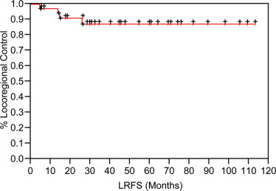
FIGURE 1. Locoregional relapse–free survival (LRFS) for the study cohort.
Schwarts DL,et al. 2008 ,Head Neck30:883-888
Notes:
FIGURE 1. Locoregional relapse–free survival (LRFS) for the
study cohort. POSTOPERATIVE RADIOTHERAPY FOR ADVANCED
MEDULLARY THYROID CANCER—LOCAL DISEASE
CONTROL IN THE MODERN ERA

Slide 70
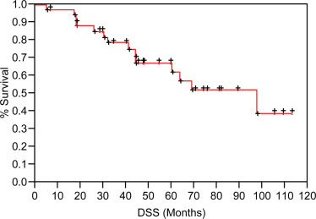
FIGURE 2. Disease-specific survival (DSS) for the study cohort.
Schwarts DL,et al. 2008 ,Head Neck30:883-888
Notes:
FIGURE 2. Disease-specific survival (DSS) for the study
cohortDepartment of Radiation Oncology, The University of Texas M. D. Anderson Cancer Center,
Houston, Texas. E-mail: docdls@mdanderson.org
2 Department of Experimental Diagnostic Imaging, The University of Texas
M. D. Anderson Cancer Center, Houston, Texas
3 Department of Endocrine Neoplasia and Hormonal Disorders, The University of Texas
M. D. Anderson Cancer Center, Houston, Texas
4 Department of Surgical Oncology, The University of Texas M. D. Anderson Cancer Center, Houston, Texas
5 Department of Head and Neck Surgery, The University of Texas M. D. Anderson Cancer Center, Houston, Texas

Slide 71
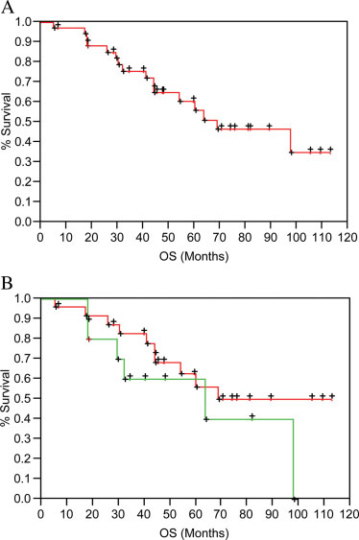
FIGURE 3.
Overall survival (OS) for the entire study cohort(A),
and
according to presence/absence of metastatic disease at the time of radiation (B) (p 5 .26 by log-rank testing).
Schwarts DL,et al. 2008 ,Head Neck30:883-888
Notes:
FIGURE 3. Overall survival (OS) for the entire study cohort
(A), and according to presence/absence of metastatic disease
at the time of radiation (B) (p 5 .26 by log-rank testing).

Slide 72
MANAGEMENT 2-3 MONTHS POSTOPERATIVE

Slide 73
Detectable basal calcitonin or Elevated CEA
Neck ultrasound
If calcitonin ≥150 pg/mL, cross-sectional imaging should include contrast enhanced CT (+ PET FDG or Ga-68 DOTATATE) or MRI with contrast of the neck, chest, abdomen with liver protocol
Bone scan in select patients
Notes:
Bone scan and MRI of axial skeleton should be considered in patients with very elevated calcitonin levels.

Slide 74
Basal calcitonin undetectable and CEA within reference range
Active surveillance
Annual serum calcitonin, CEA
Consider central and lateral neck compartments ultrasound
Additional studies or more frequent testing if significantly rising calcitonin or CEA
No additional imaging required if calcitonin and CEA stable
• For MEN2B or MEN2A, annual biochemical screenings for pheochromocytoma and hyperparathyroidism (MEN2A)

Slide 75
RECURRENT OR PERSISTENT DISEASE LOCOREGIONAL DISEASE
Surgical resection is the preferred treatment modality
or
EBRT/MRT can be considered for unresectable disease or, less commonly, after surgical resection
or
Consider vandetanib, or cabozantinib for unresectable disease that is symptomatic or progressing by RECIST criterias
or Active surveillance

Slide 76
RECURRENT OR PERSISTENT DISEASE DISTANT METASTASES: ASYMPTOMATIC DISEASE
Active surveillance
or
Consider resection (if possible), ablation (eg, RFA,
embolization, other regional therapy),
or vandetanib, or cabozantinib if not resectable and progressing by RECIST criteria

Slide 77
Symptomatic disease or progressions
Vandetanib or Cabozantinib
or
Clinical trial
Or
Consider other small-molecule kinase inhizitors
Or
Dacarbazine (DTIC)-based chemotherapy
EBRT/MRT for local symptoms
Consider intravenous bisphosphonate or denosumab therapy for bone metastases
Consider palliative resection, ablation (eg, RFA, embolization, other regional therapy), or other regional treatment
Best supportive care

Slide 78
PRINCIPLES OF KINASE INHIBITOR THERAPY IN ADVANCED THYROID CARCINOMA
• Oral kinase inhibitors demonstrate clinically significant activity in randomized, placebo-controlled clinical trials in locally recurrent unresectable and metastatic medullary thyroid cancer

Slide 79
PRINCIPLES OF KINASE INHIBITOR THERAPY IN ADVANCED THYROID CARCINOMA
• When considering kinase inhibitor therapy for individual patients, several factors should be considered.
Kinase inhibitor therapy can be associated with improved progression-free survival, but is not curative.
Kinase inhibitor therapy is expected to cause side effects that may have a significant effect on quality of life.
The natural history of MTC and DTC is quite variable with rates of disease progression ranging from a few months to many years.
• The pace of disease progression should be factored into treatment decisions. Patients with very indolent disease who are asymptomatic may not be appropriate for kinase inhibitor therapy, particularly if the side effects of treatment will adversely affect the patient's quality of life, whereas patients with more rapidly progressive disease may benefit from kinase inhibitor therapy, even if they have drug-induced side effects.

Slide 80
Advanced disease
Moderately advanced disease; tumor of any size with gross extrathyroidal extension into the nearby tissues of the neck. including subcutaneous soft tissue, larynx, trachea, esophagus, or recurrent laryngeal nerve.
Very advanced disease; tumor of any size with extension toward the spine or into nearby large blood vessels, invading the prevertebral fascia, or encasing the carotid artery or mediastinal vessels.

Slide 81
Metastatic MTC: molecular targeted therapies
•There is no indication:
–For patients with elevated Ct and or CEA levels and no other evidence of disease
–For patients with minimal disease (< 2cm), when asymptomatic and stable
•Decision to treat has to be validated by a multidisciplinary team
•Control of toxicities

Slide 82
Medullary thyroid carcinoma diagnosed after initial thyroid surgery
Basal serum calcitonin level
CEA
Screen for germline RET proto-oncogene mutations (exons 10, 11, 13–16)
Consider genetic counseling
Central and lateral neck compartments ultrasound, if not previously done
NCCN Guideline 2018

Slide 83
Medullary Thyroid Carcinoma: Prognosis & TNM Stage
Kebebw, et al Cancer 2000:88: 1139-1148

