Slide 1
به نام خداوند جان و خرد
کزاین برتر اندیشه برنگذرد

Slide 2
Life style, obesity, and smoking
M.R.Masjedi, MD.
Prof. in Pulmonology
CRDRC, NRITLD; RDRN; GARD-IRAN

Slide 3
International Shocking Facts
NCDs accounting for 85% of global deaths/year
90% of NCD-related deaths occur in Low/Middle-income societies
6M/year world deaths refer to smoking
5.1M by direct smoking
600,000 by second hand smoke
1.7M CVD deaths due to smoking in 2008
1M COPD deaths due to smoking in 2008
0.85M lung cancer deaths due to smoking in 2008
Heydari GH.R, et al. Smoking and diet in healthy adults: A cross-sectional study in Tehran. (2010)[Unpublished]

Slide 4
Shocking Facts in IRAN
26M Overweight, 48% of 15-65 y old people
21000 annually die from overweight-related diseases
24M have low physical activity
15M suffer high serum lipids 31000 deaths/y
10% smoking rate 11000 deaths/y (75000?)
80% Ca-VitD deficiency in primary school
30-40% Osteoporosis socially
MOH of Iran, 2013. On media

Slide 5
TLGS FACTS: Tehran(1991)
M, smoke 9 times at the peak ages comparing to F,
9% and 1.7% of men and women smoke>1pack/day , respectively
Overweight/obesity in >60% over 19Y old
50% of men; 68% of women
Abdominal obesity in 90% of women >50Y old
Women double men for abdominal obesity at middle ages
Adversely, Low-weight in 3 out of each 10 in Tehran

Slide 6
TLGS FACTS: Tehran(1991)
High serum total cholesterol(≥240mg/dl) in 1 among 6 in Tehran at 4th life decade; worse at 5th decade: 1 out of 4 (growing with age)
In some conditions, women double men in terms of serum total cholesterol concentration
50% of participants in Tehran experience high serum LDL(≥130mg/dl)
While, 25% high serum TG(≥200mg/dl)
Women had higher fat; men had higher cholesterol consumption as energy source

Slide 7
TLGS FACTS: Tehran(1991)
Calcium and iron deficient diets, especially among women
Botanical iron sources are weak in access and absorption compared to animals’

Slide 8
Additional Research
2602 were studied cross-sectionally in 2010
Positive correlation between smoking and unhealthy diet with OD=2.02 confirmed
Means smokers use less healthy diets like vegetable and fruit as well as white and red meat
Also means more junk food usage in smokers like fast foods
Smokers had 28% unhealthy behavior and life style as well as ill bodies compared to 16% in non-smokers
Heydari GH.R, et al. Smoking and diet in healthy adults: A cross-sectional study in Tehran. (2010)[Unpublished]

Slide 9
Obesity; Smoking and more Comparing the effects of obesity, overweight, smoking, and problem drinking on health care use and health status in US (1997-1998)
A higher BMI, beginning in the upper range of the normal weight category, is associated with increased mortality and increased risk for coronary heart disease, osteoarthritis, diabetes mellitus, hypertension, and certain types of cancer.
Sturm R. The Effects of Obesity, Smoking, and Problem Drinking on Chronic Medical Problems and Health Care Costs. Health Affairs. 2002;21(2):245-253.

Slide 10
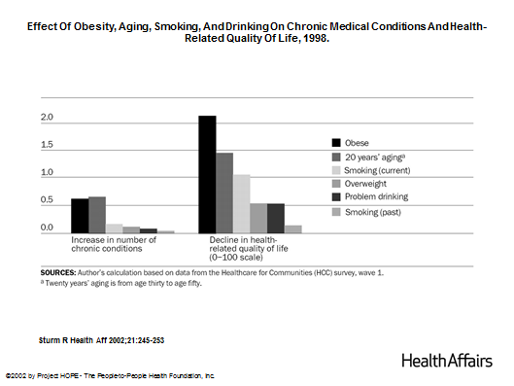
Obesity; Smoking and more
Sturm R. The Effects of Obesity, Smoking, and Problem Drinking on Chronic Medical Problems and Health Care Costs. Health Affairs. 2002;21(2):245-253.
Notes:
Effect Of Obesity, Aging, Smoking, And Drinking On Chronic Medical Conditions And Health-Related Quality Of Life, 1998

Slide 11
Obesity; Smoking and more
Obesity is significantly associated with an odds ratio larger than 1 for every condition.
daily smoking is significantly associated with lung disease and cancer (all at p < 05, most at p <.01).
Obesity and aging have significantly larger effects on heart disease, hypertension, and diabetes than smoking or problem drinking
Sturm R. The Effects of Obesity, Smoking, and Problem Drinking on Chronic Medical Problems and Health Care Costs. Health Affairs. 2002;21(2):245-253.

Slide 12
Obesity; Smoking and more
smoking has the strongest effects on cancer and lung disease (in the case of lung disease, the effect is significantly larger than the effect of obesity at p <.01).
Although cancer and lung disease can be costly, they are relatively rare and lead to death more quickly than diabetes or hypertension do (worth to interpret prevalence cautiously).
Sturm R. The Effects of Obesity, Smoking, and Problem Drinking on Chronic Medical Problems and Health Care Costs. Health Affairs. 2002;21(2):245-253.

Slide 13
Obesity; Smoking and more
Sturm R. The Effects of Obesity, Smoking, and Problem Drinking on Chronic Medical Problems and Health Care Costs. Health Affairs. 2002;21(2):245-253.

Slide 14
Obesity-Smoking Obesity Combined With Exposure to Smoking May Pose New Health Concerns
Research shows that smoking and obesity together may pose a triple health threat in addition to the increased risks for heart disease, cancer and diabetes
This dangerous combination impacts key mechanisms by which both the lung and liver perform metabolism.
American Chemical Society (ACS) (2013, September 11). Obesity combined with exposure to cigarette smoke may pose new health

Slide 15
Obesity-Smoking
Tobacco smoke and obesity also intensifies the cancer-causing potential of cigarette smoke.
Scientists have known for years that cigarette smoke can make some P450 enzymes more active. As a result, smokers may wind up with levels of medication in their blood that are too low to treat a disease.
researchers know that some alterations to the activity of P450 enzymes occur with excess body weight.
American Chemical Society (ACS) (2013, September 11). Obesity combined with exposure to cigarette smoke may pose new health

Slide 16
Obesity-Smoking
Exposure to cigarette smoke increased the activity of some of the P450 enzymes, and adding obesity had little or no change on that effect
But for other enzymes, which usually are far more active when exposed to cigarette smoke, the addition of obesity had a dramatic, opposite effect. The enzymes were 100 times less active.
One potential consequence of these combined effects is an increased risk of developing lung cancer
In other words, obesity alters the lung P450s, potentially adding to the cancer-causing effects of the smoke.
Second-hand smoke had a more pronounced effect on the activity of some enzymes than active smoking.
American Chemical Society (ACS) (2013, September 11). Obesity combined with exposure to cigarette smoke may pose new health

Slide 17
تشکر

