Slide 1
Cinacalcet and CKD
Amir A.Nassiri, M.D, D.I.U
SBUMS

Slide 2

CKD Risk Factors

Slide 3

Risk of Kidney Disease
1/3
1/4

Slide 4
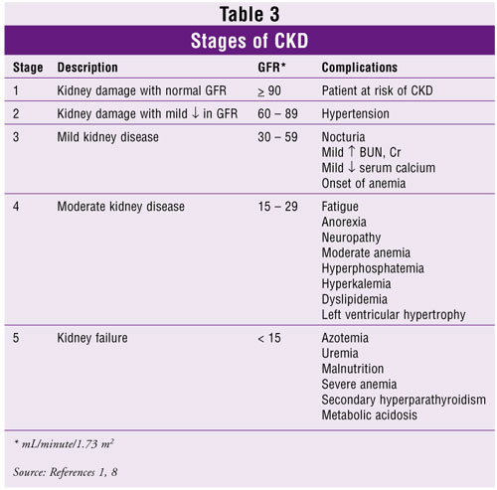
CKD

Slide 5
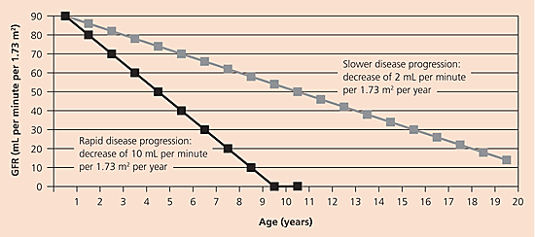
CRF a progressive disease

Slide 6
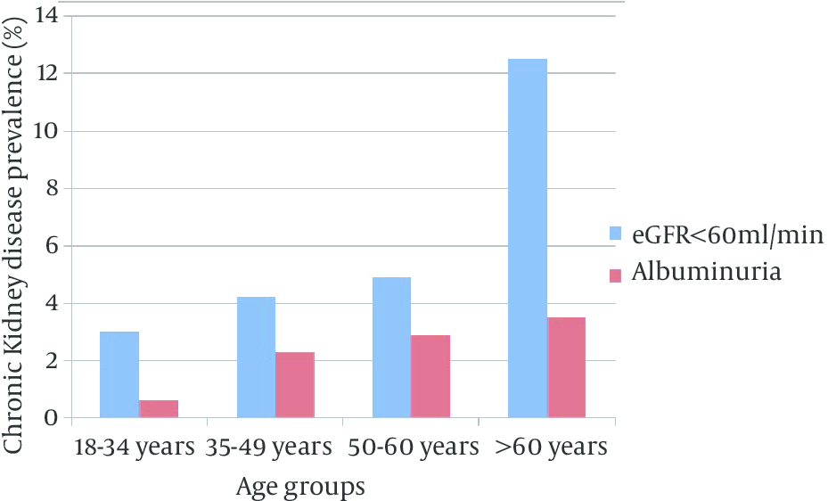
CKD Prevalence

Slide 7
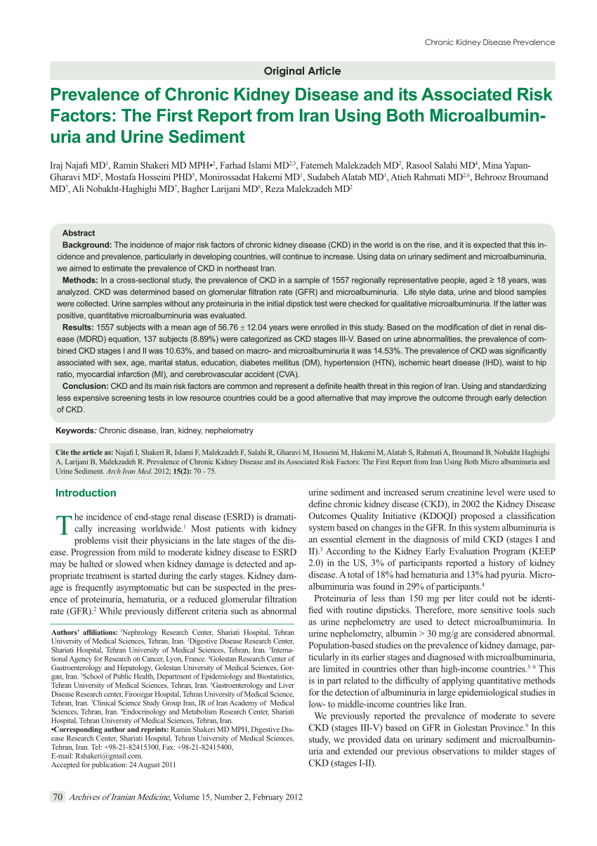
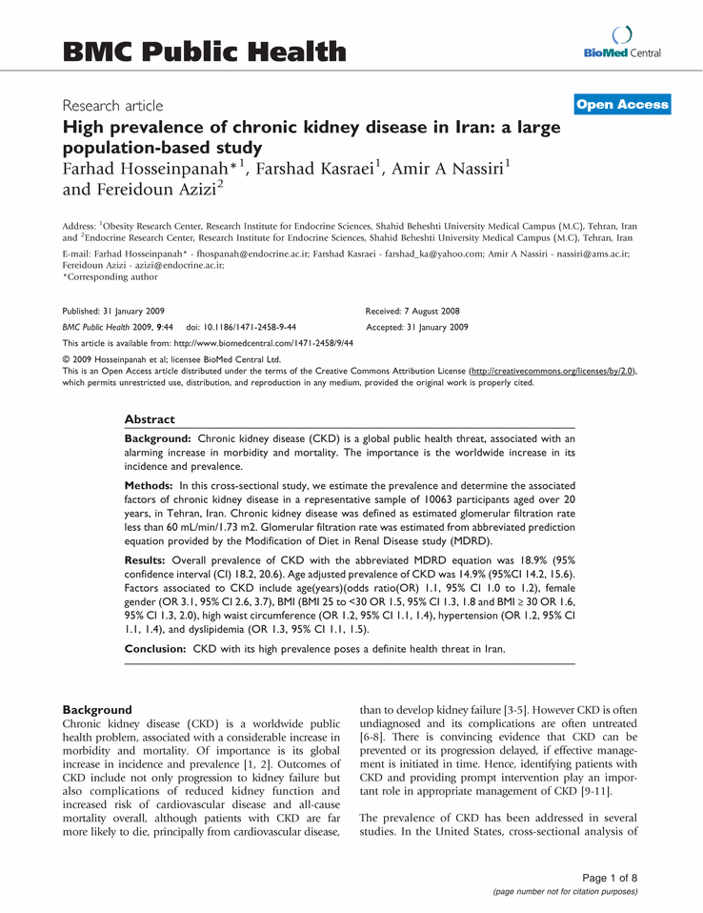

Slide 8
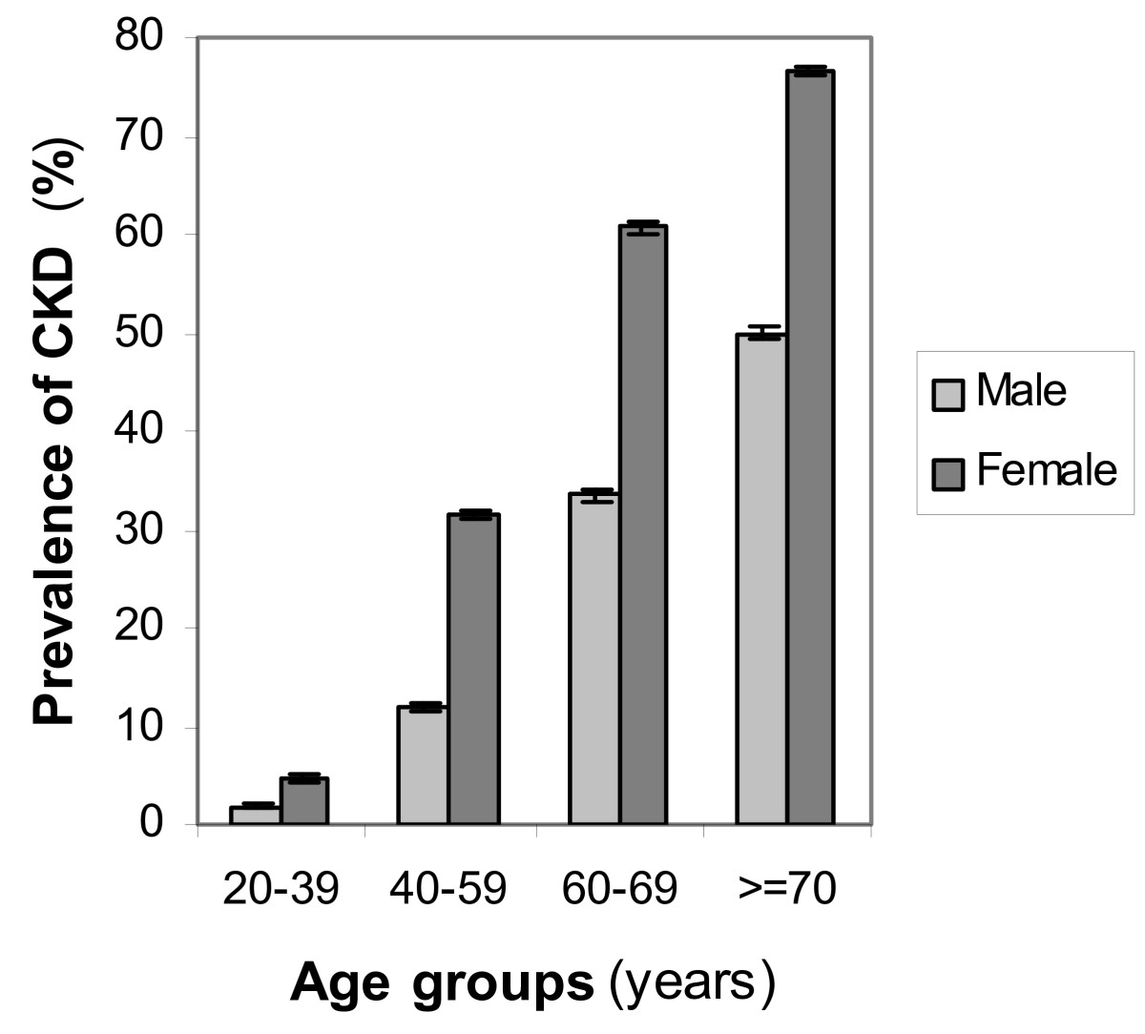
CKD Prevalence
“the TLGS study”

Slide 9
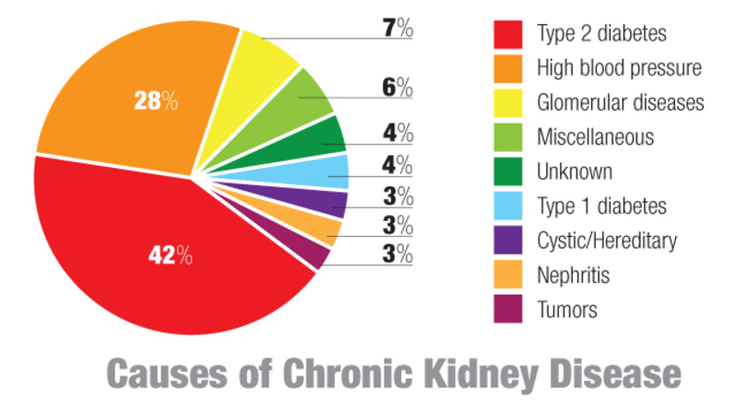

Slide 10
CKD a global public health problem
Adverse outcomes:
a- Progressive loss of kidney function
b- Cardiovascular diseases
c- Disorders of bone & mineral metabolism
d- Premature death

Slide 11
40% of CKD pts have CVD even before ESRD
CKD is an key independent risk factor for CVD
CKD pts are more likely to die from CVD than to develop ESRD
50% 0f ESRD are unlikely to survive a CVD event
The age-adjusted CVD mortality is x15-30 higher than the general population
This is more profound in the 25-34 year age group (x500 increase in CVD mortality rate)

Slide 12
CKD & CVD
40% of CKD pts have CVD even before ESRD
CKD is an key independent risk factor for CVD
CKD pts: more likely to die from CVD than to develop ESRD
ESRD: 50% unlikely to survive a CVD event
CVD mortality (age-adjusted): x15-30 than the general population
25-34 year age group: x500 increase in CVD mortality rate

Slide 13
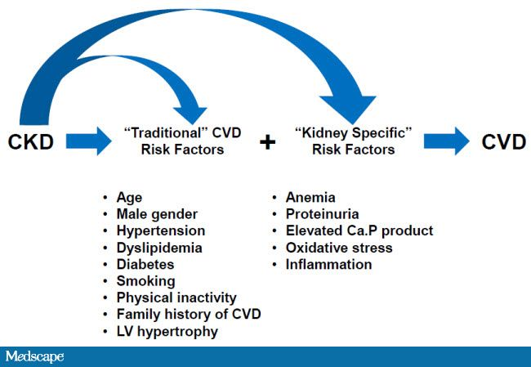

Slide 14
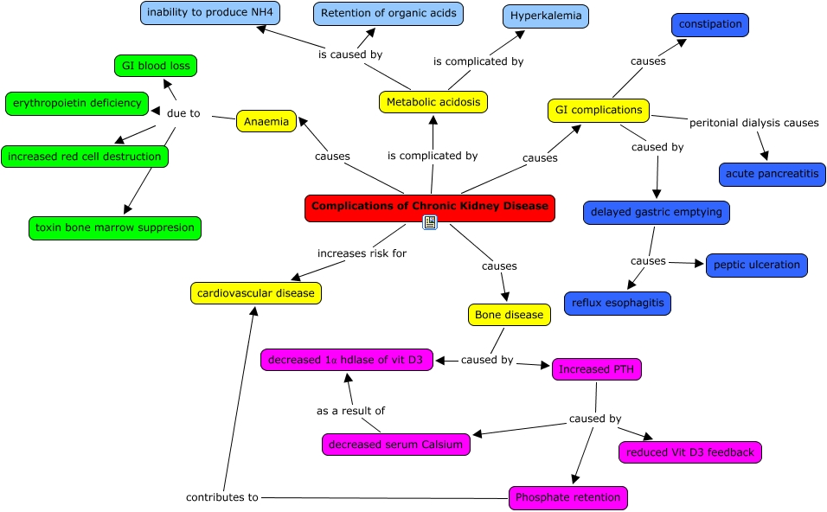

Slide 15
CKD pts: abnorm PO4, Ca, PTH, FGF23, leading to bone abnormal.
Both the lab changes + bone abnorm., contributes to vacular Ca
All 3 processes are closely interrelated with hard outcomes (Fx, CV M&M’s)
The traditional definition of ROD does not reflect all of theses manifestation associated with mineral and bone disorders.
CKD-MBD: a clinical sdrm linking many clinical, biochemical, and imaging abnormalities

Slide 16
CKD-MBD
A systemic disorder of mineral & bone metabolism due to CKD manifested by either 1 or the combination of the following:
1- abnorm Ca, PO4, PTH, or Vit D metabolism
2- abnorm in bone turnover, mineralization, volume, linear growth, or strength
3- vascular (soft tissue) Ca
Is it really a syndrome ?
ROD: alteration of bone morphology in CKD
Is defined as a trinity of:
a- laboratory abnormalities
b- bone abnormalities
c- vascular (or other soft tissue) calcification
All of the above abnormalities are linked to “hard outcomes” – Fx, CV M&M’s

Slide 17
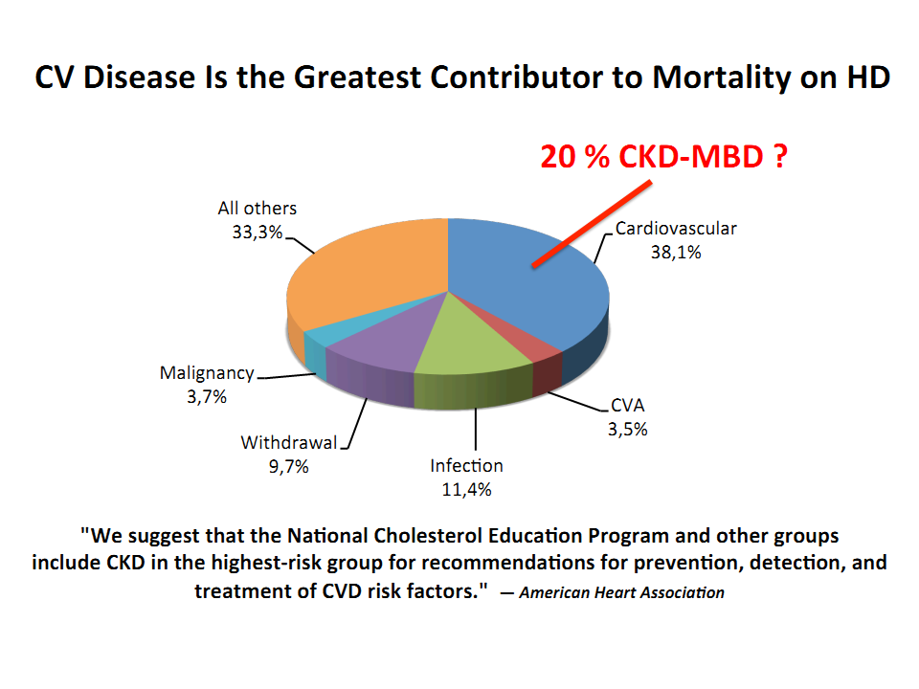

Slide 19
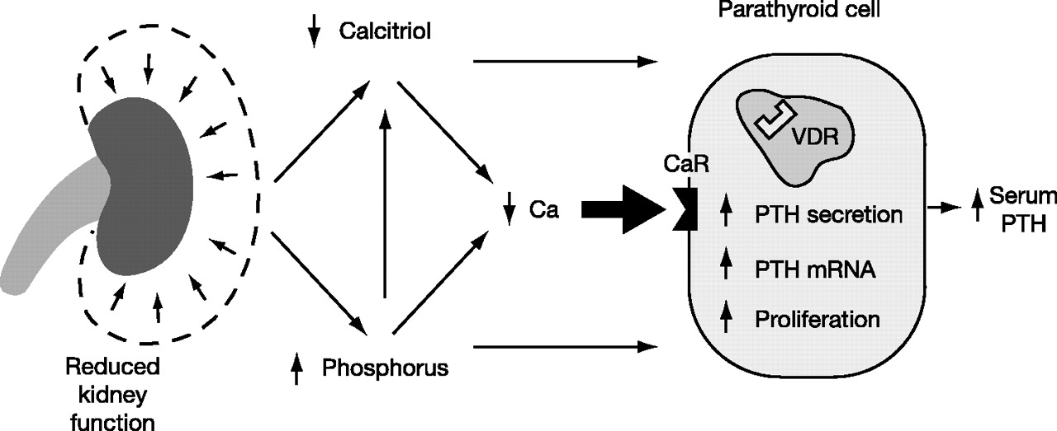

Slide 20
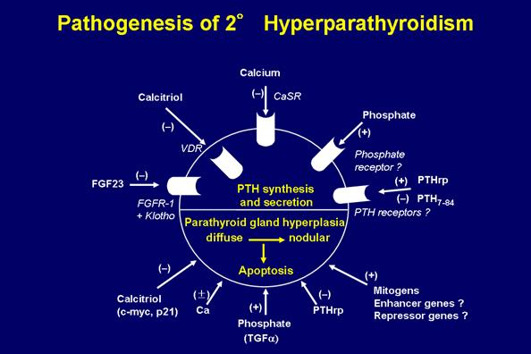

Slide 21
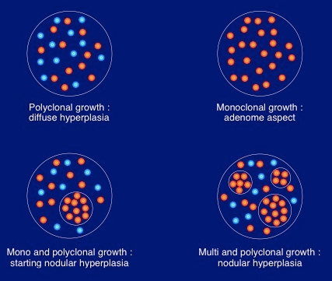
Parathyroid Gland Hyperplasia in CRF

Slide 22
Disorders Related to Kidney Bone Disease
1,25 OH Vit D (calcitriol) deficiency
25 OH Vit D deficiency
Hyper-parathyroidism
Low PTH
Increase level of ALP
Elevated FGF-23
High turnover bone disease
Adynamic bone disease
Uremic Osteoporosis
Vascular Calcification
Hyper-Pi
Hypo-Pi
Hyper-Ca
Hypo-Ca

Slide 23
Ca, PO4, and PTH, and the risk of Death

Slide 24
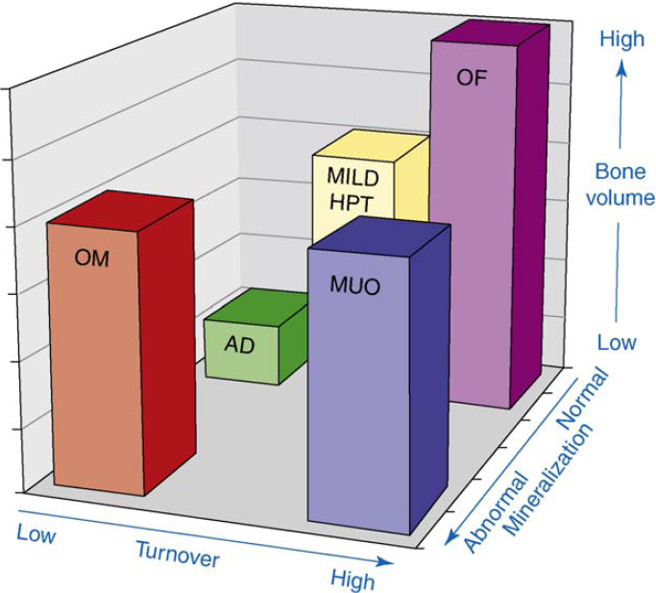
Spectrum of MBD in CKD

Slide 25
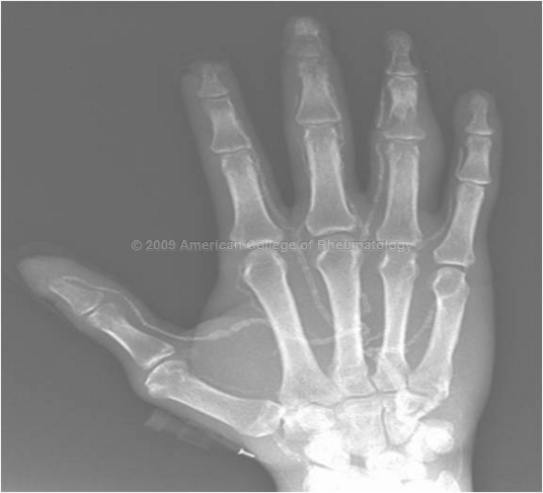
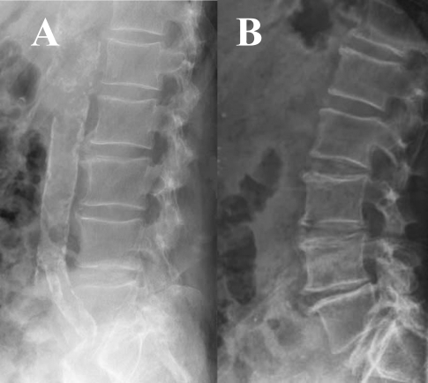
Vascular Calcification

Slide 26
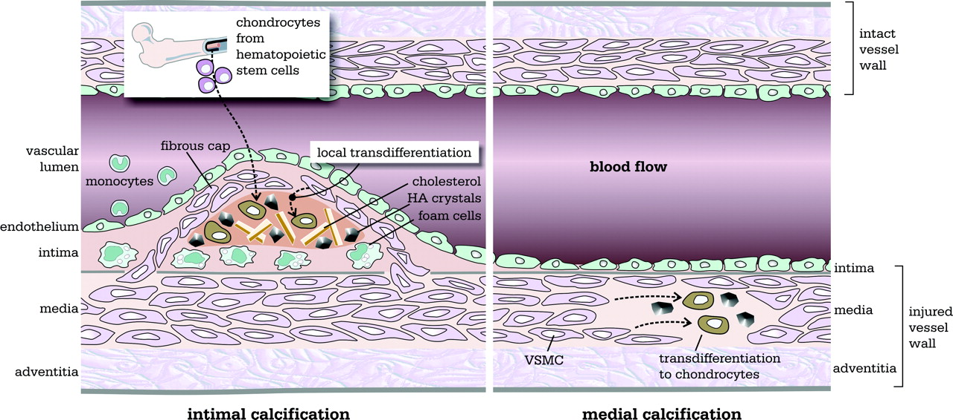
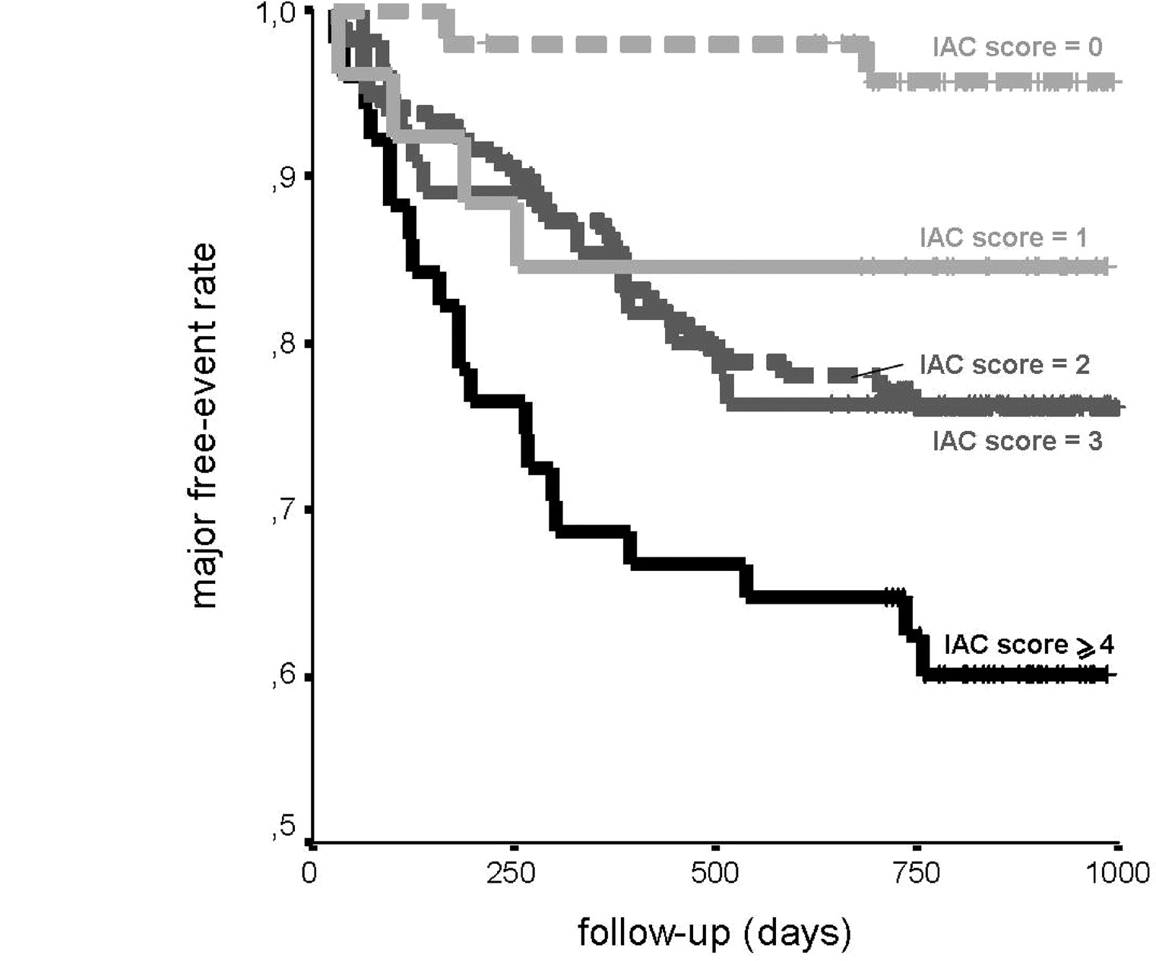
Vascular Calcification
Media: common / Intima: dangerous

Slide 27
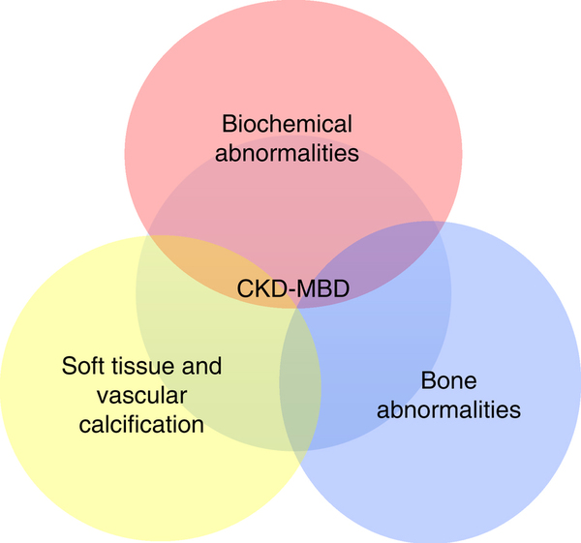

Slide 28
CKD-MBD and CVD

Slide 29
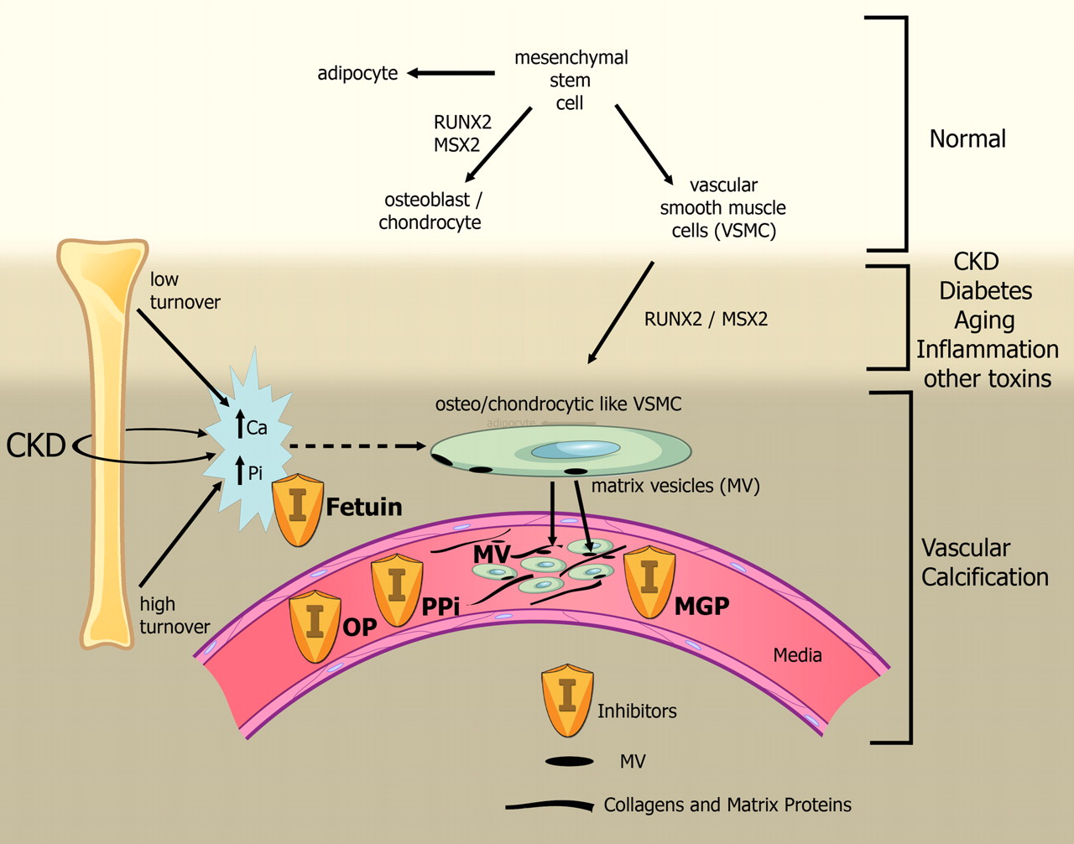
Bone
“at the heart of CKD-MBD”

Slide 30
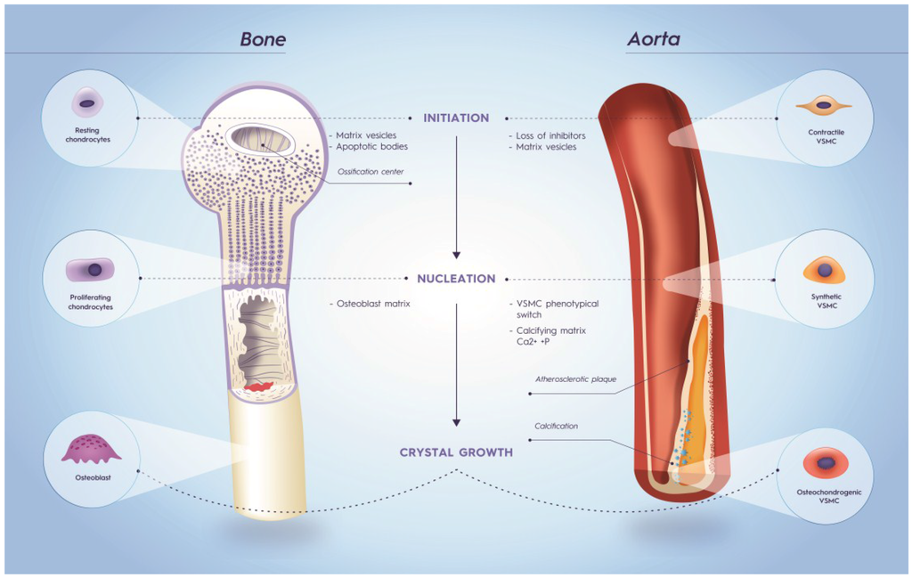

Slide 31
2nd HPT in CKD

Slide 32
Parathyroid Gland Hyperplasia in CRF

Slide 33
2nd HPT
Bone Disease
Systemic Toxicity
OFC
Demineralization
Fractures
Bone pain
CVD
Endocrine
Nervous System
Immunologic
Cutaneous

Slide 34
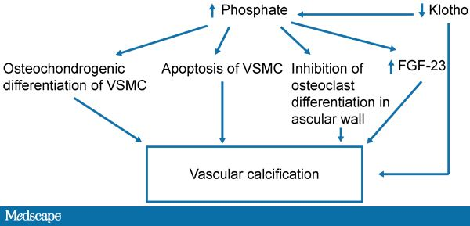

Slide 35
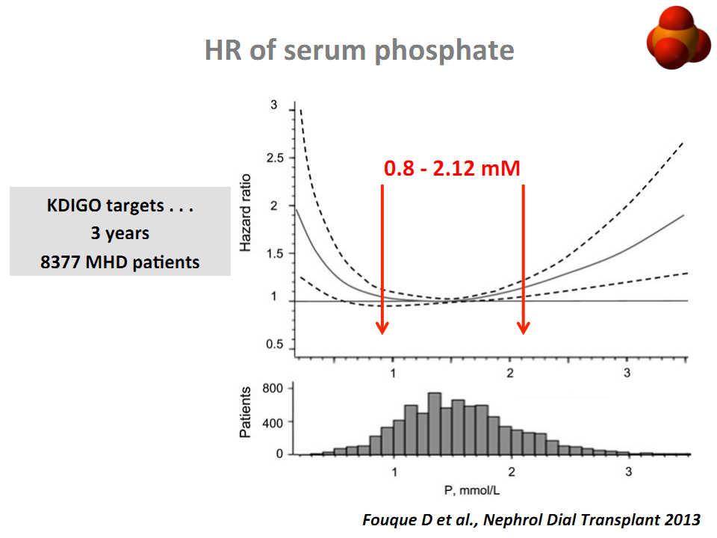

Slide 36
HR of serum Phosphate

Slide 37
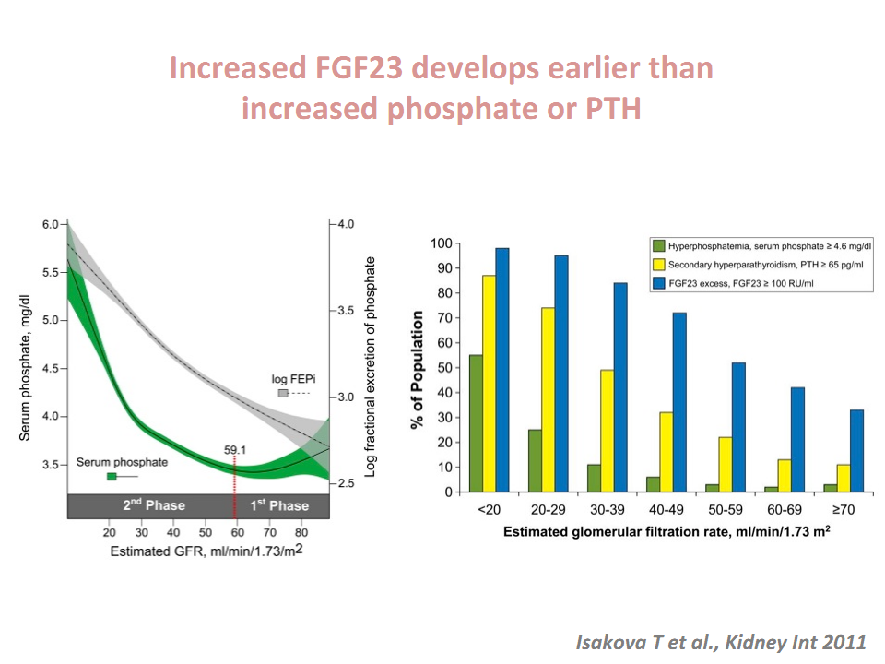

Slide 38
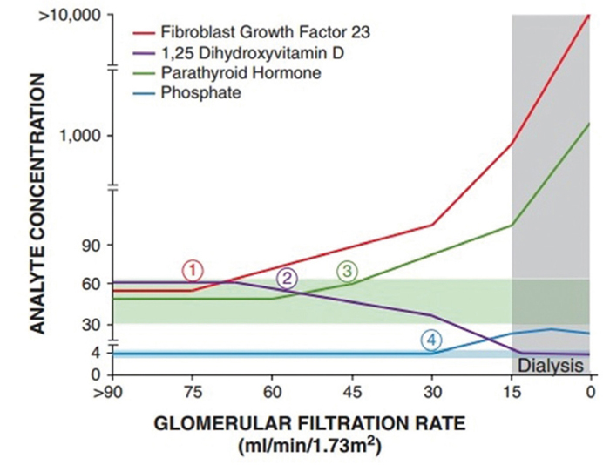
2nd HPT begin early

Slide 39
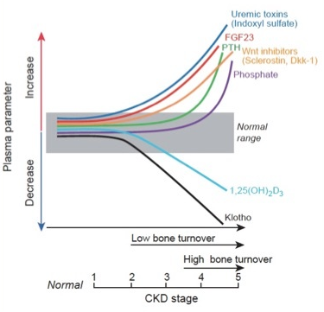

Slide 40
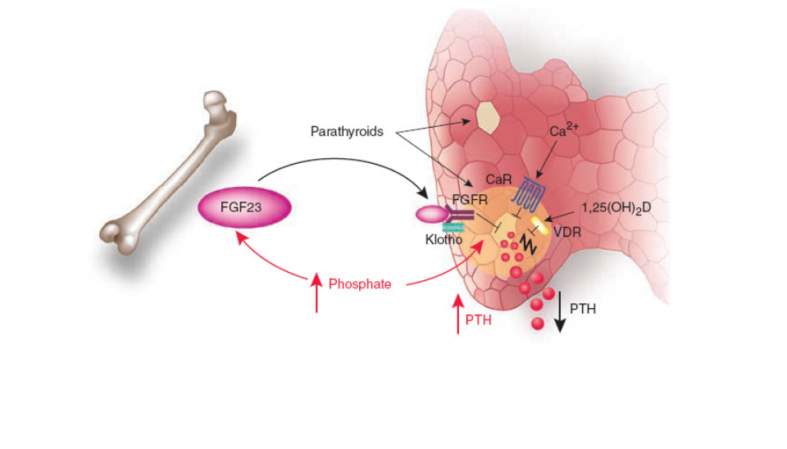
2nd HPT
“the new concept”

Slide 41
PTH & CV Calcification

Slide 42
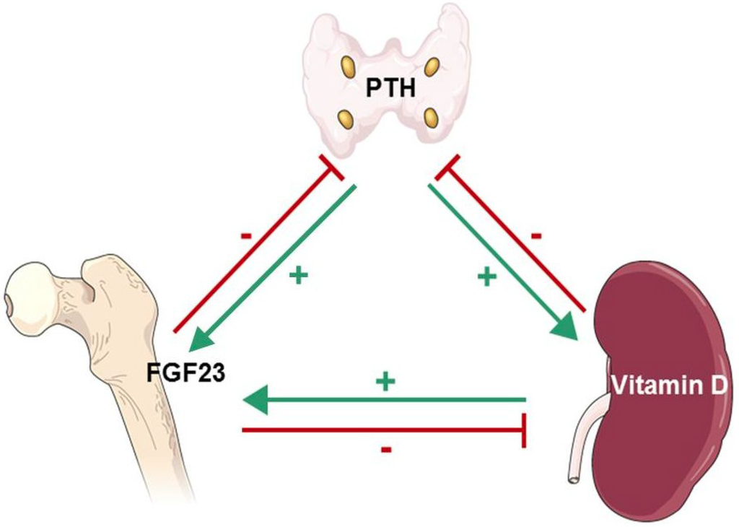

Slide 43
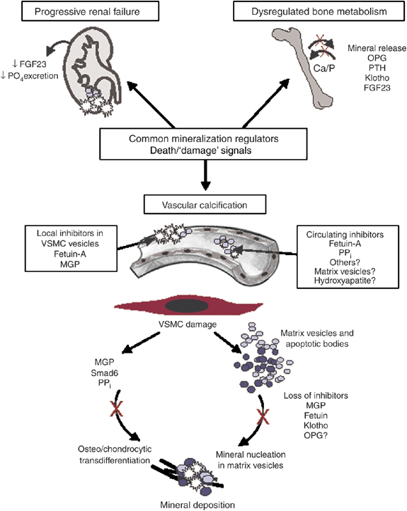

Slide 44
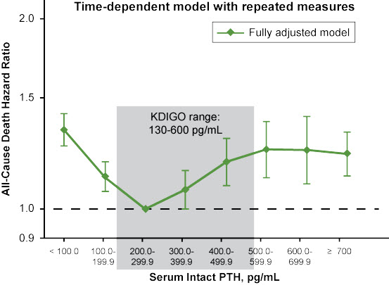
Figure 2. Risk of death by parathyroid hormone level. Kalantar-Zadeh K, et al.^{[1]}

Slide 46
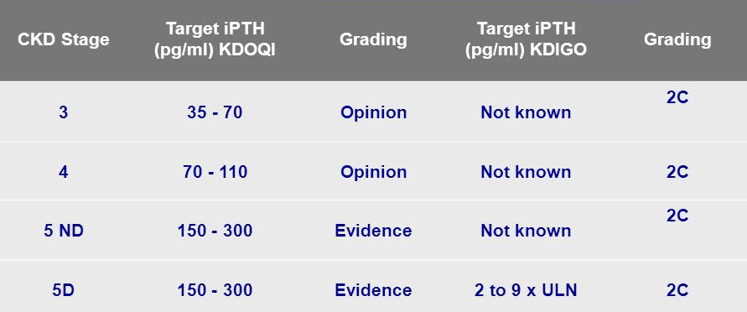
KDIGO/KDOQI
“PTH targets”

Slide 47
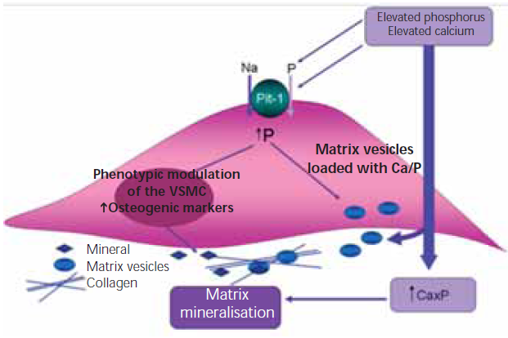
Effect of high Pi on VSMC (through Pit-1)

Slide 48
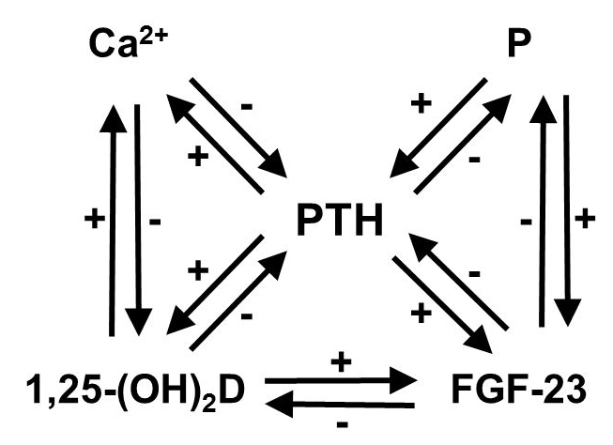
2nd HPT therapeutic strategies
Modulation of Ca & Pi hemostasis
dietary intake
dialysis
Active Vit D compounds
calcitriol
newer Vit D analogs
Pi binders
Calcimimetics
PTx

Slide 49
2nd HPT therapeutic strategies
Modulation of Ca & Pi hemostasis
dietary intake
dialysis
Active Vit D compounds
calcitriol
newer Vit D analogs
Pi binders
Calcimimetics
PTx

Slide 50
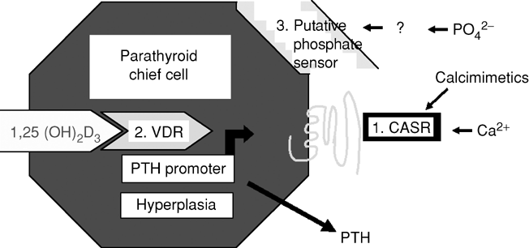
Calcium Sensing Receptors
CKD
Under-expression & Downregulation of CaSR & VDR
Decreased responsiveness and sensitivity to the inhibitory effect of Ca & calcitriol on PTH secretion
Parathyroid hyperplasia

Slide 51
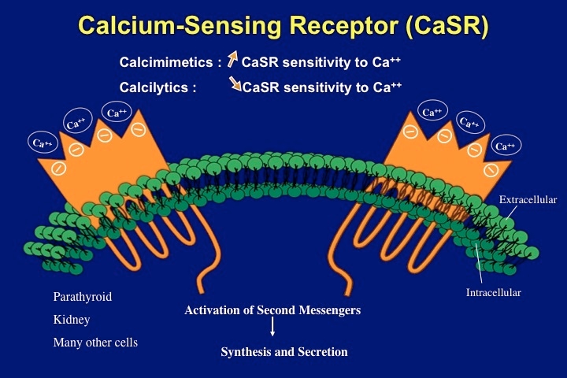

Slide 52
CaSR Ligands
Ortho-steric modulators (type I agonists):
many of divalent and trivalent cations (Ca, Mg, Al, Sr, Mn, Ni, Gd, Ba)
polycationics (gentamycin, neomycin), polyamines
Allo-steric modulators (type II agonists):
a- the 1st generation calcimimetics: NPSR-467 & R-568
b- the 2nd generation calcimimetics: AMG 073 (clinically known as cinacalcet)
c- calindol
d- velcalcetide: AMG 416 (a novel agonist of CaSR)
e- series of tri-substituted ureas
f- the calcilytics (NPS) & Calhex 231

Slide 53
CaSR Ligands
Allosteric modulators (type II agonists):
a- the 1st generation calcimimetics: NPSR-467 & R-568
b- the 2nd generation calcimimetics: AMG 073 (clinically known as cinacalcet)
c- calindol
d- velcalcetide: AMG 416 (a novel agonist of CaSR)
e- series of tri-substituted ureas
f- the calcilytics (NPS) & Calhex 231
Ortho-steric modulators (type I agonists):
many of divalent and trivalent cations (Ca, Mg, Al, Sr, Mn, Ni, Gd, Ba)
polycationics (gentamycin, neomycin), polyamines

Slide 54
Calcimimetics
Type II (allosteric) agonist (positive allosteric modulator-PAM)
Phenylalkylamine, derived from Ca channel blockers
Are not polycations
Increasing the sensitivity of the CaSR to extra-cellular Ca ions
Inhibit the synthesis & excretion of PTH
Do not alter the plasma concentration of the endogenous ligands
Do not compete & bind to different sites from the othosteric agonists (Mg,Gd)
Enhance the endogenous physiologic response
Effects are saturable

Slide 55
CaSR positive & negative allosteric modulators

Slide 56
CaSR Activation

Slide 57
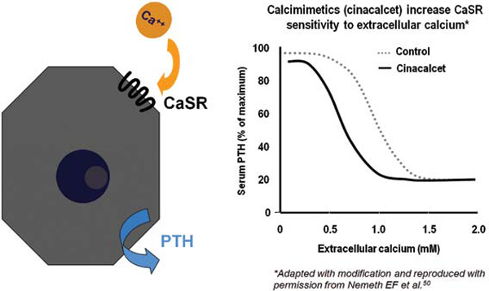
Shift to left

Slide 59
CaSR is also expressed in a variety of tissues, other than the parathyroid gland
Activation of CaSR in other tissues regulate diverse cellular processes
secretion, chemotaxis, apoptosis, proliferation, differentiation, ion-channel activities
CaSR expressed in other organs, could influence CKD-related disorders

Slide 60
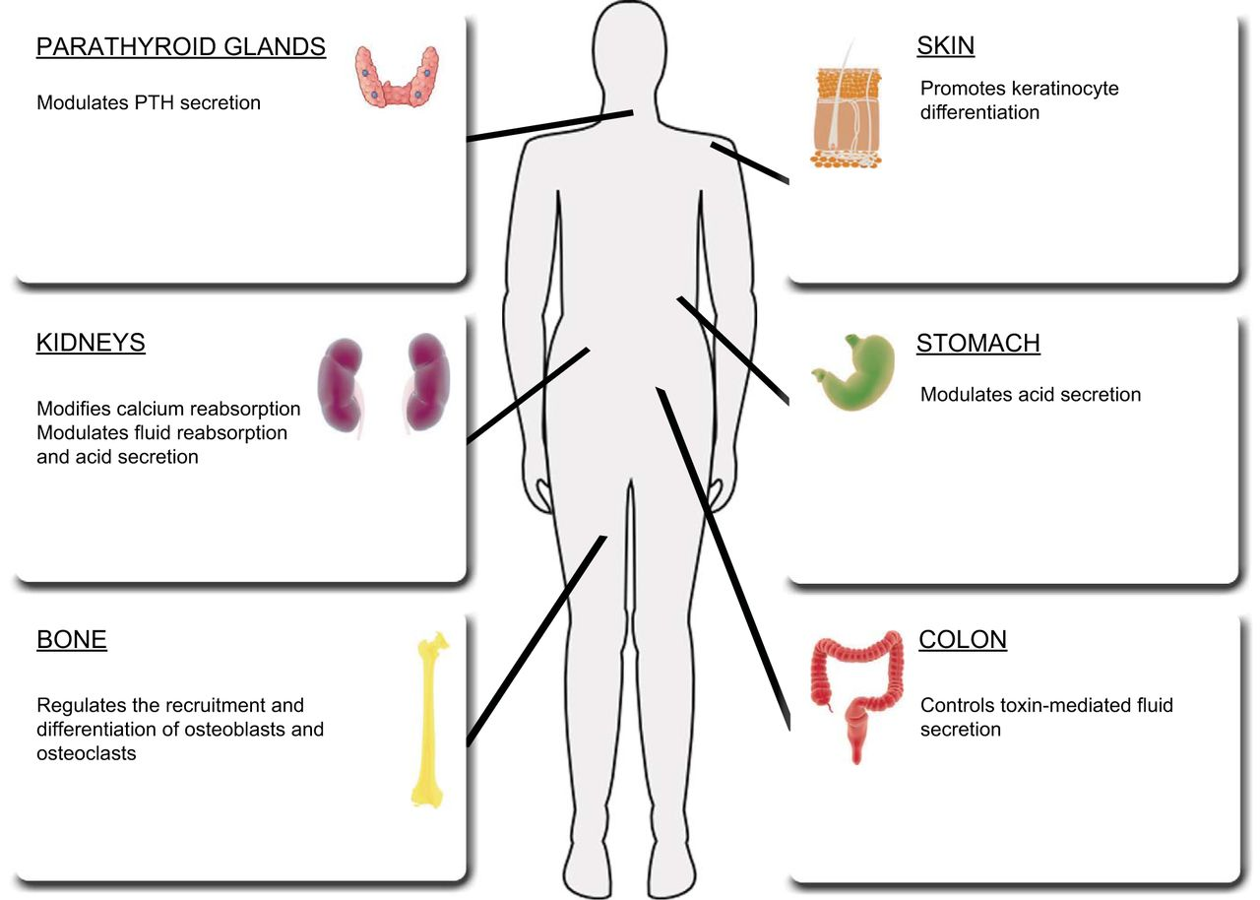

Slide 61
CaSR in CKD Beyond PTH Control
“local effects of CaSR stimulation on CKD-related disorders”

Slide 62
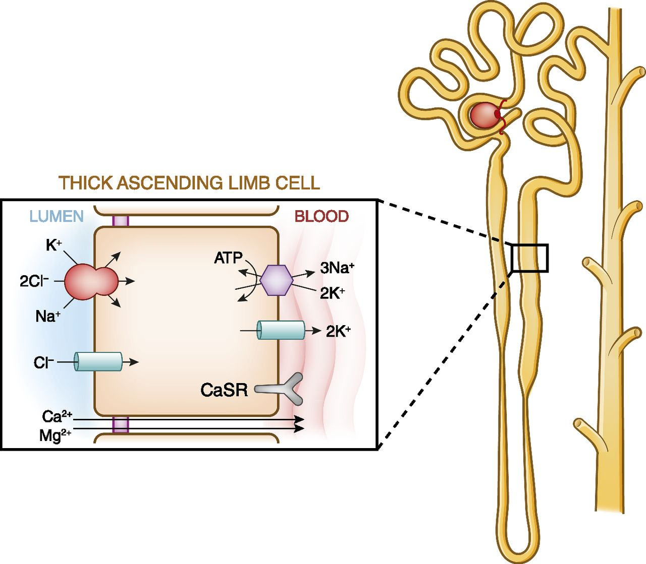
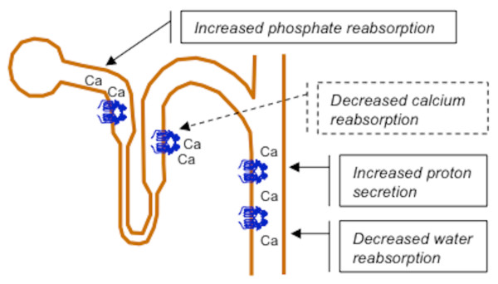
Electrolyte & Water Homeostasis
“PTH-independent”

Slide 63
Decrease in cAMP levels and cell proliferation in human ADPCKD (R-568):
inhibiting cyst progression ?
Prevent podocyte loss (R-568):
attenuation of proteinuria & glomerulosclerosis
Inhibition of renin secretion by JG cells:
chronic use of calcimimetics leads to
sustained anti-HTN effects in uremic rats

Slide 66
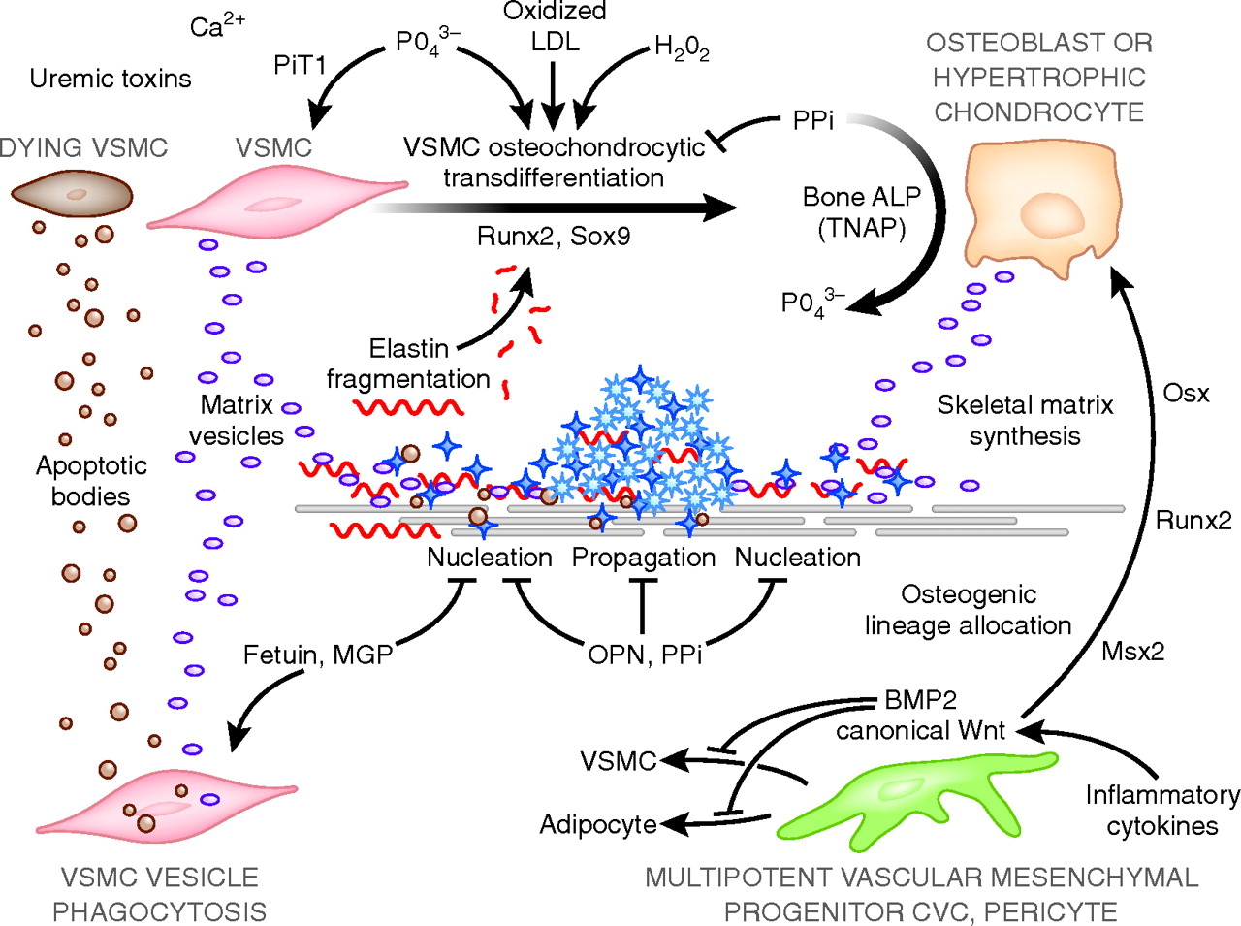

Slide 67
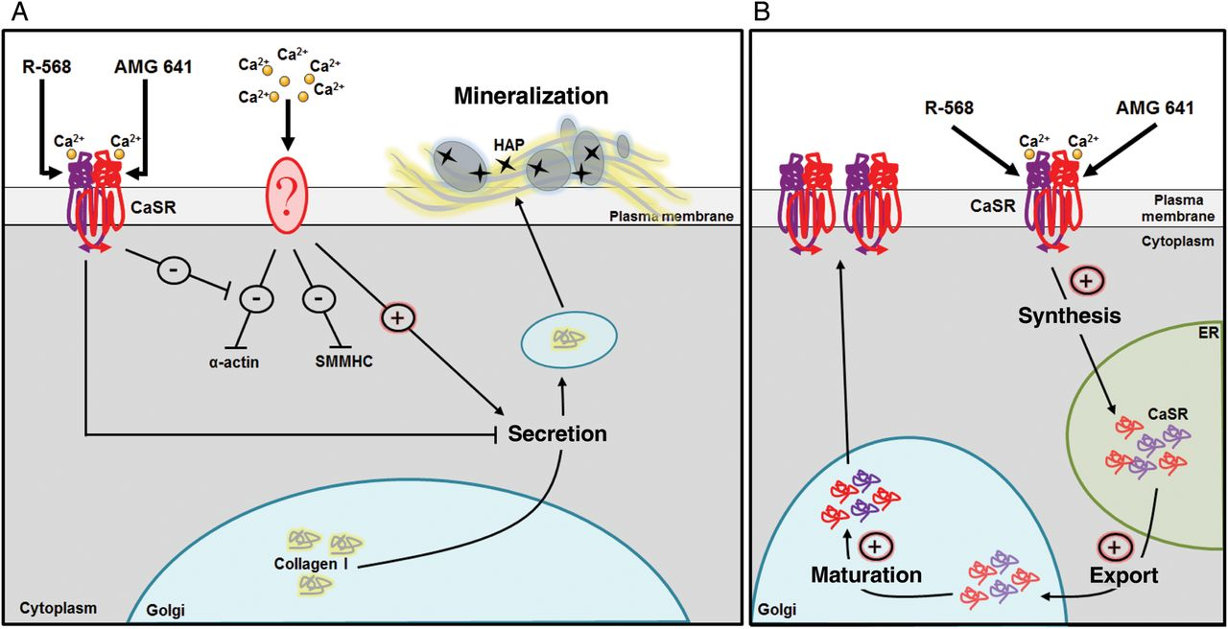
Delayed Ca-induced Mineralization of VSMC

Slide 68
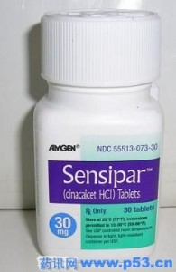
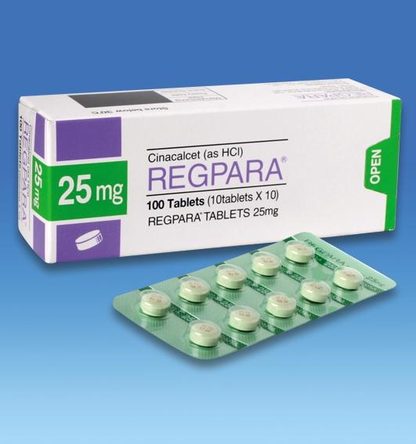
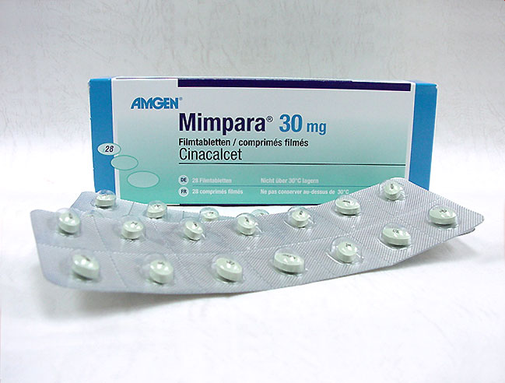
Cinacalcet

Slide 70
Cinacalcet adverse events

Slide 71
Cinacalcet
FDA approval 11 years after the CaSR was cloned (2004)
Approved for the ttt of 2nd HPT in CKD-5D (2004) – not in renal Tx pts with persistent 2nd HPT or in pts with earlier stages (3-4) of CKD –
& parathyroid carcinoma (2007)
Off-label applications
rectifying hyper-Ca/Hypo-Pi states:
Li-induced HPT
X-linked hypo-Pi
oncogenic osteomalacia
Stabilizing CaSR in an active state

Slide 76
Cinacalcet vs VitD based therapy
“the OPTIMA study”

Slide 77
Cinacalcet early achievement & stabilization of KDOQI targets

Slide 78
Cinacalcet vs traditional therapy
The Ca & Pi-lowering effect of cinacalcet enables the addition or increment of Vit D therapy to further facilitate PTH suppression

Slide 82
Cinacalcet long-term effect

Slide 83
Meta-analysis of 15 RCT efficacy & safety of cinacalcet in 3,387 Dx pts with 2nd HPT
(lowered PTHi, Ca, Pi)

Slide 84
ADVANCE less vascular progression

Slide 87
Cinacalcet all-cause & CV mortality

Slide 88
ADVANCE study post-hoc pre-protocol analysis

Slide 93
Reduces hypercalcemia
Infrequently prevents surgical PTx
Little or no effect on all-cause mortality
Imprecise effects on CV death
Associated commonly with adverse effects (hypo-Ca, nausea, vomit., diarrhea)
For 1000 pts after 1 yr:
a- no effect on mortality
b- prevent 3 pts from PTx
c- 60 pts with hypo-Ca & 150 pts with nausea

Slide 94
Reduces hypercalcemia
Infrequently prevents surgical PTx
Little or no effect on all-cause mortality
Imprecise effects on CV death
Associated commonly with adverse effects (hypo-Ca, nausea, vomit., diarrhea)
For 1000 pts after 1 yr:
a- no effect on mortality
b- prevent 3 pts from PTx
c- 60 pts with hypo-Ca & 150 pts with nausea

Slide 97
Post-EVOLVE
Routine Cinacalcet: any benefit for mortality is small
Cinacalcet: benefits for elevated PTH resistant to Vit D and PO4-binders
The –ve findings of existing trials on pt-level end points:
a- serum PTH is very high
b- other ttt have been ineffective
c- surgical PTx is contraindicated

Slide 98
It is possible that, routine Cinacalcet has beneficial effect on all-cause mortality, but any benefit for mortality is small
Need for additional placebo-controlled trials ?
Routine or 1st-line? For elevated PTH ?
We should not exclude the possibility that the drug may afford benefits for elevated PTH resistant to Vit D and PO4-binders
The –ve findings of existing trials on pt-level end points:
should be used when (?):
a- serum PTH is very high
b- other ttt have been ineffective
c- surgical PTx is contrindicated

Slide 99
Its use is widespread and costly
Provides small absolute benefits for PTx
Provides NO reduction in mortality
Frequently leads to adverse GI effects – may adversely influence nutrition and QOL
The effects of cinacalcet on all-cause mortality, PTx, side effects, … were all identifiable before the EVOLVE trial, but EVOLVE largely increased our confidence !!!
Post-EVOLVE area: a fall in cinacalcet use !

Slide 100
Lesson from EVOLVE
relying on “surrogate end-points” and “nonrandomized studies”
to evaluate “treatment efficacy” for new intervention
is likely to result in “unreliable estimate of clinical effectiveness”.
leads to extensive use of interventions that do not improve population outcome (increase healthcare expenditures)

Slide 101
Lesson from EVOLVE
The pathway from drug development to clinical use for cinacalcet remind us that:
a- relying on “surrogate end-points” and “nonrandomized studies” to evaluate “treatment efficacy” for new intervention is likely to result in “unreliable estimate of clinical effectiveness”.
b- this (in turn) leads to extensive use of interventions that do not improve population outcome (increase healthcare expenditures)

Slide 102
NICE Guideline
Cinacalcet should not be used for the routine ttt of elevated PTH in CKD pts
Cinacalcet use should be limited to people with elevated PTH refractory to Standard therapy, with normal or high serum Ca, and in whom surgical PTx is contraindicated

Slide 103
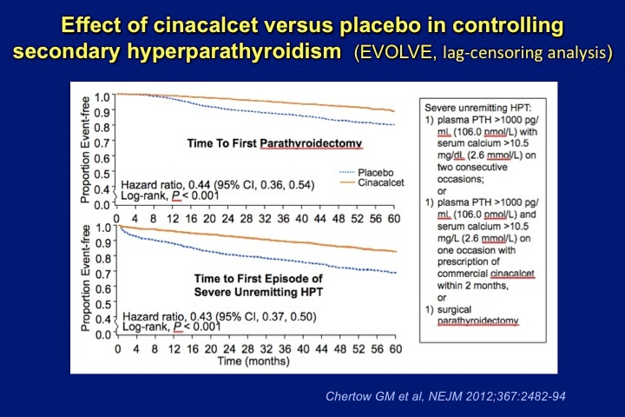
EVOVLE, lag-censoring analysis
“Cinacalcet vs placebo in controlling 2nd HPT”

Slide 105
Unmasking EVOLVE
Extremely elevated Ca score in both groups at baseline (considerable vascular damage may already have occurred – no time for change/reverse in vas Ca)
Vasc Ca is just a marker of severe underlying vascular damage, it is not surprising that no clinical improvement were detected in EVOLVE
Many aspect of clinical ttt were not predefined (ex: the use of Vit D – which is associated with improved survival - was lower in pts randomized to cinacalcet)
High drop-outs (62%)
Significant drop-ins (19%)
Nominally significant decrease in incidence of the need for PTx, episodes of calciphylaxis, and clinically reported Fx
Re-estimated statistical power of only 54%
Cinacalcet: not formally proven to improve all-cause mortality in HDx pts,
BUT neither has a positive effect been formally ruled-out.

Slide 106
EVOLVE trial
RCT, double blind
Impact of cinacalcet on a composite endpoint in HDx pts.
Composite endpoint: time to all-cause mortality, MI, hospitalization for U/A, CHF, peripheral vascular events
Cinacalcet effect more pronounced among older pts (sign in post-hoc)
Cinacalcet group:
High dropout rate in both ttt groups and the number of pts who were prescribed cinacalcet
Extremely elevated Ca score in both groups at baseline (considerable vascular damage may already have occurred – no time for change/reverse in vas Ca)

Slide 107
EVOLVE post-hoc analysis
After adjustment for imbalance, the effect became significant (HR=0.88)
In a lag censoring analysis, ttt with cinacalcet yielded significance (HR: 0.85)
The post-hoc analyses in EVOLVE indicate a cardio-protective & vascular protective effect of cinacalcet, in CKD-5D

Slide 108
Cinacalcet cost-utility analysis
Cinacalcet is an expensive drug
In US, 4 of the top 8 drugs for ESRD pts are used to treat 2nd HPT
Cinacalcet positioned at the 2nd place of cost
Economic implications in the ttt of 2nd HPT has produced mixed results

Slide 109
In HDx pts (Joy et al, J Manag Care Pharm, 2007)
IV Calcitriol: 80$/pt/w
Cinacalcet: 278$/pt/w
Cinacalcet vs PTx for uncontrolled 2nd HPT (Narayan et al, Am J Kidney Dis, 2007)
Cinacalcet is most cost-effective only for pts who are to remain on
HDx for 7.5 mo or less

Slide 110
Cost-effectiveness of cinacalcet in secondary hyperparathyroidism in the United States
Boer R, Lalla AM, Belozeroff V J Med Econ 2012
Abstract
OBJECTIVE:
Cinacalcet has been used in controlling secondary hyperparathyroidism (SHPT) in dialysis patients since 2004, but its full economic evaluation has not been conducted from the US perspective. This study assesses the cost-effectiveness of cinacalcet and low-dose vitamin D for the treatment of SHPT in dialysis patients compared with flexible vitamin D.
METHODS:
A lifetime patient-level simulation model was developed using ADVANCE trial data, including biomarker levels: parathyroid hormone, calcium, and phosphorus. The impact of the biomarkers on mortality, cardiovascular events, fractures, and parathyroidectomy were estimated from literature: Block, an observational study; Cunningham, a combined analysis of four randomized trials of cinacalcet; and Danese, a study investigating the effect of duration in recommended targets. Baseline event rates were derived from the large dialysis organizations registries. One-way and probabilistic sensitivity analyses (PSA) were conducted.
RESULTS:
The cost-effectiveness ratio for cinacalcet compared with standard of care (vitamin D and phosphate binders) was $54,560 and $72,456/quality-adjusted-life-year (QALY) gained or an incremental cost of $3155 and $2638 per year alive for the Block and Danese variants, respectively. In the Cunningham variant, cost-effectiveness ratio for cinacalcet was $5064/QALY gained or a cost saving of $1068 per year. The difference in the results of the Cunningham variant vs other variants can be explained by the favorable impact of cinacalcet on outcomes, specifically cardiovascular events observed in the Cunningham study. The PSA showed 98% likelihood for cinacalcet to be cost-effective at $100,000/QALY threshold.
LIMITATIONS:
Observational data assessing effects on clinical outcomes, trial restriction to use calcium-containing phosphate binders, no utility data in SHPT dialysis population, and insufficient evidence on long-term impact of cinacalcet and vitamin D on biochemical markers.
CONCLUSIONS:
Cinacalcet treatment is cost-effective for treatment of SHPT in the US. Due to cost offsets, cinacalcet can reduce annual costs in some scenarios.

Slide 111
A cost-utility analysis of cinacalcet in secondary hyperparathyroidism in five European countries.
Form the OPTIMA trial data
Iannazzo S, Carsi M, Chiroli S Appl Health Econ Policy 2012
BACKGROUND AND OBJECTIVE:
A probabilistic patient-level Markov model was previously developed to simulate lifetime clinical and economic outcomes of cinacalcet treatment in secondary hyperparathyroidism (SHPT) patients using local data from Italy. The present study extends the application of the model to four other European countries - Spain, Portugal, Switzerland and the Czech Republic - in order to assess the consistency of results.
METHODS:
Cinacalcet influences the levels of parathyroid hormone, serum calcium and phosphorous. Our simulation was based on data from theOPTIMA (Open-Label, Randomized Study Using Cinacalcet to Improve Achievement of KDOQI Targets in Patients with End-Stage Renal Disease) randomized controlled trial and from published correlations between bone-metabolism parameters, mortality and morbidity (cardiovascular [CV] events, fractures and parathyroidectomy). Local epidemiological and cost data for dialysis, drugs and event management were incorporated into the model. The simulation horizon was patient lifetime; standard treatment for SHPT (vitamin D sterols and phosphate binders) and cinacalcet plus standard treatment were compared. Effectiveness was measured in terms of life expectancy (LE) and quality-adjusted life expectancy (QALE). Health utility indexes derived from published literature took into account dialysis, CV events and fractures.
RESULTS:
The simulated mean LE extension in patients receiving cinacalcet was 1.20 life-years (LY) in Italy, 1.10 LY in Spain, 1.18 LY in Portugal, 1.10 LY in the Czech Republic and 1.40 LY in Switzerland. QALE increase was 0.89, 0.82, 0.89, 0.80 and 1.01 QALY in the same countries, respectively. The incremental cost-effectiveness ratio (ICER) result was €23,500/LY and €31,600/QALY in Italy, €21,800/LY and €29,300/QALY in Spain, €23,700/LY and €31,200/QALY in Portugal, €29,700/LY and €40,800/QALY in the Czech Republic and €24,700/LY and €34,200/QALY in Switzerland. Including dialysis costs as a part of the total costing doubled the ICER, from a minimum of €42,800/LY in Spain to a maximum of €82,800/LY in Switzerland and in the range from €57,500/QALY (Spain) to €114,700/QALY (Switzerland).
CONCLUSION:
Taking into consideration the limited clinical, epidemiological and health economics data available, cinacalcet treatment showed a relatively good cost-effectiveness profile in all the countries analysed, despite the differences in their healthcare systems and economic wealth.

Slide 112
Cost-effectiveness of early versus late cinacalcet treatment in addition to standard care for secondary renal hyperparathyroidism in the USA.
Ray JA, Borker R, Barber B, Valentine WJ, Belozeroff V, Palmer AJ Value Health 2008
Abstract
OBJECTIVES:
The objective of this research was to estimate lifetime cost-effectiveness of treating patients with cinacalcet early (when parathyroid hormone [PTH] levels are in the range of 300-500 pg/ml) versus delaying treatment with cinacalcet (cinacalcet initiated when PTH levels are > 800 pg/ml) in patients with secondary hyperparathyroidism (SHPT) in the US setting.
METHODS:
A Markov model was developed to simulate the effects of early versus delayed use of cinacalcet (plus standard of care). Four different PTH ranges (< or = 300 pg/ml; 301-500 pg/ml; 501-800 pg/ml; > 800 pg/ml) were used to represent four different health states within the Markov model. Associated with each Markov state (PTH range) were varying risks of major SHPT complications, including cardiovascular disease (CVD), fracture (Fx), and parathyroidectomy (PTx). Baseline cohort characteristics and risks of CVD, Fx, and PTx by PTH category were derived from a large US renal database and published sources. Costs were estimated from the US Renal Data System database and reported in 2006 US Dollars ($). Clinical and economic outcomes were discounted at 3.0% per annum.
RESULTS:
Early treatment was projected to improve quality-adjusted life years (QALYs) by 0.337 years compared to delaying treatment. The incremental cost-effectiveness ratio was $17,275 per QALY gained.
CONCLUSIONS:
Early treatment with cinacalcet was associated with improvements in QALYs and would represent good value for money compared to delaying treatment with cinacalcet.

Slide 113
Early initiation of Cinacalcet more pts achieving target PTHi & less disease severity

Slide 114
Early vs Late

Slide 115
Summary
Cinacalcet may not be warranted for ALL HDx pts
Cinacalcet is not recommended to improve survival
Cinacalcet remains an important & potent prescription for controlling moderate to severe 2nd HPT
Cinacalcet improves the achievement of target levels of all metabolic abnormalities of CKD-MBD
KDOQI/KDIGO: the primary choice of anti-PTH ttt may be based on basal levels of Ca & PO4
Pts with 2nd HPT & non-pharmaco. hyper-Ca (tertiary HPT) or pts prone to hyper-Ca, calcimimetics are often used a 1st-line ttt
Calcimimetics allow safer concomitant use of active forms of Vit D

Slide 119
CaSR is also expressed in a variety of tissues, other than the parathyroid gland
Activation of CaSR in other tissues regulate diverse cellular processes
secretion, chemotaxis, apoptosis, proliferation, differentiation, ion-channel activities
CaSR expressed in other organs, could influence CKD-related disorders

Slide 121
CaSR in CKD Beyond PTH Control
“local (off-target) effects of CaSR stimulation on CKD-related disorders”

Slide 122
Electrolyte & Water Homeostasis
“PTH-independent”

Slide 123
Decrease in cAMP levels and cell proliferation in human ADPCKD (R-568):
inhibiting cyst progression ?
Prevent podocyte loss (R-568):
attenuation of proteinuria & glomerulosclerosis
Inhibition of renin secretion by JG cells:
chronic use of calcimimetics leads to
sustained anti-HTN effects in uremic rats

Slide 127
Delayed Ca-induced Mineralization of VSMC

Slide 129
Take Home Message
CKD-MBD is associated with a high risk of mortality
No single drug intervention has been shown to decrease this risk and improve survival in HDx pts (in any RCTs)
Several robust secondary analysis point toward potential important beneficial effects of controlling 2nd HPT with Cinacalcet + standard ttt
Improvement in the management of common 2nd effects (naus, vom, hypo-Ca), and PTH over suppression is plausible
New drugs (Velcalcetide AMG 416) and new studies on HARD outcomes

Slide 130
هرگزدل من زعلم محروم نشد
کم ماند زاسرارکه معلوم نشد
هفتاد و دوسال فکر کردم شب و روز
معلومم شد که هیچ معلوم نشد

Slide 135
Cinacalcet vasculo-protective ?
CaSR in the perivascular nerve network (1997)
Functional CaSR in intact art (2005), endothelium (2005), VSMC (2006)
Loss of CsSR in the vasculature in CKD: increased vasc Ca (2009, Alam et al)
Calcimimetics delay SMC calcification (Alam et al, 2009)
Calcimimetics protect against the vascular remodeling during advanced CKD (Koleganova et al, 2009)
Calcimimetics: direct action on the vasculature (inhibition of Ca channel, or inhibition of renin secretion
Cinacalcet: Blood pressure reduction (improvement in mortality)

Slide 136
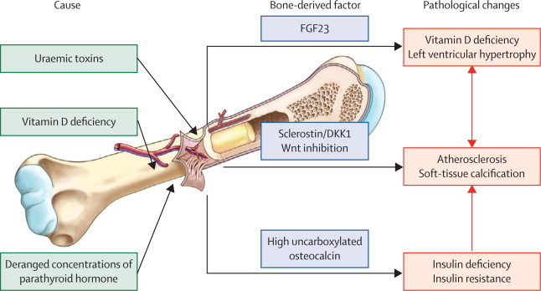

Slide 137
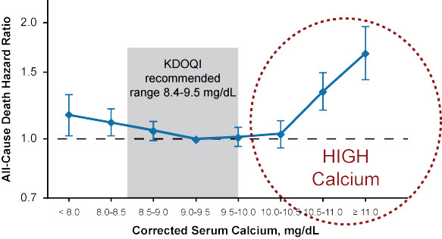
Figure 1. Risk of death by quarterly varying calcium. Kalantar-Zadeh K, et al.^{[1]}

Slide 138
Spectrum of MBD in CKD

Slide 139
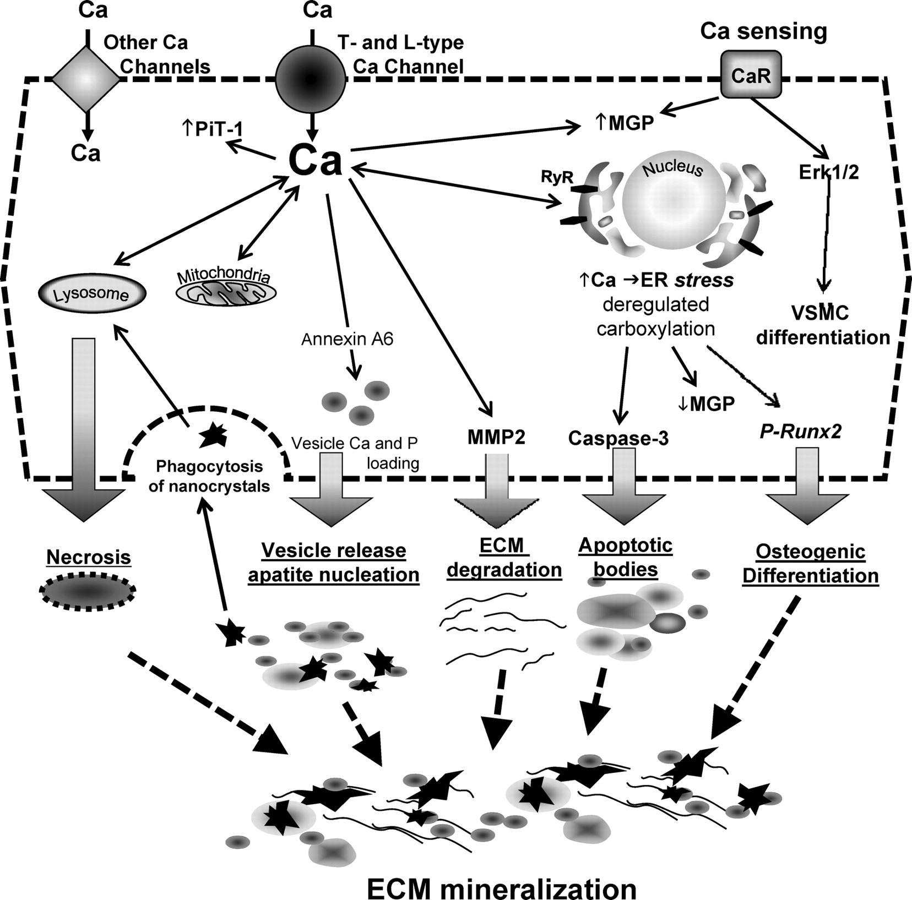

Slide 140
