Slide 1
ln the name of God

Slide 2
prepared by : Dr fatemeh kokabeh
23/3/1401

Slide 3
AGENDA:
Introduction
Part 1: glycemic targets and glycemic monitoring in DKD
Part 2: The effect and mechanism of drugs and DKD
Part 3:summary

Slide 5
Dm affects more than 450 million people
globally, which could increase to more than 700 million
people by 2045. Up to 40% of cases of diabetes are complicated by chronic kidney disease (CKD)
The most common cause of kidney failure in the world
DM
The most common cause of mortality in
CvD
And increases CKD ,
So CKD increases mortality

Slide 6
A comprehensive approach is needed for CKD patients, which includes the following steps:
Self-Management Education
Dietary and Lifestyle Management
Glycemic Treatment
Renin-Angiotensin System Inhibition
Antiplatelet Therapy

Slide 7
A comprehensive approach is needed for CKD patients, which includes the following steps:
Self-Management Education
Dietary and Lifestyle Management
Glycemic Treatment
Renin-Angiotensin System Inhibition
Antiplatelet Therapy

Slide 8
A comprehensive approach is needed for CKD patients, which includes the following steps:
Self-Management Education
Dietary and Lifestyle Management
Glycemic Treatment
Renin-Angiotensin System Inhibition
Antiplatelet Therapy

Slide 9
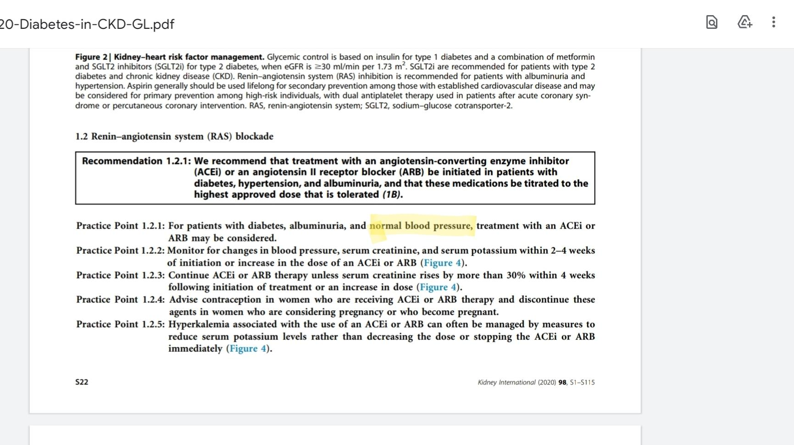
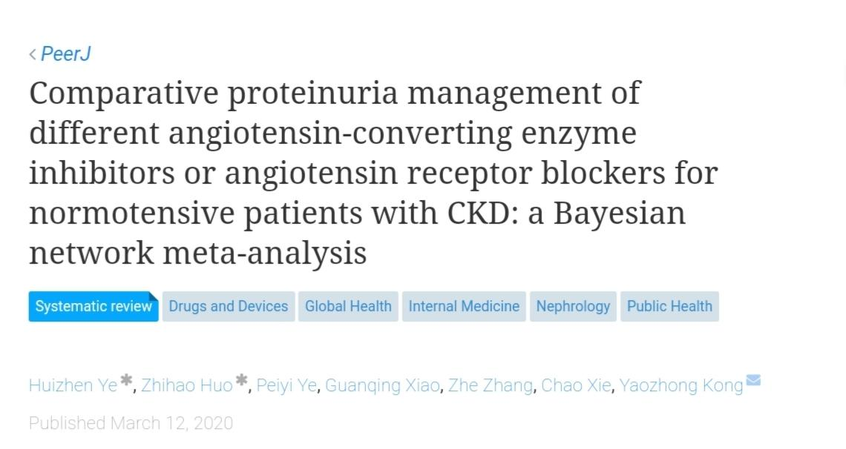
Ye, Huizhen, et al. "Comparative proteinuria management of different angiotensin-converting enzyme inhibitors or angiotensin receptor blockers for normotensive patients with CKD: a Bayesian network meta-analysis." PeerJ 8 (2020): e8575.

Slide 10
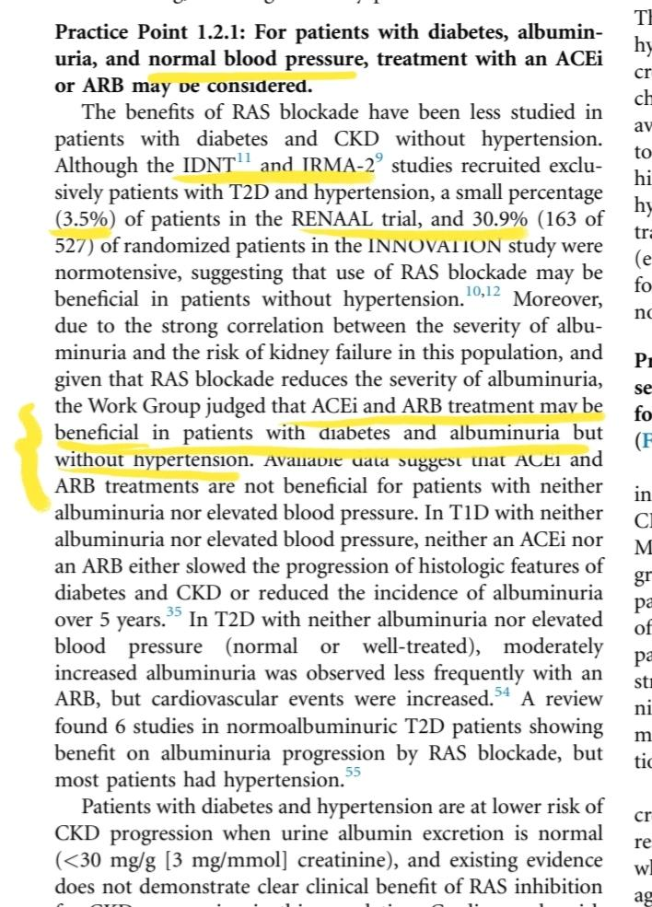

Slide 11
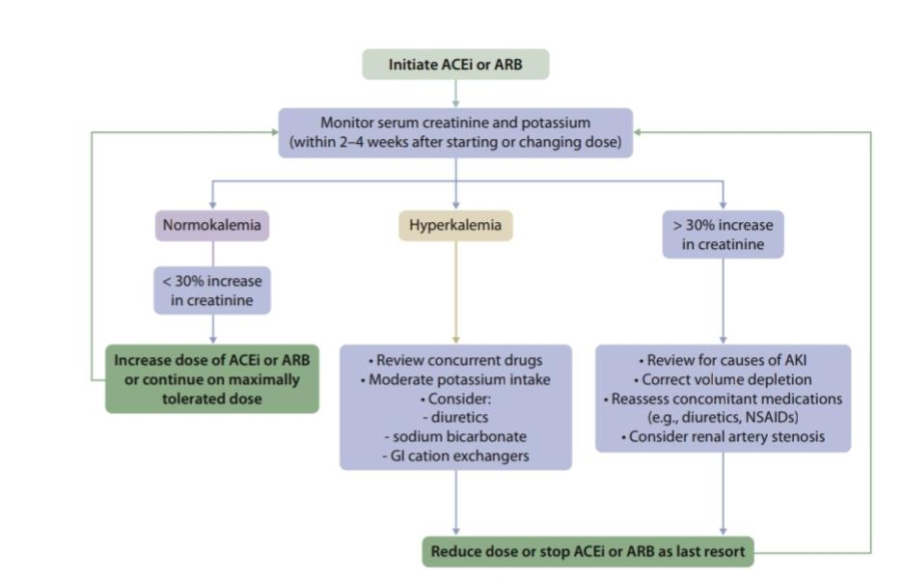

Slide 12
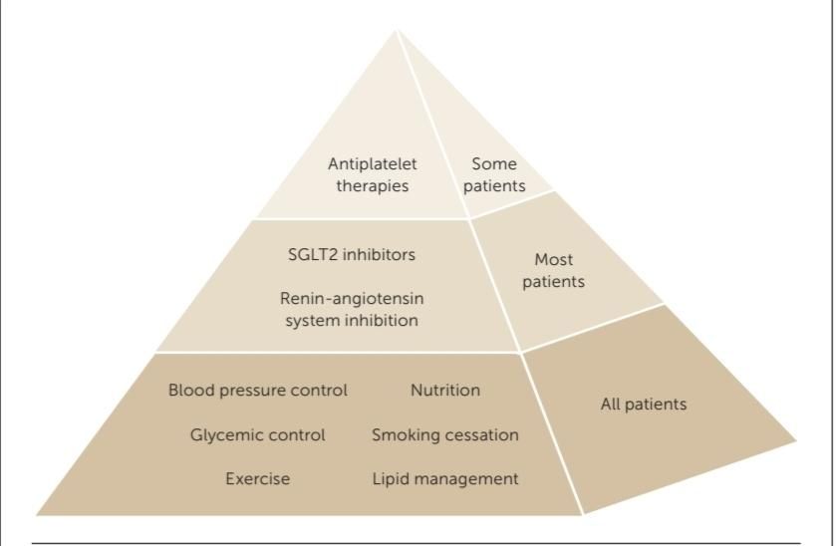

Slide 13
Glycemic control :goals of therapy and monitoring:

Slide 15
The recommended target HbA1c in nonpregnant adults by the (ADA) is ≤7%. The ADA supports higher targets (<8%) forselect patients, such as those with shorter life
expectancies, a history of severe hypoglycemia, extensive
comorbidities, and advanced complications. An HbA1c
goal of <6.5% may be appropriate for certain populations
(DCCT/EDIC) study showed
Kumamoto Study, the United Kingdom Prospective Diabetes Study (UKPDS):
(ADVANCE)
(ACCORD)
(VADT)

Slide 16
But the fact is that at the time of these studies, SGLT2 inhibitor and GLP1 AGONIST were still not approved.
Base on Guidelines from KDIGO:
there are insufficient data from clinical trials regarding the ideal glycemic control target in patients with CKD stage 3 or worse.

Slide 17
patients with diabetes and kidney failure treated by
kidney replacement therapy benefit most from maintaining their HbA1c levels in the 7% to 8% range
as HbA1clevels above 8% or below 7% carry increased risks of allcause and CVD mortality
But
Based on the 6 questions and answers, the goals of A1c in these patients should be individual

Slide 21
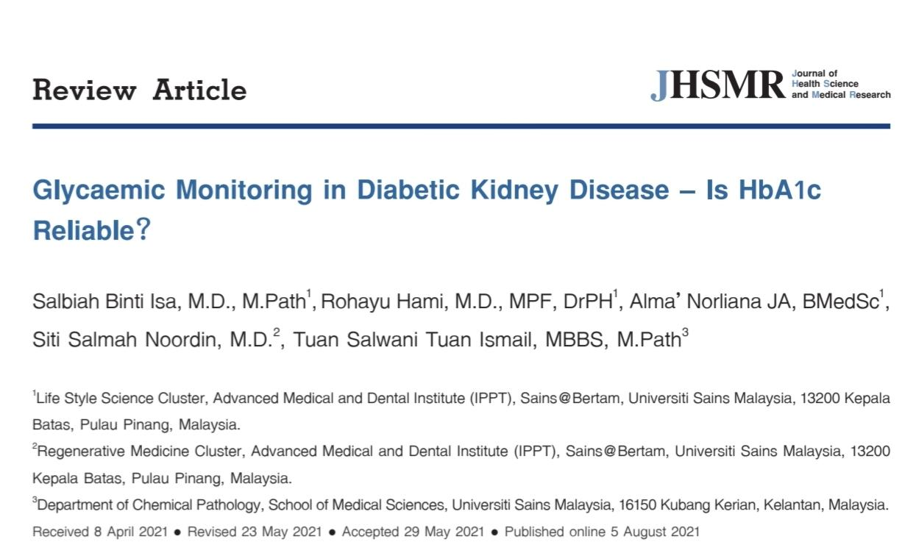
Assessment glycaemic status:
HbA1C = TIR and GMI = BS
Isa, Salbiah Binti, et al. "Glycaemic Monitoring in Diabetic Kidney Disease–Is HbA1c Reliable?." Journal of Health Science and Medical Research 40.2 (2022): 229-237.

Slide 22
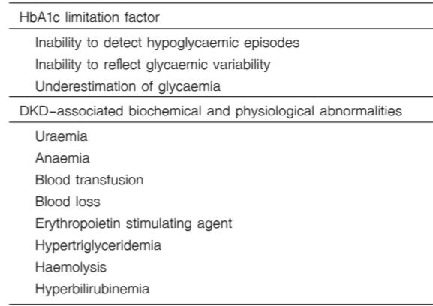
What are the problems we have with a1c?
Inability of the test to detect episodes of hypoglycemia
Various biochemical and physiological derangements
related to kidney failure

Slide 23
What is the value of A1c replacement biomarkers?
Glycated albumin (GA) and serum fructosamine
are the two common, alternative biomarkers for HbA1c,
for providing information on glycaemic control in DKD
GA is ketamine, formed through non-enzymatic glycation of
albumin with reducing sugars, such as glucose. It reflects
glycaemic status of the preceding 2-3 weeks, based on
albumins short half-life, and shows a strong correlation with
complications of DKD
As the level is independent of the Hb amount , the RBCs lifespan, iron, and
EPO treatment, GA is thought to have some advantages over HbA1c in DKD. Most studies have reported that GA is better than HbA1c
in reflecting glycaemia in DKD; especially in stage 4 and 5 including those on dialysis
As GA is a protein derivative, increased urinary protein loss and malnutrition in chronic, kidney disease and dialysis may lower GA levels, leading to an underestimation of glycaemia

Slide 24
What is the value of A1c replacement biomarkers?
Other factors; such as, acidosis and hyperosmolality, may reduce albumin glycation causing false low GA levels. Conversely, hypoosmolality and hyperphosphatemia, which are also common in DKD
may accelerate albumin glycation; thus, increasing the GA, level; regardless of glycaemia
Based on the current limitations, local or international guidelines neither recommend the routine use of GA, nor as a replacement of HbA1c for monitoring glycaemia in patients with DKD at present
While GA represents glycated albumin, serum
fructosamine represents all glycated blood proteins. It
measures short-term glycaemia, and it is similarly affected
by factors affecting GA. Since, serum fructosamine is
less extensively studied than GA and HbA1c, the data
on its performance in DKD is still sparse

Slide 25
Despite having compromised reliability, HbA1c still
remains considered as the best available glycaemic marker
for patients with advanced stage DKD, and those on dialysis.
The degree of compromised values of HbA1c are
higher in more advanced stages of DKD. Although, the
findings from many published studies have shown that
HbA1c results are reliable in mild to moderate stages of
chronic kidney disease (CKD) (stage 1 to 3, or estimated
glomerular filtration rate (eGFR) levels between 90 to 30
the reliabilityof the test becomes compromised in more advanced
stagesof CKD (stage 4 to 5, or eGFR <30 ml/min per 1.73 m2
In patients treated with dialysis, the reliability is further compromised
When the eGFR is < 30 mL/min/1.73 m2 , the HbA1c
measures 0.5% to 1.0% lower than it should; a rule-ofthumb
estimate could be to add this amount to the
measured HbA1c to get an idea of the “true” HbA1c.

Slide 26
What is The value of CGM in DKD ?
CGM utilizes sensors implanted in the subcutaneous
tissue to measure the interstitial glucose concentration at
pre-determined time intervals within a specific duration.
CGM is considered as useful diabetic technology, which
complements HbA1c, in providing a better assessment
of glycaemia in conditions when the reliability of HbA1c
is compromised; such as patients with advanced DKD:
including those on dialysis
The data obtained from CGM is useful for determination
of CGM metrics. One of the important GCM metric
is GMI, A GMI value corresponds to HbA1c in %; thus, serving as
a proxy for long-term glycaemia in the previous 3 months.
A recent study concluded that 14 day CGM data provided
a good estimate of glucose metric for a 3-month period,
The value is estimated from a formula; for example, GMI
[%] = 3.31 + 0.02392 × [mean glucose in milligram per
decilitre]

Slide 28
Part 2: The effect and mechanism of drugs and DKD

Slide 29
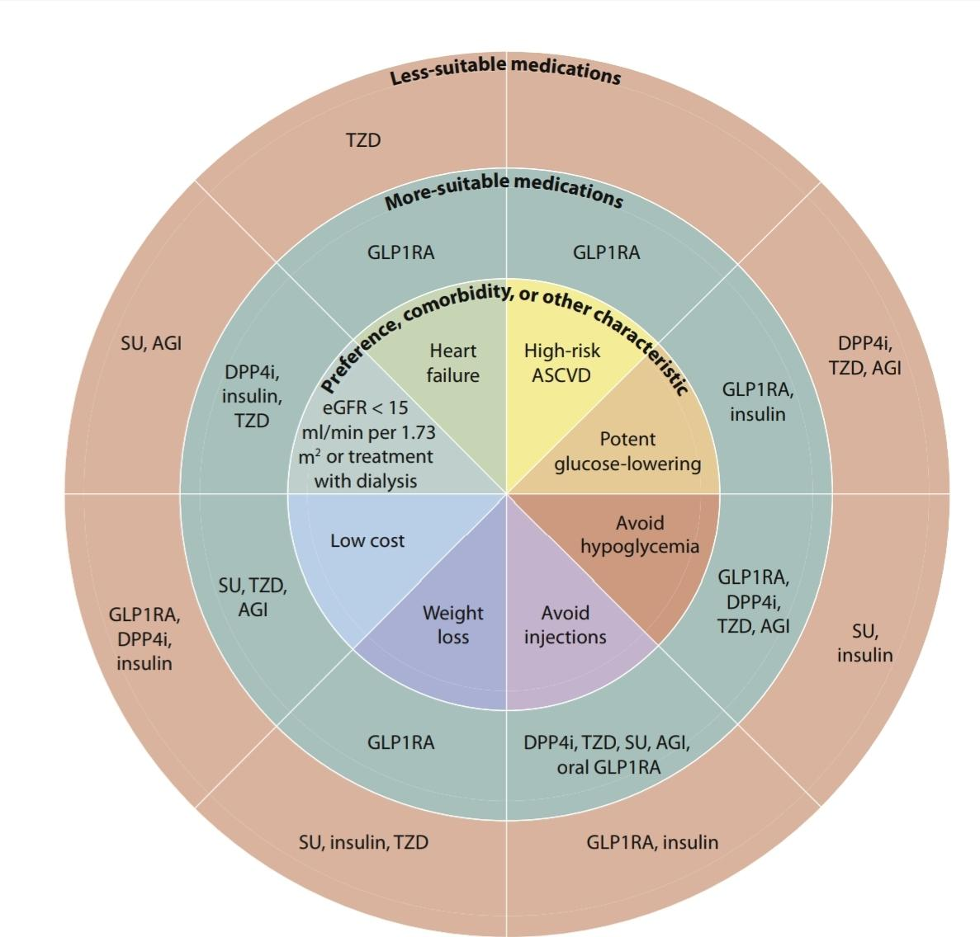

Slide 30
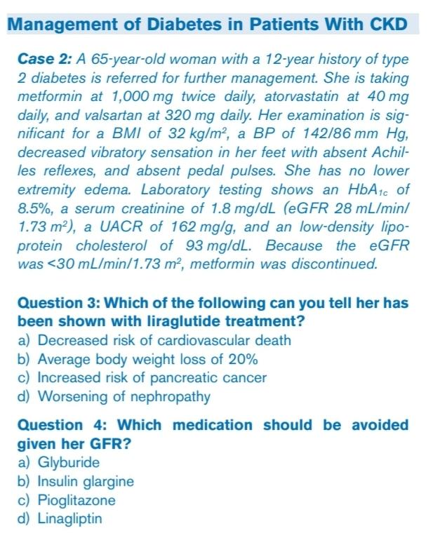

Slide 31
Injectable Medications
Insulin
Glucagon-like Peptide 1 Receptor Agonists
Oral agents:
Metformin
Sulfonylureas and Glinides
Thiazolidinediones
α-Glucosidase Inhibitors
Dipeptidyl Peptidase 4 Inhibitors
Sodium/Glucose Cotransporter 2 Inhibitors

Slide 32
Insulin

Slide 33
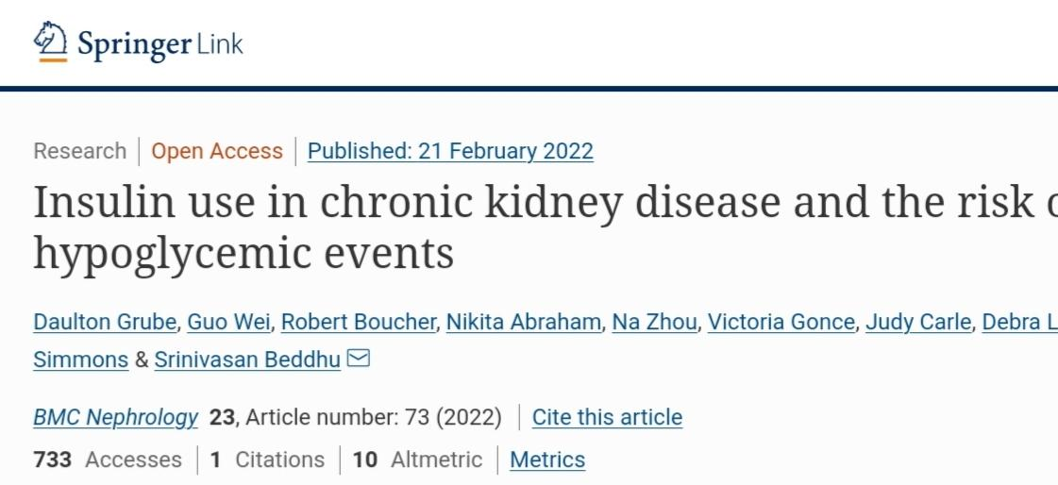
Insulin
About 30% to 80% of insulin clearance is carried out by the
kidney. A reduction in GFR results in prolongation of the
insulin half-life and a need to reduce insulin doses to avoid
hypoglycemia. All insulin preparations can be used in CKD,
but modifications of insulin type and dose may be necessary
to reduce the risk of hypoglycemia while still achieving
glycemic goals.
Grube, D., Wei, G., Boucher, R. et al. Insulin use in chronic kidney disease and the risk of hypoglycemic events. BMC Nephrol 23, 73 (2022). https://doi.org/10.1186/s12882-022-02687-w

Slide 34
Conclution
contrary to widely held assumption that advanced CKD is associated with decreased need for insulin, we found that insulin use was greater in T2D patients with more advanced CKD. Furthermore, this study also found that both insulin use and CKD are independent factors for risk of hypoglycemia, with patients with advanced CKD who use insulin being at the highest risk for a hypoglycemic event.
Grube, D., Wei, G., Boucher, R. et al. Insulin use in chronic kidney disease and the risk of hypoglycemic events. BMC Nephrol 23, 73 (2022). https://doi.org/10.1186/s12882-022-02687-w

Slide 35
The long-acting insulin analogs U-100 (100 units/mL) glargine, U-300 glargine, detemir, U-100 degludec, and U-200 degludec are used as basal insulins.
Insulin glargine has its onset of action 2-4 hours after injection, does not have a clear peak after injection, and has a duration of 20-24 hours;therefore, it is usually dosed once daily
therefore, it is usually dosed once daily. Doseslower than 15 U may have a modest peak and a shorter half-life; with doses greater than 50-60 U, splitting the dose is helpful to improve absorption

Slide 36
Insulin detemir has an onset of action at 1-3 hours, peaks at 6-8 hours, and duration of action of 18-22 hours. In patients with type 1 diabetes, insulin detemir is dosed twice daily, but in those with type 2 diabetes once daily dosing usually suffices.
U-300 insulin glargine and insulin degludec (both U-100 and U-200) have prolonged half-lives, once-daily injection suffices. These longer durations of action of U300 glargine and degludec are because of a delayed absorption from the subcutaneous injection sites and are not due to lower clearanc
The only intermediate-acting insulin is isophane NPH (neutral protamine Hagedorn) insulin. NPH has an onse of action at 2-4 hours, has a pronounced but irregular peak at 4-10 hours, and lasts for up to 10-18 hours; when given as a twice daily injection it can be used as a basal insulin. It day-to-day and dose-to-dose variability, making the longacting insulins preferable as basal insulins. However,compared with insulin analogs, the cost of NPH is much lower

Slide 37
Regular crystalline insulin is the only short-acting insulin available and has an onset of action at 30-60 peaks at 2-3 hours, and lasts for 5-8 hours. Ideally,
insulin should be given 30 minutes before a meal. It is also regular much less costly compared with insulin analogs. When used intravenously, regular insulin has a rapid onset of action and a much shorter duration of action—on the order of minutes rather than hours.
The insulin analogs aspart, lispro, and glulisine have a more rapid onset of action compared with regular insulin and a shorter duration of action. They are ideal as prandial insulins, with an onset of action of about 15 minutes, peak action of about 60 minutes, and a duration of up to 4 hours
They are injected up to 15 minutes before meals and are used in “basal-bolus therapy,” also known as multiple daily injections. A fast-acting insulin aspart (Fiasp in the United States) and a fast-acting insulin lispro (Lyumjev in the United States) have even faster onsets and offsets, so they can be given immediately before eating and can even be dosed up to 20 minutes after beginning to eat

Slide 38
Although rapid-acting insulins are usually injected before eating, some patients with stage 4-5 CKD and on dialysis may have delayed gastric emptying, so giving these rapid-acting insulins after the meal may help to match the insulin peak with the time of the postprandial blood glucose peak.
Regular insulin and all these rapid-acting insulin preparations can be used in insulin pumps except for aspart, which cannot be used in pumps from Tandem Diabetes Care because of an increased risk of occlusion
Premixed insulin preparations contain fixed percentages of NPH and a rapid- or short-acting insulin. Therefore,they have 2 separate peaks and 2 durations of actions; one example is insulin “70/30,” which consists of 70% NPH and 30% short- or rapid-acting insulin. Although the premixed preparations offer the convenience of twice daily dosing, they limit flexibility of dosing, require injection at fixed times, and require consistent food intake.

Slide 39
U-500 is only available as regular insulin. This very high concentration alters its pharmacokinetics; its onset of action is similar to that of regular insulin, around 30 minutes, but its peak is at 4-8 hours, and its duration is 14-15 hours. U500 regular is usually given up to 30 minutes before meals and is typically given 2 to 3 times daily with meals,without the need of a separate basal insulin. U-500 is usually used in patients with severe insulin resistance who require very high insulin doses, and it can be given as subcutaneous injections or in a pump
As noted previously,there are also U-300 glargine, U-200 degludec, and U-200 lispro, which can be useful in similar patients because an equal amount of insulin can be provided in a smaller volume.
.

Slide 40
Inhaled insulin is rapid-acting and can be used as a prandial insulin. Its onset of action is about 12-15 minutes,with a peak at 50 minutes, and duration of 2.5-3.0 hours.Inhaled insulin carries a risk of pulmonary complications and is not used in individuals with pulmonary disease.Although it has not been studied specifically in individuals with reduced kidney function, dosing should be adjusted just as with any insulin use in patients with CKD.
An insulin pump that delivers a continuous subcutaneous infusion of insulin (CSII) provides the closest approximation of physiologic insulin secretion and potentially can be used in all stages of CKD.

Slide 41
Rapid-acting insulin analogs infused via the pump serve as the basal,bolus, and correction insulin. The correct use of insulin pumps requires considerable vigilance on the part of the patient; their use should be overseen by experienced endocrinologists and certified diabetes educators. A critical aspect of the appropriate use of pumps and multiple daily injections is the necessary adjustment of insulin doses based upon pre- and post-meal capillary glucose measurements,requiring either multiple finger-sticks or the newer CGM devices
“Closed loop” insulin delivery systems combine the use of an insulin pump and a CGM sensor; the pump and sensor are in communication to automatically decrease, increase, or temporarily stop the delivery of insulin in response to the glucose levels. Boluses via the pump, however, are still needed to cover the amounts of carbohydrate consumed. Currently, there are 2 systems available, one from Medtronic and one from Tandem Diabetes Care.

Slide 42
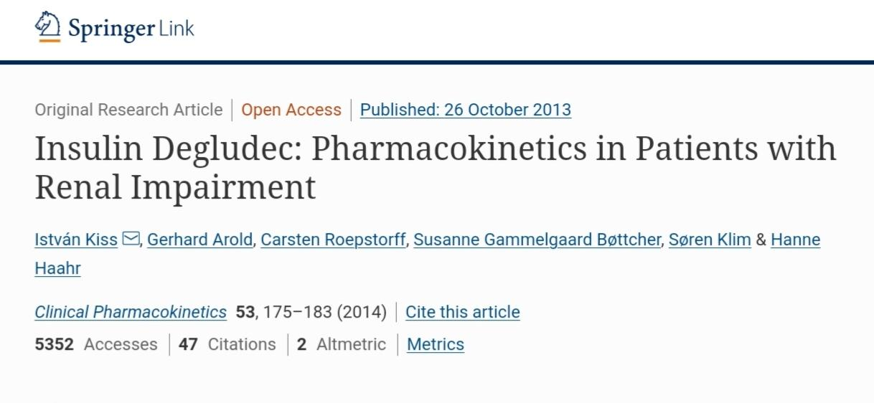
Kiss, I., Arold, G., Roepstorff, C. et al. Insulin Degludec: Pharmacokinetics in Patients with Renal Impairment. Clin Pharmacokinet 53, 175–183 (2014). https://doi.org/10.1007/s40262-013-0113-2

Slide 43
Conclusion
In conclusion, the results of this study indicate that the ultra-long pharmacokinetic properties of insulin degludec are preserved in patients with renal impairment. While insulin dose must always be adjusted on an individual basis, this trial suggests that the pharmacokinetic properties of insulin degludec are not significantly influenced by renal function, and thus specific dose adjustment may not be required for subjects with renal impairment. Accordingly, insulin degludec represents a useful insulin treatment option in subjects with co-morbid diabetes and impaired renal function, including ESRD patients undergoing hemodialysis.

Slide 44
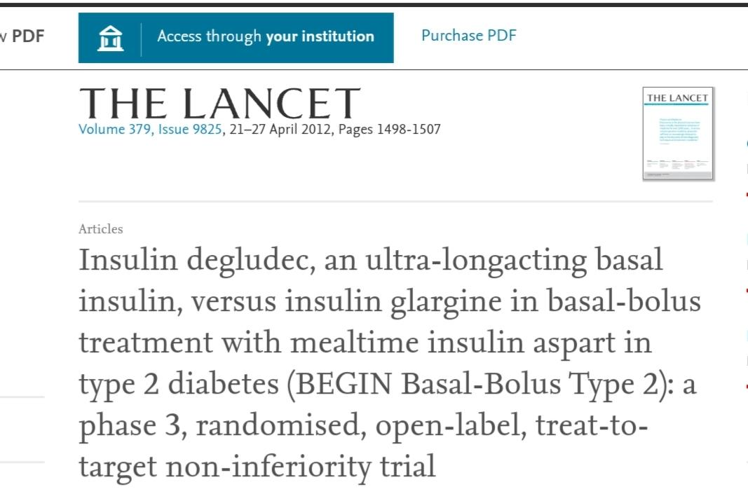
Conclusion
A policy of suboptimum diabetes control to reduce the risk of hypoglycaemia and its consequences in advanced type 2 diabetes mellitus might be unwarranted with newer basal insulins such as degludec, which are associated with lower risks of hypoglycaemia than insulin glargine.
Alan J Garber, Allen B King, Stefano Del Prato, Seamus Sreenan, Mustafa K Balci, Manuel MuÃ±oz-Torres, Julio Rosenstock, Lars A Endahl, Ann Marie Ocampo Francisco, Priscilla Hollander,
Insulin degludec, an ultra-longacting basal insulin, versus insulin glargine in basal-bolus treatment with mealtime insulin aspart in type 2 diabetes (BEGIN Basal-Bolus Type 2): a phase 3, randomised, open-label, treat-to-target non-inferiority trial,
The Lancet,
Volume 379, Issue 9825,
2012,
Pages 1498-1507,
ISSN 0140-6736,
https://doi.org/10.1016/S0140-6736(12)60205-0.
(https://www.sciencedirect.com/science/article/pii/S0140673612602050)

Slide 45
Glucagon-like Peptide 1 Receptor Agonists

Slide 46
The glucagon-like peptide 1 (GLP-1) receptor agonists are injectable subcutaneous medications that stimulate glucose-dependent insulin release, decrease glucagon secretion, delay gastric emptying, and suppress appetite ;the last may result in significant weight loss
They are fairly potent, generally causing a decrease in HbA1c of 0.5% to 1.5%. Although cases have been reported of pancreatitis with their use, epidemiologic studies have not shown a higher risk of pancreatitis in comparisonwith other agents
Nausea is a common side effect.Although GLP-1 receptor agonists have been associated with the development of thyroid C-cell tumors in animal studies, no such cases have been reported in humans; nonetheless, no GLP-1 receptor agonists should be given to patients with or at risk for medullary thyroid cancer.

Slide 47
These drugs do not cause hypoglycemia by themselves,but because they lower glucose levels hypoglycemia can be increased if they are given with insulin or sulfonylureamedications.
Exenatide (Byetta) is given twice daily,
liraglutide (Victoza) and lixisenatide (Adlyxin) are given once daily
exenatide extended-release (Bydureon),
semaglutide (Ozempic), and dulaglutide (Trulicity) are dosed once weekly
Fixed dose combinationswith insulin are also available, such as degludec/liraglutide (Xultophy) and insulin glargine/lixisenatide (Soliqua). is also now Semaglutide available as an oral preparation (Rybelsus)

Slide 48
The LEADER
REWIND studies
SUSTAIN_6
showed significant reductions in CVD mortality with and dulaglutide,
liraglutide, semaglutide,respectively,
reductions in the development
of severe albuminuria but no effects on GFR.
the REWIND study with dulaglutide showed a benefit on
eGFR as a secondary outcome.
Neither CVD nor CKD benefits were seen with extended-release
exenatide or lixisenatide

Slide 49
With declines in GFR, exenatide clearance decreases.
Cases of acute kidney injury (AKI) associated with exenatide use have been reported, so caution is warranted in patients with GFR of 30-50 mL/min/1.73 m2 exenatide should be discontinued for GFR < 30 mL/min/1.73 m2
No dose adjustment is needed for liraglutide in CKD,including kidney failure, although data are limited.However, due to some reports of AKI, caution is warranted when GFR is <30 mL/min/1.73 m2
No dosage restrictions are required with decreasing GFR for dulaglutideor semaglutide.
Due to lack of data, lixisenatide should notbe used if the GFR < 15 mL/min/1.73 m2.Close monitoring is needed in patients with eGFR < 60 mL/
min/1.73 m2

Slide 50
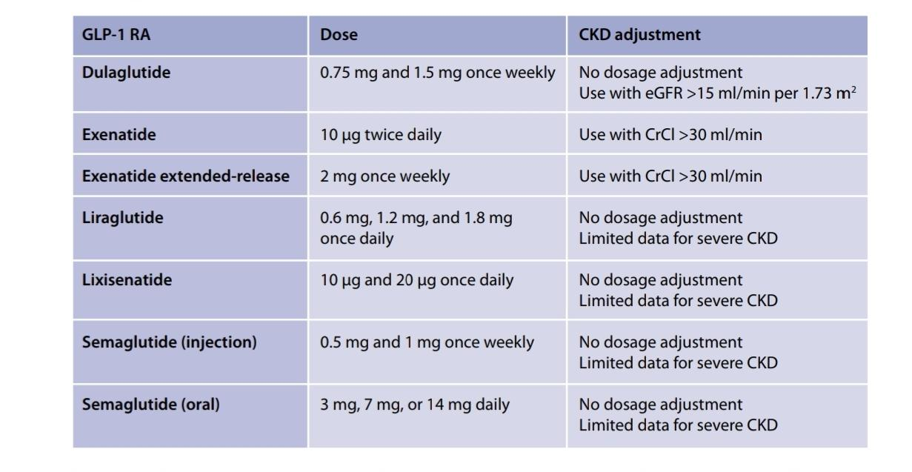

Slide 51
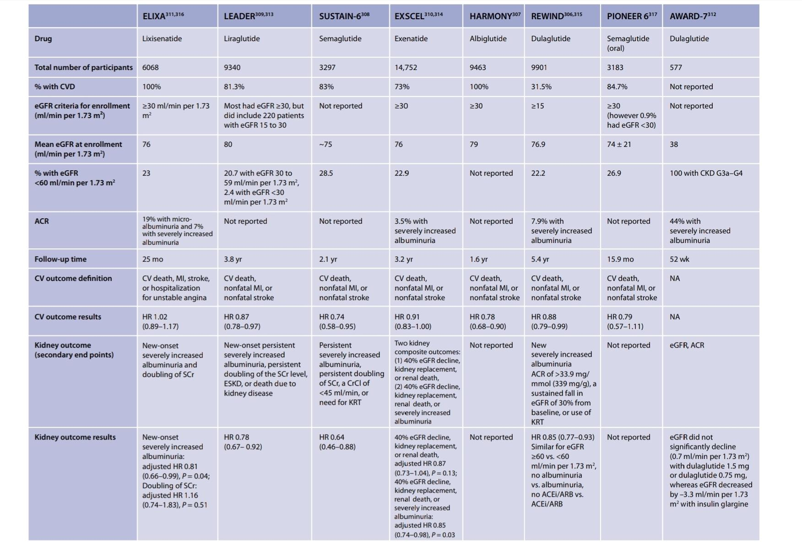

Slide 52
for question 3, the best answer is (a),
liraglutide has been shown to reduce cardiovascular deaths.
Weight loss can be significant but does not approach 20%.
Liraglutide has not been shown to cause pancreatic cancer
or worsening of kidney function.

Slide 53
Injectable Medications
Insulin
Glucagon-like Peptide 1 Receptor Agonists
Oral agents:
Metformin
Sulfonylureas and Glinides
Thiazolidinediones
α-Glucosidase Inhibitors
Dipeptidyl Peptidase 4 Inhibitors
Sodium/Glucose Cotransporter 2 Inhibitors

Slide 54
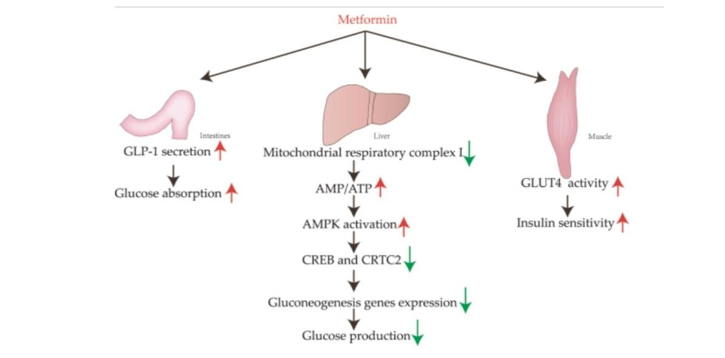
Metformin

Slide 55
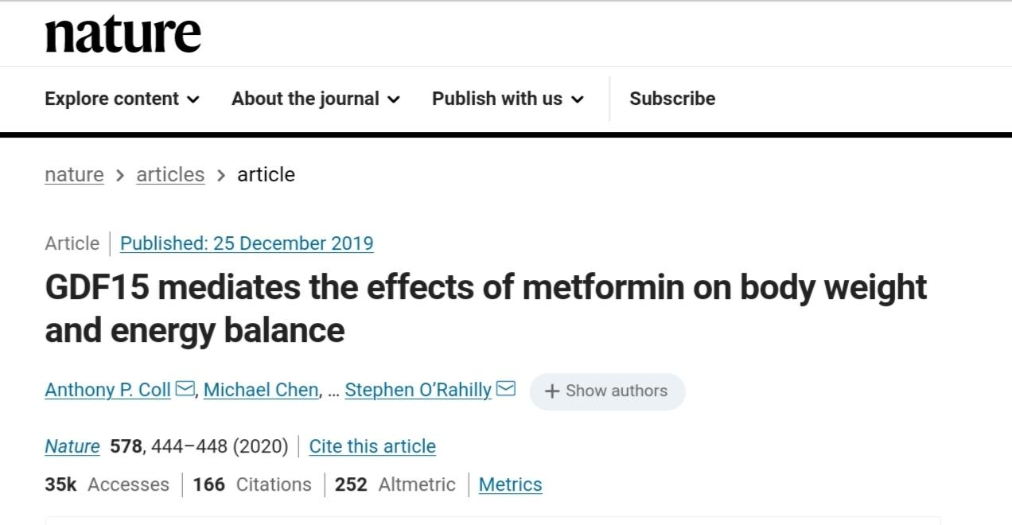
Coll et al. also reported that metformin inhibited food intake and improved weight loss via growth diﬀerentiating factor (GDF) 15
Coll, A.P., Chen, M., Taskar, P. et al. GDF15 mediates the effects of metformin on body weight and energy balance. Nature 578, 444–448 (2020). https://doi.org/10.1038/s41586-019-1911-y

Slide 56
Metformin improves insulin sensitivity and decreases hepatic
glucose production; it does not cause hypoglycemia
and reduces HbA1c by 1.0%-1.5%
The most common adverse effects are diarrhea, bloating, and abdominal
cramping, which limit use in about 15% of patients
Longterm use can lead to vitamin B12 deficiency. Because
metformin levels may increase when the GFR is decreased,
patients can be at increased risk for lactic acidosis.the incidence of lactic acidosis with metformin use isonly increased when the GFR is < 30 mL/min/1.73 m2
summarized by Inzucchi et al (2014), the risk of lacticacidosis in metformin users increases from 7.6 (95% a normal eGFR to 39 (95% CI, 4.72-140.89) per 100,000 patient-years among those with an eGFR < 30 mL/min/
.

Slide 57
FDA
suggest
that metformin should not be started for eGFR of 30-
45 mL/min/1.73 m2
. Furthermore, if the eGFR drops
below 45 mL/min/1.73 m2 in the course of treatment, the
risks and benefits of continuing metformin should be
reviewed because of the increasing probability of further
decrease. It has been recommended also that the maximum
metformi

Slide 58
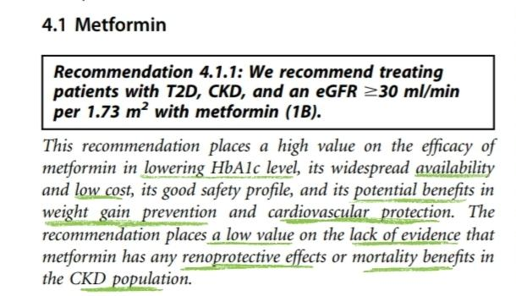
KDIGO 2020 Clinical Practice Guideline for
Diabetes Management in Chronic Kidney Disease
The United Kingdom Prospective Diabetes Study (UKPDS)study showed that metformin monotherapy in obese individuals achieved similar reduction in HbA1c levels and fasting plasma glucose levels, with lower risk for hypoglycemia when compared to those given sulfonylureas or insulin
Resultsfrom the UKPDS study demonstrated that patients allocated to metformin did not show a change in mean body weight at the end of the 3-year study period, whereas body weight increased significantly with sulfonylurea and insulin
treatment

Slide 59
Similarly, this effect was reproduced in an analysis of a subgroup of patients in the UKPDS study who failed diet therapy and were subsequently randomized to metformin, sul-fonylurea, or insulin therapy, with patients allocated to the metformin group having the least amount of weight gain.
In addition, treatment with metformin may be associated with protective effects against cardiovascular events, beyond its efficacy in controlling hyperglycemia in the general population.
The UKPDS study suggested that among patients allocated to intensive blood glucose control treatment, met-formin had a greater effect than sulfonylureas or insulin forreduction in diabetes-related endpoints, which included death from fatal or nonfatal myocardial infarction, angina, heart failure, and stroke
An RCT performed in China, the Study on the Prognosis and Effect of Antidiabetic Drugs on Type 2 Diabetes Mellitus with Coronary Artery Disease (SPREAD-DIMCAD) study, looked at the effect of metformin versus glipizide on cardiovascular events as a primary outcome.The study suggested that metformin has a potential benefit over glipizide on cardiovascular outcomes in high-risk patients,with a reduction in major cardiovascular events over a median follow-up of 5 years.

Slide 60
Indeed, in a systematic review per-formed, the signal for the reduction in cardiovascular mor-tality was again detected, with RR of 0.6–0.7 from RCTs in favor of metformin compared with sulfonylureas
Despite the potential benefits on cardiovascular mortality,the effects of metformin on all-cause mortality and other diabetic complications appeared to be less consistent in the general population. The systematic review did not demon-strate any advantage of metformin over sulfonylureas in terms of all-cause mortality or microvascular complications.
Maruthur NM, Tseng E, Hutfless S, et al. Diabetes medications as
monotherapy or metformin-based combination therapy for type 2
diabetes: a systematic review and meta-analysis. Ann Intern Med.
2016;164:740–751.
There was even a suggestion in the UKPDS that early addi-
tion of metformin in sulfonylurea-treated patients was asso-
ciated with an increased risk of diabetes-related death of 96%
(95% CI: 2%–275%, P ¼ 0.039)

Slide 61
the effect of cardioprotection with metformin use is studied mainly in the general population, evidence of this benefit in patients with CKD, especially those with reduced eGFR, is less consistent.
A systematic review considered the association of all-cause mortality and major adverse cardiovascular events (MACE) with treatment regi-mens that included metformin in patient populations for which metformin use is traditionally taken with precautions.
There were no RCTs, and only observational studies were included in the analysis of the CKD cohort. All-cause mortality was found to be 22% lower for patients on metformin treatment than for those not receiving it (HR:0.78; 95% CI: 0.63–0.96), whereas there was no difference in MACE-related diagnoses with metformin use in one study
Crowley MJ, Diamantidis CJ, McDuffie JR, et al. Clinical outcomes of
metformin use in populations with chronic kidney disease, congestive
heart failure, or chronic liver disease: a systematic review. Ann Intern
Med. 2017;166:191–200

Slide 62
a second study that had examined MACE outcomeswith metformin use suggested that metformin treatment was associated with a slightly lower readmission rate for conges-tive heart failure (HR: 0.91; 95% CI: 0.84–0.99)
Although thesignal for cardioprotection in the CKD cohort appears to be poor, the lackluster quality of the evidence and the observational nature of the studies in this population preclude any definitive conclusion on the cardiovascular benefits with metformin treatment in patients with reduced eGFR.
A search of the Cochrane Kidney and Transplant Registry identified no RCTs that had been conducted to evaluate the use of metformin in patients with T2D and CKD assessing cardiovascular and kidney protection as primary out
Come
BuT

Slide 63
metformin is a relevant initial treatment option in low-resource settings.
1*The efficacy of HbA1c reduction
2*the good safety profile including a lower risk of hypoglycemia
3*the low cost of metformin were judged to be critically important to patients
4*the benefit of weight reduction compared to use of insulin and sulfonylurea to be an important consideration, and patients who value weigh
reduction would prefer to be treated with metformin compared to having no treatment or other treatments.
5* being widely available at low cost would make metformin a relevant initial treatment option in low-resource settings.

Slide 64
Metformin is generally well-tolerated, although gastroinestinal adverse events may be experienced in up to 25% of patients treated with the immediate-release form of metformin, with treatment discontinuation occurring in about 5%–10% of patients.
In view of the overall benefits of metformin treatment,and the possibility of improved tolerability of extended-release metformin, patients who experienced significantgastrointestinal side effects from the immediate-release formulation could be considered for a switch to extended-release metformin and monitored for improvement of symptom
.
diabetes. Diabetes Care. 2006;29:759–764.
265. Ji L, Liu J, Yang J, et al. Comparative effectiveness of metformin
monotherapy in extended release and immediate release formulations
for the treatment of type 2 diabetes in treatment-naive Chinese
patients: analysis of results from the CONSENT trial. Diabetes Obes
Metab. 2018;20:1006–1013.

Slide 65
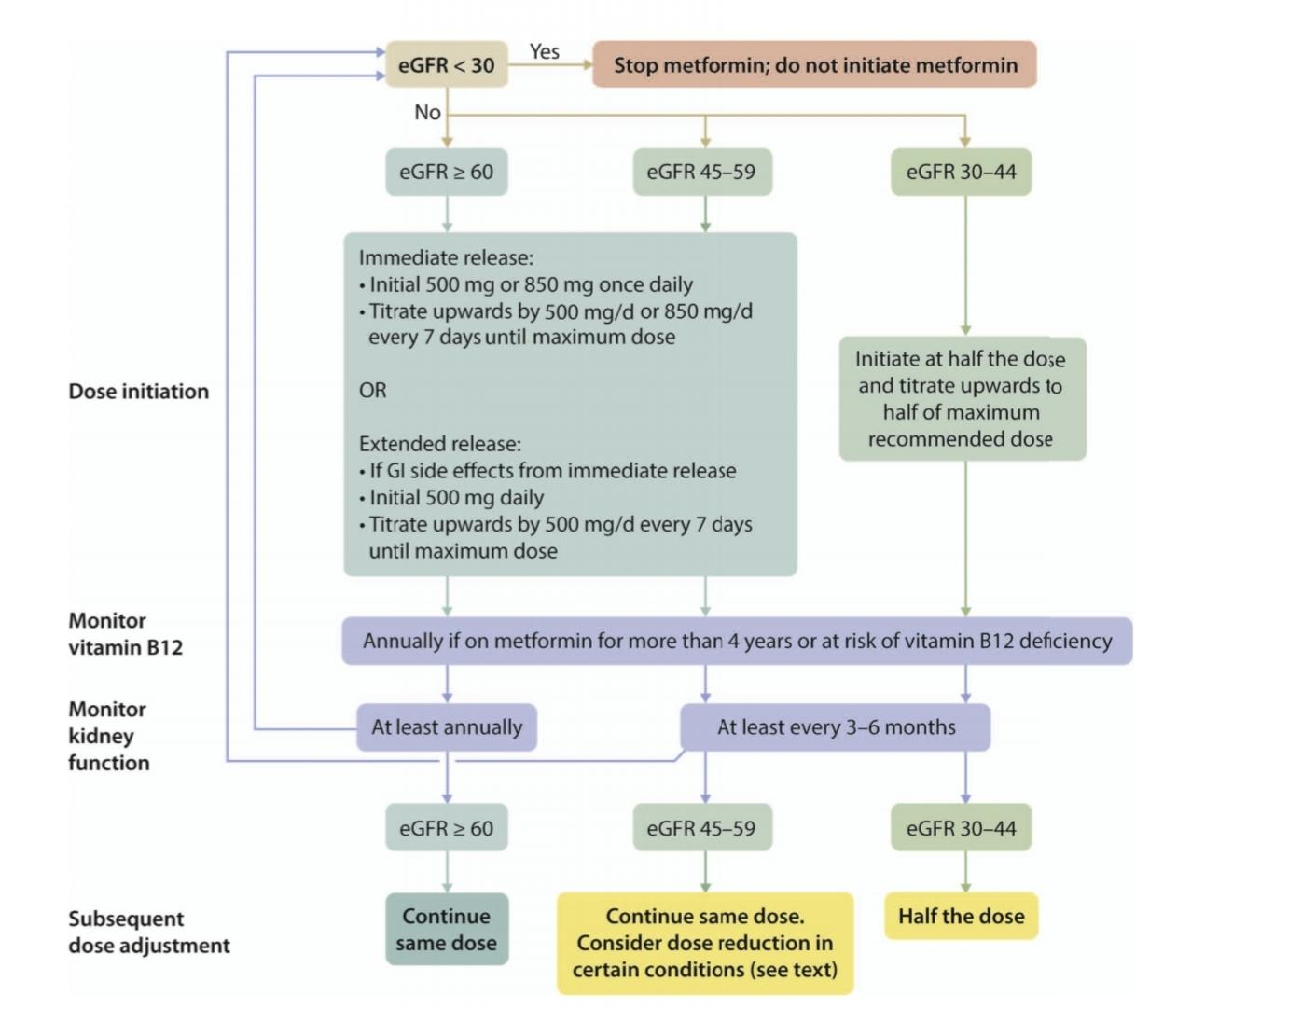
KDIGO guideline for metformin use

Slide 66
Injectable Medications
Insulin
Glucagon-like Peptide 1 Receptor Agonists
Oral agents:
Metformin
Sulfonylureas and Glinides
Thiazolidinediones
α-Glucosidase Inhibitors
Dipeptidyl Peptidase 4 Inhibitors
Sodium/Glucose Cotransporter 2 Inhibitors

Slide 67
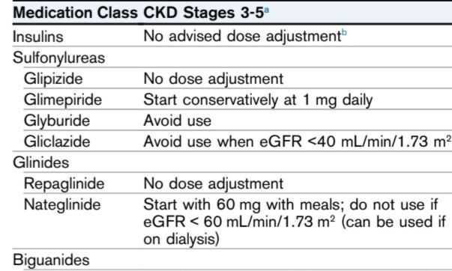
Sulfonylureas and Glinides

Slide 68
Sulfonylureas increase insulin secretion
The currently used sulfonylureas are glipizide, glimepiride, glyburide, and gliclazide (the latter is not available in the United States)
Thesulfonylureas lower HbA1c on average by 1.0%-2.0% and can cause hypoglycemia , particularly glyburide and chlorpropamide (a first-generation agent sometimes still used
As the GFR declines, there is a decrease in clearance of sulfonylureas
and their metabolites, resulting in an increased risk of hypoglycemia.
With an eGFR < 60 mL/min/1.73 m2 the risk of hypoglycemia is greatly increased with glyburide and is moderately increased with glimepiride.

Slide 69
Glyburide should not be used with an eGFR < 60 mL/min/1.73 m2
Glimepiride should be used with caution if the eGFR is < 60 mL/min/1.73 m2
and should be discontinued if eGFR is < 30 mL/min/1.73 m2. Glipizide and gliclazide do not have active metabolites that are cleared by the kidney, so dose adjustments are not needed; however, caution is still needed and it has been recommended that gliclazide not be used when the eGFR is <40 mL/min/1.73 m2
Nateglinide and repaglinide (“glinides”) also increase insulin secretion and can cause hypoglycemia but generally are much less potent than sulfonylureas. Glucose must be present for them to work, and they themselves have a short half-life and cause a quick insulin release of short duration;therefore, they should be given before each meal.

Slide 70
Nateglinide has an active metabolite that accumulates in CKD and should not be used with an eGFR < 60 mL/min/1.73 m2. Because this active metabolite is cleared by hemodialysis,however, it is possible to use nateglinide in patients on dialysis.
Repaglinide is not cleared by the kidney and appears to be safe to use in CKD. However,with an eGFR < 30 mL/min/1.73 m2 , the lowest dose (0.5 mg) with slow titration up should be carried out to avoid hypoglycemia.

Slide 71
Injectable Medications
Insulin
Glucagon-like Peptide 1 Receptor Agonists
Oral agents:
Metformin
Sulfonylureas and Glinides
Thiazolidinediones
α-Glucosidase Inhibitors
Dipeptidyl Peptidase 4 Inhibitors
Sodium/Glucose Cotransporter 2 Inhibitors

Slide 72
The thiazolidinediones (pioglitazone and rosiglitazone) increase insulin sensitivity, do not cause hypoglycemia,and lower HbA1c levels by 0.5%-1.4%.
Fluid retention can be a major side effect, so they should not be used in advanced heart failure. Because they have been associated with increased fracture rates and bone loss, their use in patients with renal osteodystrophy requires further study.
Thiazolidinediones are not cleared by the kidney, and they can be used in CKD, so no dose adjustment is needed. An earlier restriction of use of rosiglitazone by the FDA based on studies linking it to increased ischemic heart disease was removed in 2014 because subsequent analyses did not support these findings. Also, although some studies reported an association between pioglitazone and bladder cancer, subsequent analyses failed to support this.
some retrospective cohort studies showed both cardiovascular and kidney outcome benefits with use of thiazolidinediones in patients with CKD.

Slide 73
Injectable Medications
Insulin
Glucagon-like Peptide 1 Receptor Agonists
Oral agents:
Metformin
Sulfonylureas and Glinides
Thiazolidinediones
α-Glucosidase Inhibitors
Dipeptidyl Peptidase 4 Inhibitors
Sodium/Glucose Cotransporter 2 Inhibitors

Slide 74
α-Glucosidase Inhibitors
The α-glucosidase inhibitors acarbose and miglitol slow
the digestion of carbohydrates, delaying absorption of
glucose after food intake and resulting postprandial
glucose reduction. Bloating, flatulence, and abdominal
cramping are the most common adverse effects. These
drugs usually lower HbA1c by 0.5%-0.8%
With reduced GFR, serum levels of acarbose and metabolites are significantly
elevated; its use with a GFR <26 mL/min/1.73 m2 is not recommended. Miglitol has >95% kidney excretion,and its use should be avoided with a low GFR.

Slide 75
Injectable Medications
Insulin
Glucagon-like Peptide 1 Receptor Agonists
Oral agents:
Metformin
Sulfonylureas and Glinides
Thiazolidinediones
α-Glucosidase Inhibitors
Dipeptidyl Peptidase 4 Inhibitors
Sodium/Glucose Cotransporter 2 Inhibitors

Slide 76
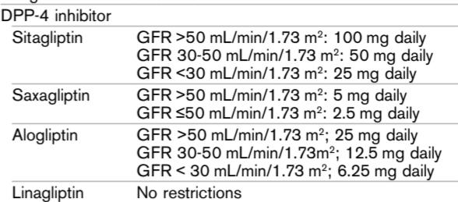
Dipeptidyl Peptidase 4 Inhibitors
breakdown of incretin hormones such as GLP-1 and The dipeptidyl peptidase 4 (DPP-4) inhibitors reduce the glucose-insulinotropic peptide (GIP). They are weight neutral, do not cause hypoglycemia, and decrease HbA1c by 0.5%-0.8%. All DDP-4 inhibitors can be used in CKD,but all require dose adjustments except for linagliptin
They have all been studied in cardiovascularoutcome trials and have not been shown to have CVD or CKD benefits or risks compared with placebo

Slide 77
Injectable Medications
Insulin
Glucagon-like Peptide 1 Receptor Agonists
Oral agents:
Metformin
Sulfonylureas and Glinides
Thiazolidinediones
α-Glucosidase Inhibitors
Dipeptidyl Peptidase 4 Inhibitors
Sodium/Glucose Cotransporter 2 Inhibitors

Slide 78
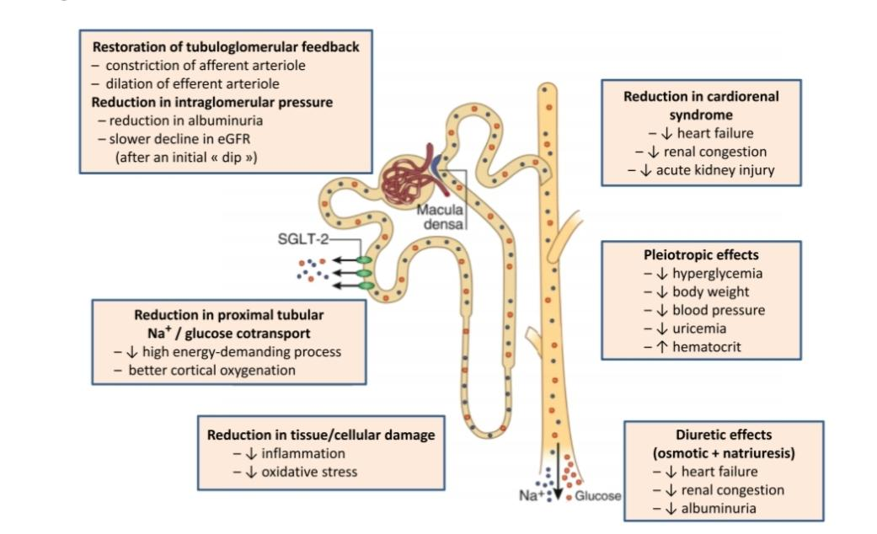

Slide 79
Sodium/Glucose Cotransporter 2 Inhibitors
The sodium/glucose cotransporter 2 (SGLT2) inhibitors reduce glucose absorption in the proximal tubule of the kidney, resulting in an increase in glycosuria and a reduction in HbA1c of about 0.5%-1.0%.
Weight loss up to 5 kg in 1 year is common, and they do not cause hypoglycemia.Genital yeast infections occur in about 10% of women and 1%-2% of uncircumcised men
Although an increase in urinary tract infections has been observed in some studies,the large CVD outcome trials did not show this. Some older patients may experience orthostatic hypotension with drug initiation, especially if they are also taking diuretics; diuretic doses should be reduced when starting these drugs.

Slide 80
An unusual but significant adverse effect is a 2- to 3-fold increased risk for the development of “euglycemic”diabetic ketoacidosis (DKA), primarily when used off-label in patients with type 1 diabetes but also rarely in patients with type 2 diabetes. In part, this DKA may be related to elevated glucagon levels, reduction in insulin doses, and volume depletion.
Education is needed so that patients can monitor for signs and symptoms of DKA, including nausea or vomiting; if such symptoms occur (even if blood glucose levels are normal), they should be checked for ketones in the urine or serum (such as using a home ketone meter).
The STICH protocol was developed as an early protocol to initiate when patients detect elevated ketones:once ketones are detected, the patient should STop the SGLT2 inhibitor, Inject insulin, Consume 30 g of carbohydrates,and Hydrate. Ketones should still be monitored and the patient should seek medical care if ketosis persists or symptoms of DKA develop.
,

Slide 81
Significant reduction of cardiovascular outcomes (especially heart failure), slower kidney disease progression, and fewer renal events (such as kidney replacement therapy initiation)
with
empagliflozin use were shown in the EMPA_REG
with canagliflozin in the CANVAS study
dapagliflozin in the DECLARE-TIMI study

Slide 82
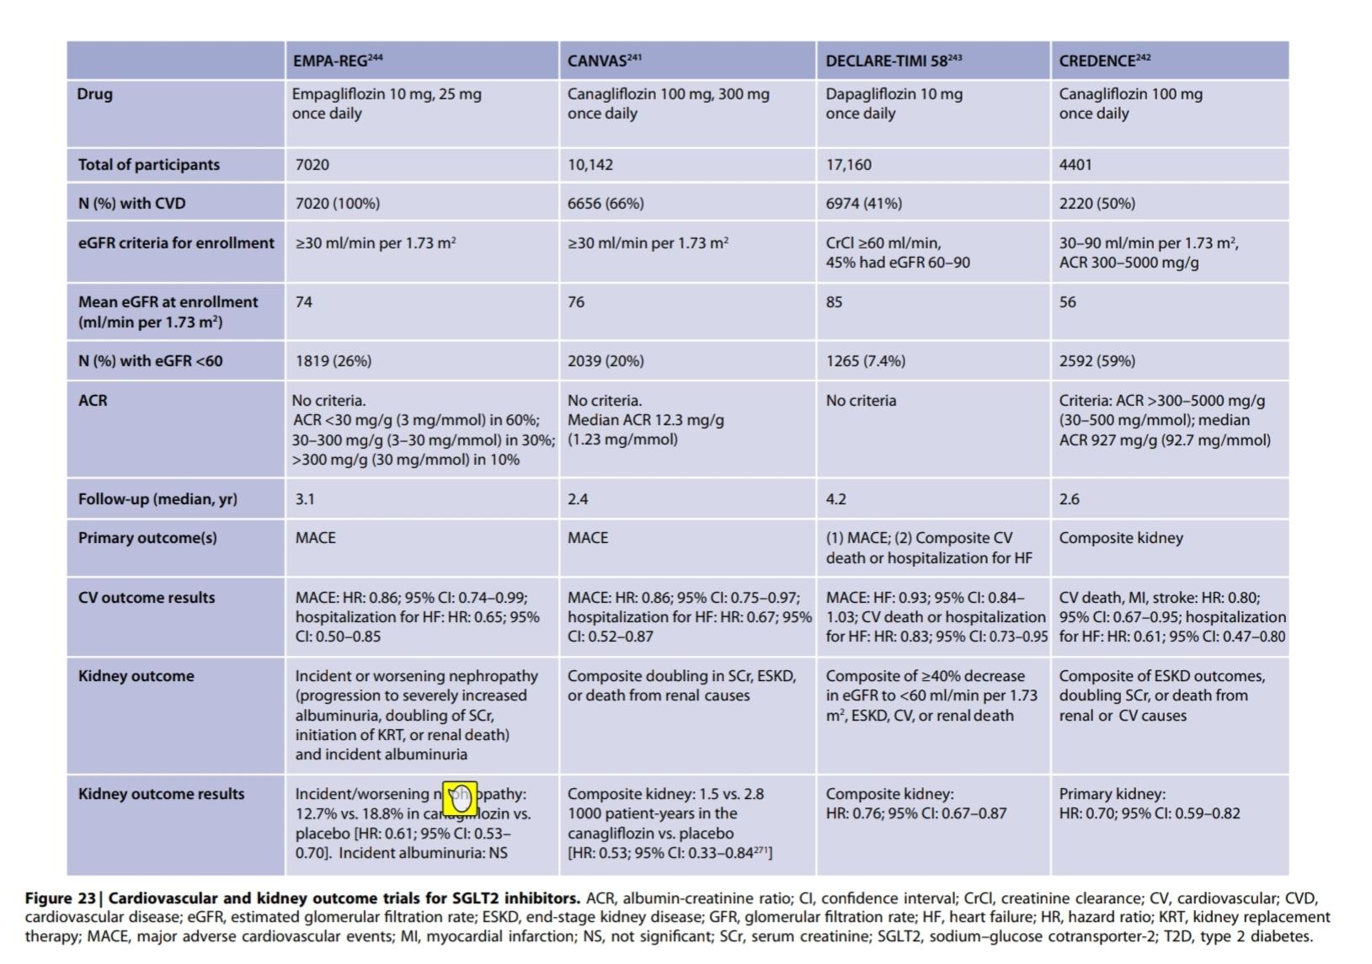

Slide 83
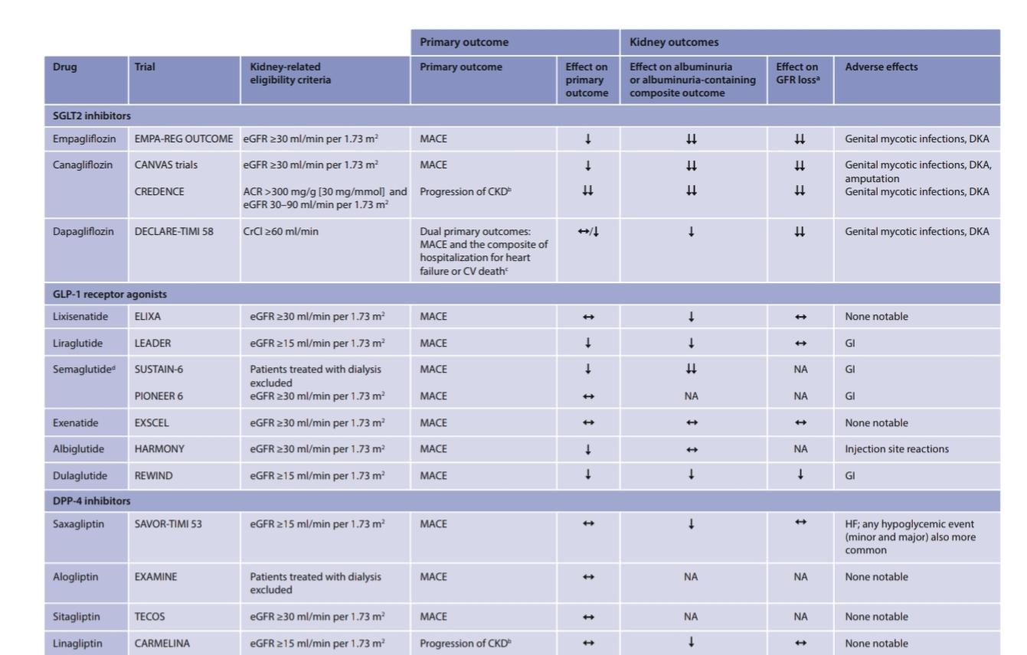
comparison

Slide 84
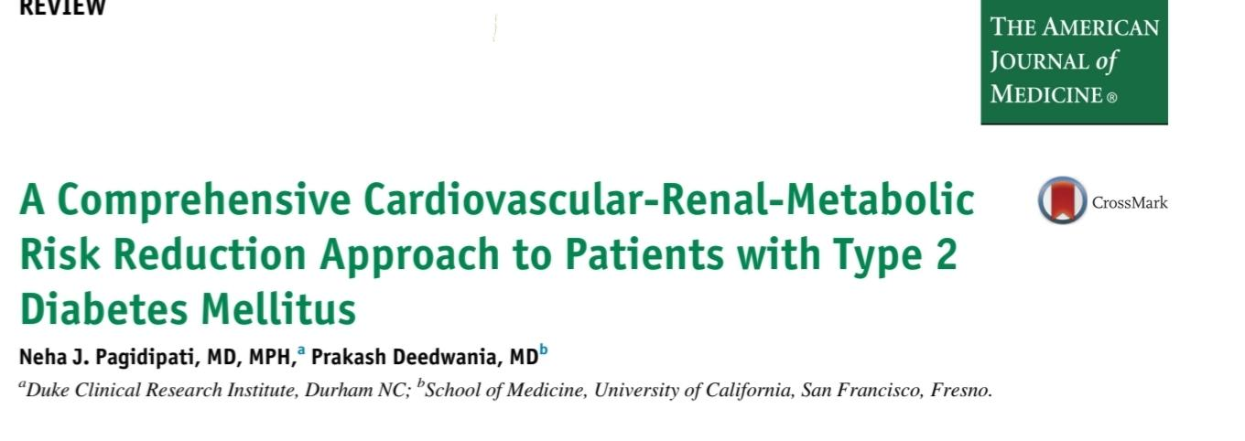
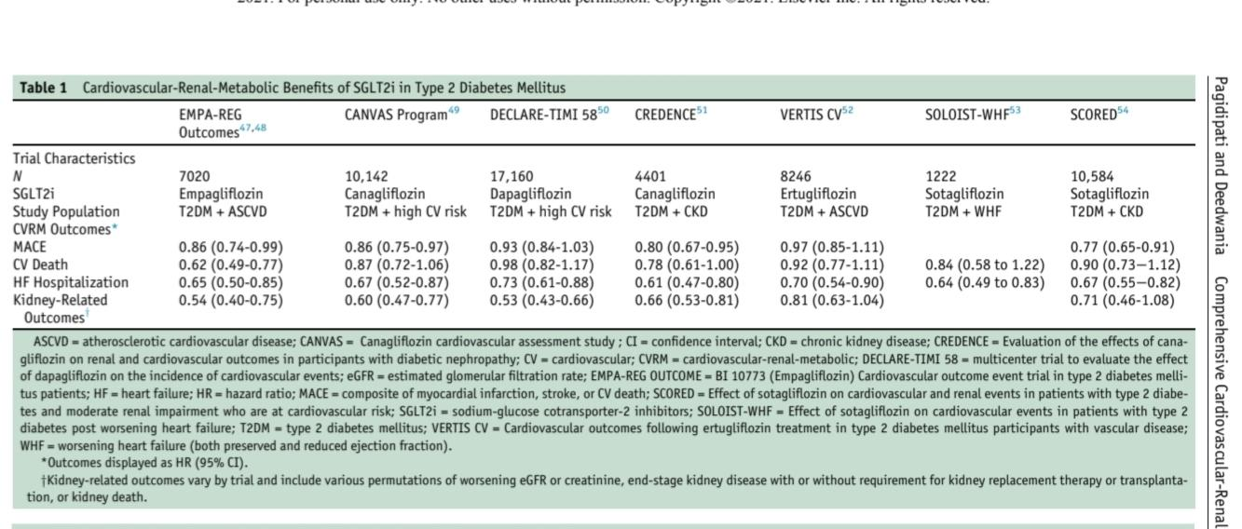

Slide 85
Although the VERTIS-CV study showed a significant reduction heart failure with ertugliflozin, the other CVD and CKD benefits were not statistically significant
The CREDENCE study showed that canagliflozin use resulted in cardiovascular and kidney benefitsthat were quite significant in patients with an eGFR down to 30 mL/min/1.73 m2 . Similar results were seen with dapagliflozin in the DAPA-CKD trial.
Reduced risks of death and hospitalization for heart failure in those newly started on empagliflozin, canagliflozin, or dapagliflozin compared with other diabetes medications were shown in the CVD-REAL study.
In the EASEL study, patients treated with SGLT2 inhibitors compared with other diabetes medications had reduced risks of major adverse cardiovascular events (hazard ratio [HR], 0.67 [95% CI, 0.60-0.75]) and allcause mortality and hospitalization for heart failure (HR 0.57 [95% CI, 0.50-0.60]).
There was also a higher risk of below-the-knee amputations (HR 1.99 [95% CI, 1.12-3.51]), mostly in those receiving canagliflozin.

Slide 86
An increased risk of amputations was also seen with canagliflozin in the CANVAS study but not in the CREDENCE study, and no such increase was seen with empagliflozin in the EMPA-REG study, dapagliflozin in the DECLARE-TIMI study, or the DAPA-CKD trial, or ertugliflozin in the VERTIS-CV trial.
Fournier gangrene, a necrotizing fasciitis of the perineum, has been reported with the use of SGLT2 inhibitors, leading to an FDA warning in 2018.
The efficacy of SGLT2 inhibitors in glucose lowering decreases substantially as the GFR declines below 60 mL/min/1.73 m2 Because of the marked benefits in reducing cardiovascular outcomes and slowing kidney disease progression,canagliflozin, empagliflozin, and dapagliflozin are very much
indicated in patients down to an eGFR of 30 mL/min/1.73 m2 based on the studies cited previously, although the package inserts state that dapagliflozin and empagliflozin should not be used with an eGFR < 3o mL/min/1.73 m2.
The dose of canagliflozin should be reduced to 100 mg daily in patients with an eGFR < 60 mL/min/1.73 m2
,
.

Slide 87
Dapa and empagliflozin is likely that these can be used safely down to an eGFR of 30 mL/min/1.73 m2, and possibly lower, for cardiovascular disease benefit but no glycemic benefit.

Slide 88
The mechanisms by which SGLT2 inhibitors cause CVD and CKD benefits are not clear but likely involve diuretic effects, increased sodium sensitivity, reduced arterial stiffness, and direct vascular effects.
Because of these benefits on CVD and CKD outcomes, it is now recommended that SGLT2 inhibitors with proven CKD benefits be used in all patients with type 2 diabetes who have evidence of CKD.

Slide 89
Summary

Slide 90
We now have many therapeutic options for patients with type 2 diabetes. Lifestyle changes are always part of treatment. Lifestyle/nutritional recommendations are complex and are fully discussed in the recent KDIGO guideline
BuT
For people with type 2 diabetes and CKD with an eGFR 30 mL per minute per 1.73 m2 or higher, metformin and sodium-glucose cotransporter 2 (SGLT2) inhibitors, in combination, are recommended for first-line medical treatment because they improve glycemic

Slide 91
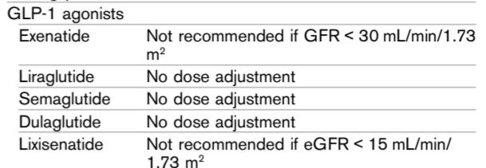
GLP-1 A can be used alone or in combination with other drugs to treat the second line
The GLP-1 receptor agonists can be used,but because of similar modes of action they should not be used concurrently with DPP-4 inhibitors
In patients with known CVD, liraglutide, semaglutide, and dulaglutide are now recommended
Semaglutide is now available as an oral agent and CVD outcome studies are pending.

Slide 92
..But the third line???

Slide 93
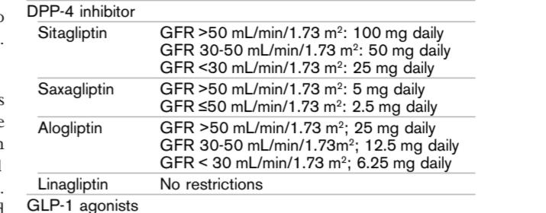
The DPP-4 inhibitors can be safely used in CKD,but all but linagliptin require dose adjustment. They do not cause hypoglycemia and are well tolerated, but the reduction in HbA1c is generally modest.
Thiazolidinediones reduce HbA1c moderately but can cause fluid retention and weight gain.

Slide 94
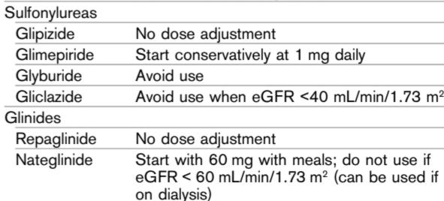
The secondgeneration sulfonylureas are inexpensive and effective,but they can cause hypoglycemia. In CKD, glipizide and gliclazide are preferable; glyburide must be avoided.

Slide 95
Insulin can often be started by giving a long-acting insulin such as glargine, detemir, ordegludec as a basal insulin once daily, with a starting dose of 10-15 units. The insulin dose can be increased by 1-2 units every few days until the fasting goal is reached while avoiding hypoglycemia. Many patients can achieve glycemic control with the combination of basal insulin and oral agents or GLP-1 receptor agonists. If such control cannot be achieved with basal insulin, a rapidacting insulin before meals can be started, especially if
hyperglycemia occurs during the day but fasting blood glucose levels meet the target. The rapid-acting insulin is often added initially before the largest meal of the day;however, prandial insulin may be required for each meal.
The doses of prandial insulin are guided by the premeal glucose level and the carbohydrate content of the meal.Uncommonly, when fasting glucose levels are not very high but hyperglycemia is present during the day,prandial rapid-acting insulin may suffice.

Slide 96
Repaglinide, pioglitazone, linagliptin, liraglutide,dulaglutide, and semaglutide can be used safely in patients on dialysis, particularly if the diabetes is fairly mild. Most patients on dialysis, however, will require insulin.
Patients who experience delayed gastric emptying may find it helpful to take their rapid-acting insulin after meals.
Glycemic responses during hemodialysis can be quite variable and unpredictable, so frequent dose adjustment may be needed
.
In those on peritoneal dialysis (PD), large amountsof glucose in the dialysate may result in marked hyperglycemia.In patients receiving continuous PD, a standard basal/bolus insulin regimen is best.
In those receiving overnight cycled PD, a fixed mixture insulin combination,
such as 70/30 or 75/25 insulin given at the start of PD,often provides better coverage of the increased glucose load
So that insulin doses can be adjusted appropriately,the patient’s endocrinologist must be informed of changes in the glucose concentration of the dialysate because of the need for more or less fluid removal.

Slide 98
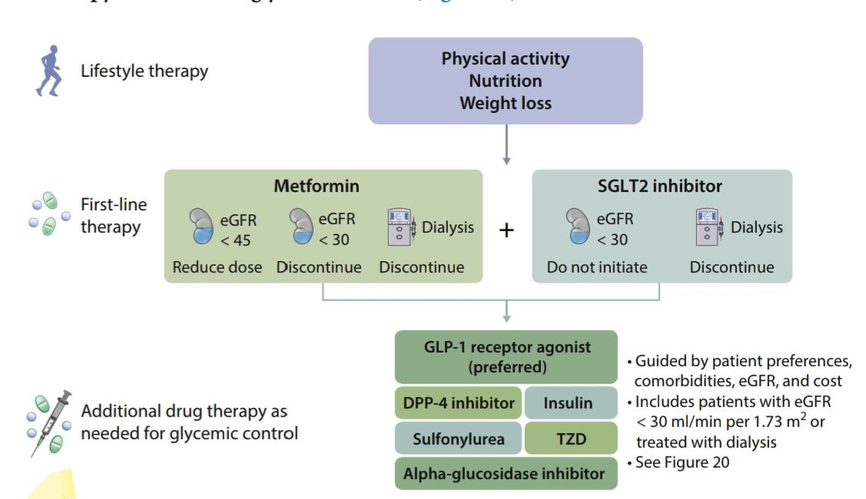
KDIGO

