Slide 1
Testosterone Therapy in Men With Hypogonadism
(Clinical Practice Guideline)
By:
Dr Batoul Birjandi

Slide 2
Agenda
Introduction
Diagnosis of Hypogonadism in Men
Treatment of Hypogonadism With Testosterone
Monitoring of Testosterone-Replacement Therapy

Slide 3
Men with symptoms potentially consistent with hypogonadism are frequently encountered in clinical practice. The clinical features associated with true male hypogonadism are nonspecific. In contrast, testosterone treatment for middle-aged and older men with functional decline, even for those with clearly low serum testosterone levels, offers modest and inconsistent benefit.
This guideline aims to educate clinicians and patients on the appropriate diagnosis and treatment of true hypogonadism.

Slide 4
Agenda
Introduction
Diagnosis of Hypogonadism in Men
Treatment of Hypogonadism With Testosterone
Monitoring of Testosterone-Replacement Therapy

Slide 5
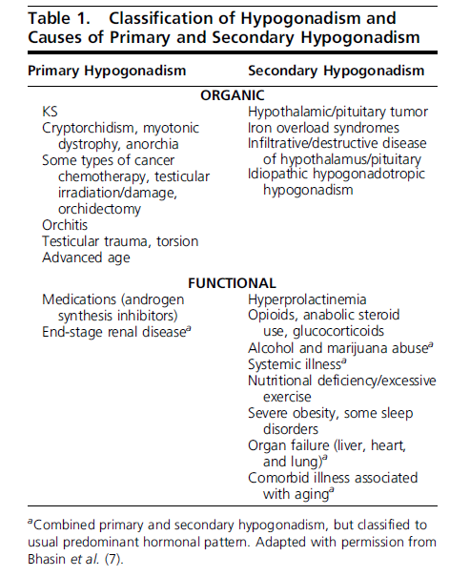
Combined primary and secondary hypogonadism results in low T concentrations, impairment of spermatogenesis, and variable gonadotropin levels, depending on whether primary or secondary hypogonadism predominates.
Shalender Bhasin et al.J Clin Endocrinal Metab,May 2018

Slide 6
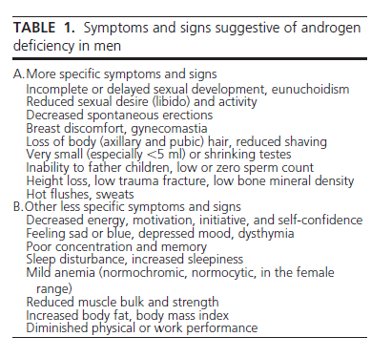
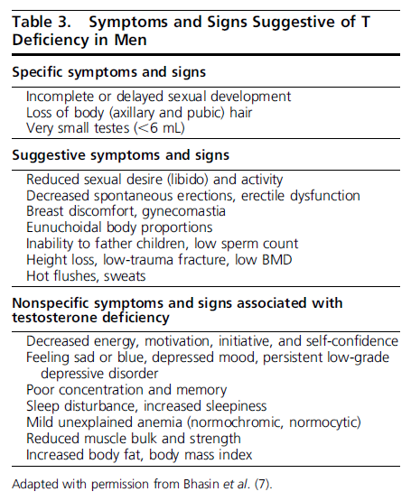
2010
2018

Slide 7
We recommend making a diagnosis of androgen deficiency only in men with consistent symptoms and signs and unequivocally low serum testosterone levels. (1QEEE)
2010
We recommend diagnosing hypogonadism in men
with symptoms and signs of testosterone deficiency and unequivocally and consistently low
serum total testosterone and/or free testosterone
concentrations (when indicated). (1QEEE)
2018

Slide 8
Evidence
Serum T concentrations vary significantly as a result of diurnal, circadian, and circannual rhythms,episodic secretion, and assay variations. It is important to confirm low T concentrations, because 30% of men with an initial T concentration in the hypogonadal range have a normal T concentration on repeat measurement.
Clin Endocrinol (Oxf). 2007;67(6):853–862.
Serum T concentrations exhibit a diurnal variation with peak values in the morning; aging reduces the magnitude of this diurnal variation
Bremner WJ,et al. J ClinEndocrinol Metab. 1983;56(6):1278–1281.
Despite this attenuation of the diurnal rhythm in older men, a substantial fraction of 65- to 80-year-old men who have low serum T concentrations in the afternoon will have normal T concentrations in the morning.
Brambilla DJ,et al. J Clin Endocrinol Metab. 2009;94(3):907–913.
Glucose and food intake suppress T concentrations
Caronia LM,et al. Clin Endocrinol(Oxf)2013;78(2):291–296.

Slide 9
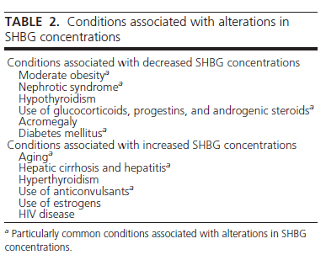
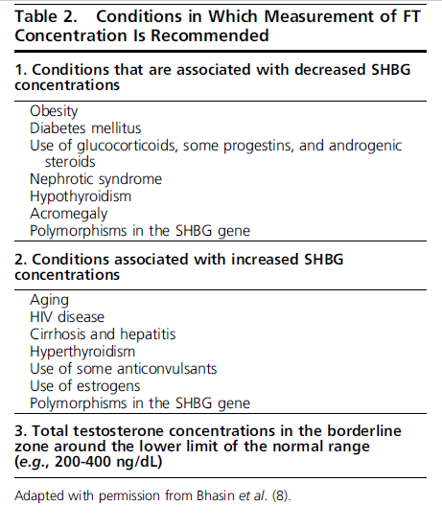
2010
2018

Slide 10
Conditions that lower SHBG [e.g., obesity, type 2 diabetes mellitus (T2DM), or androgen use] can lower TT concentrations to below the normal range, although FT concentrations might remain within the normal range.
Conditions that increase SHBG (e.g., advanced age, some anticonvulsants, or HIV infection) can raise TT concentrations to well above 400 ng/dL and sometimes into the highnormal range or even above the normal range, even though FT concentrations might be low.
Clinicians should also measure FT in men whose serum TT concentration is modestly above or below the lower limit of normal (e.g., 200 to 400 ng/dL).
In men whose TT concentrations are far below the lower limit of the normal range (e.g., ,150 ng/dL), the probability of FT concentration being within the normal range is low. So, in such circumstance, measuring FT is generally not necessary
Anawalt BD. J Urol. 2012;187(4):1369–1373.

Slide 11
In men who have conditions that alter sex hormone–binding globulin (SHBG) , or whose initial total testosterone concentrations are at or near the lower limit of the normal range, clinicians should determine free testosterone concentrations either directly from equilibrium dialysis assays or by calculations that use total testosterone, SHBG, and albumin concentrations.
Clinicians should not use direct analog-based free testosterone immunoassays, as they are inaccurate.
ZakharovMN,et al. Mol Cell Endocrinol. 2015;399:190–200.

Slide 12
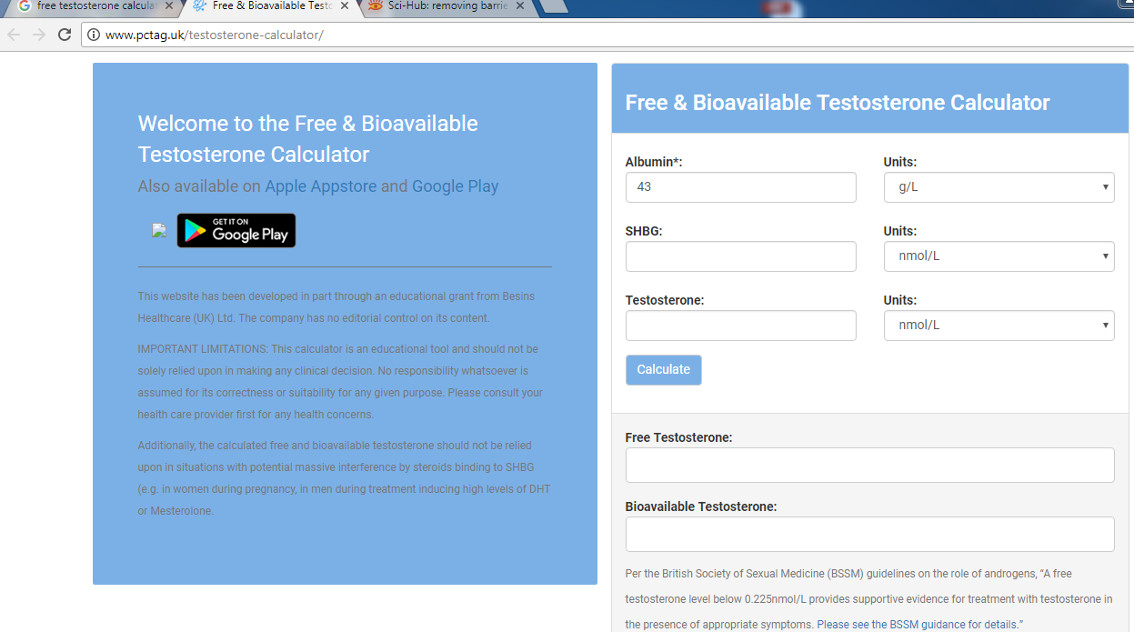

Slide 13
Screening and case detection for hypogonadism
We recommend against screening for androgen deficiency in the general population. (1QEEE)
We recommend against routine screening of men in the general population for hypogonadism.
(1QEEE)
2010
2018

Slide 14
Endogenous Testosterone and Mortality in Men: A Systematic Review and Meta-Analysis
Andre B. Araujo, Julia M. Dixon, Elizabeth A. Suarez, M. Hassan Murad, Lin T. Guey, and Gary A. Wittert
J Clin Endocrinol Metab, October 2011, 96(10):3007–3019
Objective: evaluate the association between endogenous testosterone and mortality
Design: systematic review and meta-analysis
Data Sources: Data sources included MEDLINE (1966 to December 2010), EMBASE (1988 to December2010), and reference lists.
Study Selection: (12 meta-analysis)observational studies of men that reported the association between endogenous testosterone and all-cause or cardiovascular disease (CVD) mortality.

Slide 15
Results:
Subject mean age and testosterone level were 61 yr and 487 ng/dl, respectively, and mean follow-up time was 9.7 yr.
decrease of 2.18 SD in total testosterone was associated with a 35 and 25% increased risk of all-cause and CVD mortality, respectively.
Between-study heterogeneity was observed among studies of all-cause (P<.001) and CVDmortality (P=0.06), limiting the ability to provide valid summary estimates.

Slide 16
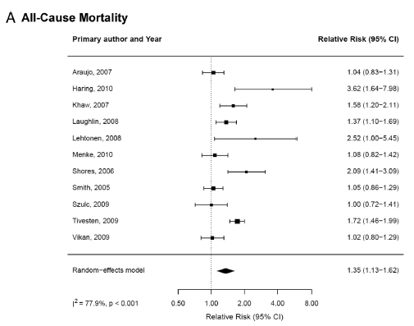
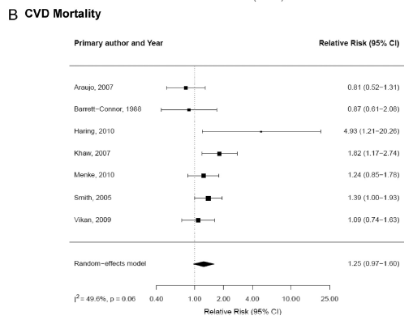
N:11
N:7

Slide 17
Treating an over diagnosed condition bears no benefit but can cause harms and generates costs.
Overtreatment also diverts health professionals from caring for those most severely ill.
Targeted screening and balanced information on its risk and benefits would also help limit overdiagnosis.
Jean-Luc Bulliard et al. Public Health Reviews2015-36:8

Slide 18
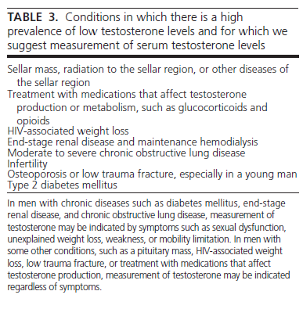
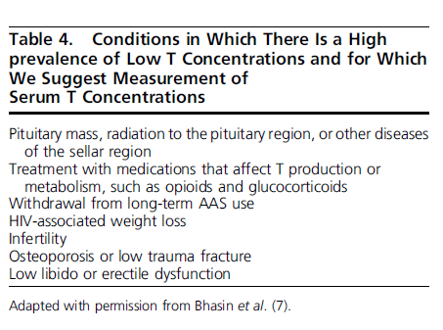
2010
2018

Slide 19
Distinguishing between primary or secondary hypogonadism
We recommend measurement of serum LH and FSH levels to distinguish between primary (testicular) and secondary (pituitary-hypothalamic) hypogonadism. (1QQEE)
In men who have hypogonadism, we recommend distinguishing between primary (testicular) and secondary (pituitary-hypothalamic) hypogonadism by measuring serum luteinizing hormone (LH) and follicle-stimulating hormone (FSH) concentrations. (1QQEE)
2010
2018

Slide 20
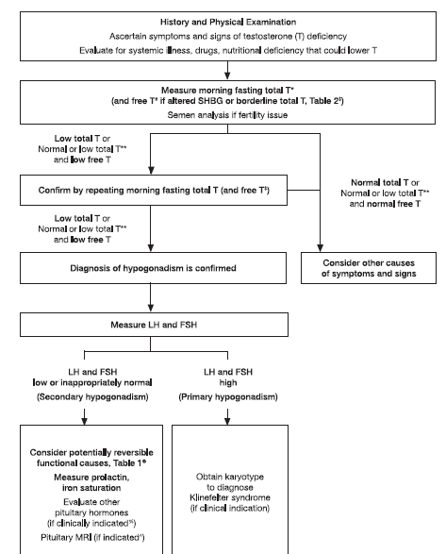
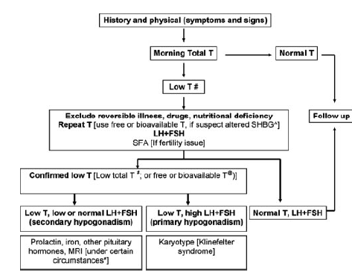








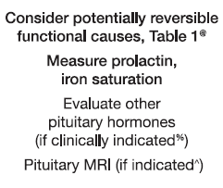
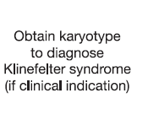
Low TT orNl / lowTT & low FT
Nl TT or Nl /low TT & Nl FT N
lowT or Nl/LowTT&low FT
2010
2018

Slide 21
Agenda
Introduction
Diagnosis of Hypogonadism in Men
Treatment of Hypogonadism With Testosterone
Monitoring of Testosterone-Replacement Therapy

Slide 22
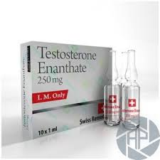
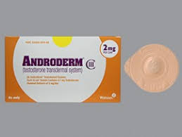
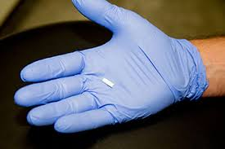
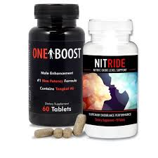
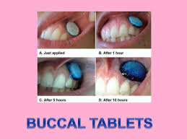
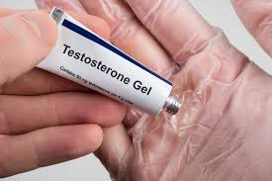

Slide 23
We recommend testosterone therapy for symptomatic men with classical androgen deficiency syndromes aimed at inducing and maintaining secondary sex characteristics
and at improving their sexual function, sense of well-being, and bone mineral density. (1QQEE)
We recommend testosterone therapy in hypogonadal men to induce and maintain secondary sex characteristics and correct symptoms of testosterone deficiency. (1QQEE)
well-being, and bone mineral density
2010
2018

Slide 24

The efficacy and adverse events of testosterone replacement therapy in hypogonadal men: A systematic review and meta-analysis of randomized, placebo-controlled trials.
Oscar J. Ponce, M.D.1, 2, 3*, Gabriela Spencer-Bonilla, M.Sc. 3, 4*, Neri Alvarez-Villalobos, M.D., M.Sc.3, 5, Valentina Serrano, M.D. M.Sc.3, 6, Naykky Singh-Ospina, M.D., M.Sc.7, Rene Rodriguez-Gutierrez, M.D., M.Sc.3, 5, Alejandro Salcido-Montenegro, M.D.5, Raed Benkhadra, M.D.1, Larry J. Prokop, MLS 1, 8, Shalender Bhasin, M.D.9, Juan P. Brito, M.D.3
The Journal of Clinical Endocrinology & Metabolism; 2018
Objective: To conduct a systematic review & meta-analysis of RCT to determine the effects of TRT on patient-important outcomes and adverse events in hypogonadal men.
Data Sources: We searched Ovid MEDLINE, Ovid EMBASE, Ovid Cochrane Database of Systematic Reviews, Ovid Cochrane Central Register of Controlled Trials, and Scopus from inception to March 2th, 2017.
Study selection: RCTs that assessed the efficacy and adverse events of TRT of at least 12 weeks compared with placebo in adult men with hypogonadism, defined by morning testosterone ≤300 ng/dL and at least one symptom or sign of hypogonadism

Slide 25
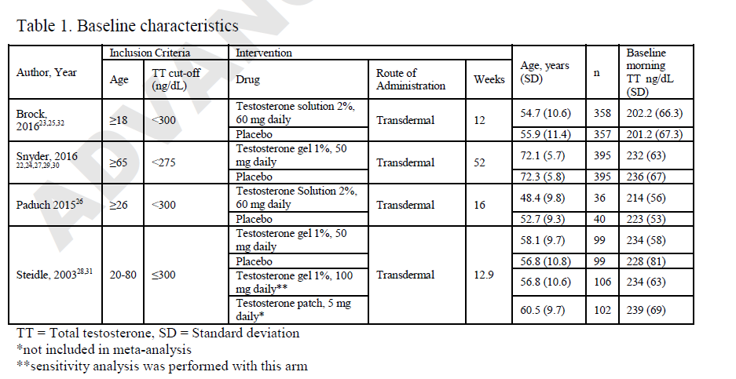

Slide 26
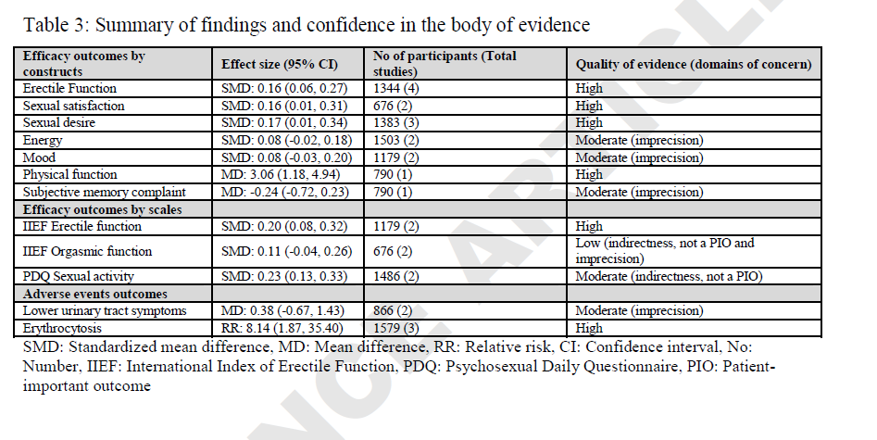

Slide 27
Data synthesis: We found 11 publications, reporting on 4 eligible trials (including 1,779 patients) at low risk of bias. Compared to placebo, TRT was associated with a small but significant increase in sexual desire or libido [standardized mean difference (SMD): 0.17, 95% CI 0.01, 0.34] (n=1383), erectile function [SMD: 0.16, 95% CI 0.06, 0.27] (n=1344), and sexual satisfaction [SMD: 0.16, 95% CI 0.01, 0.31] (n=676), but had no effect on energy or mood. TRT was associated with an increased risk of developing erythrocytosis [relative risk: 8.14, 95% CI:1.87, 35.40] (n=1579) compared to placebo, but had no significant effect on lower urinary tract symptoms (LUTS).

Slide 28
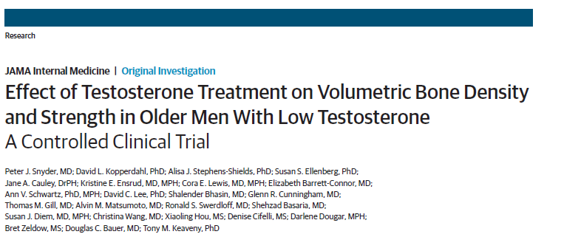
Published online February 21, 2017

Slide 29
OBJECTIVE :To determine whether testosterone treatment of older men with low testosterone increases volumetric BMD (vBMD) and estimated bone strength.
DESIGN, SETTING, AND PARTICIPANTS :Placebo-controlled, double-blind trial with treatment allocation by minimization at 9 US academic medical centers of men 65 years or older with 2 testosterone concentrations averaging less than 275 ng/L participating in the Testosterone Trials from December 2011 to June 2014. The analysis was a modified intent-to-treat comparison of treatment groups by multivariable linear regression adjusted for balancing factors as required by minimization.
INTERVENTIONS :Testosterone gel, adjusted to maintain the testosterone level within the normal range for young men, or placebo gel for 1 year.

Slide 30
RESULTS: There were 211 participants (mean [SD] age, 72.3 [5.9] years; 86%white; mean [SD] body mass index, 31.2 [3.4]). Testosterone treatment was associated with significantly greater increases than placebo in mean spine trabecular vBMD (7.5%; 95%CI, 4.8%to 10.3% vs 0.8%; 95%CI, −1.9%to 3.4%; treatment effect, 6.8%; 95%CI, 4.8%-8.7%; P < .001), spine peripheral vBMD, hip trabecular and peripheral vBMD, and mean estimated strength of spine trabecular bone (10.8%; 95%CI, 7.4%to 14.3%vs 2.4%; 95%CI, −1.0%to 5.7%; treatment effect, 8.5%; 95%CI, 6.0%-10.9%; P< .001), spine peripheral bone, and hip trabecular and peripheral bone. The estimated strength increases were greater in trabecular than peripheral bone and greater in the spine than hip. Testosterone treatment increased spine areal BMD but less than vBMD.

Slide 31
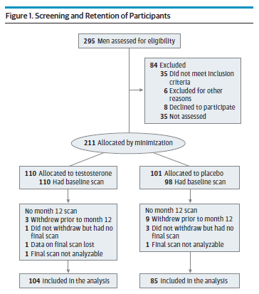
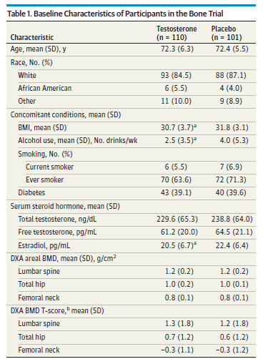

Slide 32
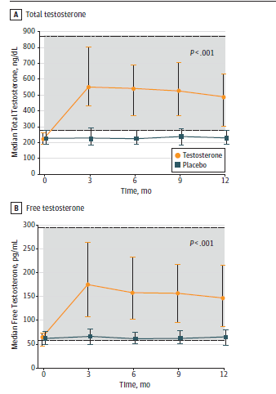
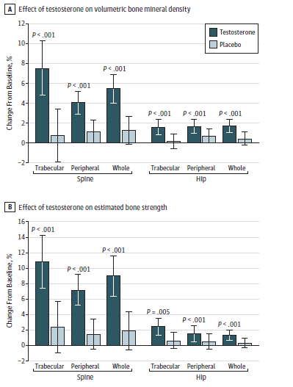

Slide 33
T therapy in healthy hypogonadal men increases areal and volumetric vertebral and femoral BMD and vertebral and femoral bone strength , but there are no studies on the effects of T on fracture risk. T is not an approved treatment for osteoporosis or for reducing fracture risk.

Slide 34
We recommend against testosterone therapy in patients with breast (1QEEE) or prostate cancer. (1QQEE) We recommend that clinicians assess prostate cancer risk in men being considered for testosterone therapy. We recommend against testosterone therapy without further urological evaluation in patients with palpable prostate nodule or induration or PSA >4 ng/ml or PSA >3 ng/ml in men at high risk of prostate cancer, such as African-Americans or men with first-degree relatives with prostate cancer. (1QEEE).Werecommend against testosterone therapy in patients with hematocrit above 50%, untreated severe OSA, severe lower urinary tract symptoms (AUA/ IPSS >19), or uncontrolled or poorly controlled heartfailure, or in those desiring fertility.
We recommend against testosterone therapy in men planning fertility in the near term or in men with breast or prostate cancer, a palpable prostate nodule or induration, a prostate-specific antigen (PSA) level > 4 ng/mL, a PSA level > 3 ng/mL combined with a high risk of prostate cancer(without further urological evaluation), elevated hematocrit, untreated severe OSA, severe lower urinary tract symptoms, uncontrolled heart failure, myocardial infarction or stroke within the last 6 months, or thrombophilia (1QEEE)
2010
2018

Slide 35
Impact Of Testosterone Replacement Therapy On Myocardial Infarction, Stroke, And Death In Men With Low Testosterone Concentrations In An Integrated Healthcare System
Jeffrey L Anderson MDa,b,et al.Am J cardiol. 2016
Objective: assess the effect of testosterone replacement therapy (TRT) on cardiovascular (CV) outcomes
Participants: Men( 1996-2011) who received care at an Intermountain Healthcare facility, were >50 years of age, had a documented low testosterone level (<212 ng/dL), a follow-up testosterone, and at least 3 years of follow-up were identified(4,736)
Outcome Measures: The primary endpoint of the study was the composite of all-cause death or nonfatal MI or stroke (MACE). Secondary endpoints were the individual components of MACE
Results: Three-year rates of MACE and death were 6.6% and 4.3%, respectively. Subjects supplemented to normal testosterone had reduced 3-year MACE (HR 0.74; 95% confidence interval [CI] 0.56 to 0.98, p = 0.04) compared to persistently low testosterone, driven primarily by death (HR 0.65, 95% CI 0.47 to 0.90). HRs for MI and stroke were 0.73 (95% CI 0.40 to 1.34), p = 0.32, and 1.11 (95% CI 0.54 to 2.28), p = 0.78, respectively. MACE was noninferior but not superior for high achieved testosterone with no benefit on MI and a trend to greater stroke risk. In conclusion, in a large general health care population, TRT to normal levels was associated with reduced MACE and death over 3 years but a stroke signal with high achieved levels suggests a conservative approach to TRT.

Slide 36
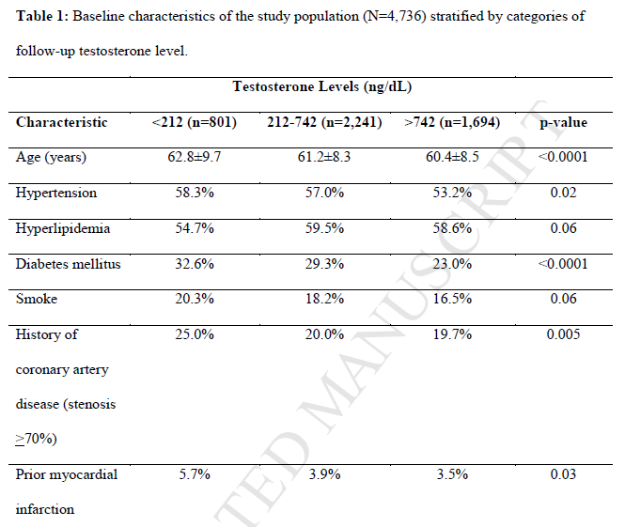

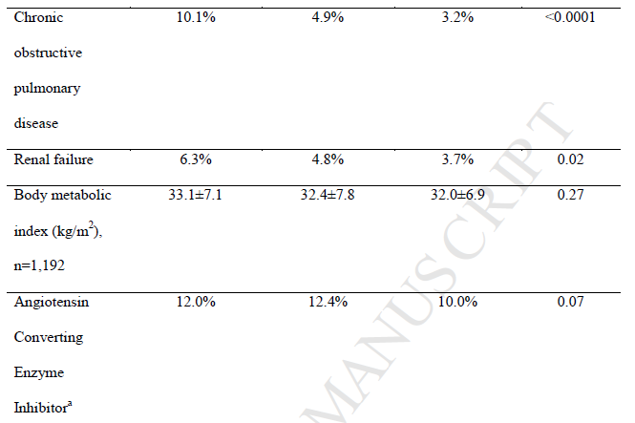
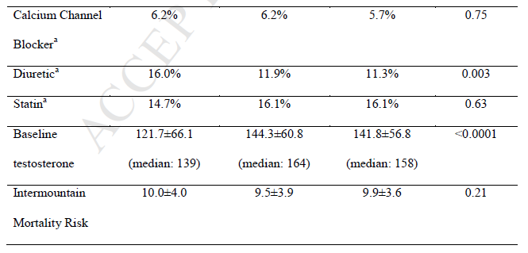
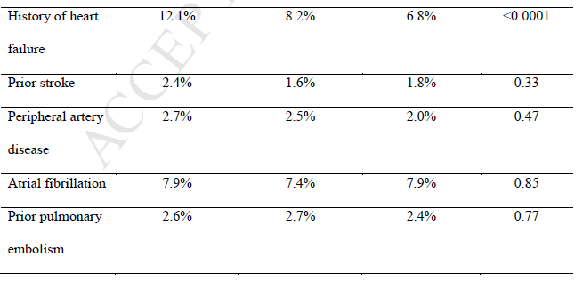

Slide 37
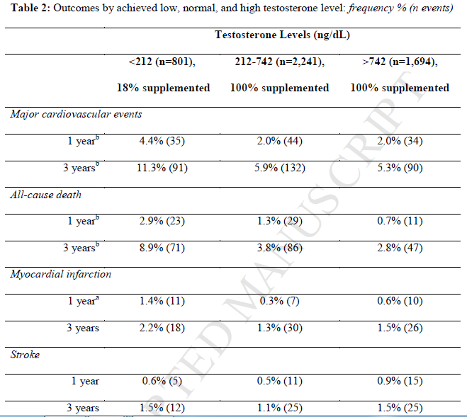

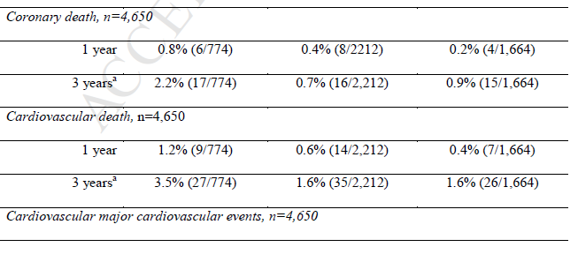
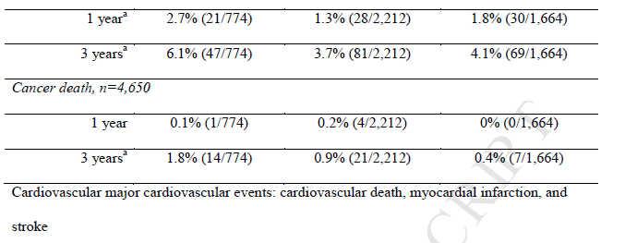

Slide 38

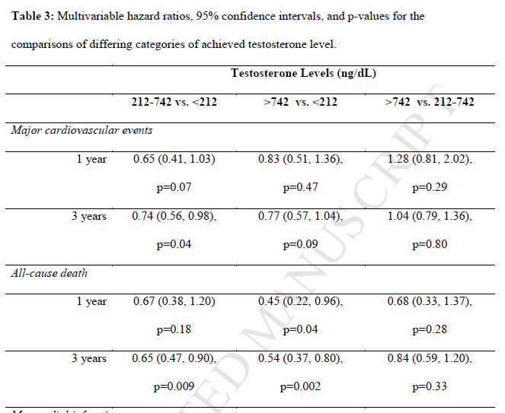
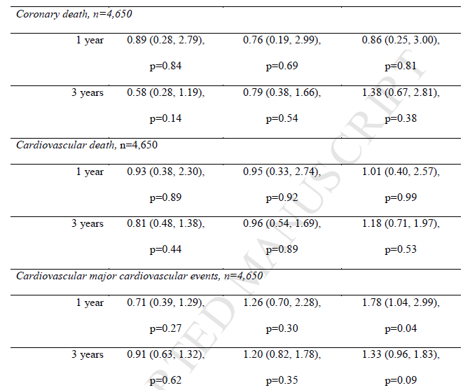
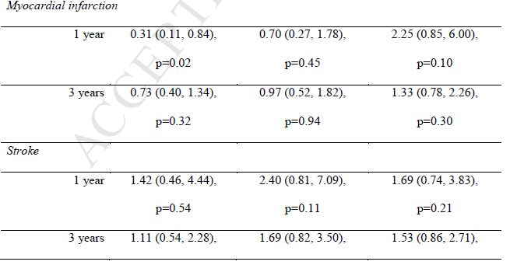
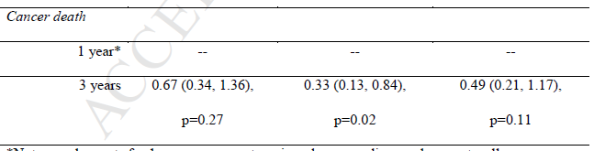

Slide 39
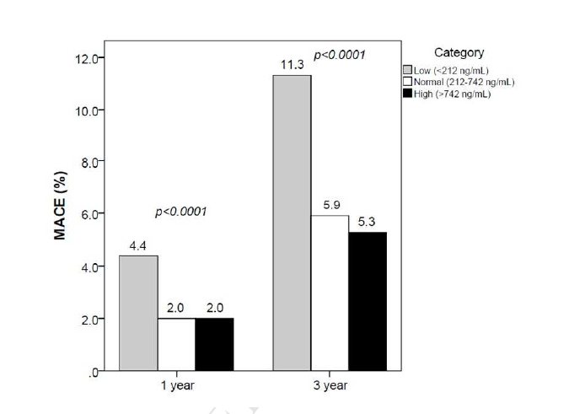

Slide 40
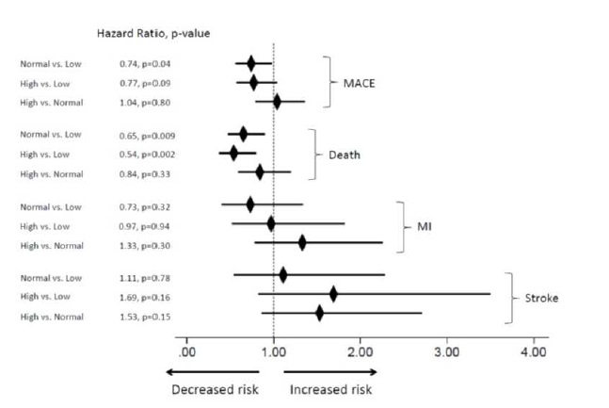
Nl vs low
High vs low
High vs Nl
Nl vs low
High vs low
High vs Nl
Nl vs low
High vs low
High vs Nl
Nl vs low
High vs low
High vs Nl

Slide 41

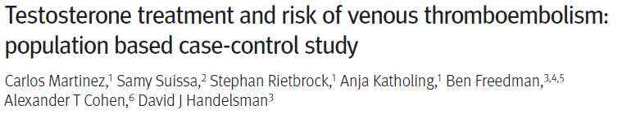
BMJ 2016; 355
Objective:To determine the risk of venous thromboembolism associated with use of testosterone treatment in men, focusing particularly on the timing of the risk.
Design: Population based case-control study.
Setting: 370 general practices in UK primary care with linked hospital discharge diagnoses and in-hospital procedures and information on all cause mortality.
Participants: 19 215 patients with confirmed venous thromboembolism (comprising deep venous thrombosis and pulmonary embolism) and 909 530 age matched controls from source population including more than 2.22 million men between January 2001 and May 2013

Slide 42
Exposure of interest: Three mutually exclusive testosterone exposure group were identified: current treatment, recent (but not current) treatment, and no treatment in the previous two years. Current treatment was subdivided into duration of more or less than six months.
Main outcome measure: Rate ratios of venous thromboembolism in association with current testosterone treatment compared with no treatment were estimated using conditional logistic regression and adjusted for comorbidities and all matching factors.
Results:
  The adjusted rate ratio of venous thromboembolism was 1.25 (95% confidence interval 0.94 to 1.66) for current versus no testosterone treatment.
  In the first six months of testosterone treatment, the rate ratio of venous thromboembolism was 1.63 (1.12 to 2.37), corresponding to 10.0 (1.9 to 21.6) additional venous thromboembolisms above the base rate of 15.8 per 10 000 person years.
  The rate ratio after more than six months’ treatment was 1.00 (0.68 to 1.47), and after treatment cessation it was 0.68 (0.43 to 1.07).
  Increased rate ratios within the first six months of treatment were observed in all strata: the rate ratio was 1.52 (0.94 to 2.46) for patients with pathological hypogonadism and 1.88 (1.02 to 3.45) for those without it, and 1.41 (0.82 to 2.41) for those with a known risk factor for venous thromboembolism and 1.91 (1.13 to 3.23) for those without one.

Slide 43
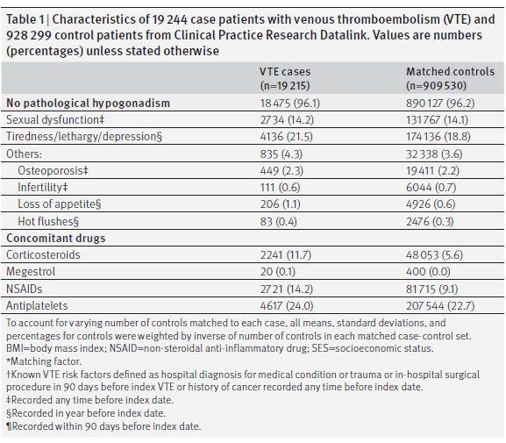

Slide 44
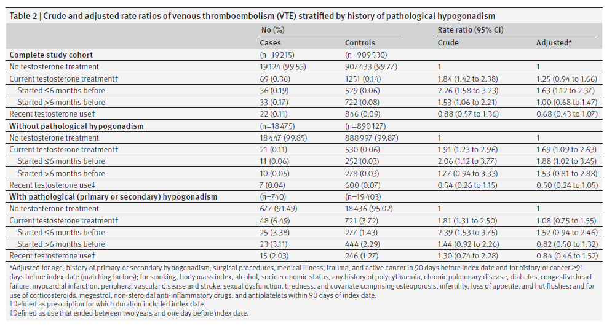

Slide 45
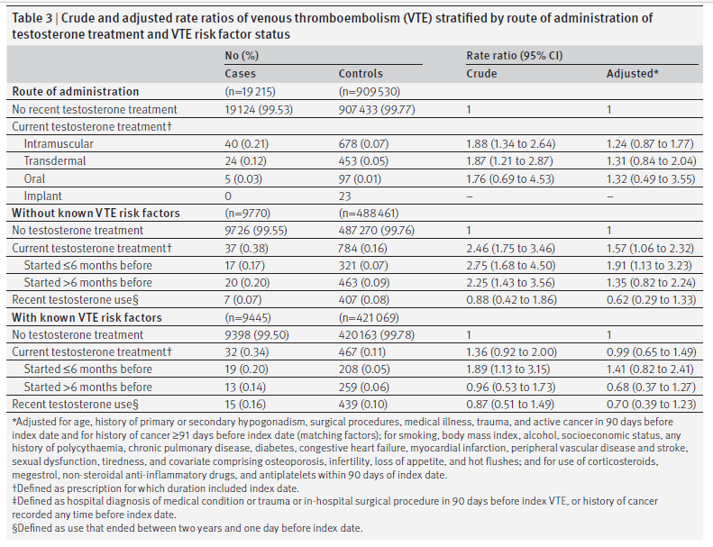

Slide 46
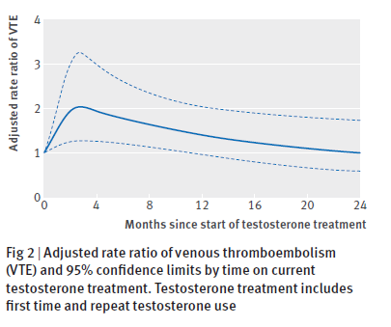

Slide 47
Starting testosterone treatment was associated with an increased risk of venous thromboembolism, which peaked within six months and declined thereafter.

Slide 48
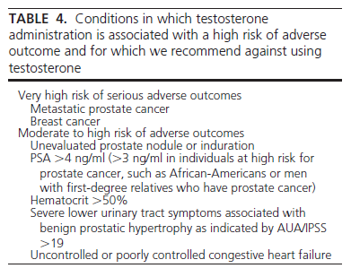
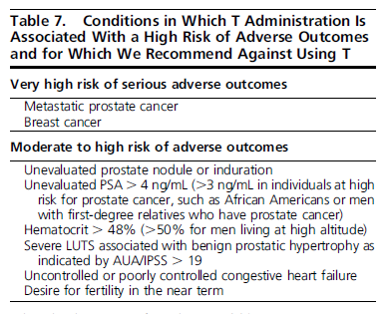
2010
2018

Slide 49
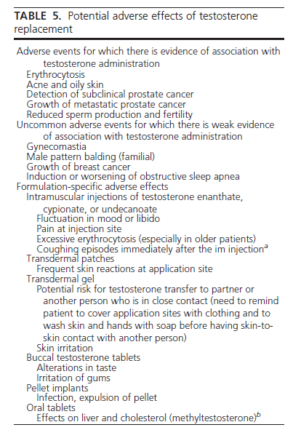
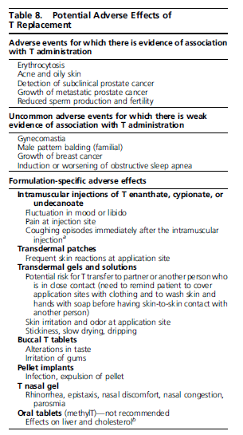
2010
2018

Slide 50

Effects of Graded Doses of Testosterone on Erythropoiesis in Healthy Young and Older Men
Objective: compare the dose-related changes in hemoglobin and hematocrit in young and older men & determine whether age-related differences in erythropoietic response to testosterone can be explained by changes in erythropoietin and soluble transferrin receptor (sTfR) levels.
Design: secondary analysis of data from a testosterone dose-response study in young and older men who received long-acting GnRH agonist monthly plus one of five weekly doses of testosterone enanthate (25, 50, 125, 300, or 600 mg im) for 20 wk.
Participants: 60 older men aged 60–75 yr and 61 young men aged 19–35 yr.
Outcome Measures: Outcome measures included hematocrit and hemoglobin and serum erythropoietin and sTfR levels.
Results: Hemoglobin and hematocrit increased significantly in a linear, dose-dependent fashion in both young and older men in response to graded doses of testosterone (P < 0.0001). The increases in hemoglobin and hematocrit were significantly greater in older than young men. There was no significant difference in percent change from baseline in erythropoietin or sTfR levels across groups in either young or older men. Changes in erythropoietin or sTfR levels were not significantly correlated with changes in total or free testosterone levels.

Slide 51
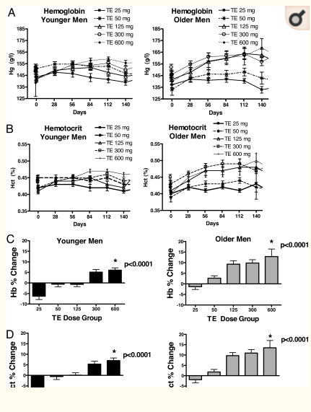

Slide 52


Slide 53
Conclusions: Testosterone has a dose-dependent stimulatory effect on erythropoiesis in men that is more pronounced in older men. The testosterone-induced rise in hemoglobin and hematocrit and age-related differences in response to testosterone therapy may be mediated by factors other than erythropoietin and sTfR.

Slide 54
HIV-infected men with weight loss
We suggest that clinicians consider short-term testosterone therapy in HIV-infected men with low testosterone concentrations and weight loss (when other causes of weight loss have been excluded) to induce and maintain body weight and lean mass gain. (2jOO)

Slide 55
Anabolic steroids for the treatment of weight loss in HIVinfected individuals (Review)
Johns KKJ, Beddall MJ, Corrin RC. Cochrane Database Syst Rev. 2005
OBJECTIVES:Our objectives were to assess the efficacy and safety of anabolic steroids for the treatment of weight loss in adults with HIV infection.
SEARCH STRATEGY: databases: Cochrane Central Register of Controlled Trials (CENTRAL), MEDLINE, AIDSLINE, AIDSearch, EMBASE, CINAHL, Current Contents, and the National Library of Medicine Gateway Abstracts for controlled trials up to April 2005
SELECTION CRITERIA:Randomized controlled trials that compared the use of an anabolic steroid to placebo to treat weight loss in adults with HIV were included

Slide 56
gender (men, women, or men and women);
gonadal status for trials with men only (hypogonadal men,eugonadal men)
study treatment duration (6 months, 16 weeks, 12 weeks,8 weeks)
study treatment dose (supraphysiologic, physiologic)
proportion of study participants on PI at baseline (less than 60%, 60% or greater)
Results:
  294 randomized to anabolic steroid & 238 randomized to placebo… change in lean body mass.
  343 randomized to anabolic steroid & 286 randomized to placebo….. change in body weight.
  Although significant heterogeneity was present for both outcomes, the average change in lean body mass was 1.3 kg (95% CI: 0.6, 2.0), while the average change in total body weight was 1.1 kg (95% CI: 0.3, 2.0).

Slide 57
AUTHORS' CONCLUSIONS: Although the results of the trials were heterogeneous, on average, the administration of anabolic steroids appeared to result in a small increase in both lean body mass and body weight as compared with placebo. While these results suggest that anabolic steroids may be useful in the treatment of weight loss in HIV infected individuals

Slide 58
Overall, short-term (3 to 6 months) T use in HIVinfected men with low T concentrations and weight loss can lead to small gains in body weight, LBM, and mood, with minimal change in quality of life.

Slide 59
In men with type 2 diabetes mellitus who have low testosterone concentrations, we recommend against testosterone therapy as a means of improving glycemic control. (1jOO)

Slide 60

OBJECTIVE:To determine whether testosterone therapy improves glucosemetabolism inmen with type 2 diabetes (T2D) and lowered testosterone.
RESEARCH DESIGN AND METHODS: a randomized, double-blind, parallel, placebo-controlled trial in 88 men(2009-2013) with T2D, aged 35–70 years with an HbA1c ≤ 8.5% (69 mmol/mol), and a total testosterone level, measured by immunoassay, of ≤12.0 nmol/L (346 ng/dL)
Participants were randomly assigned to 40 weeks of intramuscular testosterone undecanoate (n = 45) or matching placebo (n = 43).
Main outcome :insulin resistance (HOMA-IR, primary outcome) & glycemic control by HbA1c (secondary outcome).
current use of glucagon like peptide-1 agonist therapy or very low-calorie diet, or an HbA1c level ≤.8.5%
Changes in oral hypoglycemic agents or initiation of insulin therapy constituted a violation of trial protocol, leading to withdrawal from the trial.

Slide 61
RESULTS: Testosterone therapy did not improve insulin resistance (mean adjusted difference [MAD] for HOMA-IR compared with placebo20.08 [95%CI20.31 to 0.47; P = 0.23]) or glycemic control (MAD HbA1c 0.36% [0.0–0.7]; P = 0.05), despite a decrease in fat mass (MAD 22.38 kg [23.10 to 21.66]; P < 0.001) and an increase in lean mass (MAD 2.08 kg [1.52–2.64]; P < 0.001). Testosterone therapy reduced subcutaneous (MAD 2320 cm3 [2477 to 2163]; P < 0.001) but not visceral abdominal adipose tissue (MAD 140 cm3 [289 to 369]; P = 0.90).

Slide 62


Slide 63
CONCLUSIONS:Testosterone therapy does not improve glucose metabolism or visceral adiposity in obese men with moderately controlled T2D and modest reductions in circulating testosterone levels typical for men with T2D.

Slide 64
Agenda
Introduction
Diagnosis of Hypogonadism in Men
Treatment of Hypogonadism With Testosterone
Monitoring of Testosterone-Replacement Therapy

Slide 65
2010
2018
Monitoring men receiving testosterone therapy
1. Evaluate the patient 3 to 6 months after treatment initiation and then annually to assess whether symptoms have responded to treatment and whether the patient is suffering from any adverse effects.
Monitoring Men Receiving T Therapy
Explain the potential benefits and risks of monitoring for prostate cancer and engage the patient in shared decision making regarding the prostate monitoring plan.
Evaluate the patient at 3–12 mo after treatment initiation and then annually to assess whether symptoms have responded to treatment and whether the patient is suffering from any adverse effects.

Slide 66
2. Monitor testosterone level 3 to 6 months after initiation of testosterone therapy:Therapy should aim to raise serum testosterone level into the mid-normal range.
- Injectable testosterone enanthate or cypionate: measure serum testosterone level midway between injections. If testosterone is >700 ng/dl (24.5 nmol/liter) or <400 ng/dl (14.1 nmol/liter), adjust dose or frequency.
Monitor T concentrations 3–6 mo after initiation of T therapy: Therapy should aim to raise serum T concentrations into the mid-normal range.
Injectable T enanthate or cypionate: measure serum T concentrations midway between injections. If midinterval T is >600 ng/dL (24.5 nmol/L) or <350 ng/dL (14.1 nmol/L), adjust dose or frequency.

Slide 67
Transdermal gels: assess testosterone level any time after patient has been on treatment for at least 1 wk; adjust dose to achieve serum testosterone level in the mid-normal range.
Transdermal patches: assess testosterone level
3–12 h after application of the patch; adjust dose to achieve testosterone level in the mid-normal range.
Buccal testosterone bioadhesive tablet: assess level immediately before or after application of fresh system.
Transdermal gels: assess T concentrations 2–8 h following the gel application, after the patient has been on treatment for at least 1 wk; adjust dose to achieve serum T concentrations in the mid-normal range.
Transdermal patches: assess T concentrations 3–12 h after application; adjust dose to achieve T concentration in the mid-normal range.
Buccal T bioadhesive tablet: assess concentrations immediately before or after application of fresh system.

Slide 68
- Testosterone pellets: measure testosterone levels at the end of the dosing interval. Adjust the number of pellets and/or the dosing interval to achieve serum testosterone levels in the normal range.
Oral testosterone undecanoatea: monitor serum testosterone level 3 to 5 h after ingestion.
Injectable testosterone undecanoate: measure serum testosterone level just prior to each subsequent injection and adjust the dosing interval to maintain serum testosterone in
mid-normal range
T pellets: measure T concentrations at the end of the dosing interval. Adjust the number of pellets and/or the dosing interval to maintain serum T concentrations in the midnormal
range.
Oral T undecanoatea: monitor serum T concentrations 3–5h after ingestion with a fat-containing meal.
Injectable T undecanoate: measure serum T levels at the end of the dosing interval just prior to the next injection and aim to achieve nadir levels in low-mid range.

Slide 69
Check hematocrit at baseline, 3–6 mo after starting treatment, and then annually. If hematocrit is .54%, stop therapy until hematocrit decreases to a safe level; evaluate the patient for hypoxia and sleep apnea; reinitiate therapywith a reduced dose.
Measure BMD of lumbar spine and/or femoral neck after 1–2 y of T therapy in hypogonadal men with osteoporosis,
consistent with regional standard of care.
3. Check hematocrit at baseline, at 3 to 6 months, and then annually. If hematocrit is 54%, stop therapy until hematocrit decreases to a safe level; evaluate the patient for hypoxia and sleep apnea; reinitiate therapy with a reduced dose.
4.Measure bone mineral density of lumbar spine and/or femoral neck after 1–2 yr of testosterone therapy in hypogonadal men with osteoporosis or low trauma fracture, consistent with regional standard of care.

Slide 70
5. In men ≥40 yr of age with baseline PSA >0.6 ng/ml, perform digital rectal examination and check PSA level before initiating treatment, at 3 to 6 months, and then in accordance with guidelines for prostate cancer screening depending on the age and race of the patient.
6. Obtain urological consultation if there is: An increase in serum PSA concentration 1.4 ng/ml within any 12-month period of testosterone treatment.
A PSA velocity of 0.4 ng/ml yr using the PSA level after 6 months of testosterone administration as the reference (only applicable if PSA data are available for a period exceeding 2 yr). Detection of a prostatic abnormality on digital rectal examination. An AUA/IPSS of 19.
7. Evaluate formulation-specific adverse effects at each visit.
For men 55–69 yr of age and for men 40–69 years of age who are at increased risk for prostate cancer who choose prostate monitoring, perform digital rectal examination and check PSA level before initiating treatment; check PSA and perform digital rectal examination 3–12 mo after initiating T treatment, and then in accordance with guidelines for prostate cancer screening depending on the age and race of the patient.
Obtain urological consultation if there is:
An increase in serum PSA concentration.1.4 ng/mL within 12 mo of initiating T treatment A confirmed PSA > 4 ng/mL at any time Detection of a prostatic abnormality on DRE Substantial worsening of LUTS
Evaluate formulation-specific adverse effects at each visit.

Slide 71


