Slide 1
Case presentation
A 29 y/o female with primary hyperparathyroidism and extra-parathyroid uptake in nuclear imaging
Presented by: A.H. Ghanooni M.D
Mordad 1396
Taleghani Hospital
SBMU

Slide 2
Present illness
A 29 year-old single female, from Garmsar, presented with protrusion of left maxillary bone beside the nose 1 year ago.
Her complaint was not very significant for other symptoms. But she has had polyuria, and polydipsia , bone pain, weakness, and depression.
At the first step CT scan revealed a mass and surgery was performed to tumor resection.(95/4)

Slide 4
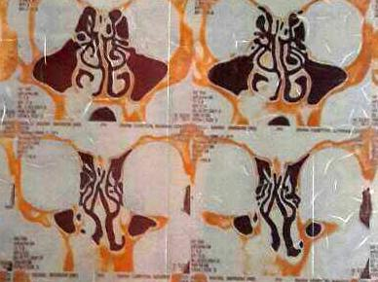
CT scan

Slide 5
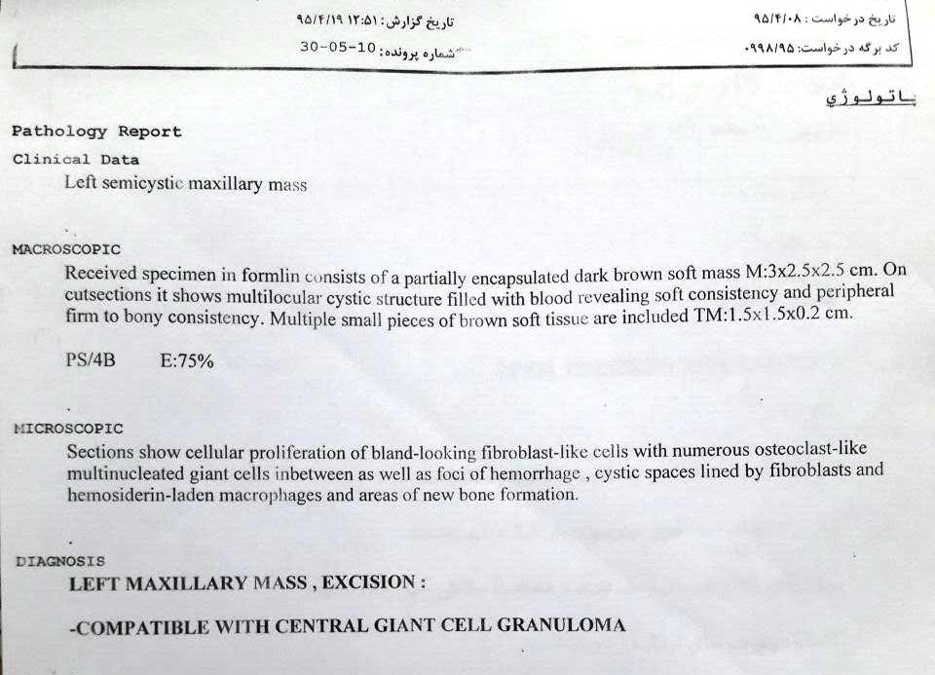
First pathology

Slide 6
After pathology report compatible to Brown Tumor, biochemical laboratory test for Hyperparathyroidism was done and the patient was referred to endocrinologist.

Slide 7
95/5/2
Result | Test
12.0 mg/dL | Ca
2.6 mg/dL | P
IU/L 535 | ALKP
Pg/mL 575 | PTH
7.3 ng/ml | Vit D (ECL)

Slide 8
95/5/24
Result | Test
137 mEq/L | Serum Na
4.3 mEq/L | Serum K
0.6 mg/dL | Creatinine
11.9 mg/dL | Ca
3.4 mg/dL | P
481 IU/L | ALKP
16 IU/L | AST
14 IU/L | ALT
0.4 mg/dL | Bilirubin T
4.5 g/L | Albumin
465 Pg/mL | PTH
580 mg/24h | Urine Creatinine 24 hrs
1450 ml | Urine Volume 24 hrs
68 Micg/day | Urine Metanephrine 24 hrs
82 Micg/day | Urine Normetanephrine 24 hrs
5.0 mg/24h | Urine V.M.A 24hrs

Slide 9
95/6/29
Result | Test
1400 mL/24h | Urine Volume /24h
1036 mg/24h | Urine Cr. /24
207 mg/24h | Urine Ca /24

Slide 10
After diagnosis of primary hyperparathyroidism - for determination of location of adenoma- TC-99m-MIBI scan was requested.

Slide 11
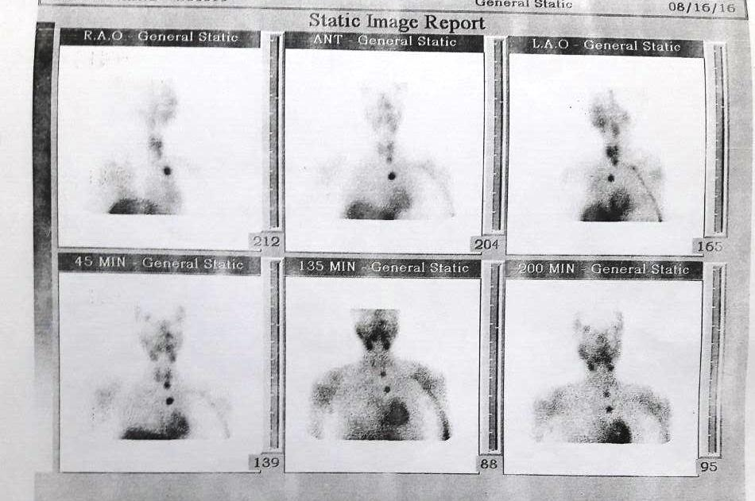
First MIBI scan 95/5/26
بيمارستان نفت

Slide 12
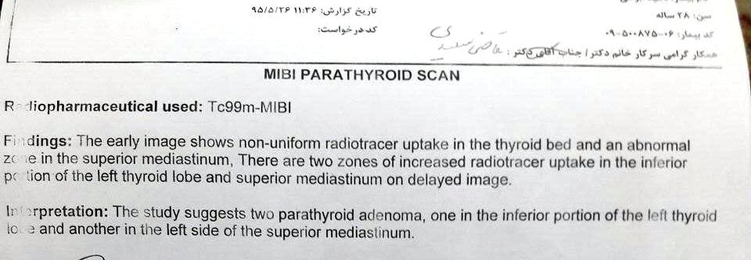
First MIBI scan report 95/5/26

Slide 13
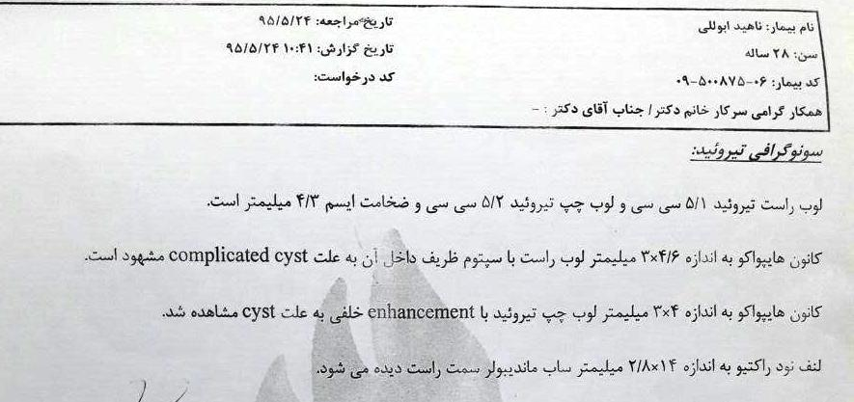
CT or US

Slide 14
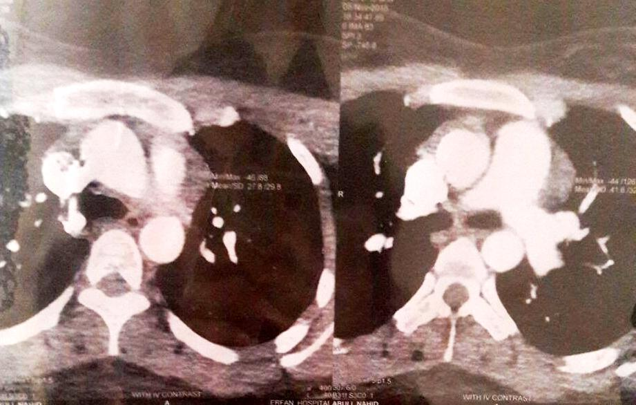
95/8/18

Slide 15
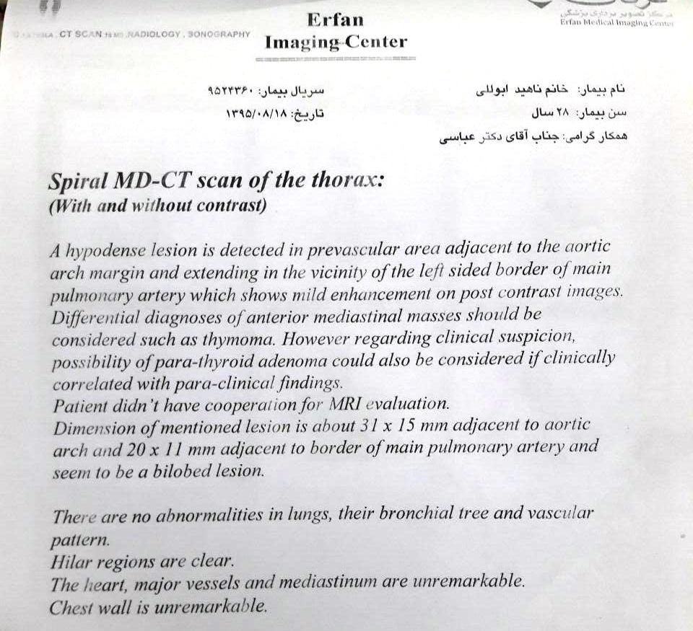

Slide 16
95/11
Video Endoscopic Thoracic Surgery (VATS) for mediastinal tumor biopsy and thymectomy was performed 6 months ago.

Slide 17
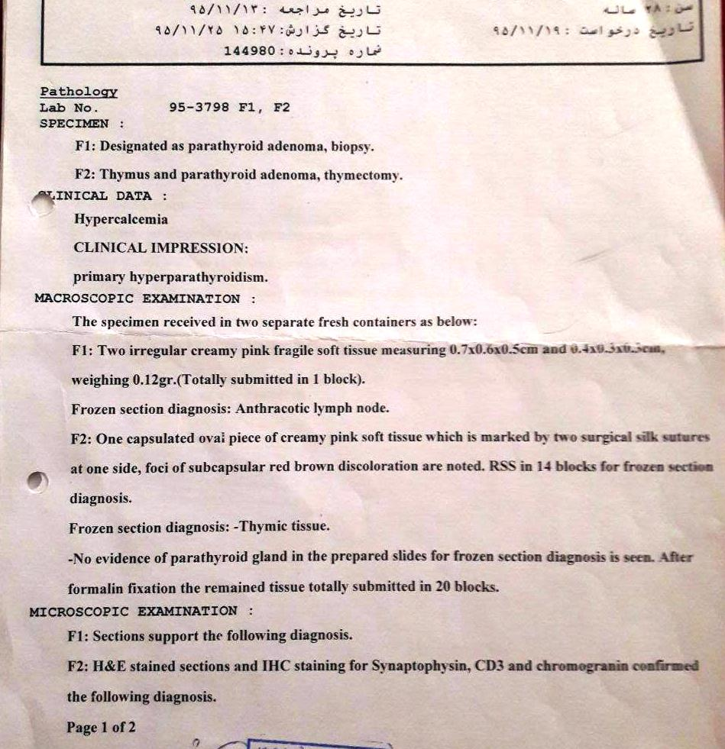
Second surgical pathology

Slide 18
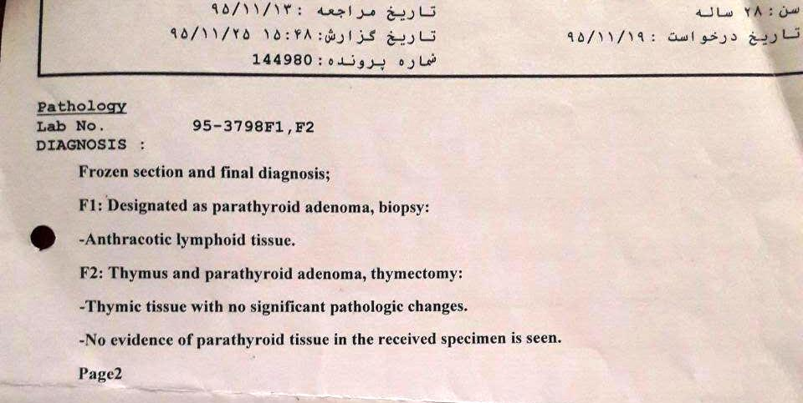

Slide 19
95/12/4
Result | Test
11.5 * mg/dL | Ca
2.2 (L) mg/dL | P
342 * Pg/mL | PTH
96/1/28
Result | Test
12.2 mg/dL | Ca
2.6 mg/dL | P
460 * Pg/mL | PTH

Slide 20
Because of unsuccessful laboratory tests results, reevaluation for parathyroid excess secretion source was done.

Slide 21
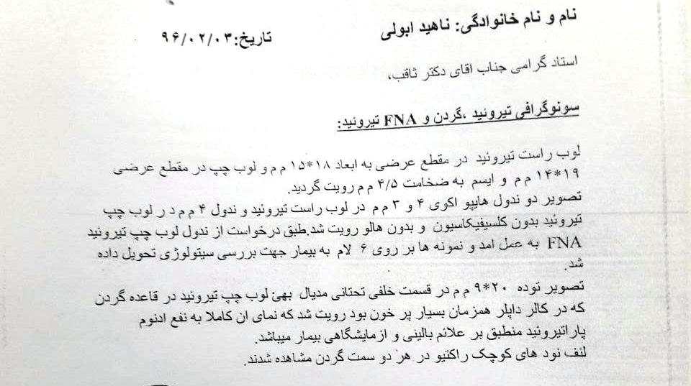
96/2/3

Slide 22
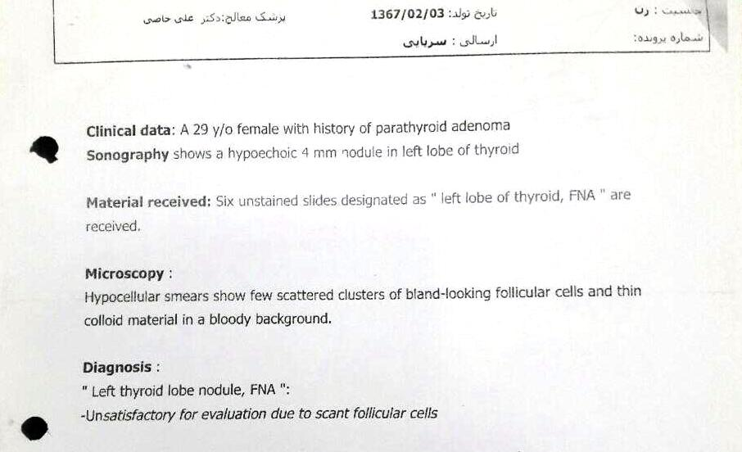
96/2/3

Slide 23
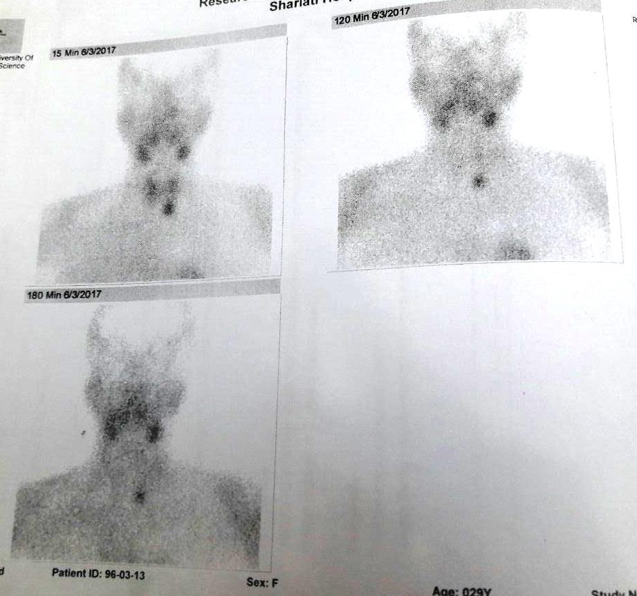

Slide 25
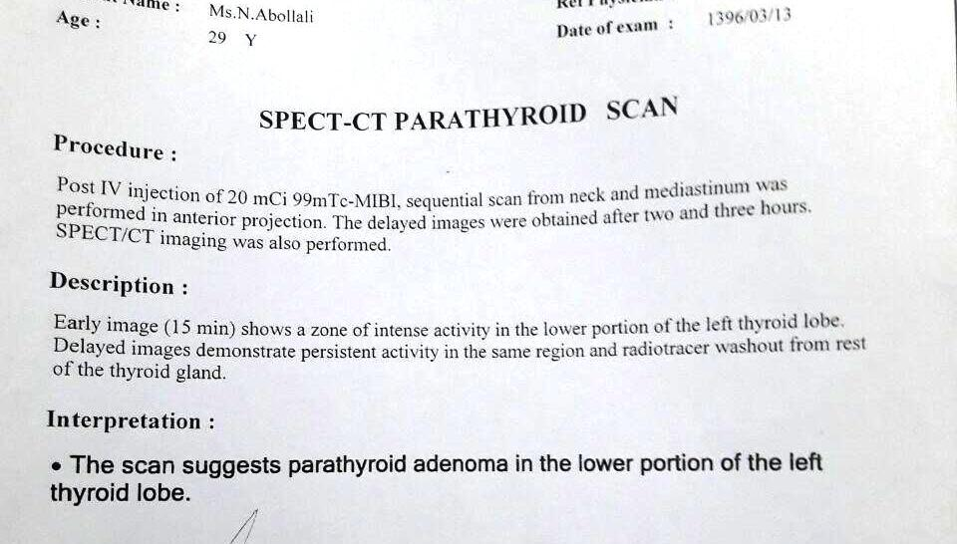
96/3/13

Slide 26
And ultimately, third operation for resection of inferior cervical mass was performed 2 months ago (96/3).

Slide 27
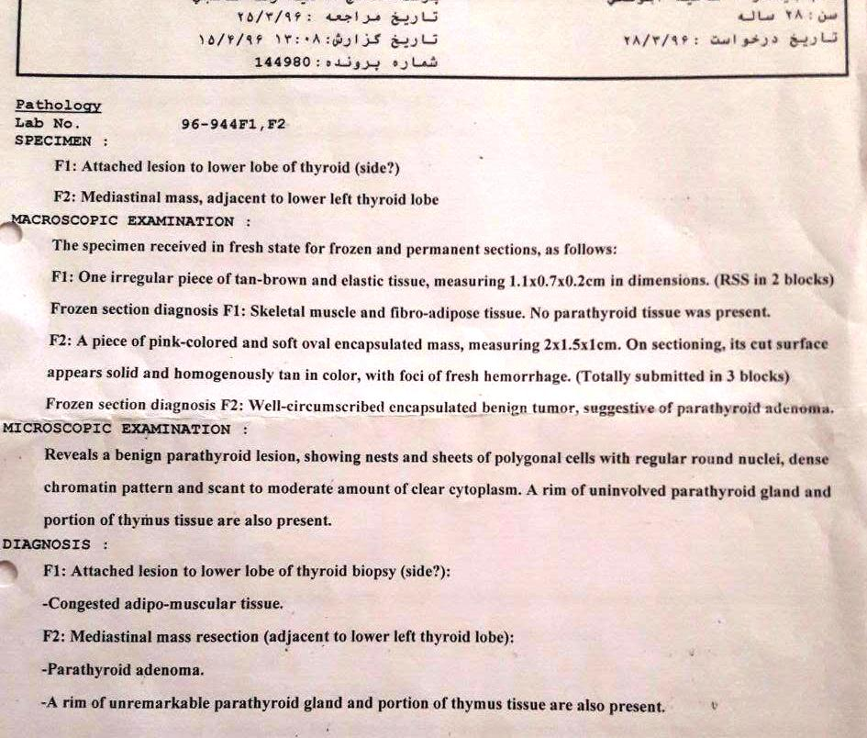
Third surgical pathology

Slide 28
96/4/10
Result | Test
7.8 (L) mg/dL | Calcium

Slide 29
Past Medical & Surgical Hx
Once episode of flank pain & renal stone passage 2 years ago.
Hx of sepal deviation of nose surgery 5 years ago.
hypertension (-)
PUD(-)

Slide 30
FHx
Renal stone in her mother and grandfather and uncle.
Hypertension and diabetes in her father

Slide 31
Review of Systems
No Fever, anorexia and weight loss
Unilateral and pulsatile headache that was decreased after last surgery
No nausea, vomiting, constipation, or abdominal pain,
Bone pain, polyuria, polydipsia

Slide 32
Physical Examinations
H : 160
W : 62
BMI : 24.2
Unfortunately, she could not come to us for a comprehensive physical examination.

Slide 33
Problem list
A 29 year-old female
Maxillary mass ( brown tumor)
polyuria, and polydipsia , bone pain, weakness, and depression
Hypercalcemia, hypophosphatemia, and elevated PTH
Cervical and mediastinal mass
Several uptakes (Cervical and mediastinal) in nuclear imaging

