Slide 1
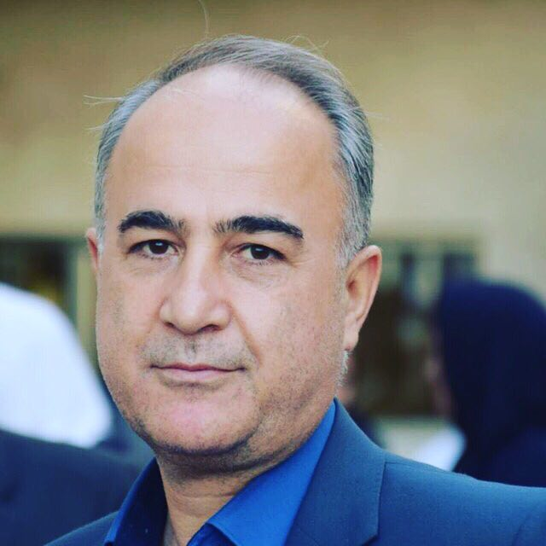
Dr E.Faraji
MD,Internist,Endocrinologist
Tabriz University of Medical Sciences
Nothing to Declare

Slide 2
HYPOCALCEMIC DISORDERS

Slide 3
Calcium in the Body
99% in Bone
1% Exchangeable
50% Bound
50% Ionized
Strong Extra- to Intracellular Gradiant (10,000:1)
Calcium Channels
Intracellular portion 99% Bound

Slide 4
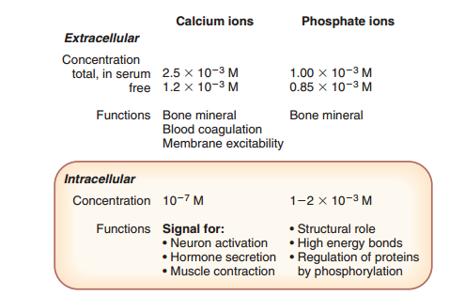

Slide 5
Calcium Regulators
PTH
1,25(OH)2 VitD3
Calcium
P

Slide 6
PTH

Slide 7
PTH Actions on Calcium Homeostasis

Slide 8
PTH – Ca Curve

Slide 9
Hypocalcemia
Acute or Chronic reduction of IONIZED Ca below normal physiologic range
8.5 – 10.5 mg/dl Total ca.
Ionized Ca below 1.2mM/l
Total Ca influenced by albumin,PH,FFA level,lipid infusions

Slide 10
s/s
Acuteness
Severity

Slide 12
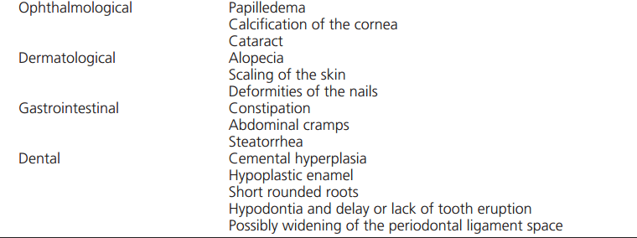

Slide 13
Classification of Etiology
PTH Related
PTH Unrelated

Slide 14
PTH related

Slide 15
PTH Unrelated

Slide 16
PTH related
Postsurgical-Autoimmune-Congenital
PTH
Secretion
Resistance
Hypomagnesemia
Pseudohypoparathyroidism

Slide 17
Genetic Etiology

Slide 18
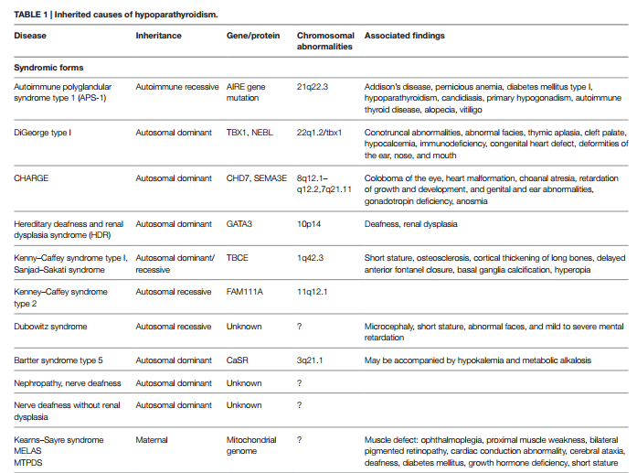

Slide 20
Postsurgical Hypoparathyroidism
Neck Surgery
Thyroidectomy (38%)
Parathyroidectomy(21%)
RLND
Any Neck surgery(5%)
75% all hypoparas

Slide 21
The incidence of postsurgical hypoparathyroidism
Depends on
the center
type of intervention
surgical expertise.
Transient postsurgical hypoparathyroidism lasting˂6 months
25.4 – 83% of patients worldwide after neck surgery
Permenant postsurgical hypoparathyroidism, defined as lasting more than 6 months
0.12– 4.6% of cases

Slide 22
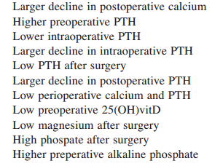
Risk Factors

Slide 23
Risk Factors

Slide 24
Morbidity

Slide 25
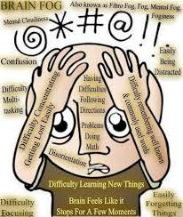
QoL
I am not the person I was before

Slide 26
Goals of Treatment
Resolve S/S Hypocalcemia
Maintain sCa at 8-9mg/dl
U/Ca normal
Phosphate in Normal range
P*Ca not more than 55
Consider and avoid complications of treatment

Slide 27
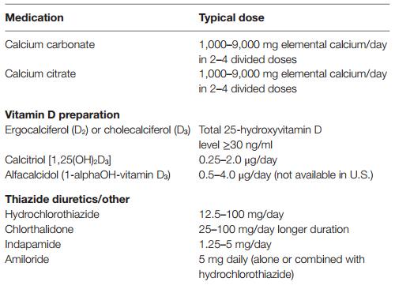
Treatment

Slide 28
Emerging Treatments
PTH(1-34)
PTH(1-84)
Not routinely recommended
Only in those who cannot be controlled with conventional treatmen
Replace
24w
134pt
rhPTH vs Placebo
53% able to reduce Ca .VitD by more than50%
43% completely stopped VitD and reduce Ca

Slide 29
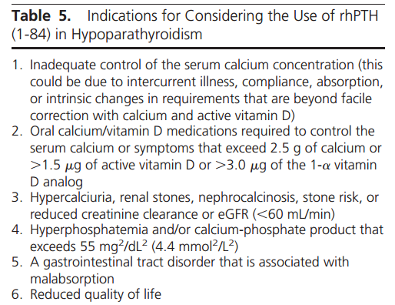

Slide 30
Complications of Treatment
Undertreatment
Overtreatment
Hyperphosphatemia
Hypercaciuria
Nephrocalcinosis
Nephrolithiasis
Renal failure
Patients are often not satisfied

Slide 31
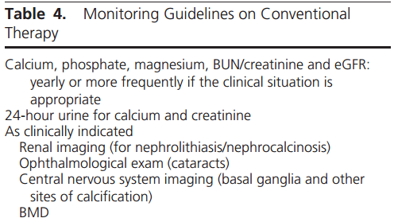

Slide 32
Summery and Key messages
Treaetment of Acute /Severe hypocalcemia is an Emergency.
Postsurgical HypoPT is the most common form of HypoPT.
Training dedicated thyroid surgeons is of utmost importance.
Careful selection of Pt and the Best surgical level.
Preoperative provisions are important.
Intra/Postoperative PTH,Ca,P levels are valuable predictive factors.
Meticulous attention to morbidities of HypoPT.
Close attention to the complications of Treatment
All medical activities should be Patient Oriented

