Slide 1


Slide 2
Non insulin treatment in T2DM

Slide 3
Outlines:
Background:
  Importance of glycemic control
  Glycemic goals
Overview of the pathogenesis of T2DM
Therapy of Type 2 Diabetes
  Nonpharmacological treatment (lifestyle changes)
  Oral hypoglycemic agents

Slide 4
Relative Risk of Progression of Diabetic Complications
RELATIVE RISK
Mean A1C
        DCCT Research Group, N Engl J Med 1993, 329:977-986.

Slide 5
What are the effects of treatment?
Lowering blood glucose levels prevents long term complications
  Type 1: microvascular AND cardiovascular ?(DCCT)
  Type 2: microvascular and? cardiovascular (UKPDS)
  Both studies show strong correlations with HgbA1C level and complications
Notes:
Recent epidemiologic data from UKPDS suggests lowering glycemia may reduce CV disease in T2DM.

Slide 6
Primary Objectives of Effective Management(cdc)
Diagnosis
lGæde P, Vedel P, Larsen N, Jensen GVH, Parving H-H, Pedersen O. Multifactorial intervention and cardiovascular disease in patients with type 2 diabetes. N Engl J Med. 2003;348:383-393.
A1C
%
9
8
7
Reduction
of both
micro- and macro-
vascular
event
rates
…by 75%!
SBP
mm Hg
145
130
LDL
mg/dL
140
100
45
50
55
60
65
70
75
80
85
90
Patient Age
Notes:
Key Points
The primary objectives of effective diabetes management are to reduce A1C to as near-normal levels (ie, 4%–6%) as is possible and safe, to lower systolic blood pressure to <130 mm Hg, and to decrease LDL cholesterol to <100 mg/dL
Achieving target levels of A1C, systolic blood pressure, and LDL cholesterol may reduce the risk of the micro- and macrovascular complications of diabetes by up to 75%
As illustrated in this slide, the objectives of effective diabetes management are to reduce A1C to as near-normal levels as is possible and safe (ie, 4%–6%), lower systolic blood pressure to <130 mm Hg, and to decrease LDL cholesterol to <100 mg/dL. Evidence suggests that achieving these target levels can reduce the risk of both microvascular and macrovascular complications of diabetes by >75%.¹
Most recently, the Steno-2 Study followed 160 patients with type 2 diabetes and microalbuminuria over 7.8 years to determine the effect of intensive treatment on long-term CV and microvascular outcomes. Researchers found that target-driven, intensive treatment consisting of stepwise diet, exercise, and pharmacotherapy for glycemia, microalbuminuria, lipids, and blood pressure resulted in a decreased risk of CV and microvascular events of about 50%. Control group members received conventional treatment in accordance with national guidelines. However, factors leading to diminished degrees of separation between the intensive treatment and control groups (eg, more than 50% of control group members were referred for specialist treatment during the course of the study) led the authors to estimate that the actual risk reduction associated with intensive versus conventional therapy may be even greater than that observed.²
References
American Diabetes Association. Clinical Practice Recommendations. Implications of the United Kingdom Prospective Diabetes Study. Diabetes Care. 2003;26(suppl 1):S28-S32.
Gæde P, Vedel P, Larsen N, Jensen GVH, Parving H-H, Pedersen O. Multifactorial intervention and cardiovascular disease in patients with type 2 diabetes. N Engl J Med. 2003;348:383-393.

Slide 7
Clinical Diabetes. 23(2):78-86, 2005.

Slide 8
ADA-EASD Position Statement Update:
Management of Hyperglycemia in T2DM, 2015
3. ANTI-HYPERGLYCEMIC THERAPY
Glycemic targets
  HbA1c < 7.0% (mean PG ∼150-160 mg/dl [8.3-8.9 mmol/l])
  Pre-prandial PG <130 mg/dl (7.2 mmol/l)
  Post-prandial PG <180 mg/dl (10.0 mmol/l)
  Individualization is key:
    Tighter targets (6.0 - 6.5%) - younger, healthier
    Looser targets (7.5 - 8.0%⁺) - older, comorbidities, hypoglycemia prone, etc.
  Avoidance of hypoglycemia
PG = plasma glucose
Diabetes Care 2012;35:1364–1379; Diabetologia 2012;55:1577–1596
Diabetes Care 2015;38:140-149; Diabetologia 2015;58:429-442
Notes:
In general, the goal in diabetes is to reduce glucose so that the glycated hemoglobin (HbA1c) concentration is reduced to 7% or less. Individualization of treatment targets is important, however. Young patients may benefit from tighter control, below 6.5%, since they are apt to have more years of life and exposure to hyperglycemia which can lead to long-term vascular complications. In contrast, in older individuals, especially those with multiple comorbidities, established vascular complications, or with a predisposition to hypoglycemia, more conservative targets are necessary, such as 7.5 – 8.0% or even higher, depending on the patient’s condition.

Slide 9
Modulation of the intensiveness of glucose lowering therapy in T2DM
Diabetes Care 2015;38:140-149; Diabetologia 2015;58:429-442
Notes:
Here is on element of decision-making used to determine appropriate efforts to achieve glycemic targets – the risks potentially associated with drug side effects, especially hypoglycemia. Again, greater concerns about this domain is represented by increasing height of the ramp. Less risk justifies more stringent efforts to lower HbA1c, whereas higher risk compels less stringent efforts.
(Adapted with permission from Ismail-Beigi et al, Ann Intern Med 2011;154:554-559.)

Slide 10
Modulation of the intensiveness of glucose lowering therapy in T2DM
Diabetes Care 2015;38:140-149; Diabetologia 2015;58:429-442
Notes:
Here is another element of decision-making used to determine appropriate efforts to achieve glycemic targets – diabetes duration. Less years of diabetes justifies more stringent efforts to lower HbA1c, whereas longer disease duration suggests the need for less stringent efforts.
(Adapted with permission from Ismail-Beigi et al, Ann Intern Med 2011;154:554-559.)

Slide 11
Modulation of the intensiveness of glucose lowering therapy in T2DM
Diabetes Care 2015;38:140-149; Diabetologia 2015;58:429-442
Notes:
Another element to consider is life expectancy. Longer life expectancy justifies more stringent efforts to lower HbA1c, whereas more conservative efforts are acceptable when life expectancy is shorter.
(Adapted with permission from Ismail-Beigi et al, Ann Intern Med 2011;154:554-559.)

Slide 12
Modulation of the intensiveness of glucose lowering therapy in T2DM
Diabetes Care 2015;38:140-149; Diabetologia 2015;58:429-442
Notes:
Important comorbidities (i.e. significant medical conditions other than diabetes) are another patient characteristic that drives decision making re A1c targets. Being in otherwise good health justifies more stringent efforts to lower HbA1c, whereas extensive comorbid conditions may compel the need for less stringent efforts.
(Adapted with permission from Ismail-Beigi et al, Ann Intern Med 2011;154:554-559.)

Slide 13
Modulation of the intensiveness of glucose lowering therapy in T2DM
Diabetes Care 2015;38:140-149; Diabetologia 2015;58:429-442
Notes:
Similarly, the clinician should weigh the presence of established vascular complications. Having no vascular complications justifies more stringent efforts to lower HbA1c, whereas advanced complications mandates a more conservative approach.
(Adapted with permission from Ismail-Beigi et al, Ann Intern Med 2011;154:554-559.)

Slide 14
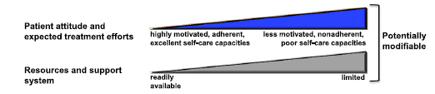

Slide 15
Modulation of the intensiveness of glucose lowering therapy in T2DM
Diabetes Care 2015;38:140-149; Diabetologia 2015;58:429-442
Notes:
Another potentially modifiable patient feature involves his or her resources and support systems. When these are not available, more stringent efforts will be more challenging. If readily available, more aggressive approaches are possible. As in the previous slide, the care team can help in certain aspects of this domain, such as assisting the patient in pursuing drug discounts, more advantageous insurance coverage, etc.
A reminder that, where possible, such decisions should be made in conjunction with the patient, reflecting his or her preferences, needs and values.
Note that this ‘scale’ is not designed to be applied rigidly but to be used as a broad construct to help guide clinical decisions.
(Adapted with permission from Ismail-Beigi et al, Ann Intern Med 2011;154:554-559.)

Slide 17
ADA-EASD Position Statement Update:
Management of Hyperglycemia in T2DM, 2015
  2. BACKGROUND
Overview of the pathogenesis of T2DM
  Insulin secretory dysfunction
  Insulin resistance (muscle, fat, liver)
  Increased endogenous glucose production
  Decreased incretin effect
  Deranged adipocyte biology
  Increased renal glucose reabsorbtion
Diabetes Care 2012;35:1364–1379; Diabetologia 2012;55:1577–1596
Notes:
The pathogenesis of T2DM is complex with multiple defects in multiple organ systems. Insulin resistance appears to be a primary defect, followed by relative beta cell failure with insulin secretory abnormalities, and increased endogenous (hepatic) glucose production. There are also derangements in incretin physiology and in the certain aspects of adipocyte biology.

Slide 18
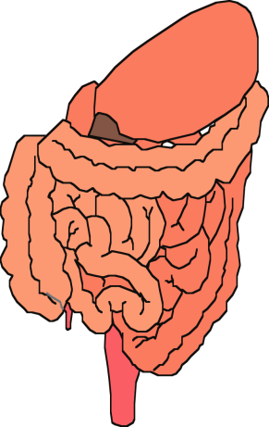
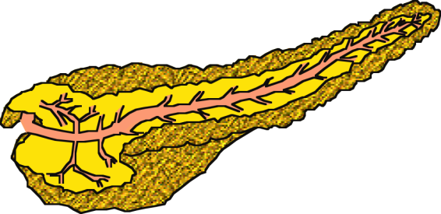
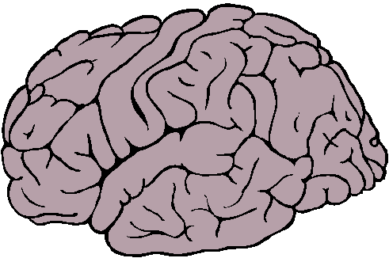

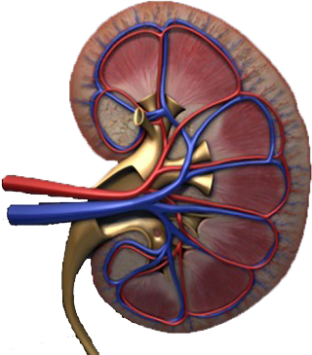
Multiple, Complex Pathophysiological Abnormalities in T2DM
pancreatic
insulin
secretion
incretin
effect
pancreatic
glucagon
secretion
_
?
gut
carbohydrate
delivery &
absorption
HYPERGLYCEMIA
_
+
peripheral
glucose
uptake
hepatic
glucose
production
renal glucose excretion
Adapted from: Inzucchi SE, Sherwin RS in: Cecil Medicine 2011
Notes:
This slide provides a broad overview of the main pathophysiological defects in type 2 diabetes. Insulin resistance is demonstrated in peripheral tissues, such as skeletal muscle and adipocytes. The pancreas develops relative insulin secretory failure and is no longer provide the amount of insulin required for normal glucose. The pancreas also demonstrates a failure of the normal suppression of glucagon after meals. This may be mediated through abnormalities in the incretin axis. Hepatic glucose production is also increased. Renal glucose output is set at a higer threshold than normal. Many of these defects may be influenced by abnormal central control of metabolism.

Slide 19
  Non Pharmacological treatment (lifestyle changes + Patient education)

Slide 20
● Variety of eating patterns are acceptable for the management of diabetes, but individualized meal planning should focus on personal preferences, needs, and goals.
Mediterranean
Dietary Approaches to Stop Hypertension (DASH)
Plant-based diets
● The diabetes plate method is commonly used for providing basic meal planning guidance as it provides a visual guide showing how to control calories (by featuring a smaller plate) and carbohydrates (by limiting them to what fits in one-quarter of the plate) and puts an emphasis on low-carbohydrate (or nonstarchy) vegetables.

Slide 21
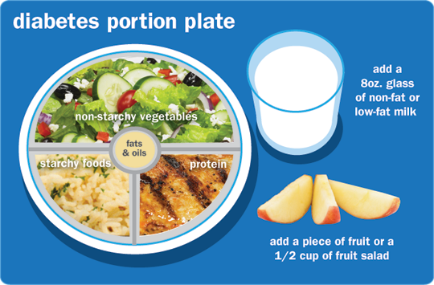

Section 4. Lifestyle Management
There is no universal ideal macronutrient distribution and that eating plans should be individualized.

Slide 22
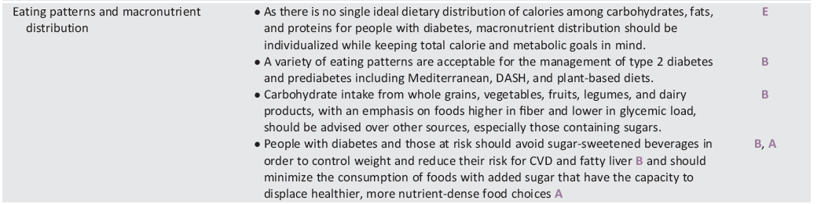
Section 4. Lifestyle Management
2017

Slide 23
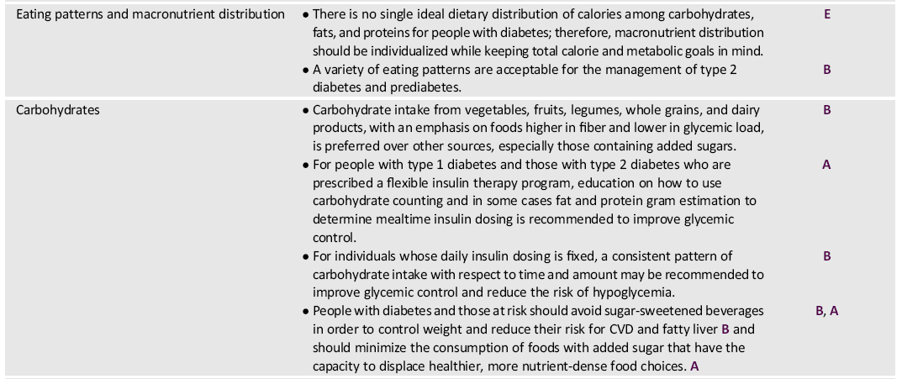
Section 4. Lifestyle Management
2018

Slide 24
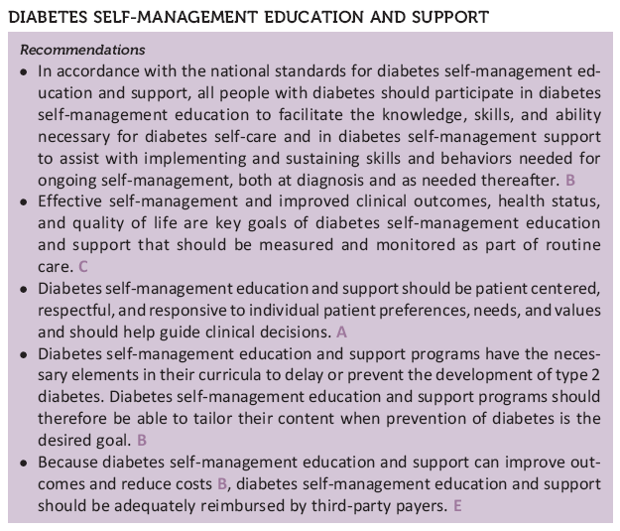
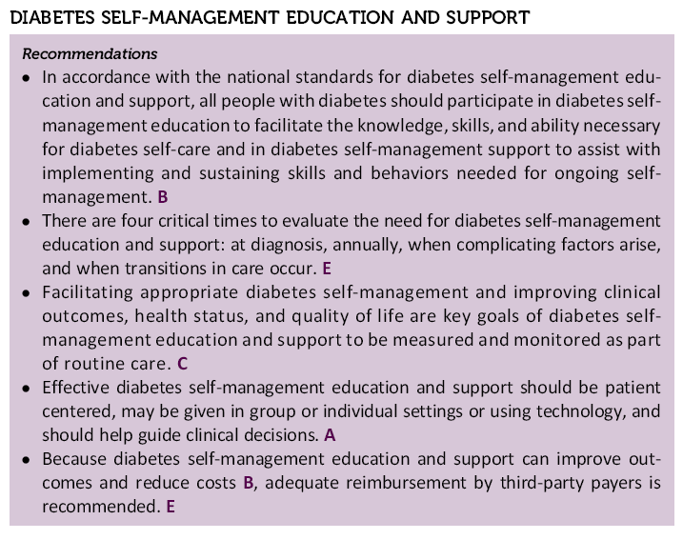
Section 4. Lifestyle Management
2017
2018

Slide 25
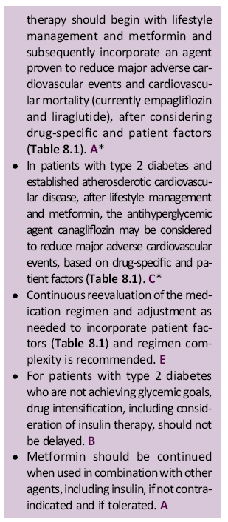
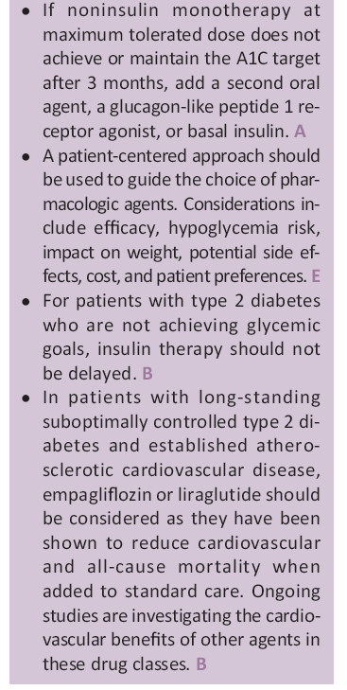
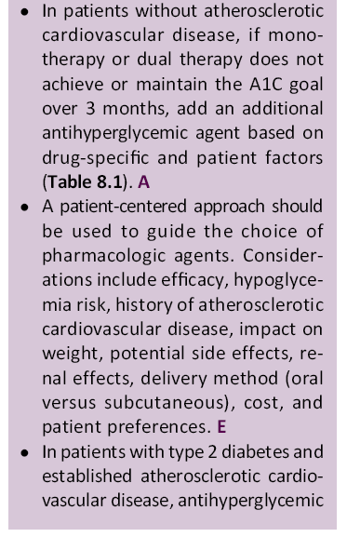
Section 8. Pharmacologic Approaches to Glycemic Treatment
2017
2018
CVD
CVD

Slide 26
Multiple, Complex Pathophysiological Abnormalities in T2DM
GLP-1R
agonists
Insulin
pancreatic
insulin
secretion
incretin
effect
Glinides
S U s
DPP-4
inhibitors
Amylin
mimetics
pancreatic
glucagon
secretion
_
DA agonists
?
A G I s
gut
carbohydrate
delivery &
absorption
HYPERGLYCEMIA
Metformin
_
T Z D s
Bile acid
sequestrants
+
peripheral
glucose
uptake
hepatic
glucose
production
renal glucose excretion
Adapted from: Inzucchi SE, Sherwin RS in: Cecil Medicine 2011
Notes:
Anti-hyperglycemic drugs for patients with T2DM are targeted at one or more of the pathophysiological abnormalities of this disease. On this slide, the main sites of action of the currently available 12 individual drug classes is depicted. Combination glucose-lowering therapy has become a standard treatment strategy when patients do not adequately respond to a single agent (often metformin.)

Slide 27
Oral Class | Mechanism | Advantages | Disadvantages | Cost
Biguanides | Activates AMP-kinase (?other) ↓ Hepatic glucose production | Extensive experience No hypoglycemia Weight neutral ? ↓ CVD | Gastrointestinal Lactic acidosis (rare) B-12 deficiency Contraindications | Low
Sulfonylurea | Closes K_{ATP} channels ↑ Insulin secretion | Extensive experience ↓ Microvascular risk | Hypoglycemia ↑ Weight Low durability ? Blunts ischemic preconditioning | Low
Meglitinides | Closes K_{ATP} channels ↑ Insulin secretion | ↓ Postprandial glucose Dosing flexibility | Hypoglycemia ↑ Weight ? Blunts ischemic preconditioning Dosing frequency | Mod.
TZDs | PPAR-g activator ↑ Insulin sensitivity | No hypoglycemia Durability ↓ TGs (pio) ↑ HDL-C ? ↓ CVD events (pio) | ↑ Weight Edema/heart failure Bone fractures ↑ LDL-C (rosi) ? ↑ MI (rosi) | Low
Table 1. Properties of anti-hyperglycemic agents
Diabetes Care 2015;38:140-149;
Diabetologia 2015;58:429-442
Notes:
Here are some of the older oral drug classes used in T2DM. The table describes the mechanism of action of each class, its advantages, disadvantages and cost. Less commonly used classes are denoted in grey font.

Slide 28
Oral Class | Mechanism | Advantages | Disadvantages | Cost
a-Glucosidase inhibitors | Inhibits a-glucosidase Slows carbohydrate digestion / absorption | No hypoglycemia Nonsystemic ↓ Postprandial glucose ? ↓ CVD events | Gastrointestinal Dosing frequency Modest ↓ A1c | Mod.
DPP-4 inhibitors | Inhibits DPP-4 Increases incretin (GLP-1, GIP) levels | No hypoglycemia Well tolerated Weight neutral | Angioedema / urticaria ? Pancreatitis ? ↑ Heart failure | High
Bile acid sequestrants | Bind bile acids ? ↓ Hepatic glucose production | No hypoglycemia ↓ LDL-C | Gastrointestinal Modest ↓ A1c Dosing frequency | High
Dopamine-2 agonists | Activates DA receptor Alters hypothalamic control of metabolism ↑ insulin sensitivity | No hypoglyemia ? ↓ CVD events | Modest ↓ A1c Dizziness, fatigue Nausea Rhinitis | High
SGLT2 inhibitors | Inhibits SGLT2 in proximal nephron Increases glucosuria | ↓ Weight No hypoglycemia ↓ BP Effective at all stages | GU infections Polyuria Volume depletion ↑ LDL-C ↑Cr (transient) | High
Table 1. Properties of anti-hyperglycemic agents
Diabetes Care 2015;38:140-149
Diabetologia 2015;58:429-442
Notes:
Additional oral agent classes used in T2DM are included on this slide. The table describes the mechanism of action of each class, its advantages, disadvantages and cost. Less commonly used classes are denoted in grey font.

Slide 29
Injectable Class | Mechanism | Advantages | Disadvantages | Cost
Amylin mimetics | Activates amylin receptor ↓ glucagon ↓ gastric emptying ↑ satiety | ↓ Weight ↓ Postprandial glucose | Gastrointestinal Modest ↓ A1c Injectable Hypo if insulin dose not reduced Dosing frequency Training requirements | High
GLP-1 receptor agonists | Activates GLP-1 R ↑ Insulin, ↓ glucagon ↓ gastric emptying ↑ satiety | ↓ Weight No hypoglycemia ↓ Postprandial glucose ↓ Some CV risk factors | Gastrointestinal ? Pancreatitis ↑ Heart rate Medullary ca (rodents) Injectable Training requirements | High
Insulin | Activates insulin receptor Myriad | Universally effective Unlimited efficacy ↓ Microvascular risk | Hypoglycemia Weight gain ? Mitogenicity Injectable Patient reluctance Training requirements | Variable
Table 1. Properties of anti-hyperglycemic agents
Diabetes Care 2015;38:140-149;
Diabetologia 2015;58:429-442
Notes:
Here now are the injectable drugs used in T2DM. The table describes the mechanism of action of each class, its advantages, disadvantages and cost. Less commonly used classes are denoted in grey font.

Slide 30
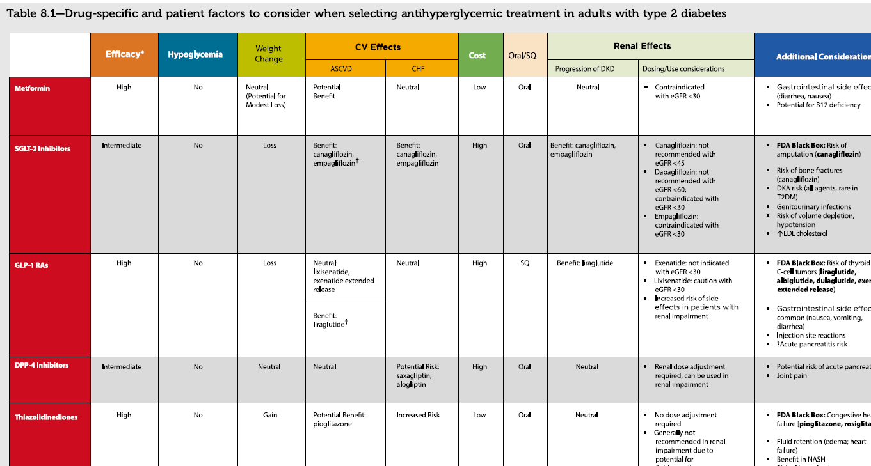

Slide 31
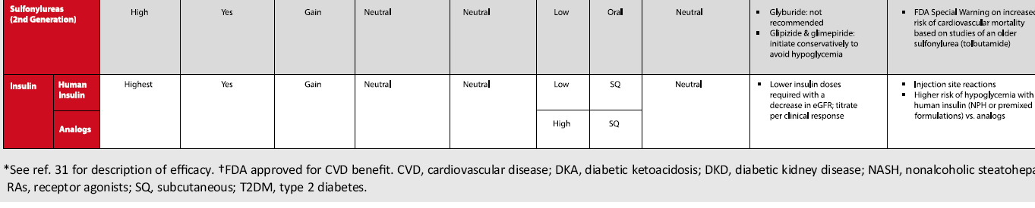
Figure 8.1 and Table 8.1 are meant to be used together to guide the choice of antihyperglycemic agents as part of patient– provider shared decision-making.

Slide 32
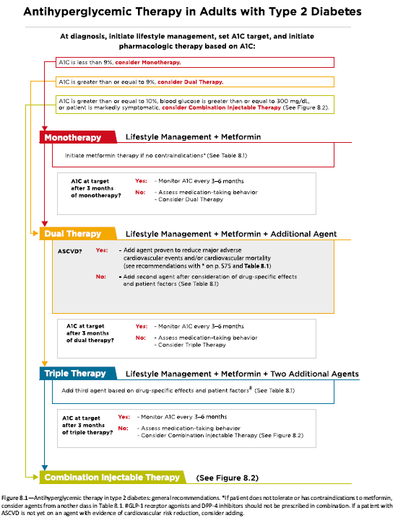
Section 8. Pharmacologic Approaches to Glycemic Treatment

Slide 33
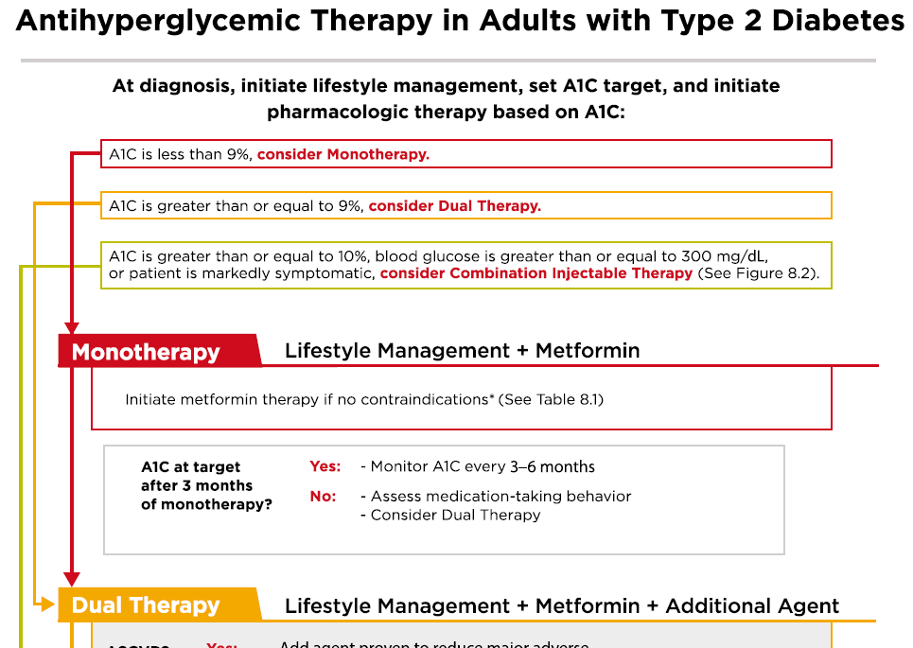

Slide 34
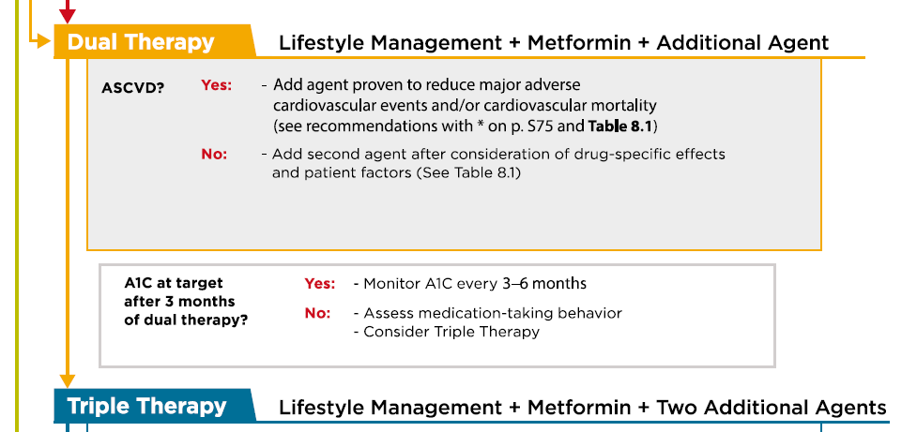

Slide 35
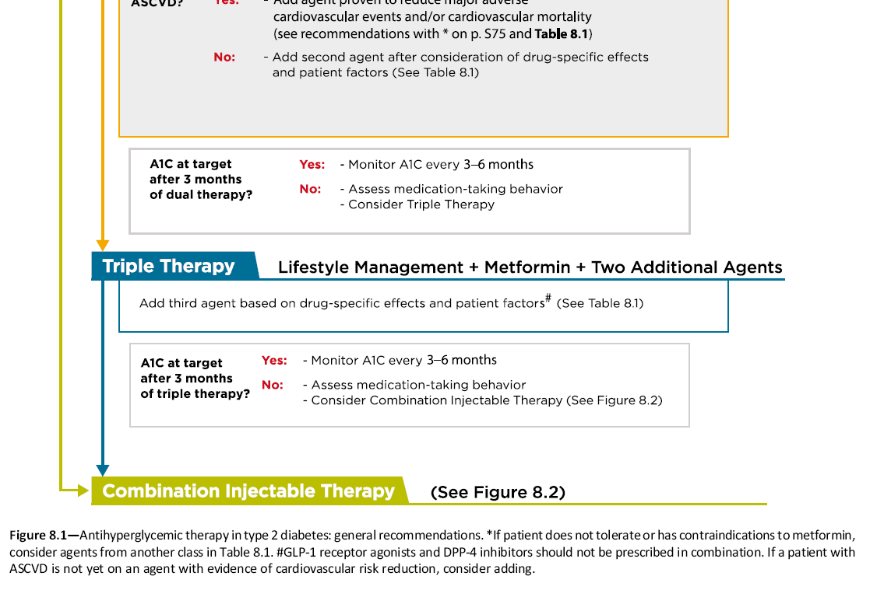

Slide 36
پوشش بیمه | قیمت (تومان) | تعداد | نام دارو
√ | 7500 (19500) | 100 | متفورمین
√ | 4000 | 100 | گلی بن کلامید
√ | 11000 (19000) | 100 | گلی کلازید
√ | 5500 | 100 | ریپگلیناید
√ | 9000 | 100 | ریپگلیناید
√ | 13000 | 100 | ریپگلیناید
● | 32-40-48000 | 100 | گلوتازون (15-30-45)
● | 22-34000 | 100 | آکاربوز
● | 30000 | 30 | زیپتین 50
√ | 12000 | 1 ویال | NPH
√ | 12000 | 1 ویال | Regular
● | 20000 | 100 عدد | سرنگ

Slide 37
Effectiveness
safety profiles
Side effects
Cost
Patient satisfaction
.extraglycemic effect.

Slide 38
Metformin intolerance or
contraindication
HbA1c ≥9%
Uncontrolled hyperglycemia (catabolic features,
BG ≥300-350 mg/dl, HbA1c ≥10-12%)
Diabetes Care 2015;38:140-149; Diabetologia 2015;58:429-442
Notes:
Potential sequences of antihyperglycemic therapy for patients with type 2 diabetes are displayed, the usual transition being vertical, from top to bottom (although horizontal movement within therapy stages is also possible, depending on the circumstances). The figure denotes relative glucose lowering efficacy, risk of hypoglycemia, effect on body weight, other side effects and approximate relative cost for each drug class.
In most patients, begin with lifestyle changes; metformin monotherapy is added at, or soon after, diagnosis, unless there are contraindications.

Slide 39



ADA-EASD Position Statement Update:
Management of Hyperglycemia in T2DM, 2015
3. ANTI-HYPERGLYCEMIC THERAPY
Therapeutic options: Lifestyle
  Weight optimization
  Healthy diet
  Increased activity level
Diabetes Care 2012;35:1364–1379; Diabetologia 2012;55:1577–1596
Notes:
Non-pharmacological options are critically important – they are cost effective and have no side effects, per se. Patients with T2DM should become more physically active, eat a healthy diet and try to optimize body weight. These efforts will result in less insulin resistance, with better blood glucose control the result. There are also additional health benefits from such interventions.

Slide 40
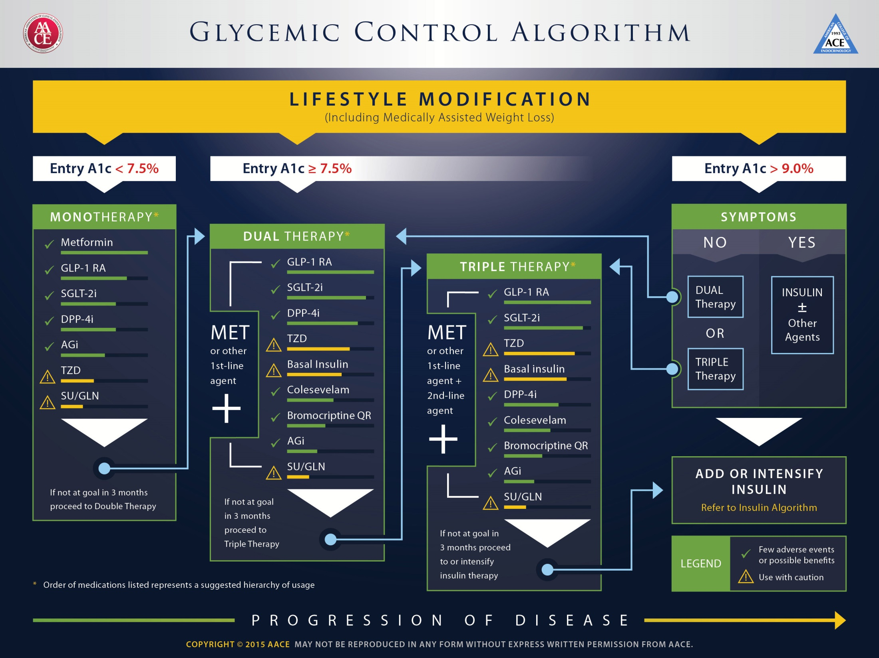

Slide 41
Take home message
Management of DM patients must be individualized for each patients
Financial constrains need to be considered to avoid the pitfalls of nonadherence & poor follow up
Avoid combination therapy with drugs that have Same pathophysiologic mechanism
Efficacy of the third antidiabetic agents decrease when added to dual therapy

Slide 43
از توجه شما متشکرم

