Slide 1
diabetic nephropathy

Slide 2
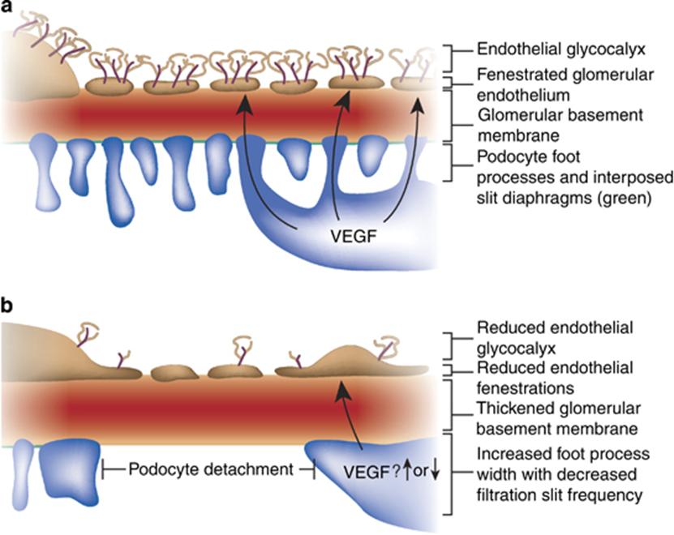
Epidemiology of chronic kidney disease in diabetes :
In either type 1 or type 2 diabetes : 25 – 40% → diabetic nephropathy in a 25 y
Diabetes → leading cause for ESRD
diabetic nephropathy :
A glomerulopathy defined by characteristic structural and functional changes
The predominant structural changes :
glomerular basement membrane thickening
mesangial expansion
glomerular sclerosis

Slide 3
Glomerular hyperfiltration :
Elevations in whole kidney GFR of 25–50% : in many patients (about 70%) with type 1 diabetes mellitus
Newly diagnosed patients with type 2 DM : glomerular hyperfiltration → in about 50% of patients.
Mechanisms :
Primary abnormalities in vascular control → afferent glomerular vasodilation and increased renal blood flow
Typically reverses after the institution of insulin therapy → elevated plasma glucose levels have a direct role
Increased proximal tubular reabsorption of glucose and sodium, which causes vasodilation secondary to suppressed tubuloglomerular feedback
elevated levels of Ins , IGF-1, ANP and AGEs
& increased intra renal NO signaling

Slide 4
The natural history of diabetic nephropathy is characterized by five stages
stage | time | characteristic
1 | At Dx | Enlarged kidney , higher blood flow & GFR
2 | 2 – 5 y | BM thickening
3 | 5 – 15 y | microAlb.uria , rise in BP
4 | 10 – 25 y | MacroAlb.uria , falling BF & GFR , high BP in 70% of pts
5 | 15 – 30 y | Rise in cr

Slide 5
Microalbuminuria
urine dipstick :
A relatively insensitive marker for initial increases in protein excretion
Not becoming positive until protein excretion > 300 to 500 mg/day
persistent albumin excretion : 30-300 mg/day
Fever, exercise, heart failure, and poor glycemic control → transient microalbuminuria
Urine albumin-to-creatinine ratio (ACR) : 30-300 mg/g of creatinine
Limitations :
optimal time to measure the urine ACR → first morning void
vigorous exercise → 24 hours prior to the test
creatinine excretion → muscular vs cachectic patient
Measurement of the urine ACR in an untimed urinary sample is the preferred screening strategy for microalbuminuria in all diabetic patients
MECHANISMS : an increase in the number of large pores (limiting size-selectivity) and decreased staining for heparan sulfate (the major component of the charge barrier), decreased degradation of filtered albumin within the tubules , impaired tubular uptake of filtered albumin
microalbuminuria predict mortality in type 2 DM and in type 1 DM.
microalbuminuria is a major independent risk factor for coronary heart disease
persists over a 3-6 month period
Microalbuminuria : Endothelial dysfunction

Slide 7
SCREENING for microalbuminuria :
patients with type 1 diabetes → five years after the onset of disease because microalbuminuria is uncommon before this time
If not found at the initial screen, yearly screening for microalbuminuria is recommended
The K/DOQI guidelines recommend use of the urine albumin-to-creatinine ratio on a spot urine sample for screening in diabetic patients and that an elevated urine albumin-to-creatinine ratio should be confirmed in the absence of urinary tract infection with at least two additional tests performed over the subsequent three to six months
The diagnosis of microalbuminuria requires an elevated ratio on at least two of the three samples.
patients with type 2 diabetes → screen for microalbuminuria , If not found at the initial screen, yearly screening for microalbuminuria is recommended

Slide 8
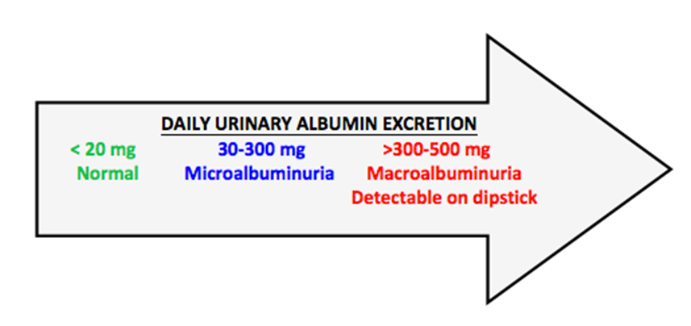
microalbuminuria:
UAE : 30 - 300 mg/day
ACR : 30 - 300 mg/g creatinine on a random urine sample
Macroalbuminuria :
UAE > 300 mg/day
ACR > 300 mg/g creatinine on a random urine sample
 | Urine dipstick | ACR (mg/g ) | 24h urine collection (mg / day )
NL | (-) | <30 | <30
microalbuminuria | (-) | 30 - 300 | 30 - 300
Macroalbuminuria | (+) | > 300 | > 300

Slide 9
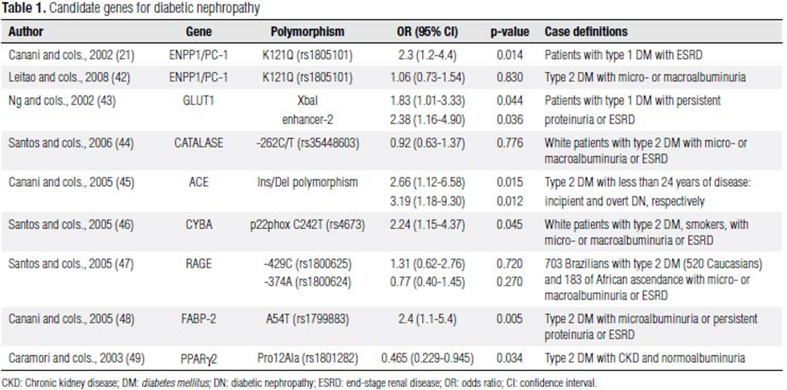
RISK FACTORS :
Genetic susceptibility :
angiotensin converting enzyme (ACE) gene genotype :
In patients with type 2 diabetes: the DD polymorphism → an increased risk for
development of diabetic nephropathy
more severe proteinuria
greater likelihood of progressive renal failure
mortality on dialysis
Compared with (I/D) and D/D genotypes, the I/I genotype protects against the development and progression of nephropathy in patients with type 1 and type 2 diabetes, possibly because it is associated with reduced plasma levels of ACE and decreased glucose induced glomerular hyperfiltration
the I/I genotype is associated with the greatest benefit from ACE inhibitor therapy among patients with diabetes who have normoalbuminuria or microalbuminuria, and the D/D genotype is associated with the greatest benefit from ACE inhibitor therapy in those with macro albuminuria.
angiotensin-II type 2 receptor gene (AT2) on the X-chromosome
aldose reductase gene

Slide 10
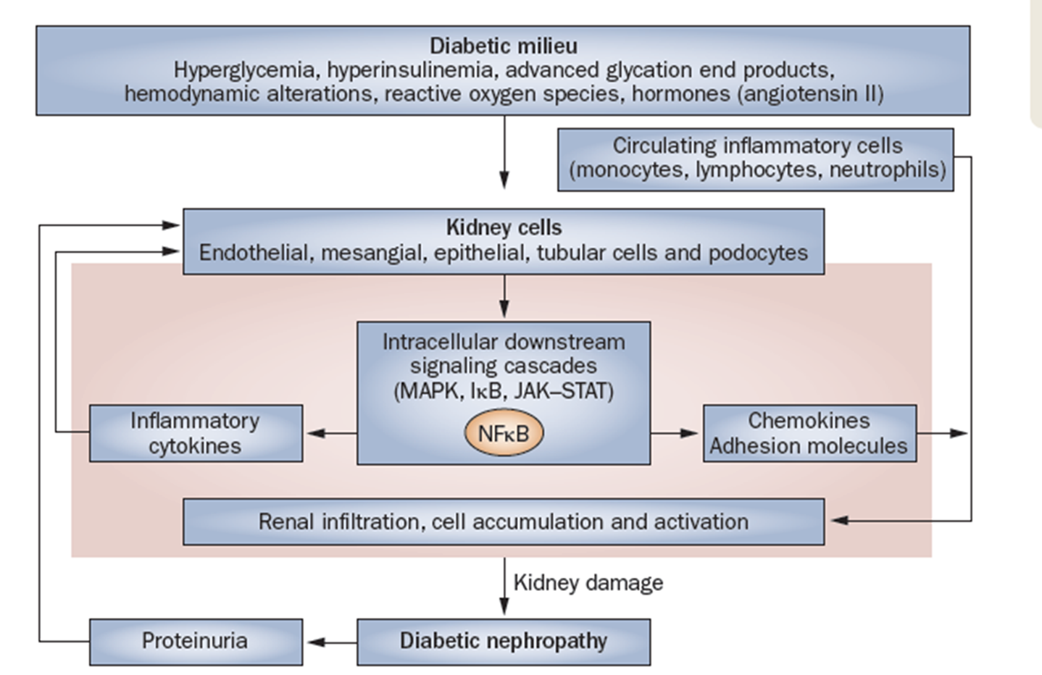
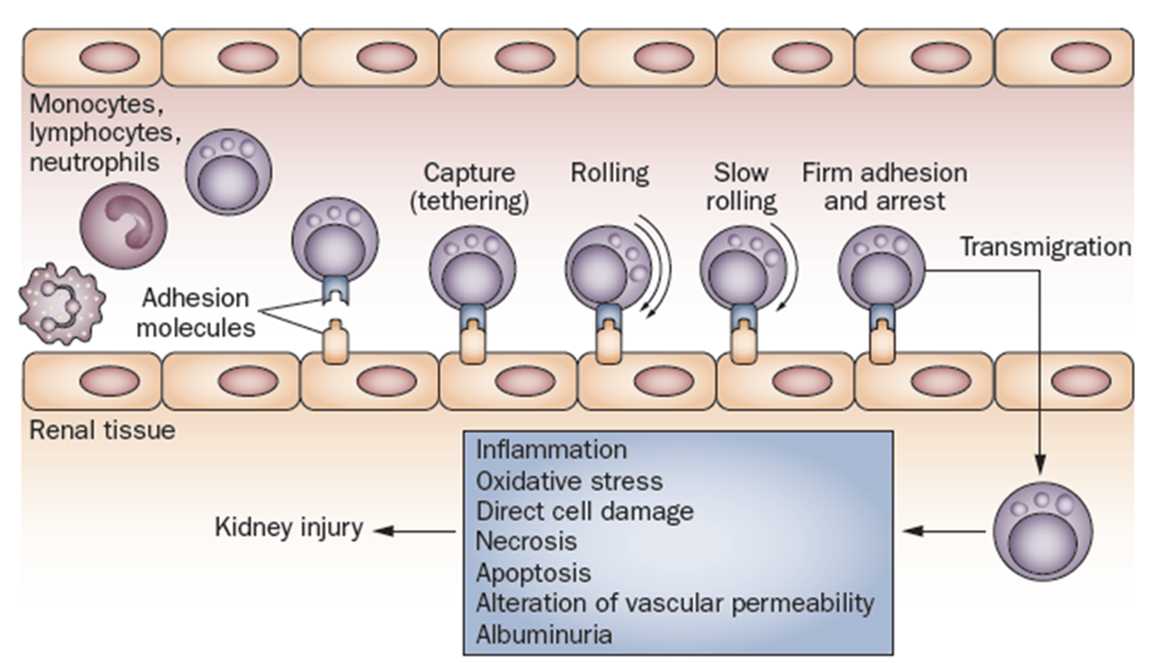
The inflammatory hypothesis
Inflammatory pathways have a central role in the development of diabetic complications, such as diabetic nephropathy .
Increased renal expression of IL‑1 → expression and synthesis ICAM‑1, VCAM-1, E‑selectin , PG E2 , PLA2
IL‑6 → Increased vascular endothelial permeability , mesangial cell proliferation , increased expression of fibronectin
increased levels of IL‑6 mRNA in the renal cortex →very early in the evolution of diabetic nephropathy
overexpression of IL‑6 →increased rates of urinary albumin excretion (UAE).
IL‑18
Macrophages, T cells and neutrophils :
C‑C motif chemokine 2 (CCL2) (MCP1) → migration of monocytes and macrophages into kidney tissue
development of intraglomerular hemodynamic abnormalities related to PG pathways (intraglomerular HTN)
mesangial expansion , GBM thickening
progression of diabetic nephropathy

Slide 11
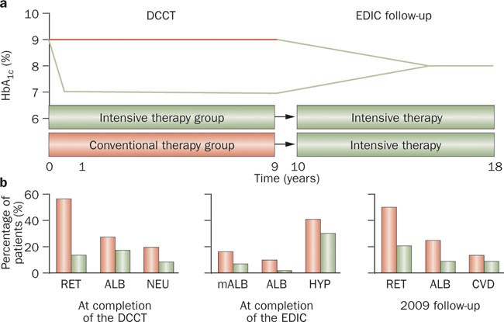
Glycemic control
Diabetic nephropathy is more likely to develop in patients with worse glycemic control
DCCT Study → Intensive blood glucose control reduces risk of kidney disease 50%
Primary prevention :
Established microalbuminuria : In addition to preventing progression, maintenance of relative normoglycemia often diminishes the degree of protein excretion, although one to two years are usually required for this effect
Established macroalbuminuria : may not slow the rate of progressive renal injury

Slide 12
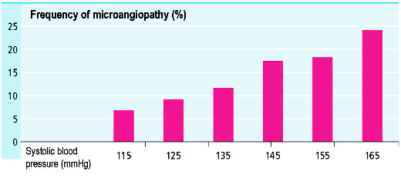
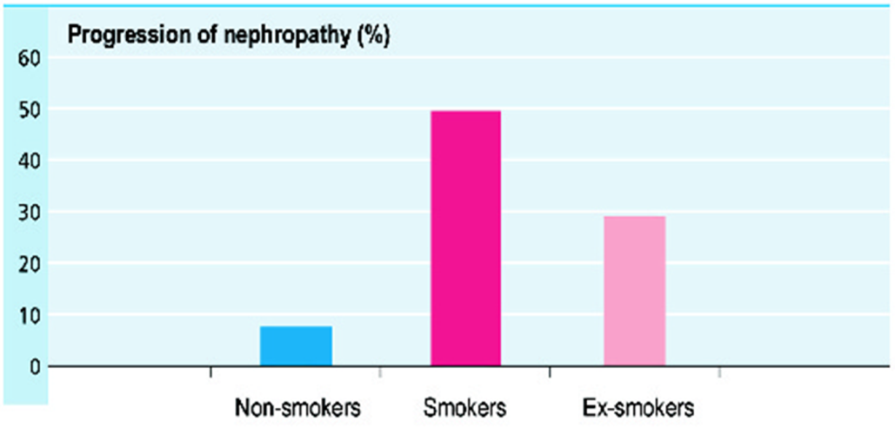
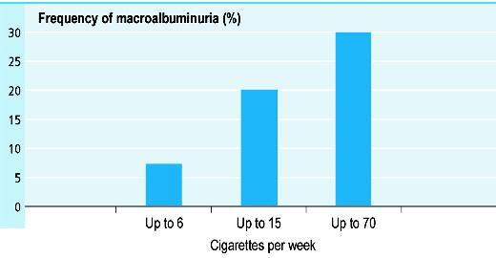
Blood pressure :
development of diabetic nephropathy → higher systemic pressures
Age :
Obesity :
Smoking :

Slide 13
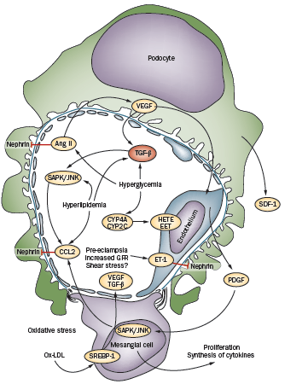
role of triglyceride-rich lipoprotein in diabetic nephropathy :
HLP → mesangial cells :
induction of type a scavenger receptors by AT-II
production of ROS → change their activity and stability
HDL suppresses the expression of markers of inflammation and cell adhesion molecules (which are markers of ED).
Lipids → TGF‑β , production of ROS and causing damage to the glomeruli and glomerular glycocalyx

Slide 14
RAAS blockade :
Excessive activity of the RAAS → deleterious effects on the kidneys and → progressive loss of renal function
Inappropriate activation of RAAS → hypertension, fluid retention, and inflammatory, thrombotic, and atherogenic effects → end-organ damage in the long term
Continued RAAS activation :
Constricts renal arterioles leading to increased peripheral and renal resistance
increases glomerular capillary pressure leading to proteinuria,
augments oxidative stress (via the NADPH oxidase pathways) leading to endothelial Dysfunction
promotes proliferation of mesangial cells (probably via MAPK or PKC-dependent pathways)
triggers pro-inflammatory pathways (including activation of nuclear factor-κB)
stimulates profibrotic processes

Slide 15
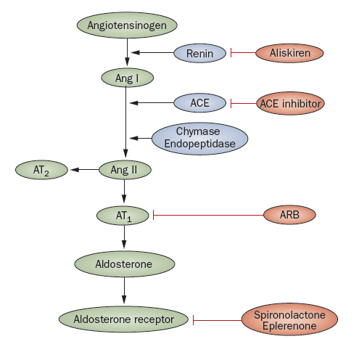
vasodilation, growth inhibition, and antiatherogenic effects, as well as potentially harmful effects such as cardiac hypertrophy and impaired revascularization following coronary or peripheral artery obstruction
vasoconstriction, aldosterone release, vascular remodeling, increased oxidative stress, and the promotion of inflammatory, atherogenic, and thrombotic states.

Slide 16
Treatment of diabetic nephropathy

Slide 17
GLYCEMIC CONTROL :
Treatment of HTN :
Target : < 130/80
ANGIOTENSIN INHIBITION :
We therefore do NOT administer these drugs for primary prevention of microalbuminuria
Albumin excretion can be lowered and progression to macroalbuminuria reduced by blood pressure control, particularly with an angiotensin converting enzyme (ACE) inhibitor or ARB which may be beneficial even in normotensive patients
Normotensive diabetic patients with persistent microalbuminuria → ACE inhibitor or ARB
The renal goal of ACE inhibitor or ARB therapy is a modest reduction in urine albumin excretion
Inhibition of TGF-beta
Other antihypertensive drugs :
Calcium channel blockers have less antiproteinuric effect than ACE inhibitors or ARBs, and the antiproteinuric effect is primarily seen with diltiazem and verapamil , not the dihydropyridines.
Reducing the intraglomerular pressure:
Dietary protein restriction or antihypertensive therapy with an ACEI or ARB
Aliskiren plus angiotensin inhibition :
Aliskiren + an ACE inhibitor or ARB does not appear to preserve renal function and increases the risk of adverse events
EFFECT OF PROTEIN EXCRETION :
lowering proteinuria →improved outcomes in patients with overt diabetic nephropathy and a decreased risk of end-stage renal disease
There appears to be a dose response relationship, with a greater reduction in proteinuria associated with greater reduction in risk of renal failure

Slide 18
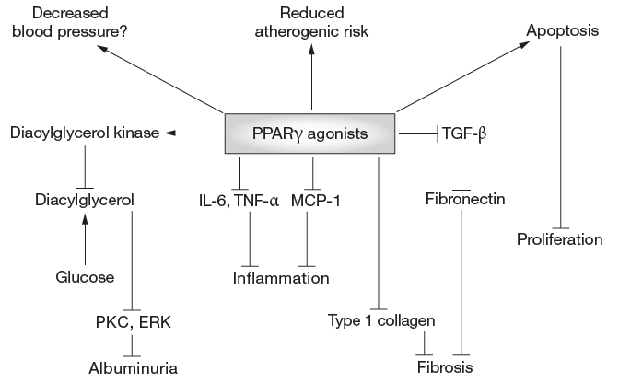
ACE inhibitor plus ARB :
may be associated with worse renal outcomes than with monotherapy , a higher incidence of adverse effects
higher rates of acute kidney injury requiring dialysis, hyperkalemia, and hypotension
we do not use combination therapy with an ACE inhibitor and ARB in patients with diabetic nephropathy.
Aldosterone antagonism :
aldosterone antagonists appear to reduce proteinuria when used alone , and to have an additive effect on proteinuria when used in combination with an ACE inhibitor or an ARB in both type 1 and type 2 diabetes
PPAR-gamma agonists :
A role in the development of nephropathy in type 2 diabetes
reduction of UAC at various stages of nephropathy, reduction of BP
Protein restriction :
dietary protein restriction slows the long-term decline in glomerular filtration rate in diabetic nephropathy. ???? uncertain
Salt intake and proteinuria :
high salt intake →blunt the antiproteinuric effects of angiotensin inhibitors in patients with non-diabetic kidney disease
WEIGHT REDUCTION :
Marked decreases in proteinuria may be observed in obese diabetics who lose weight
HYPERLIPIDEMIA :
promoting systemic atherosclerosis ,
contribute to the development of glomerulosclerosis in CKD

Slide 20
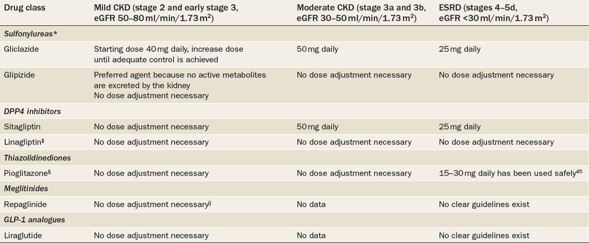

Slide 21
Treatment of the patient with end-stage diabetic nephropathy
Hemodialysis :
frequently associated with recurrent episodes of hypotension
peritoneal dialysis (PD):
PD is associated with better survival than hemodialysis among non - diabetic and younger diabetic patients
PD is generally associated with equivalent or even better survival during the first year or two of dialysis
better hemodynamic profile associated with PD makes it an advantageous modality in diabetic patients who are at increased risk of cardiovascular complications
Superior preservation of residual renal function
kidney transplantation

Slide 22
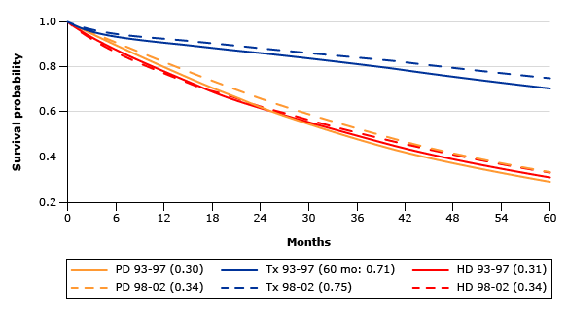
Five year survival among ESRD patients from 2007 USRDS data

Slide 23
خسته نباشید
خسته نباشید

