Slide 1

In the name of God

Slide 2
Bone Quality: What is it and can we measure it?
Mohammad Hossein Dabbaghmanesh
Professor of internal medicine
Shiraz Endocrine and Metabolism Research Center

Slide 3
Focusing Only on Bone Identifies Less than Half of Women Who Will Fracture
A relevant number of fragility fractures occur in the range of normal or slightly reduced BMD values meaning that also qualitative aspects of bone, like bone architecture and bone geometry, play a role .
Only 44% of women (and 21% of men) who sustain non-vertebral fractures have “osteoporosis "by BMD

Slide 4
Bone quality
Bone quality is generally defined as a collection of properties that contribute to fracture risk in addition to bone mineral density (BMD).

Slide 5
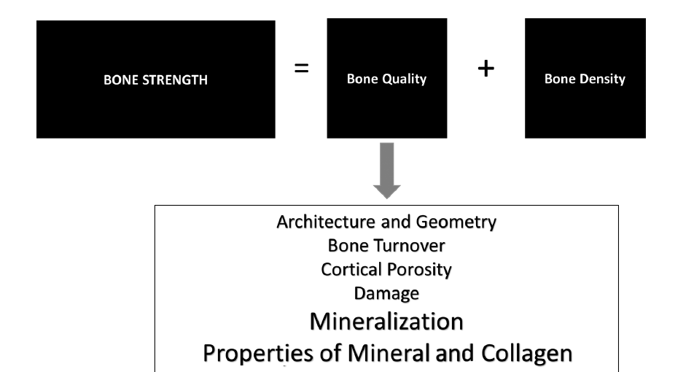

Slide 6
Methods for investigating bone quality
. Methods for investigating bone quality in vivo are being developed:
–– DXA: geometry, trabecular bone score
–– HRQCT: microarchitecture, cortical bone including porosity
–– MRI: microarchitecture
–– Quantitative ultrasound: cortical thickness, stiffness of bone
–– Digital x-ray radiogrammetry: cortical porosity
–– Microindentation: hardness of bone

Slide 7
DXA: geometry, trabecular bone score
New DXA tools recently developed, namely trabecular bone score (TBS) and hip structural analysis (HSA), obtained during DXA, can supply in formations about bone structure of spine and femur, respectively, in a not invasive way.

Slide 8
The first cited new DXA tools is the trabecular bone score (TBS), a gray-level textural measure that can be extracted from the 2-dimensional lumbar spine DXA image to estimate trabecular microstructure.

Slide 9
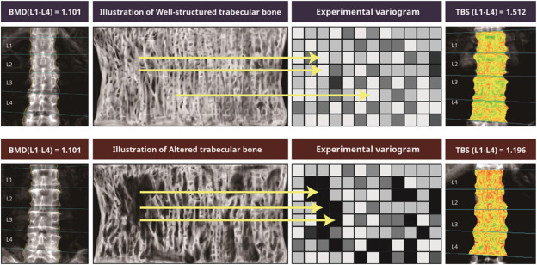
Trabecular bone score assessed with software in lumbar spine

Slide 10
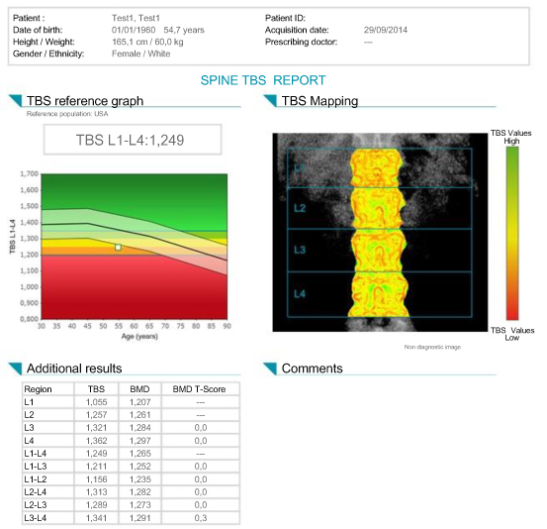

Slide 11
How the TBS numbers interpret?

Slide 12
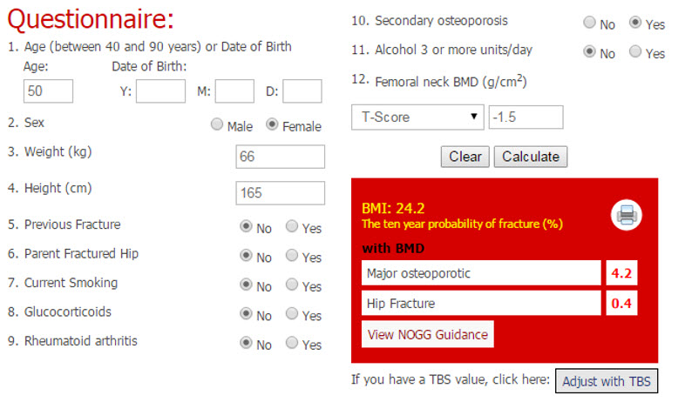

Slide 13
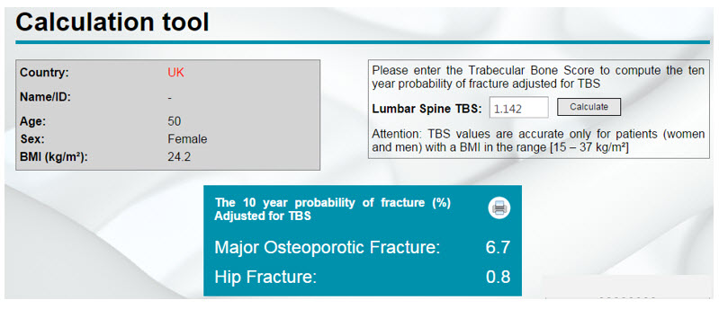

Slide 14
Clinical Applications Of Trabecular Bone Score
Combining TBS with FRAX is advantageous as fracture risk prediction with TBS alone has been shown to be inferior to FRAX
An online calculator is available on the FRAX website (www.shef.ac.uk/FRAX/tool.jsp) to calculate TBS-adjusted FRAX scores.

Slide 15
58 year old woman, current tobacco use Generally healthy, no other fracture risk factors
Femoral neck T-score -1.8
TBS 1.160
Dose the patient need treatment?

Slide 16
Degenerative Changes
Several studies have suggested that lumbar spine TBS values are relatively unaffected by the presence of degenerative changes

Slide 17
The role of trabecular bone score in monitoring treatment response
TBS increases in patients receiving antiresorptive treatment but much more modestly than lumbar spine BMD
TBS changes are only weakly correlated with changes in BMD and do not appear to be predictive of incident fractures

Slide 18
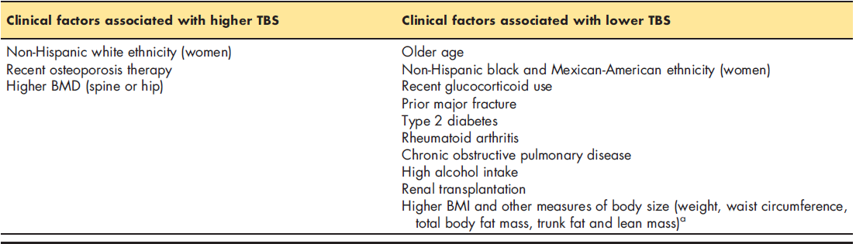

Slide 19
Glucocorticoid
Exposure
TBS (but not lumbar spine BMD) was able to discriminate patients with prevalent fractures from those without fractures.

Slide 20
DM2
Compared with controls, lumbar spine and hip BMD in women withDM2 was significantly increased, while TBS was significantly decreased.

Slide 21
Chronic Kidney Disease And Renal Transplantation
lumbar spine TBS adjusted for FRAX score and BMD was shown to be independently associated with a higher incident fracture risk.

Slide 22
Hip structure analysis (HSA)
Hip structure analysis (HSA) can be used to measure proximal femur geometry using conventional DXA scans of the hip.

Slide 23
Hip structure analysis (HSA)
The method employs the principle that a line of pixel values across the bone axis correspond to a cut plane traversing the bone at that location and contain some of the information about the cross-section.

Slide 24
It were measured by DXA at three sites,
The regions are:
1)Narrow Neck (NN) across the narrowest diameter of the femoral neck
2) Intertrochanteric (IT) along the bisector of the neck-shaft angle
3) the Shaft (S), 2 cm distal to the midpoint of the lesser trochanter.

Slide 25
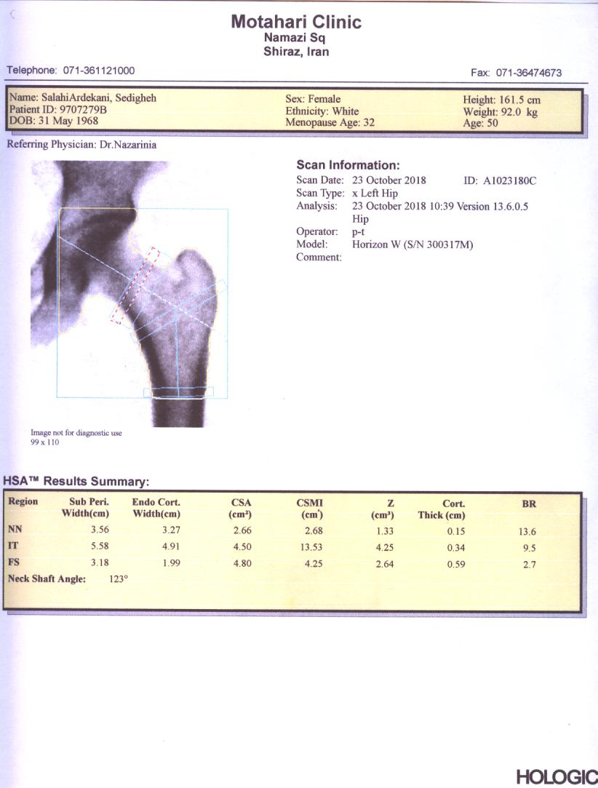

Slide 26
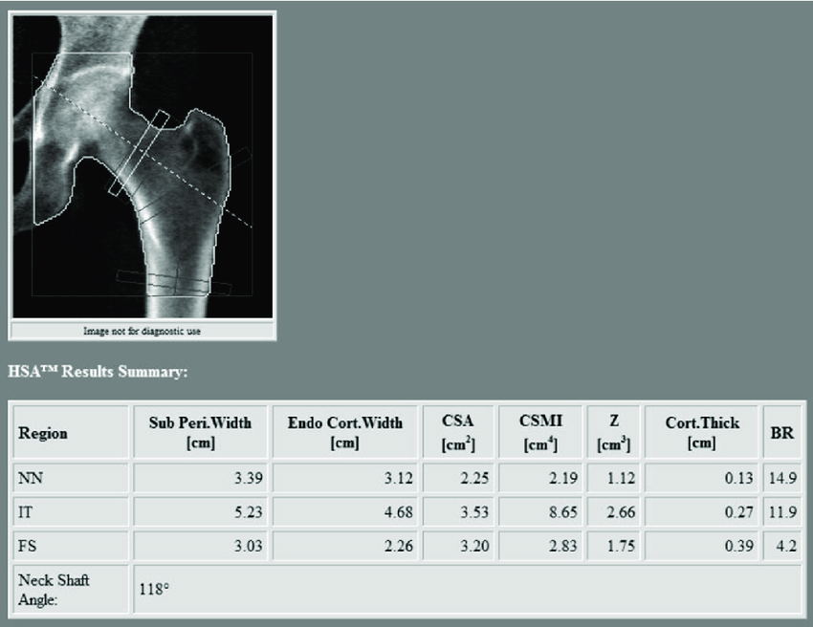
Sub Perwidth
End Cort.Width
CSA
CSMI
Z(Section Modulus)
Cortical Thickness
Buckling Ratio

Slide 29
There are different kinds of loading that occur in vivo, and they tend to be a combination of axial compression and bending.

Slide 30
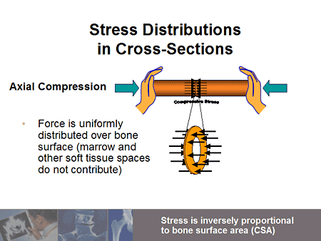
Axial Compression
Cross-Sectional Area(CSA)
The load tends to be distributed uniformly across the bone surface in the cross-section.
The marrow and the soft tissue spaces don't really contribute to this.
We would want to measure the bone surface area, or the bone cross-sectional area, so the stress would be inversely proportional to that cross-sectional area.

Slide 31
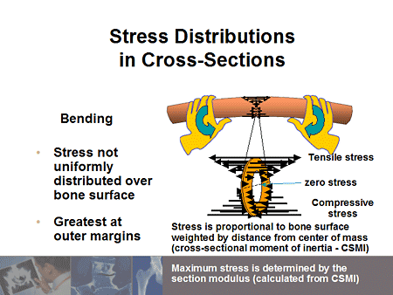
Bending
Bending, unlike axial compression, stress is nonuniformly distributed across the cross-section.
They tend to be greatest at the outer margins, so that along the top surface you are going to get tensile stresses; on the bottom surface, you are going to get compressive stresses.
Since those stresses are in opposite directions, the stresses go to zero in the middle, the neutral axis.

Slide 32
The magnitudes of these stresses are going to be proportional to the cross-sectional moment of inertia, which describes the distribution of the material from the center of mass.

Slide 33
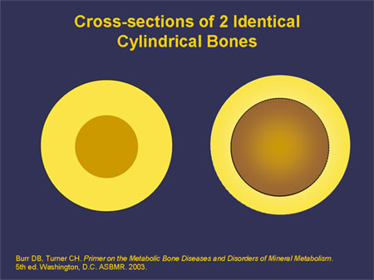
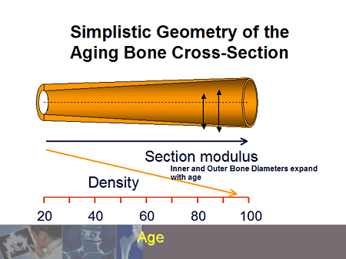

Slide 34
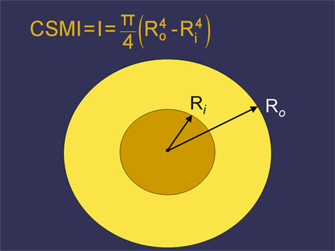
Cross-Sectional Moment of Inertia (CSMI).

Slide 35
Section Modulus
The strength parameter that is based or derived from the CSMI is called the section modulus. It's indicated with the letter Z
it's equal to the CSMI divided by what is called the centroidal distance, which is simply the distance from that centroidal axis to the edge of the section.

Slide 36
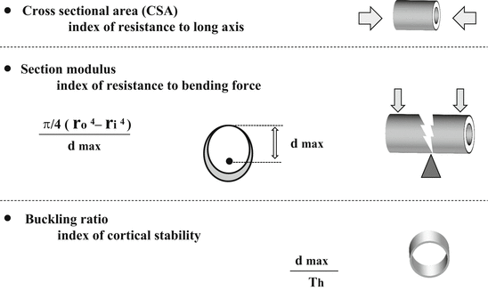

Slide 37
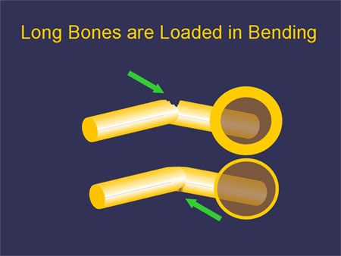
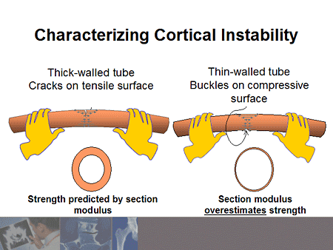
Buckling Ratio

Slide 38
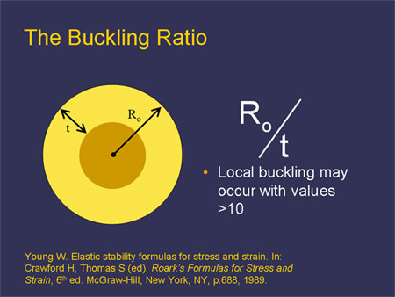
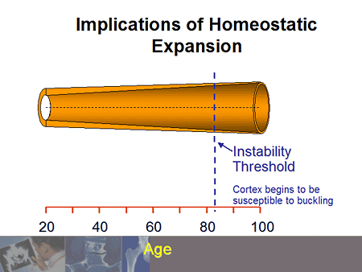
Buckling Ratio

Slide 40
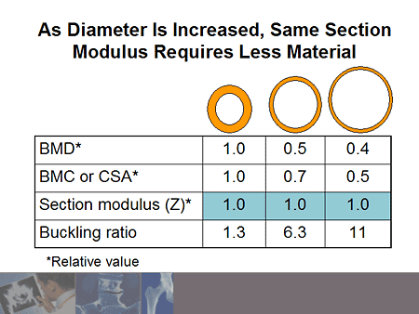

Slide 41
The magnitudes of these stresses are going to be proportional to the cross-sectional moment of inertia, which describes the distribution of the material from the center of mass.

Slide 42
Hip structural analysis in Iranian adult population
Abstract:
Background: Evaluation of bone strength is important in the diagnosis of osteoporosis. Hip Structural Analysis (HAS) is a simple and easy means that can be used to measure proximal femoral geometry and bone strength. In this study DEXA-HAS is reported in a population of Iranian men and women. Material and Method: The individuals who underwent bone mineral assessment for osteoporosis in Osteoporosis Clinic of Shiraz University of medical sciences were included. Measured parameters included bone mineral density (BMD), cross-sectional area(CSA), section modulus (Z), periosteal diameter (PD),endosteal diameter (ED), cortical thickness (CT), cross-sectional moment of inertia (CSMI), hip axis length (HAL) and neck shaft angle(NSA) and buckling ratio by Hologic Horizon densitometer Result: The study participants included 358 women (88.4%) and 47 men(11.6%), with mean age of 55.18 ± 11.0 years. The prevalence of osteoporosis and osteopenia 24.5% and 39.6% in spine, respectively. The prevalence of osteoporosis and osteopenia 17.3% and 47.2% in neck of femur, respectively. The mean value of CSA, Z, PD, ED, CT, and CSMI, buckling ratio, HAL and NSA were 2.65 cm2 ±0.52,1.20±0.31cm2,3.27±0.34cm,2.94±0.36cm,0.16±03cm,2.16±0.67cm,11.68±3.60,98.21±7.26cm and124.62±5.5o,respectively.
Conclusion: Hip geometry parameters could be clinically valuable for identification of individuals for whom fracture prevention should be considered.

Slide 43
The correlation between bone mineral density, trabecular bone score and body mass index in Iranian adults
Abstract:
Background: This study evaluated the correlation between bone mineral density (BMD), trabecular bone score (TBS) and body mass index (BMI) in Iranian adults. Material and Methods: We enrolled 405 female and male participants in their 26–83 years old that referred for bone mineral assessment for osteoporosis in Osteoporosis Clinic of Shiraz University of Medical Sciences. Spine bone density evaluation was done by Hologic Horizon densitometer. The correlation between BMD T-score/TBS and BMI were determined. Results: The prevalence of osteoporosis and osteopenia was 24.5% and 39.6% in spine. The mean value of BMI, spine T score and TBS were 27.8±5.09 kg/m2,-1.44±1.50,1.31±0.11,respectively.We found a significant positive correlation between spine T score and TBS score (r=0.624, P<0.01). BMD and BMI were observed to have a positive correlation(r = 0.294, P < 0.01). However, the negative correlation between TBS and BMI was found(r = -0.128, P < 0.05). Conclusion: BMD was positively correlated to BMI while TBS was negatively correlated to BMI. Therefore, although BMI causes an increase in BMD, it may appear to be negatively affecting bone quality.

Slide 44


