Slide 1
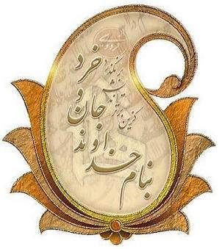

Slide 2


Bone Health in PCOS:
Is the hard tissue softened?
A Translational Research View
Miralireza Takyar, MD PhD
Physician-Scientist Resident n Internal Medicine and Endocrinology
Endocrine Research Center
Research Institute for Endocrine Sciences
Shahid Beheshti University of Medical Sciences
12th International Congress on Endocrine Disorders, Tehran, Iran
November, 15th 2018

Slide 3
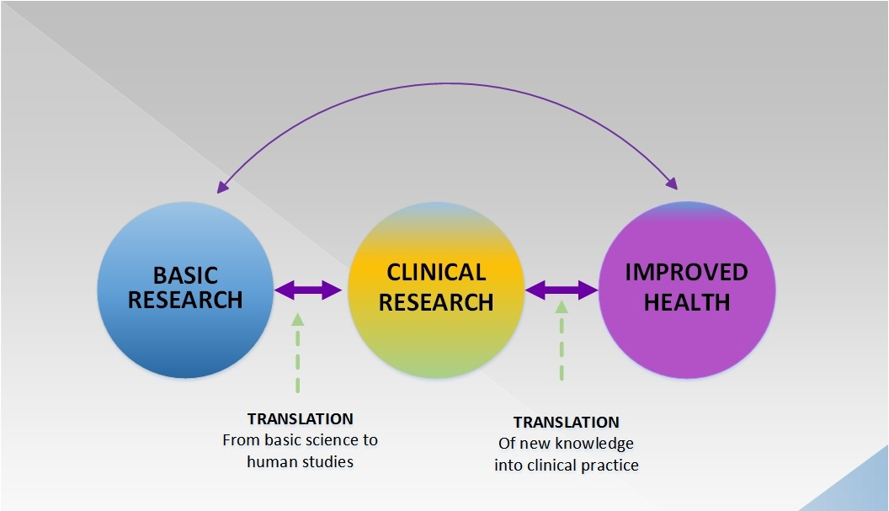
Translational Research: Definition(s):
As a process
http://www.sydneyvital.org.au/our-research/translational-research-diagram/

Slide 4
Why translational research matters?
http://www.fastercures.org
Notes:
Here, before moving on to a definition of TR, we need to address an important aspect:

Slide 5
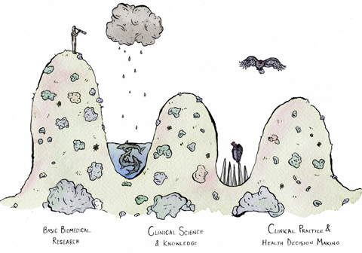
Gaps in translation: “Valleys of Death”
Credit: Art by Erinn Acland, 2016
www.painresearchforum.org/news/blog/70278

Slide 6
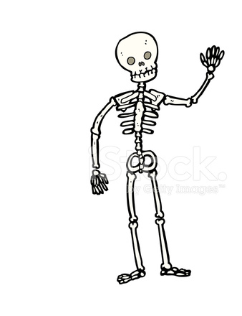
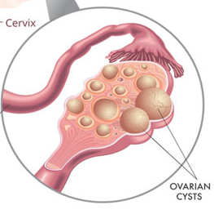
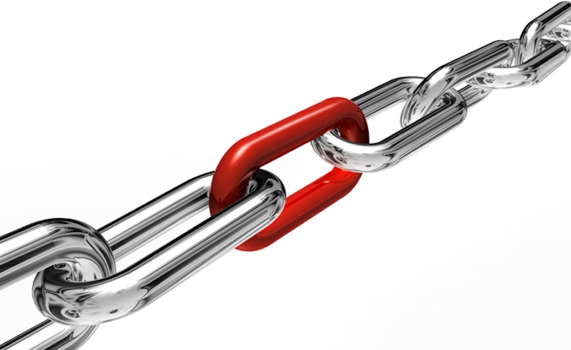
Notes:
A clear example of translational research is the way PCOS can affect development of osteoporosis.

Slide 7
PCOS and Osteoporosis
Both …
are major public health problems.
are associated with high morbidity.
have genetic bases and are affected by environmental factors.
begin early in life; phenotypically present later.
alter or result from alterations of various key hormones.
PCO-bone interactions
Notes:
سخنرانان پیش از من در مورد PCOS مفصل صحبت کردند
من تمرکز می کنم روی هومیوستاز استخوان که پروسه اصلی فیزیولوژیک آن معرف حضور هست اما مروری مجدد بر آن بد نیست:

Slide 8


Bone Remodeling
Bone Multicellular Units(BMUs)
Resorption
Formation
Osteoclast Precursors
Osteoclasts
Osteoblasts
RANK
RANKL
Osteoid
Osteocytes
Bone
Osteoblasts form bone and support osteoclast formation
Notes:
Bone remodeling is the process of renewal of skeleton whereby bone is resorbed by osteoclasts and formed again by osteoblasts.
It occurs asynchronously at multiple sites in body in a way that in adult humans the whole skeleton is renewed every 10 years! This process is tightly controlled by a lot of endocrine and paracrine factors, so that bone formation and resorption always happen in a balanced way.
Main cell types that are responsible for this well-orchestrated process are OC (that resorb bone), OB (that form bone) and Ocy (that control mineralization of bone and respond to mechanical stimuli)
*As well as forming new bone, osteoblasts produce RANKL which attaches to RANK on OC precursors and induces them to make active osteoclasts
These sites are called Bone Muti-cellular Units (BMUs).
The main point here is that cells in these units talk to one another and are talked to (!) by many other cells in the body. Any factor that affects bone (famous ones are growth hormone, glucocorticoids, female reproductive hormones) should exert their bone effects through BMUs

Slide 9
Osteoporosis: Resorption > Formation
Factors by Ob → Oc (vice versa)
Ocy interact directly with Ob
Ob-Ob contact
Adipocytes regulate both Ob and Oc
Canopy-forming osteomacs regulate Ob diff
TH cells get signals from the vicinity. Regulate Oc (+ or -)
Hormonal alterations in PCOS affect all main cells in bone.
WHAT IS THE NET EFFECT??
Sims NA: Curr Osteoporos Rep (2012) 10:109–117

Slide 10
PCOS and BMD

Slide 12
PCOS and bone turnover markers

Slide 14
PCOS and fracture risk

Slide 18
Stalemate!!

Slide 19
What is happening on the molecular front?

Slide 20
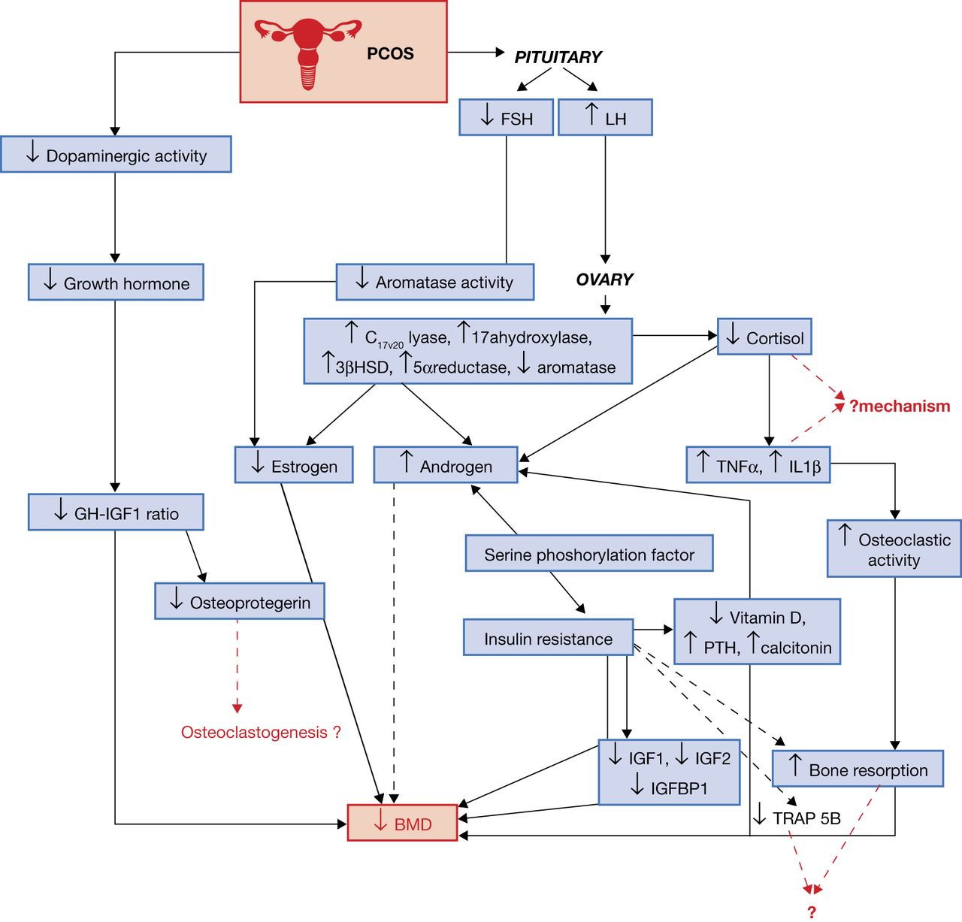

Slide 21
Molecular Confirmation of the “Stalemate”!!

Slide 22
Timing …

Slide 23
Chronic inflammation: A potentially new player

Slide 25
SSI loses its predictive power in PCOS

Slide 26
An index of inflammation can predict bone quality

Slide 27
Osteoporosis: Resorption > Formation
Factors by Ob → Oc (vice versa)
Ocy interact directly with Ob
Ob-Ob contact
Adipocytes regulate both Ob and Oc
Canopy-forming osteomacs regulate Ob diff
TH cells get signals from the vicinity. Regulate Oc (+ or -)
Hormonal alterations in PCOS affect all main cells in bone.
WHAT IS THE NET EFFECT??
Sims NA: Curr Osteoporos Rep (2012) 10:109–117

Slide 28
Conclusion and future directions
PCOS and osteoporosis are complex disorders,
their interaction is even more complex.
No conclusive clinical evidence and no proven molecular pathway yet.
Some parameters need to be considered:
  Age
  Stage
  Skeletal location (weight-bearing vs. non-weight-bearing, endochondral vs. intramembranous).
  Timing
  etc.
Better models are necessary and urgently needed.

Slide 29
