Slide 1
Nutrition clinical trials
In the name of God
By
Zahra Bahadoran
Assistant Prof. of Nutrition
Research Institute for Endocrine Sciences
Shahid Beheshti University of Medical Sciences

Slide 2
What we discuss
Definition of experimental studies
Definition of clinical trial
Definition of nutrition clinical trial (NCT)
Applications of NCTs
NCTs: translational research process point of view
Study design in NCTs
Common Challenges in NCTs
Good clinical practice in NCTs

Slide 3
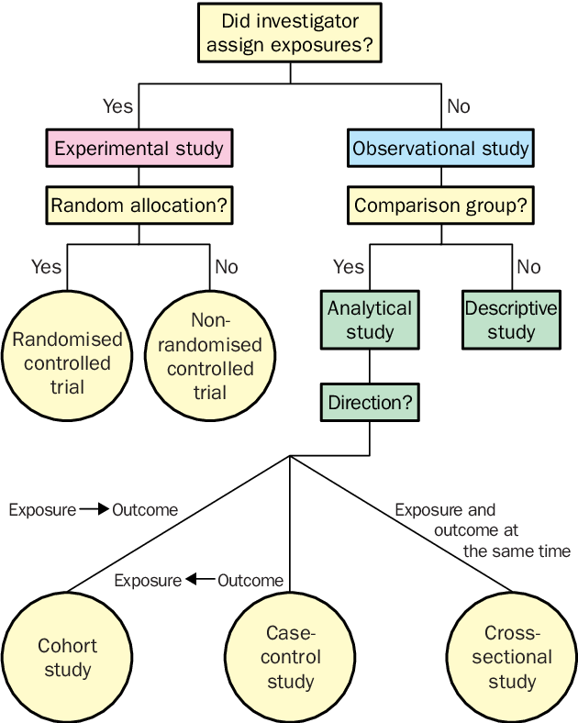
Introduction: Study Designs in Medicine

Slide 4
Introduction: Experimental studies
Experimental studies are less susceptible to confounding variables
  The investigator determines who is exposed and who is unexposed
  If exposure is allocated randomly and sample size is large then even unrecognized confounding effects become statistically unlikely
Types of Experimental Research Design
Pre-experimental design
Quasi-experimental design
True experimental design
https://www.bmj.com/about-bmj/resources-readers/publications/epidemiology-uninitiated/9-experimental-studies

Slide 5
Introduction: Experimental studies
There are two types of experiments:
  Exploratory experiments (important for hypothesis generation)
  Confirmatory experiments (test one or more hypothesis)
In most cases, these two types of study are found in the same study.
de Aguilar-Nascimento, J.E., Acta Cir Bras, 2005.

Slide 6
Introduction: Experimental studies
Experimental treatments
  Treatment describes the set of different experimental conditions to be tested
Experimental unit
  Experimental unit for a treatment factor is the smallest unit which a level of treatment can be applied to
Experimental design
  Experimental design aims to distinguish, quantify and compare variation between treatments (signal) compared to background variation (noise)
Principles of experimental design
  Randomization and blinding
de Aguilar-Nascimento, J.E., Acta Cir Bras, 2005.

Slide 7
Introduction: Definition of clinical trial
Clinical trial is defined as a experimental study prospectively assigned human participants or groups of human to one or more interventions, with or without concurrent comparison or control groups, to evaluate the effects of those interventions on health-related biomedical or behavioral outcomes.
Definition of a Clinical Trial. 2015 [cited 2019; Available from: https://hub.ucsf.edu/clinicaltrialsgov-definition-clinical-trial.

Slide 8
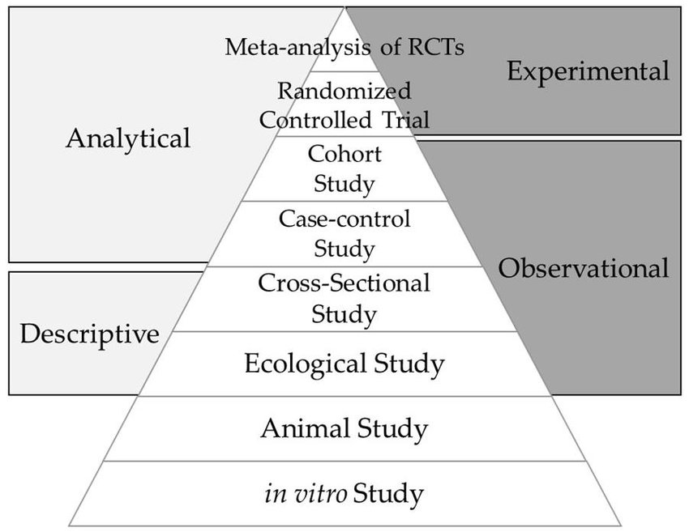
Introduction: Clinical trials in evidence-based medicine
The hierarchy of evidence, increasing from the base of the pyramid to the
gold standard for establishing causality

Slide 9
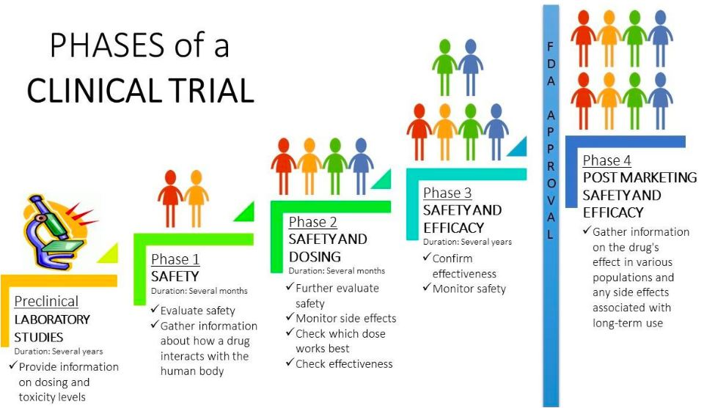
Introduction: Definition of clinical trial
n= 20-100
n= 100-300
n= 100s (100-300)
n= 1000s
Exploratory first-into-human → Proof of concept → effectiveness in public environment

Slide 10
Introduction: Definition of nutrition clinical trial
Nutrition clinical trials (NCTs) in which consumption of a nutrient, food, diet or dietary behavior is altered in human in a controlled way and, the effect on selected outcomes are measured, determine a cause-and-effect relation and provide a strong level of evidence.
Outcomes or clinical end points

Slide 11
Introduction: Applications of nutrition clinical trial
To provide strong evidence to establish causal relationships between diet and health and disease.
To assess health claims on food products which is clinically relevant to human health
To determine how foods and diet can serve as effective tools for not only prevention but also management and treatment of diseases.

Slide 12
Introduction: Applications of nutrition clinical trial
Historically, NCTs proceeded by the way of community-based interventions to solve the public health problems
  Iodized-salt or seafood-based products for iodine deficiencies
  Feeding programs for protein-energy malnutrition
  Iron supplementation or food-fortification for impaired cognitive function and anemia
  Vitamin A supplementation or food-fortification to prevent xerophthalmia
Wahlqvist, M.L., B.H. Hsu-Hage, and W. Lukito, Clinical trials in nutrition. Asia Pac J Clin Nutr, 1999

Slide 13
NCTs: translational research process point of view
T4
T3
T2
The research aimed at enhancing the adoption of best practices in the community
T1
The process of applying discoveries generated during research in the laboratory, and in preclinical studies, to the development of trials and studies in humans
McGartland Rubio D. et al., Acad Med. 2010
Coulston, A. Nutrition in the Prevention and Treatment of Disease.2008

Slide 14
NCTs: translational research process point of view
Research Phase | Example Types of Research | Sample Research Question
T0: Basic and applied science research | Defining mechanisms and targets: basic research, animal research, preclinical and pre-intervention studies | What are the mechanistic actions of carbohydrate sources on liver and pancreatic tissues in an experimental rat model?
T1: Translation to humans | Discovery of application to human health: proof of concept, early stage human clinical trials | What are the mechanistic actions of ingested carbohydrate sources on liver and pancreatic tissues in humans?
Coulston, A. Nutrition in the Prevention and Treatment of Disease.2008

Slide 15
NCTs: translational research process point of view
Research Phase | Example Types of Research | Sample Research Question
T2: Translational to patients | Discovery of application to clinical settings: later stage human clinical trials, efficacy studies, controlled observational studies, clinical guidelines | What is the effect of regulating the amount of carbohydrate sources among pre-diabetic subjects in a highly controlled clinical research setting?
Coulston, A. Nutrition in the Prevention and Treatment of Disease.2008

Slide 16
NCTs: translational research process point of view
Research Phase | Example Types of Research | Sample Research Question
T3: Translation to practice | Health application of evidence-based practice guidelines and practice guidelines to health practice: effectiveness research, health services research | What is the relative effect on diabetic risk factors (e.g., A1c, fasting glucose, weight) among Pre-diabetic patients in free-living conditions when randomized to a 6-month diet which regulates carbohydrates versus a 6-month usual diet comparison condition?
Coulston, A. Nutrition in the Prevention and Treatment of Disease.2008

Slide 17
NCTs: translational research process point of view
Research Phase | Example Types of Research | Sample Research Question
T4: Translation to community | Health application of practice to population health impact: dissemination and Implementation (D&I) research, scale-up and spread research, population health impact | What is the degree to which nutrition professionals in community health clinics can adopt, implement, and maintain an evidence-based program to encourage healthy carbohydrate modifications among at-risk clients?
Coulston, A. Nutrition in the Prevention and Treatment of Disease.2008

Slide 18

Study design
in NCTs

Slide 19
Study design in NCTs
NCTs must begin with the clear identification of the nutrition problem which needs to be addressed.
A clear and explicitly specified study question or a well-founded hypothesis with clearly defined outcomes, effectively points toward the best-fitted study design required for development of the NCTs
Shamley, D. and B. Wright, A comprehensive and practical guide to clinical trials. 2017: Academic Press
Coulston, A. Nutrition in the Prevention and Treatment of Disease.2008

Slide 20
Study design considerations
Study design
Study hypothesis and aim
(assessing a cause-and-effect or safety and efficacy)
Intervention of interest (particular nutrient, whole food, food group, whole diet, food supplement, change of behavior)
Study setting
(free-living healthy individuals, patients with specific diseases, critically ill patients)
Stages of translation research process
(T1 to T4)
Scale
(individual vs. large community-based population)
Woodside J. Study Design: Intervention Studies, in Nutrition Research Methodologies. 2015
Heaney, R.P., Guidelines for optimizing design and analysis of clinical studies of nutrient effects. Nutr Rev. 2014

Slide 21
Study design considerations
Type of intervention | Are other nutrients being displaced, and will this confound interpretation of the study? Is the dietary formulation appealing and conducive to participant compliance?
Background status | What is the baseline dietary status of the test population? Will this affect the effectiveness of the intervention?
Delivery of test diet or supplement | How does the form, matrix, other components, and processing of the test diet or nutrient supplement affect the conduct of the trial and the participants’ ability to follow the study protocol?
Controls | Is there an ethical and meaningful comparator?
Length of study | Is the intervention sufficiently long for an effect on a biomarker or health endpoint to be observed?
Blinding | How can a food or diet pattern be blinded to both the participants and the investigators?
Study population | Is the priority to study the population likely to benefit from the intervention or to achieve generalizable results?

Slide 22
Study design in NCTs
What is randomization?
A mechanism for unbiased allocation of treatments
Patients are allocated to treatments or interventions randomly (equal chance)
Study intervention
Random allocation?
Yes
No
Randomized Designs
(Explanatory or Pragmatic randomized controlled trial)
Non-randomized Designs
(Quasi-Experimental)
with or without controls

Slide 23
Common study design
in NCTs

Slide 24
Quasi-Experimental designs
Quasi-experimental studies aim to demonstrate causality between an intervention and an outcome
They can be similar to RCTs in design, but lack one or more key features of a true experiment e.g. absent of random assignment to the intervention or control group or lacking control group

Slide 25
Quasi-Experimental designs
Shadish et al. discuss 17 possible designs for quasi-experimental studies falling into 4 categories
  Before-after design (without control group)
  Having control group but not pre-test
  Having control groups with pre-tests
  Interrupted time-series design (multiple before-after measurements)

Slide 26
Quasi-Experimental designs
These designs are frequently used when it is not logistically feasible (difficulty of randomizing, low sample size) or is not ethical to conduct a RCT.
Application in NCTs
  community food-based interventions
  For exploratory studies and the evaluation of novel, untested, dietary interventions

Slide 27
Quasi-Experimental designs
The lack of random assignment (or control group) is the major weakness of quasi-experimental designs that treat internal validity and establishing causality .
These designs have obvious value when conducting research in the context of real-world practice- and community-based settings, where external validity is equally valued.

Slide 28
Randomized Clinical Trial
  Paralleled RCT (proposed by Hill in 1952)
  Main design features
  Allocation remains unchanged throughout the duration of the study
  Randomization to two or more arms (active intervention, control)
  Participant is unit of randomization

Slide 29
Randomized Clinical Trial
  Paralleled RCT
Advantages | Disadvantages
Simplicity Universal acceptance Clear temporal sequence Internally valid comparison | Double-blinding not always possible Large sample size needed (in case of low-incidence outcomes) Inefficient for diseases with rare outcomes Lifestyle interventions that have a long lag time require a long follow-up period Often low recruitment rate Questionable external validity and generalizability

Slide 30
Randomized Clinical Trial
  Crossover RCT (proposed by Louis in 1984)
  Main design features
  All study interventions are given to each subject in successive periods
  Randomization to two or more arms (active intervention, control)
  Washout period in between study periods

Slide 31
Randomized Clinical Trial
  Crossover RCT
Advantages | Disadvantages
Participants act as their own control Reduces variation in response Smaller sample size needed More efficient in terms of expense Participants receive both treatments (increases attractiveness of participating and recruitment rate) | Condition needs to be reversed to washout period Effects of intervention needs to be reversible Possible period effect and carryover effect Not appropriate for acute conditions and progressive disorders (only for intermediate endpoints) Participants serve as their own control, and no comparisons can be made if the treatment has not been received

Slide 32


Slide 33
Randomized Clinical Trial
  Pragmatic trial (PrCTs)
  Main design features
  A combined-design of real-world evidence and randomization
  Is used to inform treatment effectiveness and healthcare decisions (decision-making by patients, clinicians and policy-makers)
  Help to answer the important question of “how a treatment works in a real-world scenario”

Slide 34
Randomized Clinical Trial
  Pragmatic trial (PrCTs)
  The explanatory trials focus towards homogeneity (high internal validity), whereas PrCTs are a race towards maximal heterogeneity in all aspects (e.g. patients, treatments, clinical settings) and have high external validity.
  PRECIS-2: a 9-domain tool to score the degree of pragmatism of the RCT, ranges from very explanatory to very pragmatic.
    Domains: inclusion/exclusion criteria, recruitment, setting, organization, flexibility in delivery and adherence, follow-up, primary outcome, primary analysis
Loudon, K., et al., BMJ : British Medical Journal, 2015
Dal-Ré, R. BMC medicine, 2018

Slide 35
Randomized Clinical Trial
Pragmatic trial (PrCTs) real examples
ENRICH: Exercise Nutrition Routine Improving Cancer Health study
  Aimed to determine the effects of a group-based, face-to-face multiple health behavior change intervention on behavioral outcomes among cancer survivors
A 12-week physical activity and nutritional education program for overweight Aboriginal and Torres Strait Islander women
James, E.L., et al., BMC Cancer, 2015
Canuto, K.J., et al., BMC Public Health, 2011

Slide 36
Randomized Clinical Trial
Randomized controlled-feeding trial
A specific design for NCTs
All foods and fluids are provided to participants
The placebo group receive a diet to be inert in nature and nutritionally matched to the intervention diet in all aspects except for the active component being investigated
It is Expensive (software to design controlled diets, food and paper supplies, trained staff to design, prepare and provide study diets daily, food preparation and storage equipment and capabilities)
Davy, K.P. Frontiers in Physiology, 2019

Slide 37
Pilot or feasibility trial
A small-scale test of the methods and procedures to be used on a larger scale
It is recommended for complex interventions, e.g. broader lifestyle interventions, including diet and physical activity
Determine inclusion and exclusion criteria to balance safety, adequate recruitment, and generalizability of the trials
Evaluate recruitment rate, ability and willingness of participants to understand the intervention, participant adherence, and attrition rate prior to a definitive trials
El-Kotob, R. Pilot and feasibility studies, 2018
Kistin, C. JAMA, 2015

Slide 38
Pilot or feasibility trial

Slide 39
Pilot or feasibility trial
A pilot trial may be single-arm (before-after) study with no control group or a randomized or non-randomized trial
Pilot trial cannot be used:
  To test hypotheses about the effects of an intervention
  To examine preliminary safety of an intervention
  To estimate the effect sizes for power calculation
El-Kotob, R. Pilot and feasibility studies, 2018
Kistin, C. JAMA, 2015

Slide 40
Other types of study design in NCTs
Adaptive clinical trial designs
  They differ from conventional clinical trials
  Allow continual modifications to key components of trial design (e.g. allocation ratio, total sample size, eligibility criteria, extension of trial phases, change of treatment arms)
Single subject or “N-of-1” trials are also used to assess the utility of personalized nutrition interventions
Hybrid type trials
Comparative effectiveness research (CER)
Thorlund, K., et al., BMJ, 2018
Schork, N.J. et al., Annual review of nutrition, 2017

Slide 41
Common Challenges of design and conduct of NCTs

Slide 42
Comparison of methodological considerations between drug and dietary trials
 | Drugs | Food
Chemical effect on targets | Specific | Multicollinearity
Composition | Isolated substances with similar chemical and physical characteristics | Heterogeneous mixture of nutrients and bioactive components
Administration | Small dose taken whole at defined times | Consumed throughout the day
Baseline exposure | Can be absent before intervention | Continuous exposure and varying between persons
Yao, C.K., et al. Am J Gastroenterol, 2013
Weaver, C. M., et al. Nutrition reviews, 2017

Slide 43
Comparison of methodological considerations between drug and dietary trials
 | Drugs | Food
Placebo | Easy to make | Difficult to design
Influence of pre-conceived ideas | Small-to-moderate effect | Powerful effect
Blinding | Double-blinding easy with placebo pills | Difficult and often not feasible to double-blind
Access | No / limited access to study drugs | Readily accessible
Yao, C.K., et al. Am J Gastroenterol, 2013
Weaver, C. M., et al. Nutrition reviews, 2017

Slide 44
Complex nature of nutrition interventions
Complex ingredients
Multiple physiologic targets
Collinearity between ingredients
Outcomes
?

Slide 45
Dietary behaviors and food culture
Diversity of food cultures
Different dietary behaviors
Alter the true effectiveness of
a dietary intervention
A large inter- and intra-individual variability in response to the same dietary intervention
What is solution?
Yao, C.K., et al. Am J Gastroenterol, 2013
Weaver, C. M., et al. Nutrition reviews, 2017

Slide 46
Baseline exposure with interventions
Baseline dietary status
(nutrient deficiency vs. adequacy)
Baseline exposure to the food or food component
?
?
↓ Effectiveness of the intervention
↓ Generalizability of findings
What is solution?
Yao, C.K., et al. Am J Gastroenterol, 2013
Weaver, C. M., et al. Nutrition reviews, 2017

Slide 47
Patient’s adherence
Adherence or compliance is “the extent to which a person’s behavior-taking medication, following a diet, and/or executing lifestyle changes, corresponds with agreed recommendations from a health care provider.
Adherence to the nutrition interventions is the biggest determinant of its effectiveness.
Poor compliance:
  Difficult-to-implement diets (e.g. a very low-carbohydrate diet, very low energy diets, sodium-restricted diets)
  Strict elimination diets
  Long-term interventions
World Health Organization. Adherence to long-term therapies: evidence for action. 2003
Brownell, K.D. et al., Behav Med, 1995

Slide 48
Increase adherence to interventions
Educational tools (e.g. video, booklet)
Individual and group sessions with dietitian to barrier identification and problem solving
Reminders (e.g. telephone follow-up)
Motivational interviewing
Promotion of self-monitoring and feedback diary
Stress management and goal setting
Contract with the involvement of a family member or friend
Desroches, S., et al., The Cochrane database of systematic reviews, 2013
Gibson, A.A. et al., Behavioral sciences (Basel, Switzerland), 2017

Slide 49
Measuring patient’s adherence
Helps to indicate the extent to which intervention of interest has achieved its specific aims
Nutritional biomarkers can be used as measures of patients’ adherence in NCTs to clearly define the compliance with a new dietary regimen or food intervention.

Slide 50
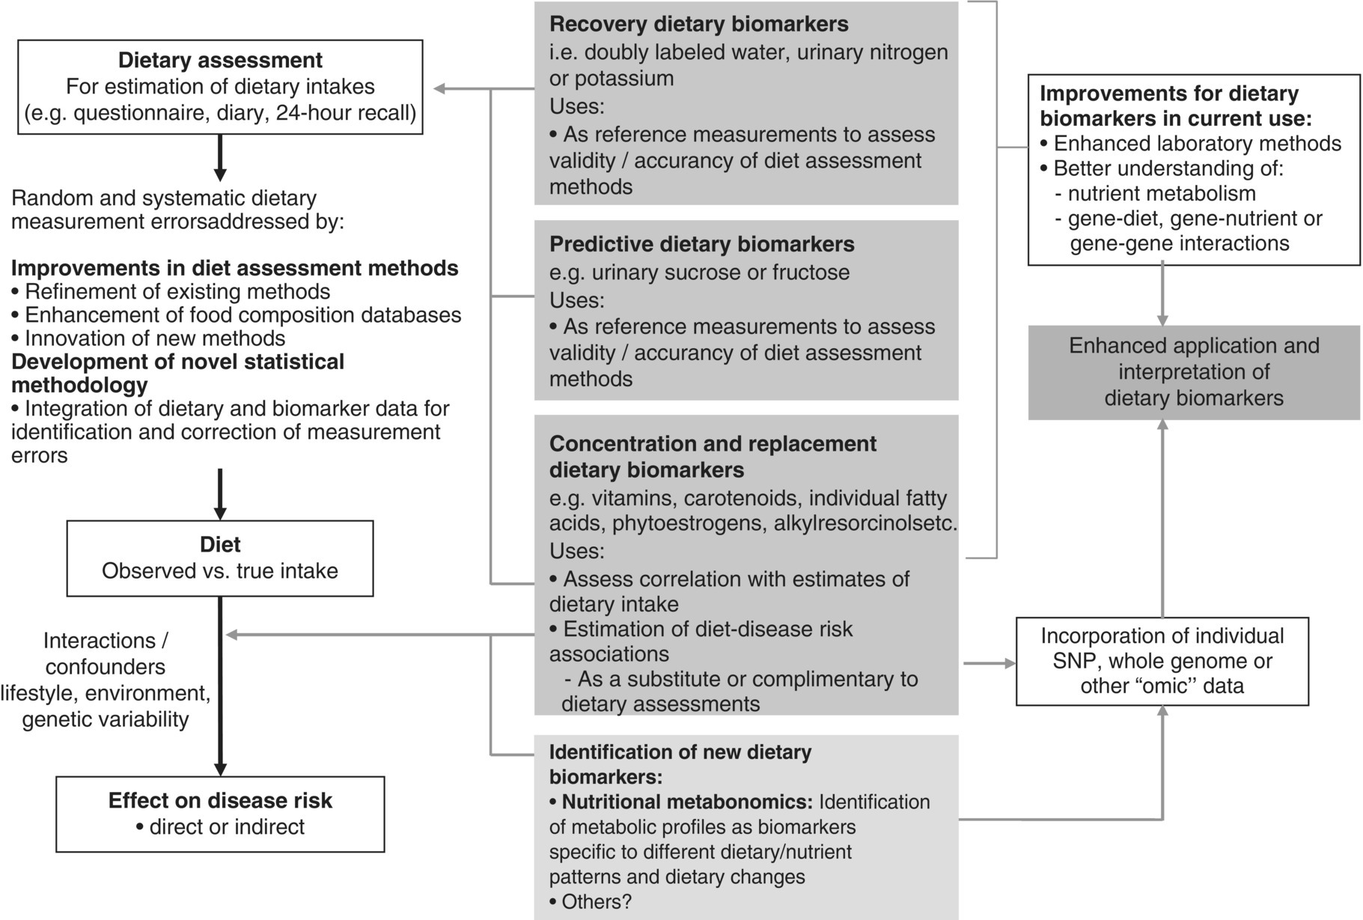
Measuring patient’s adherence
Overview of different types of biomarkers of intake

Slide 51
Biomarkers of nutrient intakes
Nutrient | Biomarkers of Dietary Exposure | Possible Functional Markers
Dietary fiber Non-starch polysaccharides | Fecal hemicellulose Urinary or plasma lignans Urinary or plasma alkylresorcinols (whole grains) | Fecal weight Fecal short-chain fatty acids
Thiamin |  | Erythrocyte transketolase activation
Biotin | Urinary 3-hydroxy-isovalerate with a loading dose of leucine | Erythrocyte pyruvate carboxylase activity
Vitamin B6 | Plasma pyridoxal 5-phosphate Urinary 4-pyridoxic acid | Erythrocyte aspartate or alanine aminotransferase
Folate | Plasma folate, Erythrocyte folate | Plasma homocysteine
Vitamin C | Plasma vitamin C Erythrocyte, lymphocyte, or platelet vitamin C Urinary carnitine | Urinary deoxypyridinoline: total collagen crosslinks
To see more you can refer to Coulston, A., Research and applied methods for observational and intervention studies. 2008, Secound ed. P.217

Slide 52
Biomarkers as general dietary indicators
Dietary pattern: plasma carotenoids and Urinary sodium to potassium ratio
Plant foods-based diet: lignan concentrations in urine or plasma
Red meat intake: 1-methylhistidine and 3-methylhistidine
Whole grains intake: Plasma concentrations and urinary excretion of alkylresorcinols and alkylresorcinol metabolites
Omega-3 fatty acid composition of the diet: fatty acid composition of membrane phospholipids
Coulston, A., Research and applied methods for observational and intervention studies. 2008, Secound ed. P.217

Slide 53
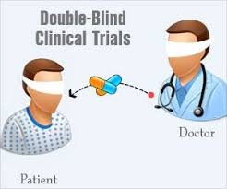
Blinding
Blinding enable minimization of subject bias and observer bias
Blinding participants to diet, whole foods or macronutrients is difficult
Blinding for micronutrients or other bioactive compounds may be provided in the form of pills is similar to pharmaceutical drug trials

Slide 54
Control group
A control group (a group similar to the test group in all aspects affecting the outcome except for the intervention of interest) is essential to demonstrate superiority, safety and efficacy of the intervention
ICH defines 5 types of control group for clinical trials:
  4 concurrently controlled (placebo, no-treatment, dose-response, active or standard treatment group)
  External or historical control groups
Defining a good control group, or lack of ability to adequate masking of intervention or inappropriate choice of placebo food or diet are major challenging issues in NCTs

Slide 55
Common control group in NCTs
No treatment control | A control group that do not receive a placebo or comparative intervention
Placebo control | A control group that receives an inert substance (e.g. sugar pill or saline) or sham advice/treatment
Feeding study control | A control group receive a inert diet (nutritionally matched to the intervention diet exclude the active component being investigated)
Re-supplementation control | A control group in which the same dietary advice is given to participants in both the intervention and control groups, followed by re-supplementation of the excluded food component to the control group
Staudacher, H.M., et al., Proceedings of the Nutrition Society, 2017.

Slide 56
Common control group in NCTs
Active comparator control | A control group that receives an active intervention (e.g. standard therapy), usually used to determine whether the treatment under investigation is superior to standard therapy
Sham diet control | A control group to whom dietary advice is provided that modifies food intake without altering intake of nutrients or the specific food component being investigated
External control | A control group outside of the trial that is used to compare with the treatment group (e.g. data from medical records)
Staudacher, H.M., et al., Proceedings of the Nutrition Society, 2017.

Slide 57
Important criteria for the development of a sham diet
These criteria were developed as an approach to interpreting fundamental principles in the use of placebos (their similar presentation as the intervention to facilitate blinding, physiologically inert with regards to the outcome of interest), but specifically tailored to dietary intervention

Slide 58
Important criteria for the development of a sham diet
The content of the sham diet must give the impression it is the true intervention diet
The sham diet must alter dietary intake but maintain intake of foods, food components or nutrients under investigation
The sham diet must not alter intake of other foods, food components or nutrients that might impact on endpoints
The sham diet must restrict or modify intake of an equivalent number of foods as the intervention diet
The burden of the sham diet should be equivalent to the intervention diet (e.g. time for shopping and cooking, level of adaptation required for preparing meals)
The sham diet should take the same amount of time to teach and should require same amount of comprehension as the intervention diet
Staudacher, H.M., et al., Proceedings of the Nutrition Society, 2017.

Slide 59
Consideration for study groups
  Study groups should be representative of the target group
  Age
  Gender
  Ethnic origin
  Genotype relevant to the function under study
  Lifestyle factors (smoking, physical activity, alcohol consumption)
  Body weight and height
  Menstrual cycle
  Usual diet
  Environmental conditions (e.g. climate)

Slide 60
Good clinical practice (GCP) in NCTs
Clinical trials should follow the Good Clinical Practice (GCP) standards, provided by ICH
  To ensure that the trials are scientifically and ethically sound
  The clinical properties of the pharmaceutical product under investigation are properly documented
  The data and reported results are credible and accurate
ICH: International Council for Harmonization of Technical Requirements for Pharmaceuticals for Human Use

Slide 61
Good clinical practice (GCP) in NCTs
GCP provides ethical and scientific quality standards for
  Design
  Conduct
  Performance
  Monitoring
  Termination
  Auditing
  Recording
  Analysis
  Reporting
  Documentation of clinical trials

Slide 62
Good clinical practice (GCP) in NCTs
In case of NCTs, careful considerations are needed for:
Hypothesis generation
Study design and conduct (i.e. clear definition of study duration, type of intervention, amount and mode of delivery, control and blinding)
Clear definition of primary and secondary outcome measures (including assessment of background diet)
Statistical power
Eligibility criteria
Data-collection methodology and ways of measuring and encouraging compliance

Slide 63
Thanks for your attention

